Slide 1

A Fast Approximation of the Bilateral Filter using a Signal Processing Approach
Sylvain Paris and Frédo Durand
Computer Science and Artificial Intelligence Laboratory
Massachusetts Institute of Technology

Slide 2
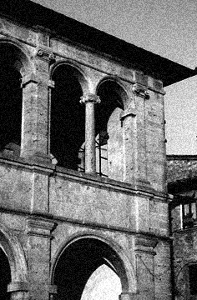


Context: Image Denoising
noisy image
naïve denoising
Gaussian blur
better denoising
edge-preserving filter
Smoothing an image without blurring its edges.

Slide 3
A Wide Range of Options
Diffusion, Bayesian, Wavelets…
  All have their pros and cons.
Bilateral filter
  not always the best result [Buades 05] but often good
  easy to understand, adapt and set up

Slide 4

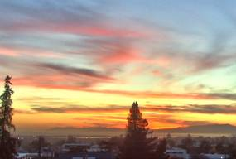
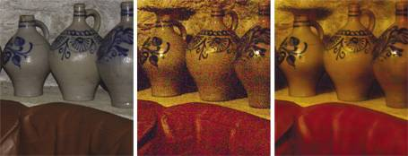



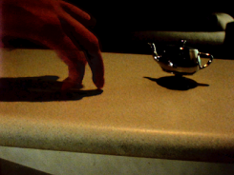



Many Applications based on Bilateral Filter
[Petschnigg 04]
Tone Mapping [Durand 02]
Flash / No-Flash [Eisemann 04, Petschnigg 04]
Virtual Video Exposure [Bennett 05]
Tone Management [Bae 06]
And many others…

Slide 5
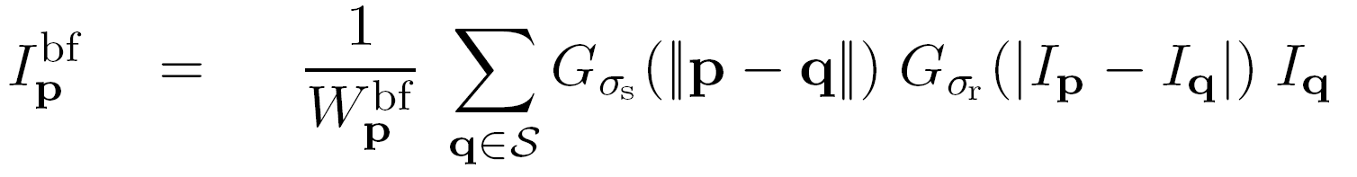
Definition of Bilateral Filter
[Smith 97, Tomasi 98]
Smoothes an image
and preserves edges
Weighted average
of neighbors
Weights
  Gaussian on space distance
  Gaussian on range distance
  sum to 1
Input
Result
space
range

Slide 6
Advantages of Bilateral Filter
Easy to understand
  Weighted mean of nearby pixels
Easy to adapt
  Distance between pixel values
Easy to set up
  Non-iterative

Slide 7
But Bilateral Filter is Nonlinear
Slow but some accelerations exist:
  [Elad 02]: Gauss-Seidel iterations
    Only for many iterations
  [Durand 02, Weiss 06]: fast approximation
    No formal understanding of accuracy versus speed
    [Weiss 06]: Only box function as spatial kernel

Slide 8
But Bilateral Filter is Nonlinear
Hard to analyze
  [van de Weijer 01]: histograms
  [Barash 02]: adaptive smoothing
  [Durand 02]: robust statistics
  [Durand 02, Elad 02, Buades 05]: PDEs
  [Mrázek]: unified view
Link with other nonlinear filters.

Slide 9
Contributions
Link with linear filtering
Fast and accurate approximation

Slide 10
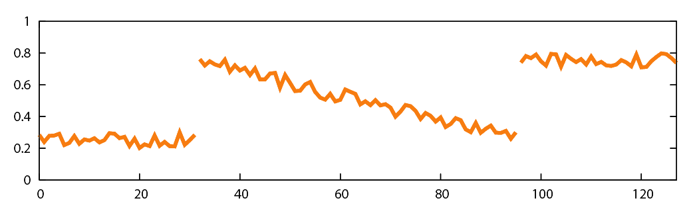
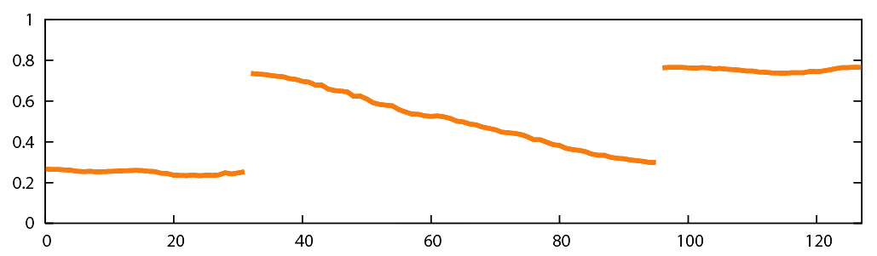
Intuition on 1D Signal
BF

Slide 11

Intuition on 1D Signal
Weighted Average of Neighbors
weights
applied
to pixels
p
Near and similar pixels have influence.
Far pixels have no influence.
Pixels with different value have no influence.

Slide 12
Link with Linear Filtering
1. Handling the Division
p
sum of
weights
Handling the division with a projective space.

Slide 13
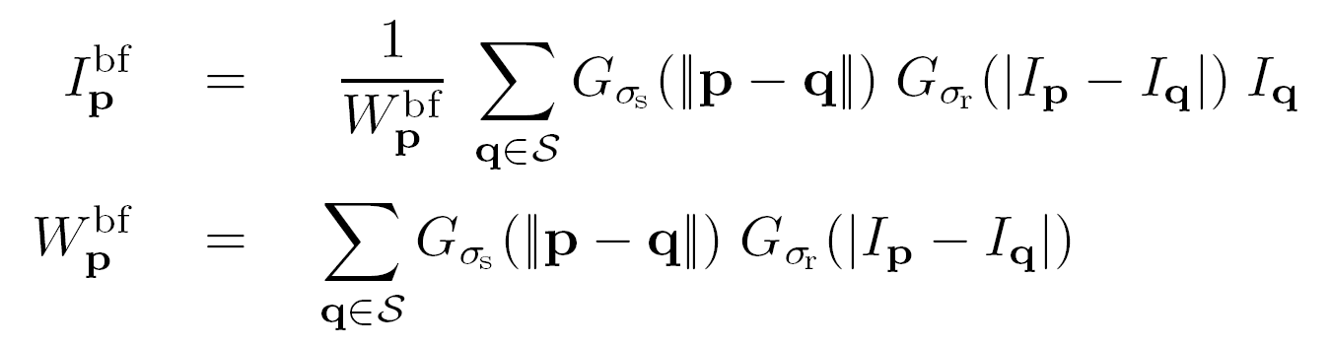
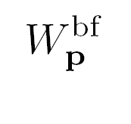
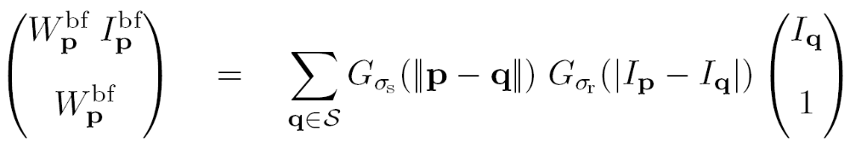
Formalization: Handling the Division
Normalizing factor as homogeneous coordinate
Multiply both sides by

Slide 14
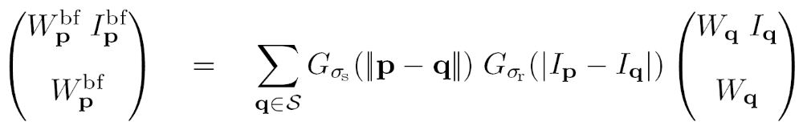
Formalization: Handling the Division
with W_{q}=1
Similar to homogeneous coordinates
in projective space
Division delayed until the end
Next step: Adding a dimension to make a convolution appear

Slide 15
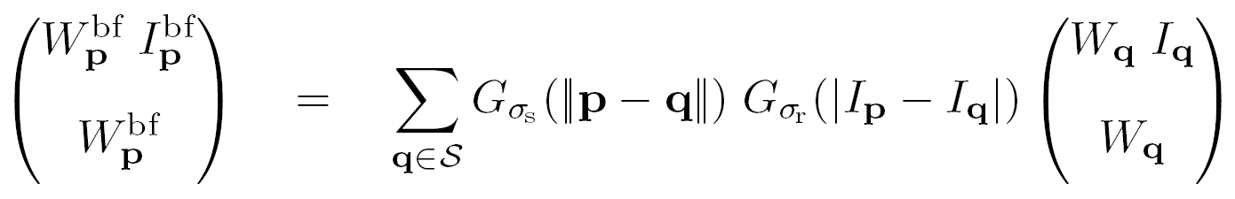
Link with Linear Filtering
2. Introducing a Convolution
space: 1D Gaussian
× range: 1D Gaussian
combination: 2D Gaussian
p
q
space
range

Slide 16
Link with Linear Filtering
2. Introducing a Convolution
space: 1D Gaussian
× range: 1D Gaussian
combination: 2D Gaussian
p
q
space x range
Corresponds to a 3D Gaussian on a 2D image.

Slide 17
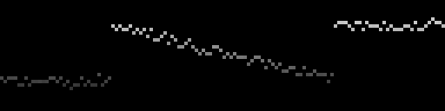
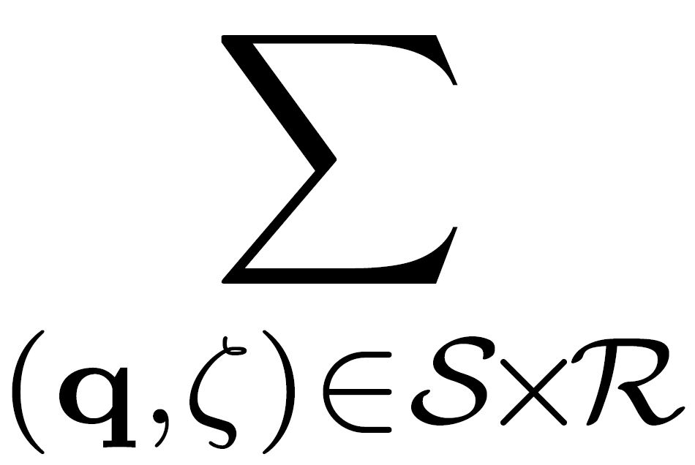
Link with Linear Filtering
2. Introducing a Convolution
sum all values
black = zero
space-range Gaussian
sum all values multiplied by kernel ⇨ convolution

Slide 18

Link with Linear Filtering
2. Introducing a Convolution
result of the convolution
space-range Gaussian

Slide 19

Link with Linear Filtering
2. Introducing a Convolution
result of the convolution
space-range Gaussian

Slide 20
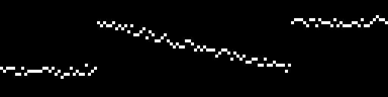


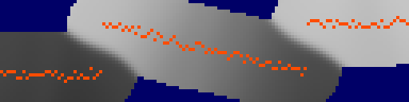
higher dimensional functions
w i
w
Gaussian convolution
division
slicing

Slide 21
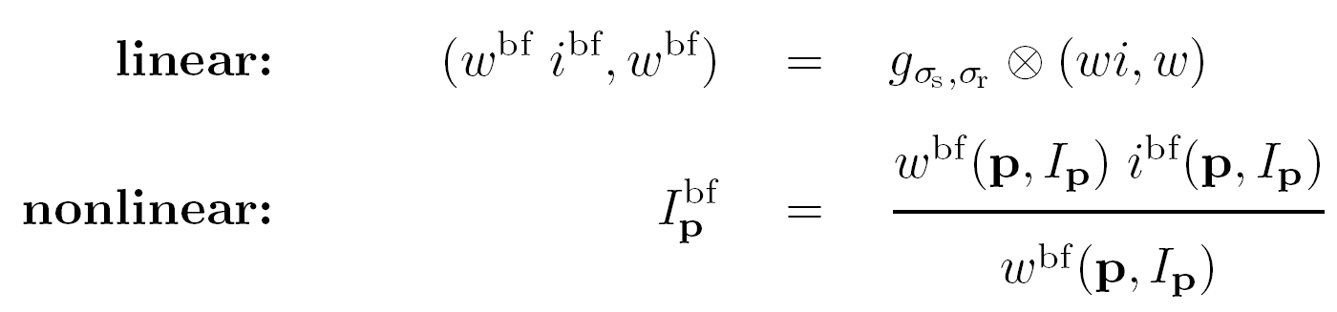
Reformulation: Summary
Convolution in higher dimension
  expensive but well understood (linear, FFT, etc)
Division and slicing
  nonlinear but simple and pixel-wise
Exact reformulation

Slide 22
higher dimensional functions
w i
w
Low-pass filter
Gaussian convolution
Almost only
low freq.
High freq.
negligible
division
slicing

Slide 23


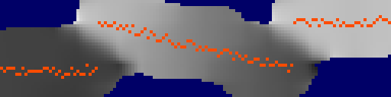
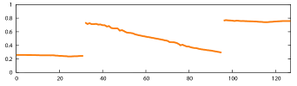
higher dimensional functions
w i
w
D O W N S A M P L E
Gaussian convolution
Almost no
information
loss
U P S A M P L E
division
slicing

Slide 24
Fast Convolution by Downsampling
Downsampling cuts frequencies
above Nyquist limit
  Less data to process
  But induces error
Evaluation of the approximation
  Precision versus running time
  Visual accuracy

Slide 25
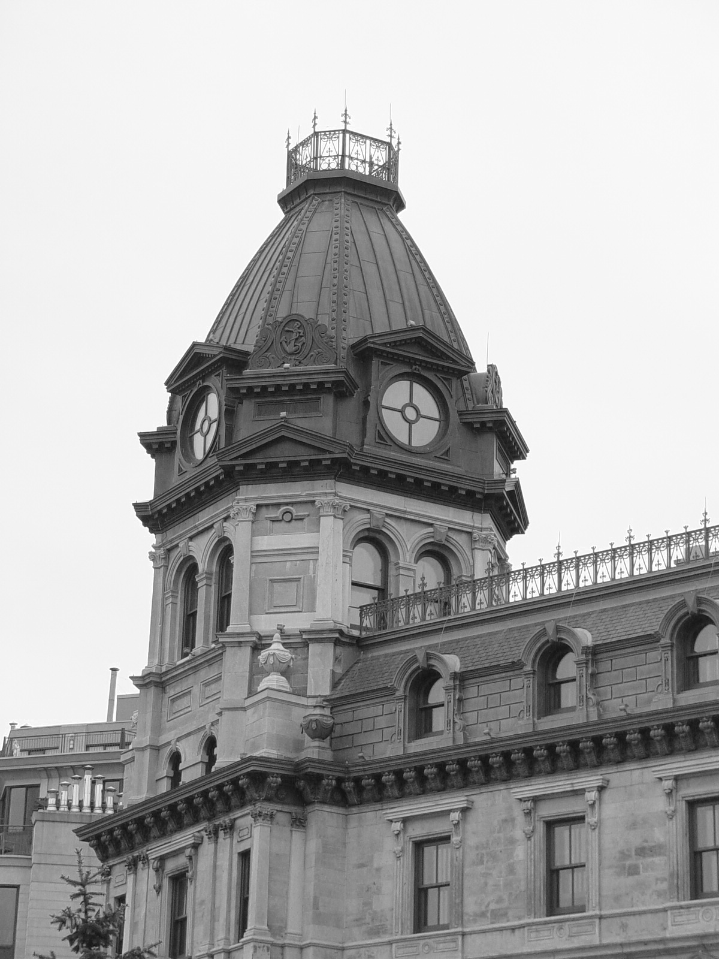
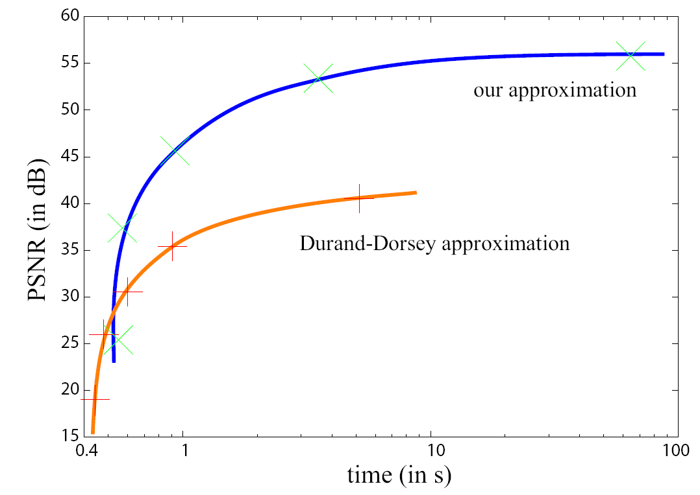
Accuracy versus Running Time
Finer sampling increases accuracy.
More precise than previous work.
PSNR as function of Running Time
Digital
photograph
1200 × 1600
finer sampling
Straightforward implementation is over 10 minutes.

Slide 26
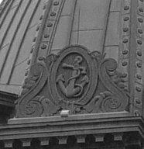
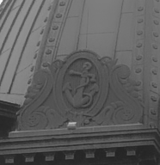


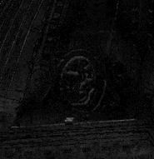
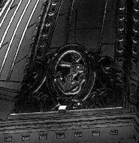
Visual Results
Comparison with previous work [Durand 02]
  running time = 1s for both techniques
1200 × 1600
input
exact BF
our result
prev. work
difference
with exact
computation
(intensities in [0:1])
0.1
0

Slide 27
Visual Results
Comparison with previous work [Durand 02]
  running time = 1s for both techniques
1200 × 1600
input
exact BF
our result
prev. work
difference
with exact
computation
(intensities in [0:1])
0.1
0

Slide 28
Visual Results
Comparison with previous work [Durand 02]
  running time = 1s for both techniques
1200 × 1600
input
our result
exact BF
prev. work
difference
with exact
computation
(intensities in [0:1])
0.1
0

Slide 29
Visual Results
Comparison with previous work [Durand 02]
  running time = 1s for both techniques
1200 × 1600
input
exact BF
our result
prev. work
difference
with exact
computation
(intensities in [0:1])
0.1
0

Slide 30
Visual Results
Comparison with previous work [Durand 02]
  running time = 1s for both techniques
1200 × 1600
input
prev. work
our result
exact BF
difference
with exact
computation
(intensities in [0:1])
0.1
0

Slide 31
Discussion
Higher dimension ⇨ advantageous formulation
  akin to Level Sets with topology
  our approach: isolate nonlinearities
  dimension increase largely offset by downsampling
Space-range domain already appeared
  [Sochen 98, Barash 02]: image as an embedded manifold
  new in our approach: image as a dense function

Slide 32
Conclusions
higher dimension ⇨ “better” computation
Practical gain
Interactive running time
Visually similar results
Simple to code (100 lines)
Theoretical gain
Link with linear filters
Separation linear/nonlinear
Signal processing framework

Slide 33
Thank you
Code is available on our webpage.
We thank the MIT Computer Graphics Group and Bill Freeman’s group for their help. We thank Todor Georgiev for insightful discussions during the conference and for advertising the talk.
This work was supported by a NSF CAREER award 0447561 “Transient Signal Processing for Realistic Imagery,” an NSF Grant No. 0429739 “Parametric Analysis and Transfer of Pictorial Style,” a grant from Royal Dutch/Shell Group and the Oxygen consortium. Frédo Durand acknowledges a MSR New Faculty Fellowship, and Sylvain Paris was partially supported by a Lavoisier Fellowship from the French “Ministère des Affaires Étrangères.”

