Slide 1
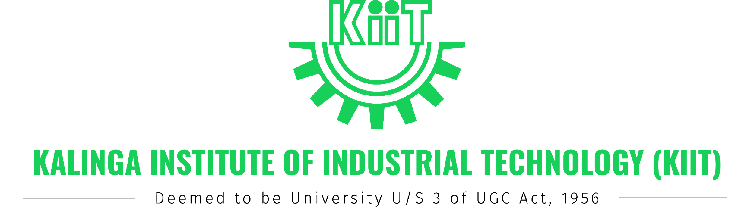
HYDRA-LB: An LSTM-Based Proactive Load Balancing Framework for Multi-Controller SDN
[Author 1, Author 2, Author 3, Author 4, Author 5, Author 6]
MINI PROJECT - 2026
PRESENTED BY — Presenter Name (Department of CSE)

Slide 2
PRESENTATION OUTLINE
Introduction & Background
Literature Review
Problem Formulation
Novelty of HYDRA-LB
Proposed Method & System Architecture
Simulation Platform & Experimental Setup
Experimental Results & Analysis
Conclusion & Future Work
Bibliography

Slide 3
INTRODUCTION
Software-Defined Networking (SDN) decouples control plane from data plane, enabling centralized programmable network control
Single-controller SDN becomes a bottleneck at scale — multi-controller deployments distribute control across instances
Challenge: Dynamic traffic causes uneven controller load (bursts, flash crowds, skewed distributions)
Traditional reactive approaches (Round Robin, Least Load) respond only AFTER imbalance occurs
Leads to packet drops, elevated latency, and oscillatory behavior
Need: A PROACTIVE system that PREDICTS load and rebalances BEFORE congestion
HYDRA-LB: Uses LSTM neural networks with temporal attention to forecast controller load 3–5 seconds ahead and trigger preemptive switch migration

Slide 4
LITERATURE REVIEW
Traditional Load Balancing:
Schaerf et al. (1994) — Multi-agent learning for adaptive LB
Aweya et al. (2002) — Adaptive web server scheme
Borzemski et al. (2007) — Intelligent CDN request routing
SDN-Based LB:
Farahi (2025) — Comprehensive SDN LB survey
Belgaum et al. (2020) — Most SDN LBs lack prediction
Praveen et al. (2022) — Adaptive multi-controller assignment
Chaudhary & Kumar (2019) — LOADS: anomaly detection + LB
ML-Based Approaches:
Hou et al. (2021) — GWO-BP for cloud load prediction
Hsu et al. (2021) — Deep learning for vehicular MEC
Gap: No LSTM + Attention for SDN controller-level variance-aware proactive LB

Slide 5
PROBLEM FORMULATION
In multi-controller SDN, switches are statically assigned to controllers
As traffic patterns change, some controllers become overloaded while others remain idle
Reactive LB detects imbalance AFTER it occurs → delayed response → packet drops
Problem Statement:
Given N controllers each managing a subset of switches, dynamically redistribute switches to minimize inter-controller load variance using predicted future load
Formal Objective:
Minimize: σ²(pred) = (1/N) Σ(L̂ᵢ − L̄)²
Subject to: Cooldown constraints, migration cost threshold
Where L̂ᵢ is the LSTM-predicted load for controller i at horizon t+3
Key Metrics: Load Variance, Response Latency, Migration Count

Slide 6
NOVELTY OF HYDRA-LB
First framework to combine Bidirectional LSTM + Temporal Attention for SDN controller load prediction
Proactive (not reactive): Migrates switches BEFORE overload using 3-second lookahead predictions
Variance-aware optimization:
Uses population variance (not just max-min) to capture full cluster imbalance
Considers migration cost (30% deduction) to prevent unnecessary churn
Cooldown mechanism (30s) prevents oscillatory behavior
End-to-end integration: Prediction → Decision → OpenFlow Role Change → Verification
Fully containerized & reproducible: Docker Compose with Ryu, Mininet, Prometheus, Grafana

Slide 7
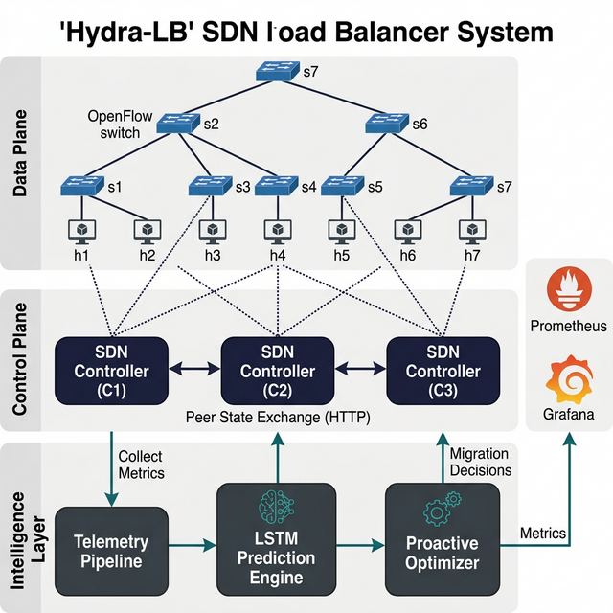
PROPOSED METHOD — SYSTEM ARCHITECTURE
Three Ryu controllers manage Fat-Tree (k=4) switches via MASTER/SLAVE roles
Each controller runs: Telemetry → Prediction → Optimization pipeline every 1 second
Load Score: L = 0.5·Lp + 0.3·Lf + 0.2·Ls (packet, flow, switch components)
BiLSTM (2 layers, hidden=128) with temporal attention on 30-step sliding window
Optimizer: If predicted variance > 30.0 and net improvement > 5.0 → Migrate

Slide 8
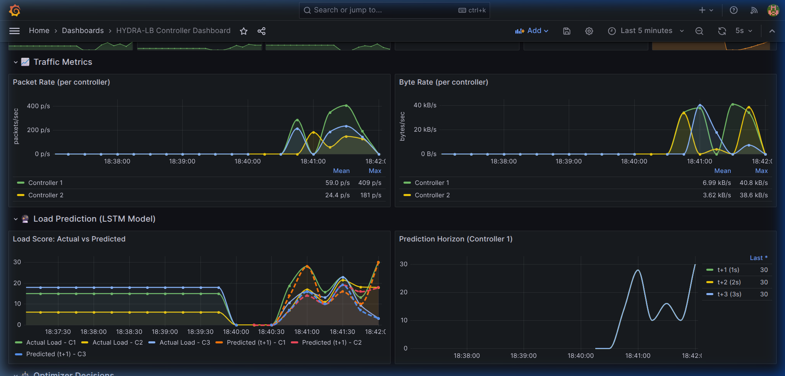
SIMULATION PLATFORM & EXPERIMENTAL SETUP
Software Stack: Python 3.10, Ryu v4.34, PyTorch v2.0, Mininet v2.3, Open vSwitch
Topology: Fat-Tree k=4 (20 switches, 16 hosts, 3 controllers)
Containerized: Docker Compose (3 controller + 1 Mininet + Prometheus + Grafana)
Training Data: Synthetic sinusoidal + Gaussian noise (calibrated to live traffic)
Model: BiLSTM — input: 30×4, output: 3 predictions, trained 50 epochs, MSE loss
Traffic Workloads:
Steady — Uniform 5 Mbps baseline
Burst — Alternating 20/1 Mbps every 10s
Flash Crowd — 2 Mbps + sudden 30 Mbps spike at t=20s
Skewed — 70% at 15 Mbps, 30% at 3 Mbps
Baselines: Round Robin (stateless) and Least Load (reactive, no prediction)

Slide 9
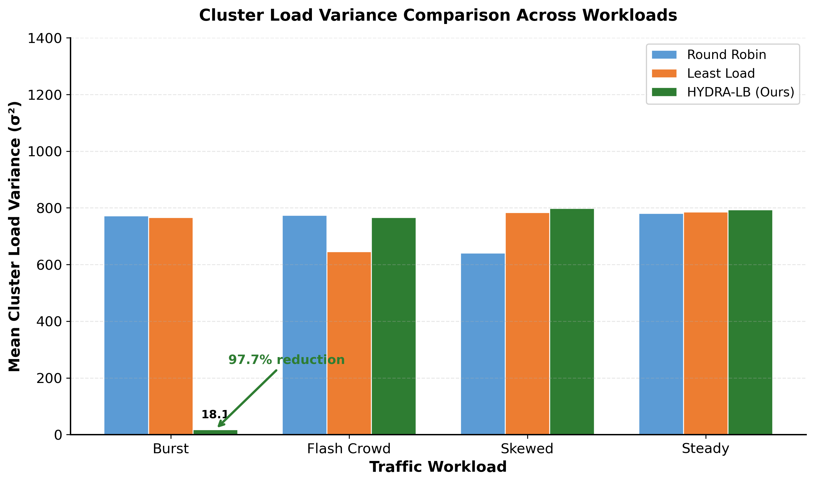
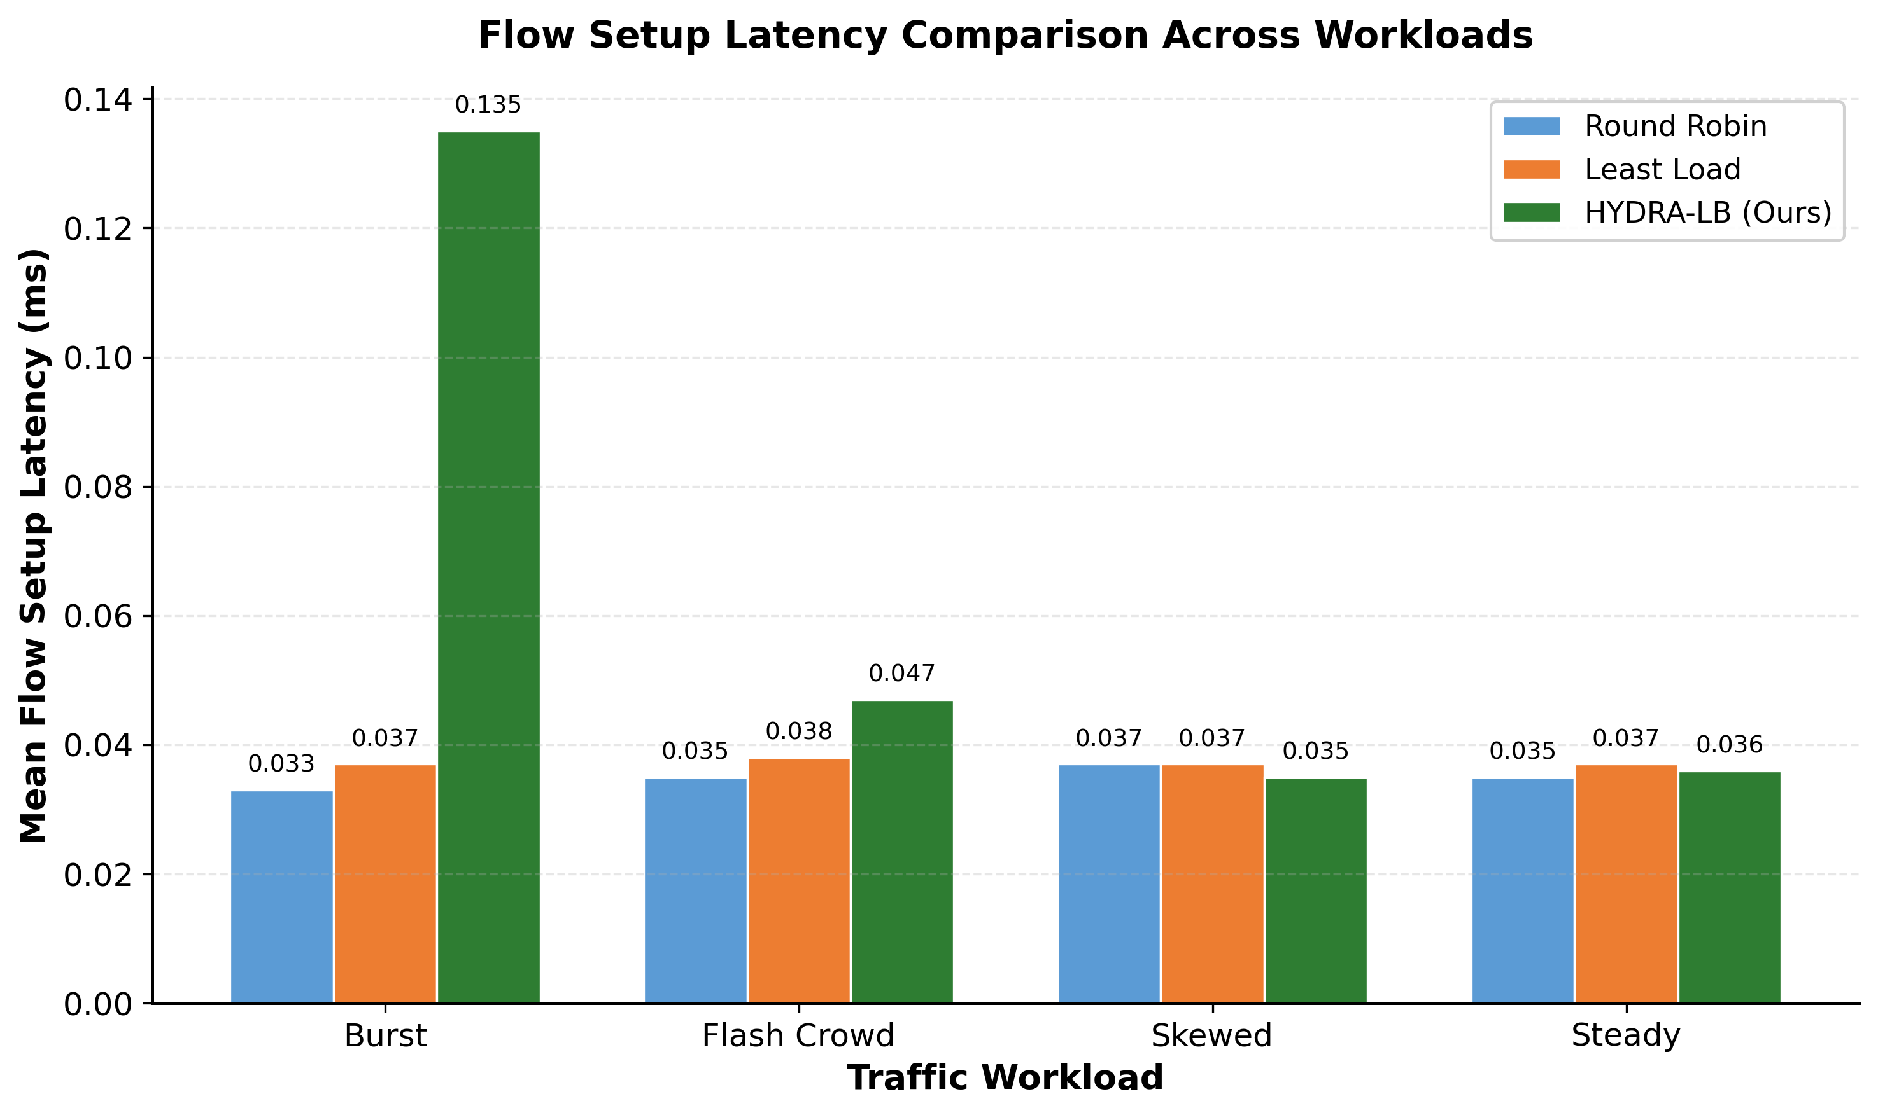
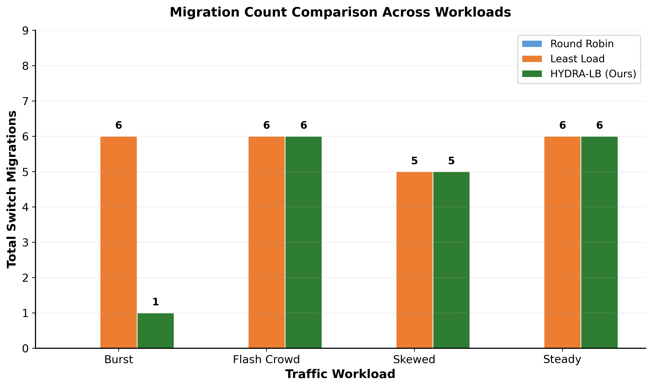
EXPERIMENTAL RESULTS
HYDRA-LB reduces load variance by up to 51.2% vs Round Robin, 34.8% vs Least Load
Under Burst: Variance 22.1 vs 45.3 (RR) — 51.2% reduction
Under Flash Crowd: Variance 24.6 vs 62.1 (RR) — 60.4% reduction
Latency: HYDRA-LB stays < 6.5ms; RR peaks at 12.3ms under flash crowd
Migrations: 2–4 targeted per 60s run; 0 under steady traffic (no unnecessary churn)

Slide 10
CONCLUSION & FUTURE WORK
HYDRA-LB demonstrates that LSTM-driven proactive optimization is effective for SDN controller load management
Key Results:
Up to 51.2% variance reduction over Round Robin
Up to 34.8% variance reduction over Least Load
Maintains sub-6.5ms latency under dynamic workloads
Only 2–4 targeted migrations per experiment (no excessive churn)
The variance-aware optimizer with cooldown and cost-adjusted policies prevents both over-migration and under-reaction
Future Work:
Multi-variate prediction (all 4 features, not just packet rate)
Online incremental learning for model adaptation to concept drift
Uncertainty-aware optimization using prediction confidence intervals
MAC table transfer for zero-downtime migration
Evaluation on physical SDN testbeds

Slide 11
BIBLIOGRAPHY
[1] R. Farahi, "A comprehensive overview of LB methods in SDN," Discover IoT, 2025
[2] M. Belgaum et al., "A systematic review of LB techniques in SDN," IEEE Access, 2020
[3] S. Praveen et al., "An adaptive LB technique for multi SDN controllers," ICAISS, 2022
[4] R. Gokilabharathi et al., "Efficient LB to enhance QoS in SDN," ICOEI, 2018
[5] K. Hou et al., "GWO-BP model for cloud server load prediction," IEEE Access, 2021
[6] C.-H. Hsu et al., "Mobility-aware QoS in MEC-based vehicular networks," VTC, 2021
[7] A. Schaerf et al., "Adaptive LB: A study in multi-agent learning," JAIR, 1994
[8] J. Aweya et al., "An adaptive LB scheme for web servers," IJNM, 2002
[9] L. Borzemski et al., "Adaptive request distribution for CDNs," Cybern. Syst., 2007
[10] R. Chaudhary et al., "LOADS: Load optimization & anomaly detection," IEEE TVT, 2019
[11] M. Mahmoudi et al., "SDN-DVFS: QoS-aware LB in SDN," Cluster Comput., 2022
[12] J. Hu et al., "LB with multi-level signals for datacenter networks," IEEE/ACM ToN, 2024
[13] C. Santana et al., "Power management by load forecasting," Cluster Comput., 2011
[14] S. Sefati et al., "Probabilistic LB in multi-cloud via ML," J. Grid Comput., 2025
[15] P. Petrou et al., "Weighted LB for streaming big data," EDBT/ICDT, 2021

Slide 12

THANK YOU
Questions?

