Slide 1
Project Presentation of CO-OP Project at Industry (Module-2) (22CS421)
On
AI Chatbots in Education: Ethical, Cognitive, and Security Implications for Children
Ashita Chhabra : 2210991405
Ansh Popli: 2210991298
Ansh Rehan: 2210991299
Jaskirat Kaur : 2210991701
Supervised By
Dr. Ajay Kumar
Department of Computer Science and Engineering,
Chitkara University, Punjab

Slide 2
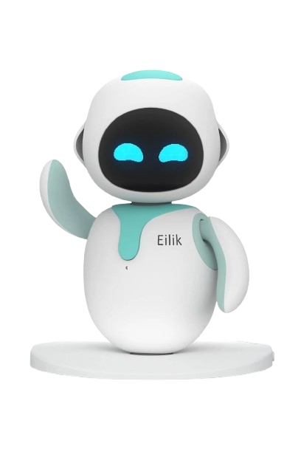
Introduction
Artificial Intelligence (AI) has become a transformative force in modern education systems worldwide
AI-powered chatbots use Natural Language Processing (NLP) to simulate human-like interactions
Tools like ChatGPT provide intelligent, context-aware responses to student queries
These systems support:
* Personalized learning experiences
* Continuous academic assistance
* Interactive and engaging learning environments
AI chatbots are increasingly used by students for:
* Homework assistance
* Concept clarification
* Writing and grammar improvement
Their accessibility makes learning flexible, especially beyond traditional classroom hours

Slide 3

Role of Chatbots in Education
AI chatbots act as virtual learning assistants.
Provide instant feedback and real-time responses to queries.
Enable adaptive learning based on individual student needs and pace.
Assist educators in:
* Designing lesson plans
* Creating assessments
Support collaborative and self-directed learning
Facilitate multilingual communication, improving accessibility for diverse learners
Available 24/7, eliminating dependency on classroom schedules

Slide 4
Background and Evolution
Early educational technologies included recorded lectures, static quizzes, and rule-based systems.
These traditional systems lacked personalization and dynamic interaction for learners.
Advancements in Artificial Intelligence (AI) and Natural Language Processing (NLP) led to the development of intelligent chatbot systems.
Modern AI chatbots can understand user intent and provide contextual, detailed explanations.
They are capable of adapting responses dynamically according to student needs.
AI chatbots are now widely adopted across educational platforms, schools, universities, and mobile learning applications.

Slide 5

Problem Statement
Increasing reliance on AI chatbots may reduce independent learning.
Students may misuse AI tools for completing assignments and exams .
Lack of transparency in AI-generated responses.
Potential for biased, misleading, or incorrect information.
Privacy concerns due to data collection and storage.
Risk of exposing children to harmful or inappropriate content.
Need to balance technological benefits with responsible usage.

Slide 6

Objectives of the study
To analyze the growing role of AI chatbots in education.
To identify ethical challenges such as bias and academic dishonesty.
To examine the cognitive impact on children’s thinking and learning abilities.
To evaluate security and privacy risks associated with AI usage.
To suggest practical recommendations for responsible and safe implementation.
To highlight the need for balanced integration of AI in education.

Slide 7
Literature Review
Existing research highlights that AI chatbots:
* Improve student engagement and motivation
* Provide instant feedback and personalized support
* Enhance accessibility to educational resources
Help simplify complex concepts through conversational explanations.
However, studies also emphasize:
* Risk of overdependence on technology.
* Reduced interpersonal interaction.
* Possibility of misinformation.
* Ethical concerns including bias and fairness.
* Privacy and data security issues.

Slide 8
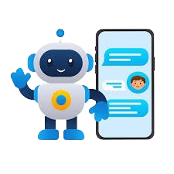
Benefits of AI Chatbots
Personalized learning tailored to individual needs.
Immediate feedback and doubt resolution.
24/7 availability for continuous learning.
Encourages independent and self-paced learning.
Simplifies complex concepts through interactive explanations.
Supports multilingual learning environments.
Provides a non-judgmental space for students to ask questions.
Enhances overall learning efficiency and engagement.

Slide 9
Ethical Implications
Academic dishonesty increases when students rely on AI for assignments and exams.
Algorithmic bias may cause AI systems to provide biased, incomplete, or misleading information.
Lack of transparency makes users unaware of how AI-generated responses are created.
Accountability issues arise because responsibility for incorrect outputs remains unclear.
Unequal access to AI tools creates a digital divide among students.
Younger learners may develop blind trust in AI responses without critical evaluation.

Slide 10
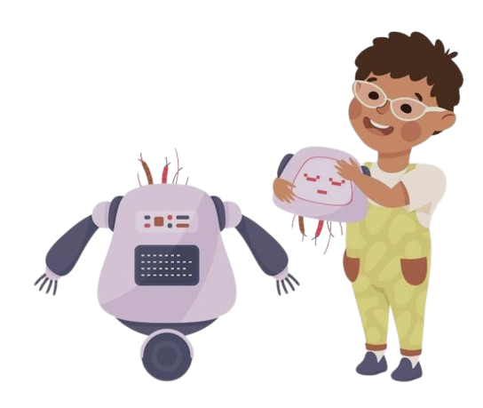
Cognitive Impact on children
Overuse of AI chatbots may reduce critical thinking skills.
Memory offloading:
* Students rely on AI instead of retaining knowledge.
Reduced creativity due to reliance on ready-made answers.
Weak problem-solving abilities.
Decreased patience for deep and analytical learning.
Risk of passive learning behavior.

Slide 11

Security and privacy risks
AI systems collect personal, behavioral, and learning data.
Risk of data breaches and unauthorized access.
Children may unknowingly share sensitive information.
Lack of awareness regarding digital privacy practices.
Exposure to harmful, misleading, or inappropriate content.
Lack of transparency in data collection and usage policies

Slide 12
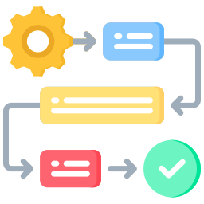
Methodology
This study is based on qualitative research using an analytical and conceptual approach.
The data was collected from secondary sources such as research papers, academic journals, reports, and case studies, with no primary data collection conducted.
The analysis was carried out using thematic analysis, which involved identifying recurring patterns and categorizing the findings into major themes.
The main focus areas of the study include ethical implications, cognitive effects, and security risks associated with AI chatbots in education.

Slide 13

Results and analysis
ChatGPT was identified as the most widely used AI chatbot among students.
High usage indicates increasing dependency on AI tools in education.
Students frequently use AI for homework, assignments, and concept clarification.
Key findings show an increase in academic dishonesty among learners.
There is a noticeable reduction in critical thinking and independent learning skills.
Many students show over-reliance on automated responses instead of self-analysis.
Limited awareness of alternative AI tools was also observed.
Growing concerns regarding data privacy and security remain a major issue.

Slide 14

Recommendations and Conclusion
Promote guided and supervised use of AI chatbots in education.
Implement strong data protection, privacy policies, and content filtering mechanisms.
Enhance digital literacy among students for responsible and safe AI usage.
Adopt innovative assessment methods like project-based learning and real-world problem-solving.
AI chatbots improve learning efficiency and accessibility but also create ethical, cognitive, and security challenges.
AI should be used as a support tool with proper regulation, not as a replacement for human intelligence.

Slide 15

Thank You
15

