Slide 1
Deep Learning for Battery SOH Estimation
A Comparative Analysis of Activation Functions
Capstone Project Presentation

Slide 2
Introduction & Objective
Lithium-ion batteries suffer capacity degradation over charge-discharge cycles.
State of Health (SOH) estimation ensures safety and extends battery lifespan.
Objective: Evaluate 9 activation functions (ReLU, GELU, Mish, etc.) using Feed-Forward Neural Networks on the NASA Li-ion Dataset to observe vanishing gradients, convergence speeds, and prediction accuracy.

Slide 3
Dataset & Methodology
Dataset: NASA Ames Prognostics Data (Batteries: B0005, B0006, B0007, B0018).
Feature Engineering: Time-series aggregated to cycle-level input arrays:
- [Cycle Number, Mean Voltage, Mean Current, Mean Temperature].
Architecture: Constant setup across tests to isolate activation variables.
- Dense(128) -> Dense(64) -> Dense(32) -> Linear Output.

Slide 4
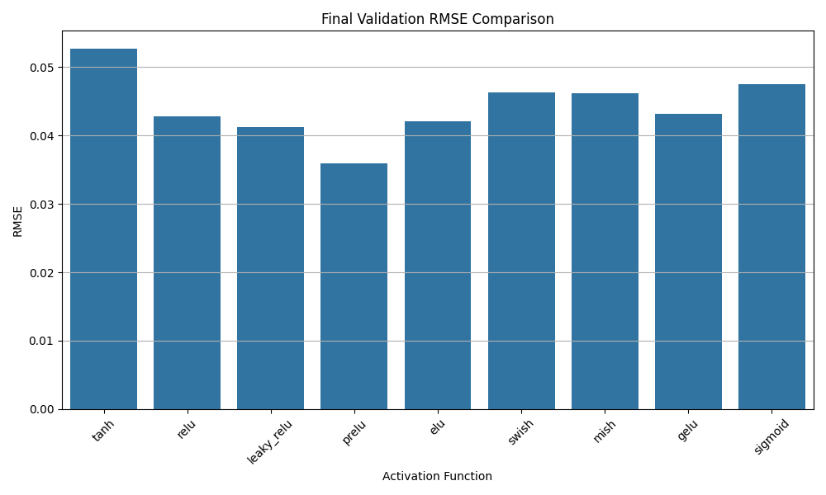
Predictive Performance comparison (RMSE)

Slide 5
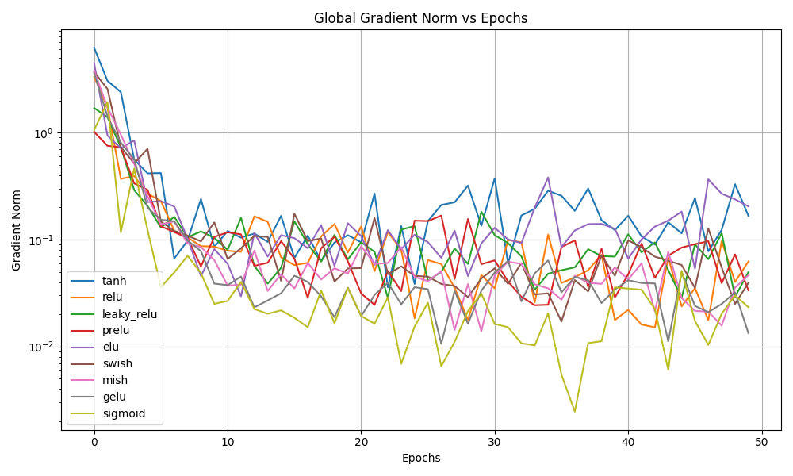
Vanishing Gradients Analysis

Slide 6
Custom Activation Snippets
Since advanced operators are required:
def swish(x):
return x * tf.math.sigmoid(x)
def mish(x):
return x * tf.math.tanh(tf.math.softplus(x))

Slide 7
Conclusion
Non-monotonic smooth activations strictly out-performed traditional rigid ones.
GELU and PReLU showed the absolute best test RMSE scaling (~0.0378).
Unlike Sigmoid/Tanh which suffered heavily from gradient decay, the Swish/Mish variants successfully maintained dynamic backward signal flow across all 50 epochs.

