Slide 1
BeagleBone Black

Slide 2
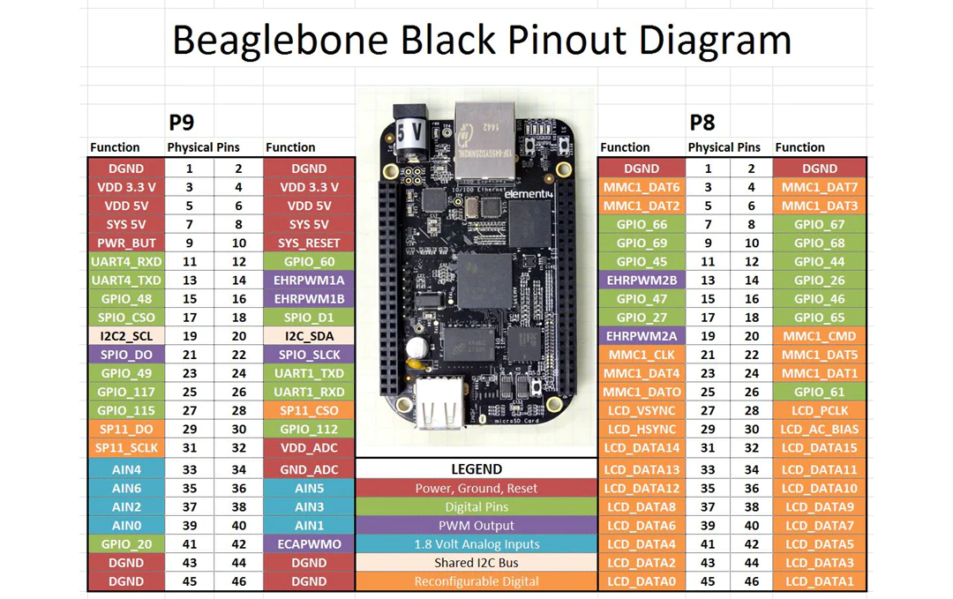

Slide 3
Linux commands
// setting up python file on linux directories
ls –gives description of location i.e. Desktop
mkdir my_Python – creating file on Desktop
cd my_python – changing directory from Desktop to my_Python
nano digOut.py – creates new python terminal to write code
python digOut.py - executes the python code

Slide 4


Digital write to the GPIO pins
I have connected P9_2 Ground to a volage measuring device.
. I have connected P9_12digital output to a voltage measuring device.

Slide 5
CODE to up-down voltage using digital pins
import Adafruit_BBIO.GPIO as GPIO
outPin=“P9_12”
GPIO.setup(outPin,GPIO.OUT)
From time import sleep // from time library we import sleep
for i in range(0,5):
GPIO.output(outPin,GPIO.HIGH)
sleep(3)
GPIO.output(outPin,GPIO.LOW)
sleep(3)
GPIO.cleanup()

Slide 6
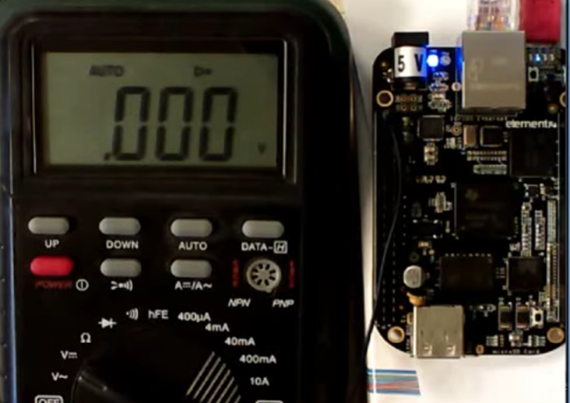
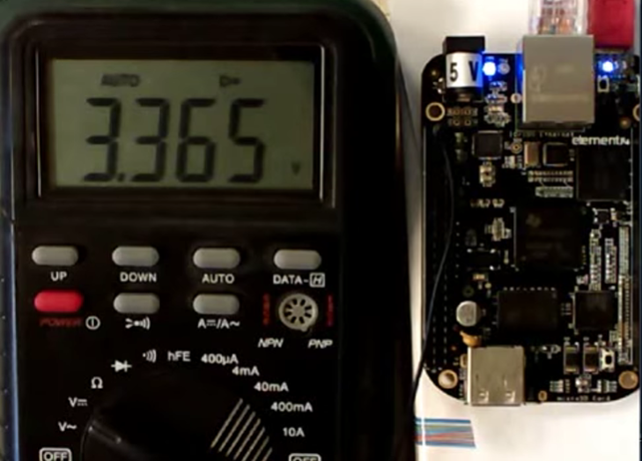




GPIO.LOW GPIO.HIGH

