Slide 1

SmartMatch ML Network
Bidirectional Talent-to-Requisition Vector Mapping Engine with Multi-Platform Ingestion & Cryptographic Security Shielding
Developer Node(s)
Submission Date
[Your Name / Group Members]
July 7, 2026
🌐 Production Source Repository: [Insert Your GitHub Link Here]

Slide 2
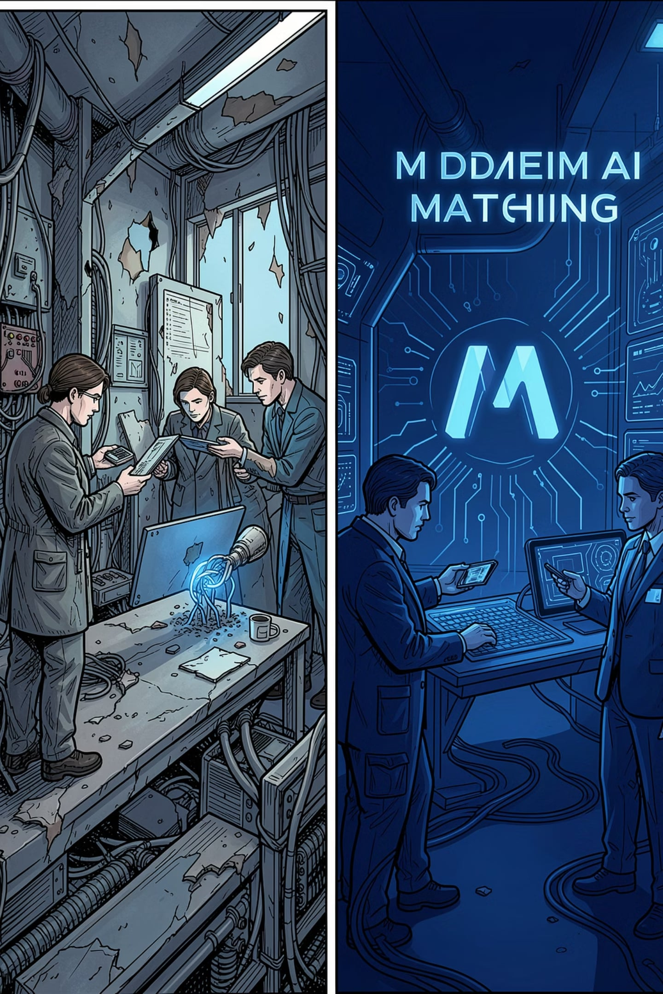
PROBLEM & SOLUTION
The Industry Deficit
❌ Why Current Systems Fail
The SmartMatch Solution
A localized Machine Learning recommendation system executing asymmetric, directional data sorting.
Dual-Sided Optimization: Dynamically transforms raw experience, profile text, and job descriptions into semantic matching indices on the fly.
The Cosine Similarity Trap: Rigid bidirectional string comparisons penalize candidates for possessing additional unrequested skills.
Algorithmic Noise: Recruiter feeds are clogged with inaccurate matching percentages; candidates get flat keyword-stuffed suggestions.

Slide 3
DEEP TECH
The Machine Learning Engine
The platform utilizes Term Frequency-Inverse Document Frequency (TF-IDF) parsing mechanics directly within the server runtime loop to calculate non-linear intersection weight vectors:

Slide 4

PROCESSING PIPELINE
Micro-Algorithmic Processing Steps
Corpus Aggregation
Vectorization Tokenizing
Boundary Normalization
Directional Rules
Combines skills arrays, experience summaries, and descriptions into text blocks; extracts semantic density weights; rescales TF-IDF frequencies into 0–100% boundary scores; injects automated experience penalization heuristics to protect real-world hiring thresholds.

Slide 5
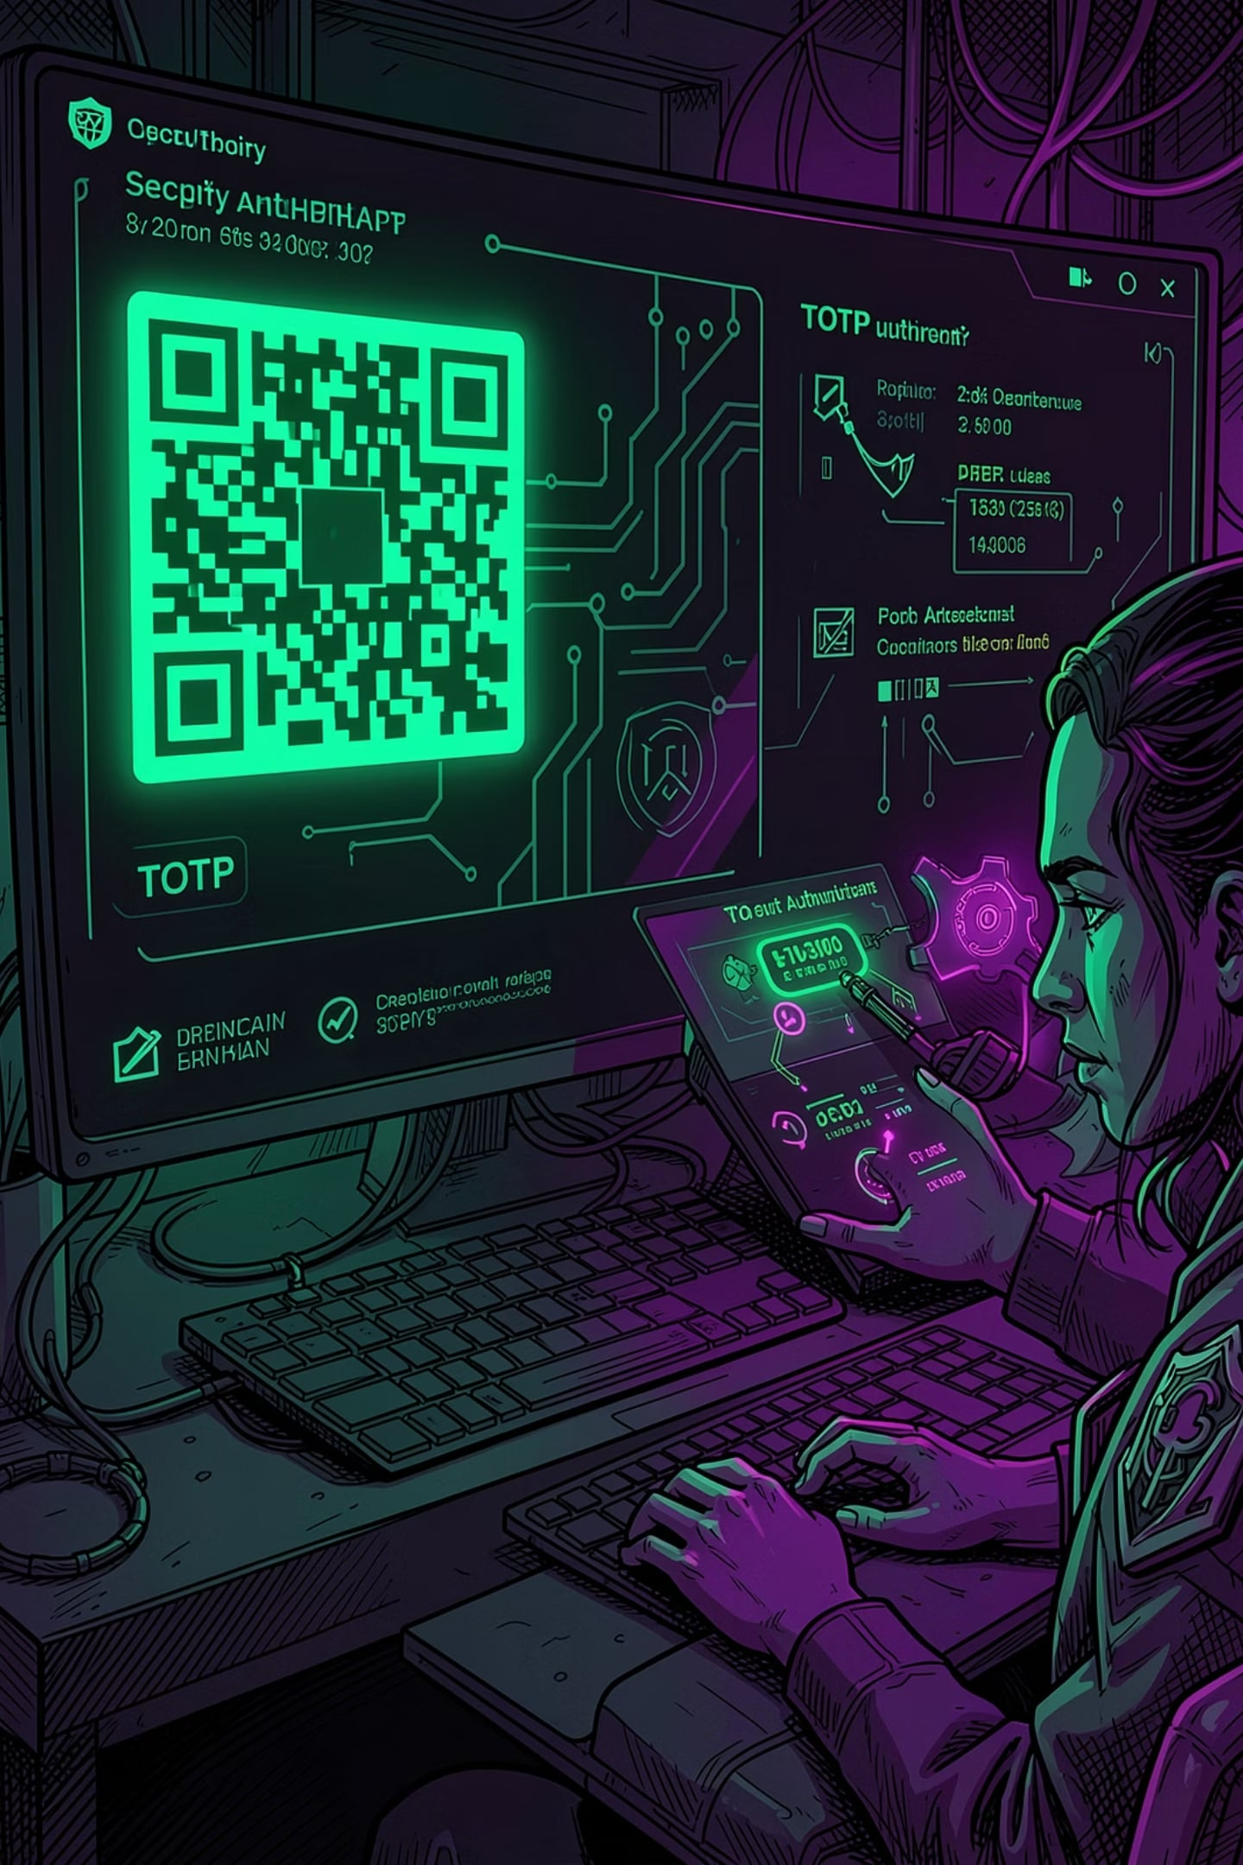
SYSTEM FEATURES
Interoperability Hub
🛡️ Cryptographic Security Node
🌐 Multi-Website Aggregator Pipeline
Implements Time-based One-Time Passwords (TOTP) via secret hashing logic. Integrates native dynamic QR Code streams for complete Multi-Factor (2FA) login gating.
Simulates automated data ingestion across major hiring indexes — LinkedIn, Indeed, ZipRecruiter. Normalizes mixed external data into localized schemas instantly.
📡 Outbound Syndication Feed
Exposes public JSON and RSS broadcast channels directly from the internal database. Enables external index aggregators to consume platform job vacancies programmatically.

Slide 6
TECHNOLOGY STACK
Engineering Architecture
Architecture Layer
Core Technology
Functionality Scope
Frontend Framework
React.js & Tailwind CSS
Real-time interactive UI dashboards with zero-latency state rendering.
Application Server
Node.js (Express Framework)
Centralized asynchronous event handling loop managing API routing.
Database Engine
MongoDB & Mongoose ODM
Document-oriented storage handling structured data schemas.
NLP / ML Library
natural JS Module
On-the-fly TF-IDF text vector analysis without external microservice dependencies.
Security Layer
speakeasy & qrcode
Cryptographic secret verification loops guarding user profiles.

Slide 7
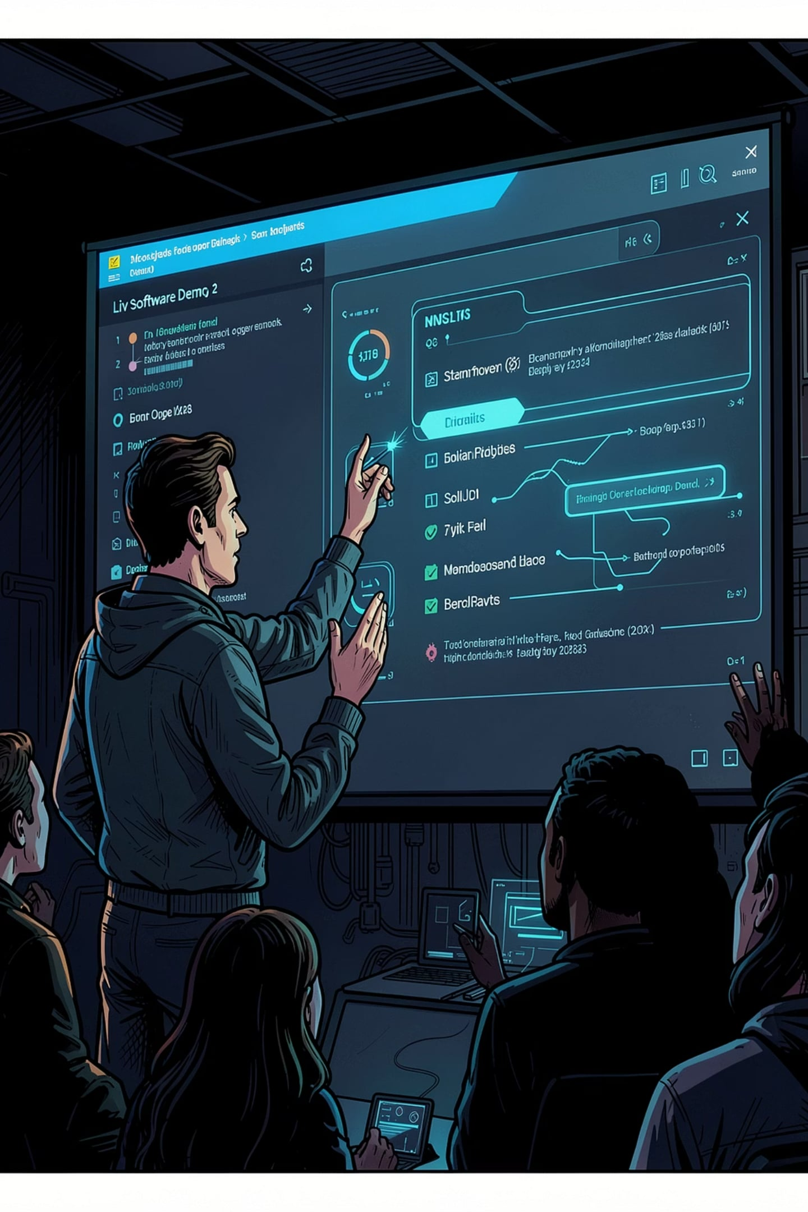

LIVE DEMO
5-Minute Demo Strategy
1
0:00 – 1:30
Security Onboarding — Create Candidate & Poster accounts + Set up 2FA via QR Code.
2
1:30 – 3:15
Recruiter View — Post job, simulate external aggregation mining, run ML matching.
3
3:15 – 5:00
Candidate Dashboard — Load profile, instantly view optimal matching percentage list.
If a candidate adds a skill not required by the job, the match percentage stays at a perfect 100% — proving our directional ML adjustment works as intended.

Slide 8
OUTCOMES
Measurable Project Outcomes
100%
100%
Functionality Complete
Code Integrity
Database integration, ML calculations, and 2FA components are fully operational.
Clean, open-source codebase published directly to GitHub with absolute environmental isolation.

Slide 9
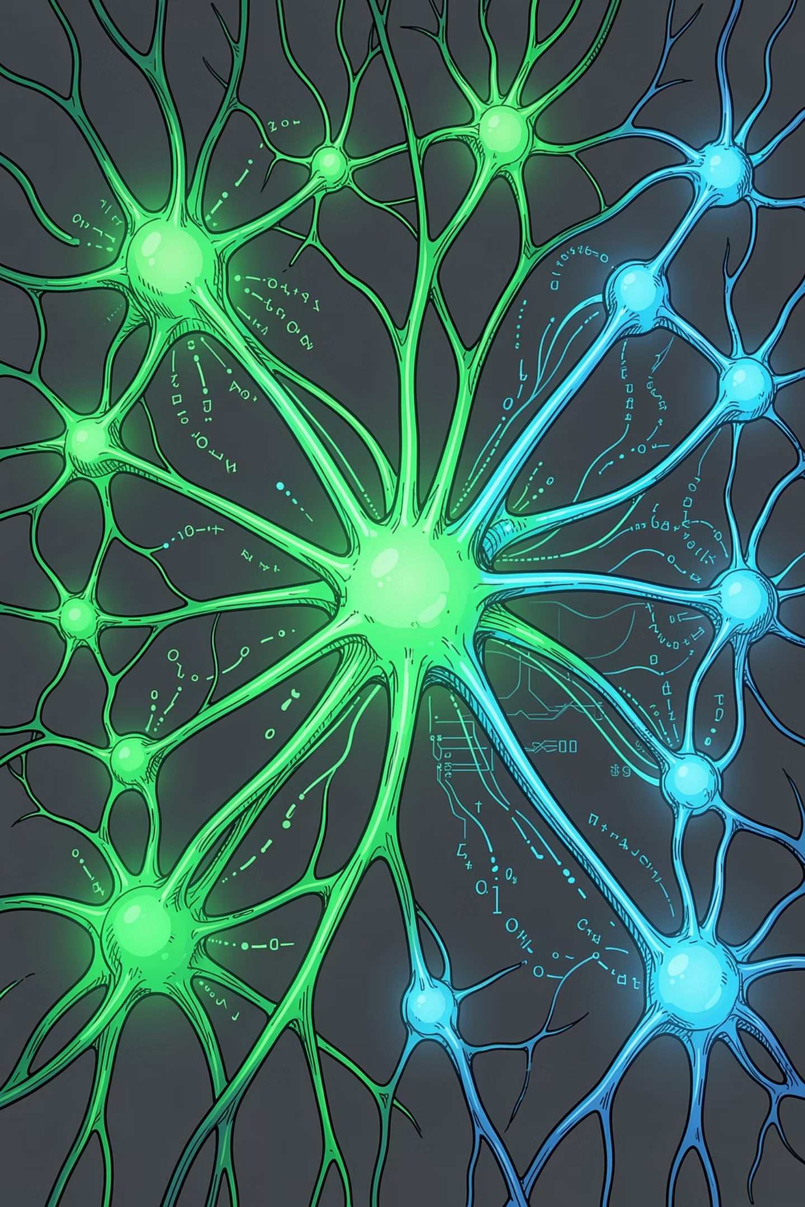
KEY INNOVATION
Directional ML: The Core Differentiator
Traditional systems use symmetric matching — penalizing candidates for having extra skills the job didn't request.
SmartMatch's asymmetric, directional approach ensures additional candidate skills never reduce the match score.
Legacy Systems
Extra skills → lower match %
SmartMatch
Extra skills → 100% preserved

Slide 10


SUMMARY
SmartMatch ML Network
Cryptographic 2FA
Asymmetric ML Match
Multi‑Platform Aggregation
A unified hiring intelligence platform combining directional TF-IDF matching, TOTP-based cryptographic security, and multi-website data ingestion — redefining how talent connects with opportunity.

