Slide 1
Diabetes Prediction Using K-Nearest Neighbor Algorithm
Submitted BY: Ansh Ujlayan (209301050)

Slide 2
INTRODUCTION
Diabetes is a chronic disease that affects millions worldwide, resulting in high blood glucose levels and serious complications. This project aims to develop a machine learning model using the K-Nearest Neighbors algorithm to predict diabetes based on clinical features such as Glucose, Blood Pressure, Skin Thickness, BMI, Insulin, and Age. The objective is to assist healthcare professionals in early identification and provide personalized care. The publicly available Pima Indians Diabetes Database, containing clinical data of women aged 21 or older, will be used. The dataset will be pre-processed, split into training and testing sets, and used to train and evaluate the model. This tool can also help individuals assess their risk of developing diabetes and take preventive measures.

Slide 3
DATASET DESCRIPTION
The dataset used in this project is the Pima Indians Diabetes Database, originally from the National Institute of Diabetes and Digestive and Kidney Diseases The medical predictor variables include:
Pregnancies: the number of times the patient has been pregnant.
Glucose: plasma glucose concentration a 2 hours in an oral glucose tolerance test.
BloodPressure: diastolic blood pressure (mm Hg).
SkinThickness: triceps skin fold thickness (mm).
Insulin: 2-Hour serum insulin (mu U/ml).
BMI: body mass index (weight in kg/(height in m)^2).
DiabetesPedigreeFunction: diabetes pedigree function, which represents the genetic influence of diabetes.
Age: age of the patient (years).

Slide 4
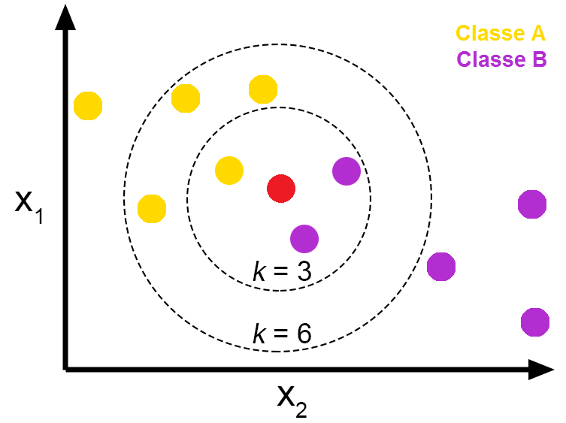
K-NEAREST NEIGHBOURS

Slide 5
K-NEAREST NEIGHBOURS
KNN (k-nearest neighbours) is a machine learning algorithm used for both classification and regression tasks. It is a non-parametric method that uses data points in the training set to classify or predict the output for a new data point based on the similarity of its features to those of the training set.
The algorithm works by calculating the distance between the new data point and the other data points in the training set. It then selects the k-nearest neighbours to the new data point and assigns a label or prediction based on the most common label or the average of the predictions of those k-nearest neighbours.
KNN is a simple yet effective algorithm that can be used for a variety of tasks, but it may not be suitable for large datasets or high-dimensional data due to its computational complexity. Additionally, choosing an appropriate value of k and a suitable distance metric can also impact the performance of the algorithm.

Slide 6
Data Visualization

Slide 7
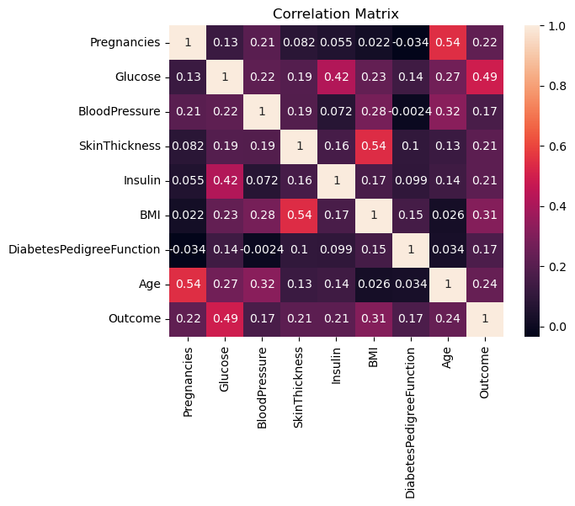
Correlation Matrix

Slide 8
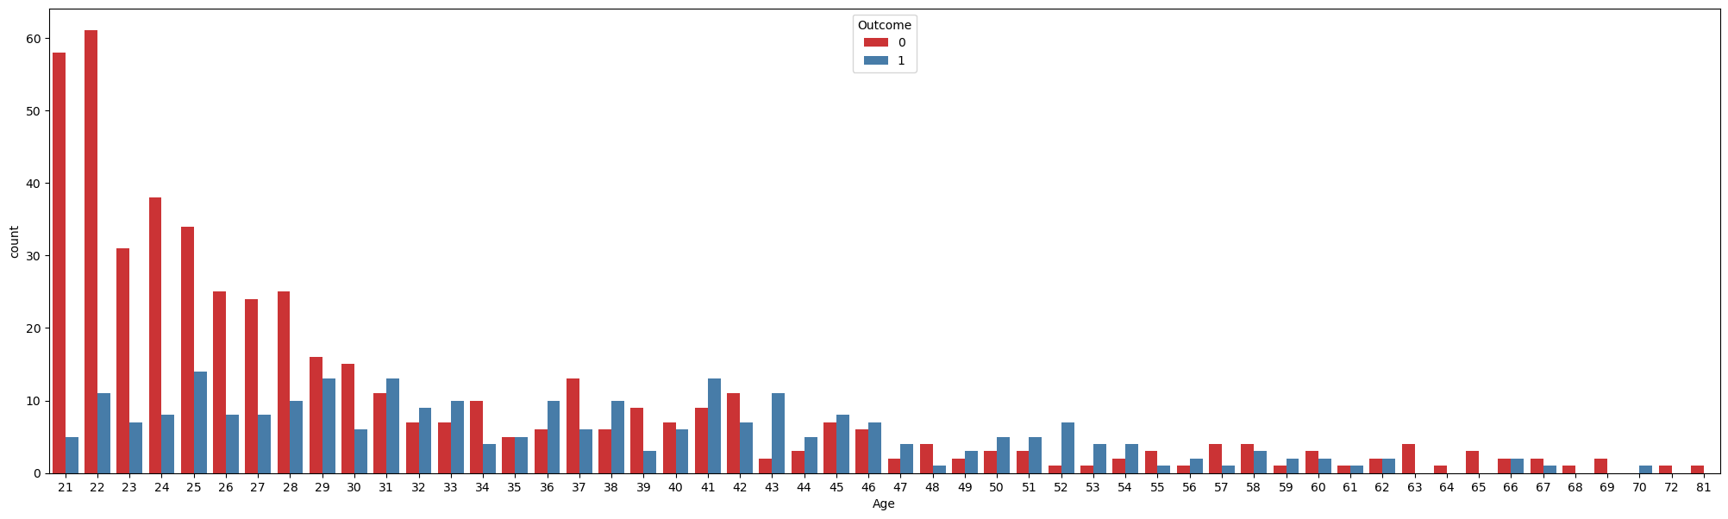
Bar Chart

Slide 9
CONFUSION MATRIX

Slide 10
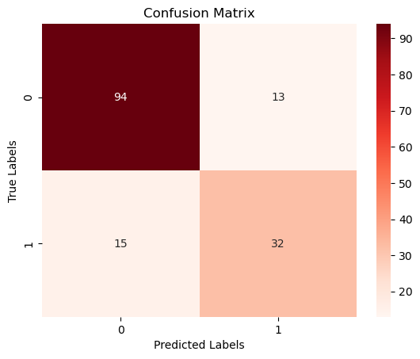
80-20 split

Slide 11
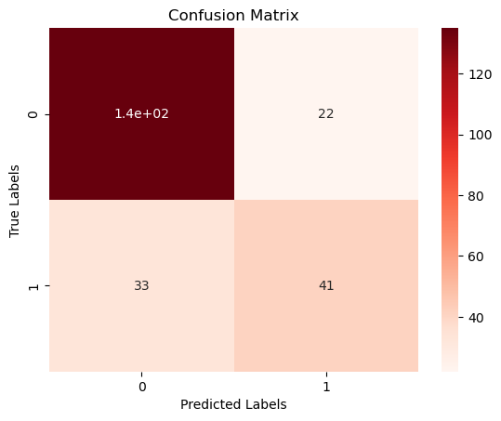
70-30 split

Slide 12
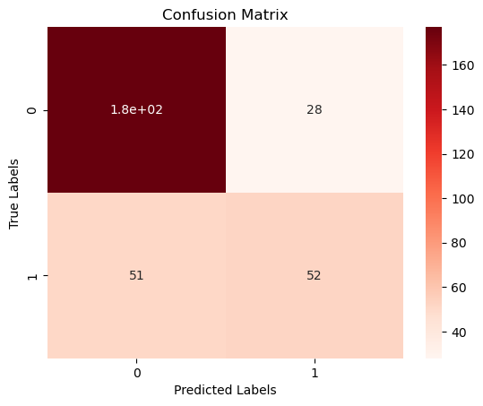
60-40 split

Slide 13
ROC curve

Slide 14
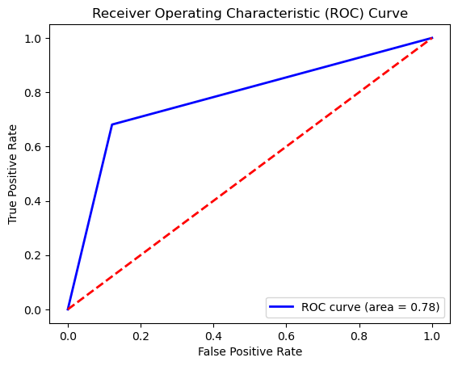
80-20 split

Slide 15
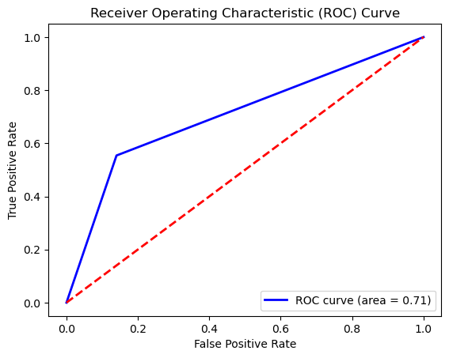
70-30 split

Slide 16
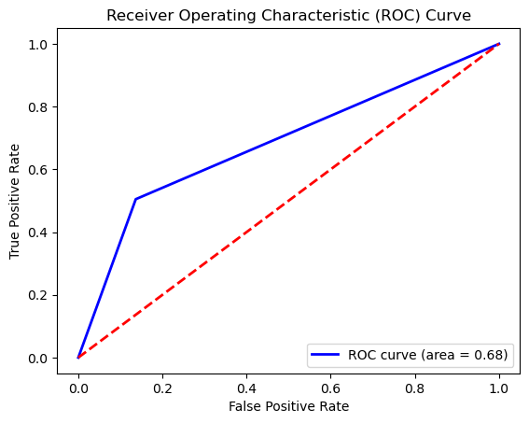
60-40 split

Slide 17
RESULT

Slide 18
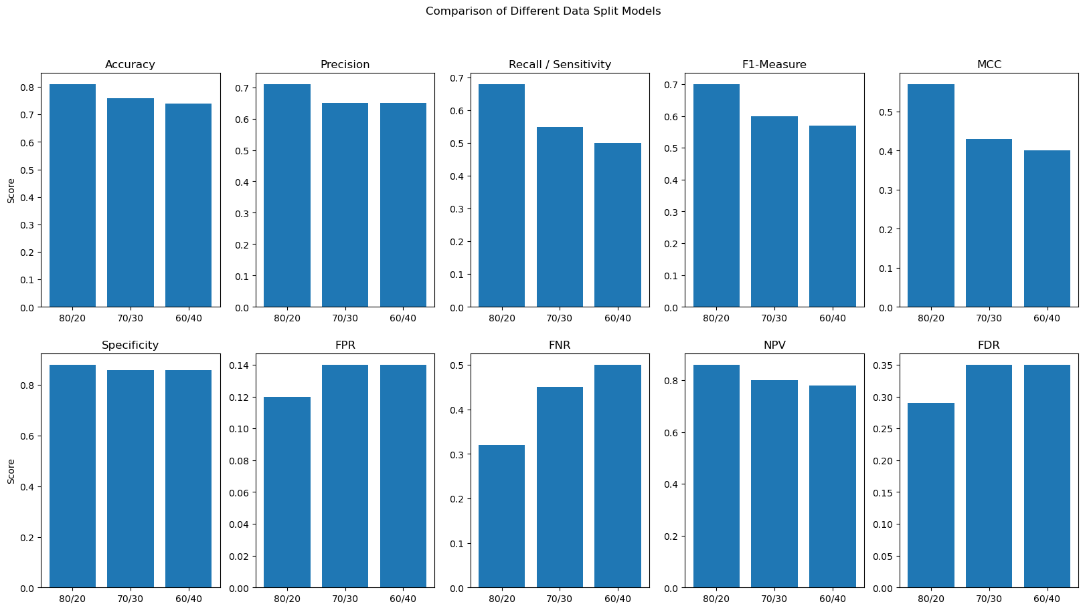
Comparison of different data split models

