Slide 1
TITLE PAGE
Problem Statement ID – 4
Problem Statement Title- AI-Powered Behavioral Anomaly Detection System
Theme- Cyber Security
PS Category- Software
Student Name (Registered on portal): Ansh
Student ID: 23BAI1384

Slide 2
IDEA TITLE
Proposed Solution & Detailed Explanation:
An intelligent Security Operations Center (SOC) dashboard that monitors access logs in real-time.
Replaces static, rule-based security with Machine Learning (XGBoost) to detect subtle, behavioral anomalies (e.g., unusual login hours, lateral movement).
Automatically ranks and queues alerts based on an AI-calculated risk score.
How it addresses the problem:
Catches zero-day threats and insider attacks that bypass traditional firewall rules.
Innovation and uniqueness:
Trust via Transparency: Integrates Explainable AI (SHAP) so security analysts can see the exact features (e.g., failed logins) that triggered the AI.
Custom-built, dark-themed cyber UI optimized for high-stress SOC environments.

Slide 3
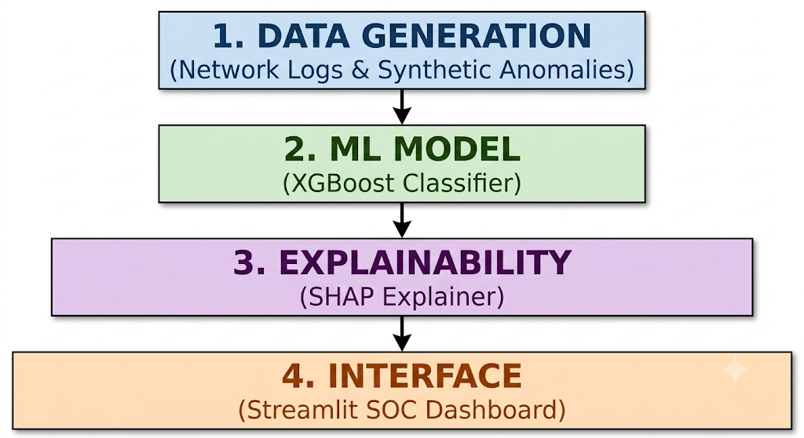
TECHNICAL APPROACH
Technologies to be used:
Programming Language: Python 3.9+
Frameworks & UI: Streamlit (Frontend), Custom CSS (Theming)
Machine Learning: Scikit-Learn, XGBoost, SHAP (Explainability)
Data & Visualization: Pandas, NumPy, Plotly Express
Methodology and Process for Implementation:
Phase 1 (Data): generate_data.py simulates network traffic and injects synthetic anomalies.
Phase 2 (Training): train_model.py trains the XGBoost classifier and exports a serialized model_pipeline.pkl.
Phase 3 (Deployment): app.py consumes live data streams and renders the real-time SOC dashboard.

Slide 4
FEASIBILITY AND VIABILITY
Analysis of the Feasibility:
Highly feasible: Built entirely on robust, open-source Python libraries with no expensive proprietary dependencies.
Lightweight architecture allows it to run smoothly on standard SOC hardware without GPU requirements.
Potential Challenges and Risks:
Risk: High false-positive rates causing "alert fatigue" for security analysts.
Risk: ML models acting as a "black box," leading to a lack of trust from security teams.
Strategies for Overcoming Challenges:
Strategy: Utilizing SHAP visual explainers directly addresses the "black box" risk by providing human-readable justifications for every alert.
Strategy: Implementing a Ranked Alert Queue prioritizes high-confidence anomalies, significantly reducing alert fatigue.

Slide 5
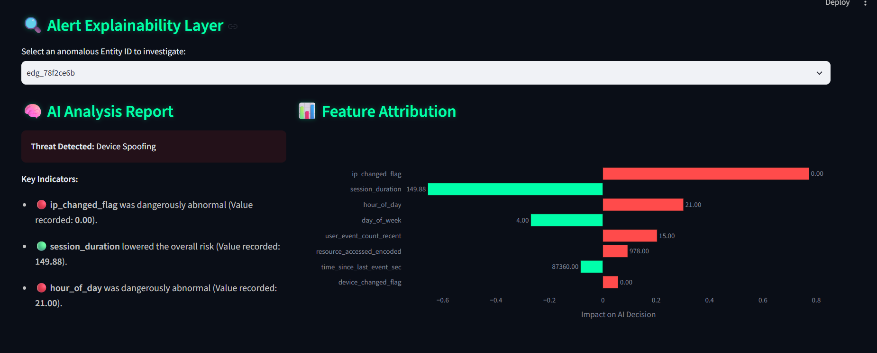
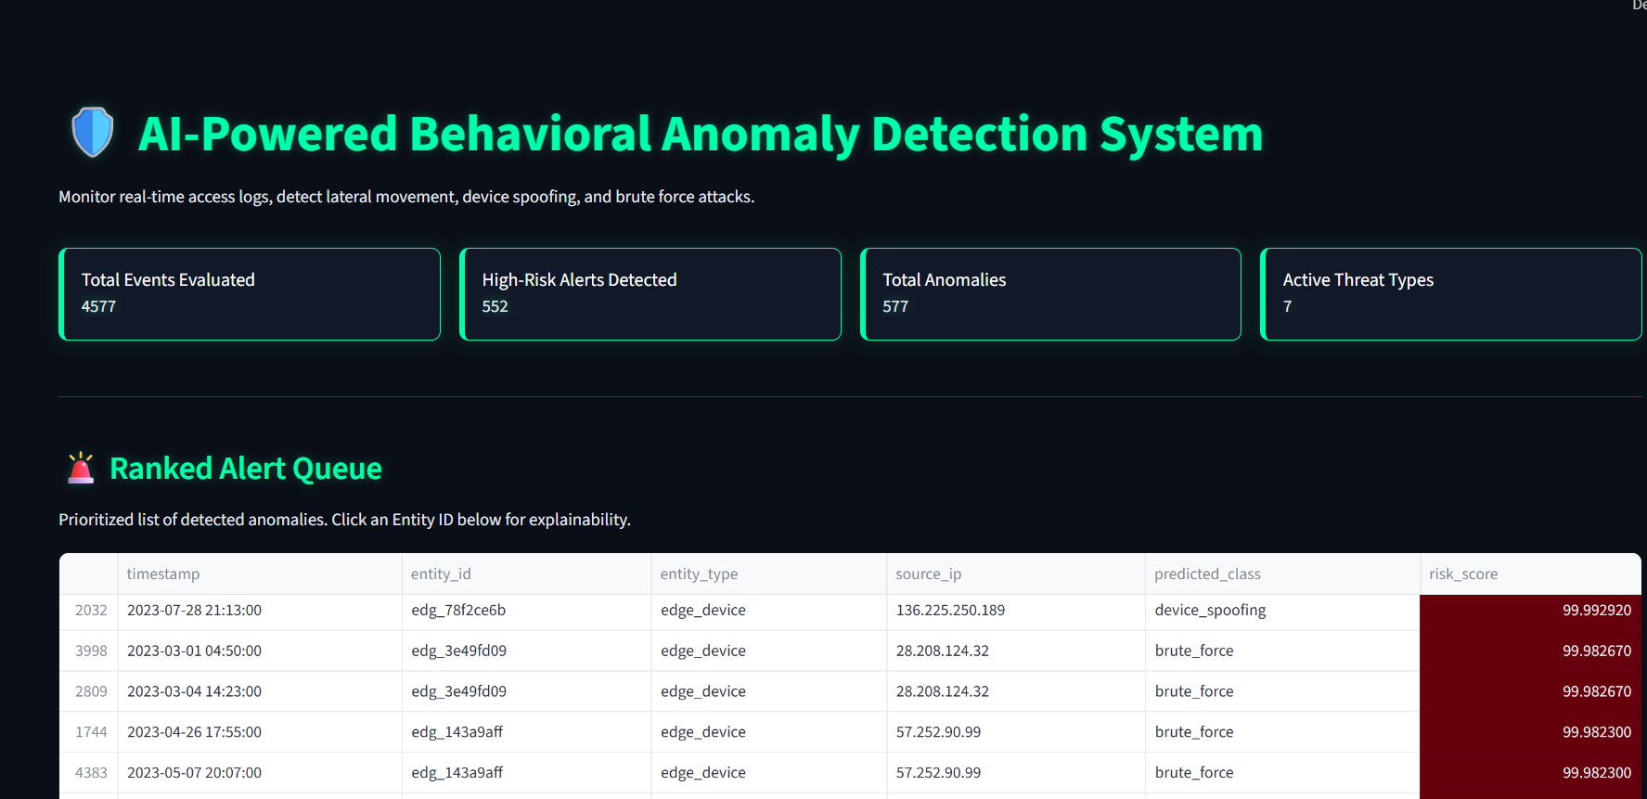
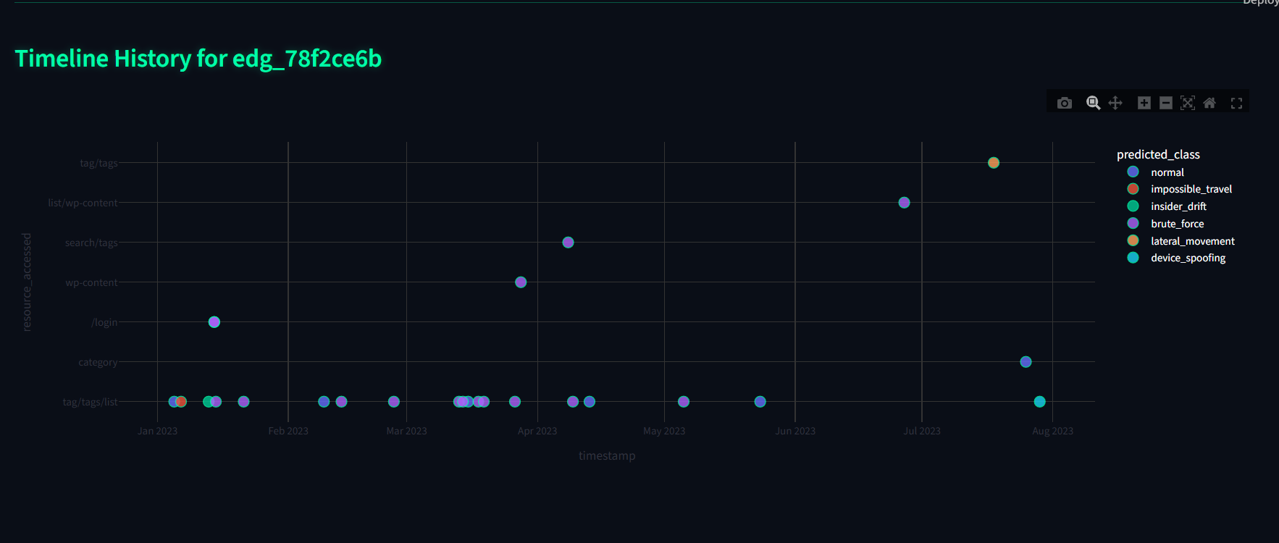
ARTIFACTS
Code Embedded: Core detection scripts (app.py, train_model.py) and packaged model_pipeline.pkl

Slide 6
RESEARCH AND REFERENCES
Details and Links:
Chen, T., & Guestrin, C. (2016). XGBoost: A Scalable Tree Boosting System. ACM SIGKDD.
Lundberg, S. M., & Lee, S.-I. (2017). A Unified Approach to Interpreting Model Predictions (SHAP). Advances in Neural Information Processing Systems.
Streamlit Documentation: https://docs.streamlit.io/
Plotly Graphing Libraries: https://plotly.com/python/

