Slide 1

Trading Strategies reliability Backtester
PROJect GUIDE
Dr. Pandi Murugan
PROject team Members
Anshul shrivastava
(17bce10116)
&
Tarun Maithil
(17bce10157)

Slide 2

INTRODUCTION
The Backtesting System is designed to provide insights into backtested results generated by applying a trading strategy on the clean historical OHLC data of a specific time frame for a specified security.
It will be providing some predefined strategies and technical indicators ensuring users can customise a strategy based on given parameters.
It is a scalable product that may improve in features and performance using ML and Cloud Computing technologies.

Slide 3
EXISTING WORK
This project belongs to a very niche market segment though very effective and important.Thus have many players around the world with their own complex solutions.
Users have to learn different complex concepts specific to a software provided , hence this market is very under penetrated.Moreover cost of such solutions are very high which fails to attract novices.
Traders generally use spreadsheets to backtest as they do not have a cost-effective, understandable and reliable software solution.
There are many traders who wants to work in a less code-oriented yet effective manner to attain their goal.

Slide 4
PROPOSED WORK
(Minimum Viable Product Functionalities)
To backtest a trading strategy on provided OHLC data(third-party) of a specific timeframe.
Will have some predefined default strategies.
Client can customise parameter values of predefined strategies.
Will virtually place orders on the given data and square them off according to the strategy's signal generation.
Showcasing of results on some given parameters after running on the provided data.
Parameters/KPIs provided i.e. CAGR, Volatility, Sharpe Ratio, and Max-Drawdown.
(Nice-to-have features)
Client can make their own strategies and use this project as an framework for their analysis.
Data Modelling enabling graphical representation of the time series analysis..

Slide 5
NOVELTY OF THE PROJECT
This system will be a non-complex & easy to use backtester that will work as a hand-on tool for both novices and professionals.
This project has been growing from scratch so as to eliminate many complex technical glitches.
Virtual experience will make traders confident over their strategies and push them towards proper risk management.
Developing markets like India which has very under penetrated zone due to high costs and lack of awareness will be benefitted the most.

Slide 6
REAL TIME USAGE
This project is very unique in a sense that it will act as a hand-on tool for traders and market analysts to apply and test their ideas and strategies before applying them in the real market scenario.
Users can filter out bad strategies and choose good ones to increase their accuracy furthermore.
Will provide users a easy to use framework which will help in increasing their efficiency.

Slide 7
HARDWARE & SOFTWARE REQUIREMENTS
(Most probably this project will be implemented as a web-app or notebook style analysis work rather than a local standalone application thus may require working with cloud systems)
RAM : 6 GB or higher.
Python Packages like numpy, pandas, matplotlib, yfinance, etc.
Data APIs provided by free vendors.
Packages like Selenium for web automation.
Jupyter notebooks
Browser : Google Chrome(recommended Version 85.0.4183.83 or higher) or any other updated browser.

Slide 8
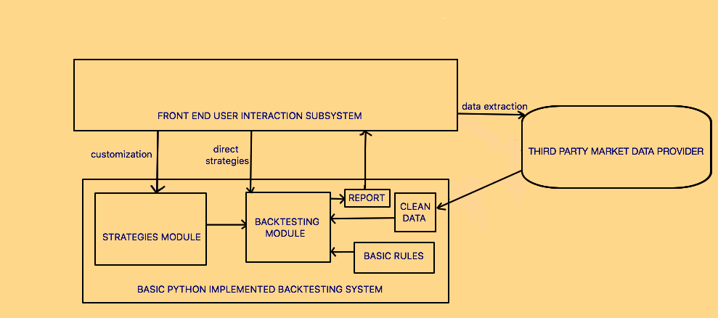
SYSTEM ARCHITECTURE DIAGRAM

Slide 9
Module : Portfolio Rebalancing Strategy
Choosing any universe of stocks (Large cap, mid cap, small cap, Industry specific, factor specific, etc) and stick to this group of stocks as the source for our portfolio for the entire duration of backtesting.
Building fixed individual position sized long only portfolio by picking m number of stocks based on monthly returns (or any other suitable criterion).
Rebalancing the portfolio every month by removing worse x stocks and replacing them with top x stocks from the universe of stocks.
Backtesting the strategy and comparing KPIs with that of simple buy and hold strategy of corresponding index.

Slide 10
Module : Price Action Strategies
Candlestick Patterns :
Doji Candlestick Pattern
Hammer Candlestick Pattern
Shooting Star Candlestick Pattern
Marubozu Candlestick Pattern
Technical Indicators :
Moving Average Convergence Divergence
Bollinger Band
Average True Range
This module can be used as an API/Library for candlestick patterns and technical indicators as a open source resource.

Slide 11
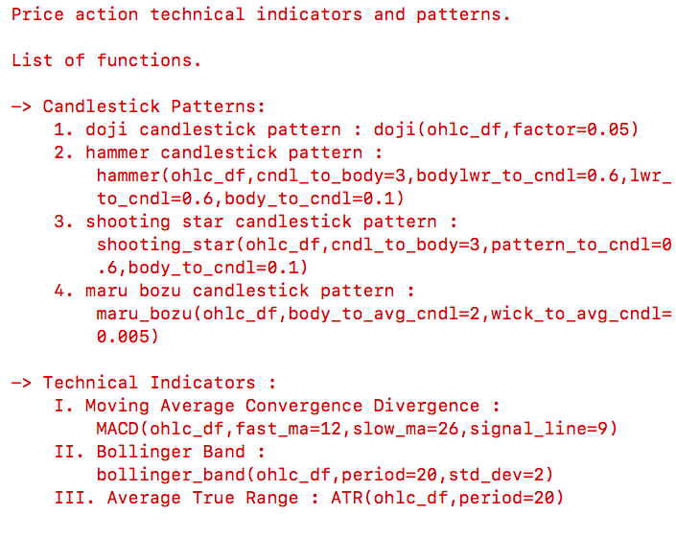
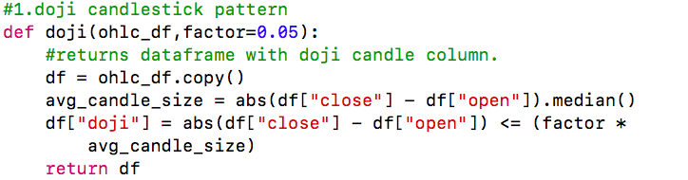
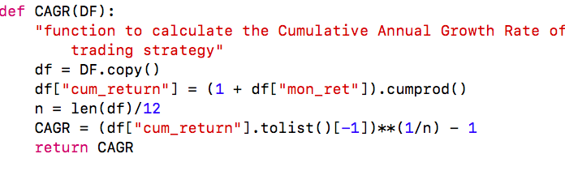
Implementation and Coding

Slide 12


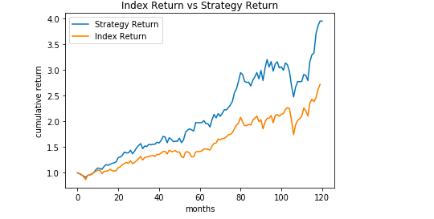
Result and Discussion
Portfolio Rebalancing Strategy on DJI vs DJI index
m = number of stock in the portfolio i.e 6
x = number of underperforming stocks to be removed from portfolio monthly i.e 3

Slide 13
Conclusion
Testing the strategy by applying the rules and trading signal criteria on historical data mimicking actual trading conditions.
Being conservative - err on the side of caution.
Backtesting is of critical importance in assessing the merit of a trading strategy/system.
Don’t deploy strategy in live market until backtested.
Criticism - Since it is based on historical data it has little predictive power.

