Slide 1

Agentic RAG Chatbot with LangChain and Groq
Using Model Context Protocol (MCP)

Slide 2
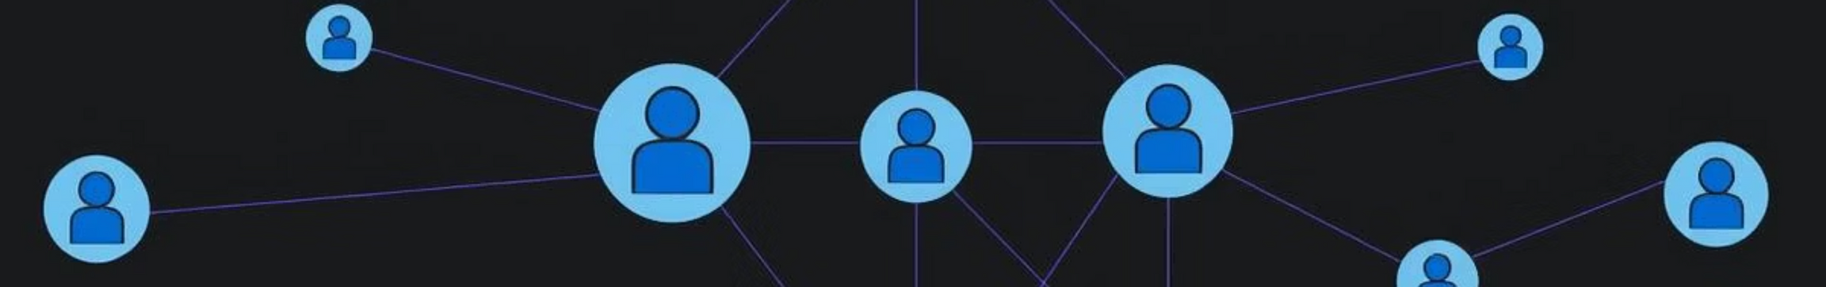




System Architecture
Our Agentic RAG Chatbot leverages a modular architecture with distinct agents communicating via the Model Context Protocol (MCP).
CoordinatorAgent
IngestionAgent
Orchestrates system flow.
Processes document uploads.
RetrievalAgent
LLMResponseAgent
Manages context retrieval.
Generates responses.

Slide 3
MCP Message Flow
The Model Context Protocol (MCP) ensures seamless communication between agents.
DOCUMENT_UPLOAD
1
User uploads a document.
INDEX_DOCUMENT
2
Document is parsed and indexed.
RETRIEVAL_QUERY
3
User query initiates retrieval.
RETRIEVAL_RESULT
4
Relevant context is returned.

Slide 4
System Flow: User Interaction
The system processes user requests from document upload to answer generation.
1.User uploads document to CoordinatorAgent.
2.IngestionAgent parses and splits documents.
3.RetrievalAgent indexes and stores in FAISS.
4.User query triggers context retrieval.
5.LLMResponseAgent generates answers via Groq.

Slide 5




Core Technologies
Our chatbot is built on a robust tech stack for optimal performance.
Frontend
Backend
Streamlit for interactive UI.
LangChain, FAISS, HuggingFace embeddings.
LLM
Document Parsing
Groq (Mixtral-8x7b) for powerful responses.
LangChain loaders for diverse formats.

Slide 6
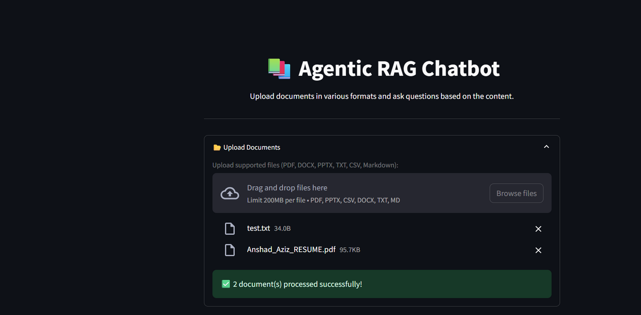
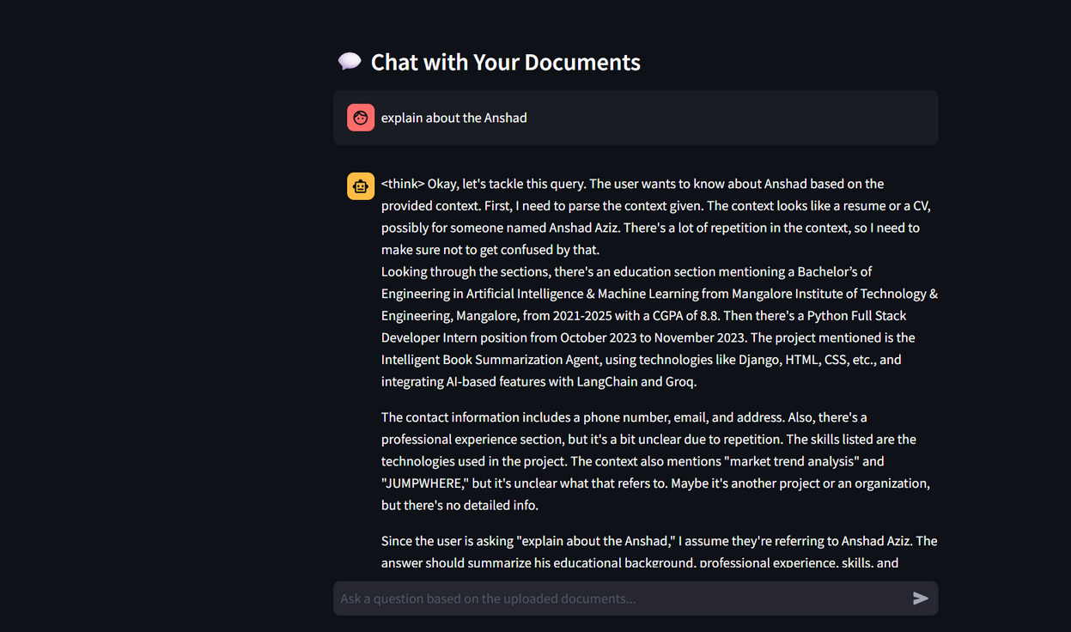
User Interface
Intuitive design for seamless document interaction and chat experience.

Slide 7
Challenges Faced
Developing the chatbot presented several key challenges.
Document Diversity
FAISS Optimization
MCP Compatibility
Handling various document formats with LangChain loaders.
Ensuring efficient retrieval with LangChain integration.
Integrating MCP with diverse LangChain components.

Slide 8
Future Scope
Our roadmap includes exciting enhancements for the chatbot.
Cloud Vector Store
Advanced Text Splitting
Integrate with cloud-based vector stores for scalability.
Real-time Updates
Implement live document updates for dynamic content.
Explore sophisticated strategies for better context.

