Slide 1
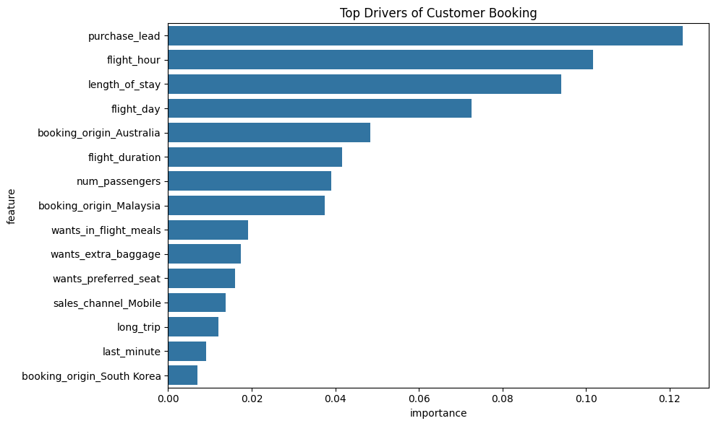
Predicting customer buying behaviour
Objective
To predict whether customers will complete a booking before travel using historical booking data.
Approach
Data prepared(cleaning, encoding, feature engineering)
Random Forest model trained with balanced class weighting
Prediction threshold adjusted to improve buyer detection
Cross-validation used
Model Performance
Accuracy: 76% | Precision: 34% | Recall: 62% | F1 Score: 0.44
Key Insight
Adjusting the prediction threshold improved recall from 13% –> 62%, making the model effective for customer acquisition.
Key Drivers of Booking
Business Impact
Identifies high-intent customers early
Enables targeted marketing campaigns
Improves conversion rates before travel
Supports data-driven decision-making

