Slide 1

ALY6980 - CAPSTONE
PROJECT PRESENTATION
MODULE 12 ASSIGNMENT
By:
Ansh Aya
Suprit Mestry
Venkat Rishi Kumar Aloor
Kelvina Pethani
Lalitesh
To:
Prof: Valerie Atherley

Slide 2
EXECUTIVE SUMMARY
This document will examine the methods used, objectives sought, and key advantages of using ML/AI for software security.
Identifying vulnerabilities more accurately and efficiently.
Prioritizing vulnerabilities before they can be exploited.
Automating security tasks.

Slide 3
AIM OF THE PROJECT
Automate vulnerability assessment to reduce manual labor and improve efficiency
Realize cost savings by minimizing human resource dependence
Enable rapid responses to evolving security threats by quickly identifying and addressing vulnerabilities
Improve overall security while optimizing resource allocation.

Slide 4
BUSINESS QUESTIONS
How can we use machine learning and artificial intelligence to collect and evaluate threat intelligence data so that we can proactively fight against new threats?
Is it possible to utilize ML/AI to improve email security by spotting phishing emails and harmful attachments?
How might ML/AI help automate and speed up incident response, such as determining the extent of an invasion of privacy and containing it?
How can ML/AI improve the accuracy of our security alerts so that our safety personnel can concentrate on actual threats?
How can we use ML/AI to evaluate the safety record of suppliers and third-party vendors?

Slide 5
TECHNIQUES & METHODOLOGY USED
Data Acquisition: Collect datasets from diverse sources.
Data Exploration: Visualize data, identify patterns, and relationships.
Data Refinement: Cleanse and preprocess data for quality.
Machine Learning and AI: Analyze large datasets efficiently.
Data Modeling: Structure and manipulate data for AI.
Additional Techniques: Understand data, clean, transform, filter, summarize, and perform feature engineering.
Initial Analysis: Study the product and its dataset for understanding vulnerabilities.
ML and AI Model: Create a model for automated vulnerability assessment, learning from past data to enhance accuracy.

Slide 6
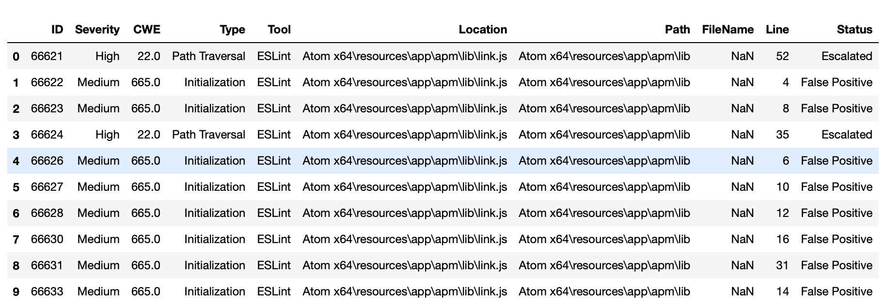
DESCRIPTIVE STATISTICS
1) Atom Dataset

Slide 7
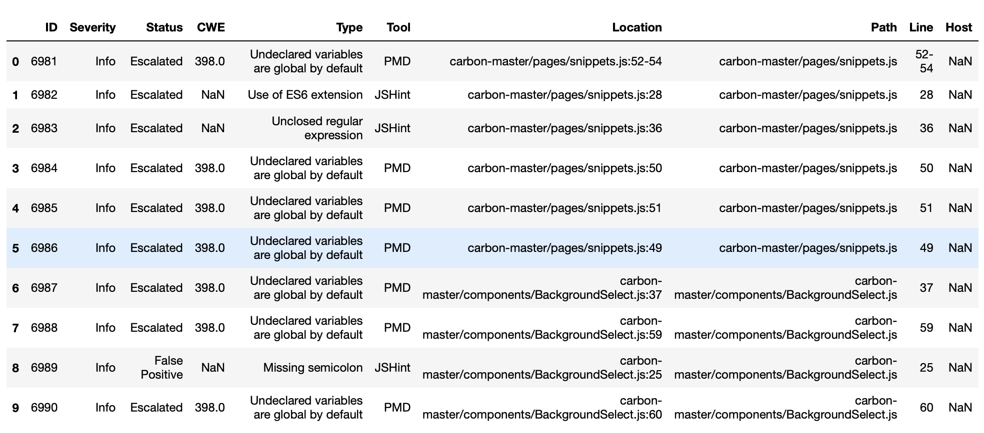
2) Carbon Dataset

Slide 8
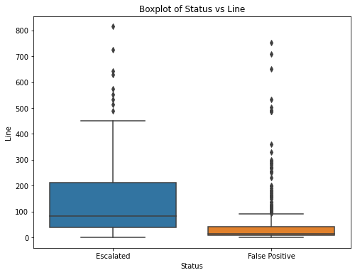
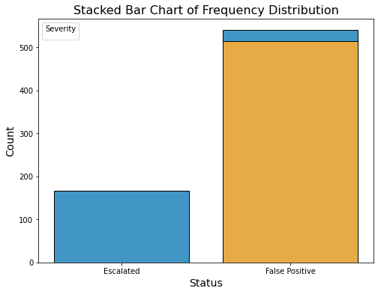
EXPLORATORY DATA ANALYSIS
eeew

Slide 9
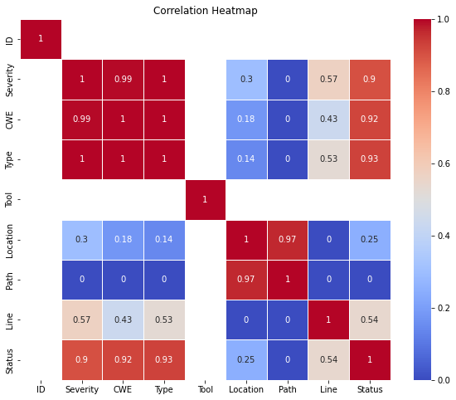
EXPLORATORY DATA ANALYSIS
eeew

Slide 10
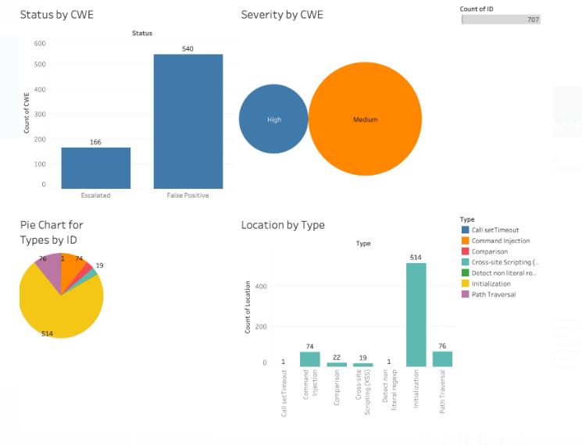
EXPLORATORY DATA ANALYSIS
eeew
Dashboard 1:
Diagram 1: Pie Chart for Types by ID
Command Injection (514), Comparison (76), and Cross-site Scripting (XSS) (74) are the most popular tool types.
Pie chart displays the percentage of tools per ID by type.
Diagram 2: Location by Type (Bar Chart)
Command Injection, Comparison, and XSS are popular in all states.
Some variation in tool popularity across states
Diagram 3: Count of ID (Bar Chart)
Command Injection (514), Comparison (76), and XSS (74) are the top 3 types in terms of tool count.
Diagram 4: Severity by CWE (Bar Chart)
Command Injection, Comparison, and XSS are prevalent, all considered high severity vulnerabilities.
Illustrates the number of tools per ID by severity level.
Overall Findings:
Command Injection, Comparison, and XSS are consistently popular tool types.
These tools target high severity vulnerabilities.
Some regional variations exist in tool preferences.

Slide 11
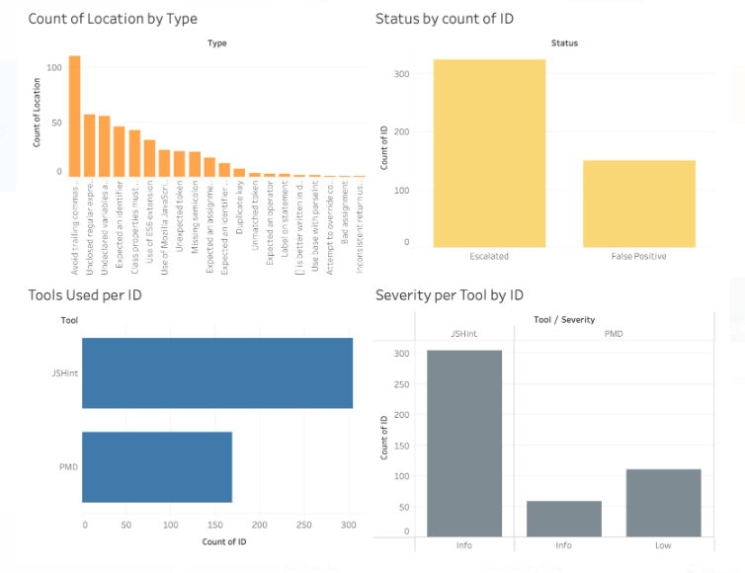
EXPLORATORY DATA ANALYSIS
eeew
Dashboard 2:
Diagram 1: Average tools per ID varies by state
Diagram 2: Majority of tools are in "Info" status (300) compared to "Low" status (100).
Diagram 3: Average tools per ID increase with severity
Diagram 4: "Info" severity dominates, with JSHint used 300 times, PMD 100 times.
Overall, variations in tools per ID are observed by state, severity level, and status.

Slide 12
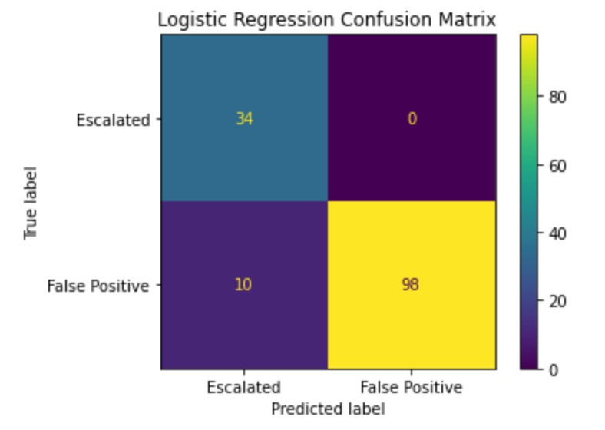
ML MODELS ON DATASETS
eeew
LOGISTIC REGRESSION
Model accuracy is impressive at 92.9%, correctly predicting outcomes in 92 out of 100 instances.
Confusion matrix breakdown reveals 34 true positives and 98 true negatives.
Absence of false positives (0 instances) underscores the model's precision in avoiding misclassification of negatives as positives.
Presence of 10 false negatives raises concerns, prompting a closer examination of consequences and contextual implications.
Additional metrics include recall (77.27%) and specificity (100%), offering nuanced insights into the model's performance.
Model rarely mislabels negatives as positives (no false positives) and excels at identifying actual positive instances.
10 false negatives suggest the need for further investigation depending on the specific context.
Future analysis planned using random forest and multi-collinearity models.

Slide 13
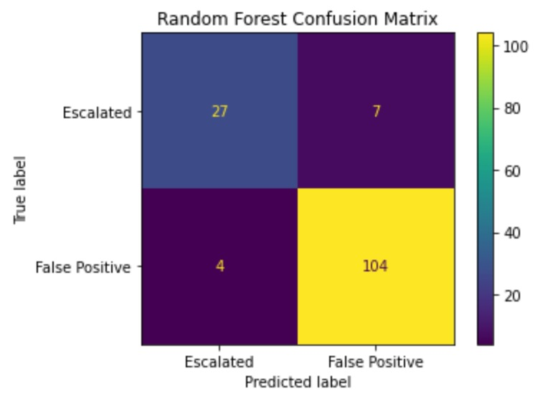
ML MODELS ON DATASETS
RANDOM FOREST CLASSIFIER
Random Forest Model Performance:
Accuracy rate: 92.2%
Reliable predictions in approximately 92 out of 100 instances for the 'status' variable.
Confusion Matrix Analysis:
True positives: 27 instances (precise identification of positive outcomes).
True negatives: 104 instances (accurate recognition of negative outcomes).
False positives: 7 instances.
False negatives: 4 instances.
High precision with minimal misclassifications.
Limited false positives highlight proficiency in avoiding mislabeling negatives as positives.
Presence of a few false negatives prompts further investigation.
Additional Metrics:
Recall: 87.1% (effectiveness in capturing positive instances).
Specificity: 93.6% (accuracy in identifying negative instances).
Summary:
Random Forest Model demonstrates robust accuracy and precision.
Promising potential in ongoing analysis.
Future exploration includes multi-collinearity models for enhanced understanding and improved predictive capabilities.

Slide 14
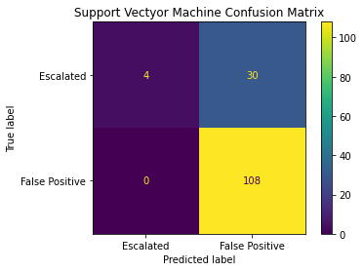
ML MODELS ON DATASETS
SUPPORT VECTOR MACHINE
Random Forest Model Performance:
Accuracy rate: 78.87%
Reliable predictions in approximately 79 out of 100 instances for the 'status' variable.
Confusion Matrix Analysis:
True positives: 4 instances (precise identification of positive outcomes).
True negatives: 108 instances (accurate recognition of negative outcomes).
False positives: 0 instances.
False negatives: 30 instances.
High precision with minimal misclassifications.
Limited false positives highlight proficiency in avoiding mislabeling negatives as positives.
Presence of a few false negatives prompts further investigation.
Additional Metrics:
Recall: 11.76% (effectiveness in capturing positive instances).
Specificity: 100% (accuracy in identifying negative instances).
Summary:
Future exploration includes multi-collinearity models for enhanced understanding and improved predictive capabilities.

Slide 15
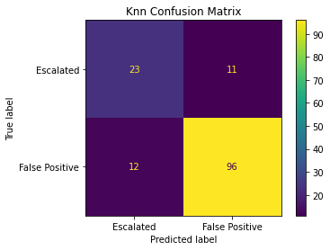
ML MODELS ON DATASETS
K-NEAREST NEIGHBOUR
Random Forest Model Performance:
Accuracy rate: 83.8%
Reliable predictions in approximately 84 out of 100 instances for the 'status' variable.
Confusion Matrix Analysis:
True positives: 23 instances (precise identification of positive outcomes).
True negatives: 96 instances (accurate recognition of negative outcomes).
False positives: 12 instances.
False negatives: 11 instances.
High precision with minimal misclassifications.
Limited false positives highlight proficiency in avoiding mislabeling negatives as positives.
Presence of a few false negatives prompts further investigation.
Additional Metrics:
Recall: 67.6% (effectiveness in capturing positive instances).
Specificity: 88.8% (accuracy in identifying negative instances).
Summary:
Random Forest Model demonstrates robust accuracy and precision.
Promising potential in ongoing analysis.
Future exploration includes multi-collinearity models for enhanced understanding and improved predictive capabilities.

Slide 16
CONCLUSION
EDA & Visualizations:
Exploratory Data Analysis on Datasets ‘ATOM’ & ‘CARBON’
Boxplot – ‘Status’ vs ‘Line’
Bar graph – Frequency distribution of ‘Severity’
Pie Chart – Vulnerability distribution based on ‘Type’
Logistic Regression Summary:
Logistic Regression attains an 92.9% accuracy.
The model demonstrates precision with a minimal count of false positives
Further investigation into the implications of 10 false negatives is advised.
Random Forest Model Summary:
The Random Forest Model exhibits remarkable accuracy at 92.2%.
It maintains high precision with few misclassifications (7 false positives, 4 false negatives).
The ongoing analysis holds promise, and exploration of multi-collinearity models is on the agenda.
Support Vector Machine Summary:
SVM attains an 78.87% accuracy.
Further Investigation is characteristics of false negatives to understand why the model is missing certain positive cases. This might involve analyzing features, data quality, or model complexity.
K-Nearest Neighbor Summary:
KNN attains an 83.8% accuracy.
Further Investigation includes specific instances of false positives and false negatives to understand if there are patterns or characteristics that could be addressed to improve model performance.

Slide 17
CONCLUSION
AI and ML are powerful tools that can help to improve the safety of software applications by identifying and assessing vulnerabilities more accurately and efficiently.
We are committed to using AI and ML to improve our software and protect our users from security threats.
We believe that AI and ML will play a vital role in the future of cybersecurity, and we are working to stay ahead of the curve.
We are excited to used our machine learning models to provide a successful deliverable to the sponsor. We believe that by using these technologies to identify and assess software vulnerabilities, we can reduce the risk of cyberattacks and protect our users from harm.

Slide 18
Future Research
To Evaluate Threat Intelligence - We will leverage NLP to analyze unstructured data such as reports, forums, and news articles, extracting valuable threat intelligence
For Pattern Recognition - Decision trees can be used for both classification and regression tasks and are quite interpretable. Also, Random Forests are ensembles of decision trees that can handle larger datasets and reduce overfitting. (K-NN)Assigns a class label to an input sample based on the majority vote of its k-nearest neighbors in the feature space.
Exploring how federated learning techniques can be applied to cybersecurity to train models across decentralized data sources without compromising data privacy and security.
To create a risk assessment tool - To detect and assess potential risks in company operations, finance, healthcare, cybersecurity, and compliance. They support better decision-making, effective resource allocation, and uncertainty management in order to reduce and manage risks and enhance performance and overall safety.
To Evaluate Threat Intelligence - We will leverage NLP to analyze unstructured data such as reports, forums, and news articles, extracting valuable threat intelligence
For Pattern Recognition - (K-NN)Assigns a class label to an input sample based on the majority vote of its k-nearest neighbors in the feature space. We also plan to execute XGBoost Classifier Model to find and gain more output accuracy.

Slide 19
REFERENCES
SentinelOne. (2023, March 15). Advancing security: The age of AI & Machine Learning in Cybersecurity. https://www.sentinelone.com/blog/advancing-security-the-age-of-ai-machine-learning-in-cybersecurity/
Simplilearn. (2023, June 6). Data modeling: Overview, concepts, and types: Simplilearn. Simplilearn.com. https://www.simplilearn.com/what-is-data-modeling-article
Villegas, F. (2023, October 18). Data manipulation: What it is, Techniques & Examples. QuestionPro. https://www.questionpro.com/blog/data-manipulation/

