Slide 1

PROManagement
Varshit Jain 181261
Dhairya Desai 181256
Ansh Aya 171013
Date of presentation: 29/5/2021
Under the guidance of: Mr Vaibhav Kala
St. Francis Institute of Technology
Department of Information Technology

Slide 2

Content
Introduction
Review of Literature
Research Gaps Identified
Problem Definition & Objectives
Proposed Solution
Scope of Project
System Description
Hardware & Software Requirements

Slide 3
Introduction
Currently, there are many project management application available they either have limited set of activities and the ones that have all of them are behind a paywall
Our aim is to create an application that will help in project management activities and reduce the human capital required by the organization.
It can help in employee assignment, task delegation, report generation and employee attrition.

Slide 4
Review of Literature
Sr. | Paper Name | Observations
[1] | A project management system for time planning and resources allocation | The problems collected by the author are clearly labeled based on the importance of them and have a specific numeric value attached to them.
[2] | Algorithms for workforce assignment problem | Solution is capital based and not time based.
[3] | Employee Performance Assessment with Profile Matching Method | The result of the profile matching method in ranking form, therefore this method makes it easier to determine the best employees according to the profile desired by the company.
[4] | A Semiautomated Human Resource Management System | The results presented by the author are a result of a simulation they performed and not a result of actual/practical usage of the proposed solution.
[5] | Project management tools-software tools | Insufficient information about the details of the features discussed in the paper.

Slide 5
Review of Literature
Sr. | Paper Name | Observations
[6] | Fatigue Consideration optimization Model for Employee Allocation in Flow Shop Scheduling Problems | The results are a result of a simulation and not an actual experiment. More preferred for blue collar jobs.
[7] | The model of universal project states classifier in project management system | Model is verified using a simulation.
[8] | Employee Performance Target Management System to Support Work Performance Assessment | Appraisal is defined but other features required for an employee management system are not present
[9] | Competence-based knowledge management in project oriented organisations in bi-adaptive context | 1. Insufficient research in terms of practical implementation. 2. Implementation is complex and difficult.
[10] | Priorities management in the portfolio of projects in complex and dynamically variable environments | Complex Implementation with requirement of a large amount of project data.

Slide 6
Research Gaps Identified
Employee Attrition prediction
To check overall progress of employee and project.
Report generation for ongoing project to view status of the project.

Slide 7
Problem Definition
The aim of the project is to develop a system for project management that can effectively and efficiently manage employees across different projects and companies for small to medium size companies.

Slide 8
Objectives
Effective utilisation of task management with assignment.
Delegation monitoring of each and every employee is done easily and efficiently.
Checking overall progress of employee and project.
Generating Reports of Projects
Predicting Employee Attrition using Random Forest.

Slide 9
Proposed Solution
Create an application to perform project management activities and assign tasks to employees.
Employees can view the tasks assigned to them.
A Dashboard to view the progress of projects and employees working on it.
Create Report based on the data.
Predicting Employee Attrition using Random Forest.

Slide 10
Scope of Project
The project will be an employee and project management system that will help with the tasks of employee assignment.
The employee tracking will be across different projects past and future. It will also improve coordination among different departments of the organization. The manager can view the progress of their assigned projects. They can overlook one or more than one project.
A dashboard will show a detailed report of the current progress of the various ongoing projects.
Admins will be able to predict Employee Attrition

Slide 11
Hardware & Software Requirements
Hardware Requirements:
PC/MAC (Window 10, macOS)
10GB Hard Disk
Processor: Intel i3 or AMD FX 63
RAM: 3GB
Graphics: 1 GB
Software Requirements:
Django 3.0.5 (Python)

Slide 12
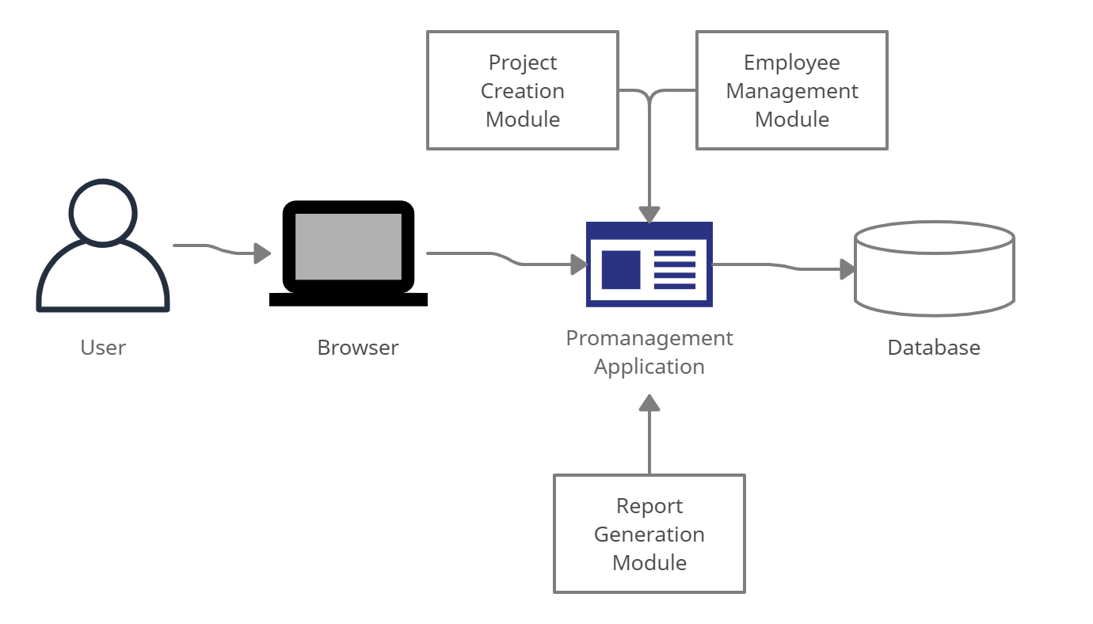
System Description

Slide 13
System Description
Promanagement application is built using Django Framework and the underlying database is sqlite3. The Promanagement application has three modules, a project creation module, a employee management module and a report generation module.

Slide 14
Methodology
We used Random Forest Model to predict employee attrition among the organization.
The model was created with a dataset of 15000 employees with 10 attributes, 8 numeric attributes and 2 non numeric attributes.

Slide 15
Result
The results of our model are as follows:
Accuracy = 0.98
Precision = 0.99
Recall = 0.95
AOC = 0.99

Slide 16
Conclusions
‘PROManagement’ is a web application that can help organization in their project management activities.
It can be used to improve the management quality of the organization and can work effectively as a stand-alone program or as a key component of an ERP system.
Although as a part of a system it will lead to better results such as less time for administrative work by managers, easier and quicker access to needed information and reduced costs.
The benefits if using a planning tool can be easily observed and measured. Having a well-thought, solid and working plan will undoubtedly lead to more well-completed projects and increasing of the business profits.

Slide 17
References
[1] T. Mladenova, "A project management system for time planning and resources allocation," 2019 42nd International Convention on Information and Communication Technology, Electronics and Microelectronics (MIPRO), Opatija, Croatia, 2019, pp. 1299-1303.
[2] R. G. Evgeny, A. L. Aleksandr and V. Z. Aleksandr, "Algorithms for workforce assignment problem," 2017 Tenth International Conference Management of Large-Scale System Development (MLSD), Moscow, 2017, pp. 1-3.
[3]Safrizal, L. Tanti, R. Puspasari and B. Triandi, "Employee Performance Assessment with Profile Matching Method," 2018 6th International Conference on Cyber and IT Service Management (CITSM), Parapat, Indonesia, 2018, pp. 1-6.
[4] M. Ilie, S. Ilie and I. Muraretu, "A Semiautomated Human Resource Management System," 2019 IEEE International Symposium on INnovations in Intelligent SysTems and Applications (INISTA), Sofia, Bulgaria, 2019, pp. 1-6.
[5] C. Desmond, "Project management tools-software tools," in IEEE Engineering Management Review, vol. 45, no. 4, pp. 24-25, Fourth Quarter 2017.

Slide 18
References
[6] S. Kerdsiri, S. Aramkul and P. Champrasert, "Fatigue Consideration optimization Model for Employee Allocation in Flow Shop Scheduling Problems," 2019 IEEE 6th International Conference on Industrial Engineering and Applications (ICIEA), Tokyo, Japan, 2019, pp. 898-902.
[7] A. S. Korznyakov, A. U. Gaida, T. G. Grigorian and K. V. Koshkin, "The model of universal project states classifier in project management system," 2017 9th IEEE International Conference on Intelligent Data Acquisition and Advanced Computing Systems: Technology and Applications (IDAACS), Bucharest, 2017, pp. 1066-1072.
[8] A. Rasyid, M. A. Akbar, N. Dengen, M. Tonggiroh, S. N. Alam and E. Budiman, "Employee Performance Target Management System to Support Work Performance Assessment," 2018 2nd East Indonesia Conference on Computer and Information Technology (EIConCIT), Makassar, Indonesia, 2018, pp. 280-284.
[9] O. Voitenko, I. Achkasov and A. Timinsky, "Competence-based knowledge management in project oriented organisations in bi-adaptive context," 2019 IEEE 14th International Conference on Computer Sciences and Information Technologies (CSIT), Lviv, Ukraine, 2019, pp. 111-115.
[10] I. Babayev, "Priorities management in the portfolio of projects in complex and dynamically variable environments," 2017 12th International Scientific and Technical Conference on Computer Sciences and Information Technologies (CSIT), Lviv, 2017, pp. 187-191.

Slide 19
Acknowledgements
We would like to thank the Director Rev. Bro. Jose Thuruthiyil and Principal Dr. Sincy George
for giving us the opportunity to work on the project and for their guidance. We would like to
express our deep gratitude towards Dr Joanne Gomes Head of The Department (INFT) and our
project guide for her encouragement, constant guidance, support along with Mr. Vaibhav Kala
for sharing her experience and knowledge and pushing us in the right direction to ensure
timely completion of all our project work.

Slide 20
Questions??
Thank You!
Notes:
The Activity Diagram gives us a gist of the stages in the application Process.

