Slide 1
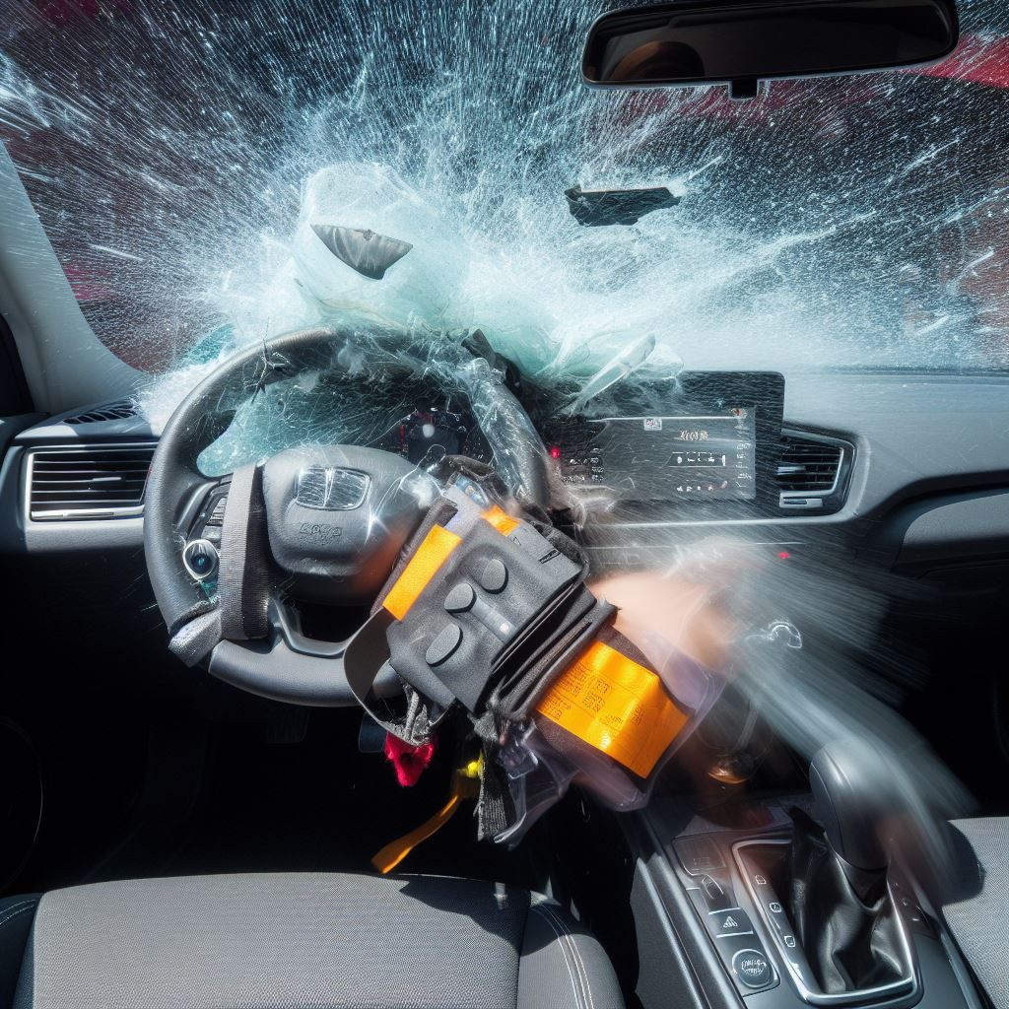

Driver’s Fault Classification
ALY6140

Slide 2
Introduction
Automated Crash Reporting System (ACRS) of the Maryland State Police, Montgomery County Police, Gaithersburg Police, Rockville Police, and the Maryland-National Capital Park Police.
It includes 166,000 rows and 43 columns.

Slide 3
Business Objective
Create an efficient and reliable system that automates fault determination, ultimately contributing to road safety.
Insurance companies for claims processing, law enforcement for assigning responsibility, and policymakers for road safety improvements.
Empower drivers to better understand their driving behavior and identify areas for improvement to contribute to safer roadways.

Slide 4
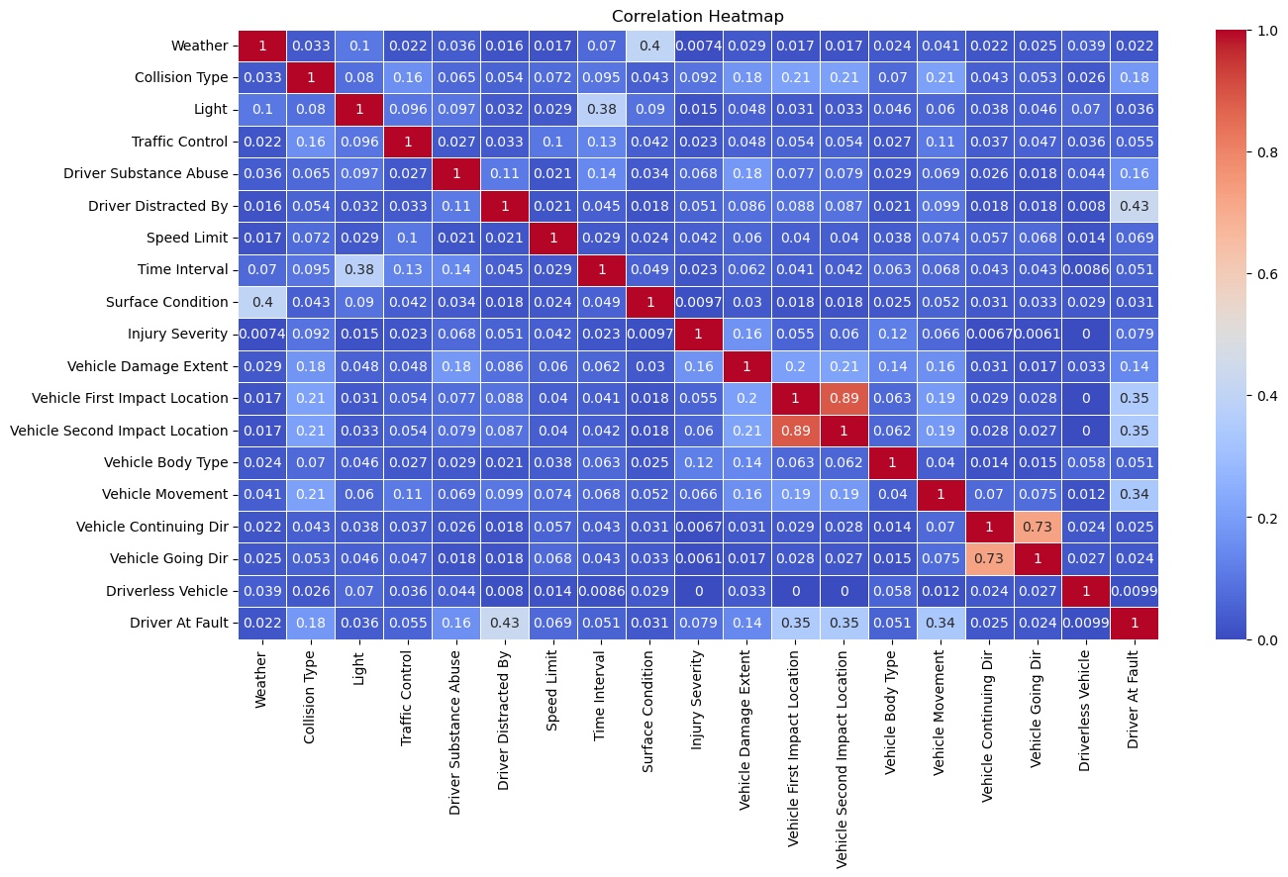
Exploratory Data Analysis– Part 1

Slide 5
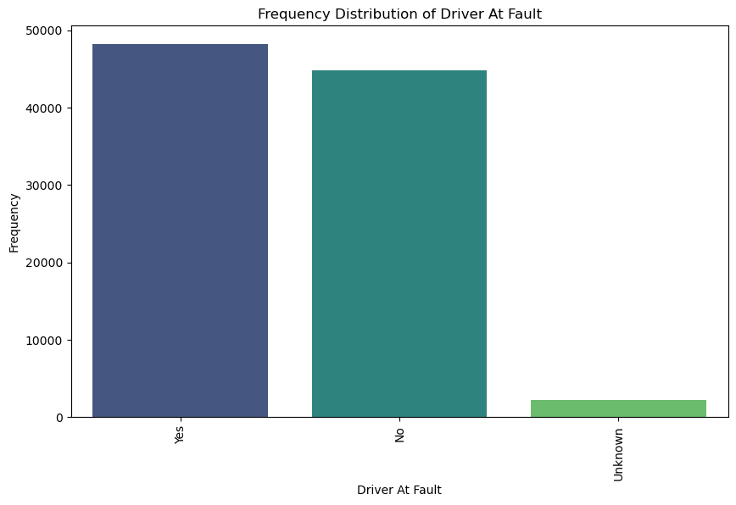
Exploratory Data Analysis – Part 2

Slide 6
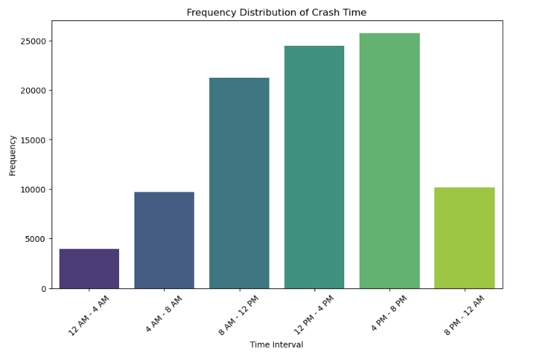
Exploratory Data Analysis – Part 3

Slide 7
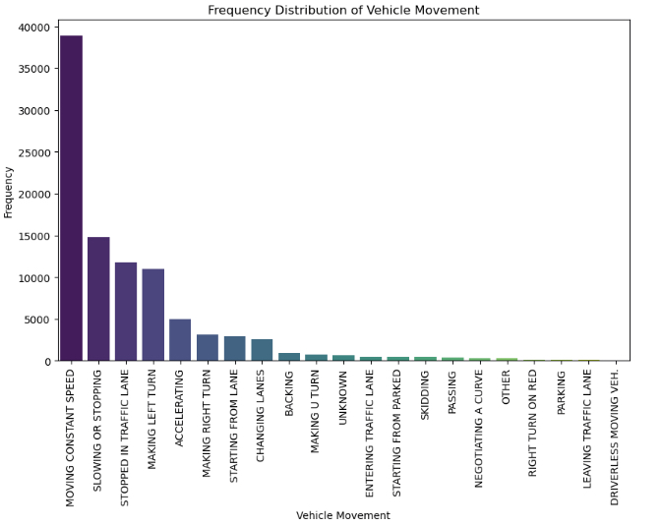
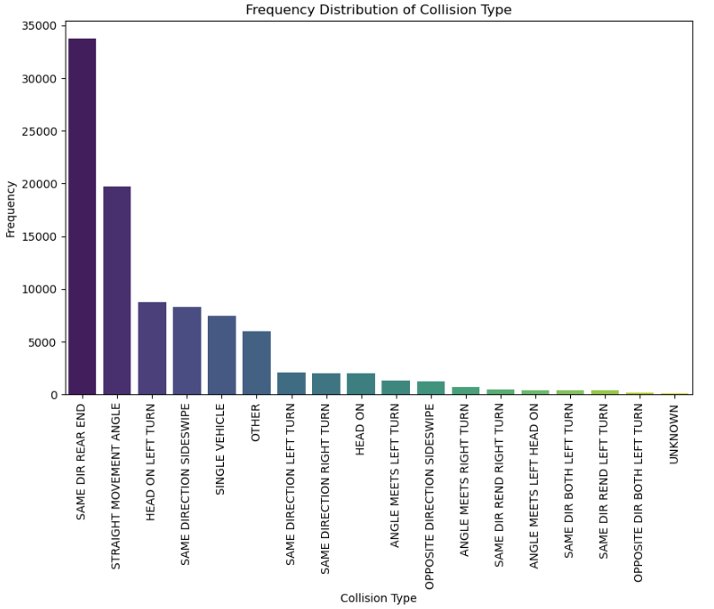
Exploratory Data Analysis – Part 4

Slide 8
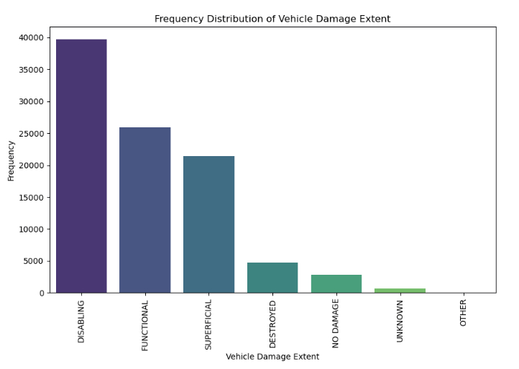
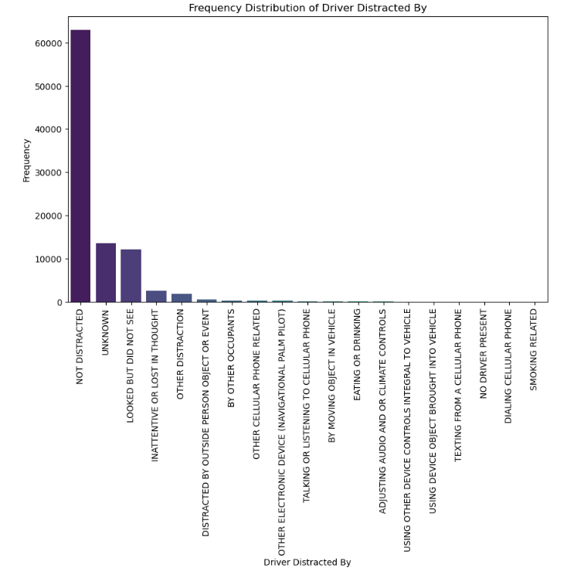
Exploratory Data Analysis – Part 5

Slide 9
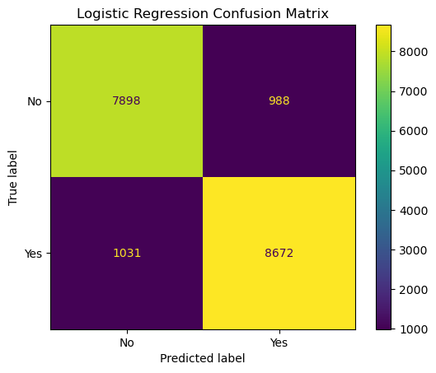
Logistic Regression Analysis
Logistic Regression Accuracy: 0.891

Slide 10
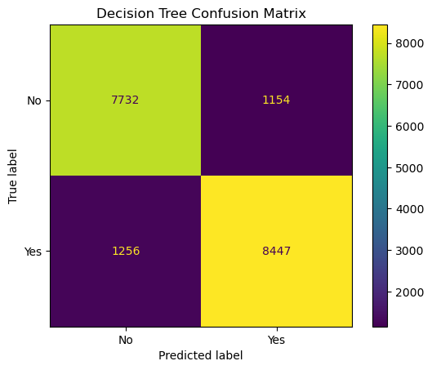
Decision Tree Classification
Decision Tree Accuracy: 0.870

Slide 11

Random Forest Classification
Random Forest Accuracy: 0.908

Slide 12

Support Vector Machine
SVM Accuracy: 0.875

Slide 13
Interpretation & Conclusion
Adoption of Random Forest Classification.
Enhanced Road Safety Measures.
Improved Driver Awareness.

Slide 14
References
Montgomery County, M. (2023, September 22). Crash reporting - drivers data: Open Data Portal. Crash Reporting - Drivers Data | Open Data Portal. https://data.montgomerycountymd.gov/Public-Safety/Crash-Reporting-Drivers-Data/mmzv-x632.
Publisher data.montgomerycountymd.gov. (2023, September 22). Crash reporting - drivers' data. Catalog. https://catalog.data.gov/dataset/crash-reporting- drivers-data.

Slide 15

Thank you

