Slide 1
Filling the Gaps: Deep Learning for Multivariate Time Series Imputation
A short story on the IJCAI 2025 survey (survey track)
Anshita Shah | CMPE 255 Data Mining | San José State University
Notes:
Hi everyone, I'm Anshita Shah, and this is my short story for CMPE 255, Data Mining. The paper I chose is "Deep Learning for Multivariate Time Series Imputation: A Survey" by Jun Wang, Wenjie Du and their colleagues, published in the IJCAI 2025 survey track. In the next twelve or so minutes I'll explain what problem this paper tackles, how the authors organise a very crowded field of deep learning methods, what they concluded, and finally what I personally took away from it, given that I work with clinical data that is full of gaps.

Slide 2
Classic fixes are fast but myopic
Mean filling
Last value forward
KNN
MICE
Replace each gap with the column average
Copy the previous reading
Borrow from the most similar rows
Chained regressions per variable
What they miss
How values evolve through time (trends, rhythms, sudden shifts)
How variables move together (falling BP with a rising heart rate)
Why the value is missing in the first place
Notes:
Let me start with the problem. Almost every real dataset recorded over time has holes in it. In a hospital, vitals like heart rate are captured often, but lab values like lactate show up only a few times a day. In the PhysioNet 2012 ICU dataset, which the survey cites, more than eighty percent of the values are missing. Sensors fail, networks drop packets, and privacy rules hide fields. Most machine learning models cannot accept a table with holes in it, so somebody has to fill those holes first. That step is called imputation. The survey's goal is to organise the many deep learning methods for doing this, compare their trade-offs, and point to fair benchmarks.
The traditional remedies are easy to reach for. Mean filling replaces every gap with the column average. Last observation carried forward just copies the previous value. KNN borrows from similar rows, and MICE runs chained regressions. They are fast and cheap, which is why everyone uses them. The trouble is that they are myopic. They treat each variable mostly in isolation and ignore how values evolve through time and how variables move together. A heart rate spike and a falling blood pressure tell a story together, and these methods cannot hear it. The result is data that looks tidy but quietly misleads whatever model you train on top of it.

Slide 3
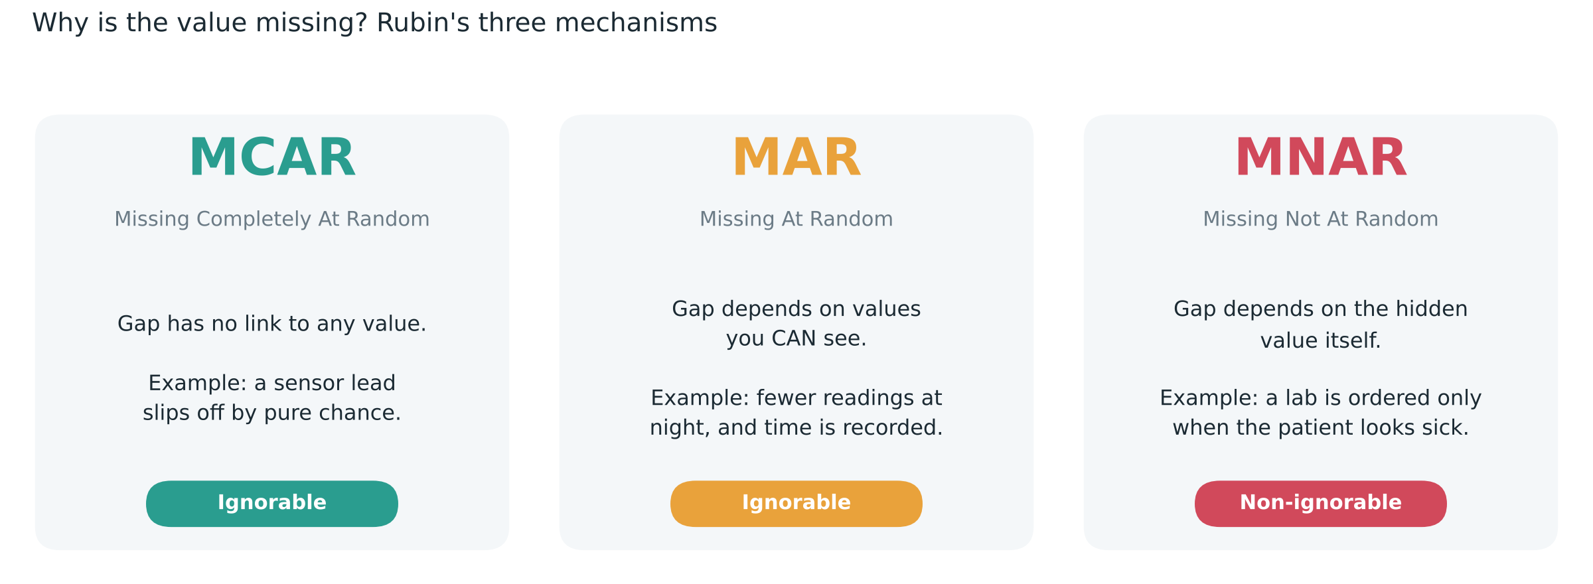
First question: why is the value missing?
MCAR and MAR: learn from observed values alone. MNAR: must model data and mask together, or estimates become biased.
Notes:
Before any model, the paper asks a deceptively simple question: why is this value missing? It uses Rubin's three classic categories. MCAR, missing completely at random, means the gap has nothing to do with any value, like a sensor lead slipping off by chance. MAR, missing at random, means the gap depends on things you can observe, for example fewer readings at night when time is recorded. MNAR, missing not at random, is the tricky one. The gap depends on the hidden value itself. A doctor orders a lactate test because the patient already looks unwell. MCAR and MAR are called ignorable, so a model can learn from what is observed. MNAR is non-ignorable, and if you ignore it your estimates become biased in a way your metrics may never reveal.

Slide 4
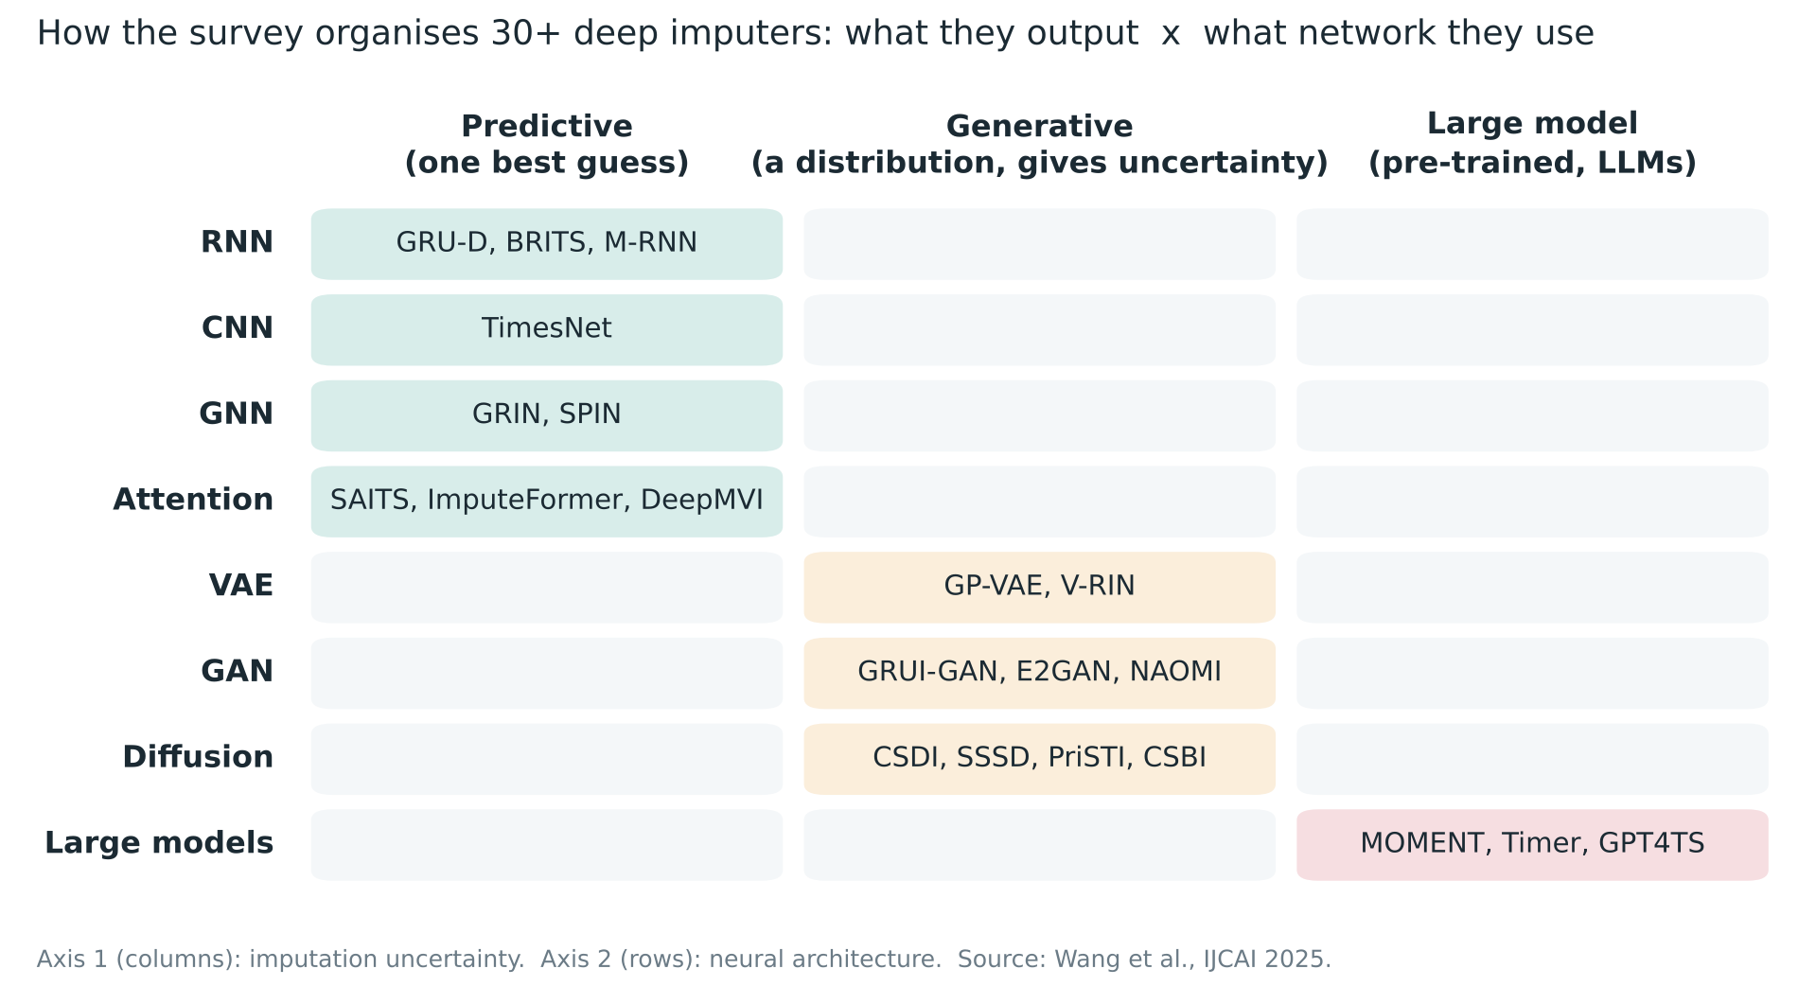
A two-axis map of 30+ deep imputers
Columns
What the model outputs: one guess, a distribution, or a pre-trained model's answer
Rows
Which neural network family does the work
Notes:
Now the heart of the survey: how to organise more than thirty deep imputers. The authors use two axes instead of one long list. The columns are about what the model outputs. Predictive methods give one best guess per missing value. Generative methods learn a whole distribution, so you can sample several plausible fills and measure uncertainty. Large model methods reuse pre-trained foundation models or language models. The rows are about the network architecture: RNNs, CNNs, graph networks, attention, VAEs, GANs, diffusion models and large models. You can see the clustering. Recurrent, convolutional, graph and attention models sit mostly on the predictive side, while VAEs, GANs and diffusion models are generative by nature.

Slide 5
Every family trades something away
Family | Examples | Strength | Weakness
RNN | GRU-D, BRITS | Natural fit for sequences | Slow on long series
CNN | TimesNet | Local patterns | Kernel size limits range
GNN | GRIN, SPIN | Links between sensors | Costly on large graphs
Attention | SAITS, ImputeFormer | Long-range, parallel; usually best | Data hungry
VAE | GP-VAE, V-RIN | Explicit probabilities | Limited generative power
GAN | E2GAN, NAOMI | Realistic outputs | Unstable training
Diffusion | CSDI, SSSD, PriSTI | Richest patterns + uncertainty | Expensive; boundary clashes
Large models | MOMENT, GPT4TS | Transfer from pre-training | Still early stage
Notes:
This table summarises what the survey says about each family. RNNs fit sequences naturally, but they process step by step, so they are slow on long series. CNNs catch local patterns but are limited by kernel size. Graph networks model how sensors relate to each other, at a high computational cost on big graphs. Attention models are generally the strongest for imputation because they see long-range dependencies and train in parallel. VAEs give explicit probabilities but limited generative power. GANs produce realistic outputs but are notoriously unstable to train. Diffusion models capture the most complex patterns but are expensive and can produce fills that clash with neighbouring observed values. Large models bring transfer from pre-training, but this area is still young.

Slide 6
Four models worth knowing by name
GRU-D
RNN . 2018
BRITS
RNN . 2018
Old readings fade: influence decays with the time since a variable was last seen
Treats gaps as variables in a bidirectional recurrent graph; can classify at the same time
SAITS
Attention . 2023
CSDI
Diffusion . 2021
Diagonally masked self-attention trained on masked imputation plus reconstruction
Starts from noise and denoises toward plausible values, conditioned on what was observed
Notes:
Let me spotlight four models that come up again and again. GRU-D, from 2018, modifies a recurrent unit so that the influence of an old reading decays based on how long ago it was seen. That idea of using time gaps as an input is very intuitive for clinical data. BRITS treats missing values as variables inside a bidirectional recurrent graph, and it can do classification at the same time. SAITS uses diagonally masked self-attention and trains on two objectives together, masked imputation and reconstruction. And CSDI was the first diffusion model designed specifically for time series imputation. It starts from noise and gradually denoises toward plausible values, conditioned on what was observed.

Slide 7
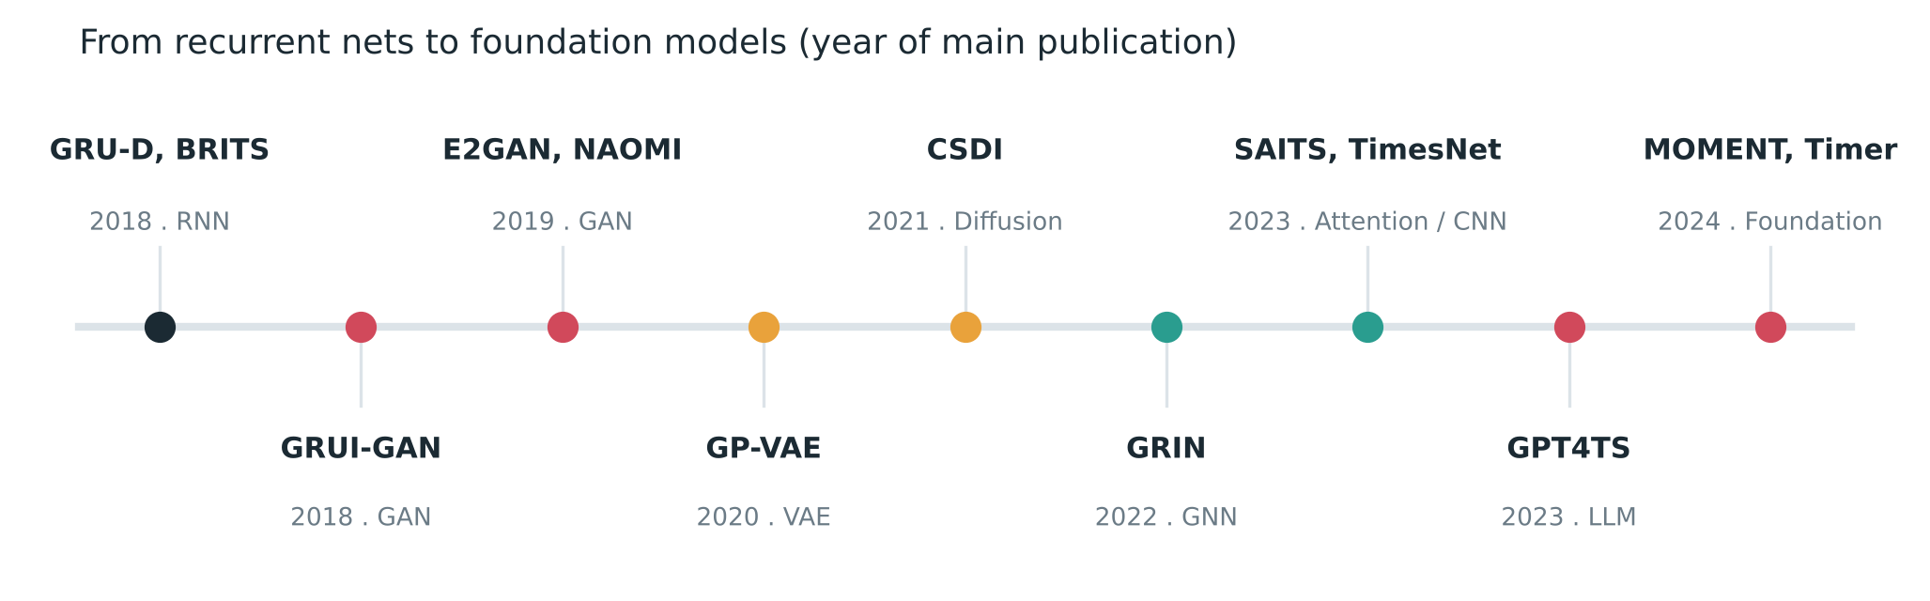
From recurrent nets to foundation models
The arc: hand-crafted recurrent tricks, then generative models, then attention, now large pre-trained models.
Notes:
Putting these on a timeline shows the arc of the field. Around 2018 it was recurrent networks and the first GANs. 2020 brought VAEs with Gaussian process priors. 2021 was the arrival of diffusion with CSDI. 2022 saw graph networks like GRIN for sensor networks. By 2023 attention models like SAITS and TimesNet were strong, and language models such as GPT4TS were being adapted. And in 2024, time series foundation models like MOMENT and Timer joined in. So the field has moved from hand-crafted recurrent tricks toward large, general, pre-trained models.

Slide 8
What the survey concludes
Attention leads
Beats RNN and CNN by modelling long-range links in parallel
Diffusion is richest
Most expressive and gives uncertainty, but costly
MNAR is neglected
Most methods assume MCAR/MAR; real clinical data often is not
Two-stage loses signal
Impute-then-predict discards the mask
Comparisons were messy
Hence shared tools: PyPOTS and TSI-Bench
Notes:
What did the authors conclude? Since this is a survey, these are judgments across the whole field rather than one experiment. One: attention-based models generally beat RNNs and CNNs. Two: generative models, especially diffusion, are the most expressive and give uncertainty, but they cost a lot to run. Three: most methods quietly assume MCAR or MAR, while real data, especially clinical data, is often MNAR. That mismatch is the biggest gap in the field. Four: the usual approach of imputing first and predicting second throws information away. And five: comparisons across papers were inconsistent, which is why they built shared tools.

Slide 9
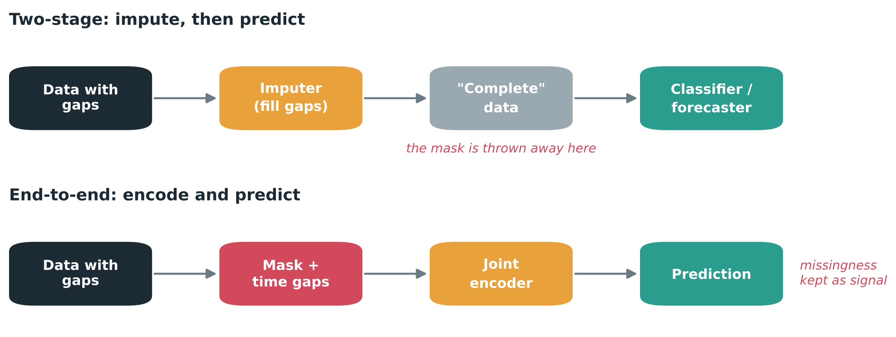
Impute then predict, or encode and predict?
The authors favour end-to-end models when the pattern of missingness itself carries meaning.
Notes:
This diagram explains point four. In the two-stage pipeline, you fill the gaps, hand the now complete data to a classifier, and the mask that told you what was missing is thrown away. In the end-to-end approach, the model receives the data together with the mask and the time gaps, encodes them jointly, and predicts directly. The authors argue the second path is more promising, especially when the pattern of missingness itself carries meaning. In a hospital, the fact that a doctor ordered a test is information.

Slide 10
Shared tools for fair comparison
37
34,804
28
8
imputation models in PyPOTS
experiments in TSI-Bench
algorithms benchmarked
datasets, varied missingness
PyPOTS: Python toolbox for partially observed time series (same research group)
TSI-Bench: benchmark suite on top of PyPOTS with standard pipelines
Notes:
To make comparisons fair, the authors point to two resources from their own group. PyPOTS is a Python toolbox for partially observed time series, with thirty-seven imputation models at the time of writing. TSI-Bench is a benchmark suite built on it, covering 34,804 experiments, 28 algorithms and 8 datasets with varied missingness patterns. For anyone wanting to try these models, PyPOTS is the obvious starting point, and that is what I would use for a small experiment.

Slide 11
Open challenges listed
Missingness patterns
Scalability
Handle MNAR properly instead of assuming it away
Deep imputers are heavy; need parallel and distributed training
Downstream focus
LLMs for imputation
Judge imputation by task results, not only reconstruction error
Domain knowledge, missingness priors, text and metadata inputs
Notes:
The survey closes with open problems. Handling MNAR data properly is first. Scaling deep imputers to very large datasets is second, since they are much heavier than statistical methods. Third is judging imputation by how well downstream tasks perform, not only by reconstruction error. And fourth is using large language models that carry domain knowledge, priors about missingness and multimodal inputs like clinical notes.

Slide 12
My take: missingness is a clinical signal
Agree
Encode-and-predict fits clinical data far better than filling first
Wish there were more
Evaluation on real decisions, like how early an alert fires
Next step
Treat MNAR as the default, not the exception
“Throwing away the mask is throwing away a clinician's suspicion.”
From my sepsis detection work on PhysioNet 2019, where labs are ordered when clinicians are worried
Notes:
Here is my own take. I work on early sepsis detection with Transformers on the PhysioNet 2019 dataset, so this problem is personal. In that data, lab values are mostly missing, and they are not missing at random. Clinicians order labs when they are worried. That makes the encode-and-predict argument very convincing to me. Throwing away the mask is throwing away a clinician's suspicion. One thing I wish the survey did more of is clinical evaluation: reporting how imputation choices change real decisions like early alerts, not just error on held-out values. And I think the biggest practical wins will come from methods that treat MNAR as the default rather than the exception.

Slide 13
Takeaways
Missing data is the norm. Ask why a value is missing before picking a method.
Attention is a strong default; diffusion when you need uncertainty and have compute.
If missingness carries meaning, keep the mask as a feature.
Paper: arxiv.org/abs/2402.04059 | Tools: PyPOTS, TSI-Bench
Notes:
To wrap up. Missing data is the norm, not the exception. Always ask why a value is missing before choosing a method. Attention models are a strong default, and diffusion models are powerful when you need uncertainty and can afford the compute. And whenever missingness carries meaning, keep the mask as a feature. The paper link, my Medium article and the slides are all in my GitHub repository. Thank you for watching.

