Slide 1
OWNERSHIP CHAIN Summer Internship ProjecT
Submitted to:
DataRitz Technologies
Submitted by:
Anshi Aggarwal
Under the guidance of Dr. BP Sharma

Slide 2
Team name:
Innovators
Team Members:
MAYANK SHARMA(LEADER)
KAMINI JHA
KOMAL
ANSHI AGGARWAL

Slide 3
Why this project ??
Whenever we purchase something, a bill is given to the persons which contains all the necessary details.
That bill and that thing will be very useful as a prove of ownership for the user.
But, many times the things get stolen or bill get lost and therefore we cannot give the proof that the particular thing belongs to us.
So, to maintain the ownership , its of high need to maintain the image of that things that show real time, date and description.

Slide 4
Project idea
Ownership Chain is a "new" approach for images management.
Our project makes image management easy by storing the images in the database and which will be used for future reference also(to prove the ownership of the user).

Slide 5

Entity
User:
USER can see the image of the bill and of the things he has purchased.
User can also upload the images.
User can also change his password if by chance he forgets it, or if he wants to change it

Slide 6
SOFTWARE REQUIREMENTS
React Native
JavaScript
Visual Studio Code
Node.js
Expo
Figma

Slide 7
Hardware Requirements
Windows 7 or later
Processor- i3 or later
Ram- 4GB
Android Phone/Apple Phone

Slide 8
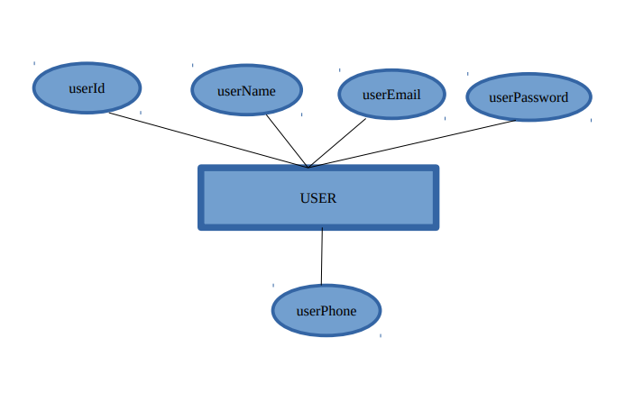
ER DIAGRAM

Slide 9
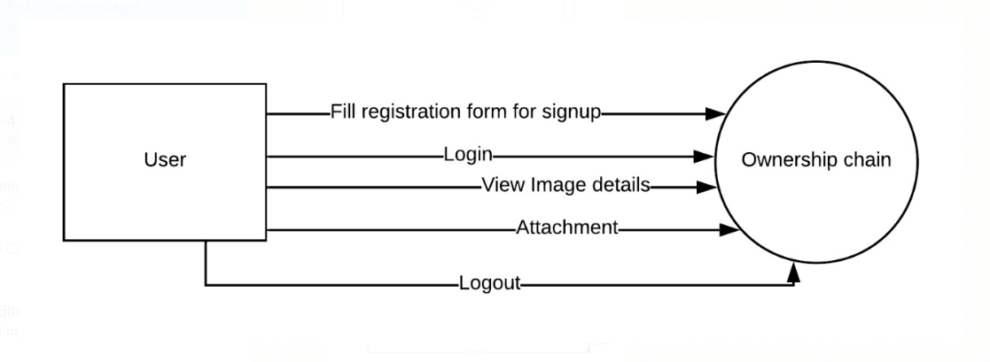
0th Level DFD

Slide 10
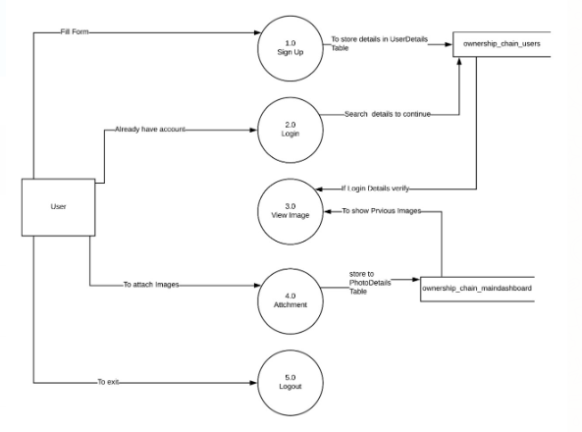
1st Level DFD

Slide 11
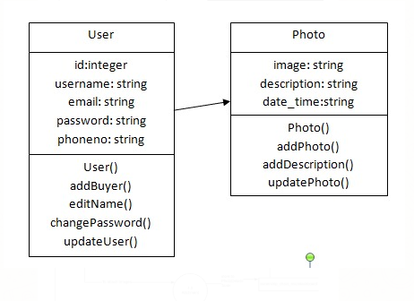
CLASS DIAGRAM

Slide 12

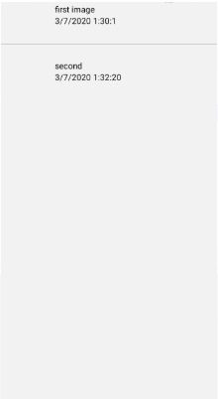
MAIN SCREEN AND DASHBOARD

Slide 13
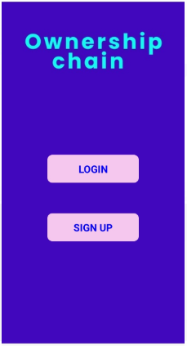
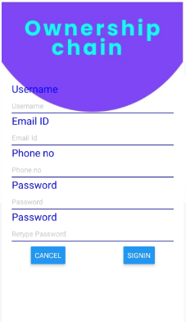
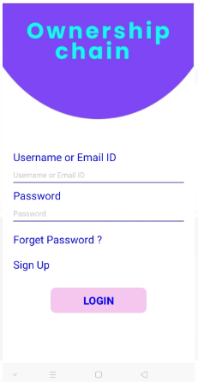
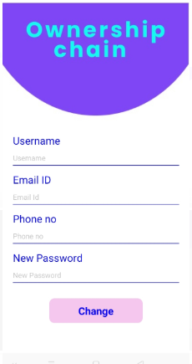
LOGIN, SIGNUP & FORGET PASSWORD

Slide 14
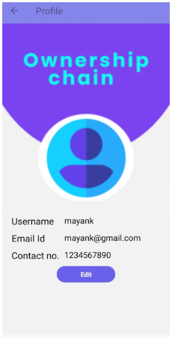
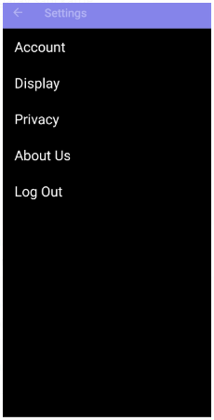
PROFILE AND SETTING

Slide 15
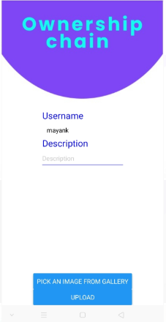

ATTACHMENT AND DRAWER

