Slide 1
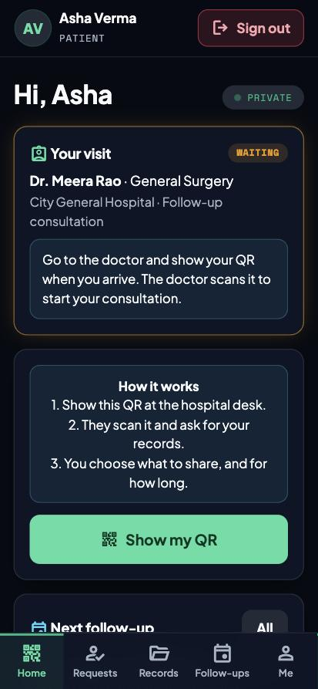
Offgrid
Your medical history lives on your phone. Hospitals see only what you approve.
Team Offgrid | ASTRA 2026 | Cyber in Healthcare | Challenge 4
Notes:
[0:00 - 0:20] We are Team Offgrid. Our idea: your medical history lives on your phone, and a hospital only sees what you approve. This is the Cyber in Healthcare track, challenge 4. Everything you see runs on synthetic data.

Slide 2




Health data is scattered, and patients have no say
Same forms, every hospital
No visibility
Patients repeat their details everywhere, and their history is split across hospitals.
Patients cannot see or control who looked at their records.
Fake looks real
Emergencies
A photo of a lab report looks the same as a doctor-verified record.
An unconscious patient cannot approve anything, yet staff need critical facts.
Notes:
[0:20 - 0:55] Four problems. Patients repeat the same forms. They cannot see who accessed their data. A photo of a report looks the same as a doctor-signed record. And in an emergency the patient cannot say yes. Hospitals today tend to share everything with whoever asks.

Slide 3





The patient approves every share
Show a QR
Hospital scans
Hospital asks
Patient decides
Approved only
One-time code, no medical data inside
It sees name and age only
Specific records, from a named hospital
Approve, narrow or deny, with a time limit
Everything else stays hidden
Revoke any time, even a single doctor. Every access is logged.
Notes:
[0:55 - 1:40] The flow. The patient shows a one-time QR that holds no data. The hospital scans it and sees only name and age. It asks for specific records. The patient approves, narrows or denies, with a time limit. Only that is returned. They can revoke at any moment, even a single doctor, and every access is logged.

Slide 4
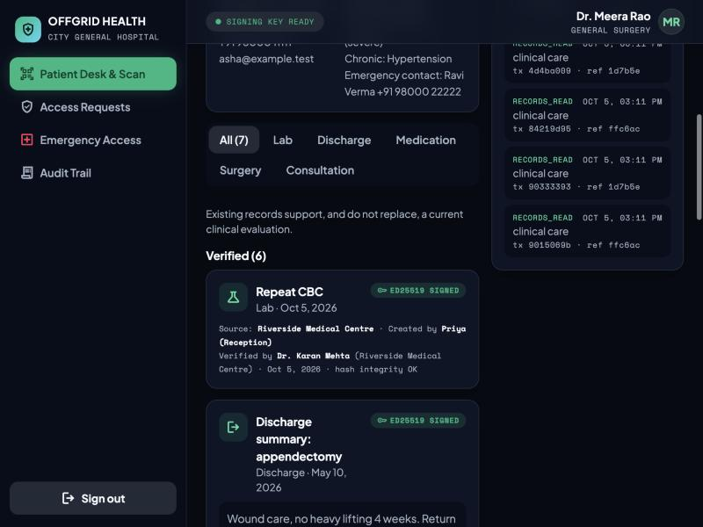
Doctor-signed records stand apart from uploads
Verified
A doctor reviewed and signed it. Source, author and date are shown.
Unverified
Uploaded or added, not yet signed. Never mixed into verified history.
Tamper alarm
Change a signed record and the signature check fails, so the app warns.
Records signed with Ed25519, shown to the hospital
Notes:
[1:40 - 2:20] Trust. Every record is either verified, meaning a doctor signed it, or unverified. A photo a patient uploads stays unverified until a doctor signs it. If anyone edits a signed record afterwards, the signature check fails and the app shows a warning. The database also blocks edits and deletes of signed records.

Slide 5
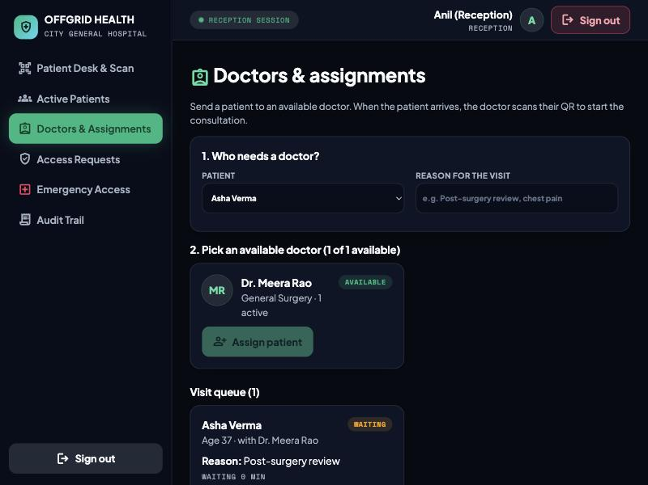
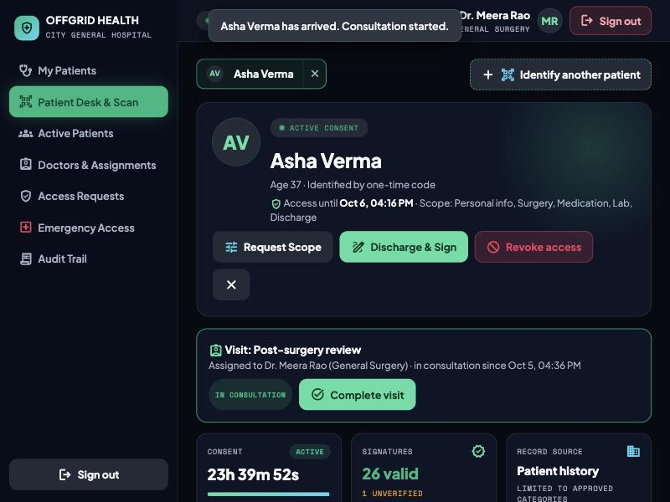
A doctor visit, start to finish
1 Reception assigns an available doctor
2 Doctor scans the patient's QR on arrival
Notes:
[2:20 - 3:20] The visit. Reception sees which doctors are available and assigns one, with a reason. The patient app shows 'Your visit' and which doctor to go to. When the patient arrives, the doctor scans the patient's QR again. Only the assigned doctor's scan works. That starts the consultation and opens the patient's file with the reason on top. If the patient stops trusting that doctor, they can revoke just that doctor and the hospital's other staff keep their access.

Slide 6





Security is built in, not bolted on
Consent on every read
Doctor signatures
Signed means locked
Valid, unexpired, unrevoked, right category, right hospital.
Ed25519 over the record and its files.
A database rule blocks edits and deletes.
Audit log
Encrypted notes
Emergency, limited
Append-only, with scrambled patient references.
AES-256-GCM at rest, bcrypt passwords.
Critical facts only, one hour, patient notified.
Notes:
[3:20 - 4:00] Security design. Every read passes the consent check. Doctors sign records with Ed25519. A database rule makes signed records and the audit log permanent. The audit log keeps scrambled patient references, not names, and we are clear that this is pseudonymization, not anonymization. Notes are encrypted at rest. Emergency access shows critical facts only for one hour and always notifies the patient.

Slide 7
Tested, and honest about limits
90
0
Fresh
What production still needs
Doctor keys in an HSM, not the database
Password reset by email code, not birth date
NFC cards and verified hospital onboarding
Encrypted file storage, TLS, regulatory review
automated checks pass
real patient records used
clone verified from GitHub
Threat model and test cases are in the repo
End-to-end test covers consent, signing, revoke, visits
Synthetic data only, local environment
Notes:
[4:00 - 4:40] Evidence and honesty. 90 automated checks pass against the real API and database, and we verified a fresh clone from GitHub works from the README. No real patient data is used. We list what a real deployment still needs: keys in an HSM, a stronger password reset than date of birth, NFC cards, encrypted file storage, TLS and a regulatory review.

Slide 8
Patient approves. Doctor signs. Everything is logged.
github.com/Anshib-m/Offgrid-
Open source (MIT) | Team Offgrid: Anshib M, Ahmed Safwan, Joffin Jaison, Alan KP
Thank you. Questions?
Notes:
[4:40 - 5:00] To close: the patient approves, the doctor signs, and everything is logged. The code is open source under MIT at the address on the slide, with setup steps, a demo script, a threat model and test evidence. Thank you.

