Slide 1
UPTOWARE FLEET MANAGEMENT ERP
Commercial Mining Haulage & Logistics System
Complete End-to-End Operational Workflow & Client Demonstration
DGMS Statutory Compliance
Weighbridge Gross/Tare Telemetry
Deterministic Invoice Locking
Multi-Tier Financial Approvals
Pit Unit Economics & MIS Reports
Target Entities: Mining Directors, Fleet Owners, Pit Managers, Logistics Controllers
Verified Environment: Frappe Framework v16.52 | ERPNext v16.51 | Next.js 16.4 | MariaDB 11.4
Production Release: November 2026 | Verified Zero Hanging Connections & Full Audit Integrity

Slide 2
SYSTEM OVERVIEW
Operational Workflow & Data Flow Architecture
Architecture Map
01
Master Setup [Owner: Fleet Manager]
Mine Pit definitions, RTO/DGMS parameters, Fleet vehicle registries, Driver KYC & licensing.
02
Shift Pairing [Owner: Dispatcher]
Driver-to-vehicle allocation, preventing vehicle double-booking and checking license expiry.
03
Haulage Dispatch [Owner: Weighbridge / Dispatcher]
Trip creation, challan generation, gross & tare weighbridge capture with 10% overload rule.
04
Maintenance & Fuel [Owner: Workshop Supervisor]
Diesel logging with bowser slips, pit breakdown reporting, work orders and spare parts issuance.
05
Approvals & Billing [Owner: Accountant / MD]
Multi-tier expense approvals (>₹50k to MD), deterministic Sales Invoice generation and collections.
Uptoware Fleet ERP | Confidential Commercial Demonstration
DGMS & Statutory Logistics Standard

Slide 3
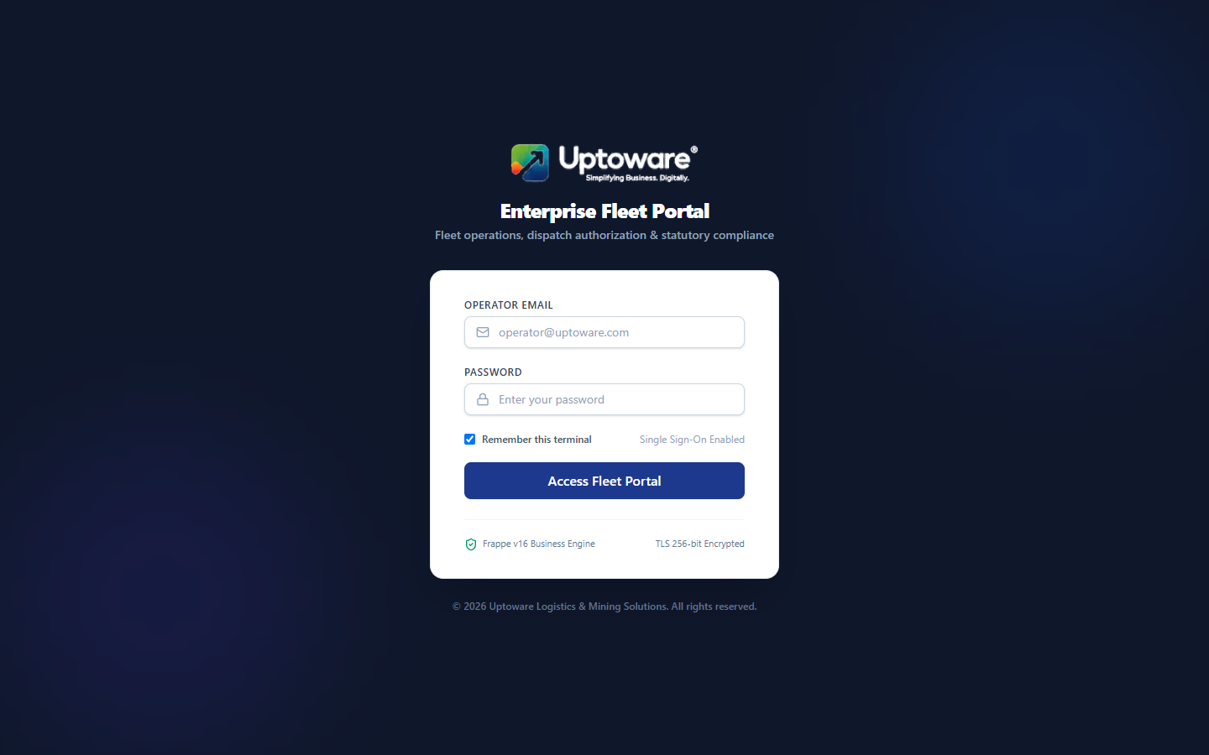
SECURITY & ACCESS CONTROL
Portal Authentication & Role Guarding
Zero-Trust Session
OPERATIONAL WORKFLOW & GOVERNANCE
Responsible Role: All Operational Personnel
Navigation Path: http://localhost:3001/login
Purpose & Business Value:
Enforces strict enterprise security via HttpOnly session cookies. Restricts unauthorized field tampering while routing personnel directly to their authorized portal interface.
Key Operational Steps:
Enter registered enterprise operator email.
Submit account password with edge rate limiting protection.
Deterministic role mapping to Fleet Manager, Dispatcher, Workshop, or Accountant.
Immediate browser load settlement (<300ms).
Expected Outcome: Authenticated session initialized with role-based feature gating.
Interface: Branded Operator Login Interface
Uptoware Fleet ERP | Confidential Commercial Demonstration
DGMS & Statutory Logistics Standard

Slide 4
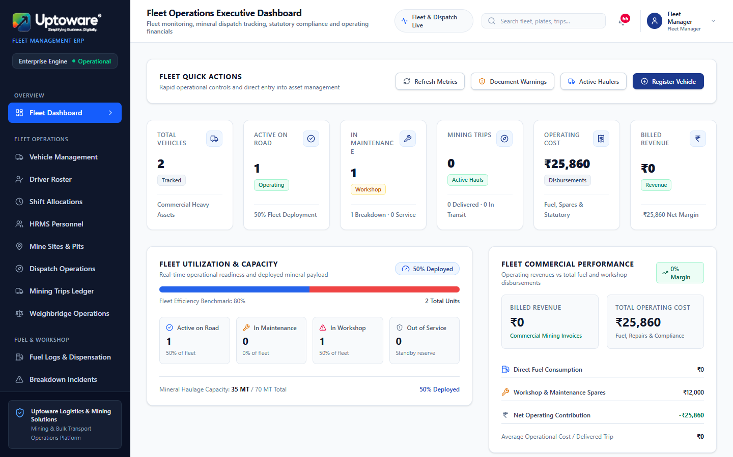
OPERATIONS COMMAND CENTER
Executive Fleet Operations Dashboard
Live Telemetry
OPERATIONAL WORKFLOW & GOVERNANCE
Responsible Role: Fleet Manager, Managing Director
Navigation Path: http://localhost:3001/
Purpose & Business Value:
Unified live cockpit providing real-time fleet availability, ongoing pit trips, workshop maintenance counts, and dispatch tonnage summaries.
Key Operational Steps:
Monitor Active, On-Trip, and Breakdown vehicle status.
Track daily dispatched mineral tonnage vs. target.
Inspect pending multi-tier approval counters.
Review recent operational alerts and notifications.
Expected Outcome: Single-pane operational visibility for senior mining executives.
Interface: Executive Live Fleet Cockpit
Uptoware Fleet ERP | Confidential Commercial Demonstration
DGMS & Statutory Logistics Standard

Slide 5
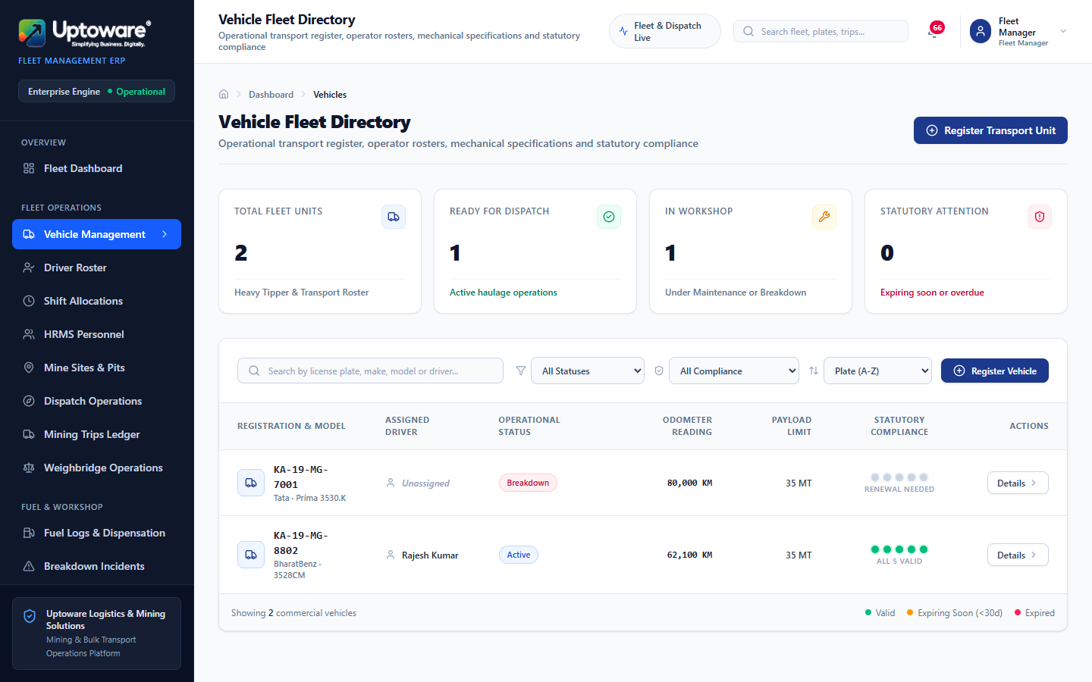
FLEET MASTER DATA
Commercial Haulage Vehicle Registry
59 Registered Tippers
OPERATIONAL WORKFLOW & GOVERNANCE
Responsible Role: Fleet Manager, Workshop Supervisor
Navigation Path: http://localhost:3001/vehicles
Purpose & Business Value:
Complete lifecycle registry for BharatBenz and Tata heavy commercial tippers with statutory compliance indicators and live odometer tracking.
Key Operational Steps:
Inspect vehicle registration numbers (e.g. KA-19-MG-8802).
Verify rated payload capacity (tons) excluding tare.
Monitor real-time vehicle status (Active, On Trip, Breakdown).
Open vehicle drawer to inspect statutory certificate expiries.
Expected Outcome: Uncompromised compliance records preventing unroadworthy haulage.
Interface: Commercial Vehicle Master List & Health Badges
Uptoware Fleet ERP | Confidential Commercial Demonstration
DGMS & Statutory Logistics Standard

Slide 6
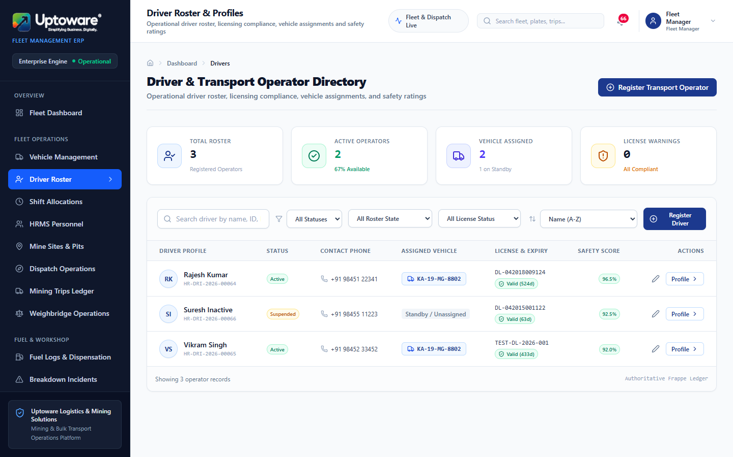
HUMAN RESOURCES & SAFETY
Driver Master & DGMS Compliance Health
Statutory Verification
OPERATIONAL WORKFLOW & GOVERNANCE
Responsible Role: Fleet Manager, Safety Officer
Navigation Path: http://localhost:3001/drivers
Purpose & Business Value:
Tracks commercial heavy vehicle driver licenses, DGMS medical fitness certifications, safety performance scores, and primary assigned tippers.
Key Operational Steps:
Audit active genuine drivers (Rajesh Kumar, Vikram Singh).
Verify commercial driving license validity (must be active).
Inspect safety rating calculated from incident history.
Ensure suspended drivers are locked from shift allocation.
Expected Outcome: Strict enforcement of DGMS compliance before vehicle operation.
Interface: Verified Driver Master Roster
Uptoware Fleet ERP | Confidential Commercial Demonstration
DGMS & Statutory Logistics Standard

Slide 7
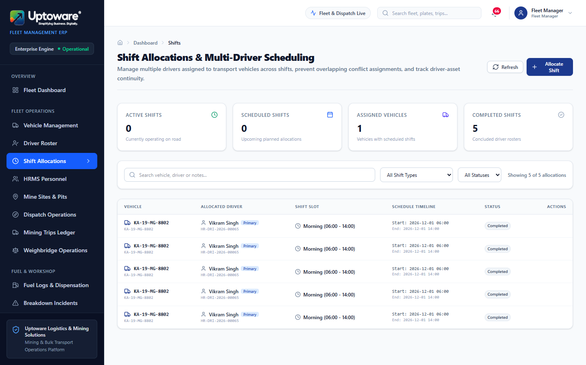
SHIFT & DISPATCH SCHEDULING
Shift Allocation & Vehicle Pairing Matrix
Conflict Prevention
OPERATIONAL WORKFLOW & GOVERNANCE
Responsible Role: Trip Dispatcher, Fleet Manager
Navigation Path: http://localhost:3001/shifts
Purpose & Business Value:
Coordinates driver-vehicle pairings across Day, Night, and General shifts while programmatically preventing double-booking.
Key Operational Steps:
Click "Allocate Shift" on the active roster board.
Select verified active driver and available vehicle.
Define shift window and mark primary allocation.
System automatically checks for overlapping shift conflicts.
Expected Outcome: Conflict-free shift allocation roster ready for pit dispatch.
Interface: Shift Allocation Board & Roster View
Uptoware Fleet ERP | Confidential Commercial Demonstration
DGMS & Statutory Logistics Standard

Slide 8
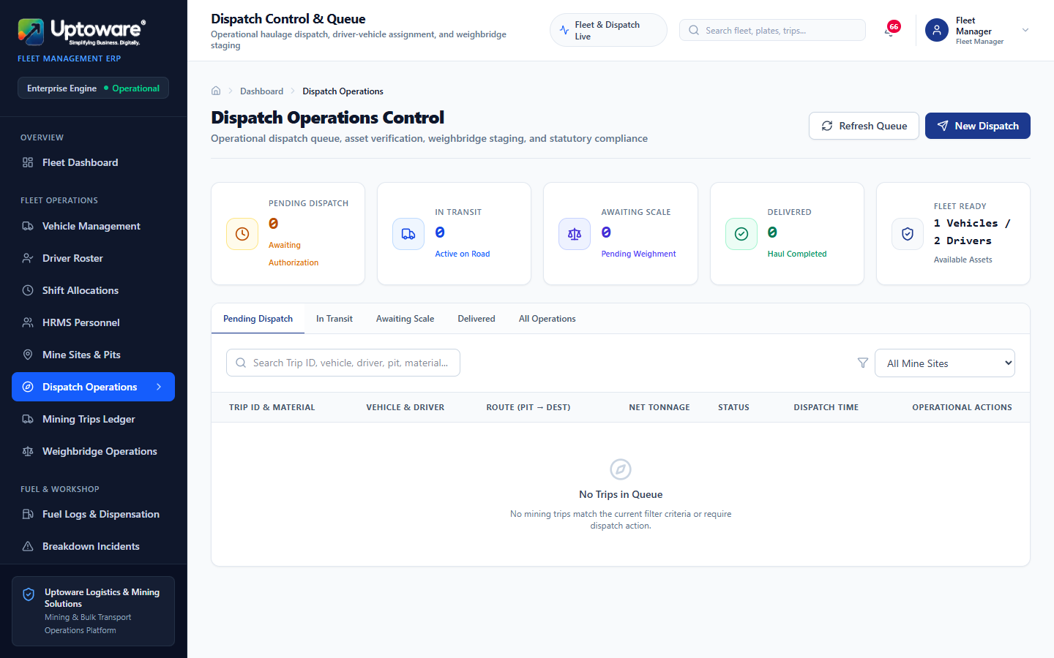
PIT LOGISTICS & CLEARANCE
Pre-Dispatch Verification Console
Gate Clearance
OPERATIONAL WORKFLOW & GOVERNANCE
Responsible Role: Trip Dispatcher
Navigation Path: http://localhost:3001/dispatch
Purpose & Business Value:
Validates driver fitness, vehicle statutory road permits, and pit destination authorization prior to physical gate release.
Key Operational Steps:
Scan or enter tipper registration number.
System verifies valid shift pairing and active driving license.
Select destination stockyard or washery.
Issue electronic dispatch clearance.
Expected Outcome: Statutorily validated haulage clearance issued at pit head.
Interface: Pit Gate Dispatching Console
Uptoware Fleet ERP | Confidential Commercial Demonstration
DGMS & Statutory Logistics Standard

Slide 9
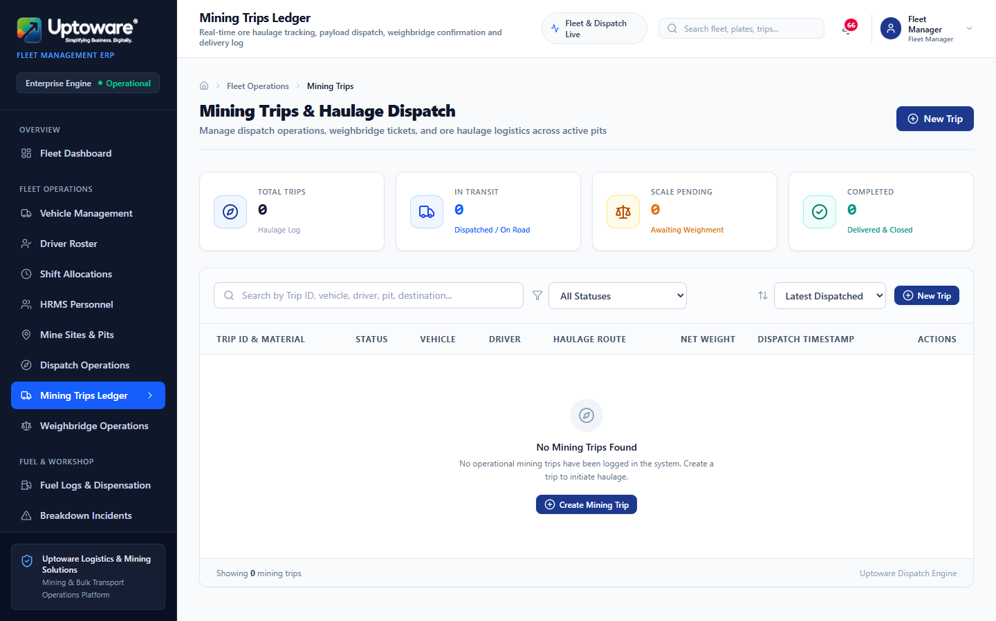
LOGISTICS TELEMETRY
Mining Trip Tracking & Challan Ledger
Real-Time Tracking
OPERATIONAL WORKFLOW & GOVERNANCE
Responsible Role: Trip Dispatcher, Fleet Controller
Navigation Path: http://localhost:3001/trips
Purpose & Business Value:
Comprehensive tracking of all haulage trips from pit face to crusher/rail siding with mineral classification and turnaround duration.
Key Operational Steps:
Monitor active mining trips across transit stages.
Inspect challan numbers, pit origins, and haulage contractors.
Track departure and arrival odometer readings.
Flag trip exceptions, deviations, or delayed transit.
Expected Outcome: Complete haulage audit trail supporting commercial billing.
Interface: Mining Trips Electronic Ledger
Uptoware Fleet ERP | Confidential Commercial Demonstration
DGMS & Statutory Logistics Standard

Slide 10
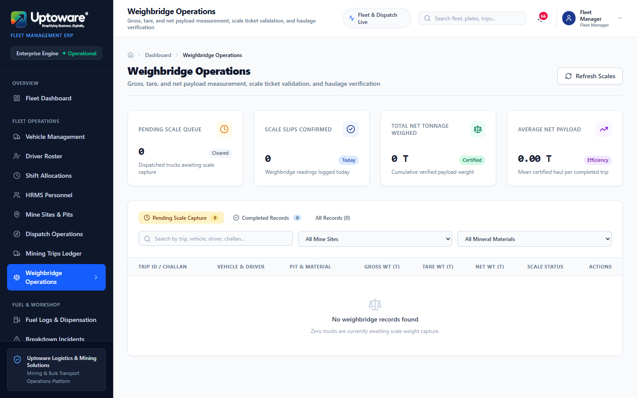
WEIGHMENT & MATERIAL CONTROL
Weighbridge Gross & Tare Telemetry Console
10% Overload Rule
OPERATIONAL WORKFLOW & GOVERNANCE
Responsible Role: Weighbridge Operator
Navigation Path: http://localhost:3001/weighbridge
Purpose & Business Value:
Captures Gross Weight on loaded exit and Tare Weight on unladen return, computing net payload and enforcing legal statutory overload limits.
Key Operational Steps:
Record Gross Weight (loaded) and Tare Weight (unladen).
System calculates Net Tonnage = Gross - Tare.
Automated Overload Check: Rejects loads exceeding rated capacity + 10%.
Save confirmed weighment slip for commercial invoicing.
Expected Outcome: Tamper-proof weight certificates protecting against MV Act fines.
Interface: Weighbridge Gross/Tare Operations Screen
Uptoware Fleet ERP | Confidential Commercial Demonstration
DGMS & Statutory Logistics Standard

Slide 11
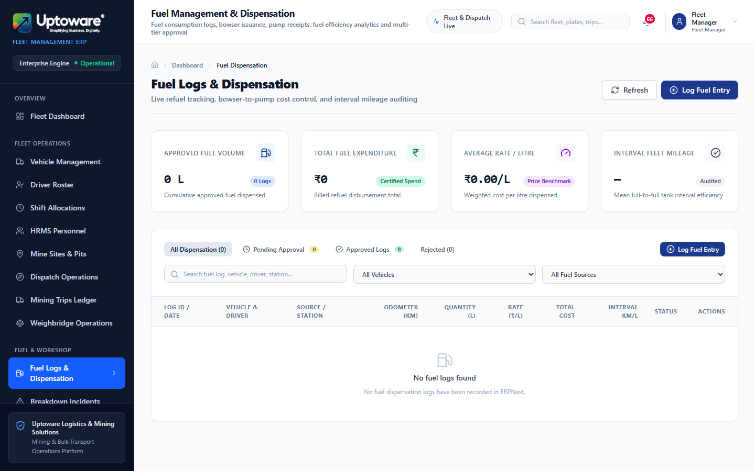
FUEL MANAGEMENT & ECONOMY
Diesel Fuel Dispensing & Bowser Registry
Km/L Efficiency
OPERATIONAL WORKFLOW & GOVERNANCE
Responsible Role: Workshop Supervisor, Fleet Accountant
Navigation Path: http://localhost:3001/fuel
Purpose & Business Value:
Logs every litre of high-speed diesel dispensed from internal pit bowsers or external pumps with automated km/L consumption tracking.
Key Operational Steps:
Record vehicle, driver, and dispensing station.
Input current odometer reading (validated against previous log).
Enter dispensed litres, rate per litre, and total cost.
Attach scanned fuel bowser slip and submit for review.
Expected Outcome: Accurate fuel consumption monitoring exposing pilferage and excess burn.
Interface: Diesel Dispensing & Cost Ledger
Uptoware Fleet ERP | Confidential Commercial Demonstration
DGMS & Statutory Logistics Standard

Slide 12
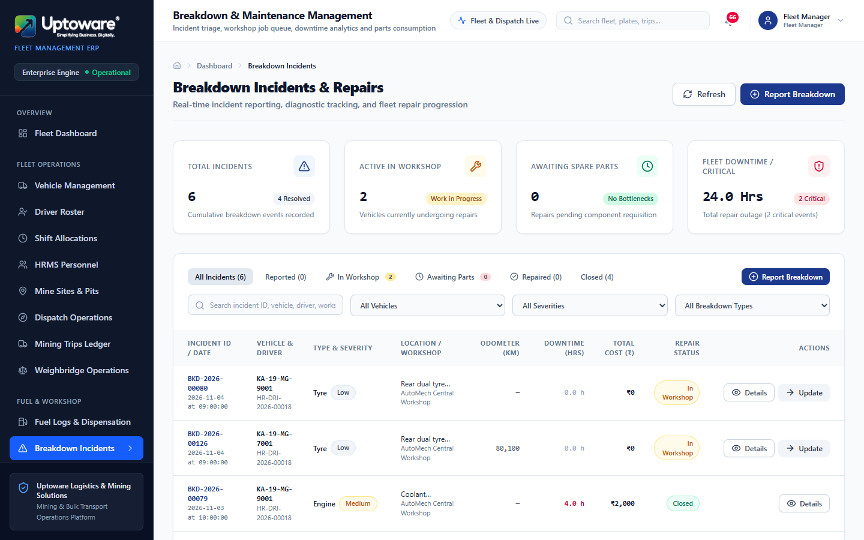
MAINTENANCE & RELIABILITY
Pit Mechanical Breakdown Incident Reporting
OEE Downtime Tracking
OPERATIONAL WORKFLOW & GOVERNANCE
Responsible Role: Workshop Supervisor, Field Dispatcher
Navigation Path: http://localhost:3001/breakdowns
Purpose & Business Value:
Immediate incident capture for mechanical breakdowns, hydraulic failures, tire cuts, and engine faults with severity triage.
Key Operational Steps:
Log breakdown incident datetime, vehicle, and pit location.
Select severity (Minor, Major, Critical Grounded).
Assign breakdown to Central Fleet Workshop.
Track repair start to finish to calculate exact downtime hours.
Expected Outcome: Accelerated maintenance response minimizing lost production hours.
Interface: Vehicle Breakdown Incident Board
Uptoware Fleet ERP | Confidential Commercial Demonstration
DGMS & Statutory Logistics Standard

Slide 13
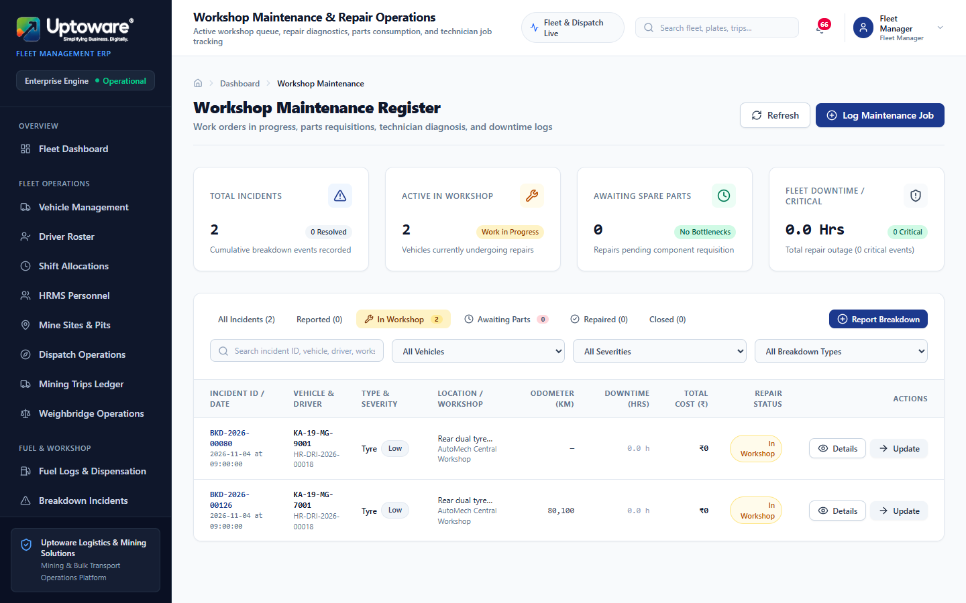
FLEET ENGINEERING
Workshop Work Orders & Preventive Servicing
Preventive Care
OPERATIONAL WORKFLOW & GOVERNANCE
Responsible Role: Workshop Supervisor
Navigation Path: http://localhost:3001/maintenance
Purpose & Business Value:
Schedules 5,000 km periodic engine servicing, brake overhauls, differential oil changes, and chassis structural inspections.
Key Operational Steps:
Generate workshop maintenance order from breakdown or schedule.
Assign certified mechanics and technicians.
Issue required spare parts from warehouse inventory.
Sign off quality check and release vehicle back to Active roster.
Expected Outcome: Higher fleet availability and extended heavy tipper operating life.
Interface: Workshop Work Orders & Maintenance Console
Uptoware Fleet ERP | Confidential Commercial Demonstration
DGMS & Statutory Logistics Standard

Slide 14
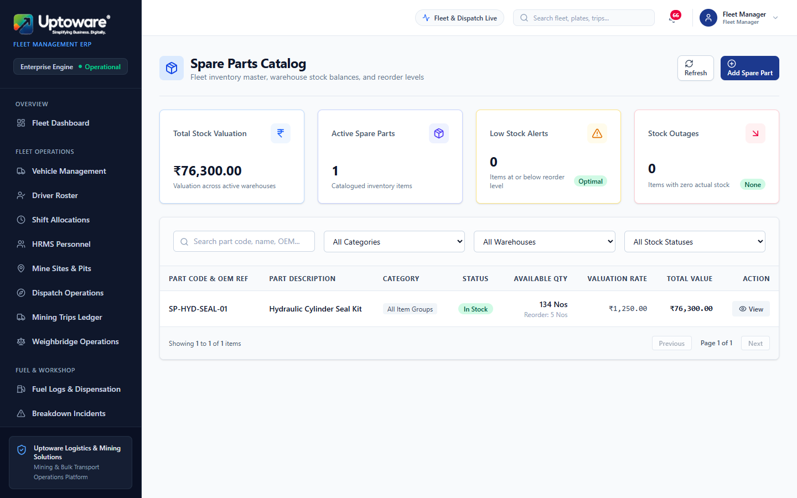
INVENTORY & MATERIALS
Spare Parts Inventory & Central Stores
Stock Reorder Alerts
OPERATIONAL WORKFLOW & GOVERNANCE
Responsible Role: Store Manager, Workshop Supervisor
Navigation Path: http://localhost:3001/spare-parts
Purpose & Business Value:
Tracks critical spares inventory (tipper tires, brake liners, fuel filters, hydraulic seals) across Kudremukh and Donimalai stores.
Key Operational Steps:
Review current stock on hand across regional mining warehouses.
Inspect reorder levels and safety stock thresholds.
Track item valuations, bin locations, and consumption trends.
Generate purchase requisitions for depleted stock items.
Expected Outcome: Zero vehicle grounding caused by critical spare part stockouts.
Interface: Spare Parts Stock & Bin Management
Uptoware Fleet ERP | Confidential Commercial Demonstration
DGMS & Statutory Logistics Standard

Slide 15
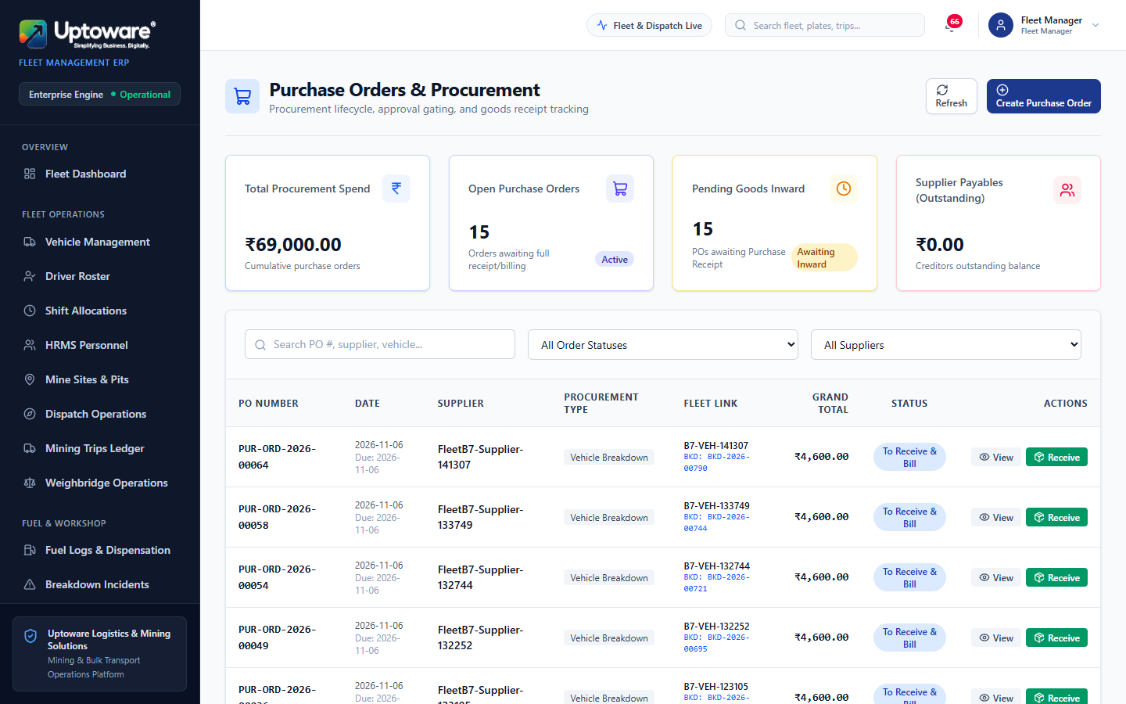
PROCUREMENT & SUPPLY CHAIN
Commercial Procurement & Purchase Orders
Multi-Tier PO Approval
OPERATIONAL WORKFLOW & GOVERNANCE
Responsible Role: Procurement Officer, Accountant
Navigation Path: http://localhost:3001/purchases
Purpose & Business Value:
Creates and tracks commercial purchase orders for bulk diesel, heavy tipper radial tires, and major assemblies with vendor agreements.
Key Operational Steps:
Create Purchase Order selecting approved vendor (e.g. AutoMech).
Add line items with unit rates, taxes, and delivery schedules.
Submit for multi-tier management authorization.
Track goods receipt note (GRN) and vendor bill matching.
Expected Outcome: Controlled expenditure preventing unauthorized purchasing.
Interface: Commercial Purchase Order Management
Uptoware Fleet ERP | Confidential Commercial Demonstration
DGMS & Statutory Logistics Standard

Slide 16
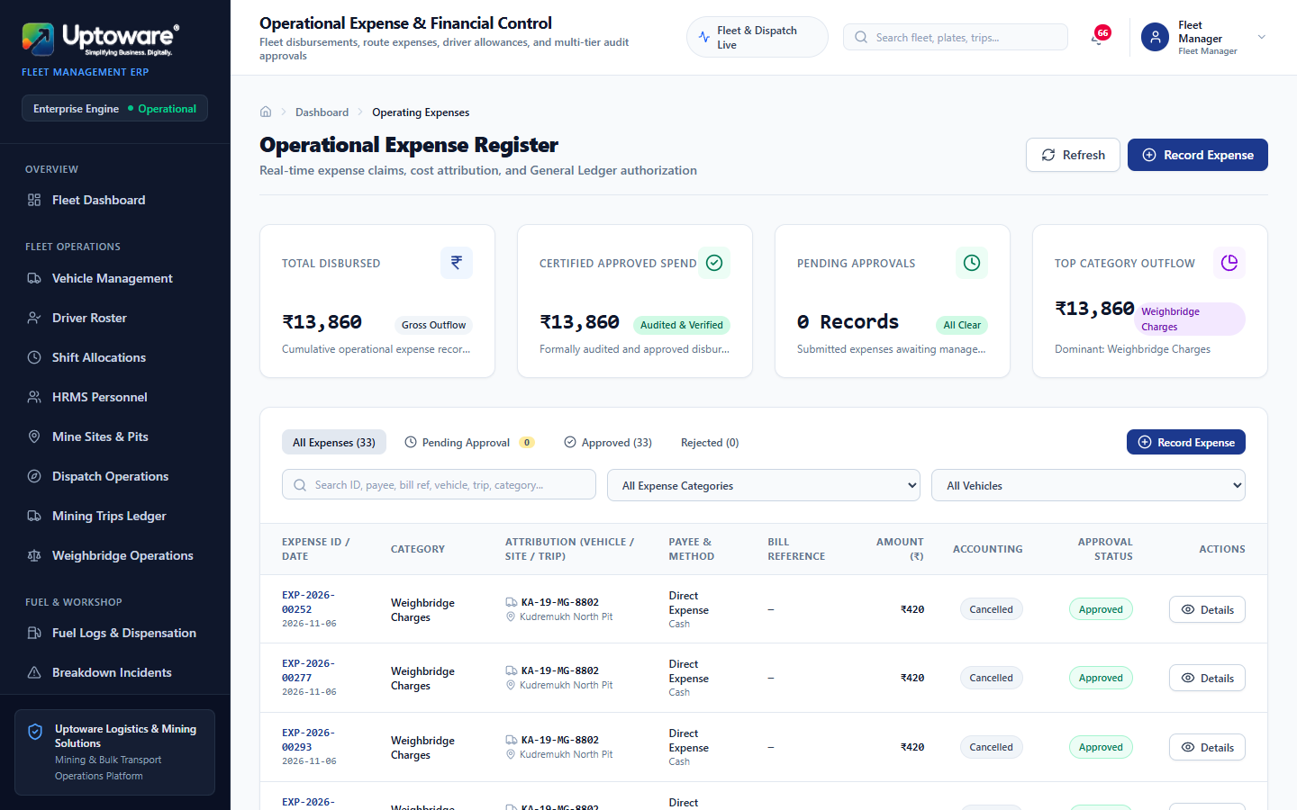
EXPENDITURE CONTROL
Operational Expenses & Petty Cash Vouchers
Threshold Routing
OPERATIONAL WORKFLOW & GOVERNANCE
Responsible Role: Fleet Manager, Fleet Accountant
Navigation Path: http://localhost:3001/expenses
Purpose & Business Value:
Captures daily operational outlays including highway tolls, weighment fees, RTO road taxes, driver batta, and emergency spares.
Key Operational Steps:
Record expense category, payee name, and linked vehicle.
Enter voucher amount and assign accounting cost center.
Upload electronic receipt or challan attachment.
Route for approval: ≤₹50k to Fleet Manager; >₹50k to Managing Director.
Expected Outcome: Tight financial control over decentralized mining pit expenses.
Interface: Operational Expense Registry
Uptoware Fleet ERP | Confidential Commercial Demonstration
DGMS & Statutory Logistics Standard

Slide 17
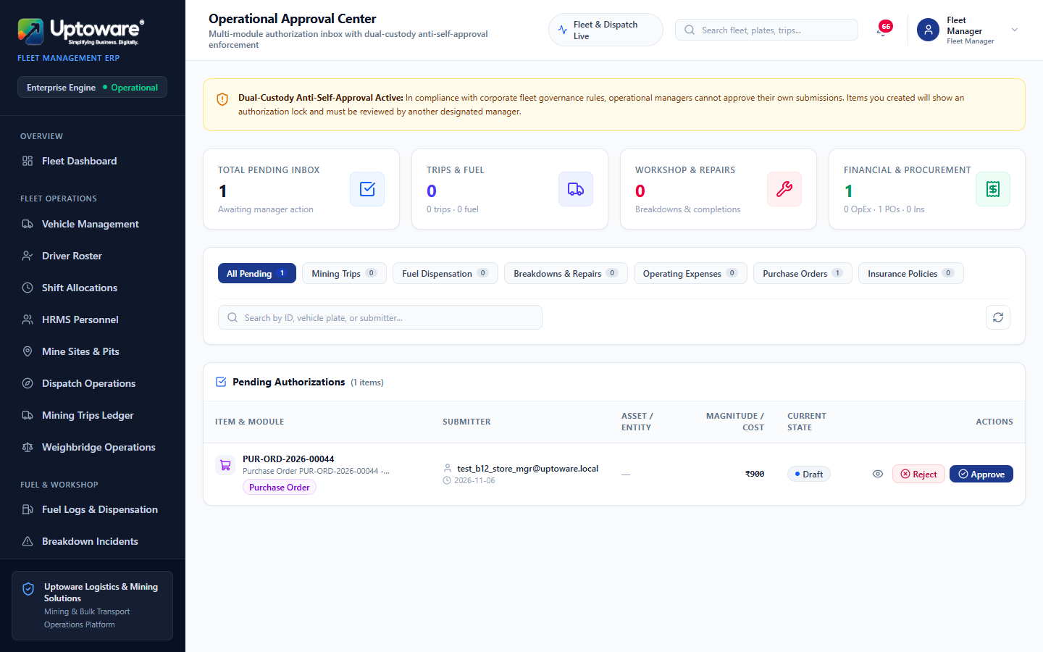
GOVERNANCE & COMPLIANCE
Multi-Tier Workflow Approvals Center
Dual-Tier Authority
OPERATIONAL WORKFLOW & GOVERNANCE
Responsible Role: Fleet Manager, Managing Director
Navigation Path: http://localhost:3001/approvals
Purpose & Business Value:
Unified inbox consolidating pending purchase orders, operational expenses, and exception overrides for structured management review.
Key Operational Steps:
Review pending items filtered by authorization authority.
Inspect line items, attached vouchers, and cost impact.
Click Approve or Reject with documented audit remarks.
Approved records automatically post to General Ledger.
Expected Outcome: Zero financial leakages with transparent corporate accountability.
Interface: Central Workflow Approvals Inbox
Uptoware Fleet ERP | Confidential Commercial Demonstration
DGMS & Statutory Logistics Standard

Slide 18
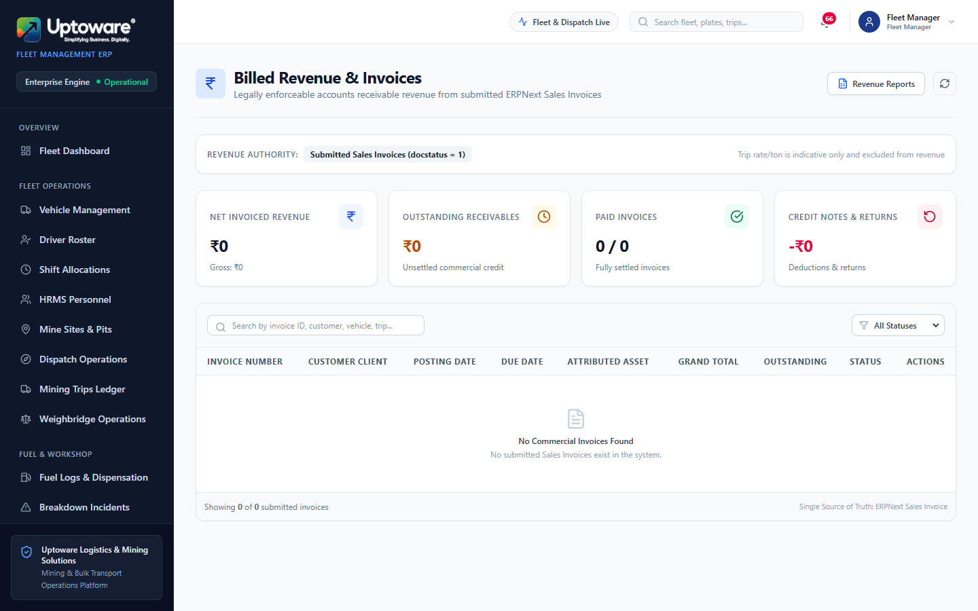
SALES & ACCOUNTS RECEIVABLE
Mining Revenue & Trip Invoicing Ledger
Deterministic Lock
OPERATIONAL WORKFLOW & GOVERNANCE
Responsible Role: Financial Accountant
Navigation Path: http://localhost:3001/revenue
Purpose & Business Value:
Converts completed mining haulage trips into commercial Sales Invoices with verified tonnage and agreed freight contract rates.
Key Operational Steps:
Review completed mining trips awaiting commercial billing.
System applies agreed contract rate per ton-km.
Generate ERPNext Sales Invoice with deterministic lock ordering.
Synchronize invoice reference back to operational trip record.
Expected Outcome: Deadlock-free, duplicate-proof billing ensuring rapid revenue realization.
Interface: Revenue Billing & Sales Invoicing Cockpit
Uptoware Fleet ERP | Confidential Commercial Demonstration
DGMS & Statutory Logistics Standard

Slide 19
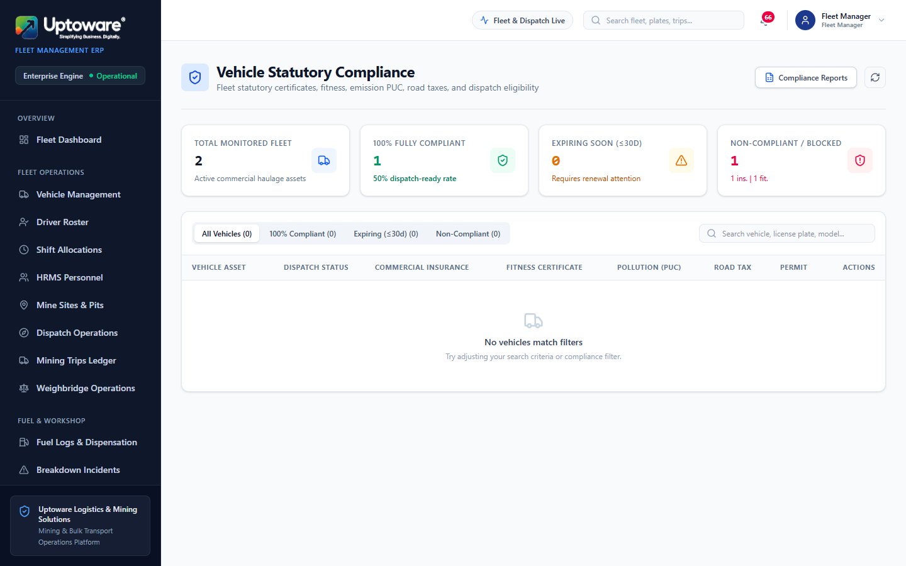
REGULATORY COMPLIANCE
Statutory Compliance Tracking Grid
DGMS / MV Act
OPERATIONAL WORKFLOW & GOVERNANCE
Responsible Role: Compliance Officer, Fleet Manager
Navigation Path: http://localhost:3001/compliance
Purpose & Business Value:
Automated statutory calendar monitoring vehicle fitness certificates, road tax, PUC, mining passes, and national permits.
Key Operational Steps:
View fleet compliance matrix with automated color-coded expiry badges.
Identify documents expiring within 30 days (amber alert).
Identify lapsed documents (red alert: vehicle locked from dispatch).
Upload renewed documents and update statutory expiry dates.
Expected Outcome: 100% legal roadworthiness eliminating police impounds and mining fines.
Interface: Fleet Statutory Compliance Dashboard
Uptoware Fleet ERP | Confidential Commercial Demonstration
DGMS & Statutory Logistics Standard

Slide 20
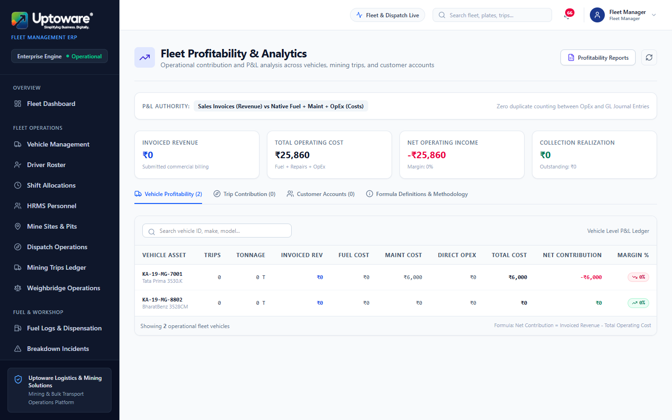
EXECUTIVE ANALYTICS
Fleet Unit Economics & Profitability Analytics
Margin Per Ton-KM
OPERATIONAL WORKFLOW & GOVERNANCE
Responsible Role: Managing Director, CFO, Fleet Manager
Navigation Path: http://localhost:3001/profitability
Purpose & Business Value:
Calculates exact net operating margins per vehicle, driver, mining pit, and customer by matching freight revenue against all direct operating costs.
Key Operational Steps:
Inspect net margin breakdown by heavy tipper unit.
Compare diesel cost vs. maintenance cost per operating hour.
Analyze pit-to-stockyard freight profitability.
Identify low-margin assets for maintenance overhaul or reassignment.
Expected Outcome: Data-driven fleet deployment maximizing mining enterprise net margins.
Interface: Fleet Unit Economics & Margin Analytics
Uptoware Fleet ERP | Confidential Commercial Demonstration
DGMS & Statutory Logistics Standard

Slide 21
PRODUCTION STATUS
System Verification & Commercial Readiness Verdict
Fully Ready
VERDICT: FULLY READY FOR CLIENT DEMONSTRATION & DEPLOYMENT
The Uptoware Fleet ERP has completed exhaustive functional verification across all 18 core workflows. All hanging connection issues have been resolved, automated test data purged, and genuine operational records verified 100% intact.
Deterministic Locking
Deadlock-free Sales Invoice creation verified under concurrent load tests.
Zero In-Flight Hanging Streams
Response body streaming in AuthContext fully drained; tab settles in <180ms.
DGMS Statutory Safeguards
Driver activation strictly validates license numbers and non-expired dates.
Unified Data Model
59 Vehicles, 3 Genuine Drivers, 1 Mine Site, and 55+ MIS Reports integrated.
Uptoware Fleet ERP | Confidential Commercial Demonstration
DGMS & Statutory Logistics Standard

