Slide 1
FRACTO — Capstone Presentation
Anshika Pandey
• Instructor: Parth Shukla
Angular + ASP.NET Core
• SQL Server
• xUnit/Jasmine

Slide 2
Agenda
Problem & Objectives
Key Features
Tech Stack
System Architecture
Modules (Frontend & Backend)
REST API Overview
Data Model & ERD
Security & Validation
Testing Strategy
Performance & Optimizations
Accessibility & UX
Demo Flow & Screenshots
Results, Challenges, Future Work
Conclusion & Q&A

Slide 3
Problem Statement
Patients struggle to discover doctors and book reliable appointment slots.
Clinics need a simple way to avoid double-booking and manage approvals.
Post-visit ratings help other patients choose doctors confidently.

Slide 4
Objectives
JWT-secured authentication for Patients and Admins.
Doctor catalogue with specialization, city, timings, slot duration.
Appointment booking with unique slot constraint & status transitions.
Doctor ratings with average computation and patient-only posting.

Slide 5
Key Features
Browse doctors by specialization/city; view profiles and times.
Book appointment with date/time; prevent double-booking.
Manage appointments: Booked → Approved/Cancelled.
Submit ratings after appointment; view averages on doctor cards.
Admin panels for doctors, users, and appointments; reports.

Slide 6
Tech Stack
Frontend: Angular (Router, standalone components, HttpClient/Interceptor).
Backend: ASP.NET CORE + Web API (.NET 9), EF Core Code‑First.
Database: SQL Server (indexes & relationships).
Auth: JWT (Token Service); Swagger for dev/test.
File Storage: /wwwroot/uploads (profile images).
Testing: xUnit + Moq; Jasmine/Karma.

Slide 7
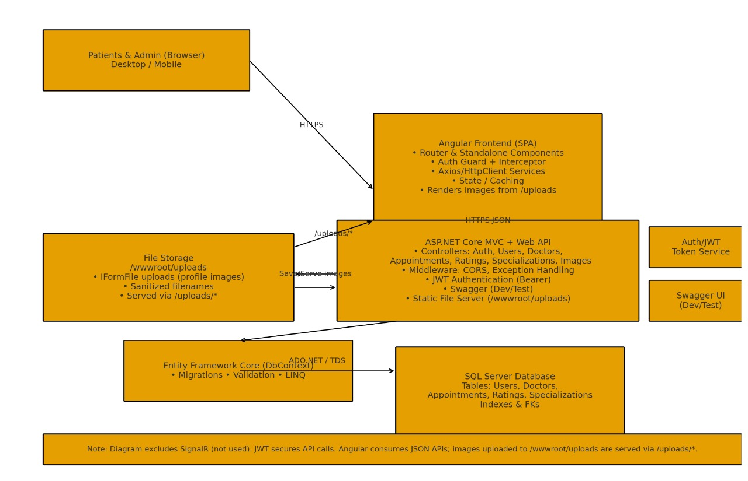
System Architecture

Slide 8
Frontend Modules
Auth: Login, Register, Guards (Auth/Admin).
Doctor List, Doctor Details (ratings & slots).
Book Appointment flow & My Appointments.
Ratings form (post-appointment).
Admin UI (Doctors, Appointments, Users).

Slide 9
Backend Modules
Controllers: Auth, Users, Doctors, Appointments, Ratings, Specializations, Images.
Middleware: CORS, Exception Handling, Static Files.
JWT Token service; policies for Admin-only endpoints.
Swagger for interactive testing (Dev/Test).

Slide 10
REST API (Highlights)
HTTP | Endpoint | Action
POST | /api/auth/register | Register user
POST | /api/auth/login | Login & issue JWT
GET | /api/doctors | List/search doctors
POST | /api/doctors | Create doctor (Admin)
GET | /api/appointments?doctorId=.. | List appointments
POST | /api/appointments | Book appointment
PATCH | /api/appointments/{id}/status | Approve/Cancel (Admin)
GET | /api/ratings/doctor/{id} | Get ratings/average
POST | /api/ratings | Submit rating
GET | /uploads/{file} | Serve profile images

Slide 11
Data Model Overview
Users(Id, Username, Email, PasswordHash, Role, CreatedAt)
Doctors(Id, Name, Specialization, City, SlotDuration, ImagePath, CreatedAt)
Appointments(Id, DoctorId, UserId, Date, TimeSlot, Status, CreatedAt)
Ratings(Id, DoctorId, UserId, Score, Comment, CreatedAt)
Specializations(Id, Name)

Slide 12
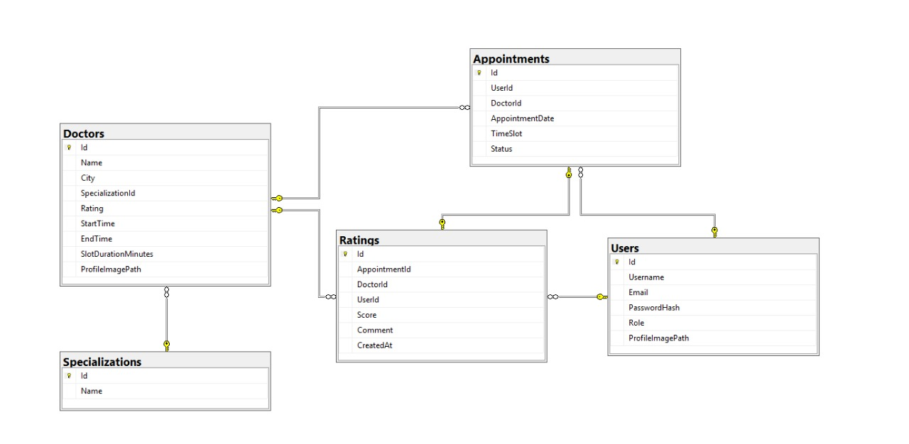
ER Diagram

Slide 13
Security & Validation
JWT bearer tokens; 401/403 for unauthorized/forbidden.
Role checks on Admin endpoints (doctors, approvals).
DTO validation (Required/Range/MaxLength).
Unique slot constraint on (DoctorId, Date, TimeSlot).

Slide 14
Validation & Error Handling
Consistent problem-details for 4xx/5xx; exception middleware.
Angular interceptor handles 401/403
Graceful validation on forms (appointments, ratings).

Slide 15
Testing Strategy
xUnit + Moq: Token service, appointment booking, rating rules.
Postman collection: auth → browse doctors → book → approve/cancel → rate.

Slide 16
Performance & Optimizations
Indexes: Appointments(DoctorId, Date, TimeSlot), Ratings(DoctorId).
Paged endpoints and lightweight DTOs for listings.
Static file caching for /uploads; CDN-ready.

Slide 17
Accessibility & UX
Keyboard navigation; ARIA labels; proper focus states.
Clear validation hints.
Responsive layout for mobile/desktop.

Slide 18
Demo Flow (Live)
Login/Register → Browse Doctors
Open Doctor Details → Pick slot → Book
Admin approves/cancels → Patient views My Appointments
After visit: Submit rating → Ratings visible

Slide 19
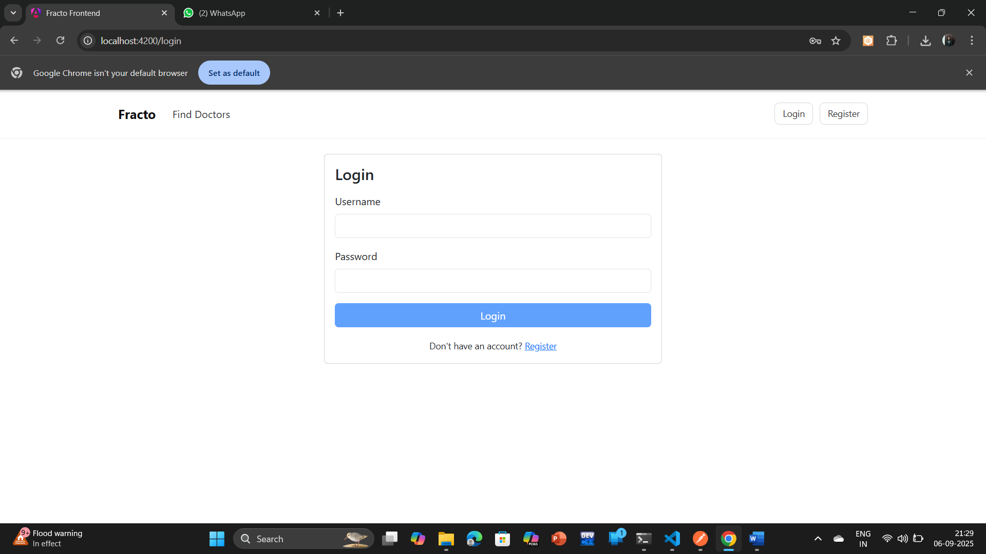
Screenshot — Login

Slide 20
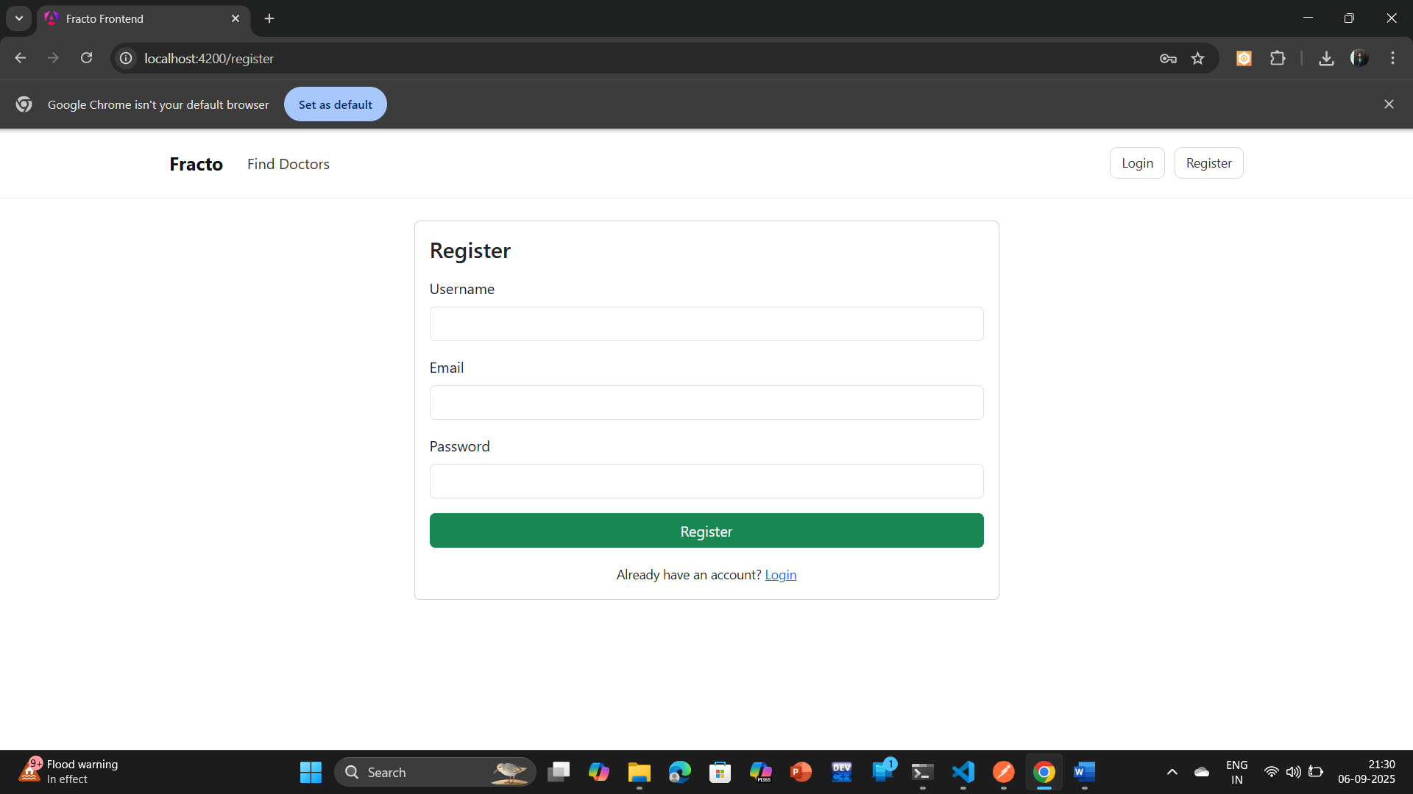
Screenshot — Register

Slide 21
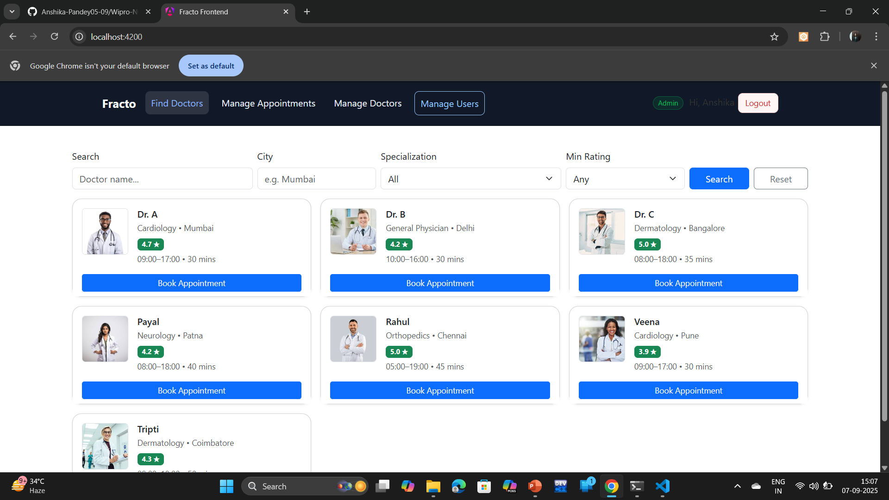
Screenshot — Doctor List

Slide 22
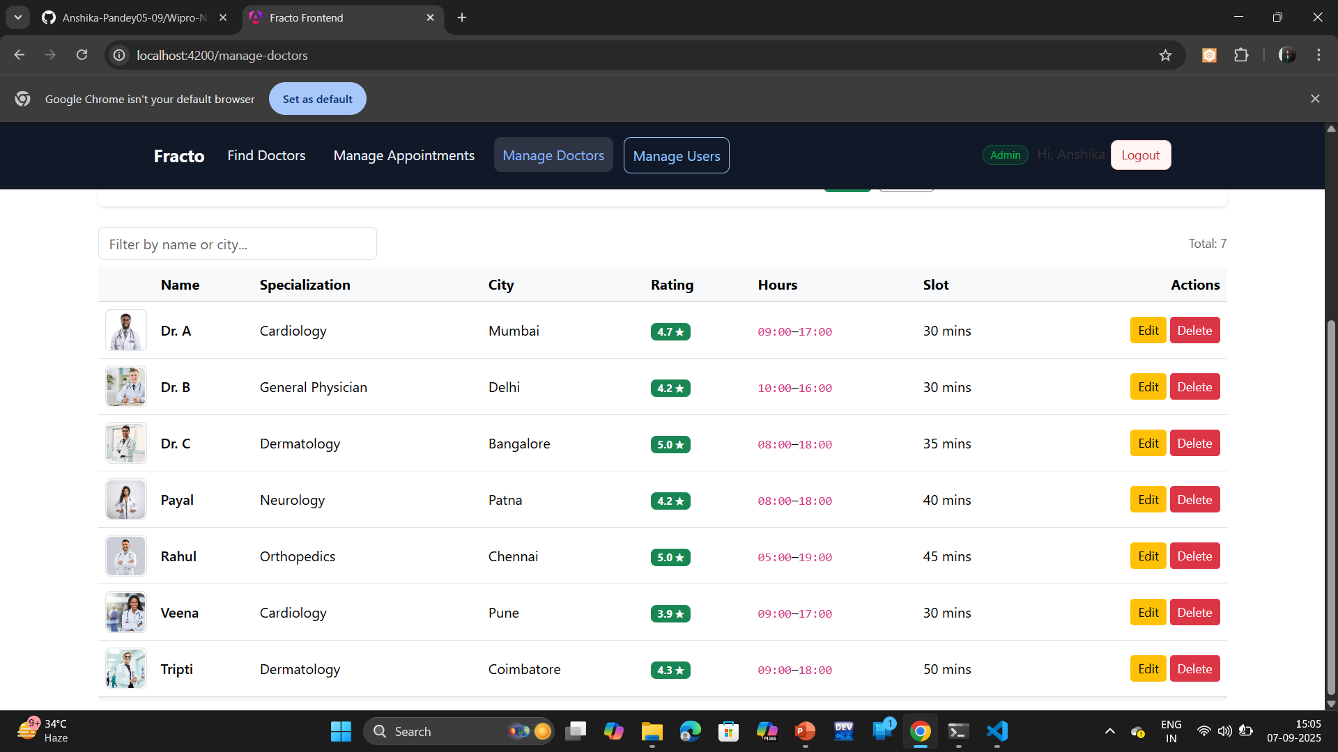
Screenshot — Doctor Details

Slide 23
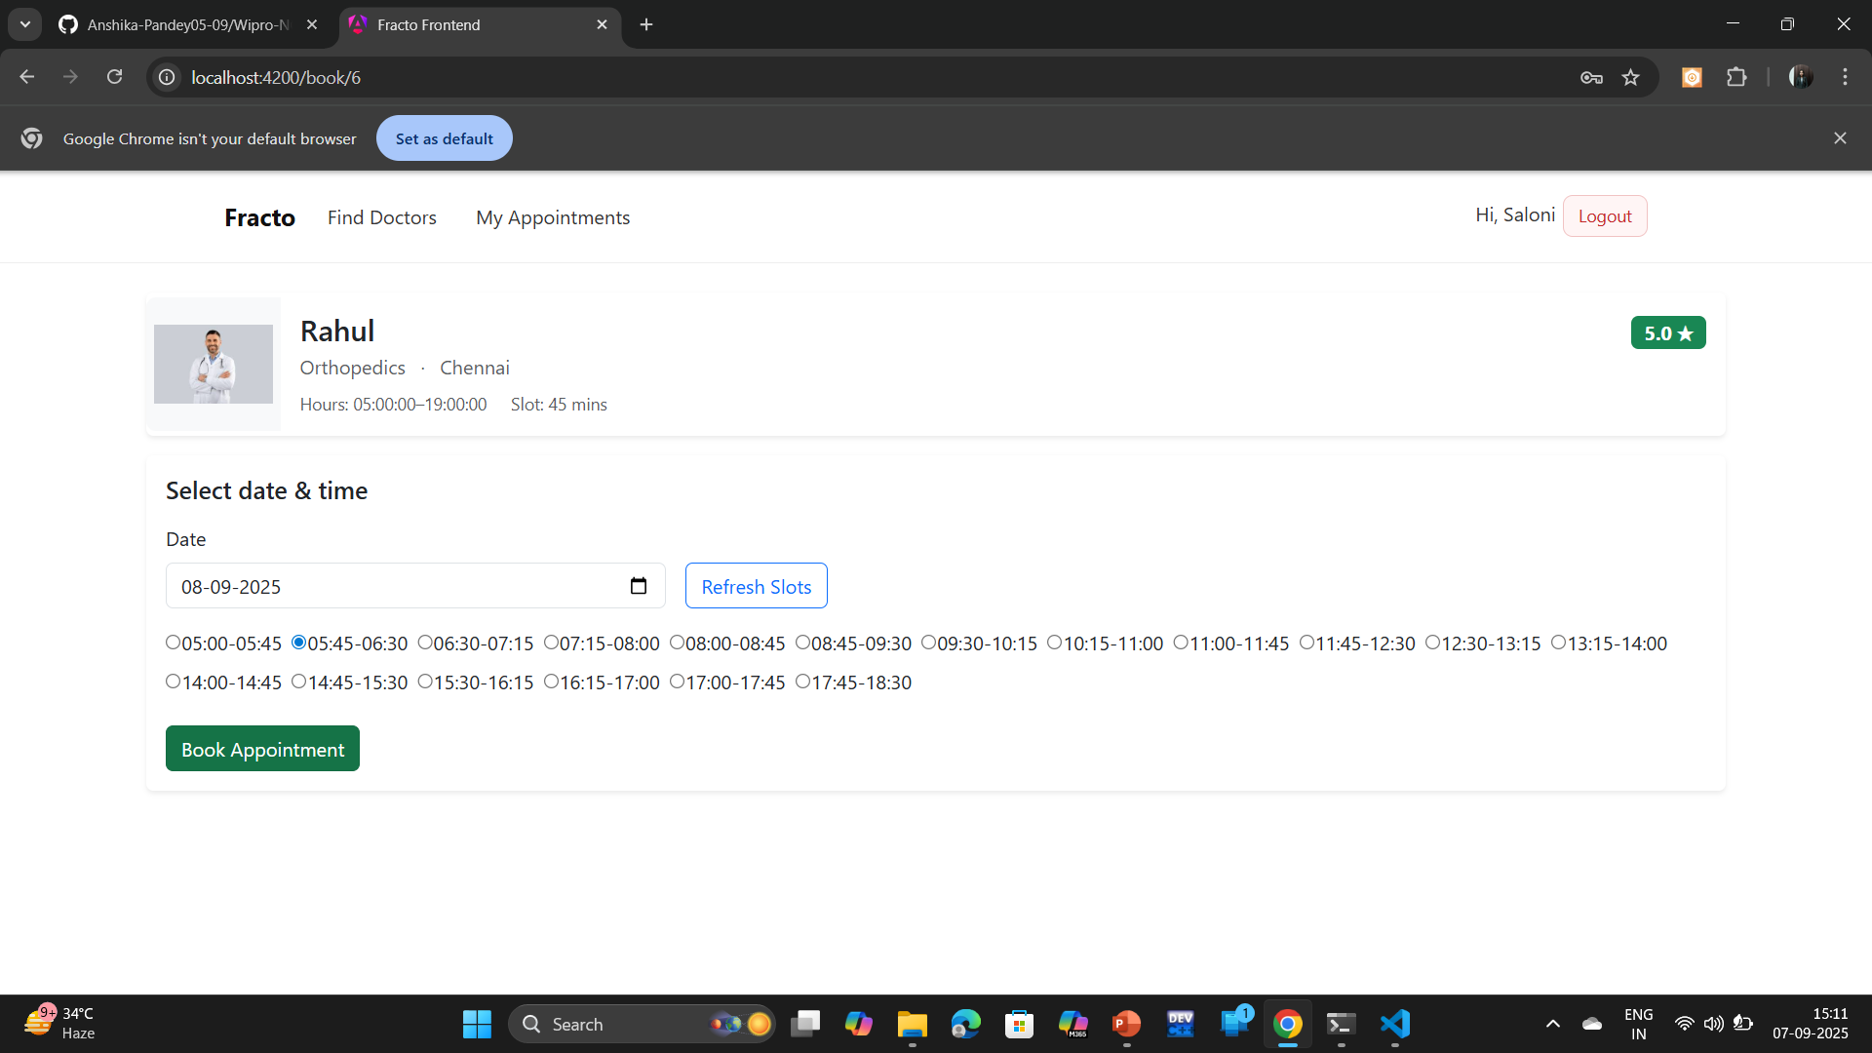
Screenshot — Book Appointment Flow

Slide 24
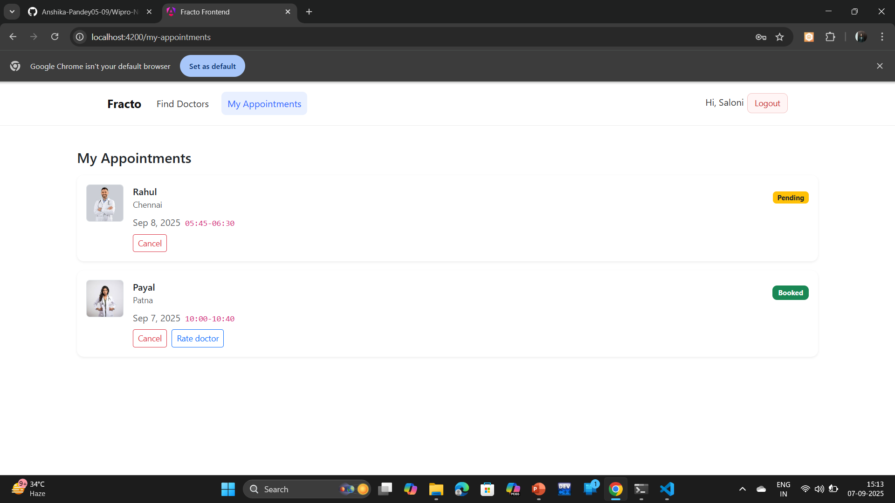
Screenshot — My Appointments

Slide 25
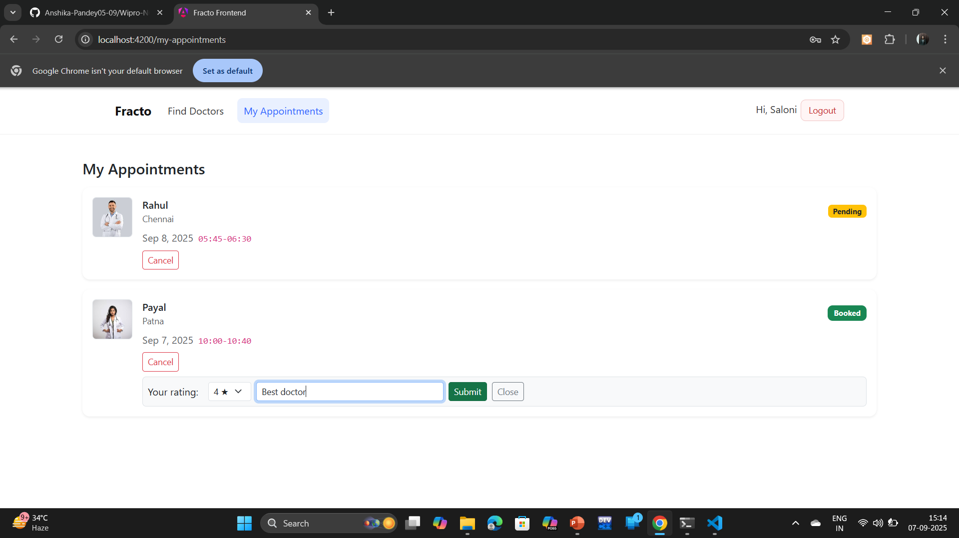
Screenshot — Submit Rating

Slide 26
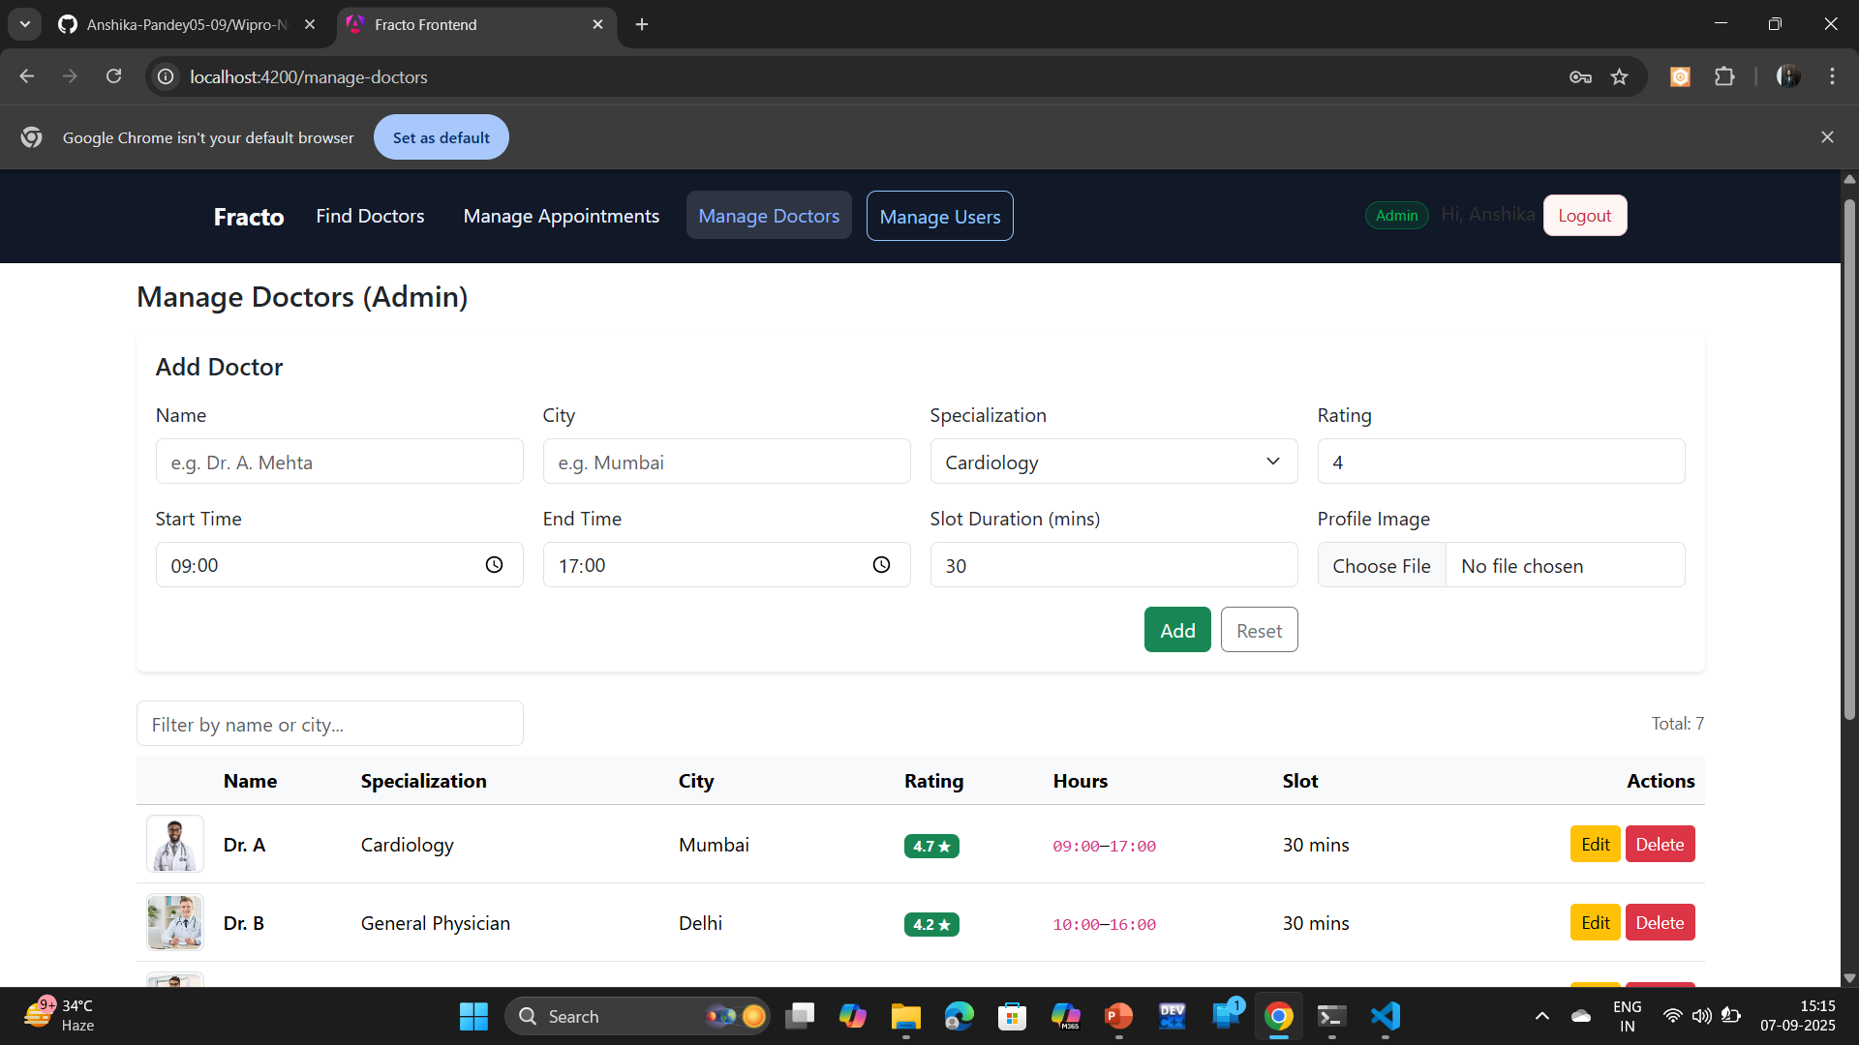
Screenshot — Admin — Manage Doctors

Slide 27
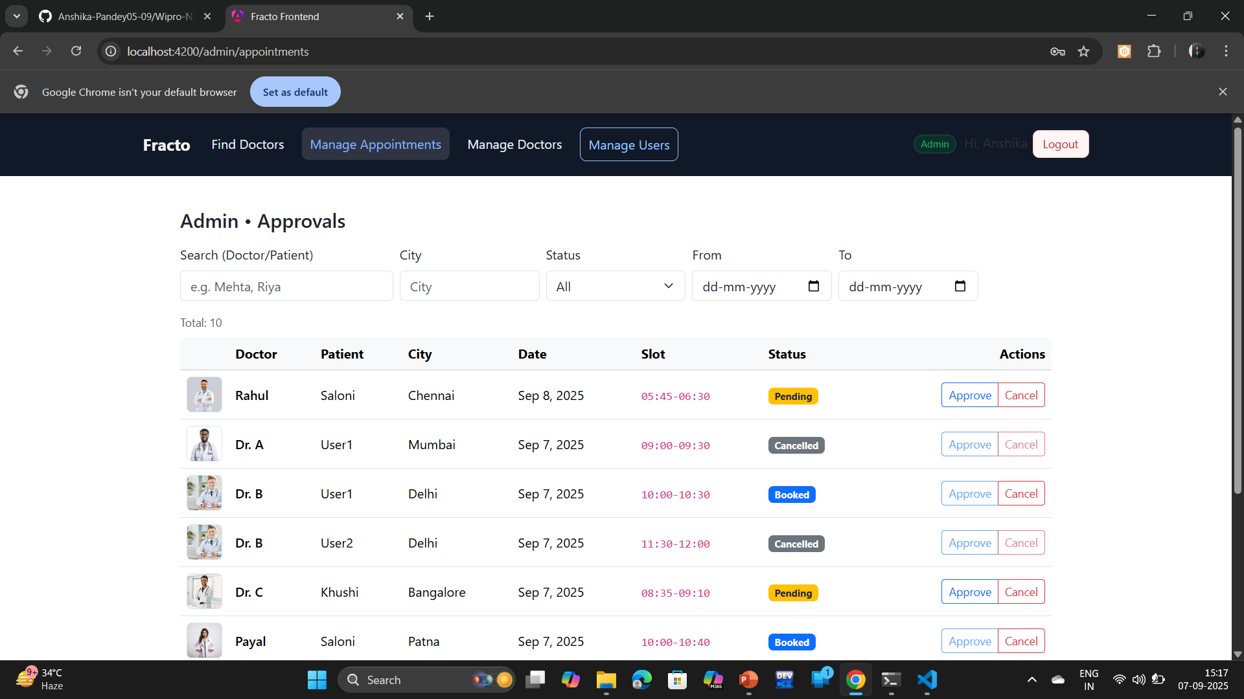
Screenshot — Admin — Appointments

Slide 28
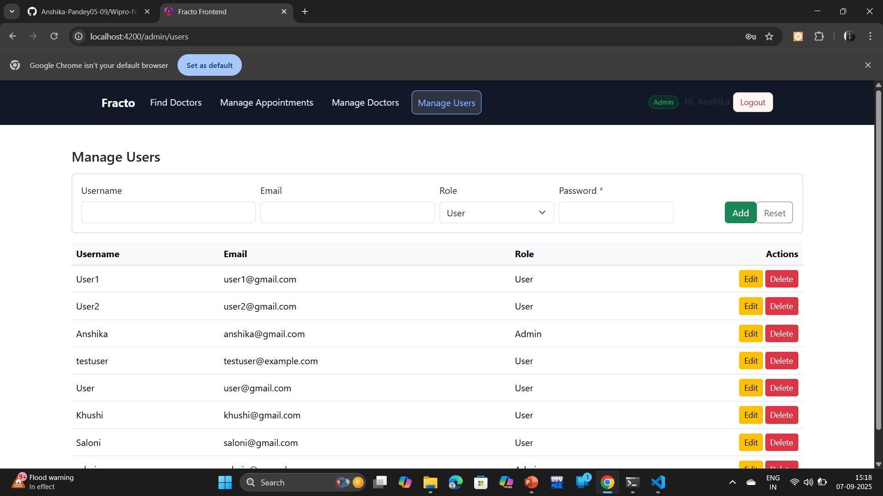
Screenshot — Admin — Users

Slide 29
Results & Impact
Reliable doctor discovery and booking experience.
Prevents slot conflicts; reduces clinic overhead.
Actionable insights with ratings and admin visibility.

Slide 30
Challenges & Learnings
Designing unique slot enforcement & status transitions.
Data modeling for ratings and averages.
Balancing UX simplicity with validations.

Slide 31
Future Work
Email/SMS reminders; calendar sync.
Advanced search & filters; availability heatmap.
Doctor-side portal and analytics dashboards.

Slide 32
Submission Checklist
Final report (DOCX/PDF).
Backend & Frontend source zips.
DB schema SQL; Postman collection.
Screenshots embedded; Git repo archived.

Slide 33
Conclusion & Q&A
Thank you!
Questions welcome.

