Slide 1
GlucoTwin
A Type 2 diabetes digital twin that warns of a glucose spike a median 90 minutes before it happens
Team: Healthbuddy
IIT Kanpur
Happiest Health Digital Twin Challenge 2026 · Phase 1 submission
Notes:
Introduce the team. One-line pitch: GlucoTwin is a personalised virtual patient for Type 2 diabetes that fuses EHR and wearable data to predict a glucose spike two hours ahead, and lets a doctor test interventions on the twin before advising the real patient.

Slide 2
Diabetes care in India is still reactive
Quarterly HbA1c tests average away the daily spikes that drive complications
101 M
136 M
~3 months
Indians living with diabetes (ICMR-INDIAB, 2023)
more with prediabetes (same study)
typical gap between HbA1c checks, blind to daily excursions
Post-meal glucose spikes are common with carbohydrate-heavy Indian meals and late dinners.
Short sleep and stress quietly raise insulin resistance the next day, and nobody connects the dots.
CGMs show where glucose is now. Doctors need to know where it is going, and what would change it.
GlucoTwin · Digital Twin Challenge 2026 · 2
Notes:
Source for 101 million and 136 million: ICMR-INDIAB national study, Lancet Diabetes & Endocrinology, 2023. Frame the gap: we measure HbA1c every few months, but the damage happens in daily spikes.

Slide 3



Our focus: predict the next post-meal spike
One condition, one outcome, done well, as the challenge brief asks
Prediction target
Patient
Gets a timely nudge: “a 15-minute walk after lunch will likely keep you in range.”
Condition: Type 2 diabetes
Event: CGM glucose > 180 mg/dL (ADA post-meal target)
Horizon: any time in the next 2 hours
Only predicted while glucose is still below 180, so every alert is genuine early warning
Refreshed every 15 minutes
Doctor
Sees a triage list of who is heading out of range, why, and what would help.
Care programme
Tracks time-in-range and targets coaching where it moves outcomes.
GlucoTwin · Digital Twin Challenge 2026 · 3
Notes:
Explain why we narrowed to one outcome. The 180 mg/dL threshold is the ADA post-prandial target. We only predict while glucose is still in range, which is harder than predicting whether it is already high, and it is the clinically useful version.

Slide 4



GlucoTwin: fuse, simulate, predict
A hybrid of a personalised physiology model and machine learning
1 Fuse
2 Simulate
3 Predict & explain
Static EHR (labs, meds, genetics) and live wearables (CGM, HR, HRV, sleep, steps, meals) are aligned on one 5-minute timeline.
A per-patient twin learns six physiological parameters in one week, then simulates the next 2 hours and answers what-if questions.
Gradient boosting combines raw signals with the twin's simulation, outputs a calibrated risk and peak range, and shows the top reasons.
GlucoTwin · Digital Twin Challenge 2026 · 4
Notes:
Walk through the three stages. Emphasise the hybrid: pure deep learning needs months of data per person; our twin works from one onboarding week and every parameter means something to a clinician.

Slide 5


Two data streams, inside the sandbox rules
Fully synthetic cohort; no real patient data touched (DPDP Act / HIPAA)
Static / historical EHR
Dynamic / real-time wearables
120 synthetic Indian T2D patients
Demographics, diagnoses, HbA1c, fasting glucose, lipids, eGFR, BP
Medications and TCF7L2 genotype
FHIR-style export, LOINC / SNOMED codes; Synthea adapter included
CGM glucose every 5 minutes, 14 days
Heart rate, HRV, steps, sleep stages
Meal-log app; only ~70% of meals logged, with estimation error
Physiology: sleep loss, walking, stress, dawn effect, rice vs wheat diets
483,840
56,744
57
72%
sensor rows
prediction points
fused features
cohort time-in-range
GlucoTwin · Digital Twin Challenge 2026 · 5
Notes:
Key credibility point: the simulator hides each patient's true insulin sensitivity. The twin never sees it and has to infer it, exactly as with a real patient. We also deliberately made the data messy: missing meal logs, logging error, sensor noise.

Slide 6
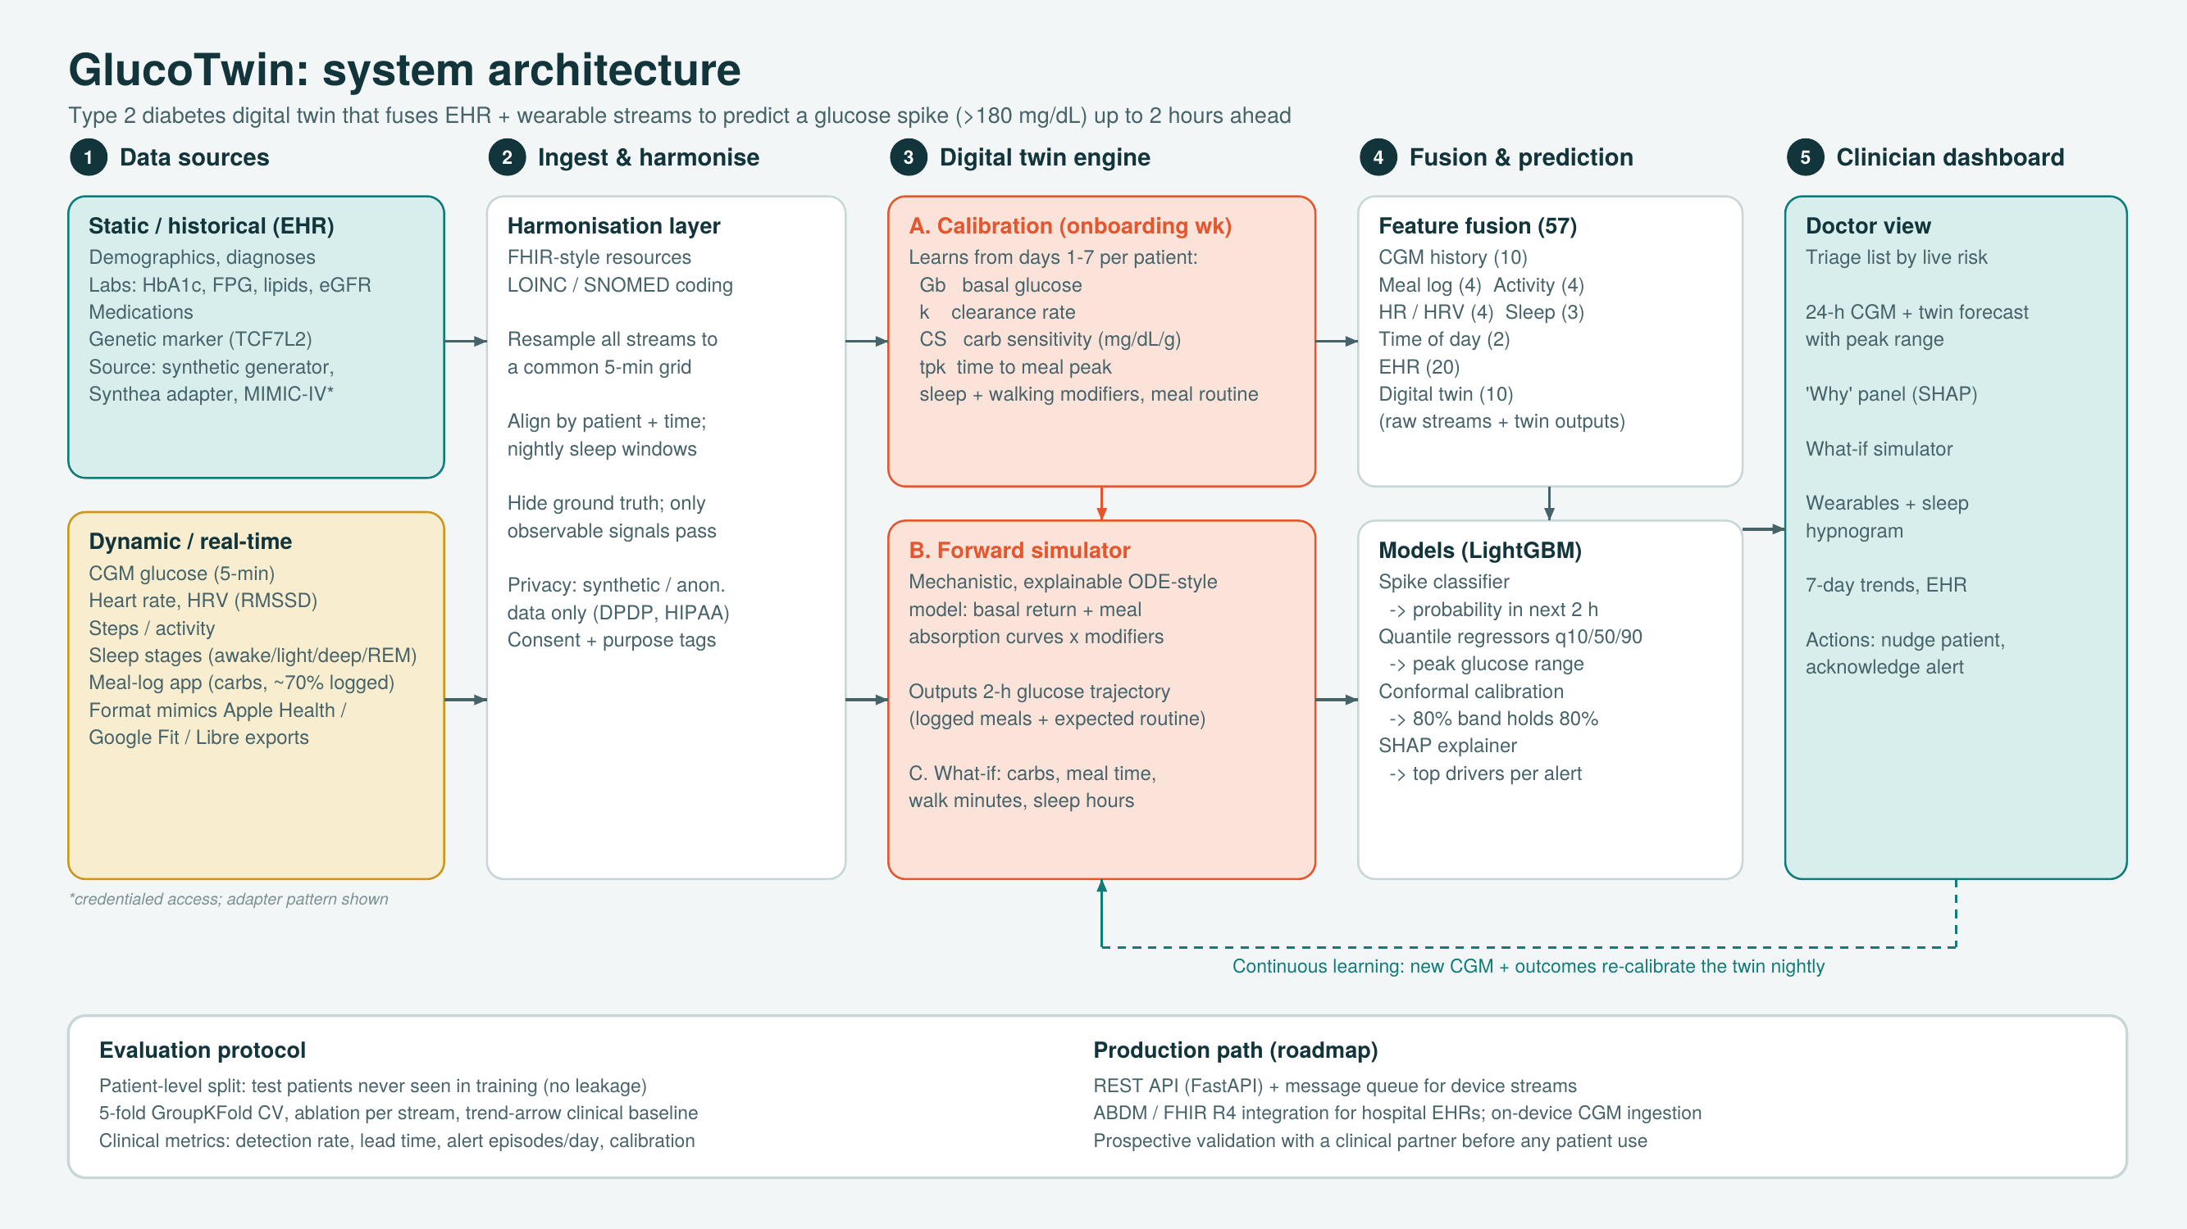
Architecture
GlucoTwin · Digital Twin Challenge 2026 · 6
Notes:
Five layers left to right: sources, harmonisation, twin engine, fusion and prediction, dashboard. Point out the nightly recalibration loop. Full two-page diagram is in the repo as Architecture_Diagram.pdf.

Slide 7
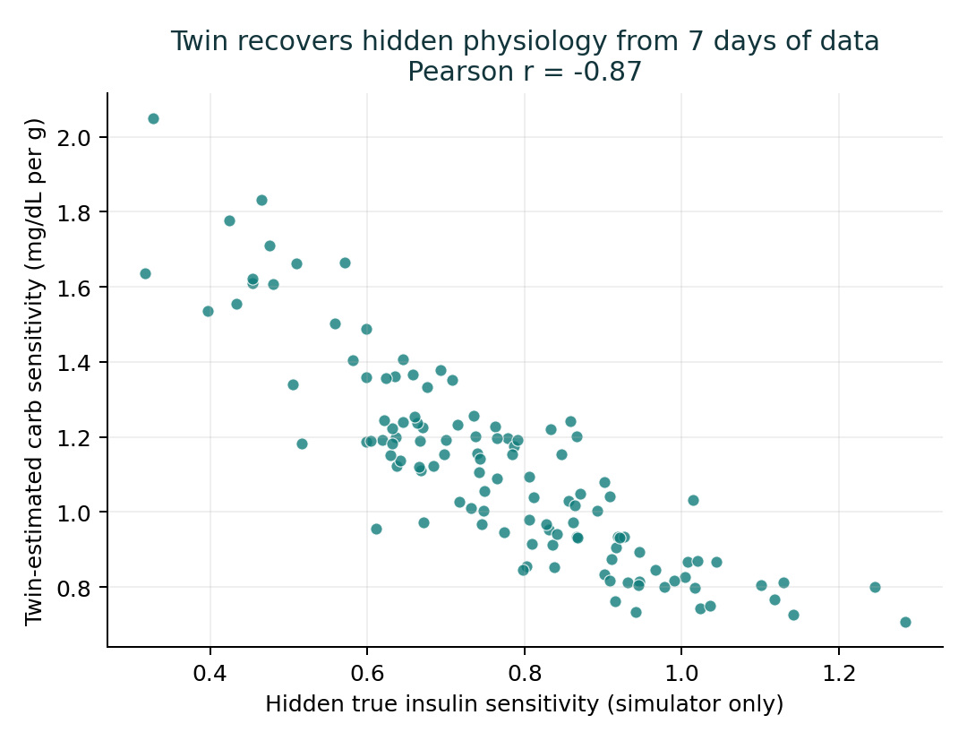
The twin learns each patient's physiology
Six interpretable parameters, calibrated from one onboarding week
Basal glucose
where glucose settles overnight
Carb sensitivity
mg/dL rise per gram of carbs
Time to peak
minutes from meal to peak
Clearance rate
how fast glucose returns
Sleep sensitivity
extra rise per hour of lost sleep
Walking benefit
peak cut by a post-meal walk
Validated: the twin's carb sensitivity tracks the hidden true insulin sensitivity (r = -0.87).
GlucoTwin · Digital Twin Challenge 2026 · 7
Notes:
This is the digital twin in the literal sense: a small set of parameters that describe this person. The scatter shows we recover the hidden physiology from observable data alone. Estimates are shrunk to population priors when data are sparse.

Slide 8
Results on unseen patients
Patient-level split: 29 test patients never seen in training
0.934
AUROC
95%
of spikes flagged in advance
90 min
median warning time
12 mg/dL
error on 2-h peak (vs 24 naive)
GlucoTwin · Digital Twin Challenge 2026 · 8
Notes:
The honest story of the ablation: stacking more raw streams helps a little (CGM only 0.916, fusion 0.928), but routing them through the physiology twin gives the biggest gain (0.934). The twin encodes interactions such as sleep loss times carb sensitivity that a tree model struggles to find from raw columns. A standard CGM trend-arrow rule scores 0.665. Also mention calibration and the conformal 80% interval which achieves 80% coverage.

Slide 9
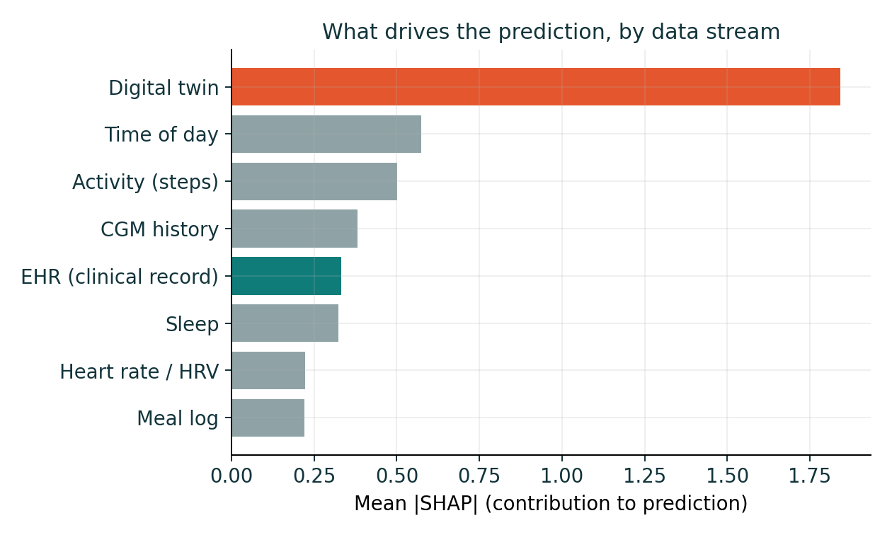
Every alert comes with its reasons
SHAP attributions, grouped by data stream and shown per prediction
Fatima, 13:00: top reasons
Twin-simulated peak: 252 mg/dL
Usual lunch window (time of day)
High personal basal glucose: 171
56% chance of a meal in next 2 h
Her lunch was never logged, yet she peaked at 259, inside the predicted 193–275 range. The twin knew her routine.
GlucoTwin · Digital Twin Challenge 2026 · 9
Notes:
The digital twin carries the most weight because it compresses EHR, sleep and meal routine into one physiologically meaningful number. Clinicians do not have to trust a black box: they see the drivers.

Slide 10
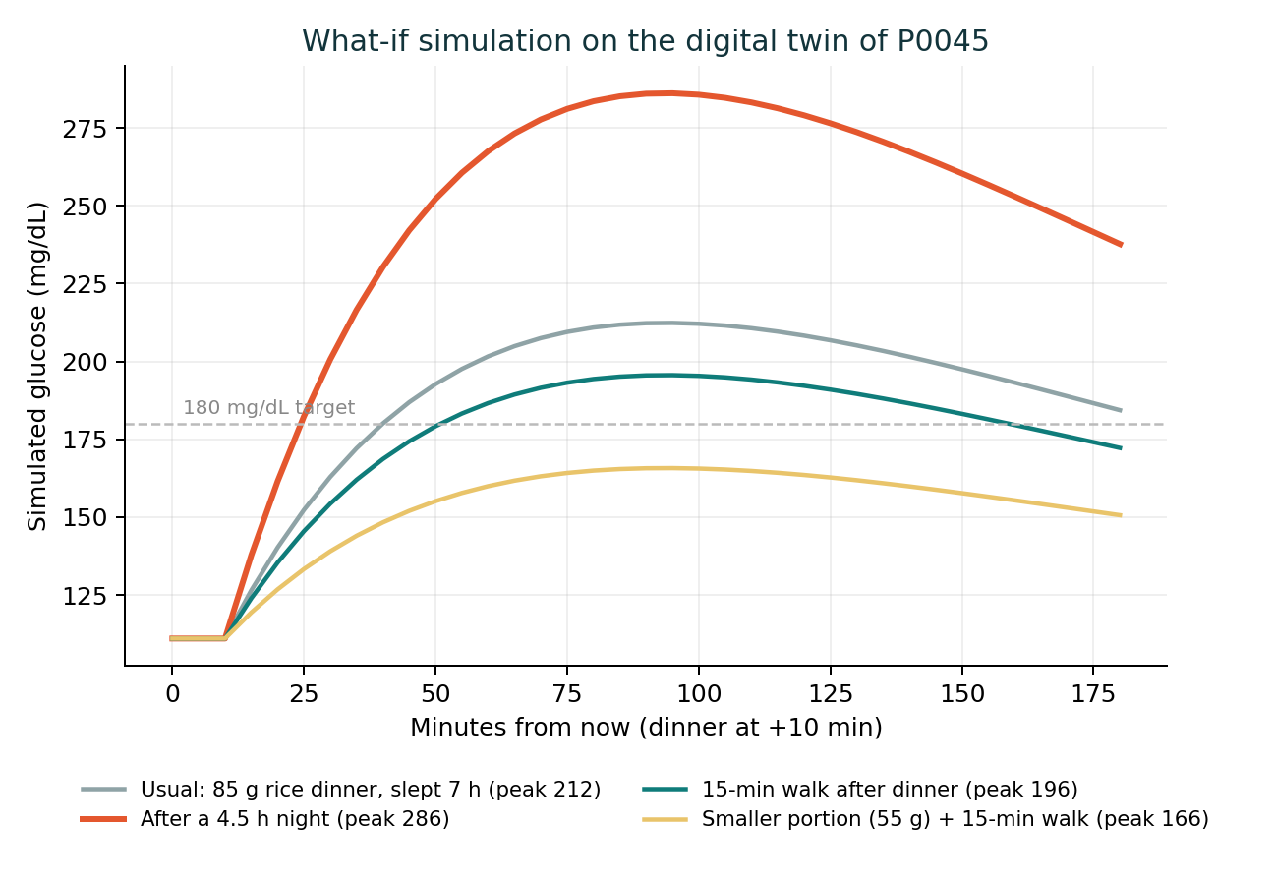
Ask the twin before advising the patient
Same 85 g rice dinner, simulated on patient P0045's twin
212 mg/dL
peak · Usual
286 mg/dL
peak · After a 4.5 h night
196 mg/dL
peak · 15-min walk after
166 mg/dL
peak · Smaller portion + walk
GlucoTwin · Digital Twin Challenge 2026 · 10
Notes:
This is what makes it a twin rather than just a predictor: counterfactuals. For this sleep-sensitive patient, one short night pushes the peak far above target, while a smaller portion plus a short walk keeps them in range. The same sliders are live in the dashboard.

Slide 11
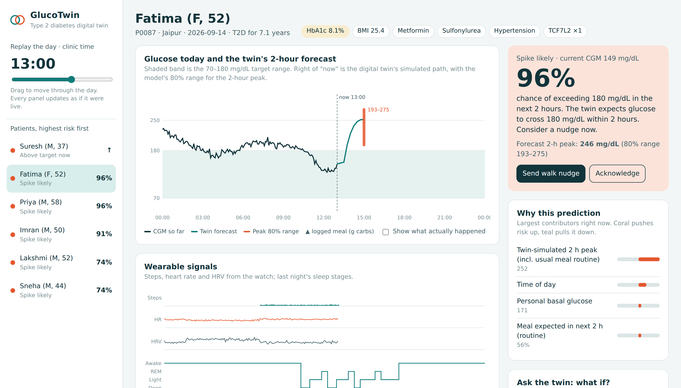
The clinician dashboard
Triage list re-sorts by live risk
24-h CGM with the twin's forecast and peak range
Risk, reasons and one-tap patient nudge
What-if sliders on the twin
Replay the day to see alerts arrive in time
Single HTML file, works offline
GlucoTwin · Digital Twin Challenge 2026 · 11
Notes:
Demo this live in the video: drag the clinic clock, watch a patient move up the triage list before their spike, open the reasons, and use the what-if sliders.

Slide 12


What this proves, what it doesn't, what's next
Limitations
Roadmap
Synthetic data: metrics show the method works, not clinical accuracy
The simulator and twin share a physiological family, which flatters results
Relies on a CGM; meal logging is imperfect
Not a medical device; decision support only
Validate on open CGM + wearable datasets, then a prospective pilot with a diabetologist
ABDM / FHIR R4 integration for hospital records
Add hypoglycaemia risk for insulin and sulfonylurea users
Sequence models once multi-month data exists
Regional-language nudges via WhatsApp
GlucoTwin · Digital Twin Challenge 2026 · 12
Notes:
Being upfront about limits builds trust with a clinical jury. The key limitation: on synthetic data we can validate the method but not clinical accuracy. The obvious next step is real CGM plus wearable data under proper ethics approval.

Slide 13
Thank you
GlucoTwin sees the spike coming, explains why, and shows what would prevent it.
Stack: Python · LightGBM · SHAP · scikit-learn · pandas · HTML/SVG dashboard
Code, data generator, models, dashboard: [GitHub repository link]
Open source under the MIT License
Team Leader Name - Anshika Singh
Email – singha23@iitk.ac.in
Notes:
Close with the one-liner and the repo link. Invite questions.

