Slide 1
FULLSTACK-2 PROJECT
Online Chat Application
Submitted by: Submitted to:
Anshika Gupta - 181500106 Mr. Pankaj Kapoor
Astha Kharya - 181500145
Pari Gupta - 181500454

Slide 2
INTRODUCTION
The “Online Chat Application” has been developed to override the problem prevailing in the practicing manual system. This software is supported to eliminate and in some cases reduce the hardships faced by this existing system. This system is designed for the particular need of the company to carry out operations in a smooth and effective manner.
No formal knowledge is needed for the user to use this system. Thus by this all it proves it is user-friendly. Online Chat Application can lead to error free, secure, reliable and fast management system. It can assist the user to concentrate on their other activities rather to concentrate on the record keeping. Thus it will help the organization in better utilization of resources.

Slide 3
OBJECTIVE
The objective of the project is to develop an instant messaging solution to enable users to seamlessly communicate with each other. The project should be very easy to use enabling even a novice person to use it. In order to make this chat application complete web support needs to be provided.
This chat application manages all the information about Chat Profile, Chat User, Chat History, and Group Chat. An efficient application for chat is the basic objective of this project and the purpose of the project is to build an application to reduce the manual work for managing the Chat Profile, Chat User, and Chat History. It tracks all the details about the Chat History, Group Chat, and Smiles Chat.

Slide 4
REQUIREMENT SPECIFICATION
Hardware Requirements
Processor: Intel i5
Operating System: Windows 10
RAM: 4GB
Hardware Devices: Computer System
Software Requirements
Web technologies: React JS
Web Server: Chat Server Engine
Web browser: Chrome or Firefox
Tools: Visual Studio code

Slide 5
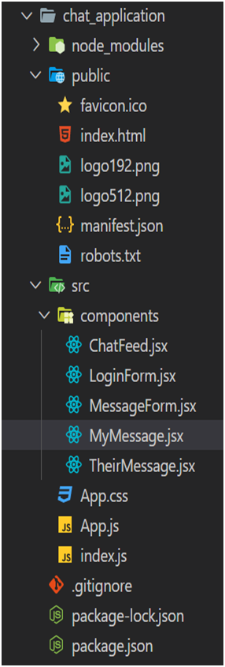
IMPLEMENTATION (folder Structure)

Slide 6
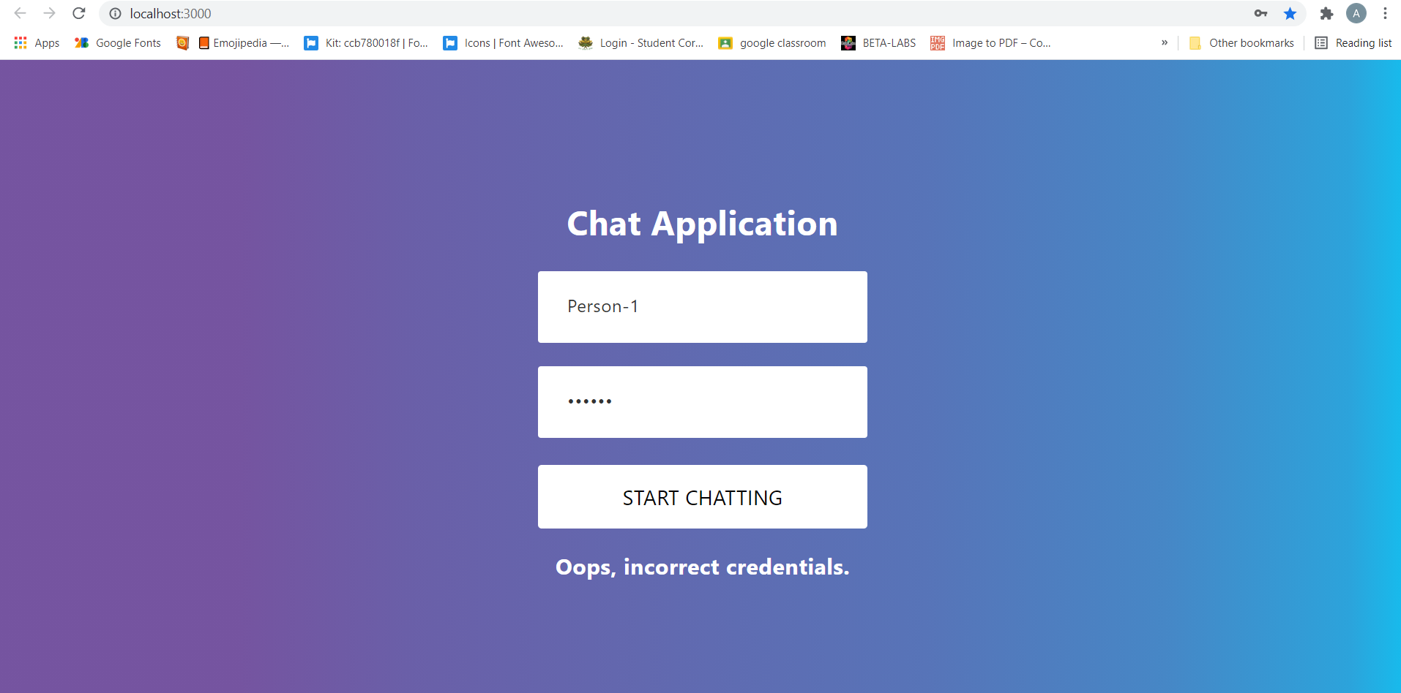
PROJECT SCREENSHOTS

Slide 7
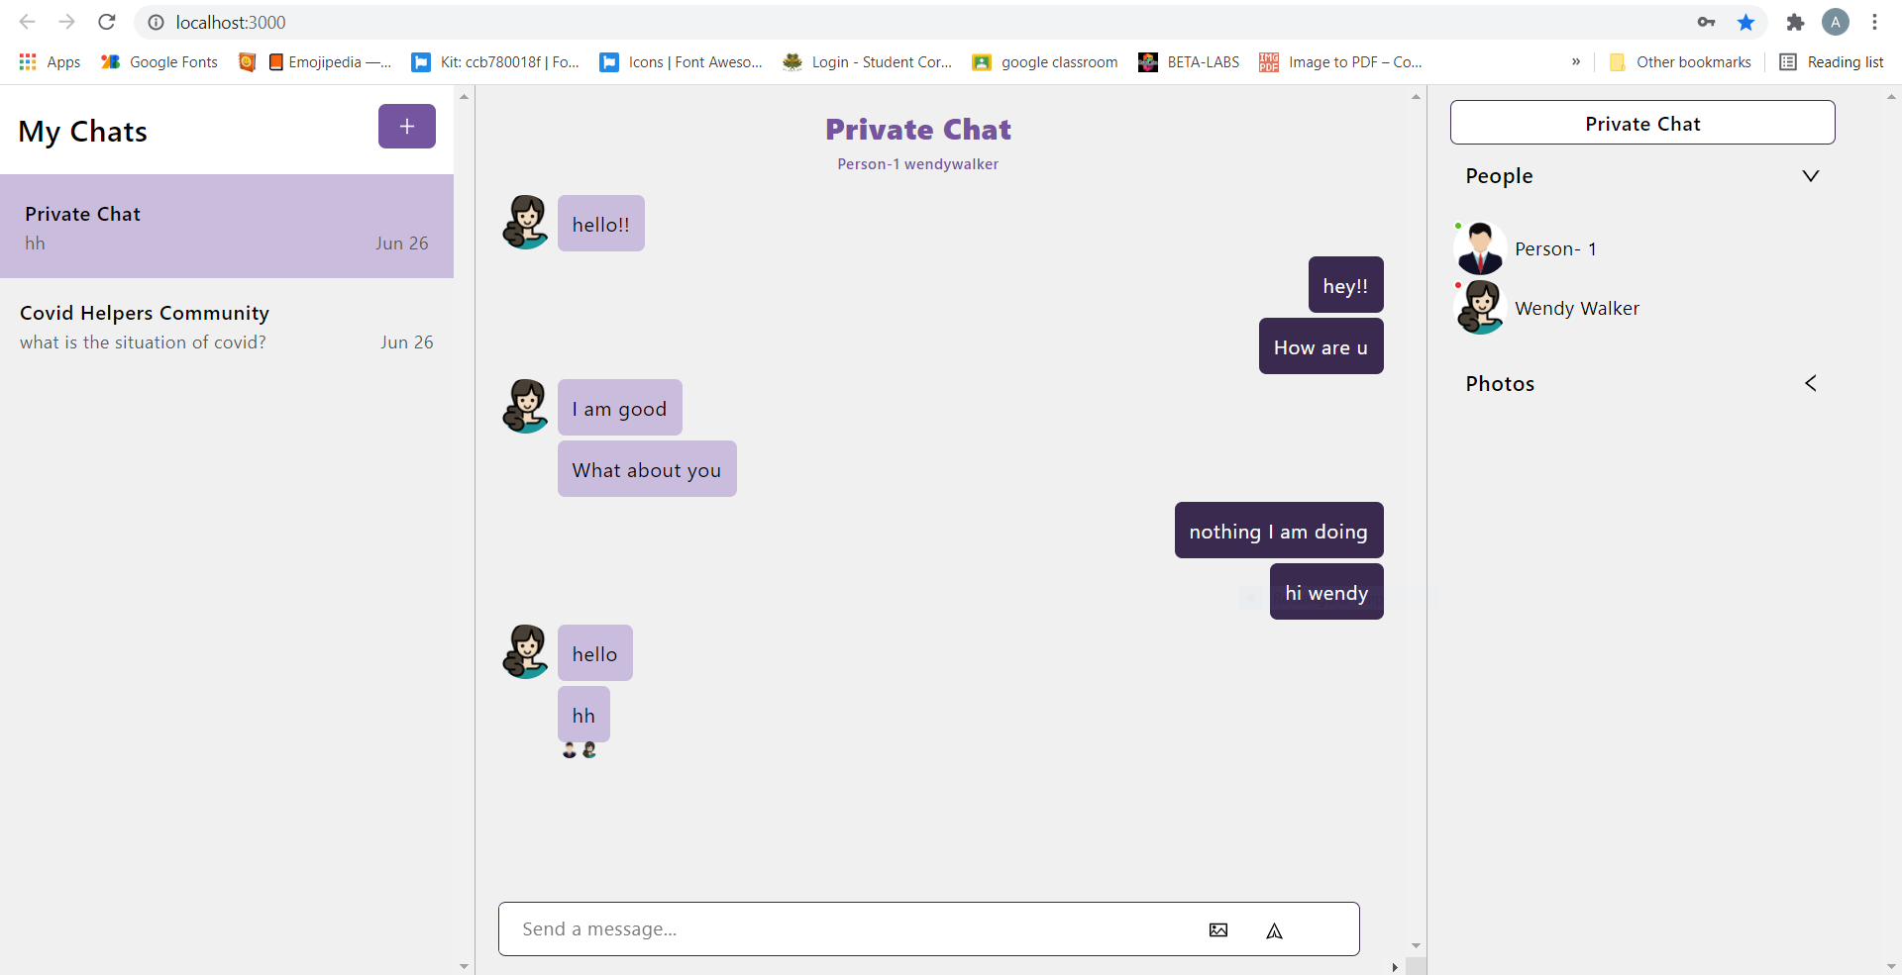
Application Interface

Slide 8
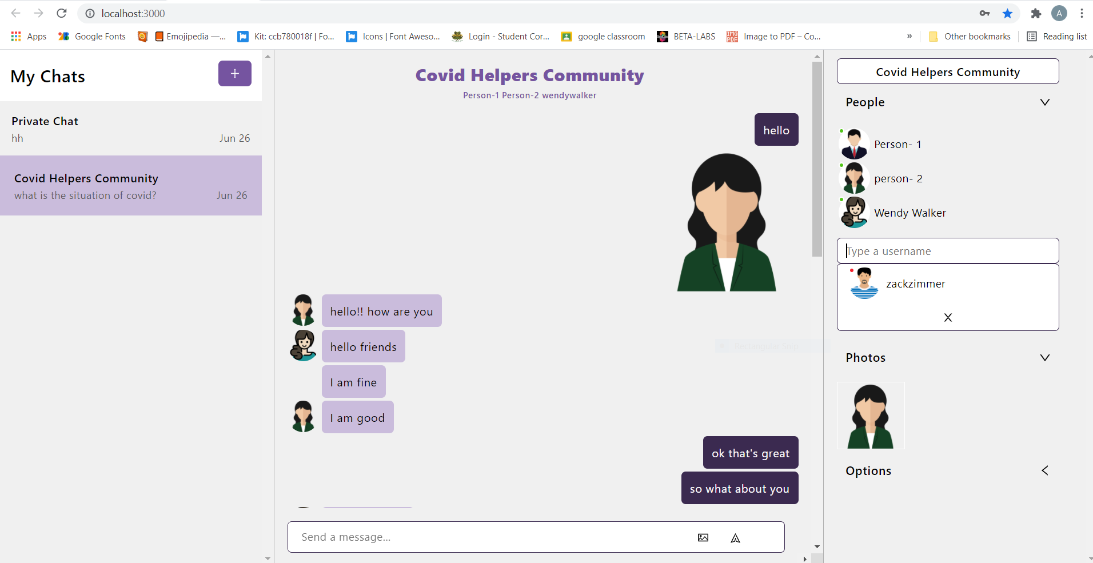
user-1 sends message:

Slide 9
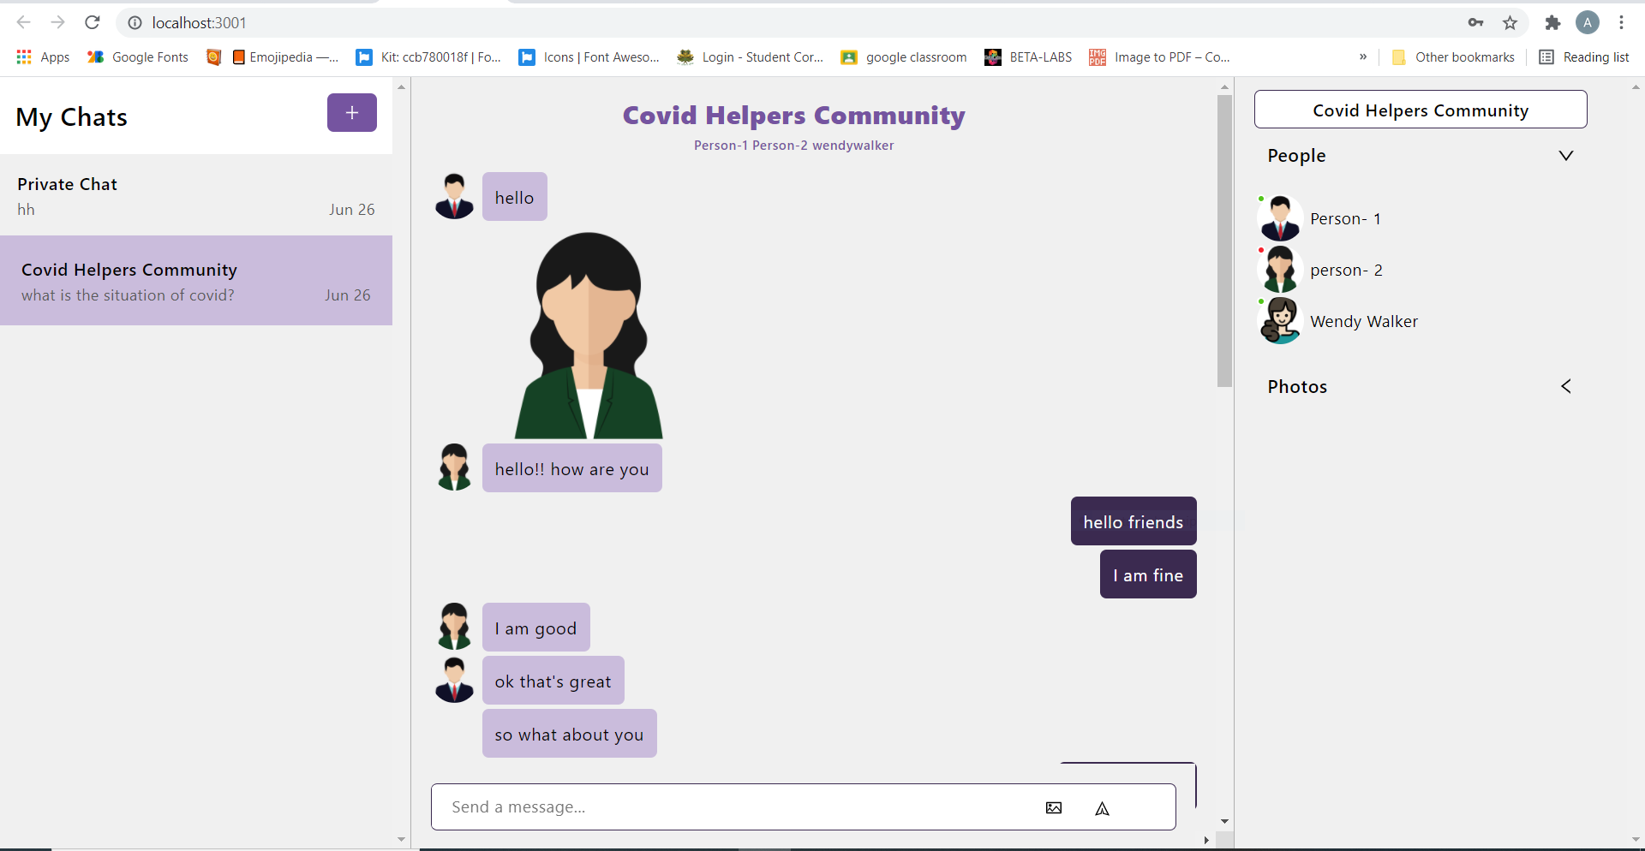

Slide 10
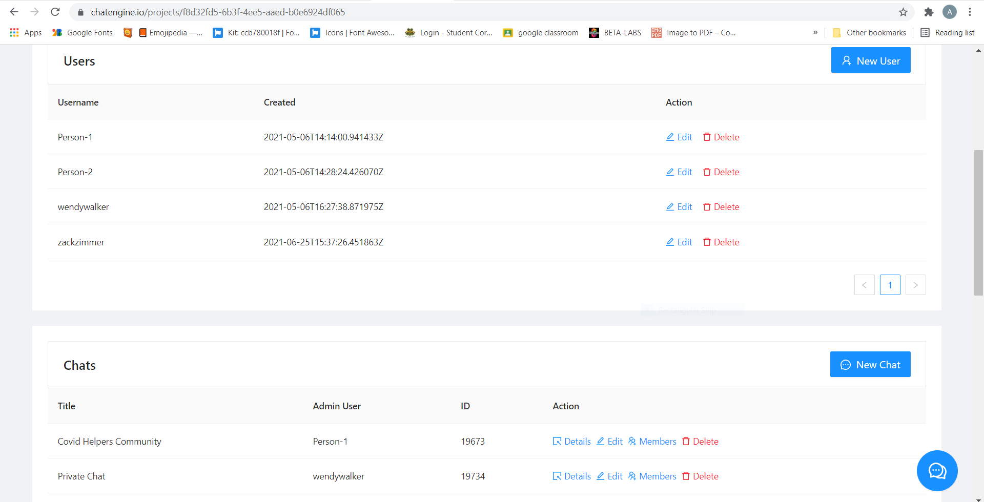
database :

Slide 11
FUTURE SCOPE
Chat Server Application is going to be text communication software, it will be able to communicate between two computers. Companies would like to have communication software wherein they can communicate instantly with their organization. The limitation of this application is it does not support audio conversations, to overcome this limitation we are concurrently working on developing better technologies. The fact that the software uses an internal network setup within the organization makes it very secure from outside attacks.
We are planning to keep managing the project and improving it based on user feedback. In future we may be extended to include features such as-
· We will add some more categories in ourwebsite.
· We’ll try to make it more user friendly than it isnow.
· We’ll try to improve itsquality.
· We’ll work on another feature in our app like Voice Message, Video Message, Audio Call, Video Call, Group Call.

