Slide 1
Full-Stack Project : Web based Quiz System (QuizBox)
Submitted by –
Anshika Gupta (181500106)
Ishika Singh (181500286)
Pallavi Solanki (181500445)
Pari Gupta (181500454)
Under the Guidance of
Mr. Pankaj Kapoor
(Assistant Professor)
Department of Computer Engineering & Applications

Slide 2
INTRODUCTION
QuizBox is a web-based examination system where quiz is taken online i.e. through the internet using computer system.
QuizBox is to take Exams in the form of quizzes in an efficient manner and no time wasting for checking the paper. QuizBox will efficiently evaluate the candidate through a fully automated system that not only saves lot of time but also gives fast results. The system carries out the examination and auto-grading for multiple choice questions which is fed into the system. It manages all the information about Students, Results, Papers.
It can also lead the error free, secure and reliable management system. From this particular organization also keep the information without redundancy. It can be used anywhere and anytime. One can also view the results at the same time after submission of test.Teachers can administer quizzes using it. The system will show one’s score after the examination is finished. Administrative control of the whole system is provided.
It will help in overcoming from the problems occur with manual system. The user with minimum knowledge of computer will also feel ease while using Quizbox.

Slide 3
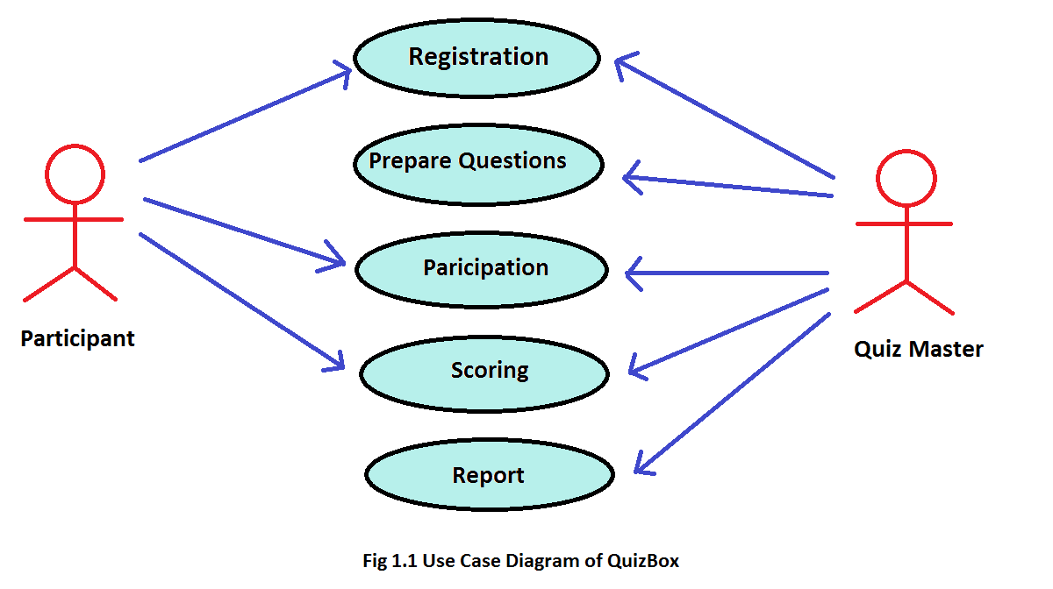
OBJECTIVE
The main objective of the project is to build a website to eliminate the manual work for managing the MCQ quiz. The project should manage the number of students, their details and details of examination, results and marks.

Slide 4
REQUIREMENTS SPECIFICATION
2.1 Hardware Requirements
Processor → Intel Pentium IV(Minimum)
RAM → 2gb(minimum)
Hard Disk → 24gb system Drive
Moniter → Any
2.2 Software Requirements
Operating System → Windows XP/Vista/7/8/10
Front End → HTML, CSS, JavaScript, Bootstrap.
Software → VS Code, XAMPP
Browser → Google Chrome
SERVER → WAMP

Slide 5
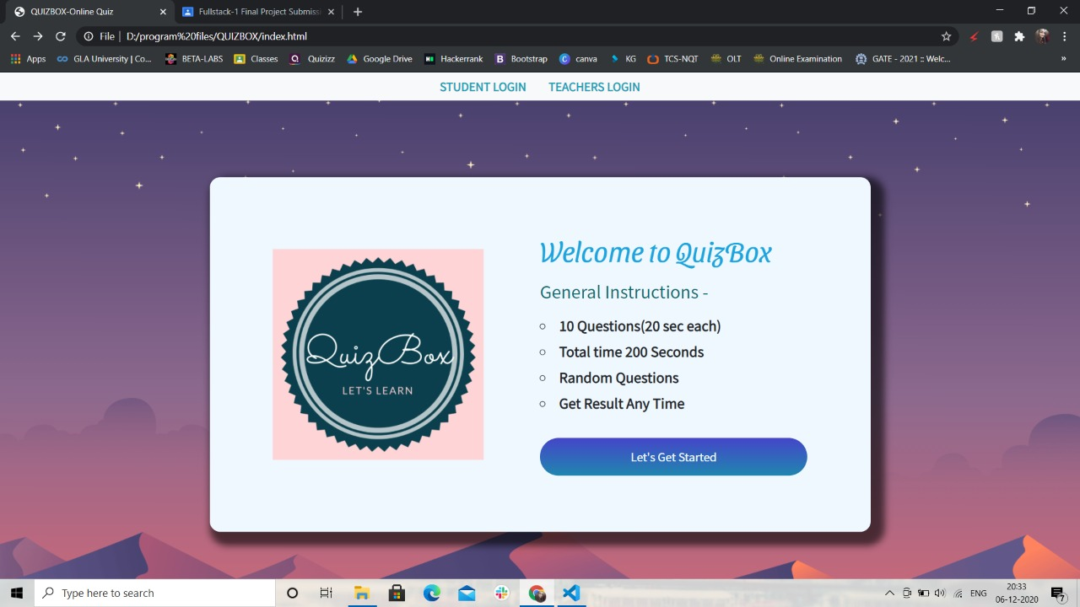
PROJECT DESIGN
INDEX PAGE

Slide 6
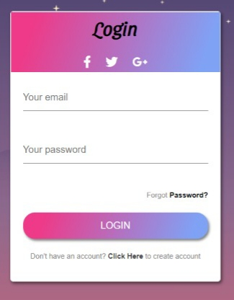
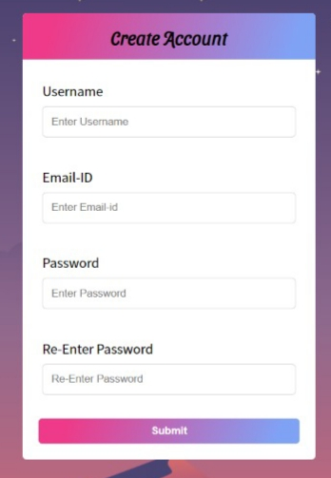
LOGIN AND SIGN-UP PAGE

Slide 7
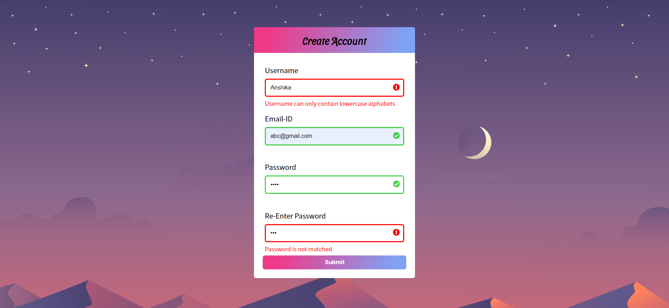
VALIDATION OF FORM

Slide 8
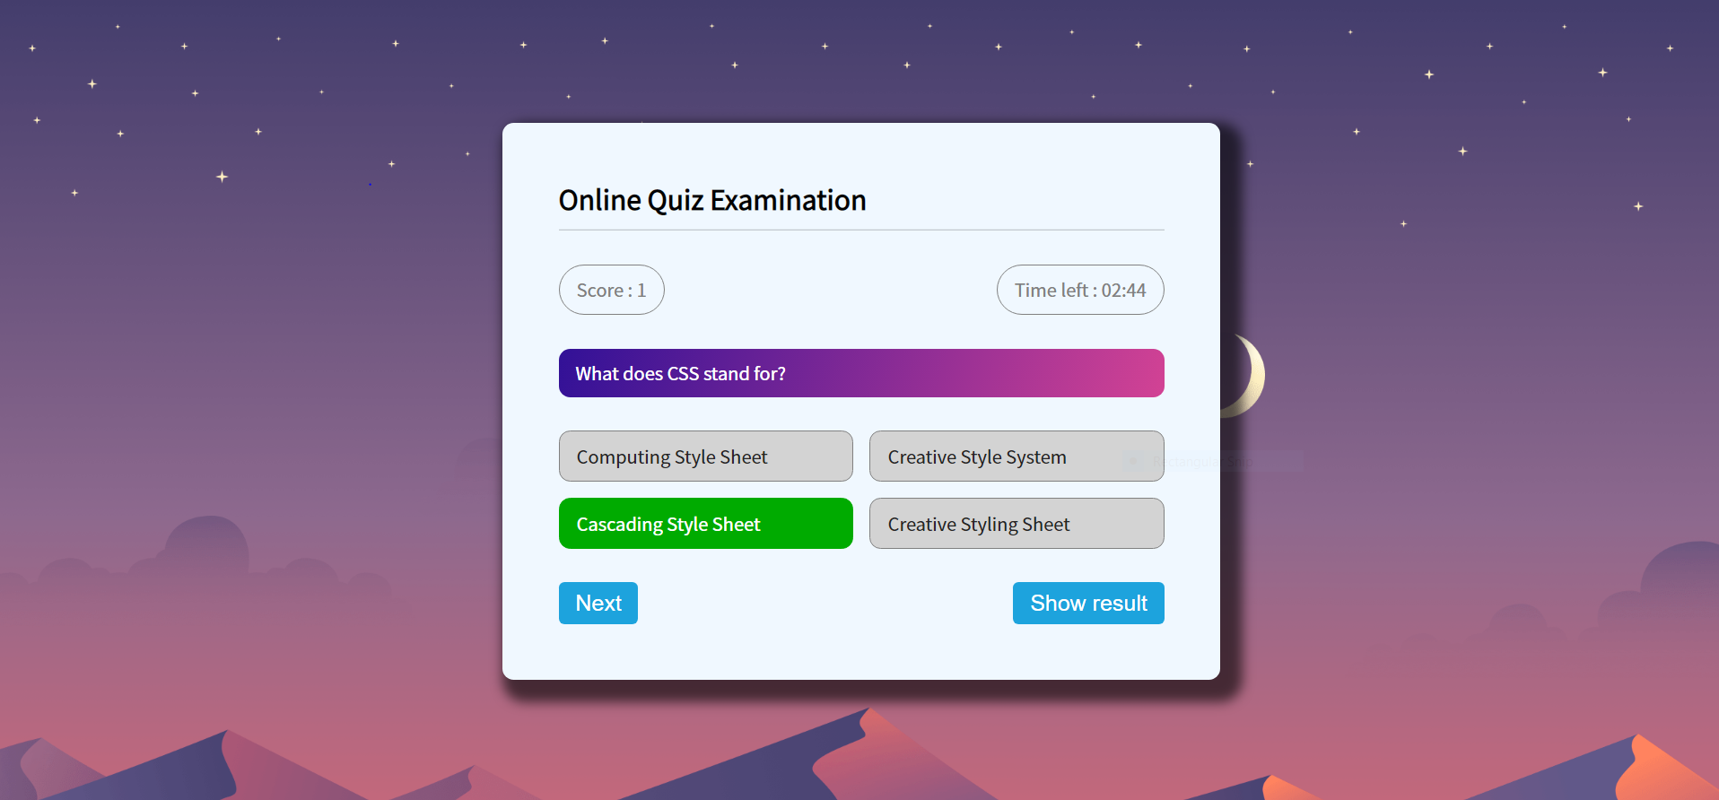
Quiz Page
1. When user will choose correct option.

Slide 9
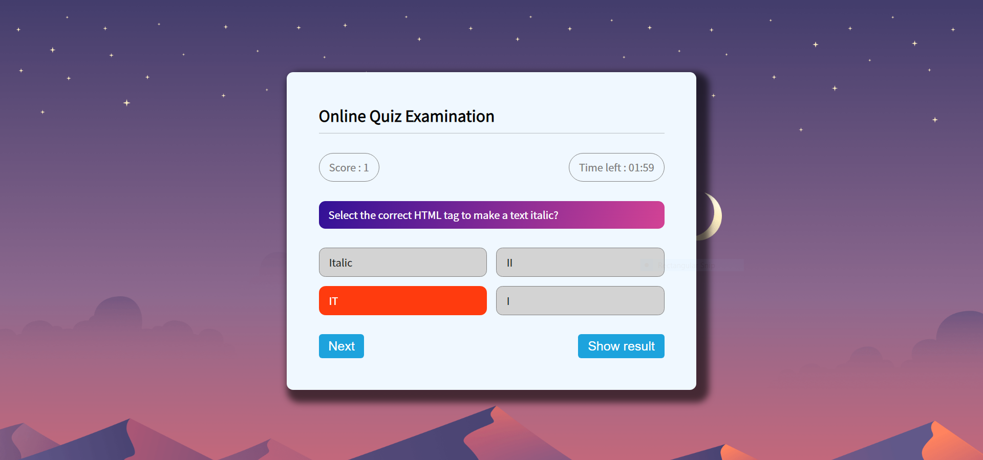
2. When user will choose wrong option.

Slide 10
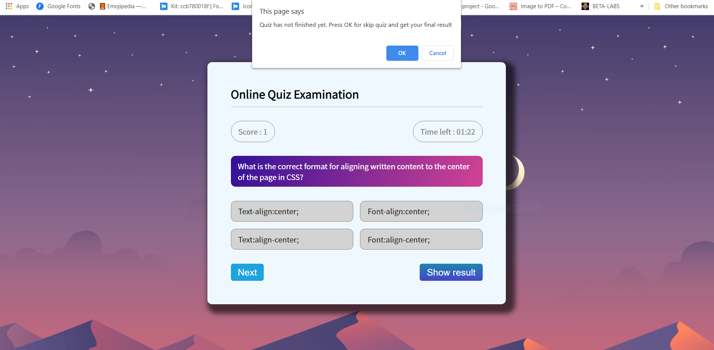
Notification on quiz screen :

Slide 11
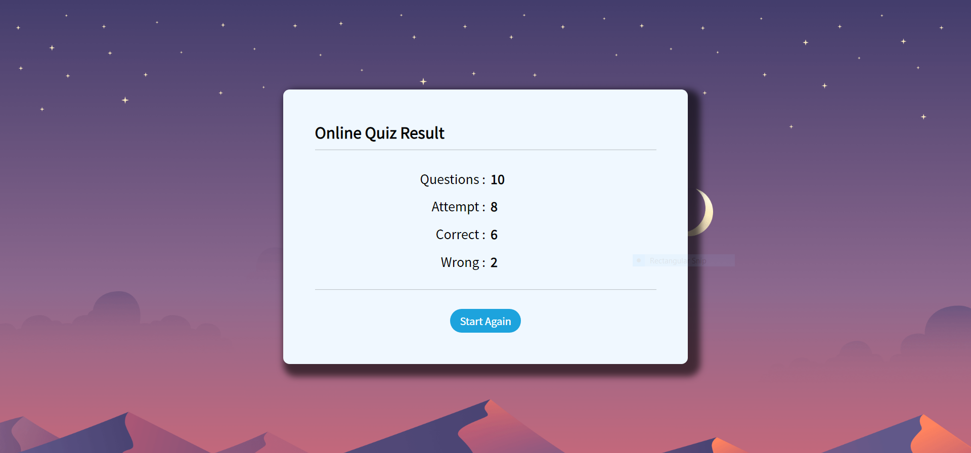
RESULT SCREEN

Slide 12
IMPLEMENTATION DETAILS
To design and implement this project we plan that the project support to different types of users apart from its administrative part. When project is run for the first time it allowed the user to select as who he/she wants to login in the system. Project support login as teacher and login as student. If a user who is student, try to login as teacher system will not allow him and vice versa. User who add as teacher in system will be able to conduct test and questions to system and also will be able to observe the result of the student which attempt tests. User who login to system as student will be able to select a particular test and attempt questions depend on this test. After attempting the test and submitting that user will receive a message that you have attempt the test successfully and if the user tries to attempt the same test, system will not allow him/her. Also a user which login to system as student will be able to observe the result of test he/she attempt.

Slide 13
LIMITATIONS
1. Cheating: This website will allow user to change the page during the quiz and also due to objective questions only, cheating can be done easily.
2. Weak Internet Connectivity: Online examination system depends on the internet connection. Once as student starts a Quiz, it cannot be paused when allotted time runs out due to weak internet connection issue, quiz will no longer be accessible to student. Hence, high or average internet connection is required for a successful submission of quiz.
3. Editing: Once a student has taken a Quiz, you can no longer edit that quiz.
4. Software: If software/operating system fail student will not be able to give the exam and progress of examination data might be deleted if the system off abruptly.
5. Server Crash: This is also a serious problem at online platform.

Slide 14
CONCLUSION
The Quizbox is successfully designed and is tested for accuracy and quality. The key concept is to minimize the amount of paper work and convert all forms of documentation in digital form. The user with minimum knowledge of computer will also feel ease while using Quizbox. It will also provide an ease in retrieving information. It will also be a less time consuming platform for students and teachers as well. It will immediately produce your result and reflect it on your progress tracker.
Thus, the proposed website can be easily adopted by universities and institutions in order to make the quiz based exam more secure and more flexible.

