Slide 1
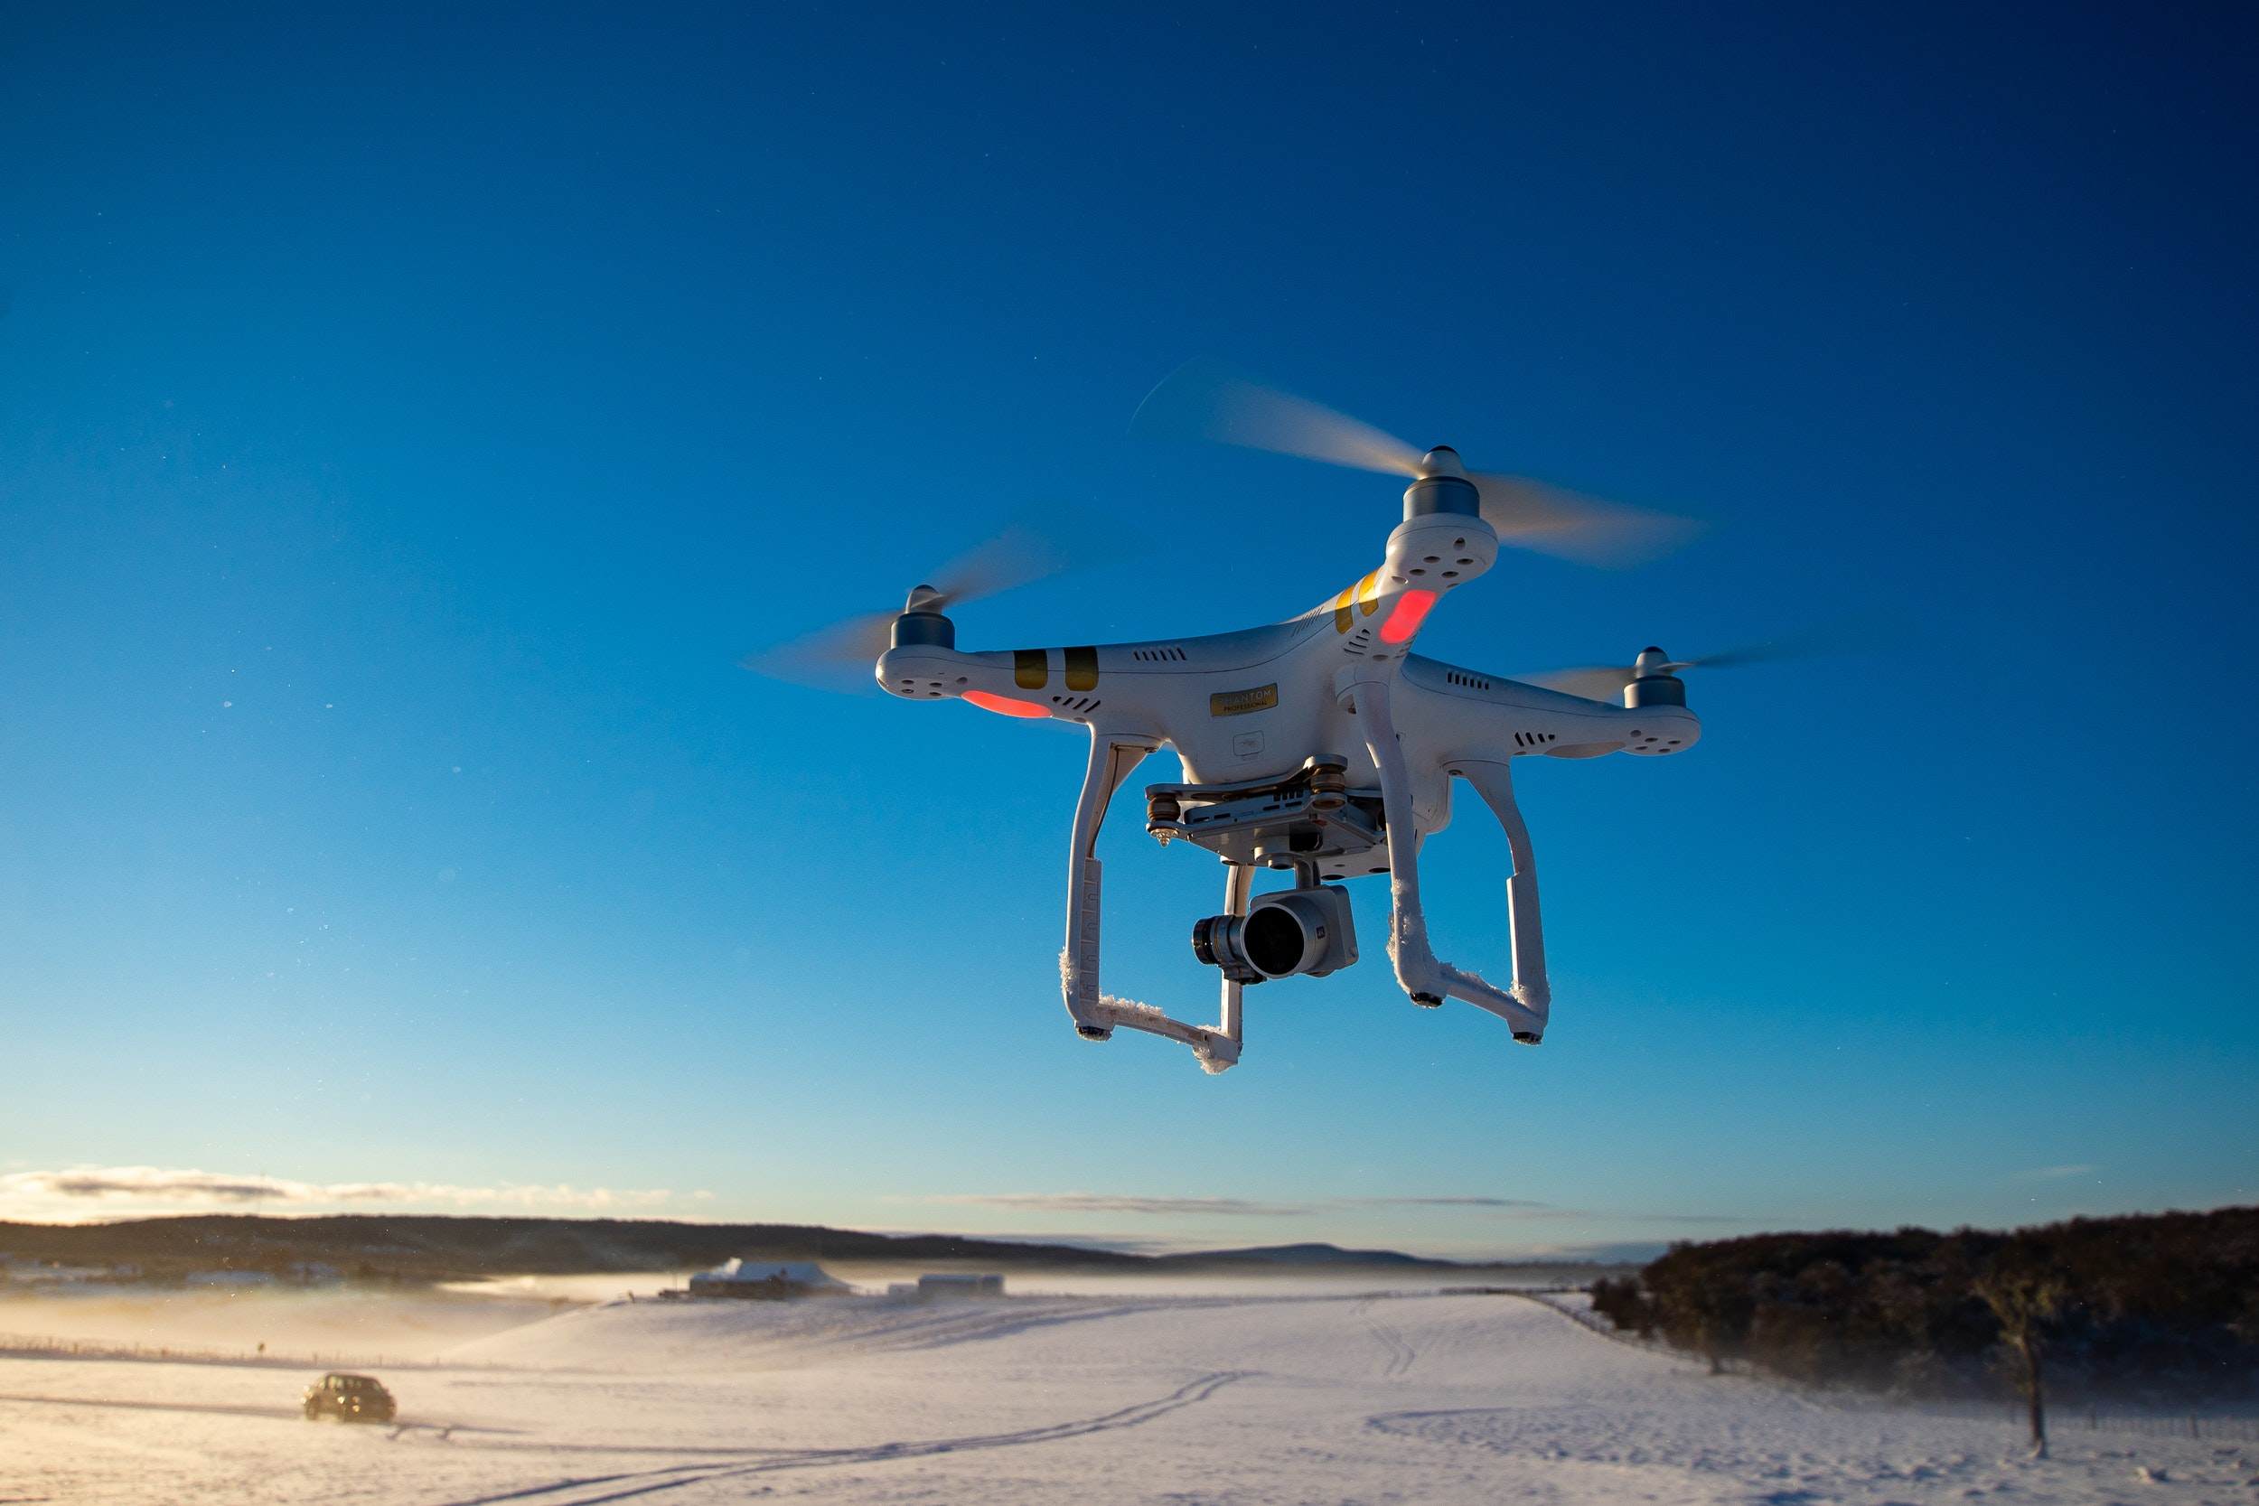
Presentation
Presented by-
Anshika Singh
Shreya Anand
Anjali Rawat

Slide 2
DRONE TECHNOLOGY
Dynamic Remotely Opertated Navigation Equipment
Introduction-
Drone photography allows images and audio ,video to be capture that might not be otherwise possible for human photographers and videographers.That capacity can be enabled by the flight abilities of drones their small size or there ability to tolerate haras environment.Drone photography often enables a first person view (FPV) that would normally be impossible to achieve.

Slide 3
Types of Drones
GPS Drones –
This drones are linked to satellite via GPS .
Helicopter Drones-
This modles uses a single rotor to stay up in tne air.It resembles a remote control helicopter that can stay in tnhe air for a long time.
Delivery Drones
A delivery drones have an anchor or basket attached to their body where the package can be affixed the and transported by the drone.
Photography Drones-
These drones have a camera /video camera attanced to their body and are specially built to withstand the damage drone by harsh weather to the cameras.

Slide 4
ADVANTAGE OF DRONES TECHNOLOGY
Agriculture
Crop monitoring
Accurate Data
Cost Saving
Data analysis with agriculture drones
Dam surveying
Search and rescue

Slide 5
Disadvantage of Drones Technology
Privacy
Flight time
Weather
Cost
Hacking
Noise

Slide 6
Thank you

