Slide 1


PREDICTING
EMPLOYEE ATTRITION
Presented By: Anshika Chauhan

Slide 2

Employee Attrition Prediction: Managing Human Resources Effectively
Accurately predicting employee attrition is crucial for organizations to proactively address retention challenges and maintain a productive workforce. This analysis aims to uncover key factors contributing to employee turnover, develop a predictive model, and provide actionable recommendations to enhance employee engagement and organizational success.

Slide 3
Understanding the Data
The dataset includes variables such as age, gender, education, job tenure, performance ratings, work-life balance, and more, which will be analyzed to uncover patterns and drivers of employee attrition.
The data will be preprocessed, with missing values handled, categorical variables encoded, and feature selection performed to ensure the model is trained on the most relevant information.
Dataset Overview
Key Features
Preparing the data
The “WA_Fn_UseC_-HR-Employee_Attrition” dataset provides comprehensive information on employee demographics, job roles, satisfaction levels, and attrition status

Slide 4
Exploring the Data
1
Distribution Analysis
2
Correlation Insights
Visualizing the distribution of key variables, such as age, tenure, and satisfaction levels, will provide insights into the characteristics of employees who tend to leave the organization
Analyzing the correlation between features and attrition status will help identify the most influential factors contributing to employee turnover.
3
Uncovering Trends
Exploring patterns and relationships within the data will reveal valuable insights that can inform the development of the predictive model and retention strategies.

Slide 5
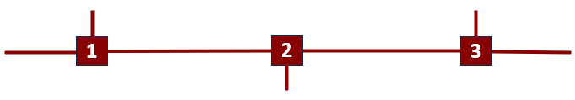
Building the Prediction Model
Model Selection
Model Evaluation
A Random Forest classifier will be employed to predict employee attrition, leveraging its ability to capture complex relationships and handle both numerical and categorical variables.
The model's accuracy, precision, recall, and F1-score will be assessed to ensure its reliability in predicting employee attrition.
The model will be trained on the preprocessed data, with a focus on optimizing its performance through feature engineering and hyperparameter tuning.
Model Training

Slide 6
Fine-Tuning for Better Results
Randomized Search
Randomized SearchCV will be used to efficiently explore a wide range of hyperparameter combinations and identify the optimal settings for the Random Forest model.
Grid Search
Grid SearchCV will be employed to systematically evaluate a defined set of hyperparameter values, further refining the model's performance.
Improved Accuracy
The hyperparameter tuning process will enhance the model's predictive capabilities, enabling more accurate identification of employees at risk of attrition.

Slide 7
Key Insights and Actionable Recommendations
1
2
3
Attrition Factors
The analysis will reveal the key factors that influence employee attrition, such as job satisfaction, work-life balance, and career advancement opportunities.
Retention Strategies
Based on the insights gained, recommendations will be provided to address the identified drivers of attrition and enhance employee engagement and retention.
Organizational Impact
Implementing these recommendations can lead to improved employee satisfaction, reduced turnover, and increased organizational productivity and profitability.

Slide 8



Concluding Remarks
Summary
Organizational Impact
Future Opportunities
This analysis has demonstrated the power of data-driven insights to address the critical issue of employee attrition and support organizational success.
Effectively managing employee turnover can lead to improved productivity, reduced costs, and a more engaged and committed workforce.
Ongoing refinement and expansion of the predictive model can further enhance its accuracy and provide even more valuable insights.
.

Slide 9
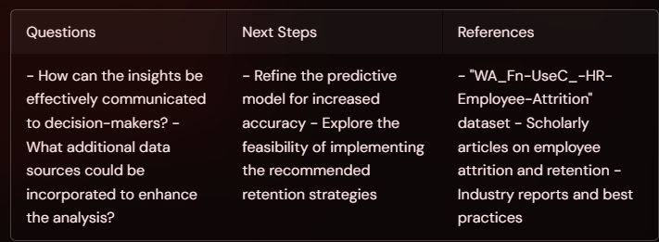
Let’s Discuss

