Slide 1
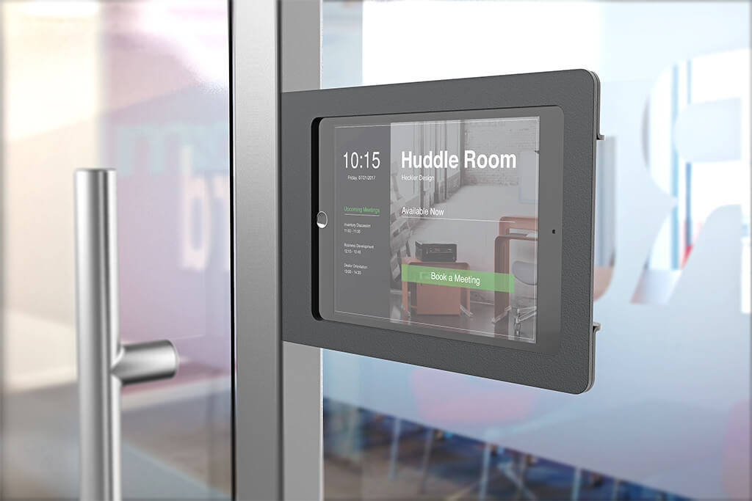
Meeting Room Booking System

Slide 2
Introduction
- Welcome to the Meeting Room Booking System presentation.
- The Meeting Room Booking System is designed to simplify and streamline the process of reserving meeting rooms.
- Our team has worked diligently to create a user-friendly and efficient platform for managing meetings effectively.

Slide 3
Project Overview
- The Meeting Room Booking System aims to improve the way organizations manage their meeting spaces.
- Objective: To provide a convenient and reliable solution for booking and scheduling meeting rooms.
- Key Features: Meeting room availability, booking process, editing facility for managers, with proper validation.

Slide 4
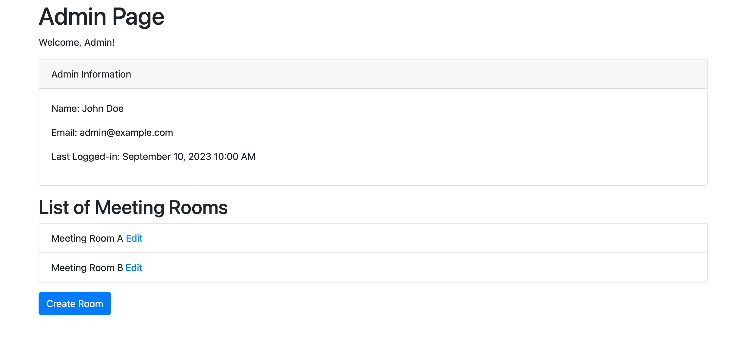
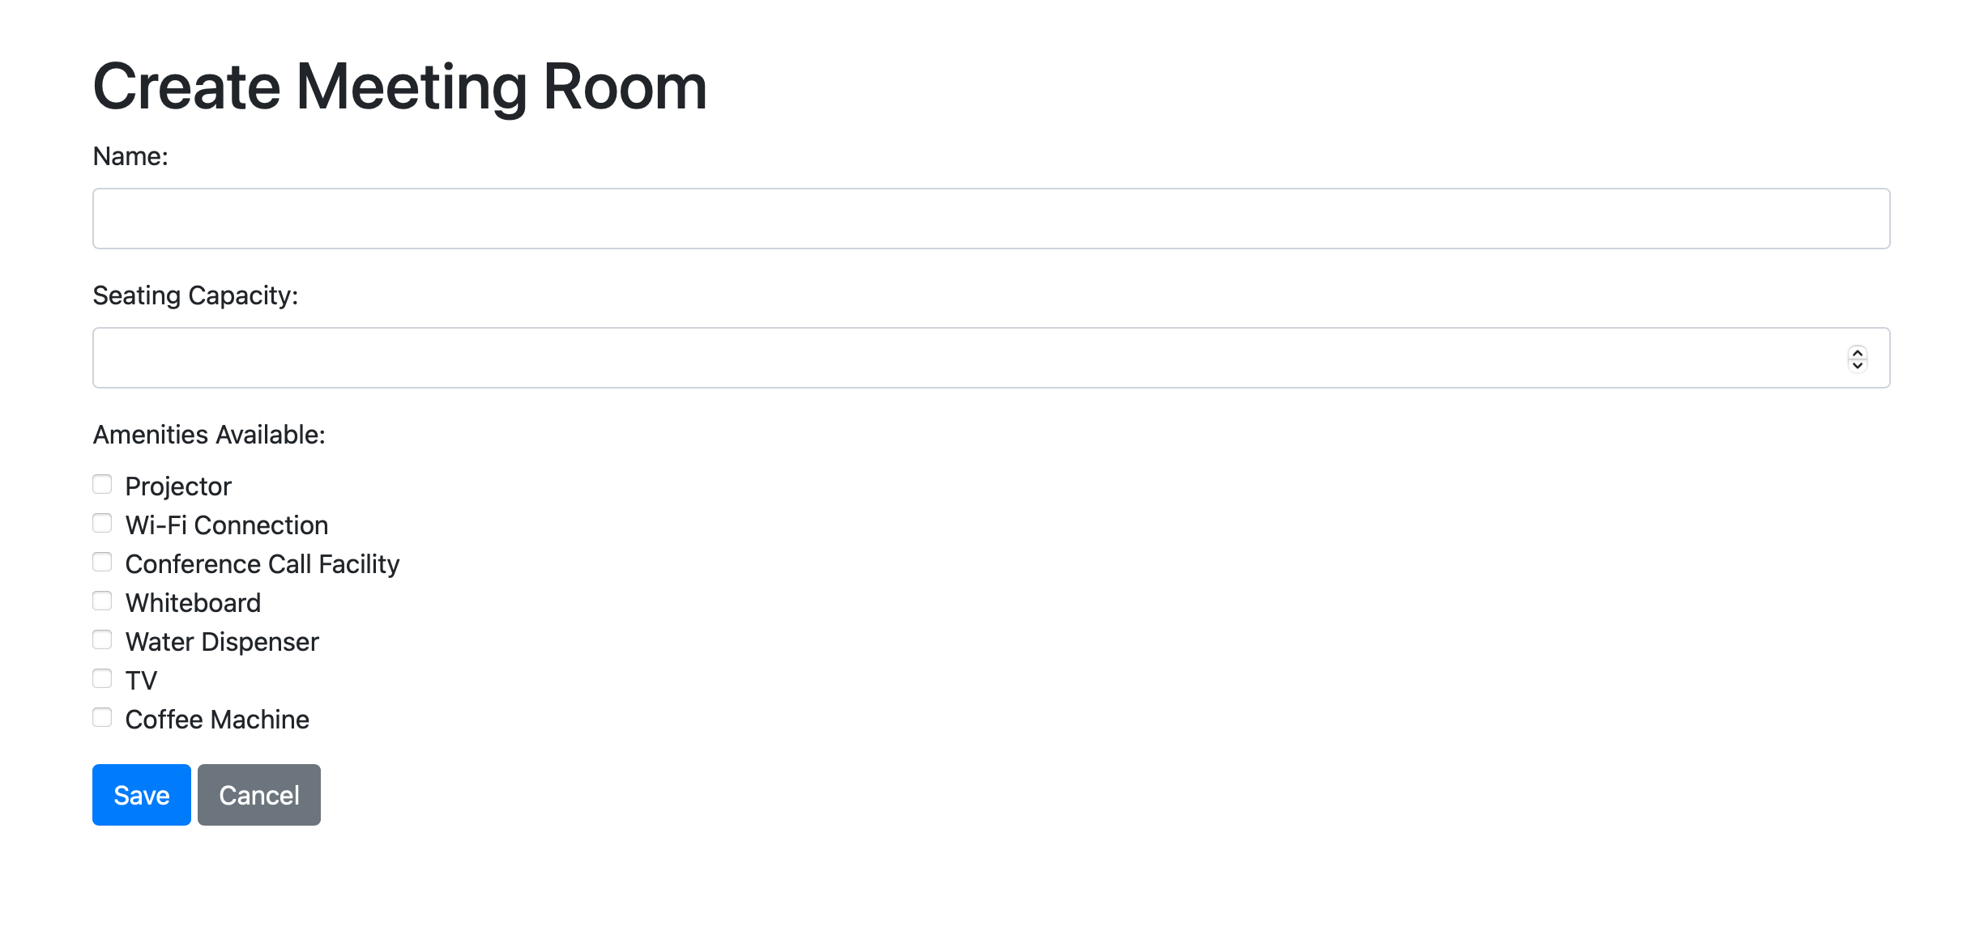
User Interface

Slide 5
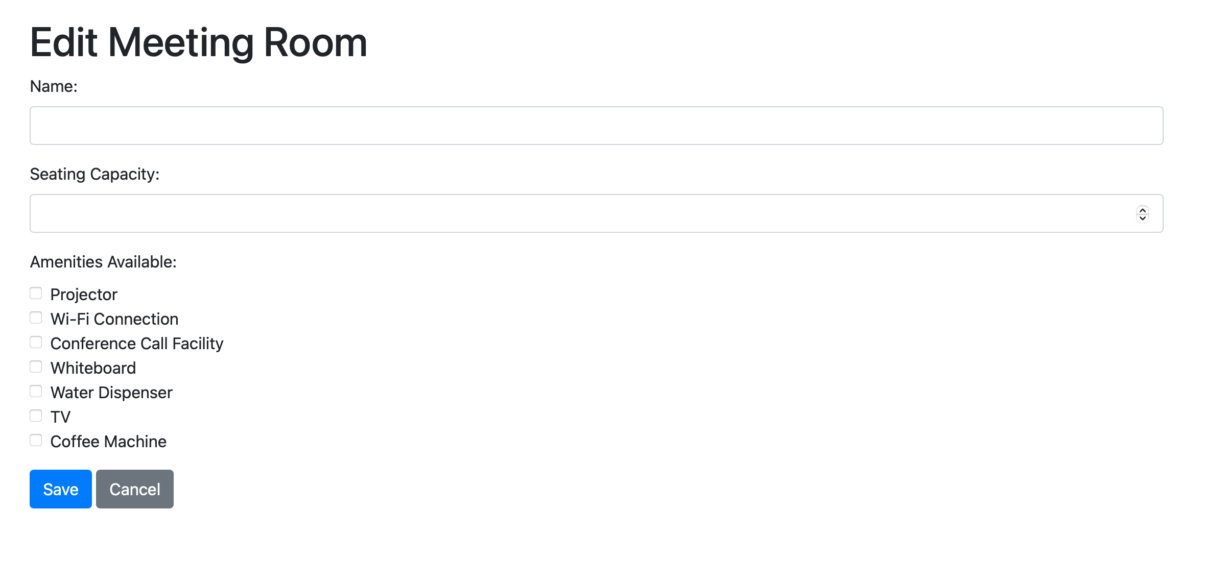
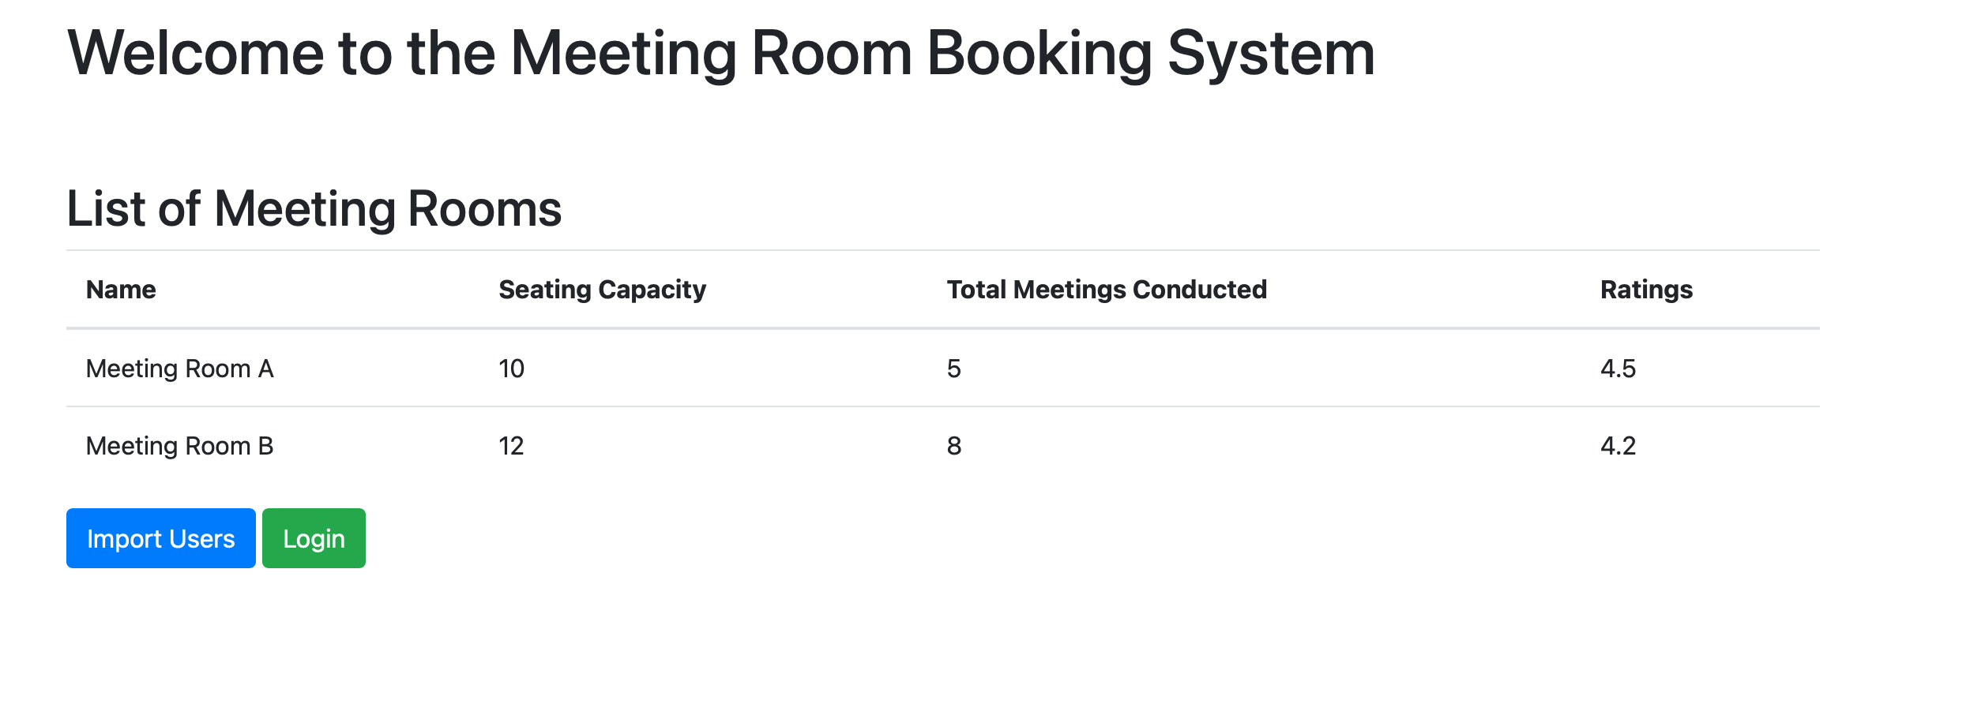

Slide 6
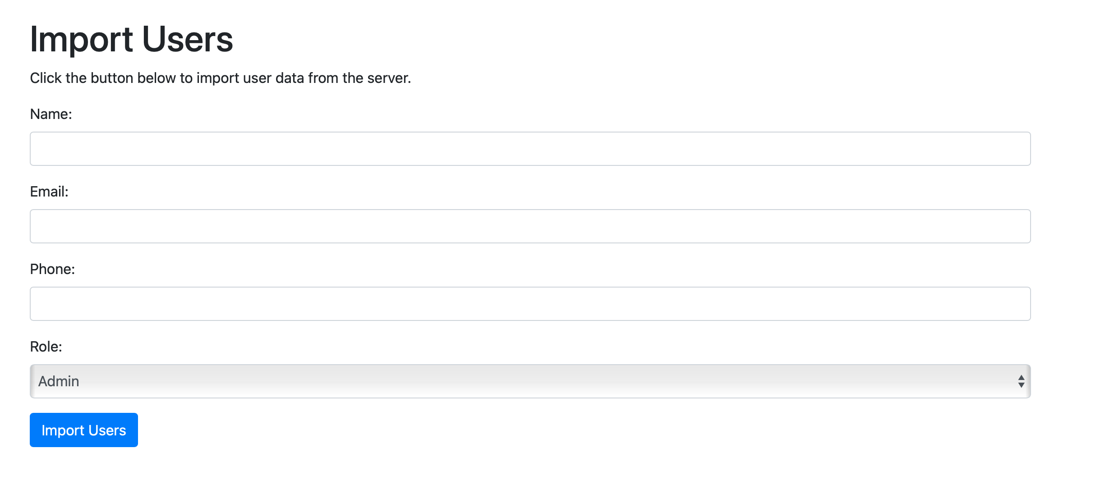
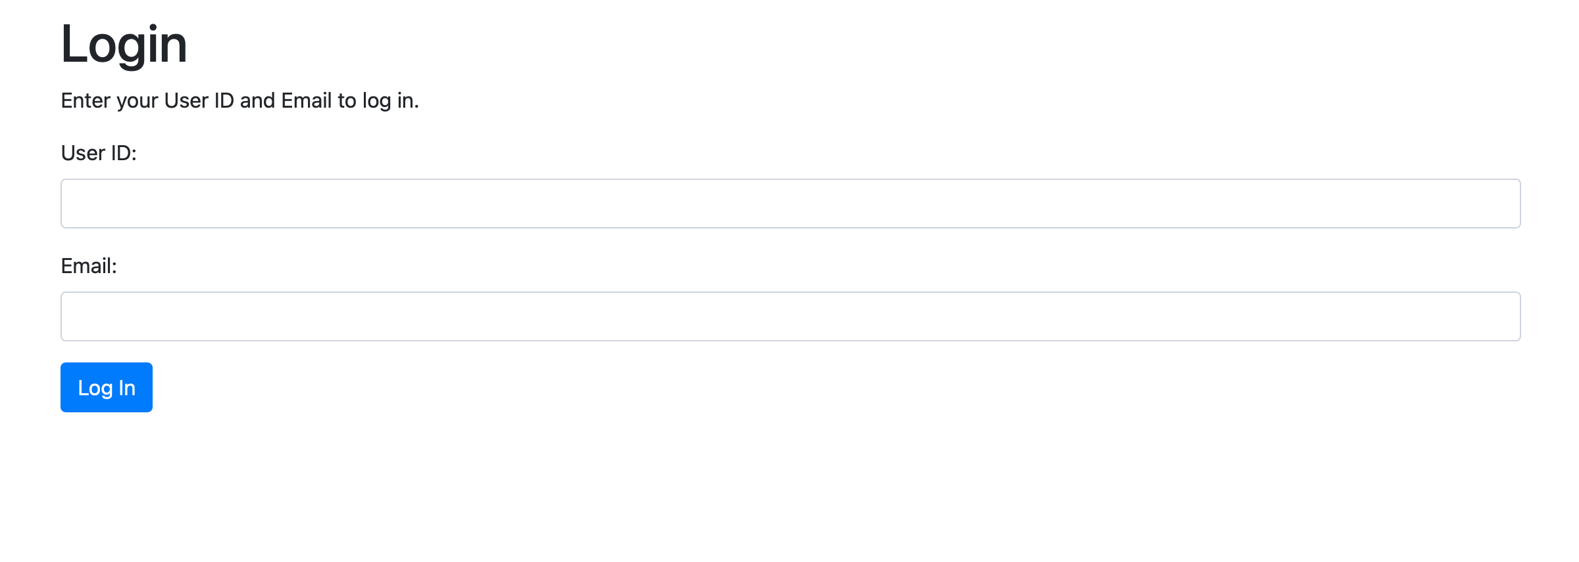

Slide 7
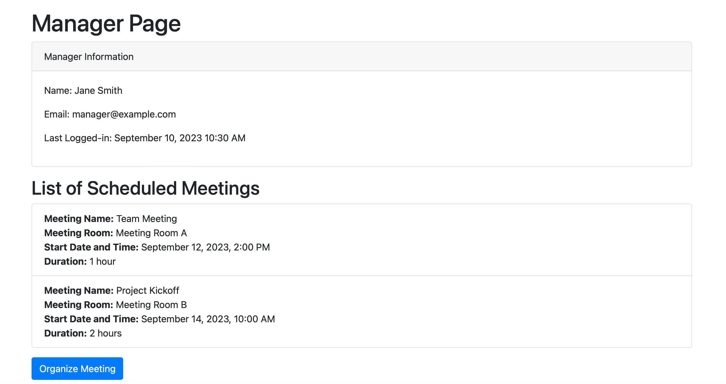
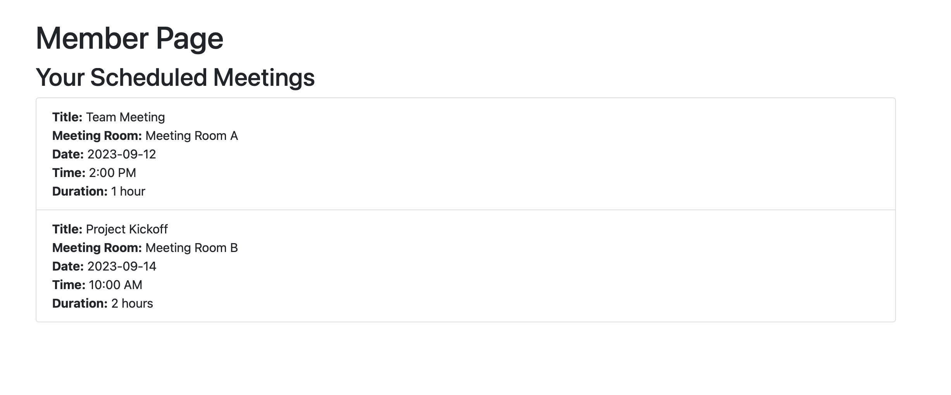

Slide 8
Architecture
- The system is built on a three-tier architecture: Frontend, Backend, and Database.
- Frontend: The user interacts with the web-based interface.
- Backend: Manages business logic and communication with the database.
- Database: Stores user data, meeting room details, and booking information.

Slide 9
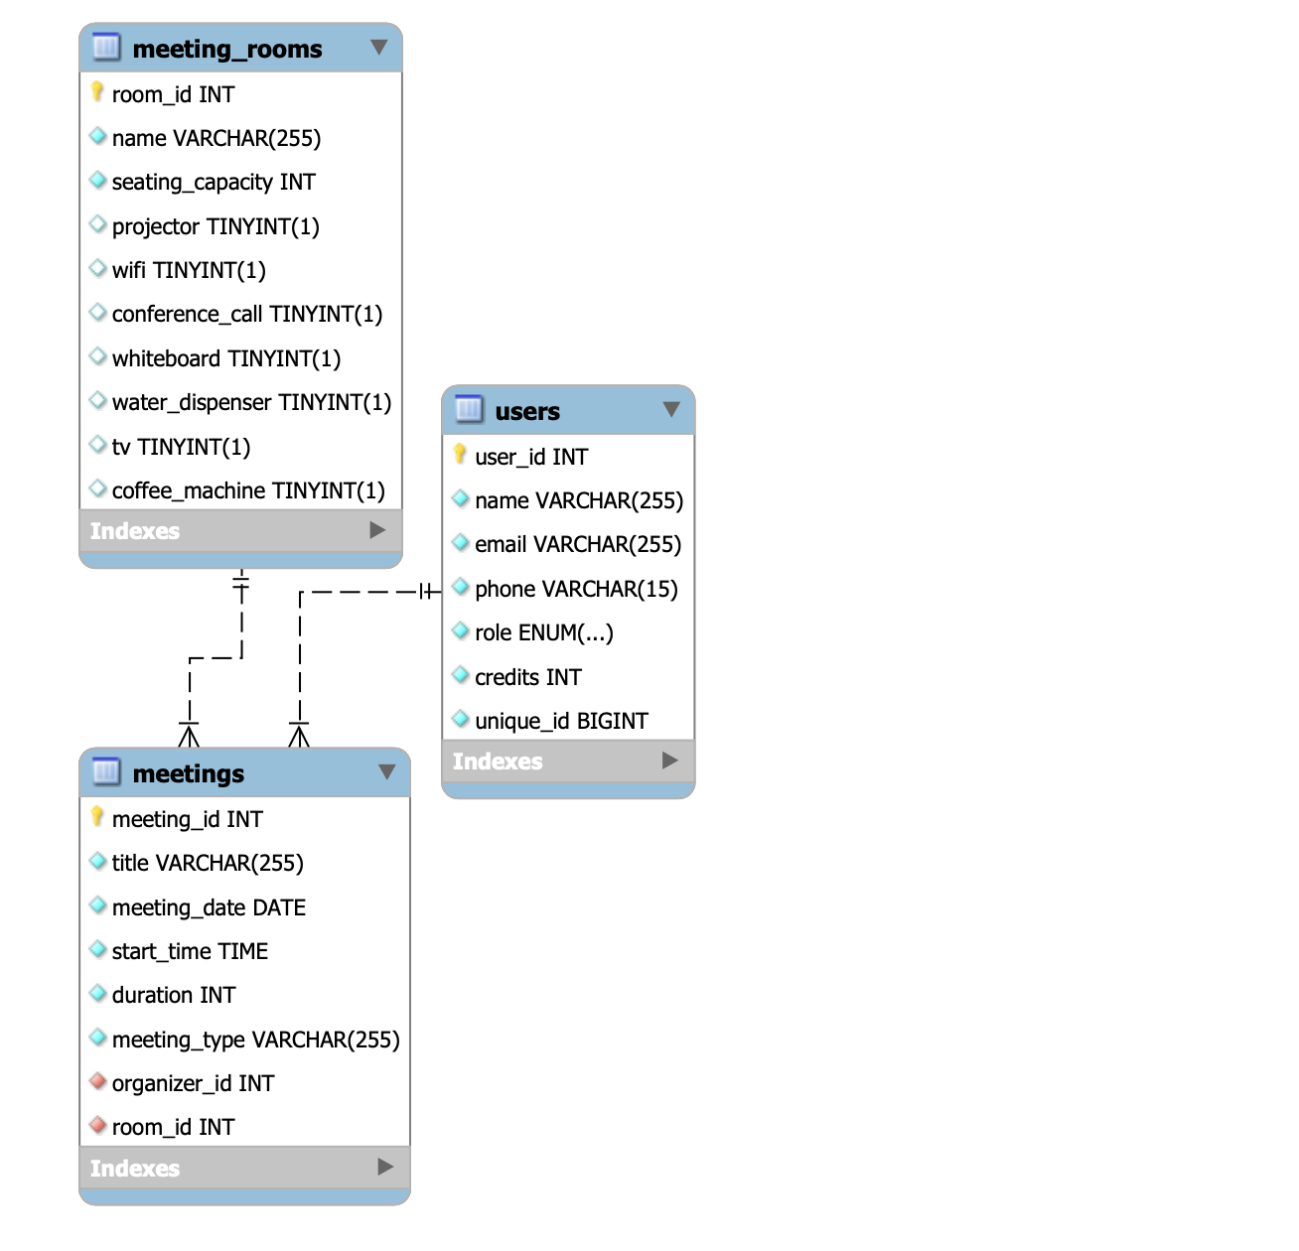
Database Schema

Slide 10
Main Features
- Meeting Room Availability:
- Real-time availability checks based on date, time, and duration.
- Booking Process:
- Seamless booking process for users.
- Credits Deduction:
- Managers can book using credits, deducted based on usage.
- Amenity Validation:
- Ensures selected amenities match the meeting type.

Slide 11
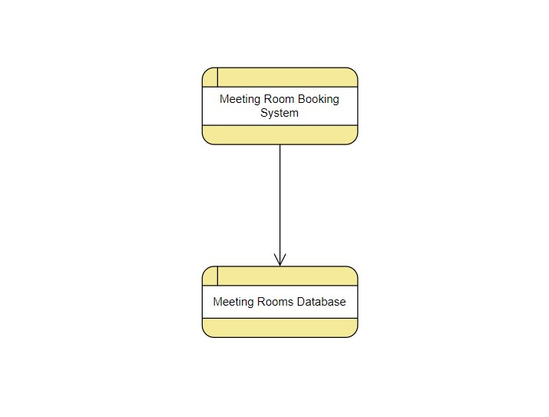
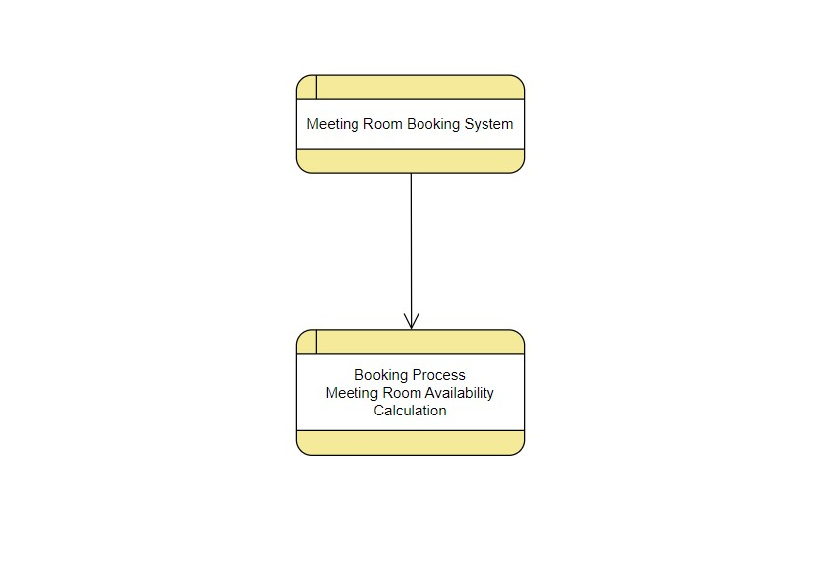
Data Flow Diagrams (DFD)

Slide 12
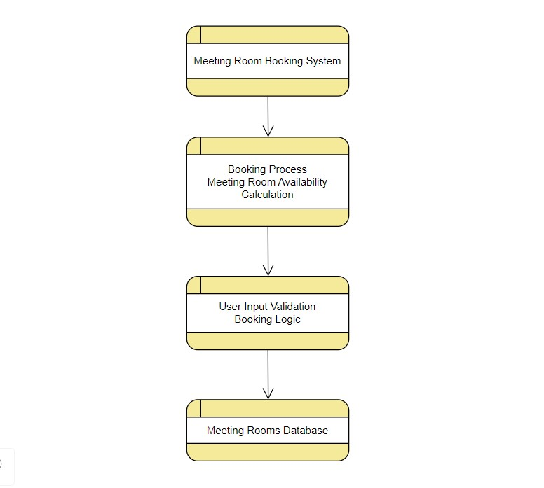
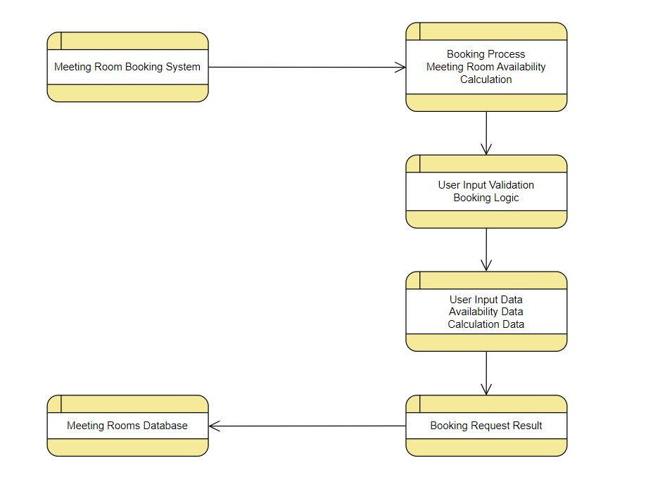

Slide 13
Challenges Faced
Technology Adaptation: Integrating new technology into the workflow can be challenging, especially if team members are not familiar with the tools or software. It may require additional time for training and troubleshooting technical issues.
Diverse Skill Sets: With 7 members, the team is likely to have diverse skill sets and expertise. Coordinating and ensuring everyone is on the same page regarding the technology and project goals can be challenging.
Communication: Effective communication is crucial in a group project. Miscommunication can lead to confusion, delays, and misunderstandings, especially when dealing with new technology.
Workload Balancing: Team members may have other work or personal commitments, making it difficult to allocate enough time to the group project. Balancing these commitments while meeting project deadlines can be a significant challenge.
Project Scope Management: Managing the project scope and ensuring that everyone is aligned on project objectives and deliverables can be challenging. Without clear scope definition, the project may become too complex or diverge from its original goals.
Conflict Resolution: With a larger team, conflicts and disagreements are more likely to arise. Managing these conflicts in a constructive way is essential to keep the project on track.

Slide 14
Conclusion
In conclusion, our automated system for booking rooms has many advantages, such as improved customer experience, meeting room availability, time saving, and the capacity for data-driven decision making. For businesses wishing to streamline their meeting room reservation procedures and raise overall office efficiency,
it is a useful tool.

Slide 15
Thank You
Team members
Ekamjot Singh
Saatvik Goel
Srishti Sharma
Jivesha Kalra
Navroop
Anshika Saxena
Shrey Sharma

