Slide 1
Topic
Presentation on Full Stack Project
Appointment Booking System
by
G-4
Anshika : 2310990288
Anshul : 2310990289
Anubhav : 2310990290 Suhani : 2310991059
Supervised by: Rahul Sir
Department of Computer Science and Engineering, Chitkara University, Punjab

Slide 2
Table of Contents
Problem Statement
Objective / Purpose
Main Topics / Sections (Depends on your topic)
Future Scope
Conclusion
References (if applicable)
Q&A / Discussion

Slide 3
Problem Statement
In today’s growing corporate environment, managing appointments, projects, and client–staff communication can be highly complex and time-consuming. Manual scheduling often leads to errors, delays, and mismanagement. Our Company Appointment System simplifies this by providing a centralized digital platform where: Super Admin (owner) can create projects and manage overall operations .Admin can add staff and clients to projects. Clients receive login credentials through mail and can book appointments easily. Clients can raise queries and request meetings, while staff and owner can respond directly .This ensures streamlined communication, effective scheduling, and improved efficiency in project and client management.

Slide 4
Objective / Purpose
Efficient Scheduling: Allow clients to book appointments seamlessly with staff or owners.
Centralized Management: Super Admin and Admin can add/manage staff, clients, and projects.
Transparency in Communication: Clients can raise questions or meeting requests, which both staff and owners can address.
Ease of Access: Clients and staff receive credentials via email to log in securely.
Goal: To build a robust, user-friendly system that simplifies company operations, saves time, and ensures professional client engagement.

Slide 5
Main Topics / Sections
1.User-Centric Design
Responsive Interface: Built with React to ensure smooth booking and management experience across devices.
Simple Navigation: Intuitive dashboards for Super Admin, Admin, Staff, and Clients.
2. Efficient Backend Architecture
Built with Node.js and Express.js to handle real-time appointment bookings and queries.
Secure authentication system for login and role-based access.
3. Secure and Scalable Database
MongoDB used for storing staff, client, project, and appointment details securely.
Data integrity maintained with proper schema design.

Slide 6
Main Topics / Sections
4.Advanced Features Implementation
Appointment Booking: Clients can schedule meetings directly with staff.
Query Management: Clients can raise queries, answered by staff or owner.
Email Integration: Automatic email notifications with login credentials and appointment confirmations.
5.Admin Controls
Admin: Manage staff & client onboarding, assign to projects, resolve issues.
6. Integration with Calendars
  Google/Outlook calendar sync for seamless meeting scheduling.

Slide 7
Future Scope
Automated Notifications
  SMS/Email reminders for upcoming appointments and project updates.
Analytics Dashboard
  Insights into client activity, staff performance, and project timelines.
AI-Powered Assistance
  Smart appointment suggestions based on staff availability.
  Auto-responses to frequently asked client queries.

Slide 8
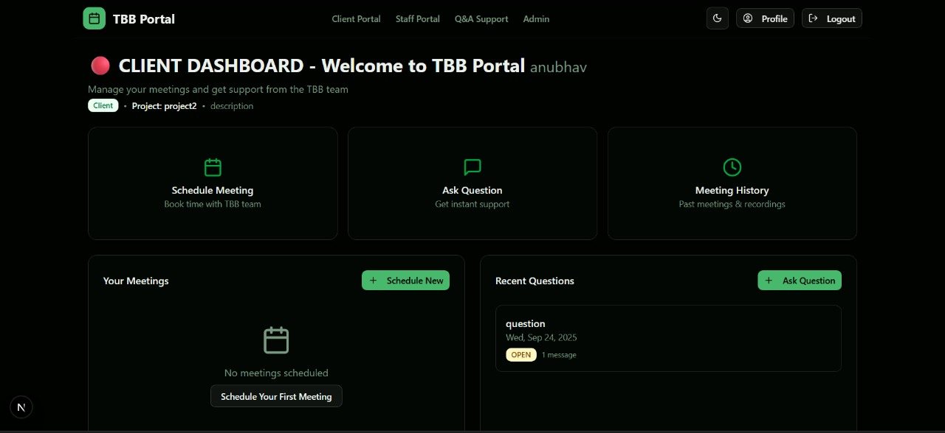
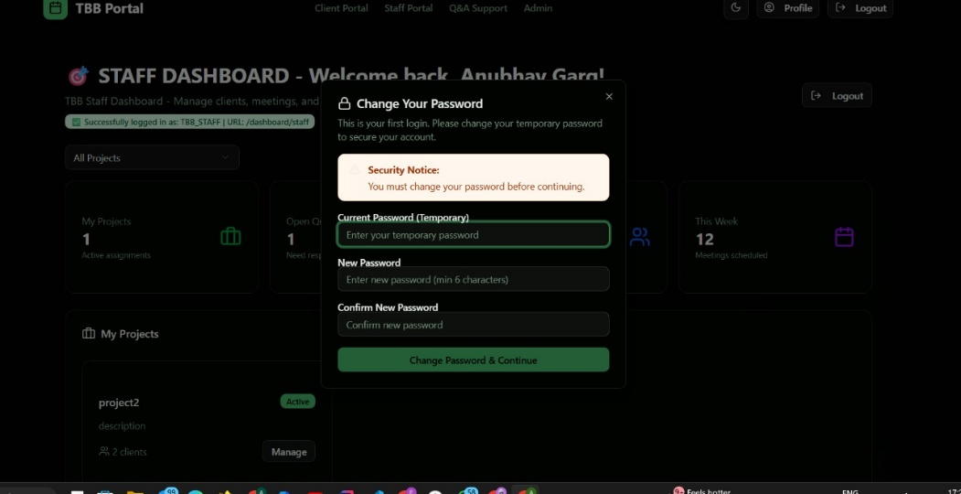
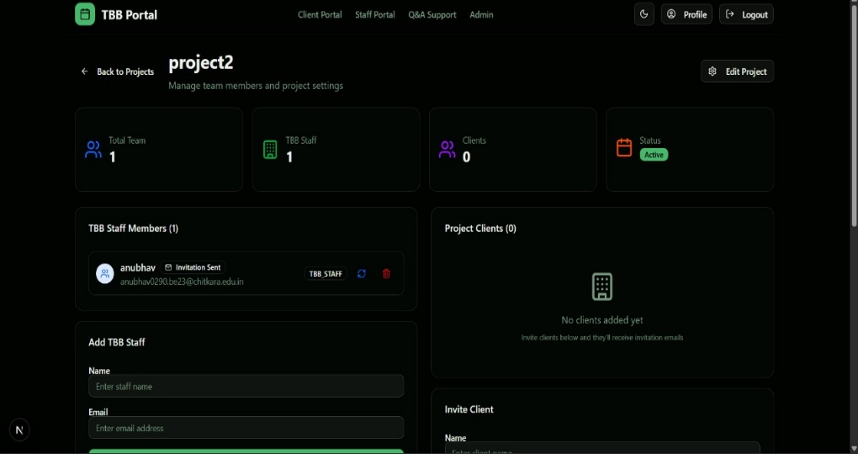
Project Snippets

Slide 9
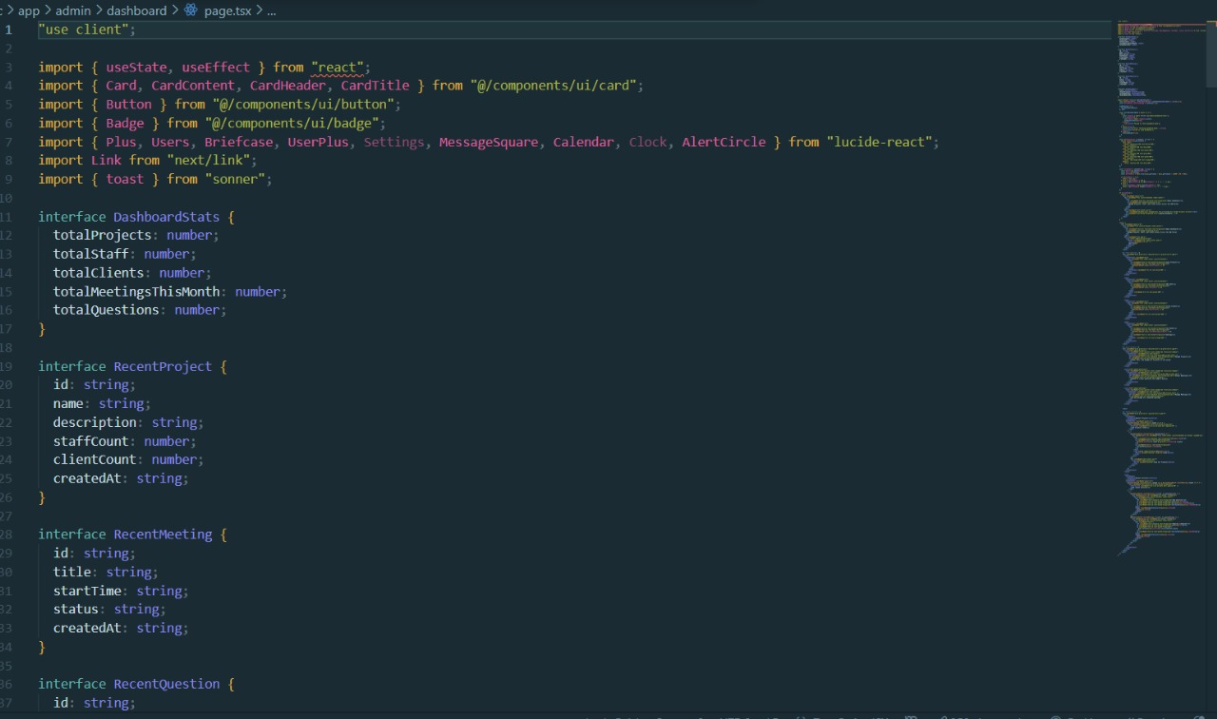
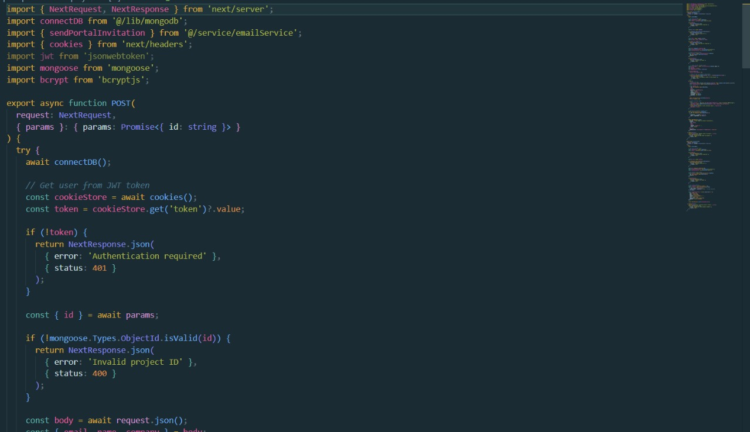
Code Snippets

Slide 10
Conclusion
1.Seamless Appointment Management
The system simplifies the entire process of booking, approving, and managing appointments between clients and staff.
2.Role-Based Access and Control
Clearly defined roles for Super Admin, Admin, Staff, and Clients ensure proper hierarchy, transparency, and security.
3.Centralized Project Handling
Projects can be created and managed by Super Admin, with staff and clients assigned efficiently, reducing confusion and overlaps.
4.Secure User Onboarding
Automatic email delivery of credentials allows quick and safe onboarding for staff and clients, minimizing manual errors.

Slide 11
References
Official Documentation: Documentation for libraries, frameworks, and tools used in the project, as well as APIs or services integrated.
https://www.google.com/
Tutorials and Guides: Online tutorials, guides, blog posts, and educational videos that provided assistance or insights during development.
https://www.geeksforgeeks.org/
Code Repositories: GitHub repositories or other code repositories where code snippets, examples, or inspiration were found.
https://chat.openai.com/
Forums and Communities: Online forums, such as Stack Overflow or Reddit, and developer communities where questions were asked, advice was sought, or discussions were participated in.
.

Slide 12
Q&A / Discussion
1. Cross-Device Responsiveness
Challenge: Smooth booking experience on mobile and desktop.
Solution: Used React’s responsive design principles.
2. Efficient Data Handling
Challenge: Managing multiple projects, staff, clients, and appointments simultaneously.
Solution: Optimized MongoDB queries & structured schema.
3. Scalability of Backend
Challenge: Handling growing users and real-time bookings.
Solution: Node.js & Express.js with load balancing.
4. Email Notifications
Challenge: Sending secure login credentials & meeting confirmations.
Solution: Integrated mailing service for automated notifications.

