Slide 1


Presentation on A system that can recommend music based on real-time emotions and behavioural patterns.
Guided By : Group Members:
Prof. Vishal Trivedi Anshika Bukhariya (0827CD221012)
github.com/AnshikaBukhariya
Prof. Deepak S. Chouhan Apoorv Betawadkar (0827CD221016)
github.com/Apoorv-0410
Katha Raghuwanshi (0827CD221041)
github.com/katharaghuwanshi
Madhuri Rathore (0827CD221046)
github.com/Madhuri0812

Slide 2
Contents
Introduction
1.1 Overview
1.2 Purpose
Requirement Engineering
2.1 Requirement Collection
2.2 Functional Requirements
2.3 Non Functional Requirements
2.4 Use Case Diagram
Technical Design
3.1 Technical Architecture
3.2 Sequence Diagram
3.3 Class Diagram
3.4 DFD
User Interface Design
Data Design
5.1 Schema Design
5.2 E-R Diagram
REFERENCES

Slide 3
1. Introduction
1.1 Overview
Emotion Detection: Uses facial recognition to identify user emotions.
Dynamic Suggestions: Recommends music based on current mood.
Personalized Experience: Adapts to emotional changes in real-time.
Enhanced Engagement: Transforms music into an emotional companion
1.2 Purpose
Adaptive System: Music recommendations based on user emotions via facial analysis.
Automatic Matching: Automatically aligns music with mood.
Various Settings: Suitable for personal, therapeutic, fitness, and retail use.
Real-Time Updates: Suggests music dynamically as moods change.

Slide 4
2. Requirement Engineering 2.1 Requirement Collection
This involves gathering the needs of stakeholders. Here are some tools and techniques used for collecting requirements:
Interviews: Conducting structured or unstructured interviews with stakeholders.
Surveys/Questionnaires: Collecting information through forms and questionnaires.
Workshops: Collaborative sessions with stakeholders to discuss and define requirements.
Observation: Watching users perform tasks to understand their needs.
Prototyping: Creating simple prototypes to gather feedback on requirements.
Use Case Analysis: Describing how users will interact with the system.
Brainstorming: Generating ideas collaboratively with stakeholders.

Slide 5
2.2 Function Requirements
Functional requirements specify what the system should do. Examples include:
Login functionality for users.
Ability to search for products.
Generating reports.
Data input, processing, and storage.

Slide 6
2.2 Non Functional Requirements
Non-functional requirements specify how the system should perform. Examples include:
Performance: The system should handle 1000 requests per second.
Scalability: It should support future growth.
Security: Ensure data encryption and secure access.
Usability: The system should be user-friendly.
Reliability: Minimum downtime or failures.

Slide 7
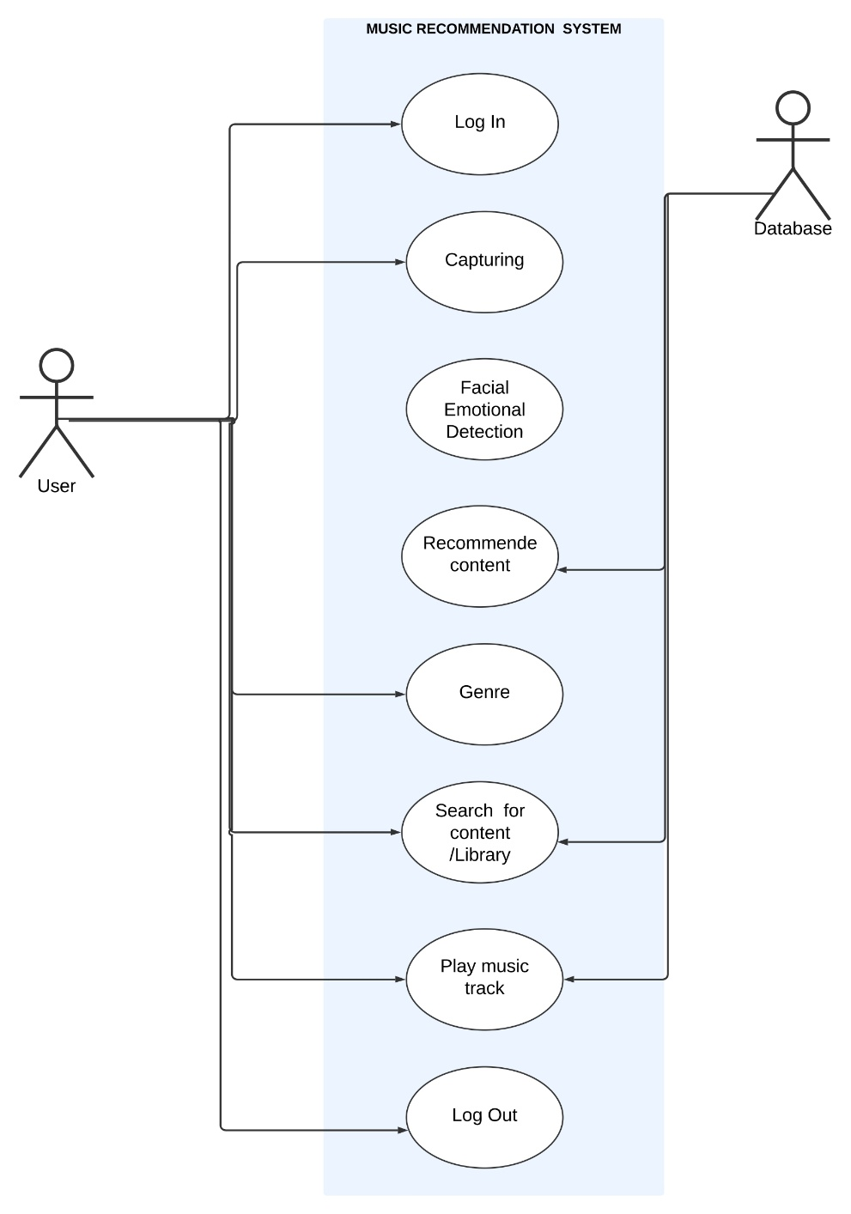
2.3 Use Case Diagram

Slide 8
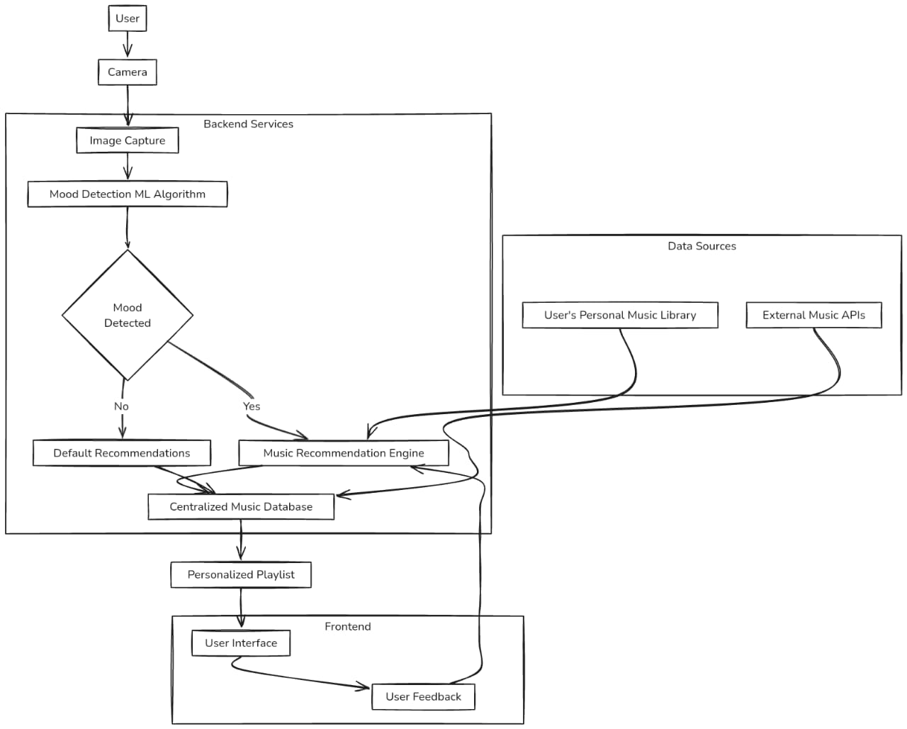
3. Technical Design 3.1 Technical Architecture

Slide 9
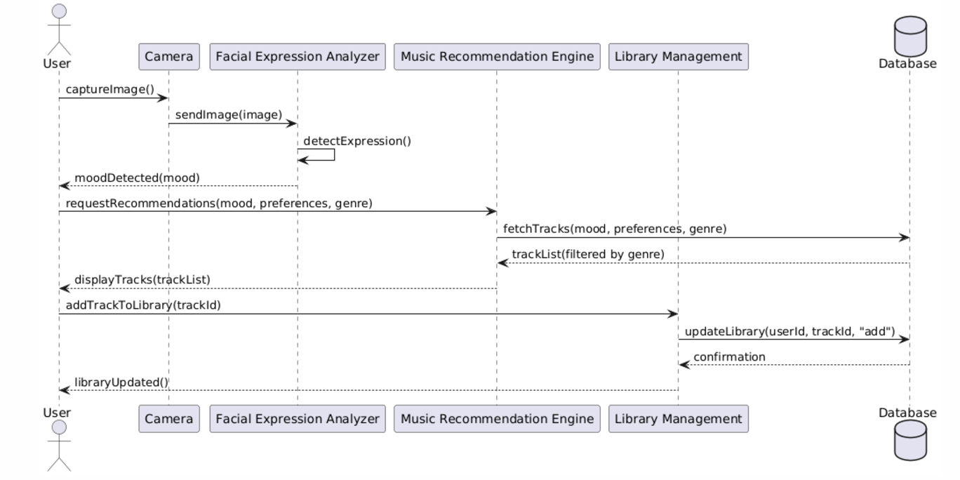
3.2 Sequence Diagram

Slide 10
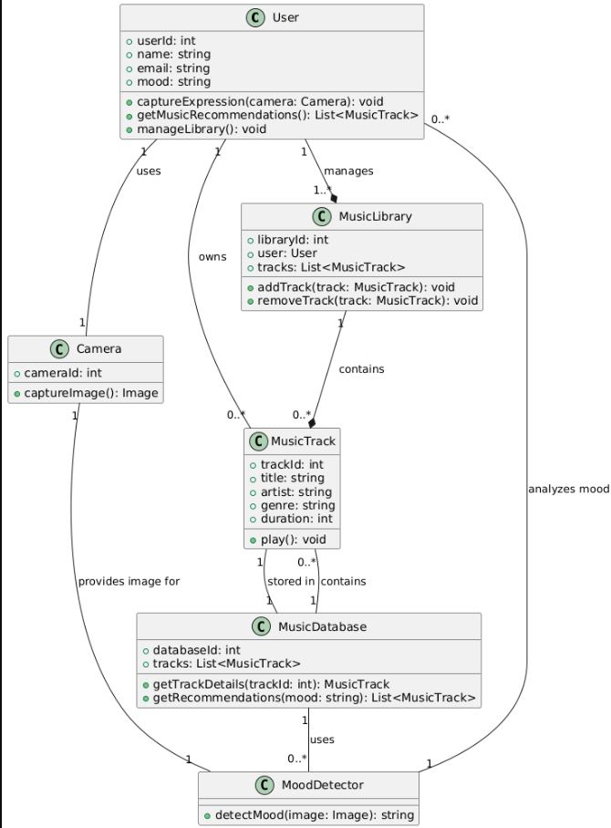
3.3 Class Diagram

Slide 11
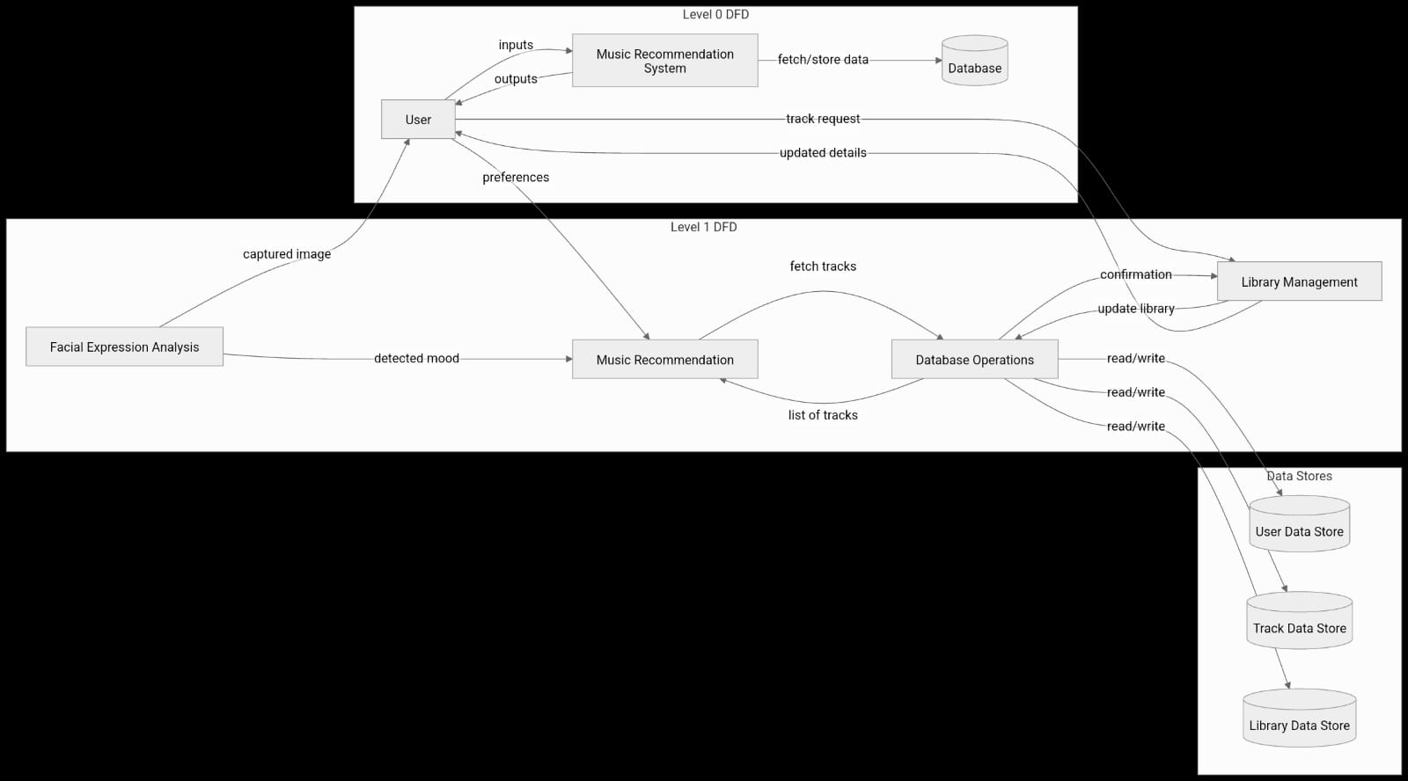
3.4 DFD

Slide 12
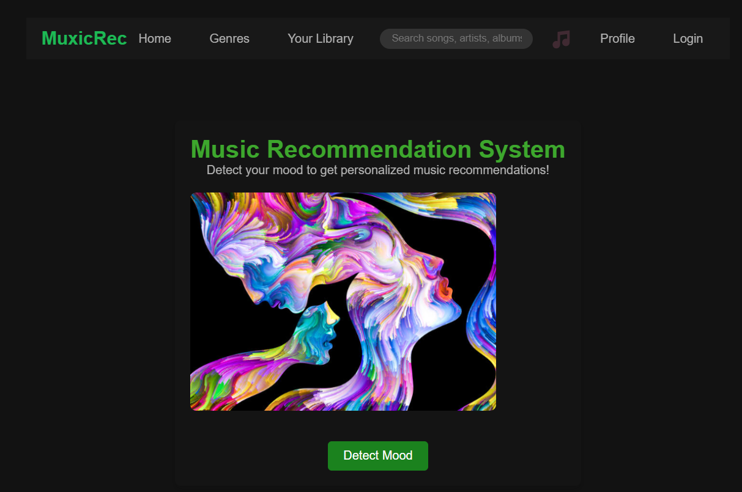
4. User Inface Design

Slide 13
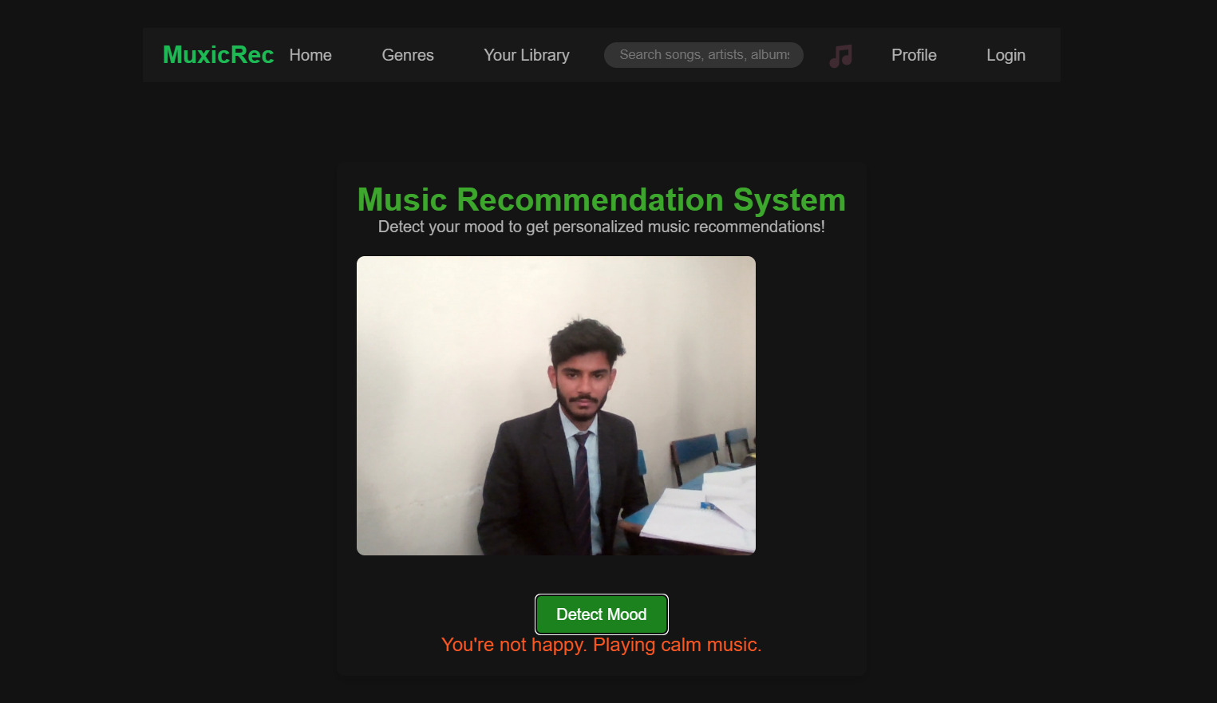

Slide 14
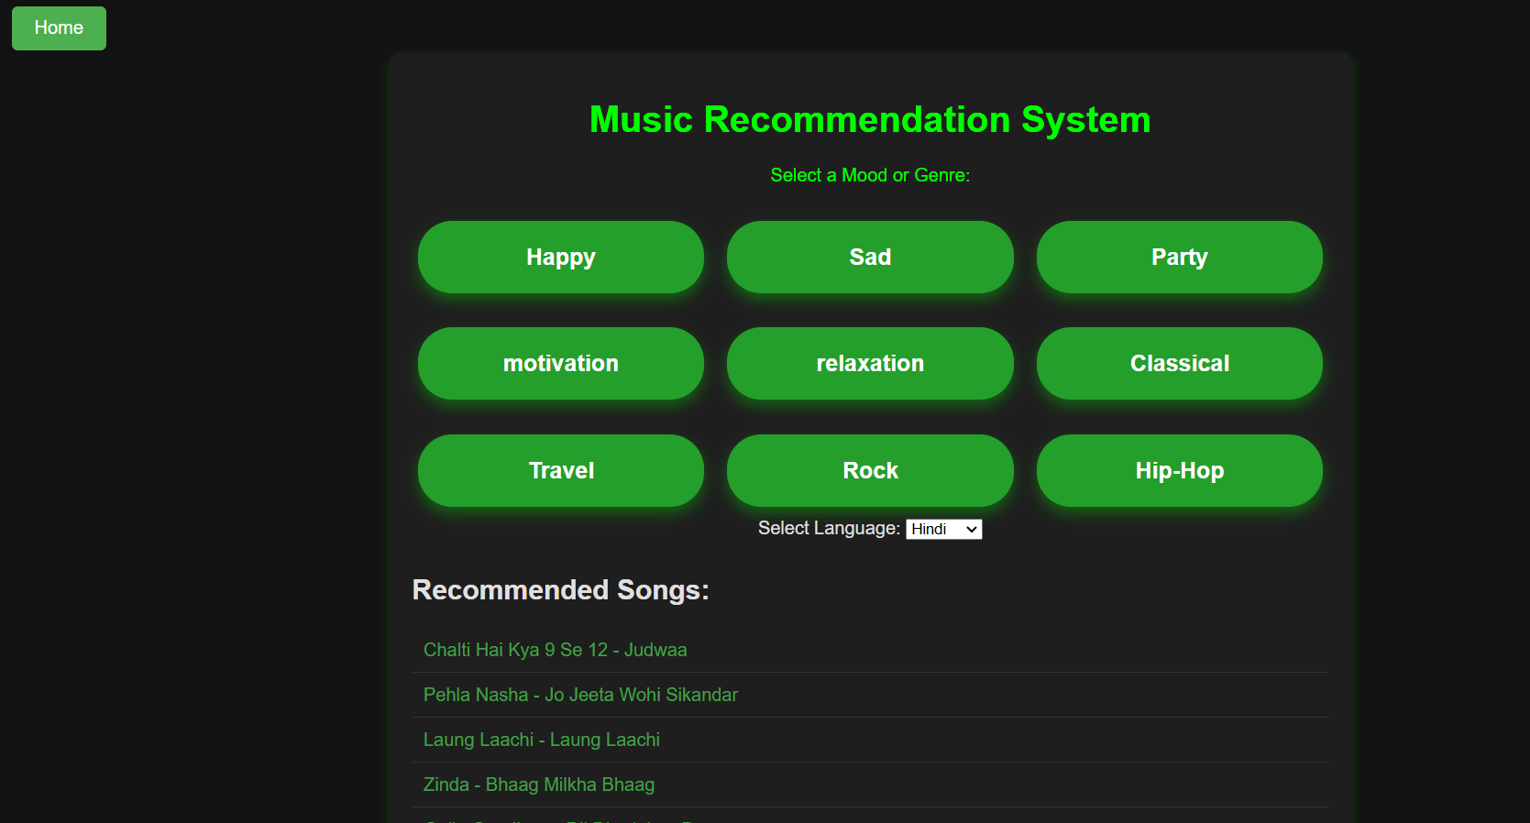

Slide 15
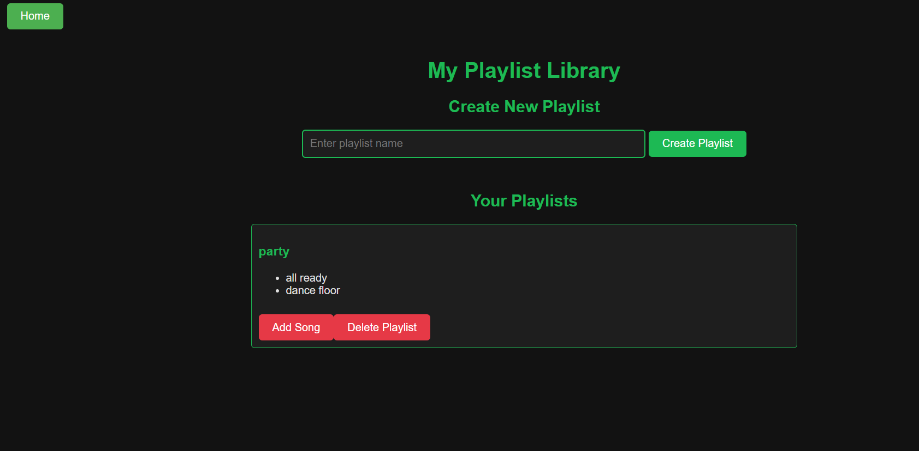

Slide 16
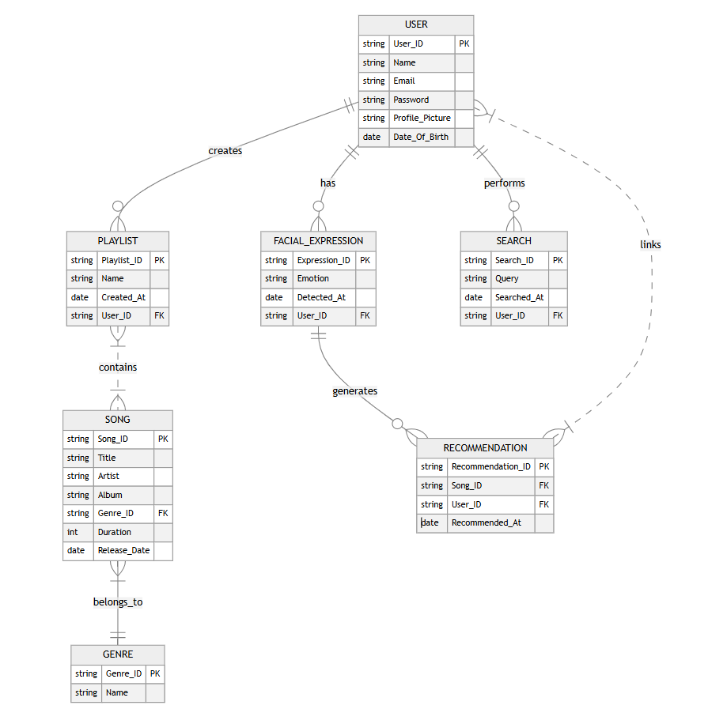
4. Data Design 4.1 Schema Definition

Slide 17
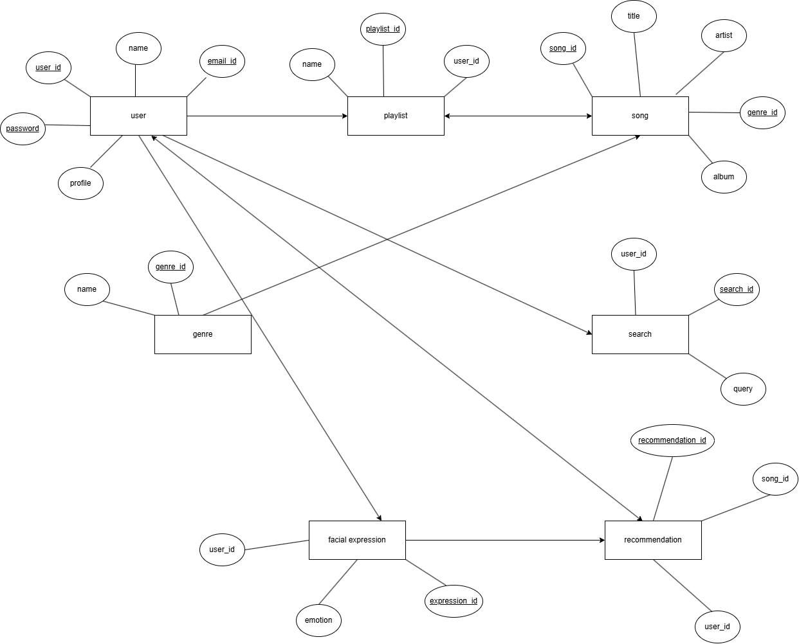
4.2 E-R Diagram

Slide 18
GitHub Link
link of GitHub repository
https://github.com/AnshikaBukhariya/A-system-that-can-recommend-music-based-on-real-time-emotions-and-behavioural-patterns.

Slide 19
REFERENCES
Chen, T., & Zhang, Y. (2020). "Emotion detection through facial expression and wearable devices: A survey." Journal of IoT and AI Integration.
Smith, J. (2019). "AI and Music: The Future of Intelligent Music Recommendations." IEEE Music Tech Review.
Spotify API Documentation. (2023). "Music Recommendation System API." Available at [www.spotify.com].
OpenCV Documentation. (2022). "Facial Emotion Recognition with OpenCV." Available at [www.opencv.org].

Slide 20
Thank You
Queries ?

