Slide 1






AI Research Assistant Platform
An n8n automation that collects, filters, summarises, cites and delivers research papers
n8n Capstone Project · Assignment 8 · IIT Jammu AI/LLM Summer School 2026 · Anshika Rana
Register
Collect
Summarise
Cite & archive
Digest
Audit
workflow 01
workflow 02
workflow 03
workflow 04
workflow 05
workflow 06
Notes:
Introduce yourself and the project: assignment 8 of the n8n capstone, an AI Research Assistant Platform. One sentence on the idea: register a research topic once, and the system keeps collecting, filtering, summarising, citing and delivering papers for you. The six circles are the six stages; each one is a separate n8n workflow.

Slide 2





Keeping up with research is slow, manual and repeated
The same searches, every week
Stakeholders
Queries are re-typed on arXiv, Semantic Scholar and publisher sites
Researchers & students
Too much to read
relevant papers, trustworthy summaries, ready citations
Keyword search returns many papers that only mention the term
Faculty supervisors
Inconsistent notes
a quick view of a topic; consistent references
Summaries miss the method, datasets or limitations
Lab admin
Messy references
no secrets in code, audit trail, alerts, controlled LLM cost
Hand-copied citations in mixed formats, with duplicates
Library / knowledge mgmt
New work is missed
a searchable repository with stable IDs and PDFs
Nobody is notified when a matching paper appears
Notes:
Business context: students and faculty do their literature tracking by hand. Walk through the five pain points on the left. Then the stakeholders: researchers are the main users, supervisors want a quick view, the lab admin runs n8n and pays for the APIs, and the library cares about a stable, searchable repository.

Slide 3
Each objective in the brief maps to one workflow
Workflow 01
Workflow 02
Workflow 03
Workflow 04
Workflow 05
Register topics
Collect papers daily
AI-powered summaries
Organise references
Track new publications
Web form + REST API, validation, duplicate check
arXiv + Semantic Scholar daily, merged & de-duplicated, AI relevance ≥ 0.70
10-field structured note per paper with GPT-5-mini
APA + BibTeX in code, PDF archive, search API
Personal digest: daily, weekly or monthly, with an AI overview
Workflow 06 · Error Handler & Audit Log covers the brief's advanced features: error handling, retries, logging and an audit trail for every run and every failure.
Notes:
The brief lists five objectives and suggests five sub-workflows. I built them one-to-one, so each card is one workflow. Workflow 06 is the extra layer for the advanced features: retries, error handling, logging and the audit trail. In total: 8 workflow files, 114 nodes. The brief asks for 4–6 workflows and 20–25 nodes.

Slide 4
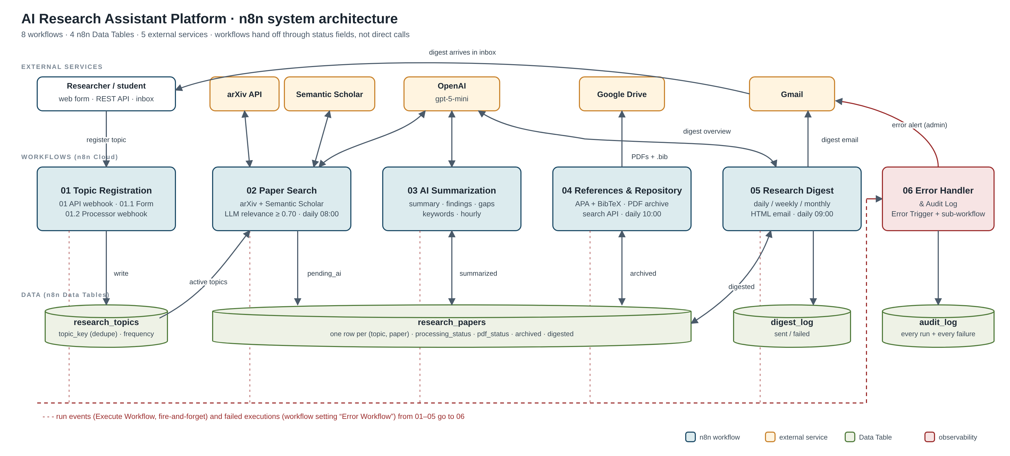
System architecture: 8 workflows, 4 Data Tables, 5 services
Notes:
Three layers. Top row: the external services. Middle row: the workflows, from registration on the left to the digest on the right, with 06 as the error handler. Bottom row: the n8n Data Tables. Researchers register through the form or API, receive digests by email and can query the search API. The dashed red line means every workflow reports to 06.

Slide 5


Workflows hand off work through status fields, not direct calls
01
02
03
04
05
Registered
Collected
Summarised
Archived
Delivered
active=true
pending_ai
summarized
archived=true
digested=true
Each workflow reads rows in one state from the Data Tables, does its job and writes the next state.
Independent stages
Failures stay contained
Status is visible
Each workflow has its own schedule and can be re-run or debugged alone.
A failed stage never corrupts another stage. Its rows simply wait in their current state.
A paper's row shows exactly where it is in the pipeline, which makes the audit easy.
Notes:
This is the key design decision. Workflows never call each other to pass work along. Each one reads rows in a given state and writes the next state, so the Data Tables act as a state machine. This is why I can run 03 again without touching 02, and why a failure in one stage can never corrupt another. Workflow 06 receives a run summary from every stage.

Slide 6
Registration: validated, de-duplicated, audited
POST /webhook/research/topic
200
Registered
{
"researcher": "Anshika Rana",
"email": "you@example.com",
"topic": "Retrieval Augmented Generation",
"keywords": "RAG, retrieval, LLM",
"frequency": "weekly"
}
topic_id TOPIC-<ms>-<rand>; keywords lower-cased and de-duplicated
400
Invalid
All problems listed at once: name, email, topic length, keywords, frequency
Also available as an n8n web form (01.1), which posts to a processor webhook (01.2) and shows one of three result pages.
409
Duplicate
topic_key = email|topic ignores case and spaces, so a researcher can't register the same topic twice
Notes:
Registration has two front doors: a REST API for tools and an n8n web form for people. Validation collects every error at once rather than stopping at the first. The duplicate key is the email plus the normalised topic, so changing case or adding spaces does not create a second registration. Every registration is logged to 06. Tested in T1–T4.

Slide 7
Collection: two sources, one clean list, an AI relevance gate
1
Daily 08:00: one query per active topic
37
36
2
arXiv + Semantic Scholar in parallel: rate-limited, 30 s timeout, 3 retries
candidates after de-duplication (3 topics)
stored as relevant (≥ 0.70)
3
Normalise both formats; merge duplicates by arXiv ID → DOI → title + year
1
0
4
Skip papers already stored for this topic, before any LLM call
filtered out by the AI gate
AI failures in the live run
5
GPT-5-mini scores relevance 0–1 with a reason; output validated
6
Store papers scoring ≥ 0.70 as pending_ai; log the rest
Live run, 7 Oct 2026 (execution #86, 66 s). Stored papers scored 0.92–0.98.
Notes:
Walk through the six steps. Two points matter most. First, duplicates from the two sources are merged, not just dropped, so a missing abstract or PDF link gets filled in from the other source. Second, already-stored papers are skipped before the LLM, so no paper is scored twice. In the live run: 37 candidates, 36 stored, 1 filtered, 0 AI failures. One topic returned no arXiv results, and the run still succeeded.

Slide 8
Summarisation: every paper becomes a structured research note
10 fields per paper (strict JSON, validated)
Real output · FAIR-RAG (arXiv 2510.22344)
summary
key_findings
Summary An agentic RAG framework that decomposes a query into required findings, audits the evidence for gaps and issues targeted sub-queries until the evidence is sufficient.
Key finding F1 0.453 on HotpotQA, +8.3 points over the strongest iterative baseline.
Datasets HotpotQA · 2WikiMultiHopQA · MusiQue
Research gap A structured, evidence-driven process that explicitly finds and fills information gaps for multi-hop reasoning.
methodology
datasets
models
limitations
research_gap
research_significance
extracted_keywords
research_category
The prompt forbids anything not in the abstract. Invalid output → ai_failed, never a broken run.
36 / 36 papers summarised · 0 AI failures
Notes:
Workflow 03 runs hourly and takes up to 20 unprocessed papers per run. The prompt asks for these ten fields as strict JSON and forbids inventing datasets, models or numbers. A Code node validates the output. On the right is a real note the system produced for FAIR-RAG; the numbers come from the abstract. Both batches in the live run succeeded: 36 out of 36.

Slide 9
References, PDF archive and a searchable repository
Citations are built in code, not by the LLM
Search API
Asl, M. A., Asgari-Bidhendi, M., & Minaei-Bidgoli, B. (2025). FAIR-RAG: Faithful Adaptive Iterative Refinement for Retrieval-Augmented Generation. arXiv preprint arXiv:2510.22344.
GET /webhook/research/papers/search
?q=faithfulness attribution
11
VISA: RAG with Visual Source Attribution
@misc{asl2025fair,
title = {FAIR-RAG: Faithful Adaptive ...},
author = {Mohammad Aghajani Asl and ...},
year = {2025}, eprint = {2510.22344},
archivePrefix = {arXiv} }
7
RAG in Quranic Studies: 13 open-source LLMs
6
Overview of the TREC 2025 RAG Track
PDF outcome per paper
Ranking: title ×3, keywords ×2, summary and abstract ×1. ?paper_id= returns related papers.
stored
drive_upload_failed
download_failed
no_link
Notes:
Workflow 04 builds an APA 7 citation and a BibTeX entry for every summarised paper, deterministically in code, so references cannot be hallucinated. It downloads each PDF and archives it to Google Drive, plus a .bib library per run. Every outcome is recorded; Drive is not connected yet, so the live run shows drive_upload_failed while the run itself succeeds. This run also exposed a real bug with 25 PDFs at once, which I fixed. The same workflow serves the search API; these are the real top three results for "faithfulness attribution".

Slide 10

The digest: an AI-written briefing, not just a list of links
Research digest: Retrieval Augmented Generation – 10 new paper(s)
On the researcher's schedule
"These papers show RAG moving from proof-of-concept demos toward engineering-first, trust-oriented systems that prioritize faithfulness, attribution, and domain adaptivity."
daily · weekly on Mondays · monthly on the 1st (09:00 IST)
Emerging trends
AI overview with a fallback
Faithfulness and attribution-first RAG
Maturing benchmarks and evaluation (shared tracks, multi-dimensional metrics)
Modular, agentic and multi-agent architectures
If the LLM call fails, the digest still goes out with a plain list
Read first: FAIR-RAG · Engineering the RAG Stack · TREC 2025 RAG Track overview
Safe delivery
A failed send is logged; papers stay undigested and the next run retries
Then one card per paper: summary, key findings, PDF link, APA citation.
Notes:
This is real output from the live run on 7 Oct for the RAG topic, written by GPT-5-mini from the ten stored summaries: an overview, trends, a read-first list and open questions. Each topic gets its digest on the schedule the researcher chose. Gmail is not connected on this instance yet, so the send went to the failure branch: it was logged as failed, and the papers stay undigested for the next run.

Slide 11
Built to fail safely, and tested on every failure path
Situation | What the system does
Invalid or duplicate topic | 400 with every error, or 409. Nothing is written
arXiv / Semantic Scholar down or rate-limited | Timeout, 3 retries with back-off, then 0 results from that source
LLM fails or returns bad JSON | Validated: score 0 (02), ai_failed (03), plain-list digest (05)
Broken PDF link or Drive failure | pdf_status records the outcome; the run continues
Email send fails | digest_log = failed; papers retried in the next run
Any unhandled node error | Error Workflow 06 → audit_log + admin alert
14
scenario tests passed (T1–T14)
7
live pipeline steps on real data
1
real bug found and fixed
Bug: with 25 PDFs failing at once, items lost their paired link. Fix: an "Attach Reference" node carries each paper's data along with its PDF.
Notes:
The table shows how each kind of failure is handled. All of these were tested: 14 scenario tests on 6 Oct, including invalid input, duplicates, no results, an API outage, LLM failure, broken PDFs, a failed email and a simulated 429. Then a 7-step live run on real data on 7 Oct, which found one real bug in the PDF branch; it is fixed and documented. No API key is stored in any workflow file.

Slide 12
Results and next steps
What I learned
Use AI for judgement, code for facts: relevance and summaries by LLM; citations, de-duplication and search in code
Treat LLM output as untrusted input and give every failure an explicit branch
Loose coupling through Data Tables makes each stage easy to test and re-run
Next steps
Connect Gmail, Google Drive and Semantic Scholar on the live instance
Full-text PDF summaries and a citation-based "related papers" graph
A human approval step before a digest is sent
Notes:
Close with the numbers from the live run: 37 candidates, 36 stored, all 36 summarised, cited and archived, and 20 papers in the two digests that were built (each digest shows up to 10 papers per topic; the rest go into the next one). They were not emailed, because Gmail is not connected yet. Three lessons, then next steps: connect the remaining credentials, summarise full-text PDFs, and add a human approval step. Thank the audience and point to the GitHub repository.

