Slide 1
Lec29
Graph Theory

Slide 2
Graph
A graph G = (V, E) consists of V , a nonempty set of vertices (or nodes) and E, a set of edges.
Each edge has either one or two vertices associated with it, called its endpoints. An edge is said to connect its endpoints.
The set of vertices V of a graph G may be infinite.
A graph with an infinite vertex set or an infinite number of edges is called an infinite graph.
A graph with finite vertex set and a finite edge set is called a finite graph.
Example:
Airline Scheduling
Search Engine Algorithms
In showing flow of computation in complex problems.

Slide 3
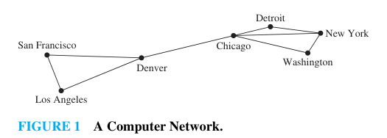
Example
A network is made up of data centers and communication links between computers.
We can represent the location of each data center by a point and each communications link by a line segment.

Slide 4
Properties
If two vertices in a graph are connected by more than one edges, then these edges are called multiple edges.
If one vertex is connected by itself, then the edge joining the vertex to itself is called loop.
Simple Graph: A graph which has no multiple edges and no loop is called simple graph.
Multi-graph: A graph with multiple edges is called multi-graph.
Pseudo-graph: A graph with loops , and possibly multiple edges connecting the same pair of vertices or a vertex to itself, is called pseudo-graph.

Slide 5
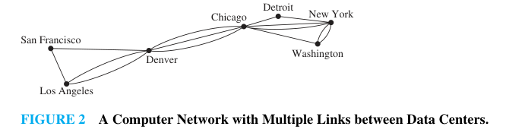
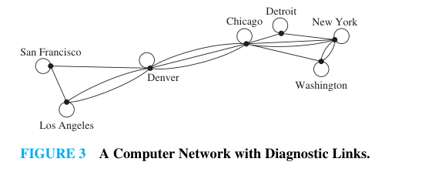
Figure 1 is Simple Graph, Figure 2 is multi-graph, and Figure 3 is pseudo-graph.

Slide 6
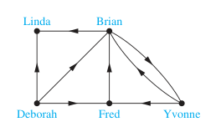
A directed graph (or digraph) (V, E) consists of a nonempty set of vertices V and a set of directed edges E.
Each directed edge is associated with an ordered pair of vertices.
The directed edge associated with the ordered pair (u, v) is said to start at u and end at v.

Slide 7
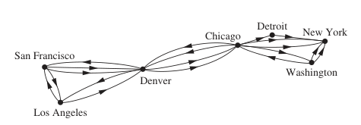
Undirected Graphs: Graphs in which the edges are undirected.
A directed graph with no multiple directed edges and loops is called simple directed graph.
A directed graph with multiple directed edges and loops is called directed multi-graph.
A graph with both directed and undirected edges is called a mixed graph.

Slide 8
Graph Terminology and Special Types of Graphs
Terminology for undirected graphs:
Two vertices u and v in an undirected graph G are called adjacent (or neighbours) in G if u and v are endpoints of an edge e of G.
Such an edge e is called incident with the vertices u and v.
The set of all neighbours of a vertex v of G = (V, E), denoted by N(v), is called the neighbourhood of v.
The degree of a vertex in an undirected graph is the number of edges incident with it, except that a loop at a vertex contributes twice to the degree of that vertex. The degree of the vertex v is denoted by deg(v).

Slide 9
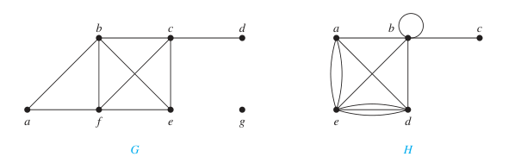
Examples
In graph G, deg(a) = 2, deg(b) = deg(c) = deg(f ) = 4, deg(d ) = 1, deg(e) = 3, and deg(g) = 0. The neighborhoods of these vertices are N(a) = {b, f }, N(b) = {a, c, e, f }, N(c) = {b, d, e, f }, N(d) = {c}, N(e) = {b, c, f }, N(f ) = {a, b, c, e}, and N(g) = ∅.
In graph H, deg(a) = 4, deg(b) = deg(e) = 6, deg(c) = 1, and deg(d ) = 5. The neighborhoods of these vertices are N(a) = {b, d, e}, N(b) = {a, b, c, d, e}, N(c) = {b}, N(d) = {a, b, e}, and N(e) = {a, b, d}.

Slide 10
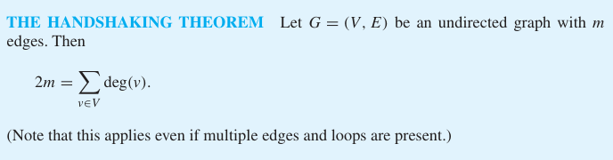
Handshaking Theorem
Example: How many edges are there in a graph with 10 vertices each of degree six?
Solution: Because the sum of the degrees of the vertices is 6 · 10 = 60, it follows that 2m = 60, where m is the number of edges. Therefore, m = 30.

Slide 11
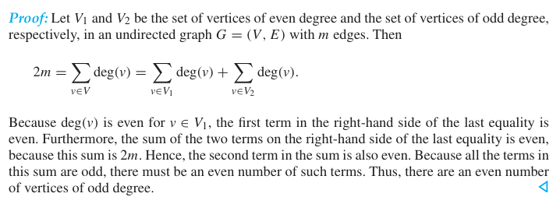
Theorem: An undirected graph has an even number of vertices of odd degree.

Slide 12
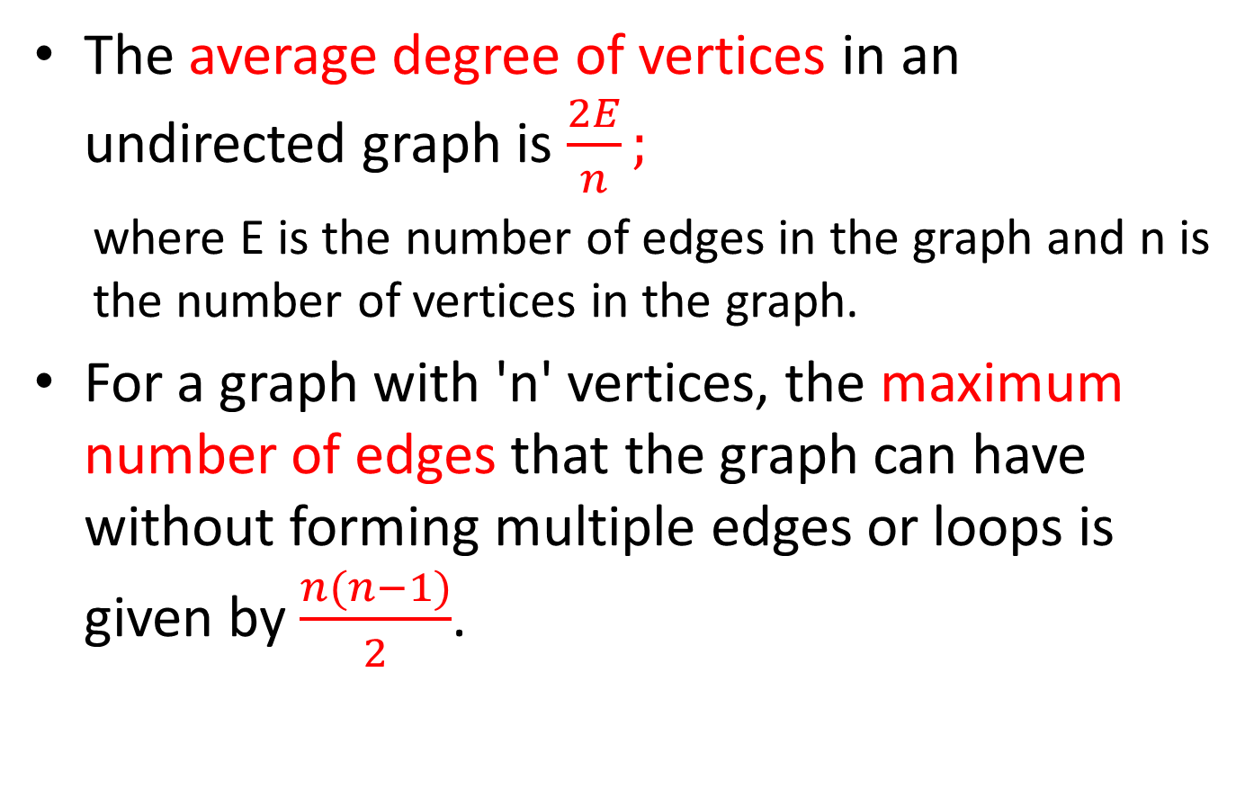
Average and Maximum Number of Edges
The average degree of vertices in an undirected graph is $\frac{2E}{n};$
where E is the number of edges in the graph and n is the number of vertices in the graph.
For a graph with 'n' vertices, the maximum number of edges that the graph can have without forming multiple edges or loops is given by $\frac{n(n−1)}{2}$.

Slide 13
Terminology for undirected graphs:
When (u, v) is an edge of the graph G with directed edges, u is said to be adjacent to v and v is said to be adjacent from u.
The vertex u is called the initial vertex of (u, v), and v is called the terminal or end vertex of (u, v).
The initial vertex and terminal vertex of a loop are the same.

Slide 14
Degree of Vertex in Directed Graph
In a graph with directed edges the in-degree of a vertex v, denoted by deg⁻(v), is the number of edges with v as their terminal vertex. The out-degree of v, denoted by deg⁺(v), is the number of edges with v as their initial vertex.
Note that a loop at a vertex contributes 1 to both the in-degree and the out-degree of this vertex.

Slide 15
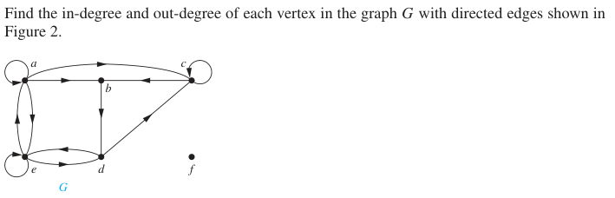

Example

Slide 16
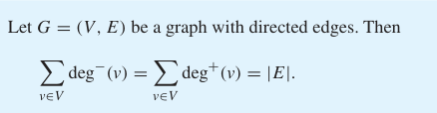
Result
Because each edge has an initial vertex and a terminal vertex, the sum of the in-degrees and the sum of the out-degrees of all vertices in a graph with directed edges are the same. Both of these sums are the number of edges in the graph, i.e.,

Slide 17
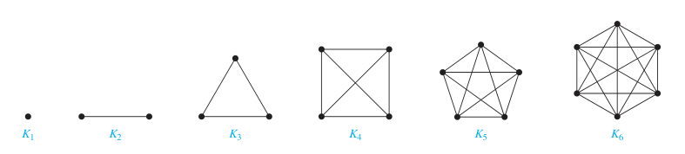
Some Special Simple Graphs
Complete Graphs:
A complete graph on n vertices, denoted by K_{n}, is a simple graph that contains exactly one edge between each pair of distinct vertices.
A simple graph for which there is at least one pair of distinct vertex not connected by an edge is called non-complete.
The complete graphs for n=1,2,3,4,5,6 are as follows.

Slide 18
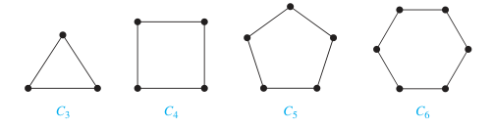
Cycle
A cycle C_{n}, n ≥ 3, consists of n vertices v₁, v₂, . . . , v_{n} and edges {v₁, v₂}, {v₂, v₃}, . . . , {v_{n-1}, v_{n}}, and {v_{n}, v₁}. The cycles C₃, C₄, C₅, and C₆ are displayed as follows.
We can see here that the cycle C₃ is complete, but C₄, C₅, and C₆ are not complete graphs.

Slide 19
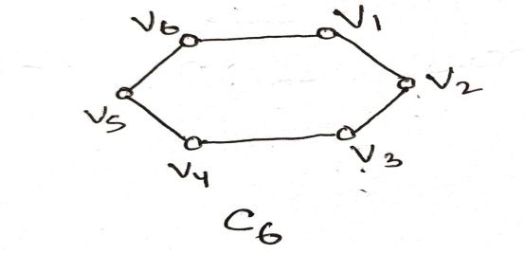
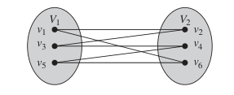
Bipartite Graph
A simple graph G is called bipartite if its vertex set V can be partitioned into two disjoint sets V₁ and V₂ such that every edge in the graph connects a vertex in V₁ and a vertex in V₂.
No edge in G connects either two vertices in V₁ or two vertices in V₂.
When this condition holds, we call the pair (V₁, V₂) a bipartition of the vertex set V of G.
Ex. C₆ is bipartite, because its vertex set can be partitioned into the two sets V₁ = {v₁, v₃, v₅} and V₂ = {v₂, v₄, v₆}, and every edge of C₆ connects a vertex in V₁ and a vertex in V₂.

Slide 20
K₃ is not bipartite
To verify this, note that if we divide the vertex set of K₃ into two disjoint sets, one of the two sets must contain two vertices.
If the graph were bipartite, these two vertices could not be connected by an edge, but in K3 each vertex is connected to every other vertex by an edge.

Slide 21
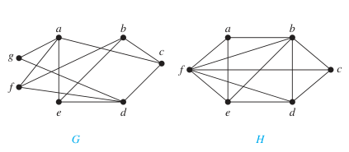
Which graph is bipartite?
Graph G is bipartite because its vertex set is the union of two disjoint sets, {a, b, d} and {c, e, f, g}, and each edge connects a vertex in one of these subsets to a vertex in the other subset. (Note that for G to be bipartite it is not necessary that every vertex in {a, b, d} be adjacent
to every vertex in {c, e, f, g}. For instance, b and g are not adjacent.)
Graph H is not bipartite because its vertex set cannot be partitioned into two subsets so that edges do not connect two vertices from the same subset.

Slide 22
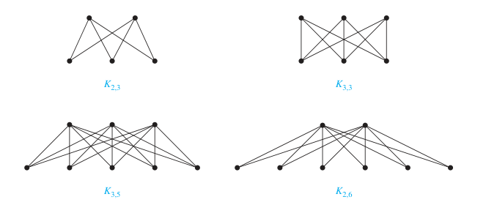
Complete Bipartite Graphs
A complete bipartite graph K_{m,n} is a graph that has its vertex set partitioned into two subsets of m and n vertices, respectively with an edge between two vertices if and only if one vertex is in the first subset and the other vertex is in the second subset.

Slide 23
Regular Graph
A simple graph is called regular if every vertex of this graph has the same degree.
A regular graph is called n-regular if every vertex in this graph has degree n.
Ex. Complete graphs are always regular. In particular, K₁ is 1-regular, K₂ is 2-regular, K₃ is 3-regular, and so on….

Slide 24
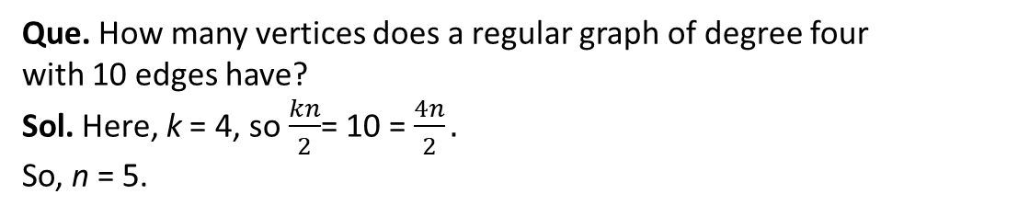
Regular Graph
Cycles are always regular.
In particular, cycles are 2-regular graphs because the degree of each vertex is 2.
Result: A regular graph of degree k with n vertices has $\frac{kn}{2}$ edges.
Que. How many vertices does a regular graph of degree four
with 10 edges have?
Sol. Here, k = 4, so $\frac{kn}{2}$= 10 = $\frac{4n}{2}.$
So, n = 5.

Slide 25
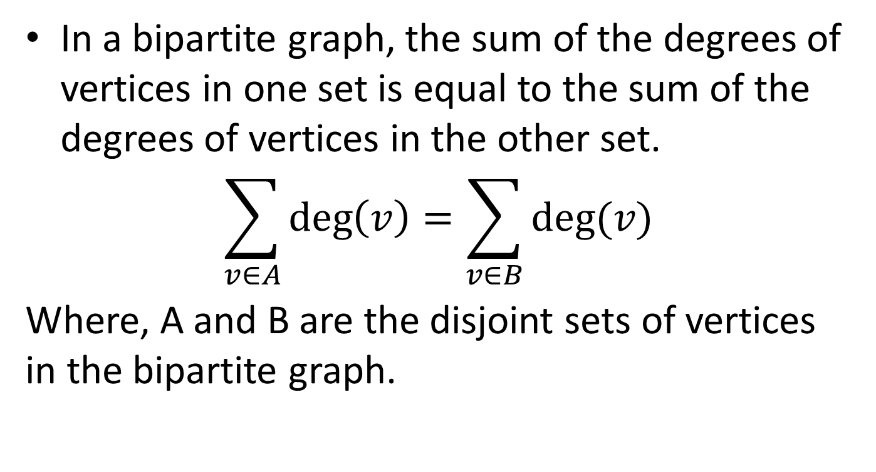
Handshaking Theorem for Bipartite Graphs
In a bipartite graph, the sum of the degrees of vertices in one set is equal to the sum of the degrees of vertices in the other set.
$$\sum_{v∈A}{\deg\left(v\right)=\sum_{v∈B}{deg⁡(v)}}$$
Where, A and B are the disjoint sets of vertices in the bipartite graph.

Slide 26
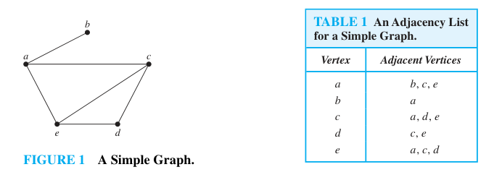
Representation of Graphs
Adjacency List: It is a way to represent a graph with no multiple edges, which specify the vertices that are adjacent to each vertex of the graph.

Slide 27
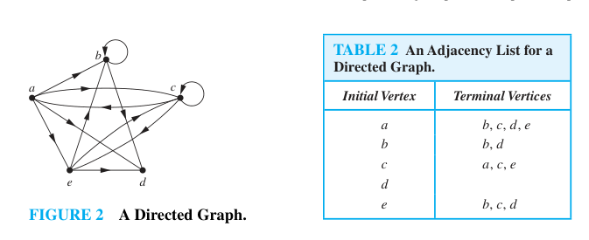
Representation of Graphs
Adjacency list for Directed Graph:

Slide 28
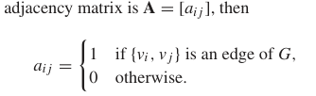
Adjacency Matrices
Suppose that G = (V, E) is a simple graph where |V| = n.
Suppose that the vertices of G are listed arbitrarily as v₁, v₂, . . . , v_{n}.
The adjacency matrix A (or A_{G}) of G, with respect to this listing of the vertices, is the (n x n) zero–one matrix with 1 as its (i, j)th entry when v_{i} and v_{j} are adjacent, and 0 as its (i, j)th entry when they are not adjacent.

Slide 29
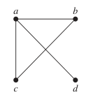
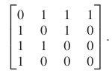
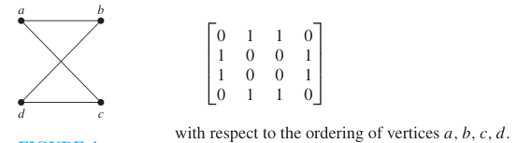
Adjacency matrices

Slide 30
Adjacency Matrices for Simple Graphs
There may be as many as n! different adjacency matrices for a graph with n vertices, because there are n! different orderings of n vertices.
The adjacency matrix of a simple graph is symmetric, that is, a_{ij} = a_{ji}, because both of these entries are 1 when vi and vj are adjacent, and both are 0 otherwise.
Simple graph has no loops, so each entry a_{ii} = 0 , i = 1, 2, 3, . . . , n.

Slide 31
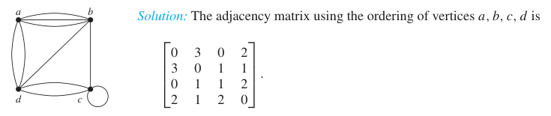
Adjacency Matrix for Multi-graphs
Adjacency matrices can also be used to represent undirected graphs with loops and with multiple edges.
A loop at the vertex vi is represented by a 1 at the (i, i)th position of the adjacency matrix.
When multiple edges connecting the same pair of vertices vi and vj, or multiple loops at the same vertex, are present, the adjacency matrix is no longer a zero–one matrix, because the (i, j)th entry of this matrix equals the number of edges that are associated to {vi, vj}.

Slide 32

Adjacency Matrix for Directed Graph
The matrix for a directed graph G = (V, E) has a 1 in its (i, j)th position if there is an edge from v_{i} to v_{j}, where v₁, v₂, . . . , v_{n} is an arbitrary listing of the vertices of the directed graph.
In other words, the adjacency matrix A = [a_{ij}] for directed graph is

Slide 33
Adjacency Matrix for Directed Graph
The adjacency matrix for a directed graph needs not have to be symmetric, because there may not be an edge from v_{j} to v_{i} when there is an edge from v_{i} to v_{j}.
Adjacency matrices can also be used to represent directed multi-graphs. Again, such matrices are not zero–one matrices when there are multiple edges in the same direction connecting two vertices.
In the adjacency matrix for a directed multi-graph, a_{ij} equals the number of edges that are associated to (v_{i}, v_{j}).

Slide 34
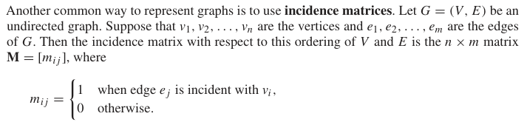
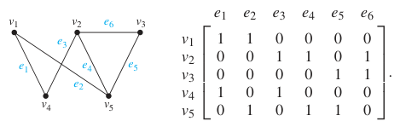
Incidence Matrix

Slide 35
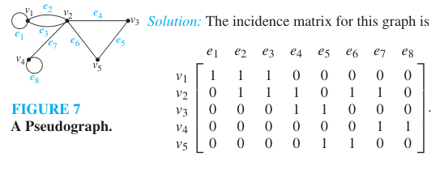
Incidence Matrix for Multi-graph and Pseudo-graph
Multiple edges are represented in the incidence matrix using columns with identical entries, because these edges are incident with the same pair of vertices.
Loops are represented using a column with exactly one entry equal to 1, corresponding to the vertex that is incident with this loop.

Slide 36
CONNECTIVITY

Slide 37
Path
A path is a sequence of edges that begins at a vertex of a graph and travels from vertex to vertex along edges of the graph.
Let n be a nonnegative integer and G an undirected graph. A path of length n from u to v in G is a sequence of n edges e₁, . . . , e_{n} of G for which there exists a sequence x₀ = u, x₁, . . . , x_{n-1}, x_{n} = v of vertices such that e_{i} has the endpoints x_{i-1} and x_{i} , for i = 1, . . . , n.
When the graph is simple, we denote this path by its vertex sequence x₀, x₁, . . . , x_{n.}
The path is a circuit if it begins and ends at the same vertex, that is, if u = v, and has length greater than zero.
A path or circuit is simple if it does not contain the same edge more than once.
In some books, path is termed as walk, circuit as closed walk, and simple path as trial.

Slide 38
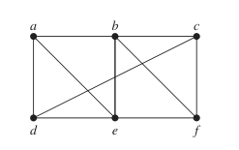
Example
In the simple graph shown in above Figure,
a, d, c, f , e is a simple path of length 4, because {a, d}, {d, c}, {c, f }, and {f, e} are all edges.
d, e, c, a is not a path, because {e, c} is not an edge.
b, c, f , e, b is a circuit of length 4 because {b, c}, {c, f }, {f, e}, and {e, b} are
edges, and this path begins and ends at b.
The path a, b, e, d, a, b, which is of length 5, is not simple because it contains the edge {a, b} twice.

Slide 39
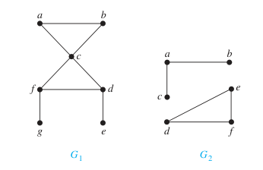
Connected Graph
An undirected graph is called connected if there is a path between every pair of distinct vertices of the graph.
An undirected graph that is not connected is called disconnected.
In the following figure, the graph G₁ is connected and G₂ is disconnected.

Slide 40
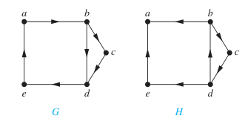
Connectedness in Directed Graphs
A directed graph is strongly connected if there is a path from a to b and from b to a whenever a and b are vertices in the graph.
A directed graph is weakly connected if there is a path between every two vertices in the underlying undirected graph.
In the following graphs, G is strongly connected as well as weakly connected but H is only weakly connected.

Slide 41
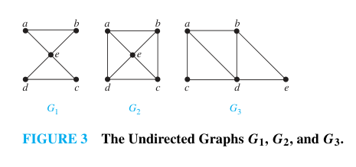
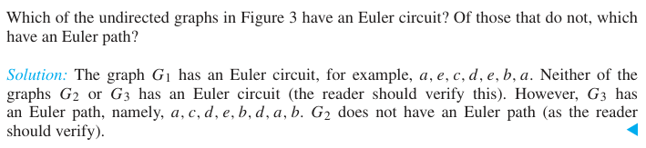
Euler Graph
An Euler circuit in a graph G is a simple circuit containing every edge of G.
An Euler path in G is a simple path containing every edge of G.

Slide 42
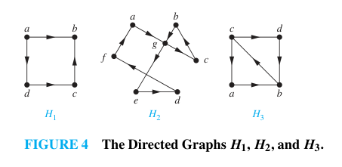
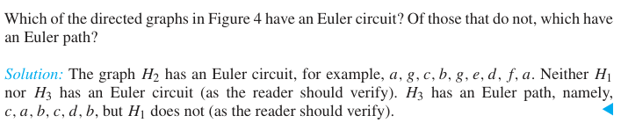
Euler Graph

Slide 43
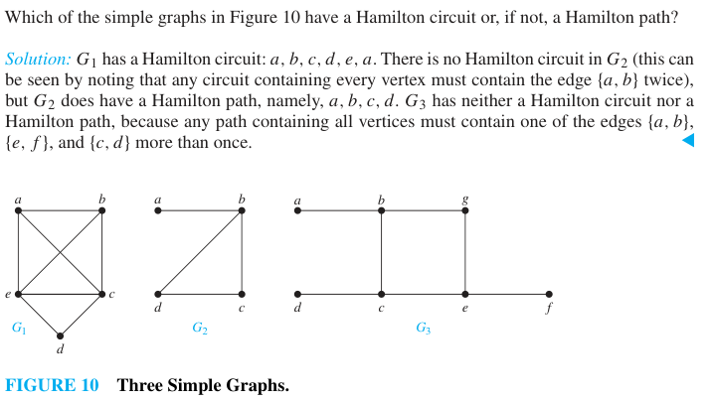
Hamilton Graph
A simple path in a graph G that passes through every vertex exactly once is called a Hamilton path.
A simple circuit in a graph G that passes through every vertex exactly once is called a Hamilton circuit.

Slide 44
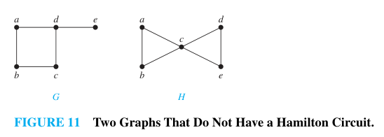
Example
There is no Hamilton circuit in G because G has a vertex of degree one, namely, e.
Now consider H. Because the degrees of the vertices a, b, d, and e are all two, every edge incident with these vertices must be part of any Hamilton circuit.
It is now easy to see that no Hamilton circuit can exist in H, for any Hamilton circuit would have to contain four edges incident with c, which is impossible.

Slide 45
Example
Show that K_{n} has a Hamilton circuit whenever n ≥ 3.
Solution:
We can form a Hamilton circuit in K_{n} beginning at any vertex.
Such a circuit can be built by visiting vertices in any order we choose, as long as the path begins and ends at the same vertex and visits each other vertex exactly once.
This is possible because there are edges in K_{n} between any two vertices.

