Slide 1
Mathematic for Computer Science - III CS203B
Lecture 10:
Computing a random sample and permutation

Slide 2
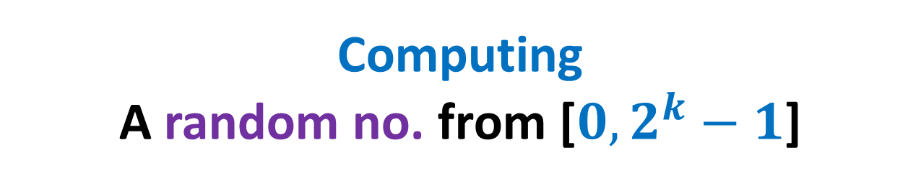
Computing A random no. from [$0,2^{k}−1$]
using a fair coin

Slide 3

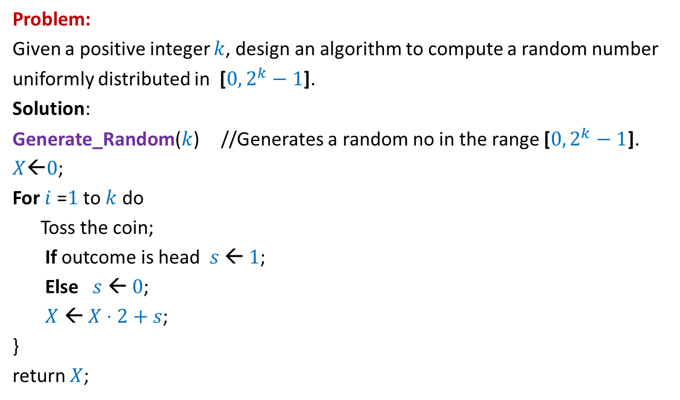

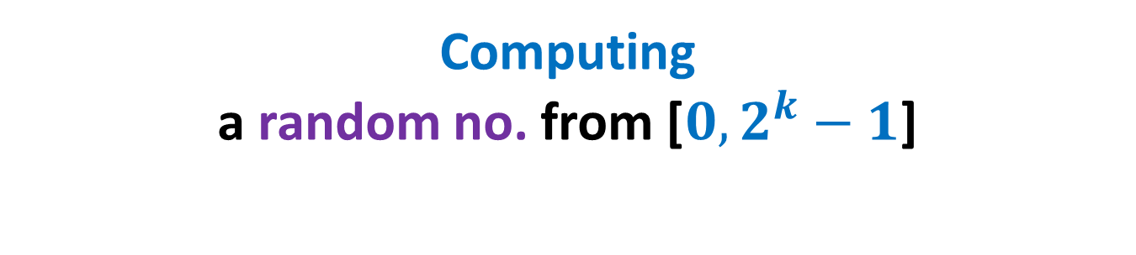




Computing a random no. from [$0,2^{k}−1$]
Problem:
Given a positive integer $k$, design an algorithm to compute a random number
uniformly distributed in [$0,2^{k}−1$].
Solution:
Generate_Random($k$) //Generates a random no in the range [$0,2^{k}−1$].
$X$←$0$;
For $i$ =$1$ to $k$ do
Toss the coin;
If outcome is head $s$ ← $1$;
Else $s$ ← $0$;
$X$ ← $X⋅2+s$;
}
return $X$;
Let $t∈\text{[}0,2^{k}−1\text{].}$
$$\frac{1}{2^{k}}$$
P($X=t$) = ?
Binary-representation of $t$
$$0$$ | $$1$$ | $$0$$ | $$1$$ | $$1$$ | $$1$$ | $$0$$ | $$1$$
$$1 2 … k$$

Slide 4
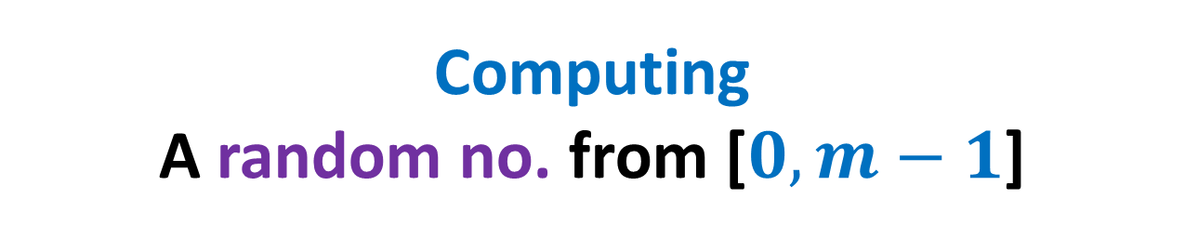
Computing A random no. from [$0,m−1$]
using a fair coin

Slide 5
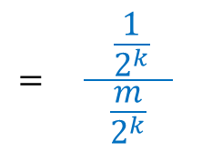
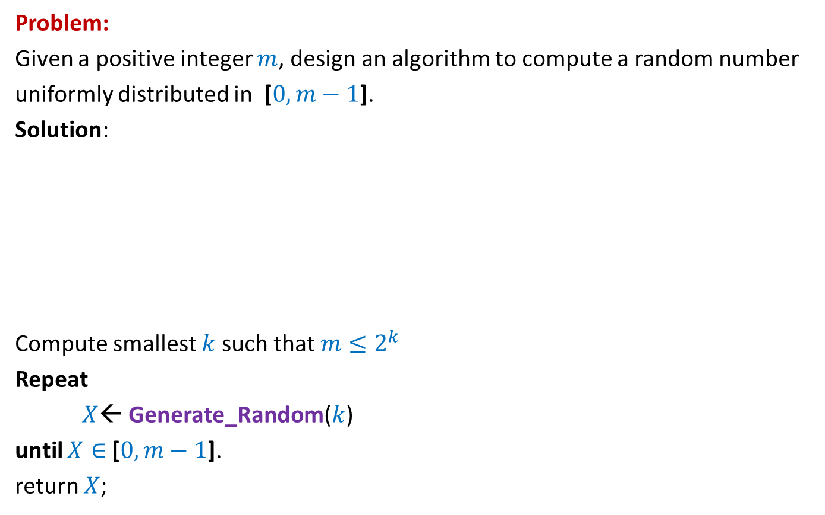

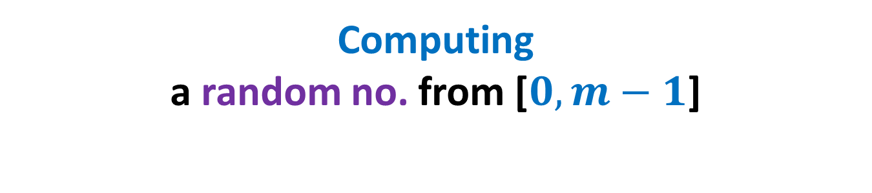

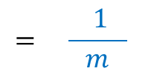

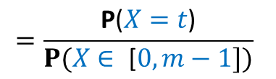


Computing a random no. from [$0,m−1$]
Problem:
Given a positive integer $m$, design an algorithm to compute a random number
uniformly distributed in [$0,m−1$].
Solution:
Compute smallest $k$ such that $m≤2^{k}$
Repeat
$X$← Generate_Random($k$)
until $X∈$ [$0,m−1$].
return $X$;
$$0$$
$$m−1$$
$$2^{k}−1$$
Let $t∈\text{[}0, m−1\text{].}$
P($X=t | X∈ \text{[}0,m−1\text{]}$)
$$=\frac{\text{P}\text{(}X=t\text{)}}{P(X∈ \text{[}0,m−1])}$$
$$= \frac{ \frac{1}{2^{k}} }{\frac{m}{2^{k}}}$$
$$= \frac{ 1 }{m}$$

Slide 6


Computing a random no. from [$0,m−1$]
Problem:
Given a positive integer $m$, design an algorithm to compute a random number
uniformly distributed in [$0,m−1$].
Solution:
Compute smallest $k$ such that $m≤2^{k}$
Repeat
$X$← Generate_Random($k$)
until $X∈$ [$0,m−1$].
return $X$;
$$0$$
$$m−1$$
$$2^{k}−1$$
$Y$ : the number of iterations of repeat loop
A geometric random variable with parameter > $\frac{1}{2}$

Slide 7
Helping Ram distribute the apple among two friends
Using least no. of random bits.

Slide 8

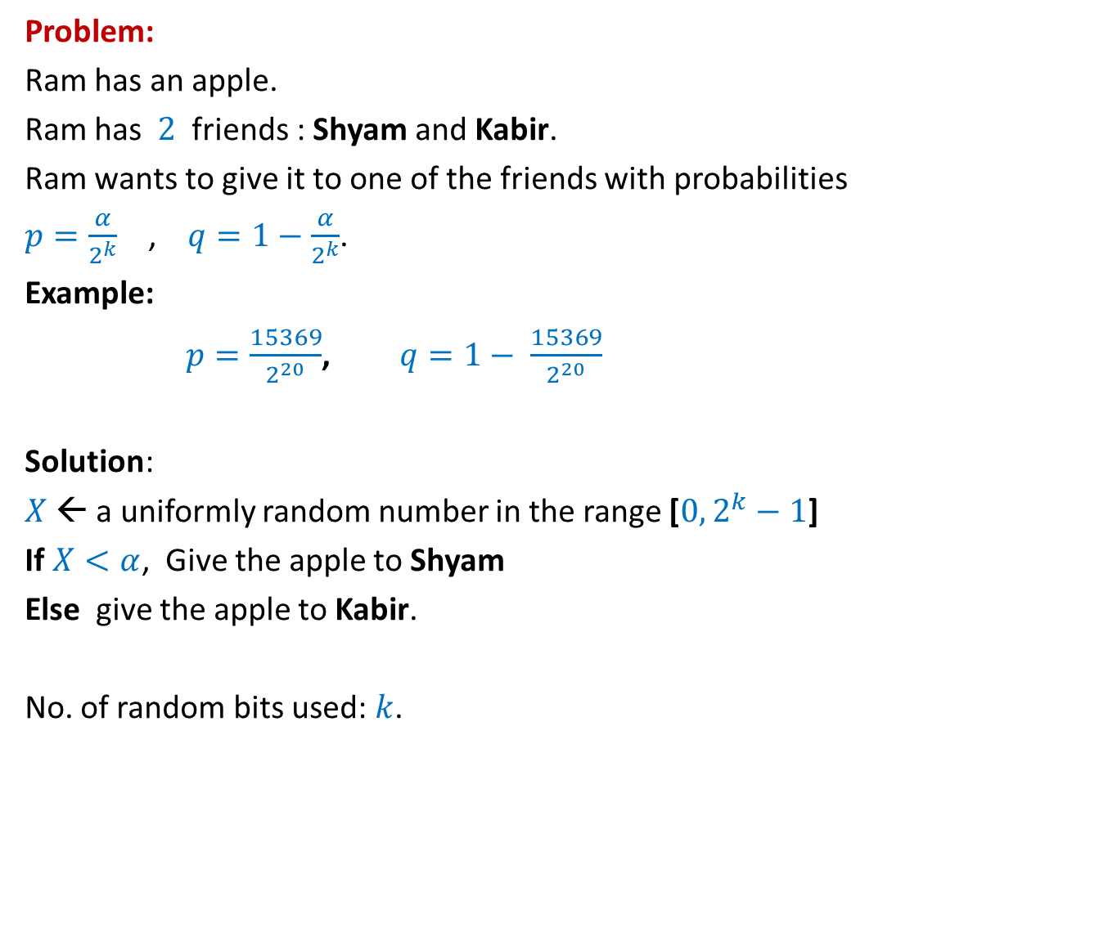
How many random bits ?
Problem:
Ram has an apple.
Ram has $2$ friends : Shyam and Kabir.
Ram wants to give it to one of the friends with probabilities
$p=\frac{α}{2^{k}}$ , $q=1−\frac{α}{2^{k}}$.
Example:
$p=\frac{15369}{2^{20}}$, $q=1− \frac{15369}{2^{20}}$
Solution:
$X$← a uniformly random number in the range [$0,2^{k}−1$]
If $X<α$, Give the apple to Shyam
Else give the apple to Kabir.
No. of random bits used: $k$.
$α$ : any given positive integer $≤2^{k}$
Can we do it in still fewer bits ?
Yes, in expectation ☺

Slide 9

An illustrative example
$$k=2$$
$p=\frac{1}{4}$, and
$1−p=\frac{3}{4}$

Slide 10
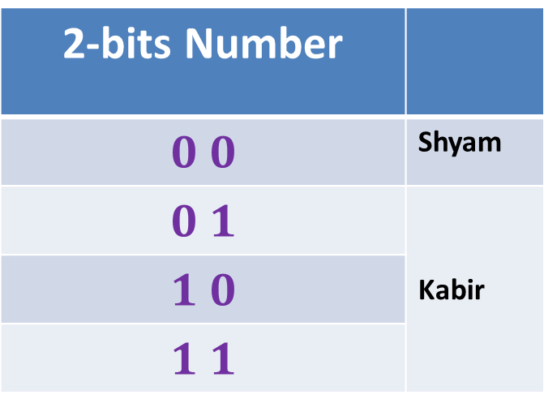
How many random bits ?
2-bits Number
$$0 0$$ | Shyam
$$0 1$$ | Kabir
$$1 0$$
$$1 1$$
Let us generate the random bits lazily
,i.e., only when it is absolutely necessary

Slide 11
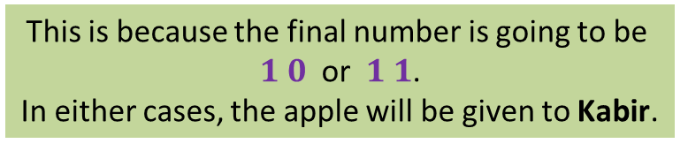


How many random bits ?
No.
2-bits Number
$$0 0$$ | Shyam
$$0 1$$ | Kabir
$$1 0$$
$$1 1$$
This is because the final number is going to be
$1 0$ or $1 1$.
In either cases, the apple will be given to Kabir.
$$1$$
Revealed
If the MSB is $1$,
do we need other bits of the number ?
Let us generate the MSB (Most Significant Bit) first.

Slide 12
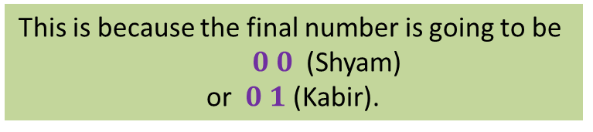

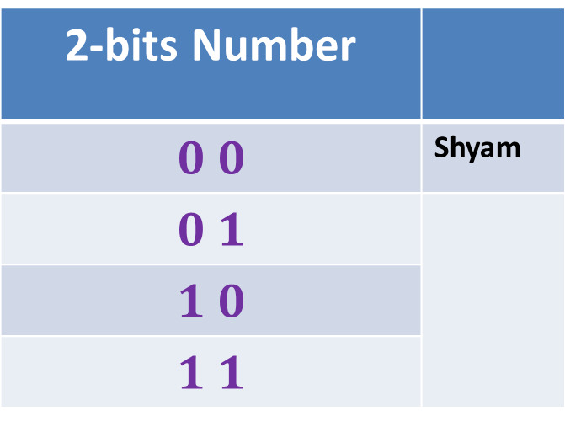



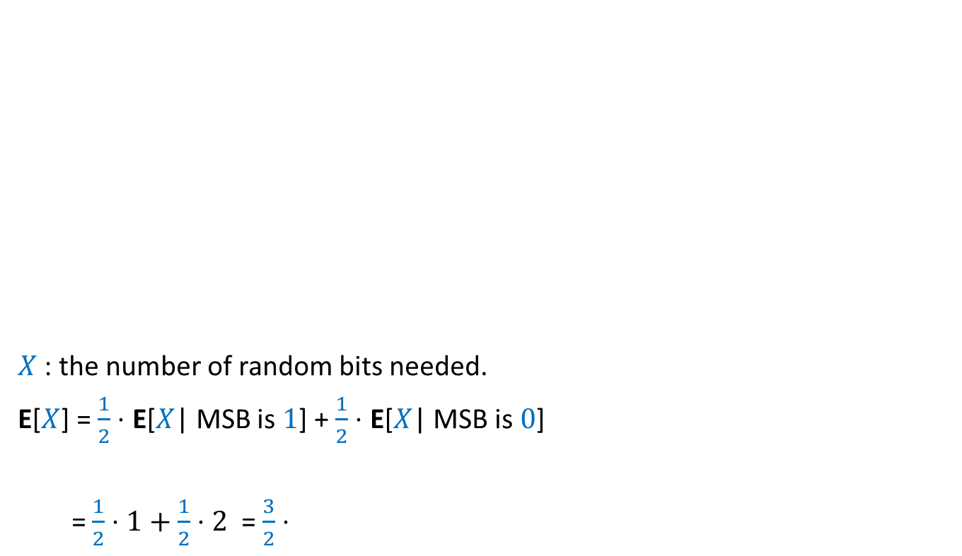



How many random bits ?
Yes.
2-bits Number
$$0 0$$ | Shyam
$$0 1$$
$$1 0$$
$$1 1$$
$X$ : the number of random bits needed.
E[$X$] = $\frac{1}{2}⋅$ E[$X$| MSB is $1$] + $\frac{1}{2}⋅$ E[$X$| MSB is $0$]
= $\frac{1}{2}⋅1+\frac{1}{2}⋅2$ = $\frac{3}{2}⋅$
This is because the final number is going to be
$0 0$ (Shyam)
or $0 1$ (Kabir).
Revealed
$$0$$
But now the problem becomes simpler. Can you see ?
Kabir
If the MSB is $0$,
do we need other bits of the number ?
It is now like the case of $k=1$ now.
$$1$$
$1+$ No. of bits to distribute with $p=\frac{1}{2}$
$$2$$
That is, distributing with $p=\frac{1}{2}$ .

Slide 13
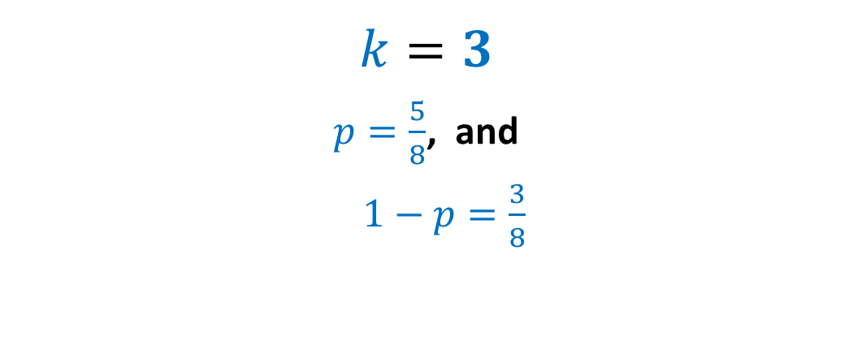
An illustrative example
$$k=3$$
$p=\frac{5}{8}$, and
$1−p=\frac{3}{8}$

Slide 14
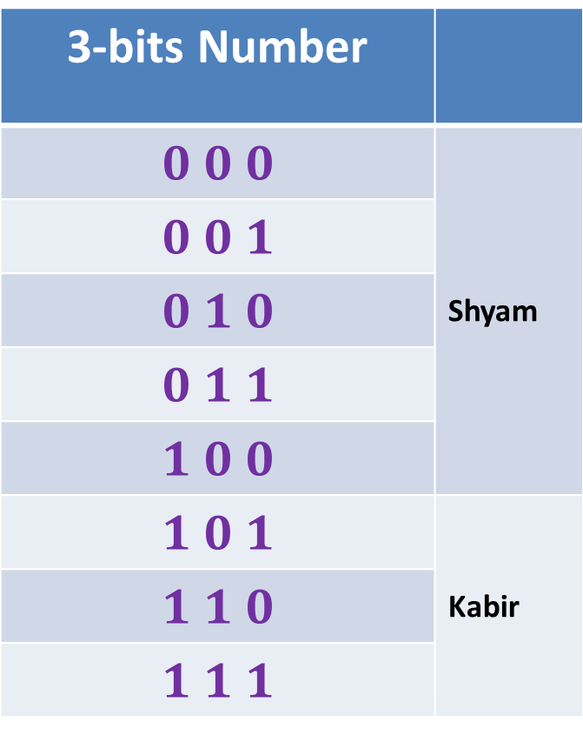
How many random bits ?
3-bits Number
$$0 0 0$$ | Shyam
$$0 0 1$$
$$0 1 0$$
$$0 1 1$$
$$1 0 0$$
$$1 0 1$$ | Kabir
$$1 1 0$$
$$1 1 1$$
Let us generate the random bits lazily
,i.e., only when it is absolutely necessary

Slide 15
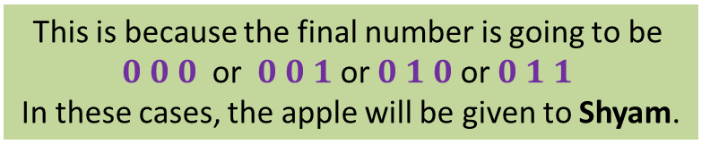
How many random bits ?
No.
3-bits Number
$$0 0 0$$ | Shyam
$$0 0 1$$
$$0 1 0$$
$$0 1 1$$
$$1 0 0$$
$$1 0 1$$ | Kabir
$$1 1 0$$
$$1 1 1$$
This is because the final number is going to be
$0 0 0$ or $0 0 1$ or $0 1 0$ or $0 1 1$
In these cases, the apple will be given to Shyam.
$$0$$
Revealed
If the MSB is $0$,
do we need other bits of the number ?
Let us generate the MSB (Most Significant Bit) first.

Slide 16

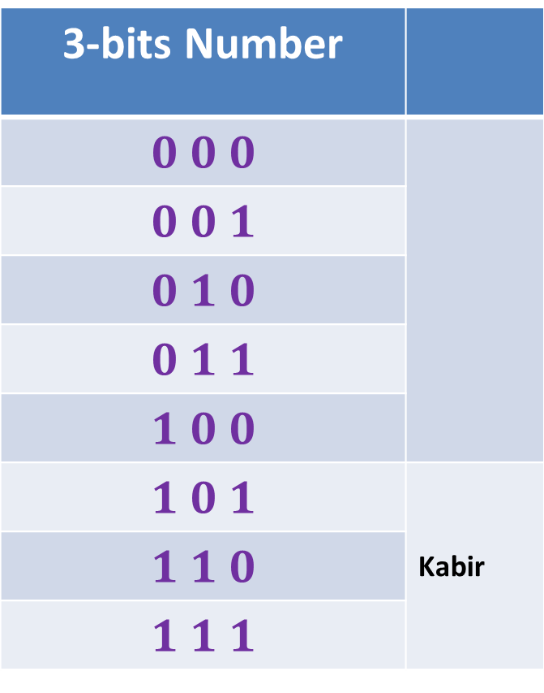

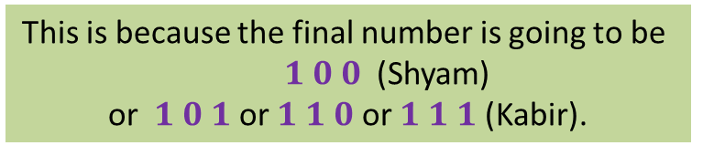
How many random bits ?
Yes.
3-bits Number
$$0 0 0$$
$$0 0 1$$
$$0 1 0$$
$$0 1 1$$
$$1 0 0$$
$$1 0 1$$ | Kabir
$$1 1 0$$
$$1 1 1$$
This is because the final number is going to be
$1 0 0$ (Shyam)
or $1 0 1$ or $1 1 0$ or $1 1 1$ (Kabir).
$$1$$
Shyam
2-bits Number
But now the problem becomes simpler. Can you see ?
If the MSB is $1$,
do we need other bits of the number ?
Revealed
It is now like the case of $k=2$ now.
That is, distributing with $p=\frac{1}{4}$ .
Let us generate the MSB (Most Significant Bit) first.

Slide 17



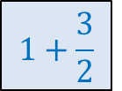
$X$ : the number of random bits needed.
E[$X$] = $\frac{1}{2}⋅$ E[$X$| MSB is $0$] + $\frac{1}{2}⋅$ E[$X$| MSB is $1$]
= $\frac{1}{2}⋅1+\frac{1}{2}⋅\frac{5}{2}$
= $\frac{7}{4}⋅$
$$1$$
$1+$ Expected no. of bits to distribute with $p=\frac{1}{4}$
$$1+\frac{3}{2}$$

Slide 18
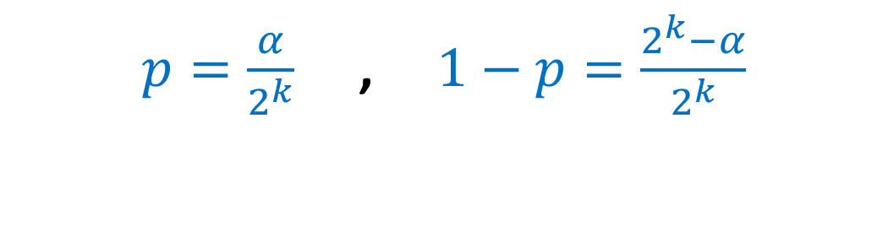
The generic example
$p=\frac{α}{2^{k}}$ , $1−p=\frac{2^{k}−α}{2^{k}}$

Slide 19





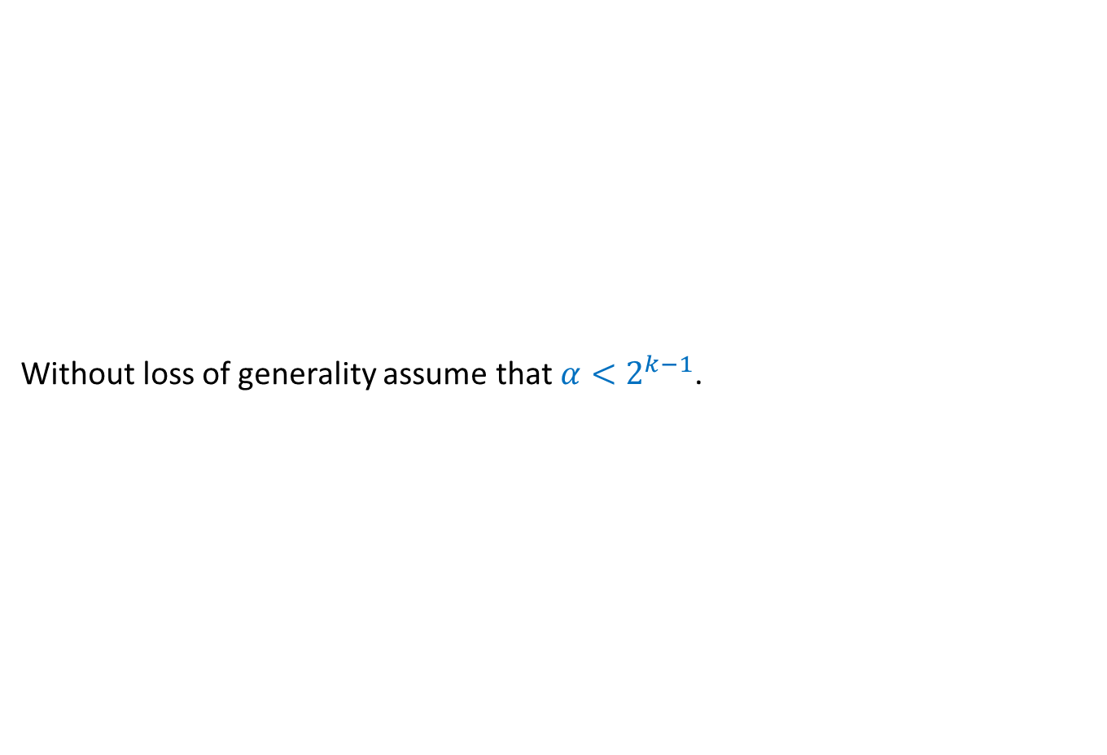
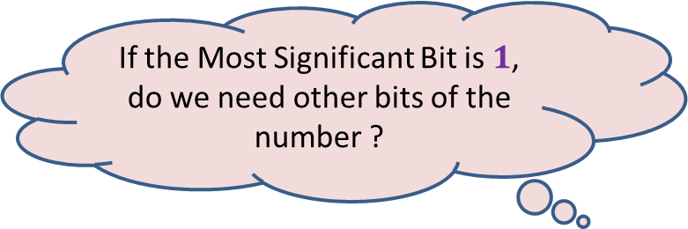








How many random bits ?
Not needed
Without loss of generality assume that $α<2^{k−1}$.
$$1$$ | $$1$$ | $$0$$ | $$1$$ | $$0$$ | $$0$$ | $$0$$ | $$1$$
$$1 2 … k$$
Shyam
Kabir
$$0$$
$$α−1$$
$$2^{k−1}−1$$
$$2^{k}−1$$
$$0 0 0…0$$
$$0 1 1…1$$
$$1 1 1…1$$
$k0$’s
$(k−1)1$’s
$$k{ 1}^{′}s$$
If the Most Significant Bit is $1$,
do we need other bits of the number ?
Suppose a random $k$-bit number is generated.

Slide 20








How many random bits ?
B($α,k$) : Expected number of bits to divide with parameters $p=\frac{α}{2^{k}}$
B($α, k$) = $1 + \frac{1}{2}⋅0 +\frac{1}{2}⋅$
= $1+\frac{1}{2}⋅$ B($α,k−1$)
$$0$$
$$1 2 … k$$
$$0$$
$$α−1$$
$$2^{k−1}−1$$
$$0 0 0…0$$
$$0 1 1…1$$
$$1 1 1…1$$
$$k−1$$
$$k$$
If the Most Significant Bit is $0$,
do we need other bits of the number ?
B($α,k−1$)
Yes, indeed.
$$<2$$
But problem now reduces to a smaller problem.
Think over it before pressing next button...

Slide 21

Computing a random sample of size $k$from [$0,n−1$]
In an efficient manner.

Slide 22


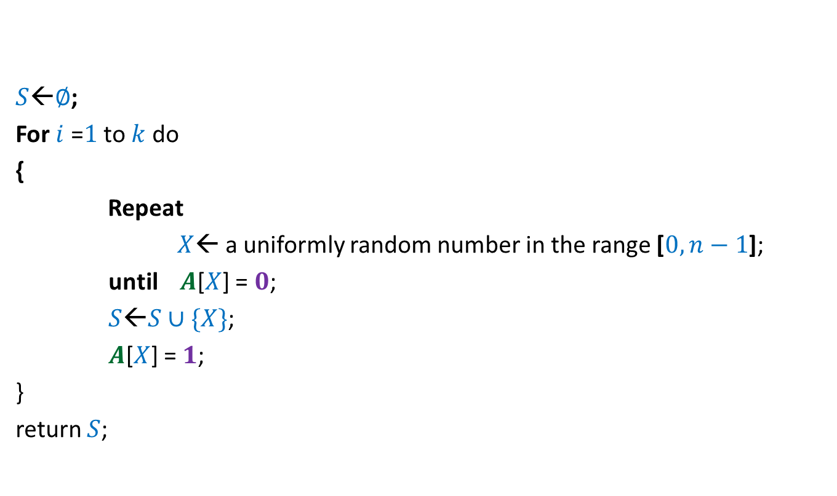



$$0$$ | $$0$$ | $$0$$ | $$0$$ | $$0$$ | $$0$$ | $$0$$ | $$0$$
$$A$$
$$1$$
$$1$$
$$1$$
$$1$$
$S$←$∅$;
For $i$ =$1$ to $k$ do
{
Repeat
$X$← a uniformly random number in the range [$0,n−1$];
until $A$[$X$] = $0$;
$S$←$S∪\{X\}$;
$A$[$X$] = $1$;
}
return $S$;
$$0 1 … n−1$$
Homework: Prove that the algorithm indeed computes a uniformly random sample.

Slide 23

Computing a random permutation of [$0,m−1$]
In an efficient manner.

Slide 24

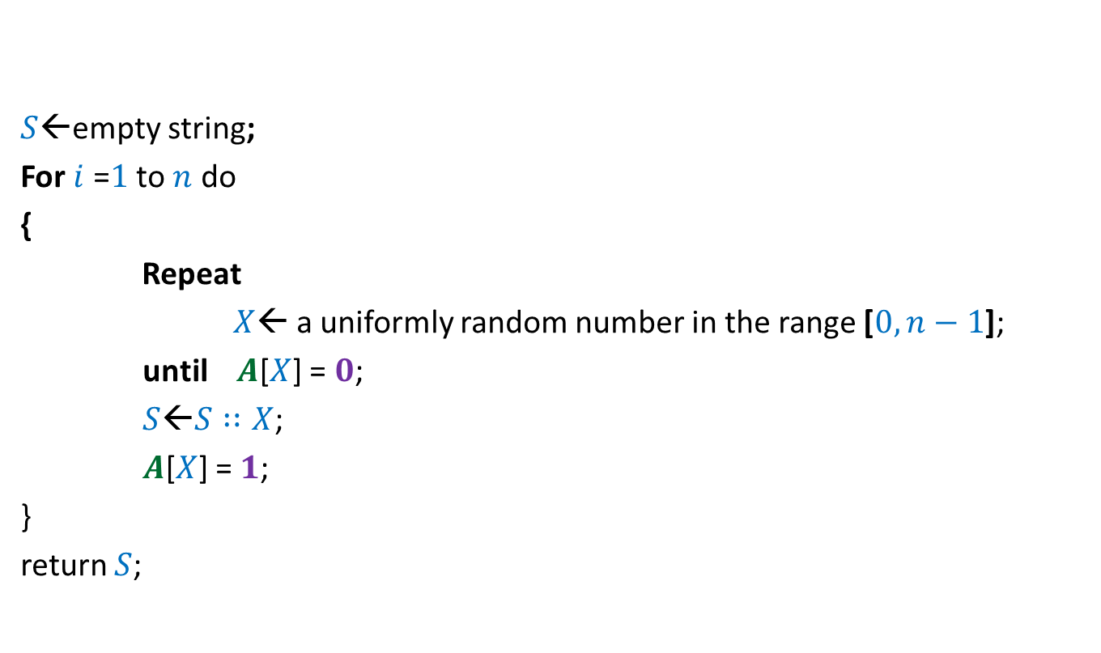
$$0$$ | $$0$$ | $$0$$ | $$0$$ | $$0$$ | $$0$$ | $$0$$ | $$0$$
$$A$$
$$1$$
$$1$$
$$1$$
$$1$$
$$1$$
$$1$$
$S$←empty string;
For $i$ =$1$ to $n$ do
{
Repeat
$X$← a uniformly random number in the range [$0,n−1$];
until $A$[$X$] = $0$;
$S$←$S∷X$;
$A$[$X$] = $1$;
}
return $S$;
$$0 1 … n−1$$
What is the expected no. of calls to “random number generator” this algorithm makes ?
Homework: Prove that the algorithm indeed computes a uniformly random permutation.

