Slide 1
Mathematic for Computer Science - III CS203B
Lecture 11:
Function of random variable
Tools for bounding deviation of a random variable

Slide 2
Homework
From the last class

Slide 3

Computing a random permutation of [$0,n−1$]
In an efficient manner.

Slide 4



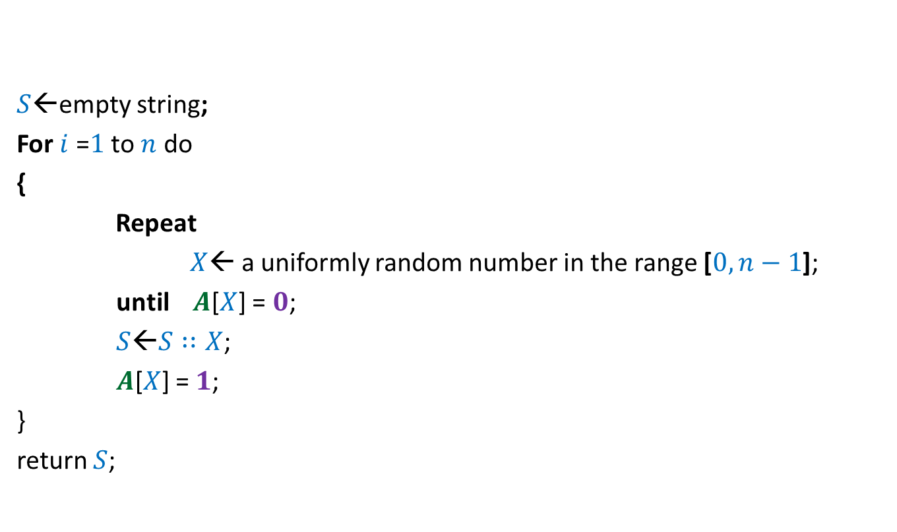



$$0$$ | $$0$$ | $$0$$ | $$0$$ | $$0$$ | $$0$$ | $$0$$ | $$0$$
$$A$$
$$1$$
$$1$$
$$1$$
$$1$$
$$1$$
$$1$$
$S$←empty string;
For $i$ =$1$ to $n$ do
{
Repeat
$X$← a uniformly random number in the range [$0,n−1$];
until $A$[$X$] = $0$;
$S$←$S∷X$;
$A$[$X$] = $1$;
}
return $S$;
$$0 1 … n−1$$
What is the expected no. of calls to “random number generator” this algorithm makes ?
Homework: Prove that the algorithm indeed computes a uniformly random permutation.

Slide 5

It was a huge disappointment to find that hardly $2−3$ students only attempted these homework problems.

Slide 6
Homework 1
To be solved in the next class
Expectation of
a random number of random variables

Slide 7


Elevator problem
The number of people that enter an elevator at ground floor
is a Poisson random variable with mean $10$.
There are $N$ floors above the ground floor.
Each person is equally likely to get off at any one of the $N$ floors independently.
Compute the expected number of stops that the elevator will make before
discharging all of its passengers.

Slide 8
Homework 2
To be solved in the next class
Expected value of
Product of independent random variables

Slide 9





$X$ : a random variable defined over a probability space ($Ω$,P).
$Y$ : a random variable defined over the same probability space.
$X$ and $Y$ are independent.
Theorem:
$$E\left[X⋅Y\right]=E\left[X\right]⋅E[Y]$$
For all $b∈Y, a∈X$
$$P\left[X=a | Y=b\right]$$
?
$$P[X=a]$$
$$=$$

Slide 10
Functions of random variables

Slide 11










What do these expressions mean ?
$X$ : a random variable defined over a probability space ($Ω$,P).
Random variables
Value taken for elementary event $ω$
$aX+b$
$aX(ω)+b$
$$X^{2}$$
$$({X(ω))}^{2}$$
$$\frac{1}{X}$$
$$\frac{1}{X(ω)}$$
$$e^{X}$$
$$e^{X(ω)}$$

Slide 12







Under what conditions ?
$X$ : a random variable defined over a probability space ($Ω$,P).
$$y=f(x)$$
$$Y=f\left(X\right)$$
Let $y$ be any function defined on a subset of real numbers
$Y$ can be viewed as a random variable
Range of $f$
$$⊆$$
A subset of Real no.
Domain of $f$
$$⊇$$
Range of $X$
To ensure that $f$ is defined for each value taken by $X$.
requirement to be a random variable

Slide 13
Examples

Slide 14
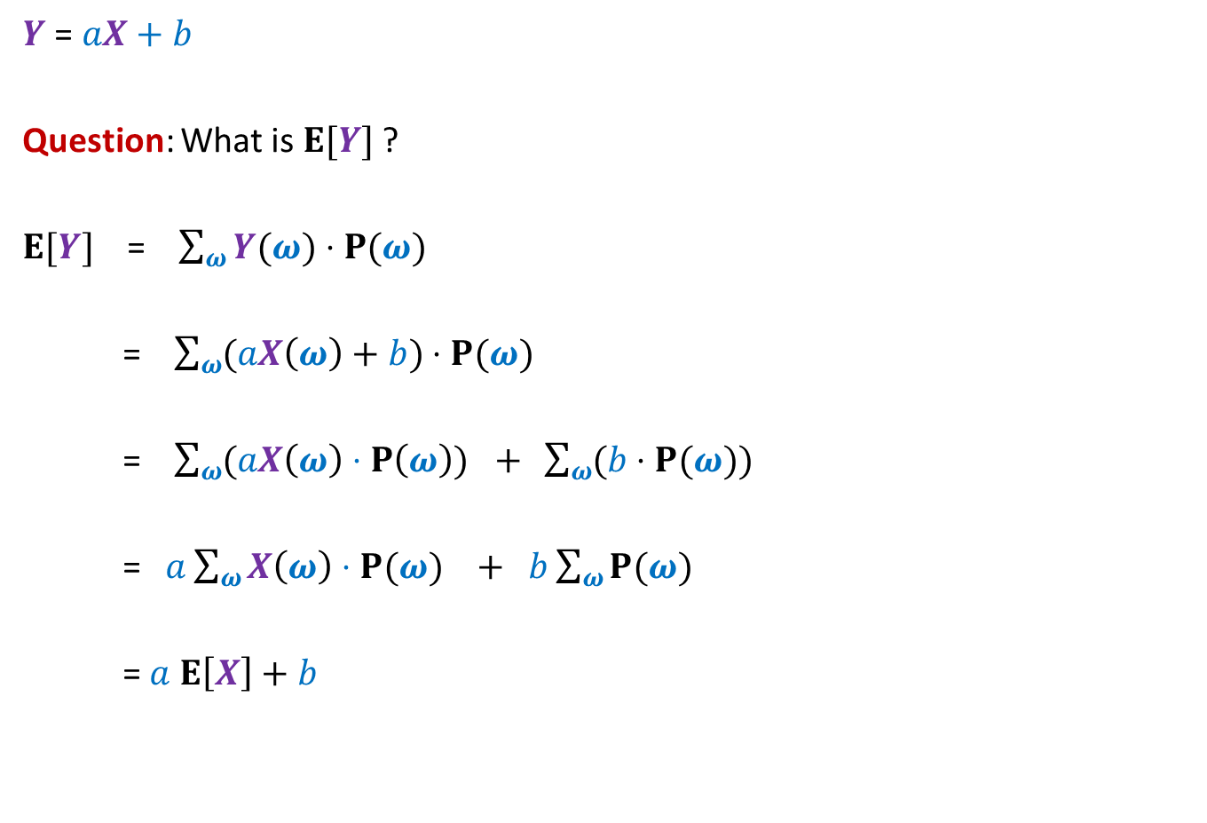

$aX+b$
$Y$ = $aX+b$
Question: What is $E[Y]$ ?
$E[Y]$ = $\sum_{ω}{Y(ω)}⋅P(ω)$
= $\sum_{ω}{(aX\left(ω\right)+b})$ $⋅P(ω)$
= $\sum_{ω}{(aX\left(ω\right)⋅P\left(ω\right))}$ $+ \sum_{ω}{(b}⋅P(ω))$
= $a\sum_{ω}{X\left(ω\right)⋅P(ω)}$ $+ b\sum_{ω}{P(ω)}$
= $a$ $E\left[X\right]+b$

Slide 15
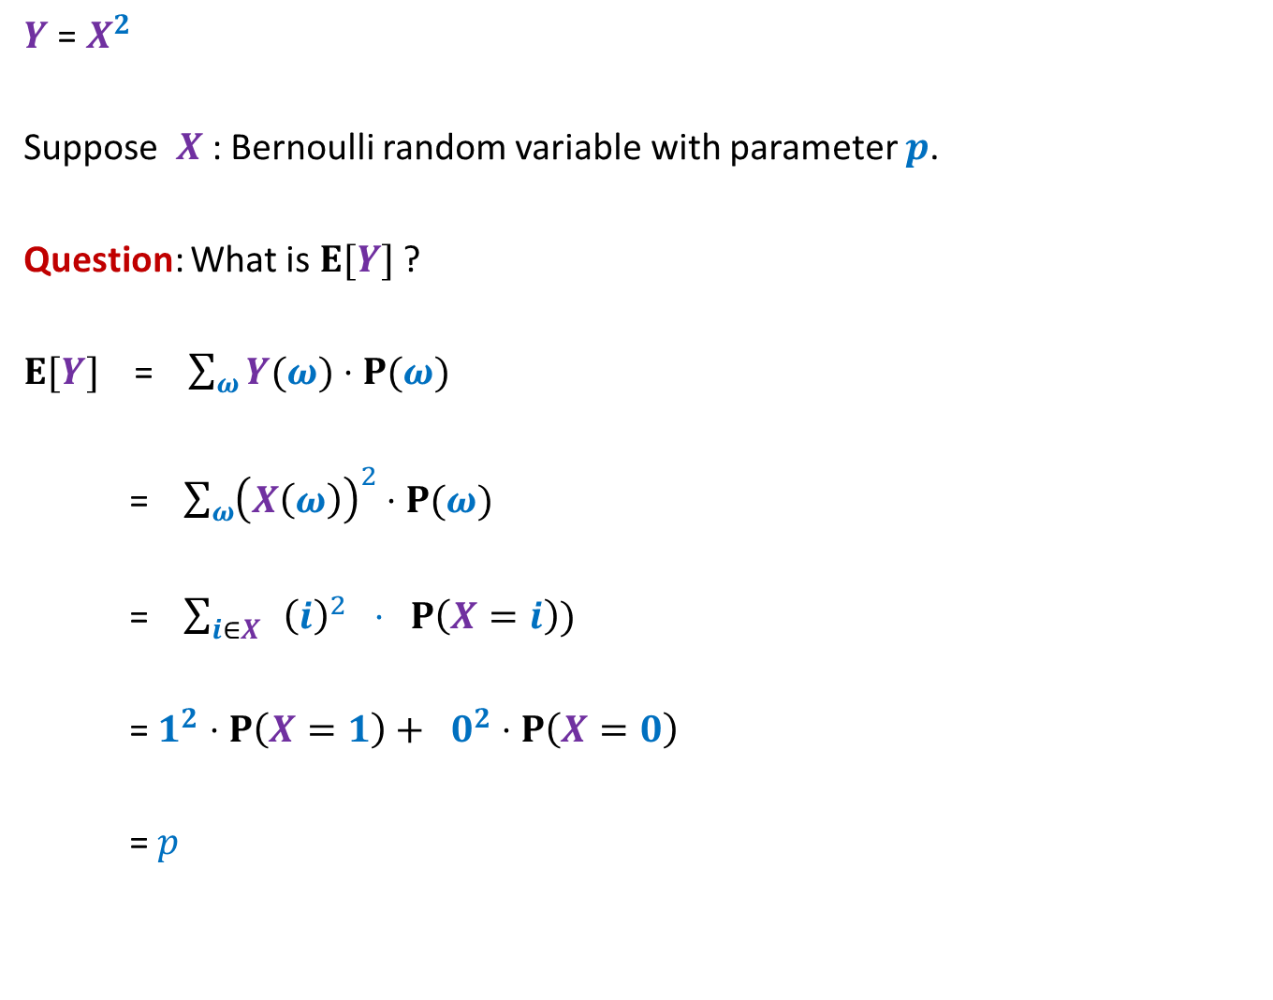

$X^{2}$
$Y$ = $X^{2}$
Suppose $X$ : Bernoulli random variable with parameter $p$.
Question: What is $E[Y]$ ?
$E[Y]$ = $\sum_{ω}{Y(ω)}⋅P(ω)$
= $\sum_{ω}{{\left(X\left(ω\right)\right)}^{2}}$ $⋅P(ω)$
= $\sum_{i∈X}{{ \left(i\right)}^{2} ⋅ P\left(X=i\right))}$
=$1^{2}⋅P\left(X=1\right)+ 0^{2}⋅P\left(X=0\right)$
= $p$

Slide 16

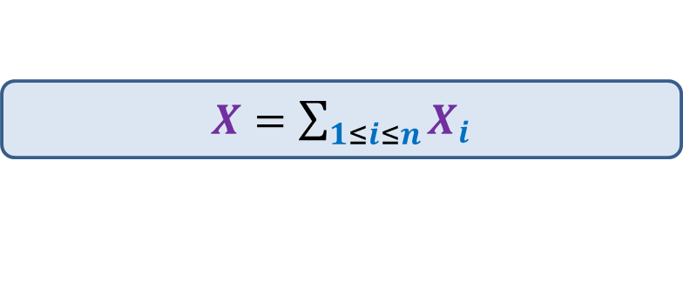

$X^{2}$
$Y$ = $X^{2}$
Suppose $X$ : Binomial random variable with parameters $n$and $p$.
Question: What is $E[Y]$ ?
$E[Y]$ = $\sum_{ω}{{\left(X\left(ω\right)\right)}^{2}}$ $⋅P(ω)$
= $\sum_{i∈X}{{ \left(i\right)}^{2} ⋅ P\left(X=i\right))}$
$$\left({n \atop i}\right)⋅p^{i}⋅{\left(1−p\right)}^{n−i}$$
$X=\sum_{1≤i≤n}{X_{i}}$
Where $X_{i}$’s are $n$ independent Bernoulli random variable.

Slide 17

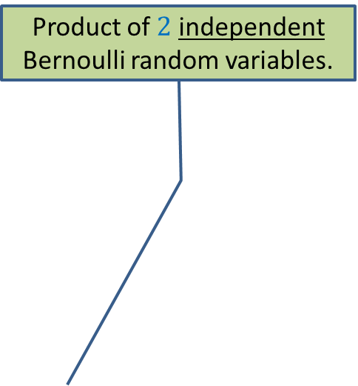

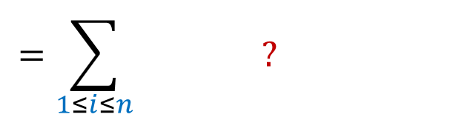

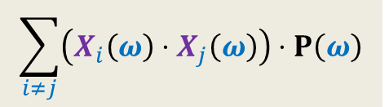
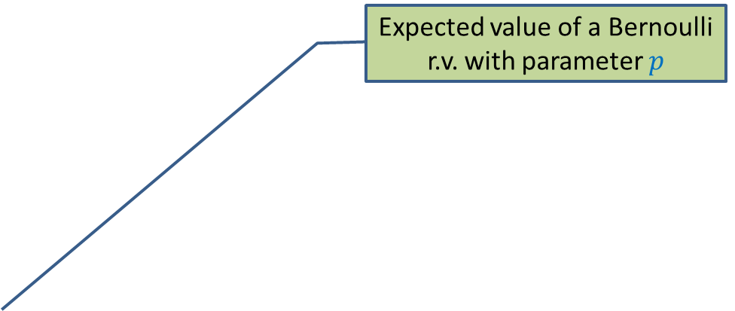
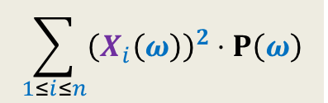

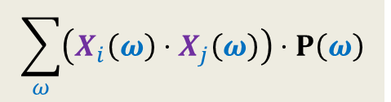

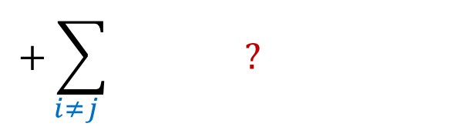
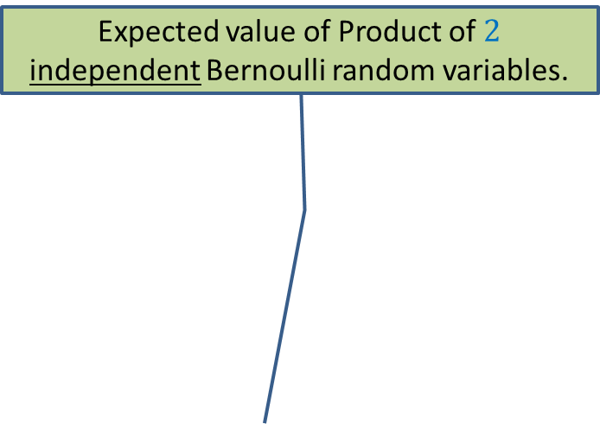
$X^{2}$
$Y$ = $X^{2}$
Suppose $X$ : Binomial random variable with parameters $n$and $p$.
Question: What is $E[Y]$ ?
$E[Y]$ = $\sum_{ω}{{\left(X\left(ω\right)\right)}^{2}}$ $⋅P(ω)$
= $\sum_{ω}{{ \left(X_{1}\left(ω\right)+X_{2}\left(ω\right)+⋯+X_{n}\left(ω\right)\right)}^{2} ⋅ P\left(ω\right)}$
Expected value of Product of $2$ independent Bernoulli random variables.
Product of $2$ independent Bernoulli random variables.
Expected value of a Bernoulli r.v. with parameter $p$
$$=\sum_{ω}{ ? + ?}$$
$$\sum_{1≤i≤n}{{\left(X_{i}\left(ω\right)\right)}^{2}}⋅P\left(ω\right)$$
$$\sum_{i≠j}{\left(X_{i}\left(ω\right)⋅X_{j}\left(ω\right)\right)⋅P\left(ω\right)}$$
$$=\sum_{1≤i≤n}{ ? }$$
$$n\left(n−1\right)p^{2}$$
$$np$$
$$+\sum_{i≠j }{ ? }$$
$$\sum_{ω}{{\left(X_{i}\left(ω\right)\right)}^{2}}⋅P\left(ω\right)$$
$$\sum_{ω}{\left(X_{i}\left(ω\right)⋅X_{j}\left(ω\right)\right)⋅P\left(ω\right)}$$

Slide 18

Homework
Suppose $X$ : Geometric random variable with parameter $p$.
What is $E[X^{2}]$ ?
What is $E[\frac{1}{X}]$ ?

Slide 19

How to show
P[$X≥(1+ε)E[X]$]
P[$X≤(1−ε)E[X]$]

Slide 20
Tools
Markov’s Inequality
Chebyshev’s Inequality
Chernoff bound

Slide 21

Markov’s Inequality
Theorem: Suppose $X$is a random variable defined over a probability space ($Ω$,P)
such that $X(ω)$≥ 0 for each $ω$ϵ $Ω$.
Then for any positive real number $a$,
P($X\text{≥}a$) $≤\frac{E[X]}{a}$
Important point 1:
Applicable only for a nonnegative random variable.
The proof of above theorem crucially exploits this fact.

Slide 22
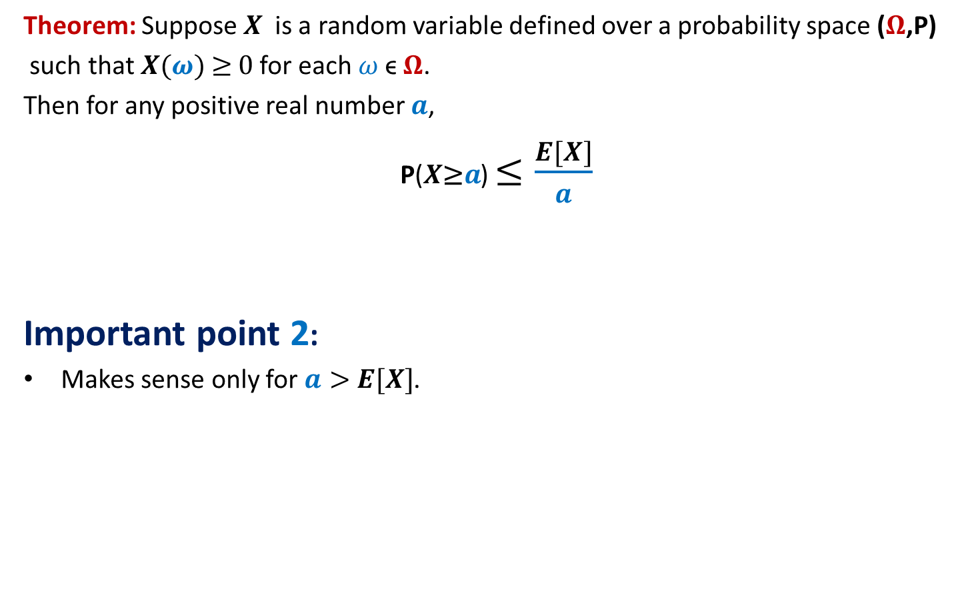
Markov’s Inequality
Theorem: Suppose $X$is a random variable defined over a probability space ($Ω$,P)
such that $X(ω)$≥ 0 for each $ω$ϵ $Ω$.
Then for any positive real number $a$,
P($X\text{≥}a$) $≤\frac{E[X]}{a}$
Important point 2:
Makes sense only for $a>$ $E[X]$.
Otherwise, probability of the above event becomes $>1$ and hence useless.

Slide 23
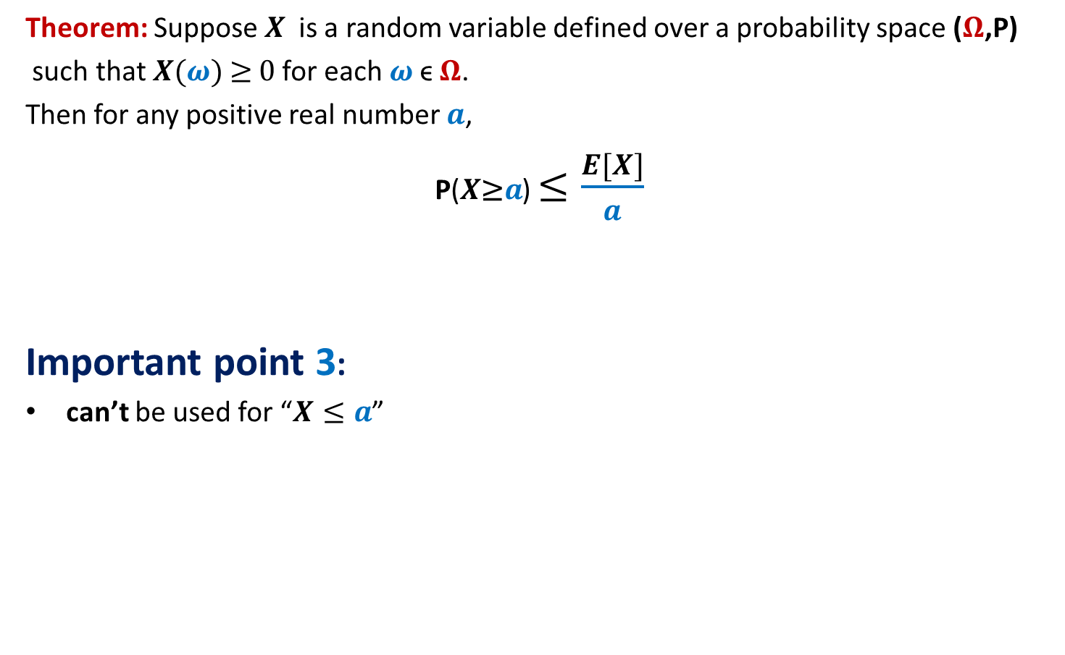
Markov’s Inequality
Theorem: Suppose $X$is a random variable defined over a probability space ($Ω$,P)
such that $X(ω)$≥ 0 for each $ω$ϵ $Ω$.
Then for any positive real number $a$,
P($X\text{≥}a$) $≤\frac{E[X]}{a}$
Important point 3:
can’t be used for “$X≤a$”
Try on your own to realize it.
Also see the proof of above theorem to get convinced.

Slide 24

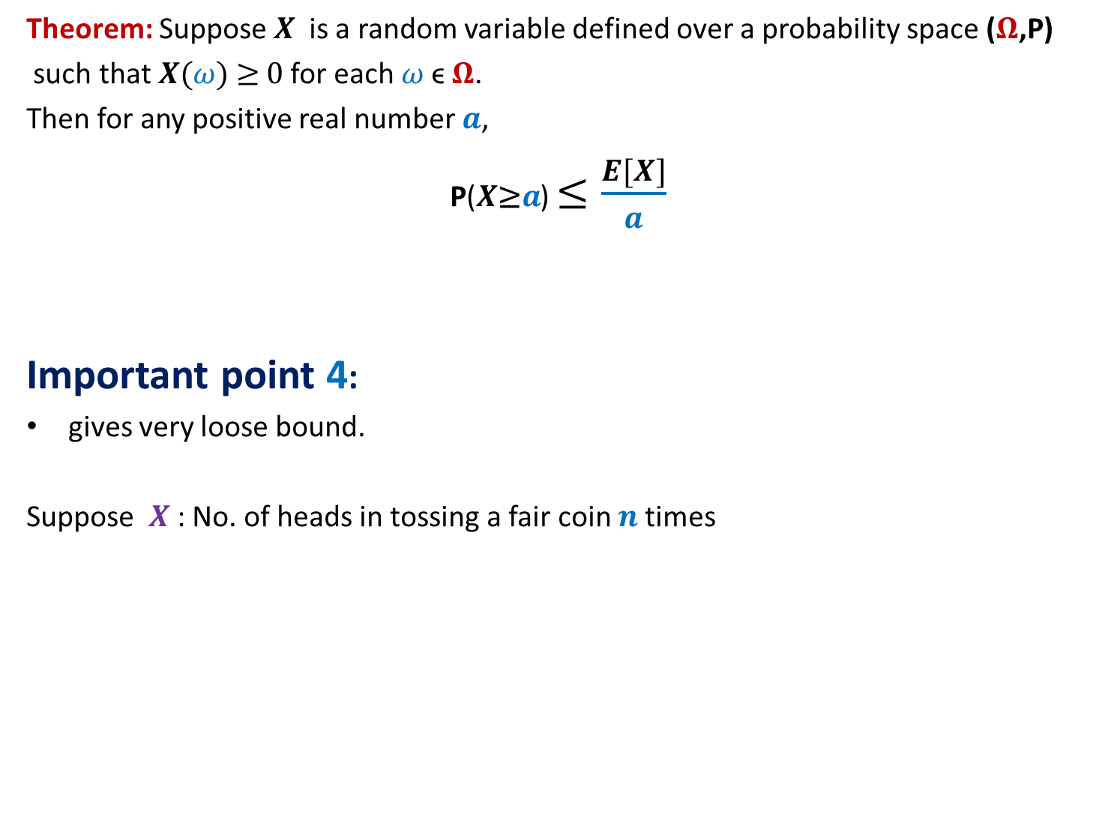
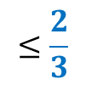
Markov’s Inequality
Theorem: Suppose $X$is a random variable defined over a probability space ($Ω$,P)
such that $X(ω)$≥ 0 for each $ω$ϵ $Ω$.
Then for any positive real number $a$,
P($X\text{≥}a$) $≤\frac{E[X]}{a}$
Important point 4:
gives very loose bound.
Suppose $X$ : No. of heads in tossing a fair coin $n$times
so not useful most of the times ☹.
P($X\text{≥} \frac{3}{4}n$)
$$≤\frac{2}{3}$$
But, it plays a key role in deriving other powerful inequalities,
like Chebyshev Inequaity and Chernoff bound ☺.

Slide 25

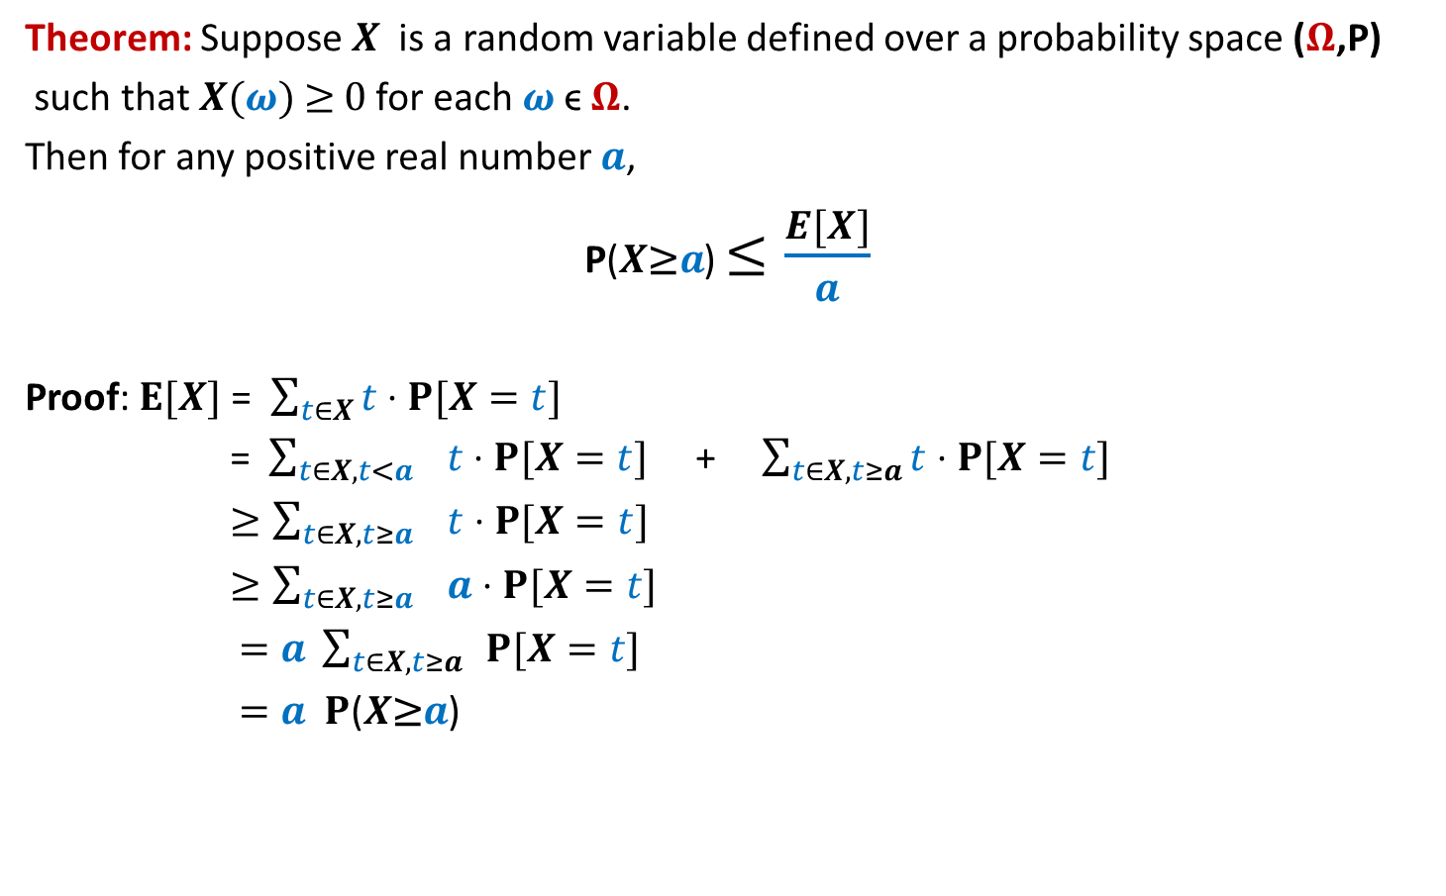

Markov’s Inequality
Theorem: Suppose $X$is a random variable defined over a probability space ($Ω$,P)
such that $X(ω)$≥ 0 for each $ω$ϵ $Ω$.
Then for any positive real number $a$,
P($X\text{≥}a$) $≤\frac{E[X]}{a}$
Proof: $E[X]$ = $\sum_{t∈X}{t}⋅P[X=t]$
= $\sum_{t∈X,t<a}{ t}⋅P[X=t]$ + $\sum_{t∈X,t≥a}{t}⋅P[X=t]$
$≥\sum_{t∈X,t≥a}{ t}⋅P[X=t]$
$≥\sum_{t∈X,t≥a}{ a}⋅P[X=t]$
$=a \sum_{t∈X,t≥a}{ }P[X=t]$
$=a P$($X\text{≥}a$)
Since $X(ω)$≥ 0
$a P$($X\text{≥}a$)
Try to internalize this proof fully.

