Slide 1
Mathematic for Computer Science - III CS203B
Lecture 5:
Random variables and expected value

Slide 2
Homework from last class

Slide 3
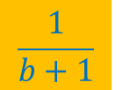
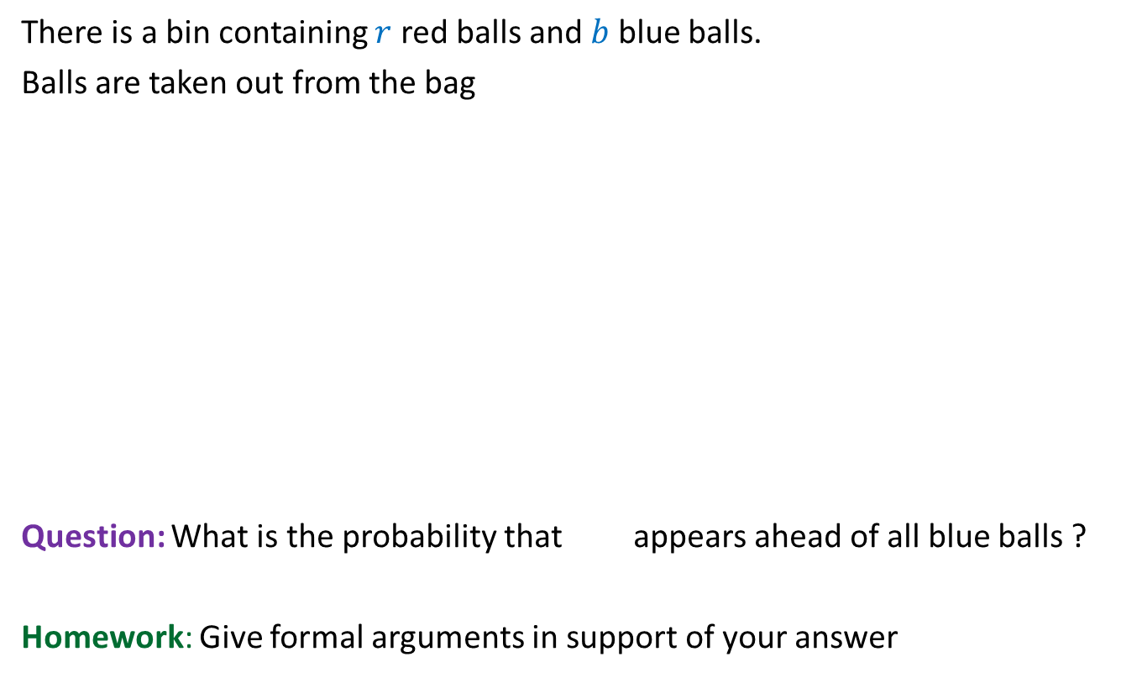
Balls Out of Bin
There is a bin containing $r$ red balls and $b$ blue balls.
Balls are taken out from the bag
Question: What is the probability that appears ahead of all blue balls ?
Homework: Give formal arguments in support of your answer
uniformly randomly
and without replacement.
$$\frac{1}{b+1}$$
by applying Partition Theorem carefully.

Slide 4
Recruitment problem

Slide 5







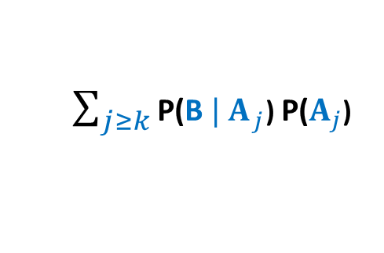



Conditioned on even $A_{j}$,
you will have to define a partition of the reduced sample space based on
“the set of applicants that occupy first $j−1$ positions”.
Then provide suitable arguments to conclude that $\text{P}\text{(}{\text{B} | A}_{j}$) is $\frac{k}{j−1}$ .
B :
the best person is selected.
$A_{j}$ :
“the best” candidate is
occupying the $j$th place
$\text{P}\text{(}\text{B}$) =
$\sum_{j≥k}{\text{P}\text{(}{\text{B} | A}_{j}}$) $\text{P}\text{(}A_{j}$)
$$?$$
$$\frac{1}{n}$$
B
Ω
$$j$$
$$1 2 k n$$
Hint:
Under what conditions will
the best applicant be selected if $A_{j}$ happens ?
Answer:
the best among the first $j−1$ applicants
is occupying a position among the first $k$.

Slide 6
Random Variable

Slide 7

Tossing a fair coin 5 times
Probability of getting
at least 3 HEADS in 5 tosses
Number of HEADS in 5 tosses
0 to 5

Slide 8
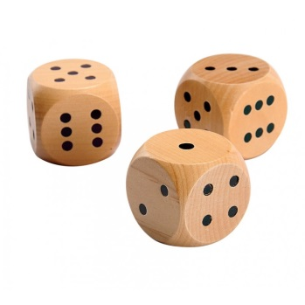
Throwing 3 dices
Probability of getting
total sum 10 in 3 throws
Sum of numbers in 3 throws
3 to 18

Slide 9

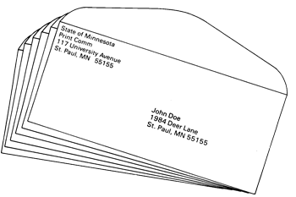

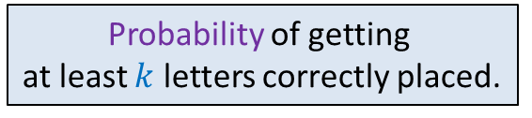



Putting $n$ letters randomly uniformly into $n$envelopes
$n$ envelopes
Probability of getting
at least $k$ letters correctly placed.
$n$ letters
The numbers of letters that are correctly placed.
0 to $n$

Slide 10

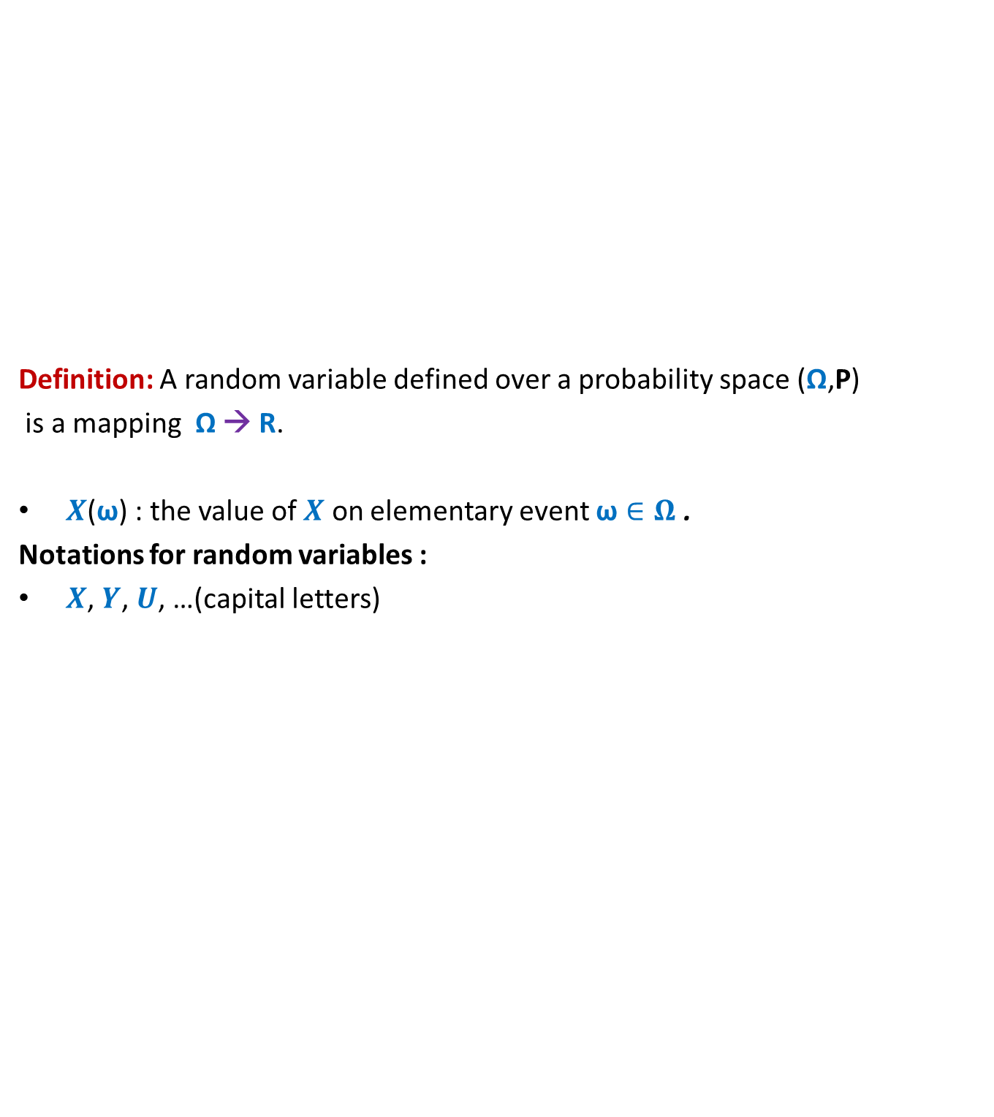
Random variable
Definition: A random variable defined over a probability space (Ω,P)
is a mapping Ω → R.
$X$($\text{ω}$) : the value of $X$ on elementary event $\text{ω}∈Ω$ .
Notations for random variables :
$X$, $Y$, $U$, …(capital letters)
$$X$$
Set of real numbers
R
Ω

Slide 11
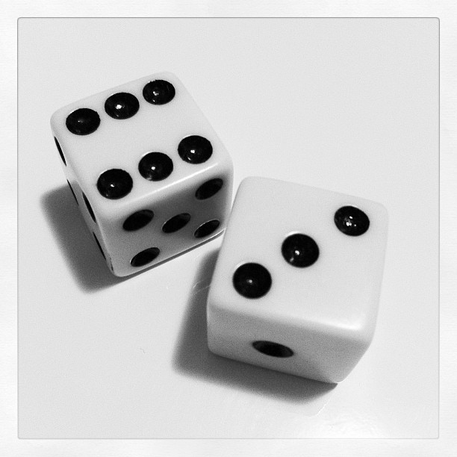
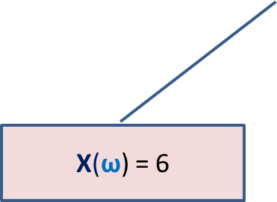
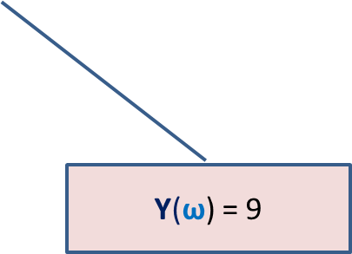

Many Random Variables for the same Probability space
Random Experiment: Throwing a dice two times
X : the largest number seen
Y : sum of the two numbers seen
X($\text{ω}$) = 6
$$\text{ω}$$
Y($\text{ω}$) = 9

Slide 12
Expected value of a random variable

Slide 13
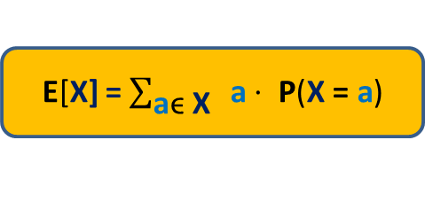

Expected Value of a random variable (average value)
Definition: Expected value of a random variable X defined over a probability space (Ω,P) is
E[X] = $\sum_{\text{ω}\text{ϵ} \text{Ω}}{\text{X}\text{(}\text{ω}\text{)}⨯ \text{P}\text{(}\text{ω}\text{)}}$
X= c
Ω
X= a
X= b
E[X] = $\sum_{\text{a}\text{ϵ} \text{X}}{ \text{a}⋅ \text{P}\text{(}\text{X}\text{ = }\text{a}\text{)}}$

Slide 14


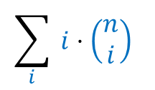









Example 1
Random experiment : A fair coin is tossed n times
X: The number of HEADS
E[X] = $\sum_{i}{i⋅ \text{P}\text{(}\text{X}\text{ =}i\text{)}}$
= ${ ⋅(1/2)}^{i}{ ⋅ (1/2)}^{n−i}$
= $1/{2^{n}}$
= $1/{2^{n}}$
= $\frac{n}{2}$
Replacing $x$ by $1$ on both sides.
$$\sum_{i}{ i⋅\left(\begin{matrix}n \\ i\end{matrix}\right)}$$
$$\sum_{i}{ i⋅\left(\begin{matrix}n \\ i\end{matrix}\right)}$$
Differentiating both sides with respect to $x$.
$${⋅n⋅2}^{n−1}$$
$${\left(1+x\right)}^{n}=$$
$$1+\left(\begin{matrix}n \\ 1\end{matrix}\right)x+ ⋯+\left(\begin{matrix}n \\ i\end{matrix}\right)x^{i}+⋯+\left(\begin{matrix}n \\ n\end{matrix}\right)x^{n}$$
$${n\left(1+x\right)}^{n−1}=$$
$$\left(\begin{matrix}n \\ 1\end{matrix}\right)+ ⋯+i⋅\left(\begin{matrix}n \\ i\end{matrix}\right)x^{i−1}+⋯+n⋅\left(\begin{matrix}n \\ n\end{matrix}\right)x^{n−1}$$
$${n⋅2}^{n−1}=$$
$$\left(\begin{matrix}n \\ 1\end{matrix}\right)+ ⋯+i⋅\left(\begin{matrix}n \\ i\end{matrix}\right)+⋯+n⋅\left(\begin{matrix}n \\ n\end{matrix}\right)$$

Slide 15





Example 2
Random Experiment : $3$letters into $3$ envelopes
X: The number of letters correctly placed into envelopes.
E[X] = $\sum_{i}{i⋅ \text{P}\text{(}\text{X}\text{ =}i\text{)}}$
= $1⋅ \text{P}\text{(}\text{X}\text{ =}1$)
= $1⋅$
= $1$
+ $3⋅\text{P}\text{(}\text{X}\text{ =}3$)
$$\frac{3}{6}$$
+ $3⋅$
$$\frac{1}{6}$$

Slide 16



Example 3
Random Experiment : Tossing a fair coin $5$ times
X: number of times pattern HHT appears.
E[X] = $\sum_{i}{i⋅ \text{P}\text{(}\text{X}\text{ =}i\text{)}}$
=
$$3$$
$$\frac{1}{8}$$
One simple solution is based on observation that there can be only one occurrence of HHT in 5 tosses. Another solution is based on solving the problem in a recursive manner. We follow the latter approach since it seems to be generalizable. So we start with the answer for 3, and then 4, and then solve for 5.

Slide 17





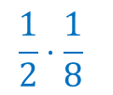
Example 3
Random Experiment : Tossing a fair coin $5$ times
X: number of times pattern HHT appears.
E[X] = $\sum_{i}{i⋅ \text{P}\text{(}\text{X}\text{ =}i\text{)}}$
=
=
$$4$$
T
$$\frac{1}{2}⋅\frac{1}{8}$$
$$\frac{1}{8}$$
$$\frac{1}{16}$$
*
H
+
+
H
T
$$\frac{1}{4}$$
H | H | H | T

Slide 18










Example 3
Random Experiment : Tossing a fair coin $5$ times
X: number of times pattern HHT appears.
E[X] = $\sum_{i}{i⋅ \text{P}\text{(}\text{X}\text{ =}i\text{)}}$
=
T
(
H | T
$$\frac{1}{2}$$
$$⋅\frac{1}{4}$$
$$\frac{1}{4}$$
$$⋅\frac{1}{8}$$
$$\frac{1}{4}$$
$$\frac{1}{2}$$
$$\frac{1}{4}$$
$$\frac{1}{8}$$
(
=
+
+
+
+
H | H
T * *
=
$$\frac{3}{8}$$
H | H | H | T | *
H | H | H | H | T

Slide 19
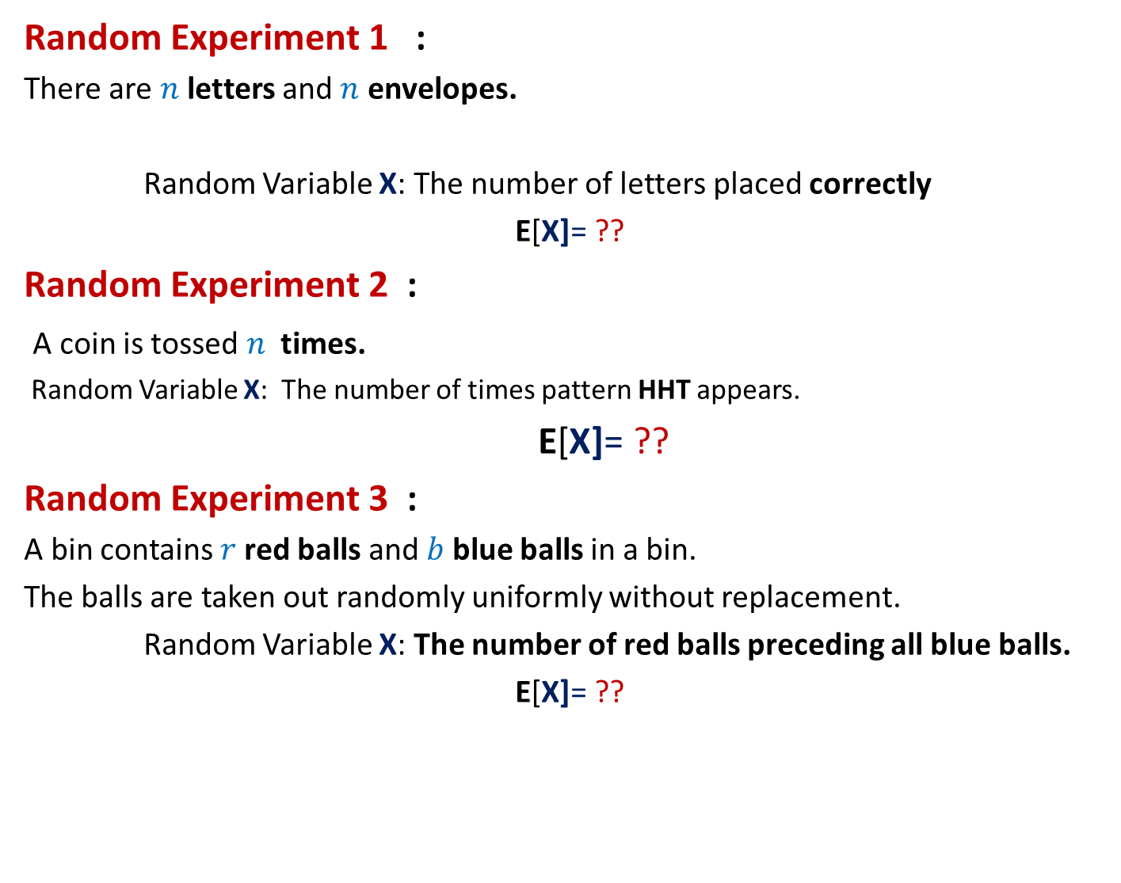
Can we solve these problems ?
Random Experiment 1 :
There are $n$letters and $n$ envelopes.
Random Variable X: The number of letters placed correctly
E[X]= ??
Random Experiment 2 :
A coin is tossed $n$ times.
Random Variable X: The number of times pattern HHT appears.
E[X]= ??
Random Experiment 3 :
A bin contains $r$red balls and $b$ blue balls in a bin.
The balls are taken out randomly uniformly without replacement.
Random Variable X: The number of red balls preceding all blue balls.
E[X]= ??

Slide 20
Spend at least 2 hours today trying to solve the 3 problems given in the previous slide.
These 2 hours will be very valuable for you in the long run.
I really mean it.

