Slide 1
Mathematic for Computer Science - III CS203B
Lecture 8:
Conditional Expectation contd.
An application in computer science

Slide 2
Summary of last class

Slide 3

Conditional Expectation
$$E[X|ε]$$
We are revisiting this concept to ensure that you fully internalize this concept and its use.

Slide 4

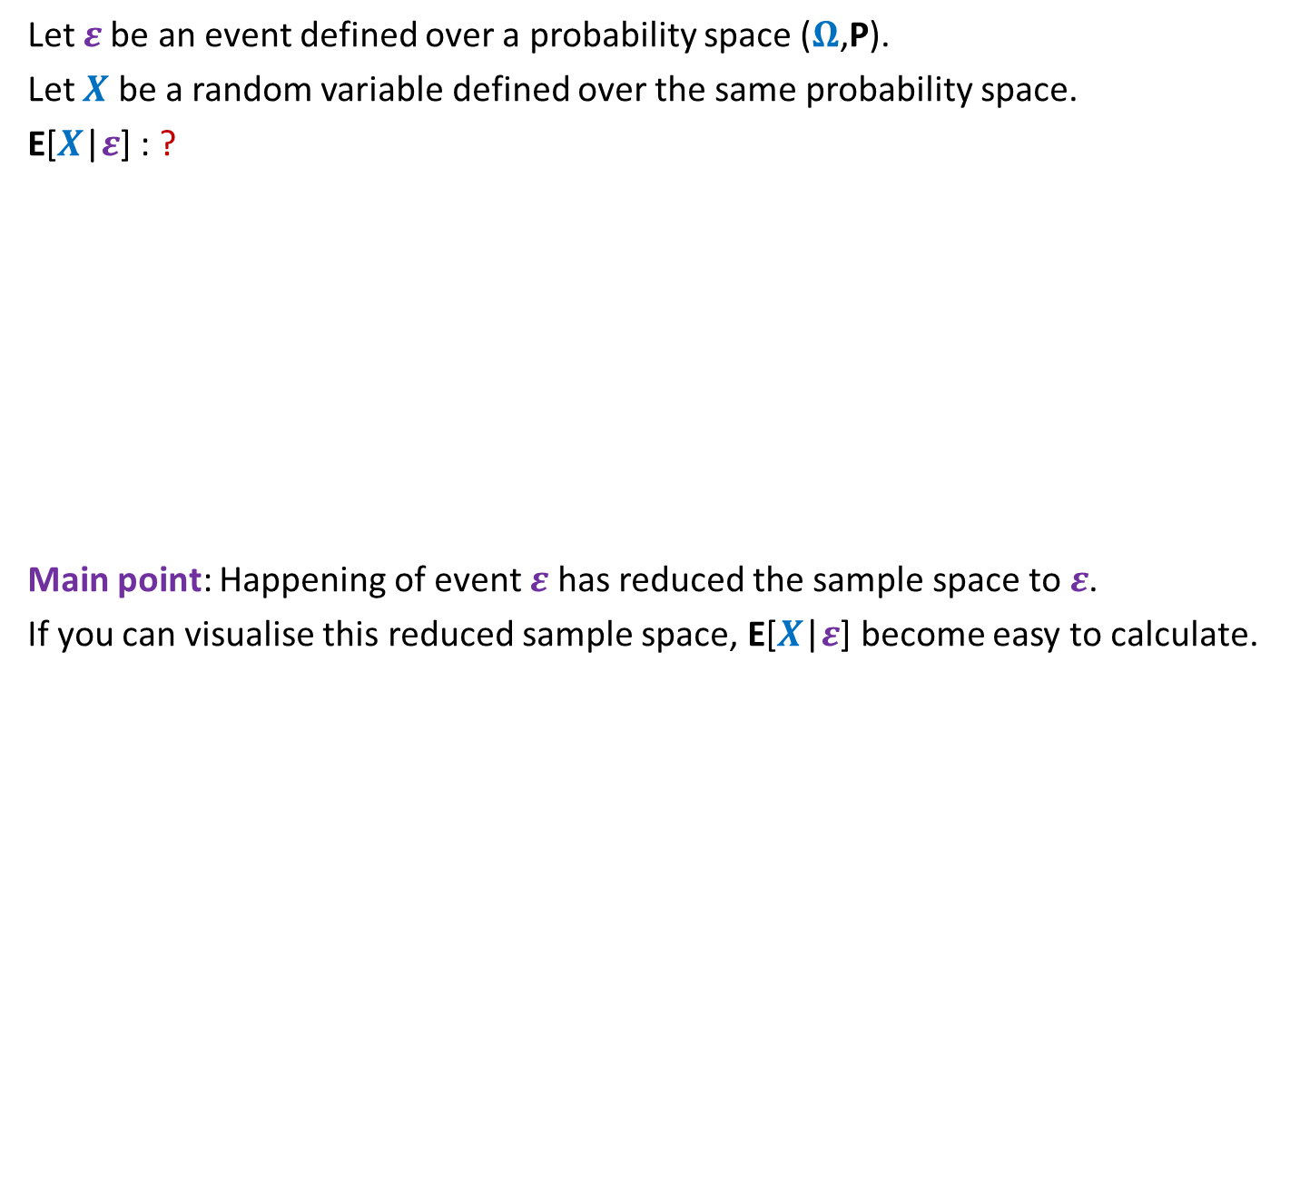


Conditional Expectation
Let $ε$be an event defined over a probability space ($Ω$,P).
Let $X$ be a random variable defined over the same probability space.
E[$X$|$ε$] : ?
Main point: Happening of event $ε$ has reduced the sample space to $ε$.
If you can visualise this reduced sample space, E[$X$|$ε$] become easy to calculate.
Expected value of $X$
given that event $ε$ has happened.
$$ε$$
Ω

Slide 5

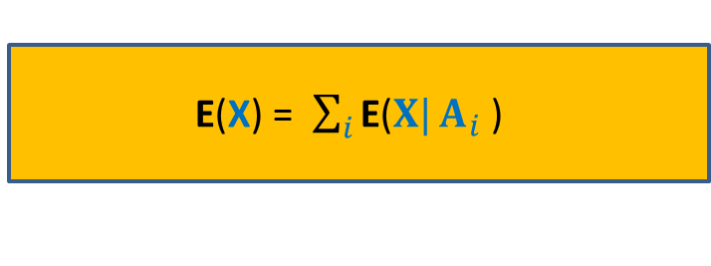







Partition of sample space
A set of events $A_{1}$,…, $A_{n}$ defined over a probability space ($Ω$,P)
is said to induce a partition of $Ω$ if
$\bigcup_{i=1}^{n}{A_{i}}$ = $Ω$
$A_{i}\bigcap{A_{j}}$ =∅ for all$i≠j$
For a random variable X, how can we express E(X) in terms of a given partition ?
$$A_{6}$$
$$A_{5}$$
$$A_{4}$$
$$A_{1}$$
$$A_{3}$$
Ω
$$A_{2}$$
E(X) = $\sum_{i}{\text{E}\text{(}X|}A_{i}$ )
$$⋅\text{P}\text{(}A_{i}\text{)}$$

Slide 6





















A Dice Problem
A fair dice is successively rolled.
$X$ : The number of rolls to get a $6$.
$Y$ : The number of rolls to get a $5$.
$$1$$
$$4$$
$$2$$
$$2$$
$$6$$
$$4$$
$$5$$
$$3$$
$3 1 2 5 6 4 2$
$$X:$$
A geometric random variable with parameter $p=\frac{1}{6}$
$P[X=j]$ = ?
${\left(\frac{5}{6}\right)}^{j−1}$ $⋅\frac{1}{6}$
${\left(\frac{5}{6}\right)}^{j−1}$ $⋅\frac{1}{6}$
$P\left[X=i+j\right| X>j]$ = ?
$P\left[X=j\right]$
Memorylessness of geometric random variable
$$\frac{1}{p}$$
$E[X]$ = ?
$$=6$$

Slide 7














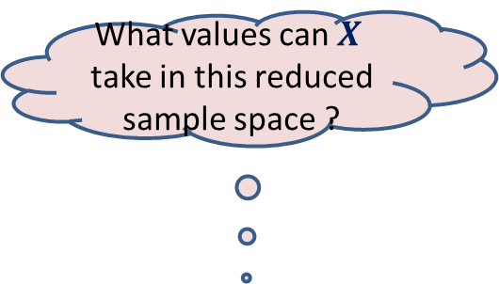








A Dice Problem
Please go through this slides slowly, very slowly...
A fair die is successively rolled.
$X$ : The number of rolls to get a $6$.
$Y$ : The number of rolls to get a $3$.
$E[X]$ =
$E\left[X\right| Y=1]$ =
$E\left[X\right| Y=5]$ =
$$3$$
$$3$$
$$6$$
What is the reduced sample space ?
$$≠3$$
$1+E[X]$
= $7$
$$1,2,3,5,6,…$$
$$1⋅ P[X=1|Y=5]$$
$\frac{1}{5}$
What values can $X$ take in this reduced sample space ?
$$+ 2⋅ P[X=2|Y=5]$$
$2⋅\frac{4}{5}⋅\frac{1}{5}$
$$+ 3⋅ P[X=3|Y=5]$$
$3⋅\frac{4}{5}⋅\frac{4}{5}⋅\frac{1}{5}$
$$+ 4⋅ P[X=4|Y=5]$$
$4⋅\frac{4}{5}⋅\frac{4}{5}⋅\frac{4}{5}⋅\frac{1}{5}$
$\frac{4}{5}⋅\frac{4}{5}⋅\frac{4}{5}⋅\frac{4}{5}$
$$+ E\left[X\right| X>5]$$
$$5$$
$$+ ?$$
$5+E[X]$
$$⋅P[X> 4 |Y=5]$$

Slide 8
Homework
What is the expected number of coin tosses to get 3 consecutive heads ?
Hint: Define partition space based on the 1st occurrence of TAIL.

Slide 9
Probability for computer Science
Application
Checking equality of files

Slide 10






Aim: To determine if File A is identical to File B by communicating fewest bits ?
Network
File A
File B
size(A) = $n$ bits
size(B) = $n$ bits
 | No. of bits to be sent
Trivial
$$n$$
Using elementary probability
O(log($n$))
On a few occasions

Slide 11






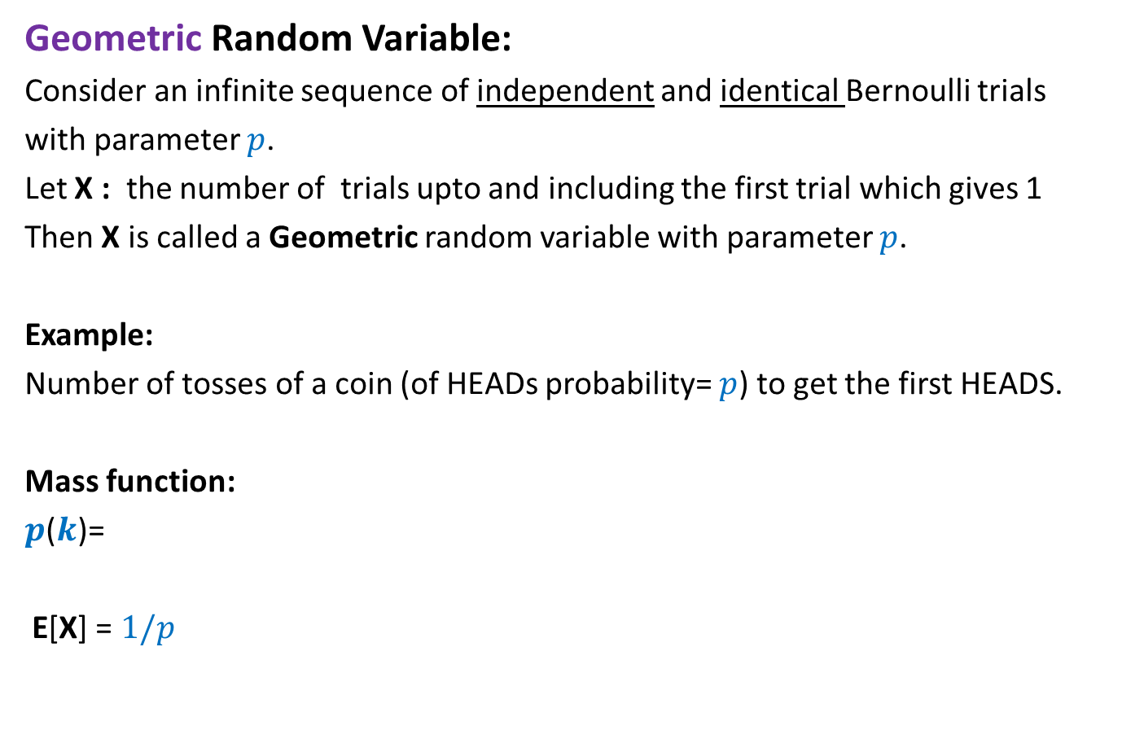

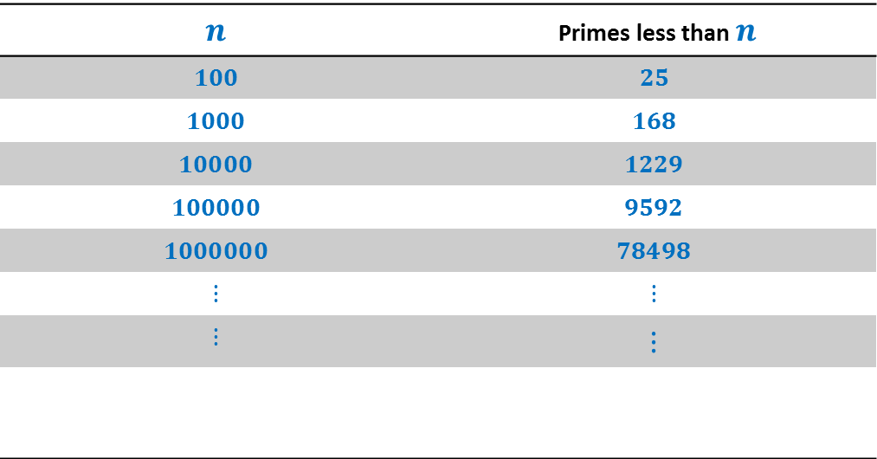


How many primes less than $n$ ?
$$n$$ | Primes less than $n$
$$100$$ | $$25$$
$$1000$$ | $$168$$
$$10000$$ | $$1229$$
$$100000$$ | $$9592$$
$$1000000$$ | $$78498$$
$$⋮$$ | $$⋮$$
$$⋮$$ | $$⋮$$
$π\left(n\right)$:
$$π\left(n\right)$$
$$≈n/{\log{n}}$$
Huge gap
How many prime factors of $n$ ?
$$<\log{n}$$
$$=$$
$$2^{2}∙5^{3}∙7$$
$$3500$$
$$2^{2}∙5^{3}∙7$$
Notes:
Randomization will exploit this huge difference to achieve a very simple and elegant algorithm.

Slide 12
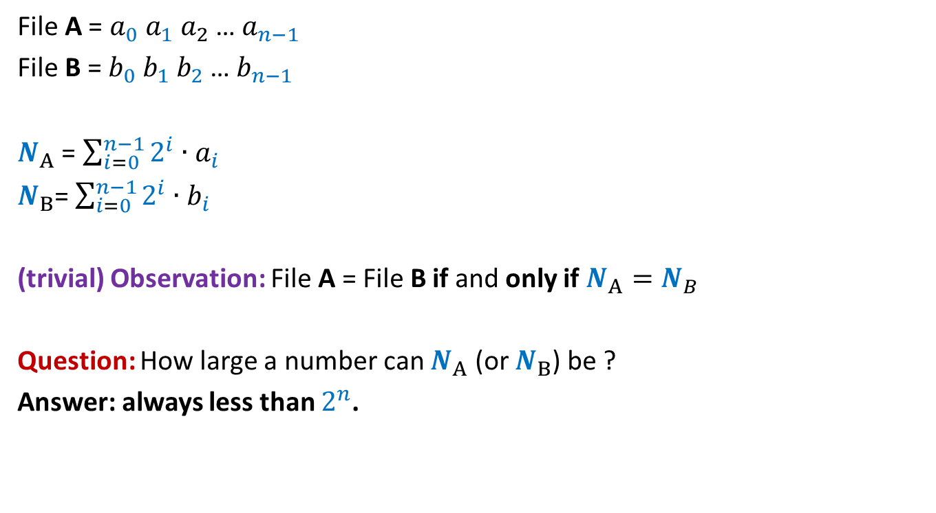
Key idea: Visualize a file as a binary number
File A = $a_{0} a_{1} a_{2}$… $a_{n−1}$
File B = $b_{0} b_{1} b_{2}$… $b_{n−1}$
$N_{A}$ = $\sum_{i=0}^{n−1}{2^{i}∙a_{i}}$
$N_{B}$= $\sum_{i=0}^{n−1}{2^{i}∙b_{i}}$
(trivial) Observation: File A = File B if and only if $N_{A}=N_{B}$
Question: How large a number can $N_{A}$ (or $N_{B}$) be ?
Answer: always less than $2^{n}$.

Slide 13
Network
File A
File B
size(A) = $n$ bits
size(B) = $n$ bits
What should be sent ?

Slide 14
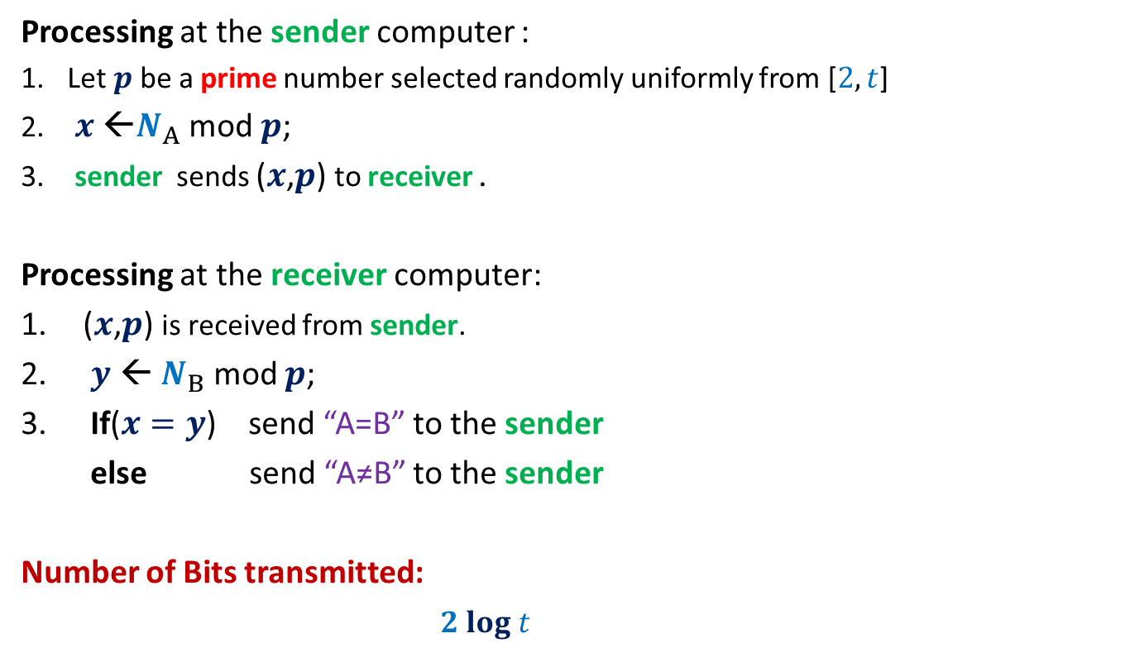
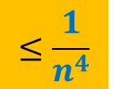
RandomEqualityChecking-Protocol($A$,$B$)
Processing at the sender computer :
Let $p$be a prime number selected randomly uniformly from [$2,t$]
$x$ ←$N_{A}$ mod $p$;
sender sends ($x$,$p$) to receiver .
Processing at the receiver computer:
($x$,$p$) is received from sender.
$y$ ← $N_{B}$ mod $p$;
If($x=y$) send “A=B” to the sender
else send “A≠B” to the sender
Number of Bits transmitted:
$2 log t$

Slide 15






Error Analysis
Cases
Let $d$ = $|N_{A}− N_{B}|$
Observation: If $N_{A}≠N_{B}$, then surely $d>0$.
The protocol makes an error if and only if
$N_{A} mod p=N_{B} mod p$
$N_{A} mod p−N_{B} mod p=0$
($N_{A} −N_{B}$) $mod p$ $=0$
$p$divides $d$
$$N_{A}=N_{B}$$
$N_{A}mod p=N_{B} mod p$
$$N_{A}mod p=N_{B} mod p$$
$$N_{A}≠N_{B}$$
?
$$with some probability$$

Slide 16


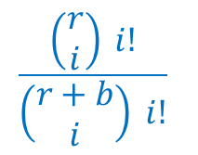









Error Analysis
Cases
$$N_{A}=N_{B}$$
$N_{A}mod p=N_{B} mod p$
$$N_{A}mod p=N_{B} mod p$$
$$N_{A}≠N_{B}$$
?
$$with some probability$$
$$≤\frac{n}{π(t)}$$
$$1$$
$$d$$
$$2^{n}$$
The prime factors of $d$
$$≤n$$
$$1$$
$$t$$
prime numbers in the range [$2,t$].
$$≈\frac{t}{log t }$$
$$π(t)$$

Slide 17
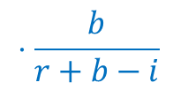
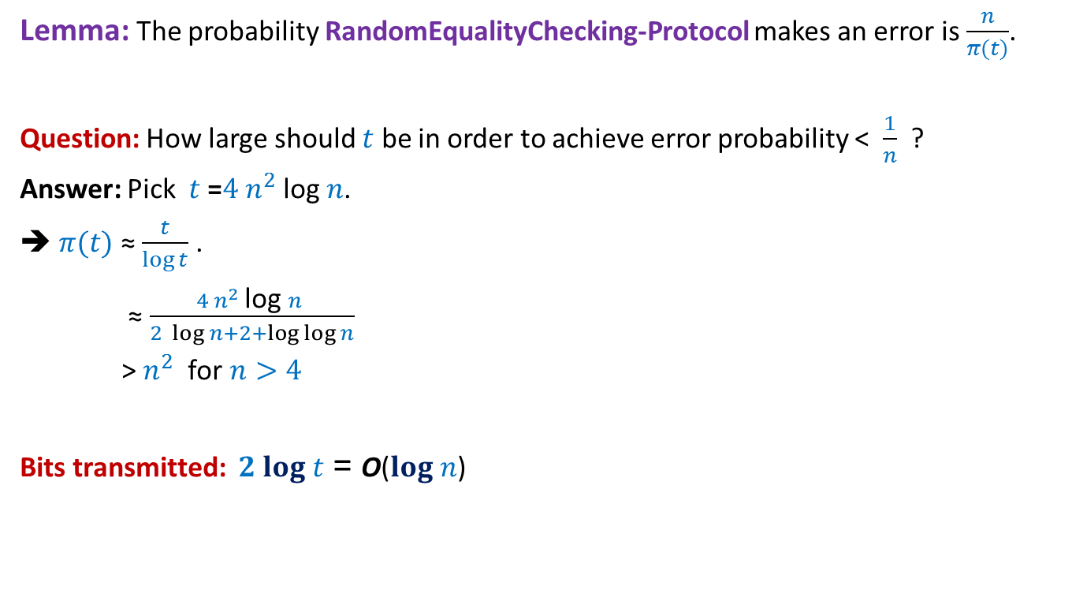
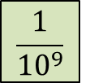
Error Analysis
Lemma: The probability RandomEqualityChecking-Protocol makes an error is $\frac{n}{π(t)}$.
Question: How large should $t$ be in order to achieve error probability < $\frac{1}{n}$ ?
Answer: Pick $t$ =$4 n^{2}$log $n$.
➔ $π(t)$ ≈ $\frac{t}{\log{t}}$ .
≈ $\frac{4 n^{2} \text{log} n }{2 \log{n}+2+\log{\log{n}}}$
> $n^{2}$ for $n>4$
Bits transmitted: $2 log t$ = O($log n$)
$$≈\frac{t}{log t }$$
$$\frac{1}{{10}^{9}}$$
$$π(t)$$
How often ?

