Slide 1
Mathematic for Computer Science - III CS203B
Lecture 9:
Poisson Random variable
Computing a random sample

Slide 2



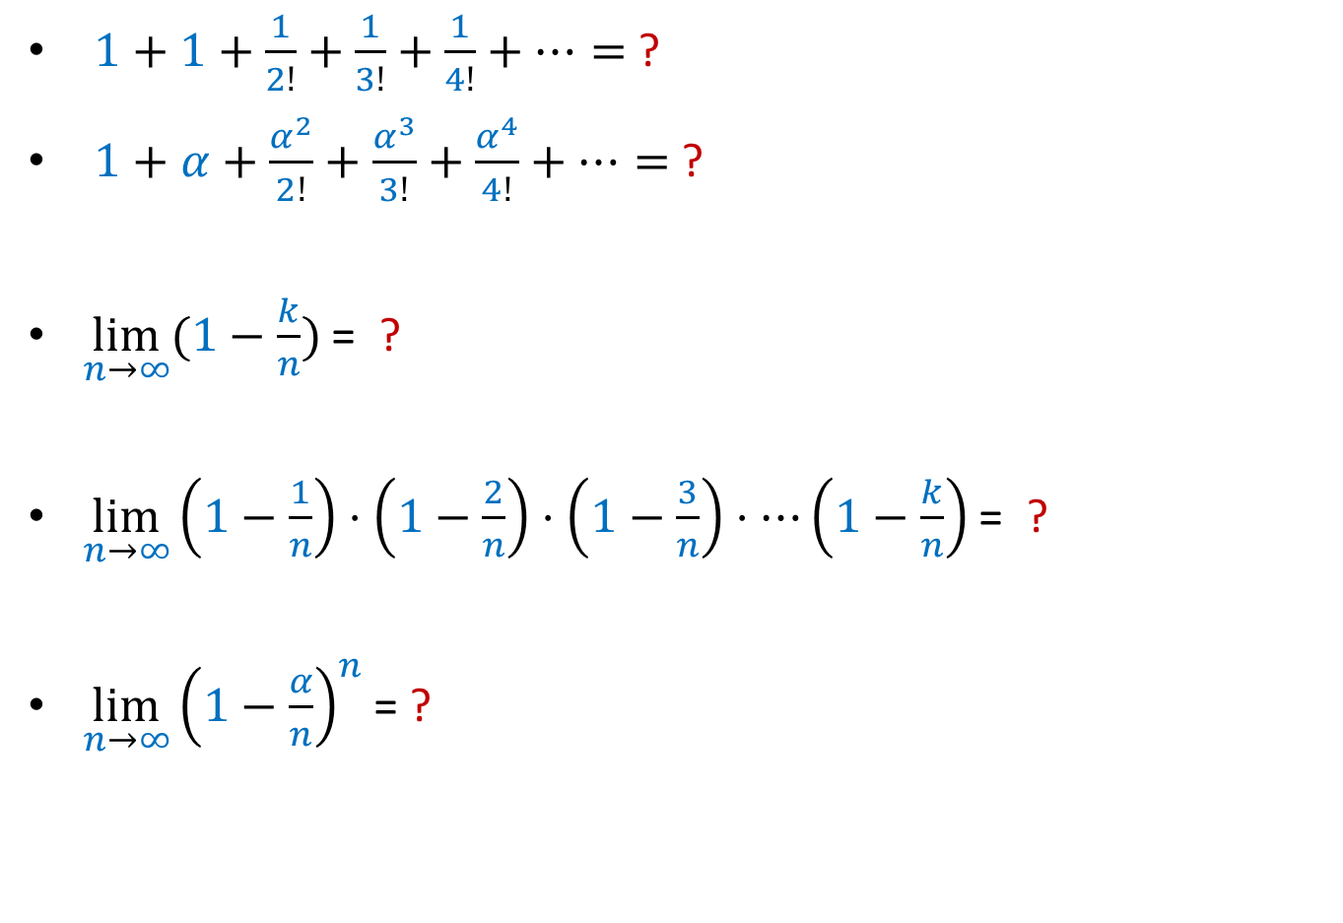
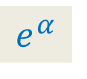
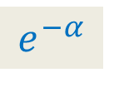

Revisiting some math equalities
$α,k$ : constants, however large they may be.
$1+1+\frac{1}{2!}+\frac{1}{3!}+\frac{1}{4!}+…=$ ?
$1+α+\frac{α^{2}}{2!}+\frac{α^{3}}{3!}+\frac{α^{4}}{4!}+…=$ ?
$\lim_{n→∞}{(1−\frac{k}{n})}$ = ?
$\lim_{n→∞}\left(1−\frac{1}{n}\right)⋅\left(1−\frac{2}{n}\right)⋅\left(1−\frac{3}{n}\right)⋅⋯\left(1−\frac{k}{n}\right)$ = ?
$\lim_{n→∞}{{\left(1−\frac{α}{n}\right)}^{n}}$= ?
$$e$$
$$e^{α}$$
$$1$$
$$1$$
$$e^{−α}$$

Slide 3
Known Random variables
Binomial random variable
Geometric random variable
Negative Binomial random variable
We shall now re-invent a new and very popular random variable.
We shall do it with the help of an example.

Slide 4
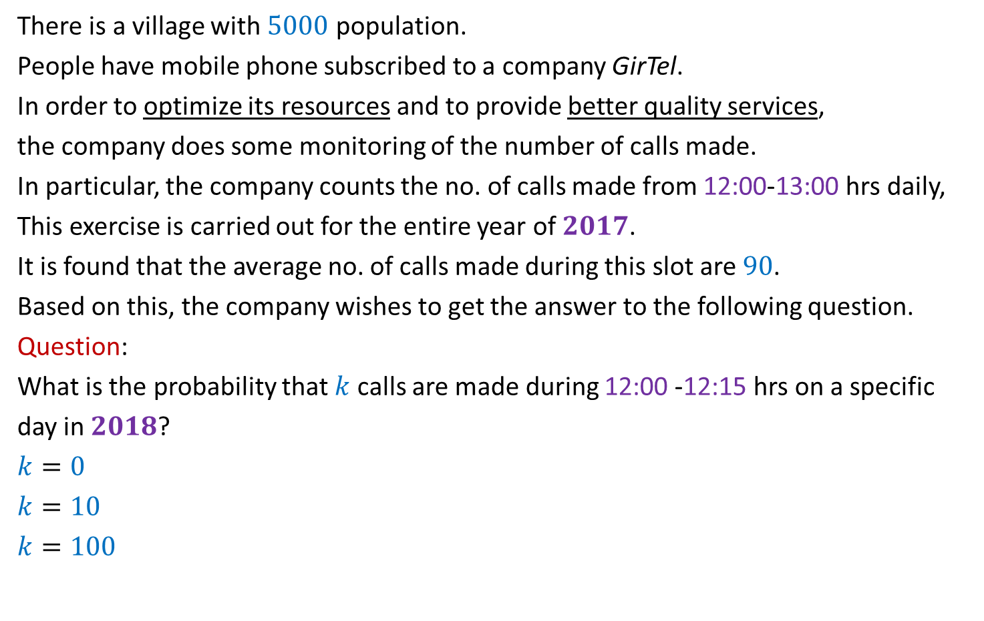
An example
There is a village with $5000$ population.
People have mobile phone subscribed to a company GirTel.
In order to optimize its resources and to provide better quality services,
the company does some monitoring of the number of calls made.
In particular, the company counts the no. of calls made from 12:00-13:00 hrs daily,
This exercise is carried out for the entire year of $2017$.
It is found that the average no. of calls made during this slot are $90$.
Based on this, the company wishes to get the answer to the following question.
Question:
What is the probability that $k$ calls are made during 12:00 -12:15 hrs on a specific
day in $2018$?
$k=0$
$k=10$
$k=100$
Is it possible to answer this question based on the information provided ?
No.

Slide 5
An example
The team of Engineers of GirTel has done extensive experimental study on the calls.
They monitored the calls during various intervals of varying lengths.
This led them to arrive at the following empirical facts.
Empirical fact 1:
The average no. of calls made during each interval are proportional to the length of
interval.
12:00
13:00

Slide 6
An example
The team of Engineers of GirTel has done extensive experimental study on the calls.
They monitored the calls during various intervals of varying length.
This led them to arrive at the following empirical facts.
Empirical fact 2:
The no. of calls made during an interval are independent of other non-overlapping
intervals.
A natural question: How they did it ?
Answer: They found that for an interval, average no. of calls made remained almost the same irrespective of the no. of calls made during other intervals.
12:00
13:00

Slide 7

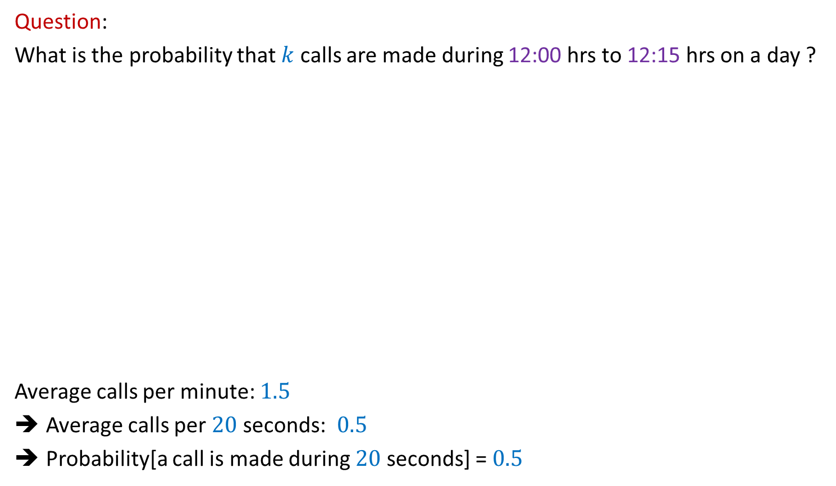



An example
Question:
What is the probability that $k$ calls are made during 12:00 hrs to 12:15 hrs on a day ?
Average calls per minute: $1.5$
Average calls per $20$ seconds: $0.5$
Probability[a call is made during $20$ seconds] = $0.5$
Split the interval of 15 minutes into tiny intervals of identical length.
With the help of the two Empirical Facts, how would you attempt this question now ?
What kind of random variable does $X$appear to be now ?
$X$ : a Binomial random variable
$X$ : No. of calls
12:00
12:15
13:00
Treat each $20$ seconds interval as a Bernoulli trial
20 seconds

Slide 8

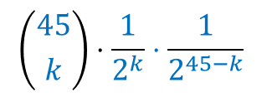
An example
Question:
What is the probability that $k$ calls are made during 12:00 hrs to 12:15 hrs on a day ?
Average calls per minute: $1.5$
Average calls per $20$ seconds: $0.5$
Probability[a call is made during $20$ seconds] = $0.5$
Split the interval of 15 minutes into tiny intervals of identical length.
There is something wrong with this approach.
Can you figure it out ?
$X$ : No. of calls
12:00
12:15
13:00
$$\left({45 \atop k}\right)⋅\frac{1}{2^{k}}⋅\frac{1}{2^{45−k}}$$
Treat each $20$ seconds interval as a Bernoulli trial
P($X=k$) =
There could be multiple calls in $20$ seconds interval

Slide 9


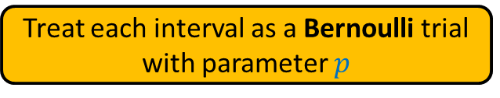

An example
This flaw also points to a solution quite naturally:
Divide the interval into $n$ small intervals of same length.
Average call per small interval = $α/n$
Do a more finer partition
Let average no. of calls during the interval 12:00-12:15 = $α$
12:00
12:15
13:00
Treat each interval as a Bernoulli trial
with parameter $p$
$$=α/n$$
This is justified if …
$$\lim_{n→∞}{ }$$

Slide 10
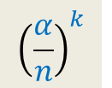

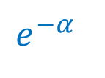





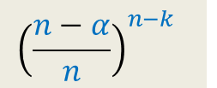
P($X=k$) = ?
P($X=k$)
= $\left({n \atop k}\right)⋅p^{k}⋅{\left(1−p\right)}^{n−k}$ = $\frac{n!}{k!\left(n−k\right)!}⋅p^{k}⋅{\left(1−p\right)}^{n−k}$
= $\frac{n\left(n−1\right)\left(n−2\right)⋯(n−k+1)}{k!}⋅ p^{k} ⋅ {\left(1−p\right)}^{n−k}$
= $\frac{α^{k}}{k!}⋅\left[1 \left(1−\frac{1}{n}\right)\left(1−\frac{2}{n}\right)⋯\left(1−\frac{k−1}{n}\right)\right]⋅{\left(1−\frac{α}{n}\right)}^{n−k}$
= $\frac{α^{k}}{k!}⋅\left[1 \left(1−\frac{1}{n}\right)\left(1−\frac{2}{n}\right)⋯\left(1−\frac{k−1}{n}\right)\right]{⋅\left(1−\frac{α}{n}\right)}^{n}⋅{\left(1−\frac{α}{n}\right)}^{−k}$
= $e^{−α}⋅\frac{α^{k}}{k!}$
$${\left(\frac{α}{n}\right)}^{k}$$
$${\left(\frac{n−α}{n}\right)}^{n−k}$$
$$p=α/n$$
$$\lim_{n→∞}{ }$$
$$1$$
$$e^{−α}$$
$$1$$

Slide 11
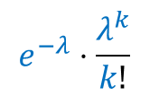
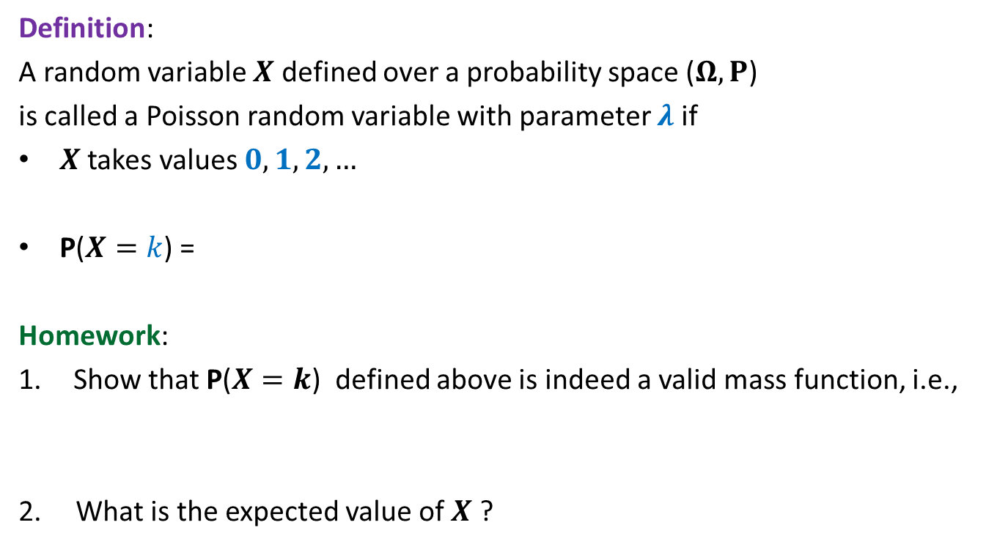
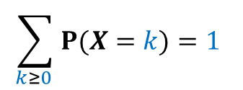
Poisson Random variable
Definition:
A random variable $X$ defined over a probability space ($Ω,P$)
is called a Poisson random variable with parameter $λ$ if
$X$takes values $0,1,2,…$
P($X=k$) =
Homework:
Show that P($X=k$) defined above is indeed a valid mass function, i.e.,
2. What is the expected value of $X$ ?
$$e^{−λ}⋅\frac{λ^{k}}{k!}$$
$$\sum_{k≥0 }{P(X=k)}=1$$

Slide 12

Binomial Random variable
$Approximation$of
By
Poisson Random Variable

Slide 13
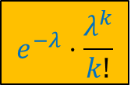
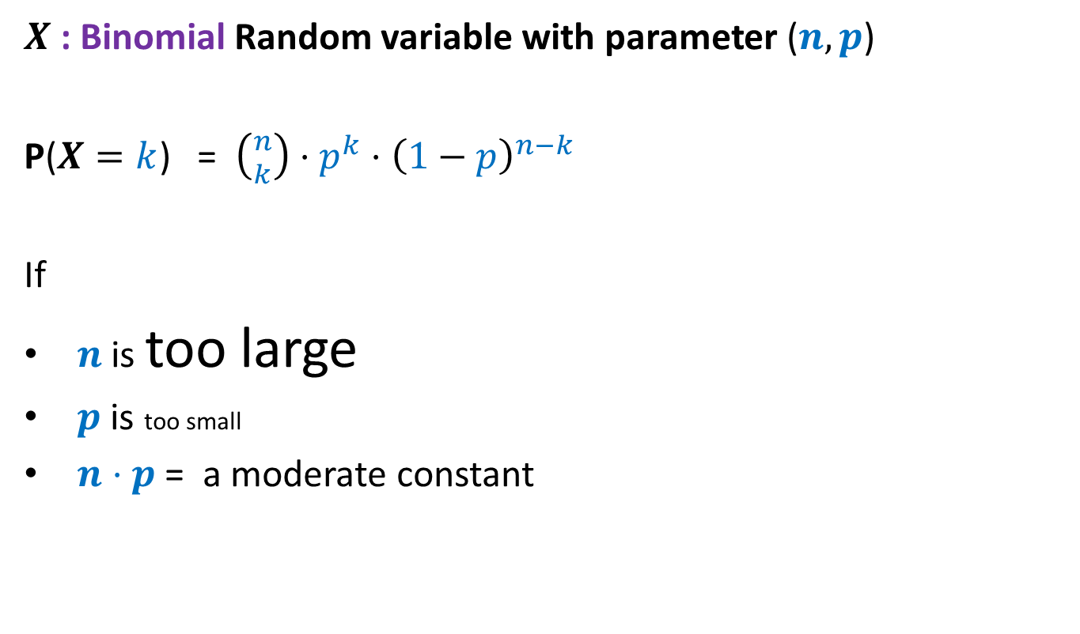


$X$: Binomial Random variable with parameter ($n,p$)
P($X=k$) = $\left({n \atop k}\right)⋅p^{k}⋅{\left(1−p\right)}^{n−k}$
If
$n$ is too large
$p$ is too small
$n⋅p$ = a moderate constant
$$e^{−λ}⋅\frac{λ^{k}}{k!}$$
$$≈$$
where $λ=np$

Slide 14


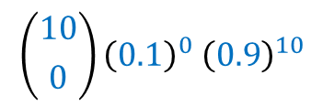









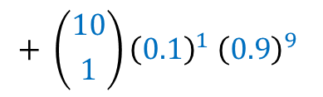


Example:
Suppose that
The probability that an item produced by a machine will be defective is $0.1$.
Each item is going to be defective independent of other items.
Find the probability that a sample of $10$ items will contain at most $1$ defective item.
$X$ :
the random variable for the number of defective items.
$$\left({10 \atop 0}\right){\left(0.1\right)}^{0}{ \left(0.9\right)}^{10}$$
$$+ \left({10 \atop 1}\right){\left(0.1\right)}^{1}{ \left(0.9\right)}^{9}$$
$$= 0.7361$$
P($X≤1$) =
P($X=0$)
$$+$$
P($X=1$)
$$e^{−1}$$
$$= 0.7358$$
$$e^{−1}$$
$X$ : a Binomial random variable
Let us approximate it using Poisson random variable …
$λ=1$
P($X=k$) = $e^{−λ}⋅\frac{λ^{k}}{k!}$

Slide 15
Computing A random Sample

Slide 16
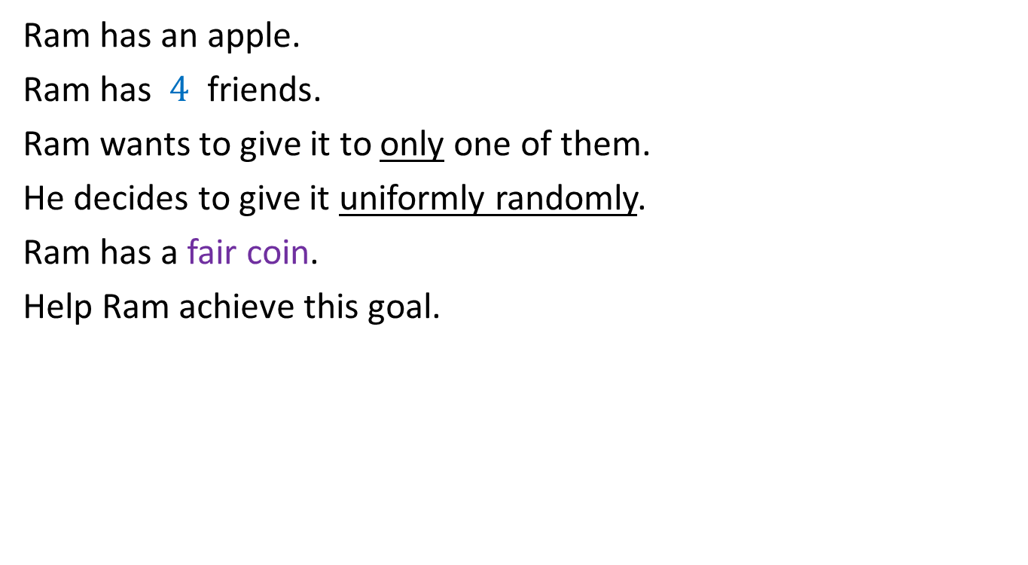
Exercise 1
Ram has an apple.
Ram has $4$ friends.
Ram wants to give it to only one of them.
He decides to give it uniformly randomly.
Ram has a fair coin.
Help Ram achieve this goal.
Toss the coin 2 times.
Outcome of tosses | Action
HH
Give it to Friend 1
HT
Give it to Friend 2
TH
Give it to Friend 3
TT
Give it to Friend 4

Slide 17
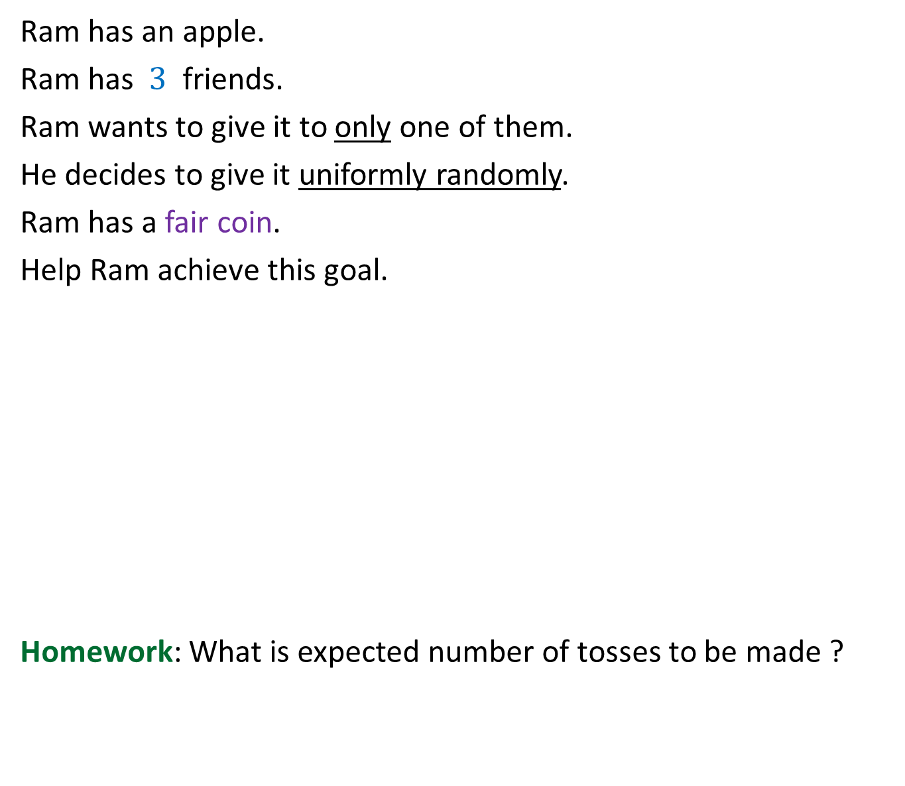
Exercise 2
Ram has an apple.
Ram has $3$ friends.
Ram wants to give it to only one of them.
He decides to give it uniformly randomly.
Ram has a fair coin.
Help Ram achieve this goal.
Homework: What is expected number of tosses to be made ?
Toss the coin 2 times.
Outcome of tosses | Action
HH
Give it to Friend 1
HT
Give it to Friend 2
TH
Give it to Friend 3
?
TT
Toss the coin twice again

Slide 18

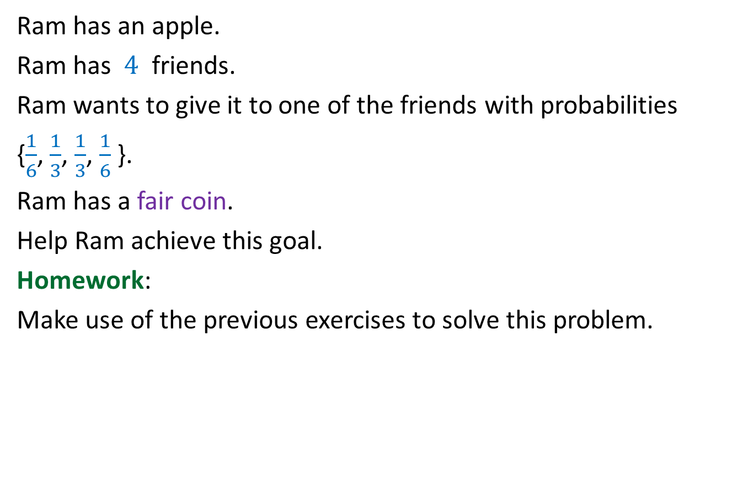
Exercise 3
Ram has an apple.
Ram has $4$ friends.
Ram wants to give it to one of the friends with probabilities
{$\frac{1}{6}$, $\frac{1}{3}$, $\frac{1}{3}$, $\frac{1}{6}$ }.
Ram has a fair coin.
Help Ram achieve this goal.
Homework:
Make use of the previous exercises to solve this problem.
What if the probabilities are:
$\frac{151}{1006}$, $\frac{349}{1006}$, $\frac{407}{1006}$, $\frac{99}{1006}$

Slide 19
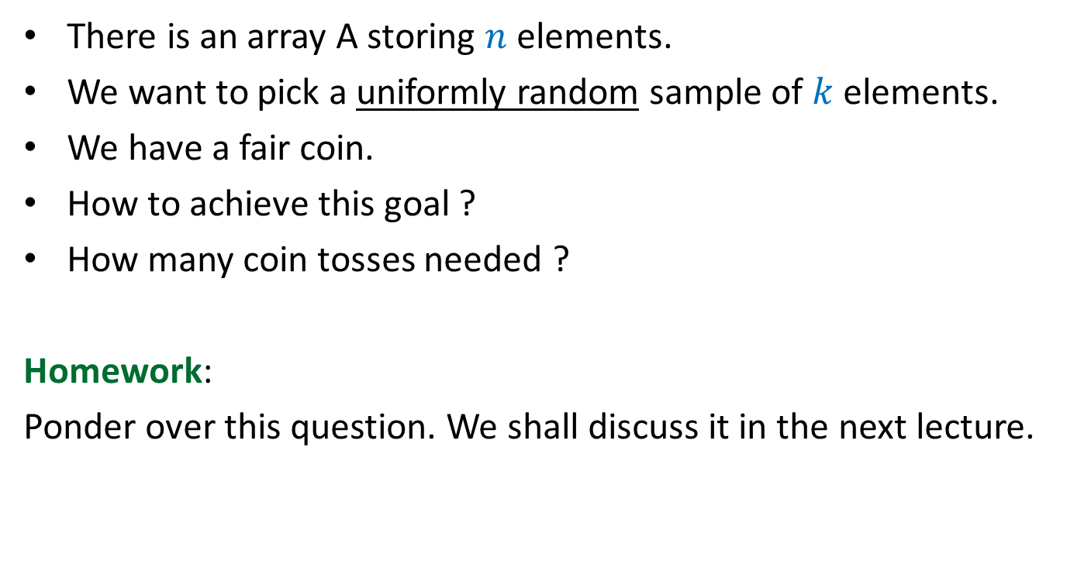
Exercise 4
There is an array A storing $n$ elements.
We want to pick a uniformly random sample of $k$ elements.
We have a fair coin.
How to achieve this goal ?
How many coin tosses needed ?
Homework:
Ponder over this question. We shall discuss it in the next lecture.

