Slide 1
Design and Analysis of Algorithms
Algorithms-II : CS345A
Website: hello.iitk.ac.in
Lecture 12
Greedy strategies (last lecture)
Shortest paths
in graphs with positive weights

Slide 2
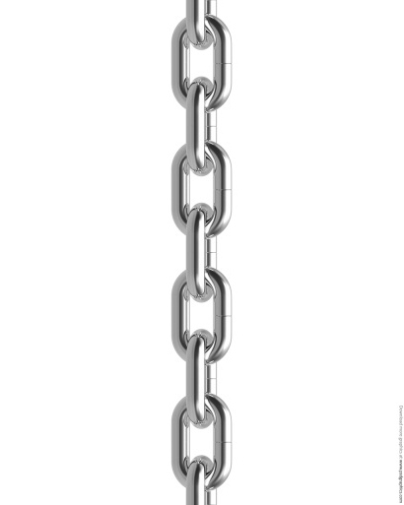




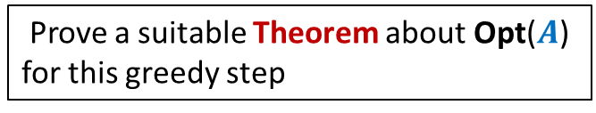


A generic way to design and analyse a greedy algorithm
P: a given optimization problem
1. Try to establish a relation between OPT($A$) and OPT($A′$);
2. Try to prove the relation formally by
deriving a solution of $A$ from OPT($A′$)
deriving a solution of $A′$ from OPT($A$)
If you succeed,
you have an algorithm
Opt($A$)
$$A$$
instance of size $n$of problem P
Greedy
step
Prove a suitable Theorem about Opt($A$) for this greedy step
Opt($A′$)
$$A′$$
instance of size $<n$of problem P
from construction
use Theorem

Slide 3
Example Minimum spanning tree

Slide 4

instance $A$
170
54
33
63
35
50
70
31
41
81
64
78
53
42
52
80
49
54
42
60
44
43
50
30
49
57
29
102

Slide 5
instance $A$
Lemma 1 : There is a MST with edge (u,v)
170
54
33
63
35
50
70
31
41
81
64
78
53
42
52
80
49
54
42
60
44
43
50
30
49
57
u
29
102
v

Slide 6
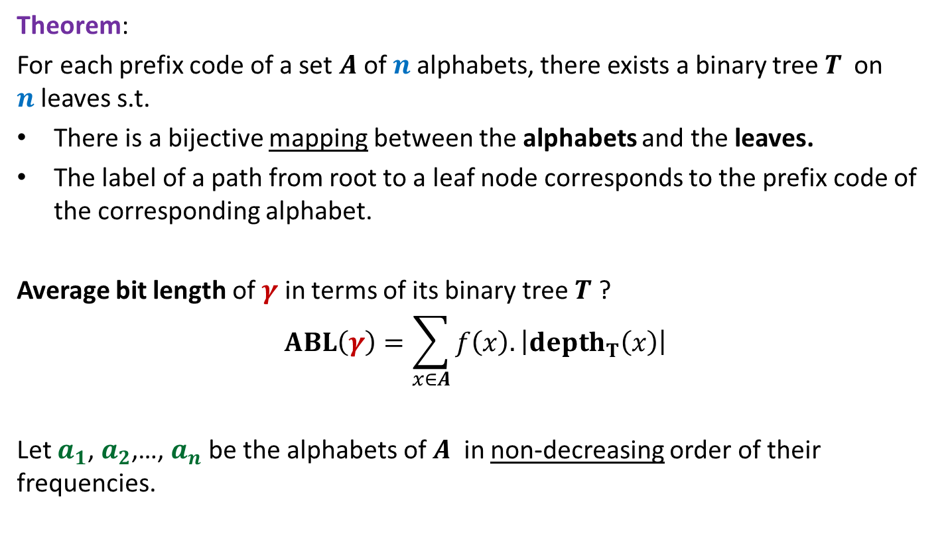

instance $A′$
170
54
33
63
35
50
70
31
41
81
64
78
53
42
52
80
49
54
42
44
60
43
50
30
49
57
w
102
This is graph $G′$

Slide 7
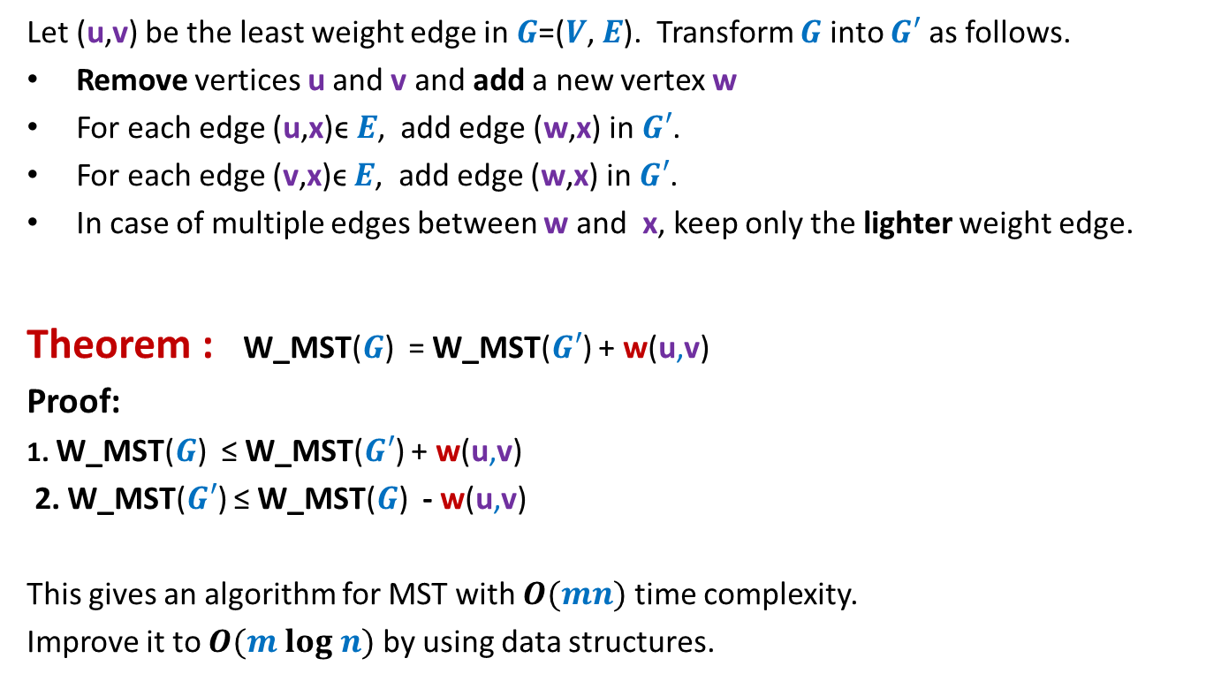

How to compute instance $A′$
Let (u,v) be the least weight edge in $G$=($V$, $E$). Transform $G$ into $G′$ as follows.
Remove vertices u and v and add a new vertex w
For each edge (u,x)ϵ $E$, add edge (w,x) in $G′$.
For each edge (v,x)ϵ $E$, add edge (w,x) in $G′$.
In case of multiple edges between w and x, keep only the lighter weight edge.
Theorem : W_MST($G$) = W_MST($G′$) + w(u,v)
Proof:
1. W_MST($G$) ≤ W_MST($G′$) + w(u,v)
2. W_MST($G′$) ≤ W_MST($G$) - w(u,v)
This gives an algorithm for MST with $O(mn)$ time complexity.
Improve it to $O(m log n)$ by using data structures.
From construction
Use Lemma 1

Slide 8
Homework

Slide 9

The 2 problems we discussed
Synchronizing the delays in a circuit
Scheduling jobs to minimize maximum lateness
Electric signal
6
5
3
2
4
2
$$0$$
time
2
1
6
2
1
2
3
2
Design and analyse a greed algorithm based on the generic technique.

Slide 10
Shortest pathS in a graph

Slide 11


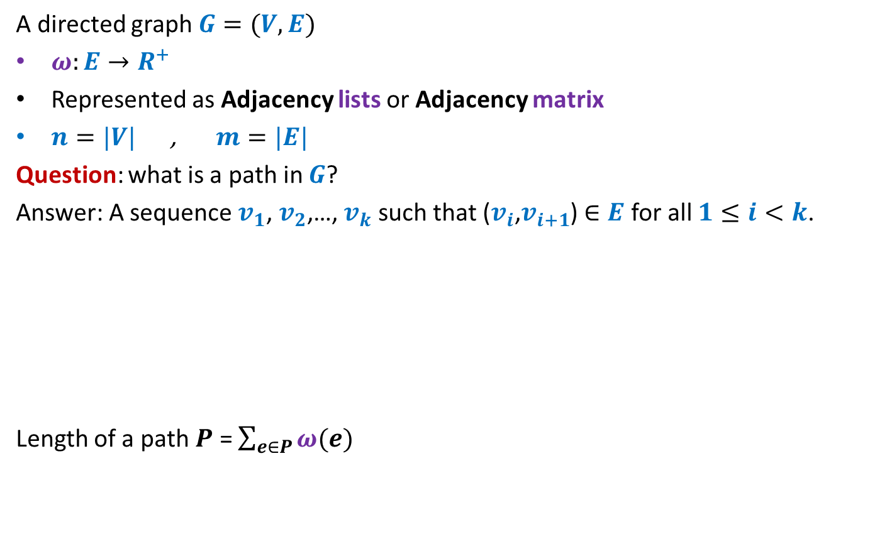



Notations and Terminologies
A directed graph $G=(V,E)$
$ω:E→R^{+}$
Represented as Adjacency lists or Adjacency matrix
$n=|V|$ , $m=|E|$
Question: what is a path in $G$?
Answer: A sequence $v_{1}$, $v_{2}$,…, $v_{k}$ such that ($v_{i}$,$v_{i+1}$) $∈E$ for all $1≤i<k$.
Length of a path $P$ = $\sum_{e∈P}{ω(e)}$
No vertex is repeated
12
3
…
29
$$v_{1}$$
$$v_{2}$$
$$v_{3}$$
$$v_{k−1}$$
$$v_{k}$$

Slide 12
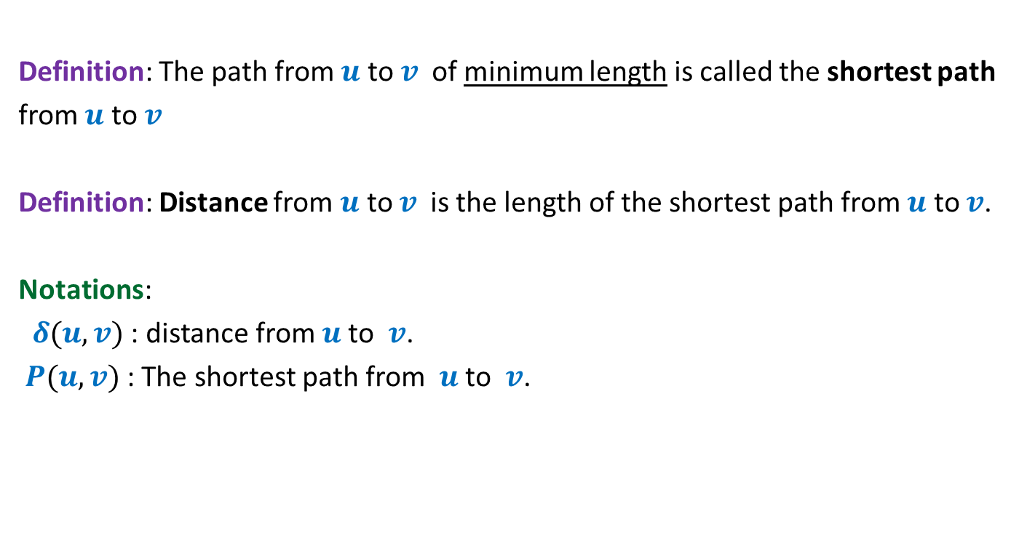
Notations and Terminologies
Definition: The path from $u$ to $v$of minimum length is called the shortest path
from $u$ to $v$
Definition: Distance from $u$ to $v$is the length of the shortest path from $u$ to $v$.
Notations:
$δ(u,v)$ : distance from $u$to $v$.
$P(u,v)$ : The shortest path from $u$to $v$.

Slide 13
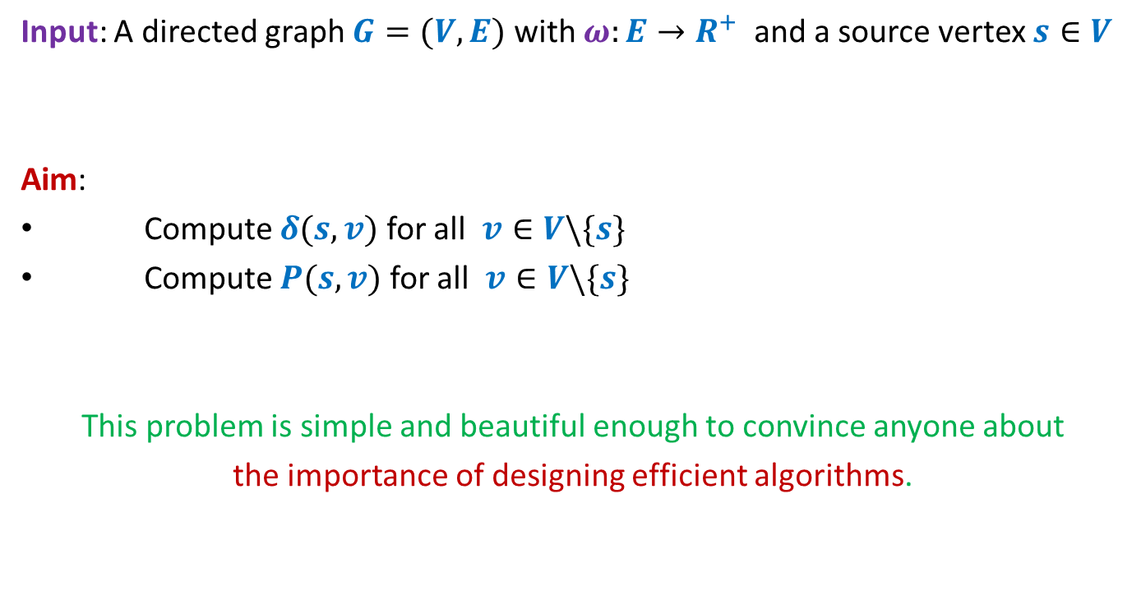
Problem Definition
Input: A directed graph $G=(V,E)$ with $ω:E→R^{+}$ and a source vertex $s∈V$
Aim:
Compute $δ(s,v)$ for all $v∈V\backslash \{s\}$
Compute $P(s,v)$ for all $v∈V\backslash \{s\}$
This problem is simple and beautiful enough to convince anyone about
the importance of designing efficient algorithms.

Slide 14


An example to get an insight into this problem
Inference:
The distance to any vertex depends upon global parameters.
$$q$$
5
7
6
12
G
$$s$$
16
4
9
11

Slide 15


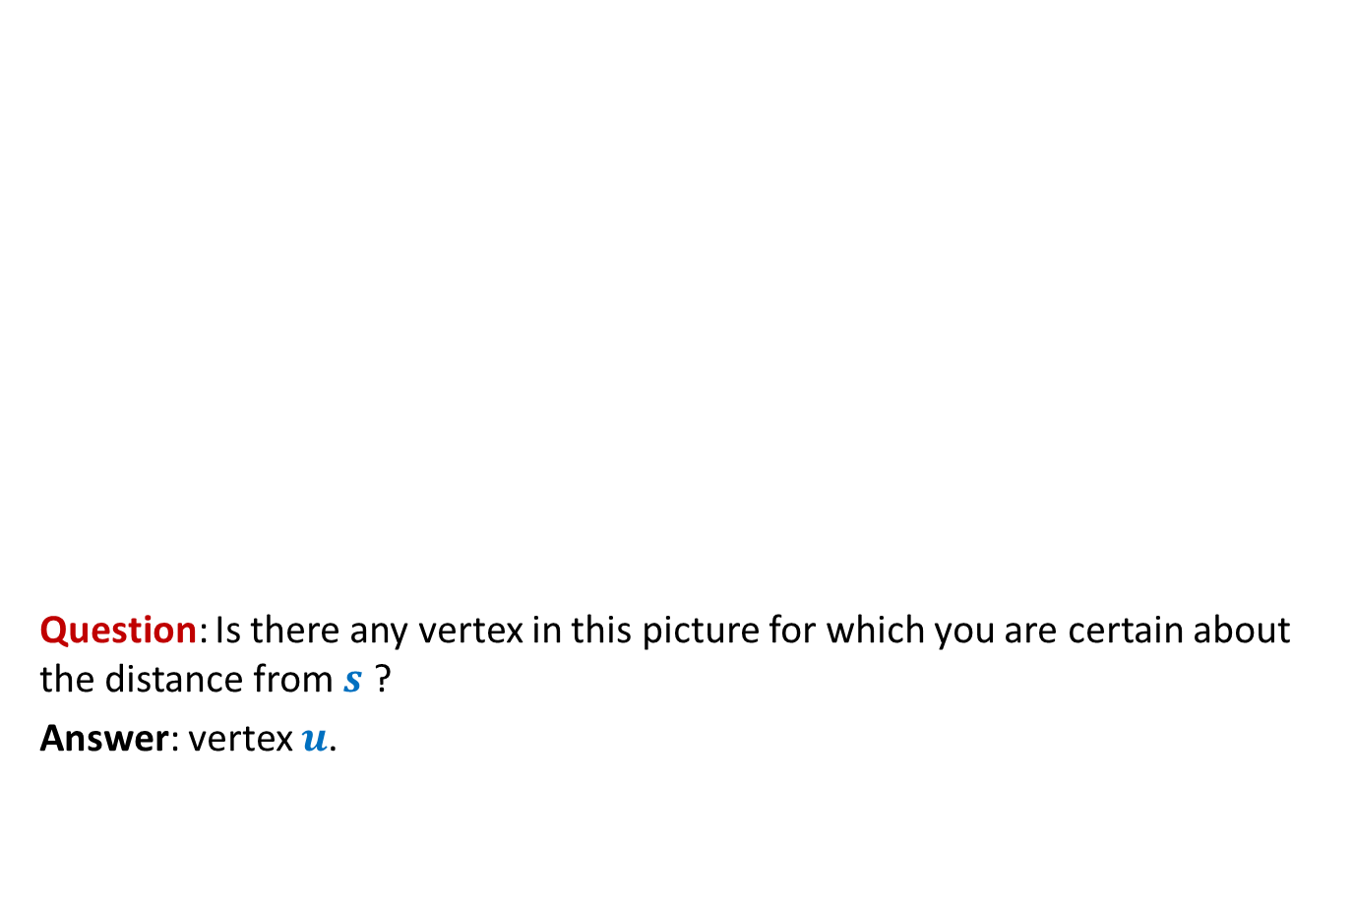



An example to get an insight into this problem
Question: Is there any vertex in this picture for which you are certain about the distance from $s$ ?
Answer: vertex $u$.
$$z$$
10
$$v$$
G
12
7
$$x$$
$$s$$
3
5
$$u$$
$$y$$
Give reasons.

Slide 16


An example to get an insight into this problem
➔ The shortest path to vertex $u$ is edge ($s$,$u$).
$$z$$
10
$$v$$
G
12
7
$$x$$
$$s$$
3
5
$$u$$
$$y$$
$$>0$$

Slide 17





Designing a greedy algorithm for shortest paths
Establish a relation between shortest paths in $G$
and
shortest paths in $G′$
$$G$$
instance of size $n$
Greedy
step
$$G′$$
instance of size $<n$

Slide 18



An example to get an insight into this problem
Question: Can you remove vertex $u$ without affecting the distance from $s$ ?
$$z$$
10
$$v$$
G
12
7
2
$$x$$
$$s$$
21
$$t$$
3
5
$$u$$
3
8
$$y$$
$$r$$

Slide 19

An example to get an insight into this problem
$$z$$
10
$$v$$
12
7
+3
G’
2
+3
$$x$$
21
$$t$$
$$s$$
5
+3
+3
8
3
$$y$$
$$r$$

Slide 20
An example to get an insight into this problem
$$z$$
10
$$v$$
G’
12
7
5
$$x$$
24
$$t$$
$$s$$
5
6
11
$$y$$
$$r$$

Slide 21
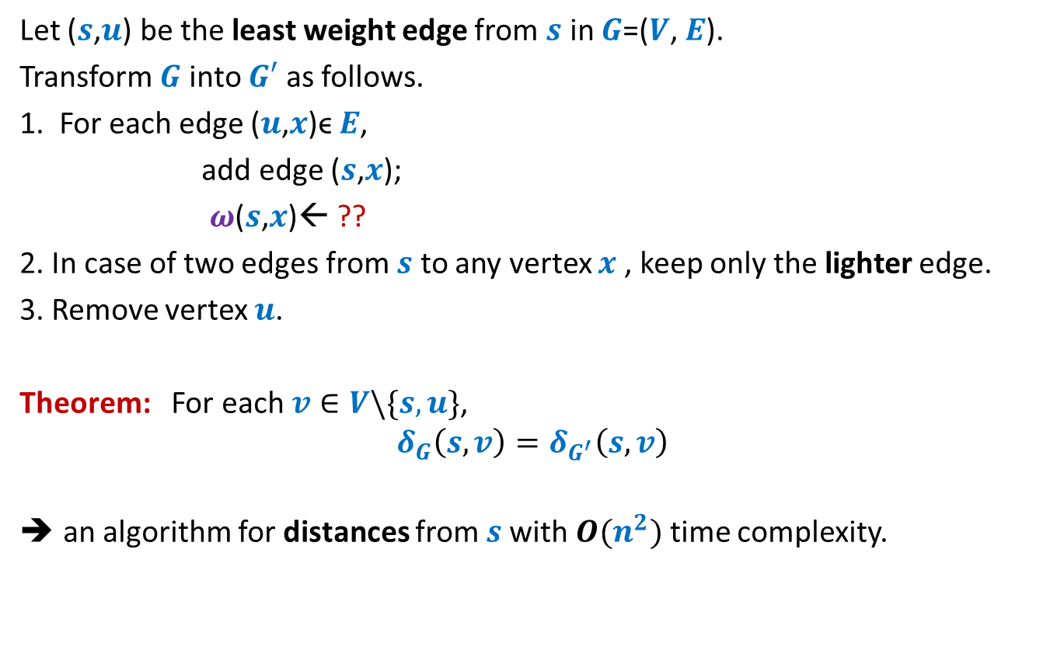


How to compute instance $G′$
Let ($s$,$u$) be the least weight edge from $s$ in $G$=($V$, $E$).
Transform $G$ into $G′$ as follows.
1. For each edge ($u$,$x$)ϵ $E$,
add edge ($s$,$x$);
$ω$($s$,$x$)← ??
2. In case of two edges from $s$ to any vertex $x$ , keep only the lighter edge.
3. Remove vertex $u$.
Theorem: For each $v∈V\backslash \{s,u\}$,
$$δ_{G}\left(s,v\right)=δ_{G^{′}}\left(s,v\right)$$
an algorithm for distances from $s$with $O(n^{2})$ time complexity.
$ω$($s$,$u$) + $ω$($u$,$x$);
Can you see some negative points of this algorithm ?

Slide 22
Shortcomings of the algorithm
No insight into the (beautiful) structure of shortest paths.
Just convinces that we can solve the shortest paths problem in polynomial time.
Very few options to improve the time complexity.
Silent about a compact data structure for storing all shortest paths from the source.
We shall now design a very insightful algorithm based on properties of shortest paths.

Slide 23
Property of a shortest path

Slide 24



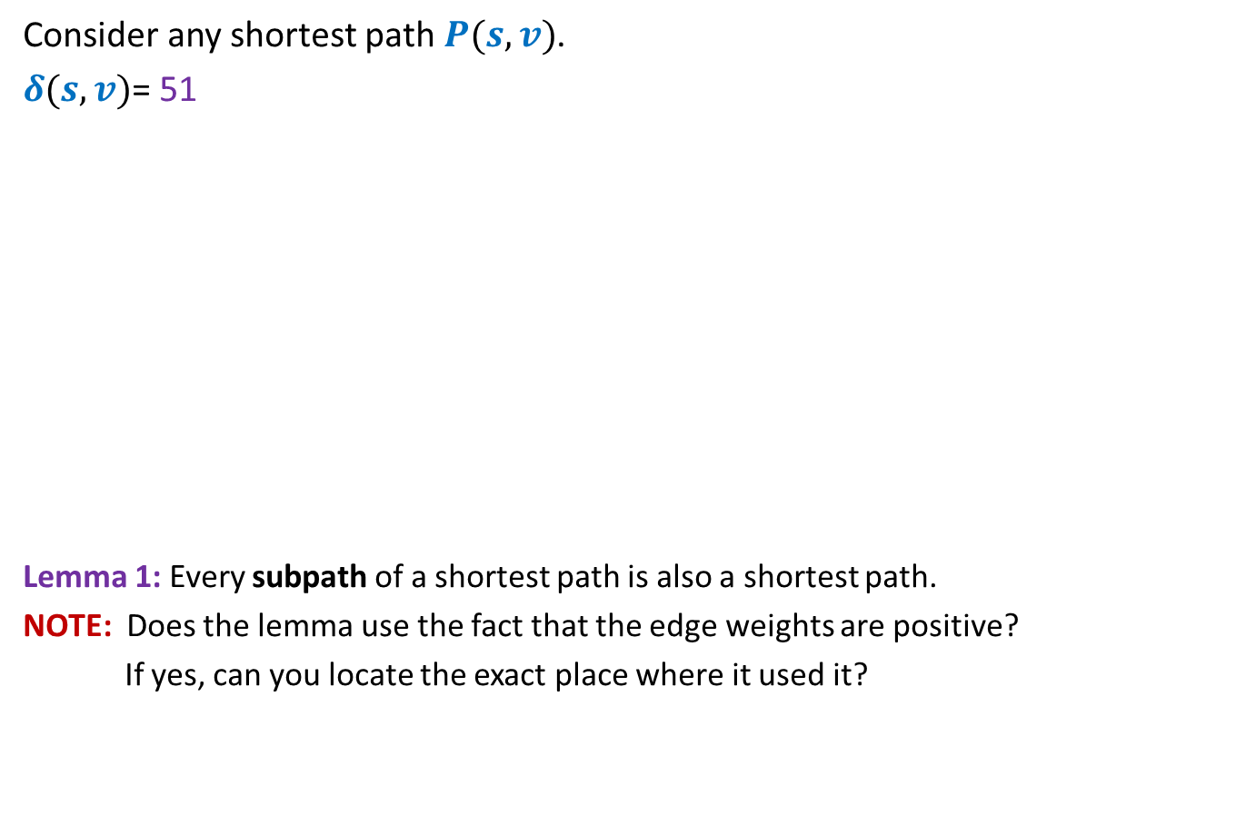




Optimal subpath property
Consider any shortest path $P(s,v)$.
$δ(s,v)$= 51
Lemma 1: Every subpath of a shortest path is also a shortest path.
NOTE: Does the lemma use the fact that the edge weights are positive?
If yes, can you locate the exact place where it used it?
< 27
12
3
7
5
15
9
$$s$$
$$a$$
$$g$$
$$y$$
$$u$$
$$x$$
$v$
Can you realize an assumption in your proof ?
?
Homework: Write a complete and formal proof for Lemma 1

Slide 25




Exploiting the positive weight on edges
Consider once again a shortest path $P(s,v)$.
➔ $δ\left(s,a\right)<δ\left(s,g\right)<δ\left(s,y\right)<δ\left(s,u\right)<δ(s,x)<δ(s,v)$
The nearest vertex of $s$ must be its neighbor.
$$>0$$
$$>0$$
$$>0$$
$$>0$$
$$>0$$
$$>0$$
$$s$$
$$a$$
$$g$$
$$y$$
$$u$$
$$x$$
$v$
(1)

Slide 26







More insights …
What can we say about $x$ ?
Let $s_{i}$ : $i$th nearest vertex from $s$.
$s_{0}$ = $s$.
Consider the shortest path $P\left(s,s_{i}\right)$.
Lemma 2: $P\left(s,s_{i}\right)$ must be of the form $s ⇝$ $s_{j} →s_{i}$ for some $j<i$.
$x$ must be $s_{j}$ for some $j<i$.
$$s$$
$$x$$
$s_{i}$
What picture captures all shortest paths from $s$?

Slide 27








Complete picture of all shortest paths ?
Shortest paths tree
$$s$$
$$s_{4}$$
$$s_{1}$$
$$s_{7}$$
$$s_{5}$$
$$s_{2}$$
$$s_{3}$$
$$s_{6}$$

Slide 28
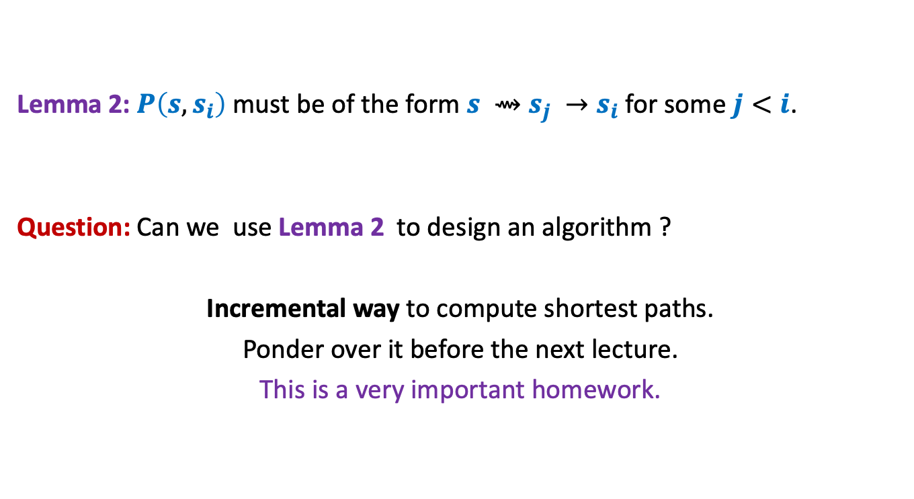
Designing the algorithm …
Lemma 2: $P\left(s,s_{i}\right)$ must be of the form $s ⇝$ $s_{j} →s_{i}$ for some $j<i$.
Question: Can we use Lemma 2 to design an algorithm ?
Incremental way to compute shortest paths.
Ponder over it before the next lecture.
This is a very important homework.
shortest

