Slide 1
Design and Analysis of Algorithms
Algorithms-II : CS345A
Website: hello.iitk.ac.in
Lecture 13
Shortest paths in graphs with positive weights
A new paradigm …

Slide 2
Homework 1 from last class
Optimal subpath property

Slide 3








Optimal subpath property
Can you realize an assumption in your proof ?
Consider any shortest path $P(s,v)$.
$δ(s,v)$= 51
Lemma 1: Every subpath of a shortest path is also a shortest path.
< 27
12
3
7
5
15
9
$$s$$
$$a$$
$$g$$
$$y$$
$$u$$
$$x$$
$v$
?
Proof:
Replacing $P\left(g,x\right)$ with the blue path will give a shorter $P\left(s,v\right)$. A contradiction!
Justify it.
Assumption:
The blue path intersects neither $P(s,g)$ nor $P(x,v)$.

Slide 4

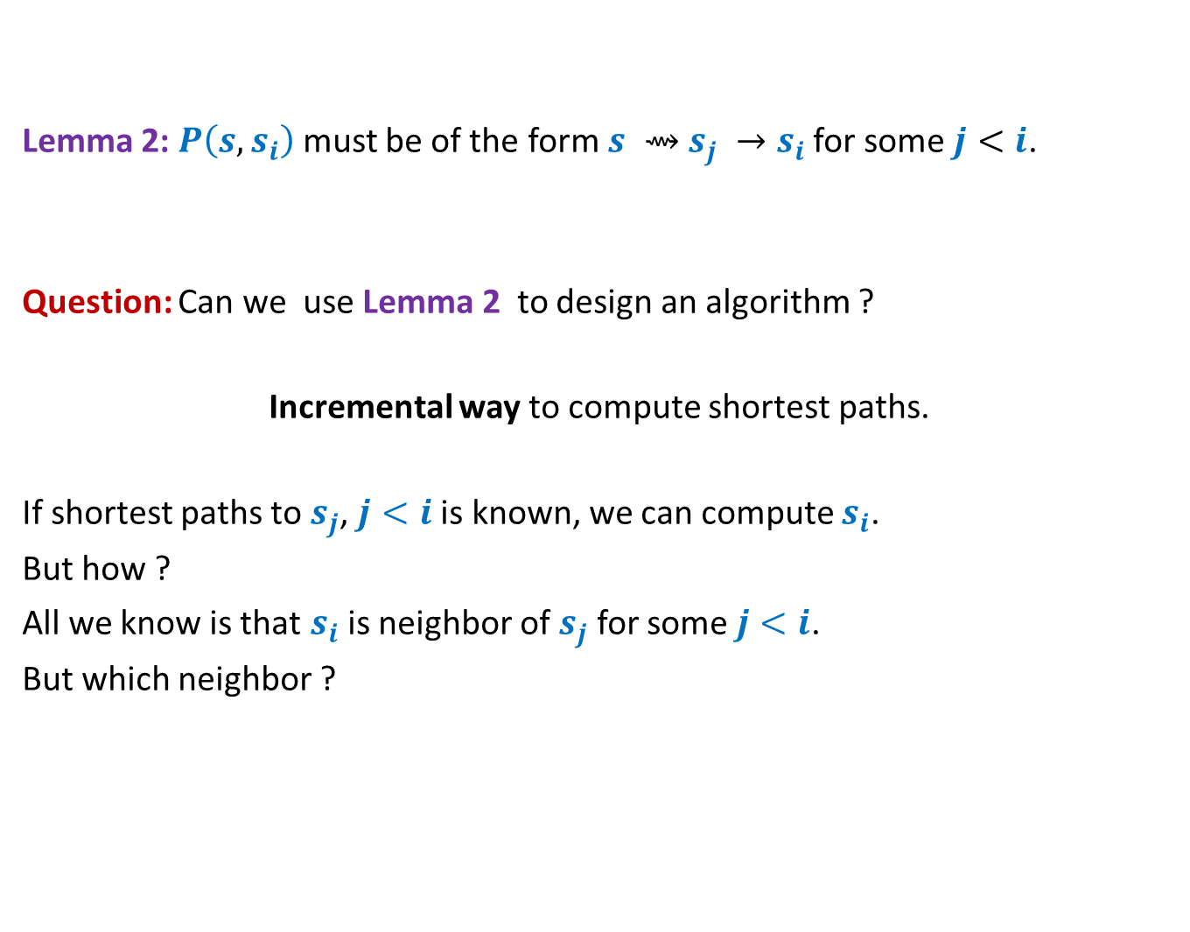
Designing the algorithm …
Lemma 2: $P\left(s,s_{i}\right)$ must be of the form $s ⇝$ $s_{j} →s_{i}$ for some $j<i$.
Question: Can we use Lemma 2 to design an algorithm ?
Incremental way to compute shortest paths.
If shortest paths to $s_{j}$, $j<i$ is known, we can compute $s_{i}$.
But how ?
All we know is that $s_{i}$ is neighbor of $s_{j}$ for some $j<i$.
But which neighbor ?
shortest
The next slide explains it precisely.
Hint:
For each neighbor, compute some label based on Lemma 2 s.t. $s_{i}$ is the neighbour with least label.

Slide 5



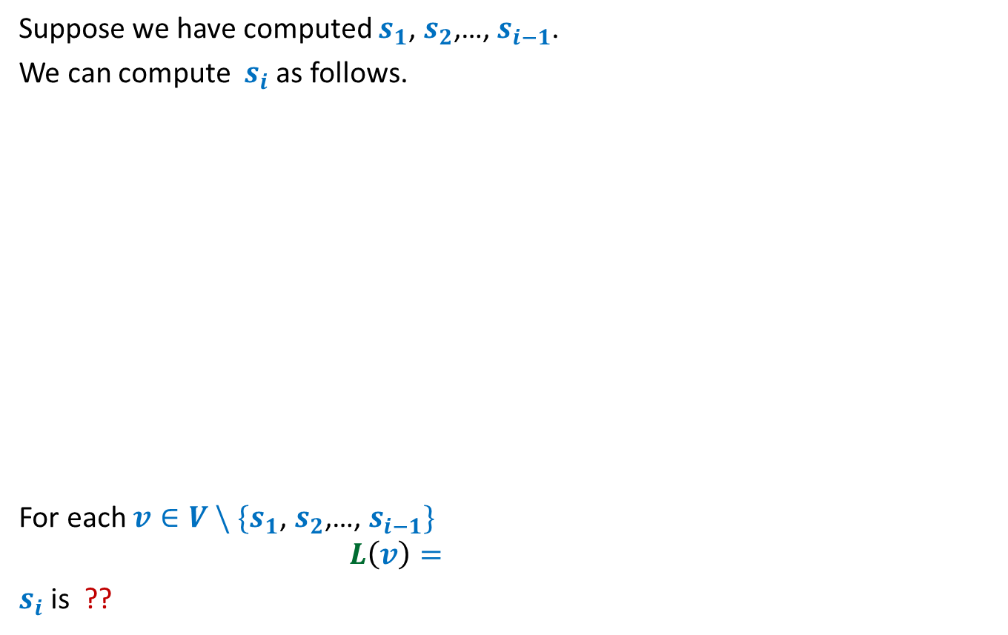






Suppose we have computed $s_{1}$, $s_{2}$,…, $s_{i−1}$.
We can compute $s_{i}$ as follows.
For each $v∈V \backslash \{s_{1}\text{,} s_{2}\text{,…,} s_{i−1}\}$
$$L\left(v\right)=$$
$s_{i}$ is ??
$$s$$
G
$$s_{1}$$
$$s_{4}$$
$$v$$
$$s_{2}$$
$$s_{3}$$
$$\left(δ\left(s,s_{j}\right)+ω\left(s_{j},v\right)\right)$$
$$\min_{\left({(s}_{j},v\right)∈E)}{ ? }$$
the vertex with minimum value of $L$.

Slide 6
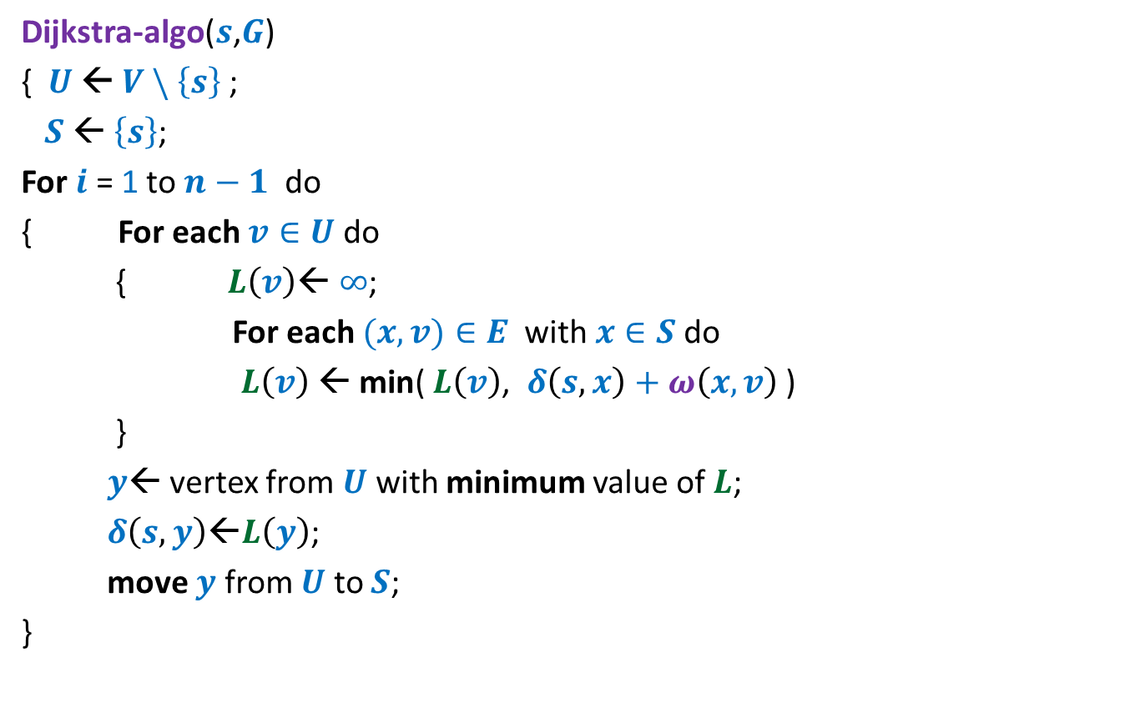
Dijkstra’s algorithm
Dijkstra-algo($s$,$G$)
{ $U$ ← $V \backslash \left\{s\right\}$;
$S$← $\left\{s\right\}$;
For $i$ = 1 to $n−1$ do
{ For each $v∈U$ do
{ $L\left(v\right)$← $∞$;
For each $(x,v)∈E$ with $x∈S$do
$L\left(v\right) \text{←}$ min( $L\left(v\right)$, $δ\left(s,x\right)+ω\left(x,v\right)$ )
}
$y$← vertex from $U$ with minimum value of $L$;
$δ\left(s,y\right)\text{←}L\left(y\right)$;
move $y$ from $U$ to $S$;
}

Slide 7
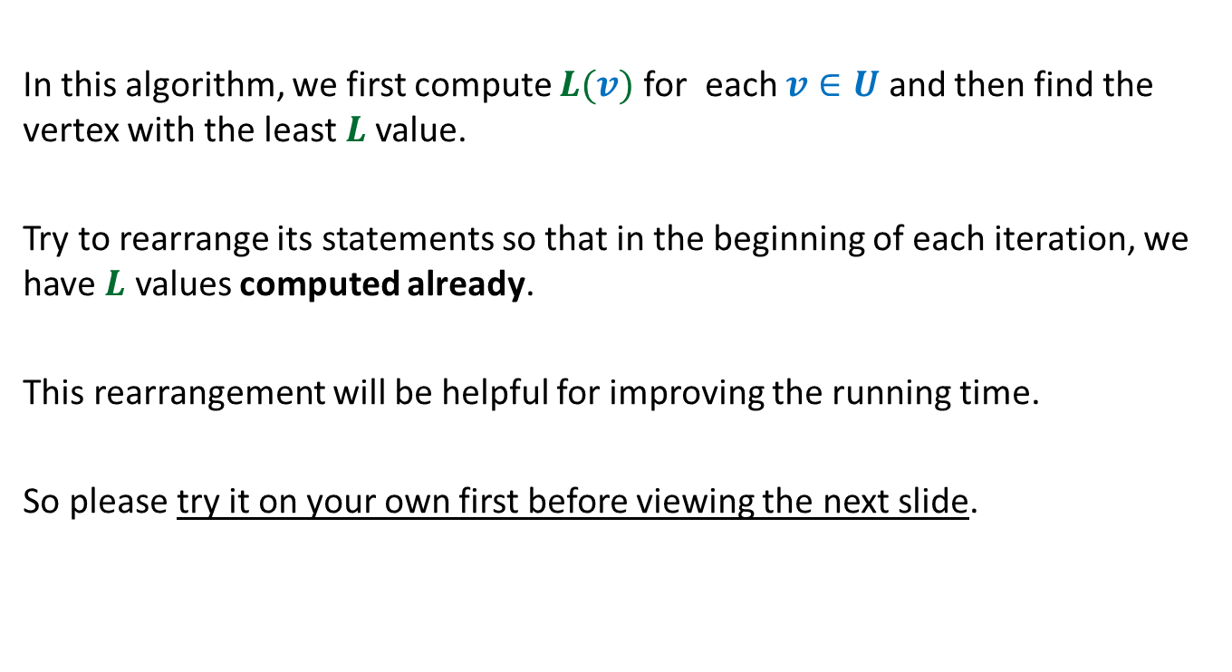
In this algorithm, we first compute $L(v)$ for each $v∈U$ and then find the vertex with the least $L$value.
Try to rearrange its statements so that in the beginning of each iteration, we have $L$ values computed already.
This rearrangement will be helpful for improving the running time.
So please try it on your own first before viewing the next slide.

Slide 8

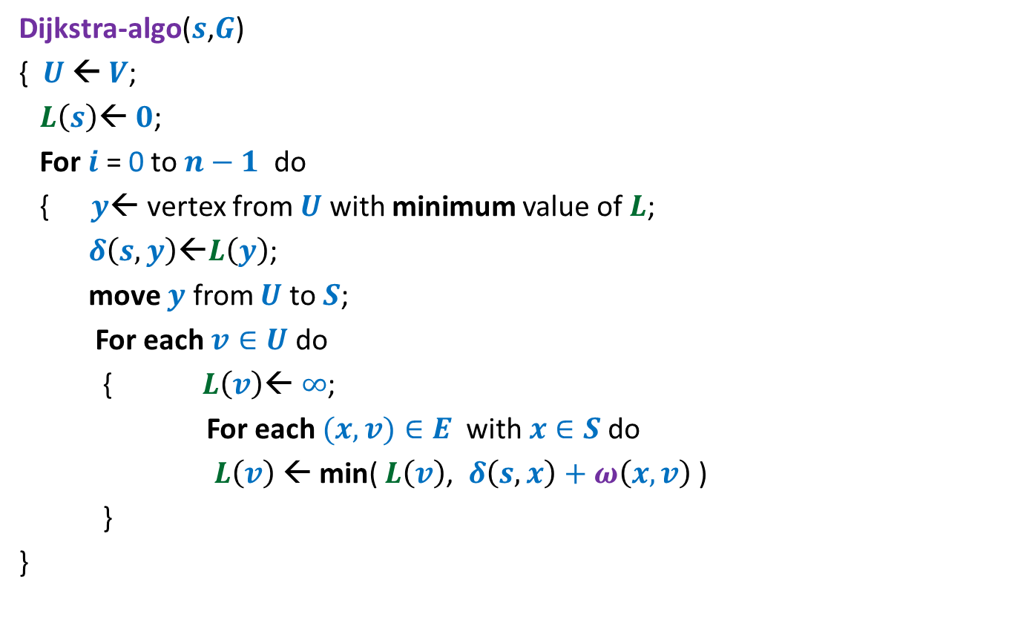
Dijkstra’s algorithm
Dijkstra-algo($s$,$G$)
{ $U$ ← $V$;
$L\left(s\right)$← $0$;
For $i$ = 0 to $n−1$ do
{ $y$← vertex from $U$ with minimum value of $L$;
$δ\left(s,y\right)\text{←}L\left(y\right)$;
move $y$ from $U$ to $S$;
For each $v∈U$ do
{ $L\left(v\right)$← $∞$;
For each $(x,v)∈E$ with $x∈S$do
$L\left(v\right) \text{←}$ min( $L\left(v\right)$, $δ\left(s,x\right)+ω\left(x,v\right)$ )
}
}
$L\left(v\right)$← $∞$ for all $v∈U$ ;
a lot of re-computation

Slide 9

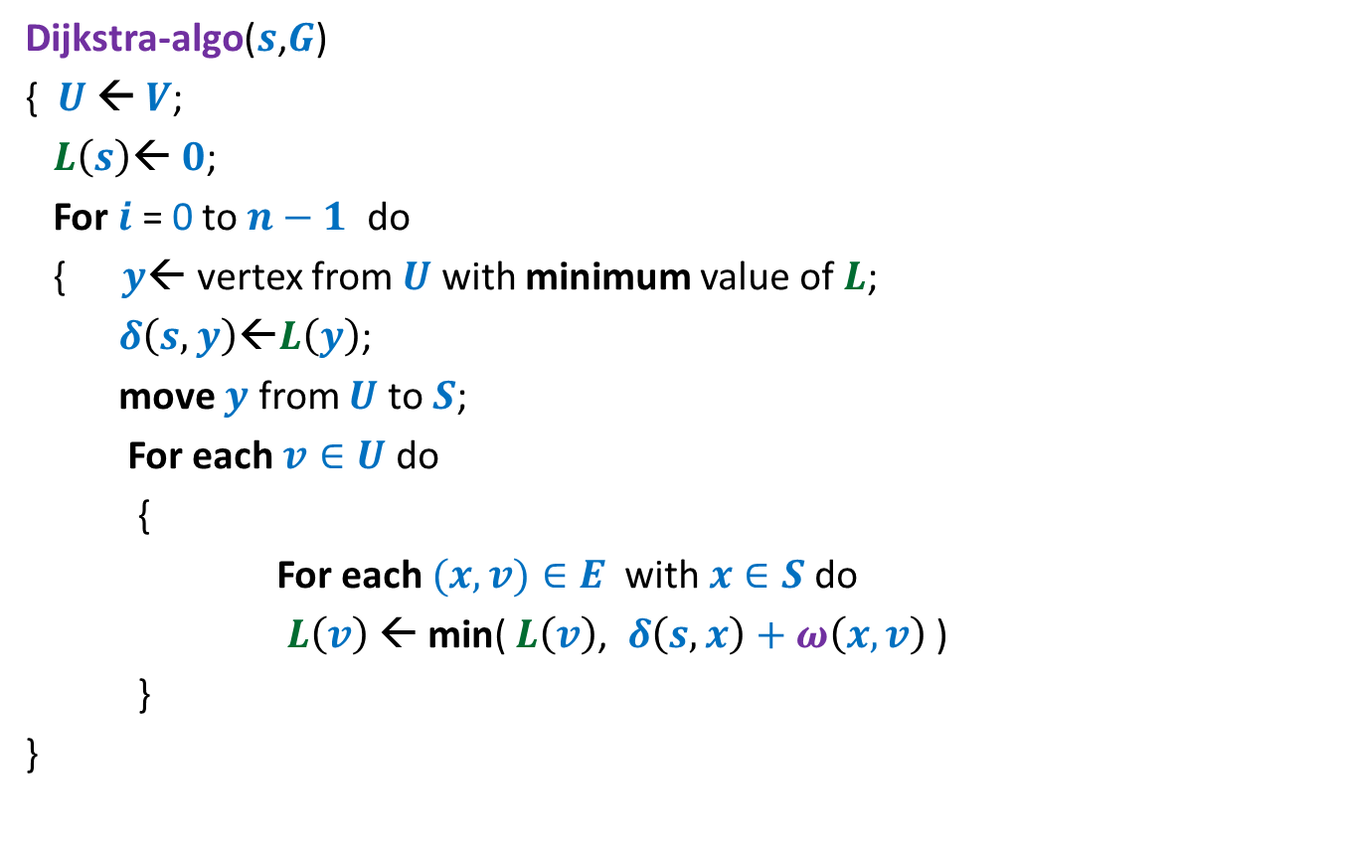

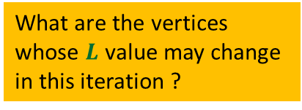
Dijkstra’s algorithm
Dijkstra-algo($s$,$G$)
{ $U$ ← $V$;
$L\left(s\right)$← $0$;
For $i$ = 0 to $n−1$ do
{ $y$← vertex from $U$ with minimum value of $L$;
$δ\left(s,y\right)\text{←}L\left(y\right)$;
move $y$ from $U$ to $S$;
For each $v∈U$ do
{
For each $(x,v)∈E$ with $x∈S$do
$L\left(v\right) \text{←}$ min( $L\left(v\right)$, $δ\left(s,x\right)+ω\left(x,v\right)$ )
}
}
Only neighbors of $y$
$L\left(v\right)$← $∞$ for all $v∈U$ ;
What are the vertices
whose $L$ value may change
in this iteration ?

Slide 10
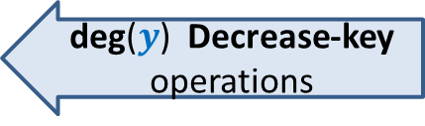
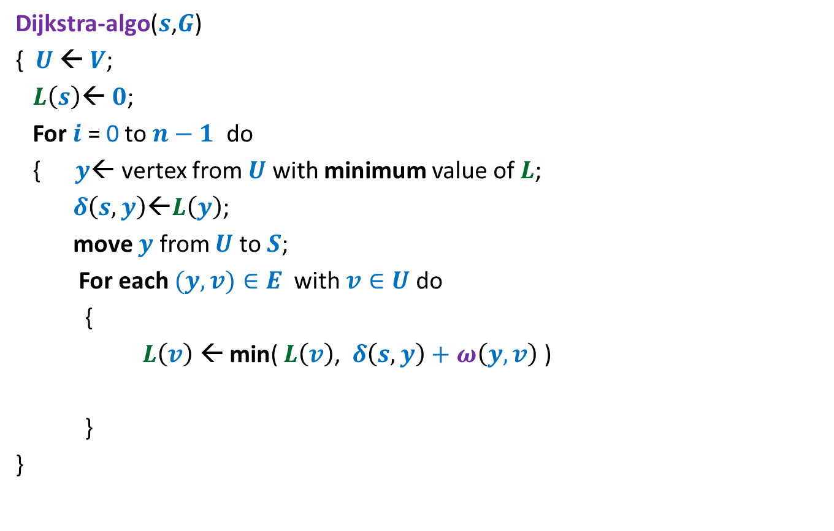
Dijkstra’s algorithm
Dijkstra-algo($s$,$G$)
{ $U$ ← $V$;
$L\left(s\right)$← $0$;
For $i$ = 0 to $n−1$ do
{ $y$← vertex from $U$ with minimum value of $L$;
$δ\left(s,y\right)\text{←}L\left(y\right)$;
move $y$ from $U$ to $S$;
For each $(y,v)∈E$ with $v∈U$do
{
$L\left(v\right) \text{←}$ min( $L\left(v\right)$, $δ\left(s,y\right)+ω\left(y,v\right)$ )
}
}
$L\left(v\right)$← $∞$ for all $v∈U$ ;
1 extract-min operation
deg($y$) Decrease-key operations

Slide 11
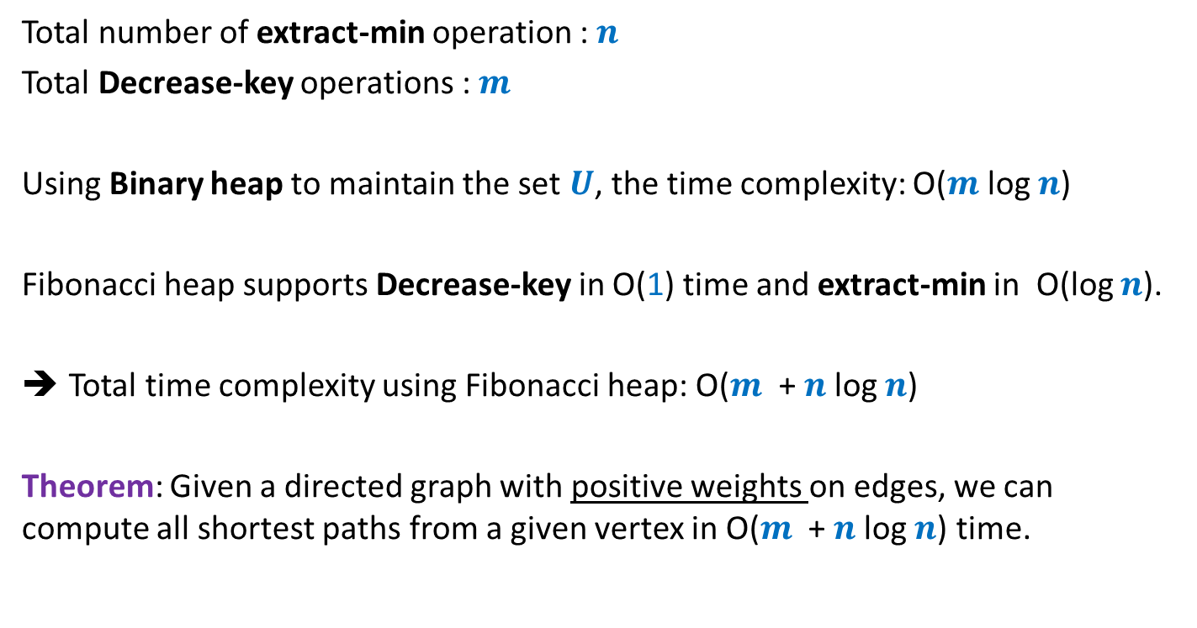
Time complexity of Dijkstra’s algorithm
Total number of extract-min operation : $n$
Total Decrease-key operations : $m$
Using Binary heap to maintain the set $U$, the time complexity: O($m$ log $n$)
Fibonacci heap supports Decrease-key in O(1) time and extract-min in O(log $n$).
Total time complexity using Fibonacci heap: O($m$ + $n$log $n$)
Theorem: Given a directed graph with positive weights on edges, we can compute all shortest paths from a given vertex in O($m$ + $n$log $n$) time.

Slide 12
a new Algorithm Paradigm …

Slide 13
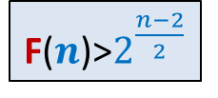
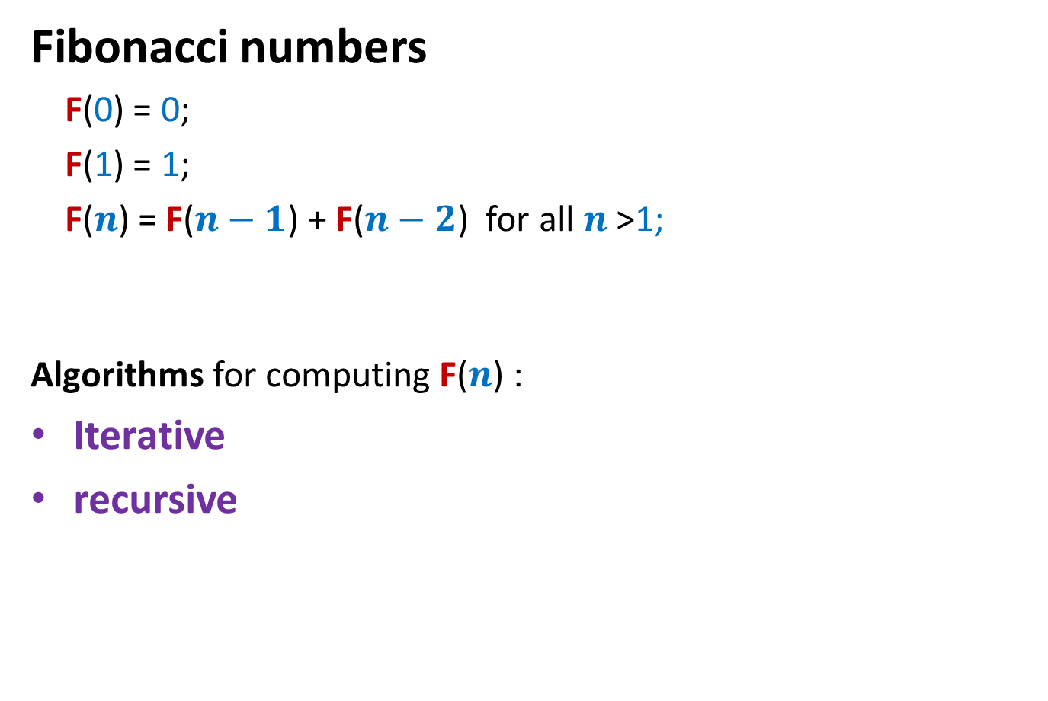
Fibonacci numbers
Fibonacci numbers
F(0) = 0;
F(1) = 1;
F($n$) = F($n−1$) + F($n−2$) for all $n$ >1;
Algorithms for computing F($n$) :
Iterative
recursive
F($n$)>$2^{\frac{n−2}{2}}$

Slide 14




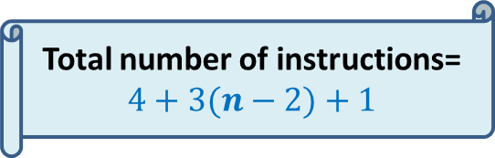

Iterative Algorithm for F($n$)
Total number of instructions= $4+3(n−2)+1$
IFib($n$)
if $n$=0 return 0;
else if $n$=1 return 1;
else { a ← 0; b← 1;
For($i$=2 to $n$) do
{ temp ← b;
b← a+b;
a← temp;
}
}
return b;
$$< 3n$$
4 instructions
$n−2$ iterations
3 instructions per iteration
the final instruction
F
0 1
0 | 1 | 2 | …
$$i$$

Slide 15
Recursive algorithm for F(n)
Rfib(n)
{ if n=0 return 0;
else if n=1 return 1;
else return(Rfib(n-1) + Rfib(n-2))
}
Let G(n) : No. of instruction executed by RFib(n)
G(0) = 1; G(1) = 2;
For n>1 G(n) = G(n-1)+G(n-2) + 4
Observation 1: G(n)>F(n) for all n;
It follows from Observation 1 and Exercise 1 that G(n) is exponential in n !
Explore the recursion tree of Rfib(n) to find the reason behind this exponential time.

Slide 16








Recursive algorithm for $F$($n$)
Recursion tree
$F$($n$)
$F$($n−1$)
$F$($n−2$)
$F$($n−3$)
$F$($n−4$)
$F$($n−2$)
$F$($n−3$)
Computing same number again.

