Slide 1
Design and Analysis of Algorithms
Algorithms-II : CS345A
Website: hello.iitk.ac.in
Lecture 24
Network Flow – V

Slide 2

Polynomial Time algorithm for max-flow
Algorithm 2
For Networks with edge capacities $∈R^{+}$

Slide 3

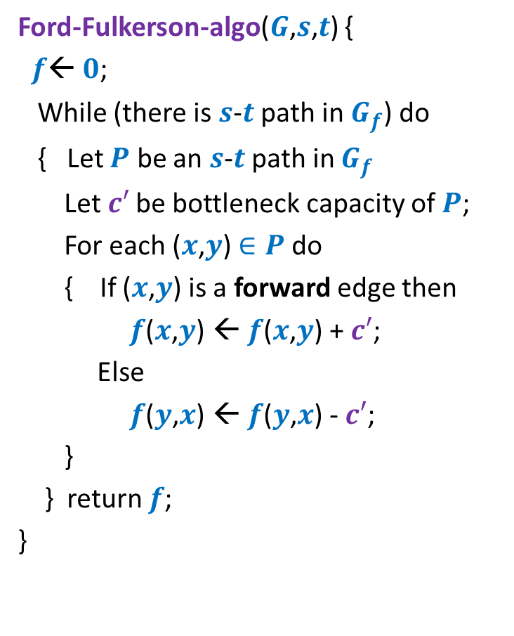
Towards Designing Algorithm 2
Ford-Fulkerson-algo($G$,$s$,$t$) {
$f$← $0$;
While (there is $s$-$t$ path in $G_{f}$) do
{ Let $P$ be an $s$-$t$ path in $G_{f}$
Let$c′$ be bottleneck capacity of $P$;
For each ($x$,$y$) $∈P$ do
{ If ($x$,$y$) is a forward edge then
$f$($x$,$y$) ← $f$($x$,$y$) + $c′$;
Else
$f$($y$,$x$) ← $f$($y$,$x$) - $c′$;
}
} return $f$;
}
In each iteration, at least one edge disappears from $G_{f}$.

Slide 4
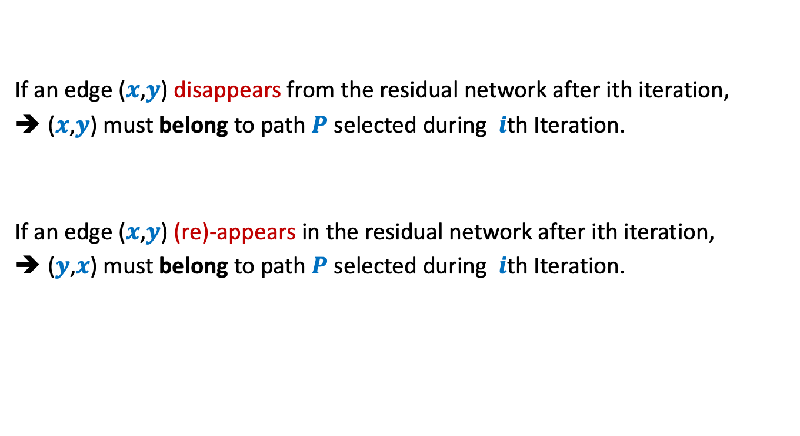
Disappearance/Reappearance of an edge in residual network
If an edge ($x$,$y$) disappears from the residual network after ith iteration,
($x$,$y$) must belong to path $P$ selected during $i$th Iteration.
If an edge ($x$,$y$) (re)-appears in the residual network after ith iteration,
($y$,$x$) must belong to path $P$ selected during $i$th Iteration.

Slide 5



Algorithm 2
Ford-Fulkerson-algo($G$,$s$,$t$) {
$f$← $0$;
While (there is $s$-$t$ path in $G_{f}$) do
{ Let $P$ be an $s$-$t$ path in $G_{f}$
Let$c′$ be bottleneck capacity of $P$;
For each ($x$,$y$) $∈P$ do
{ If ($x$,$y$) is a forward edge then
$f$($x$,$y$) ← $f$($x$,$y$) + $c′$;
Else
$f$($y$,$x$) ← $f$($y$,$x$) - $c′$;
}
} return $f$;
}
Algorithm-2($G$,$s$,$t$) {
Let $P$ be the shortest $s$-$t$ path in $G_{f}$;
How to achieve :
An edge can disappear and re-appear O($n$) times.

Slide 6









A crucial observation
Lemma : Distance from $s$ to each vertex increases monotonically in $G_{f}$.
$$δ_{f}\left(s,x\right)≤δ_{f′}\left(s,x\right)$$
$$δ_{f}(s,x)$$
$$s$$
$$t$$
$$x$$
$$G_{f}$$
After $i$th Iteration
$$δ_{f′}(s,x)$$
$$s$$
$$t$$
$$G_{f′}$$
$$x$$

Slide 7



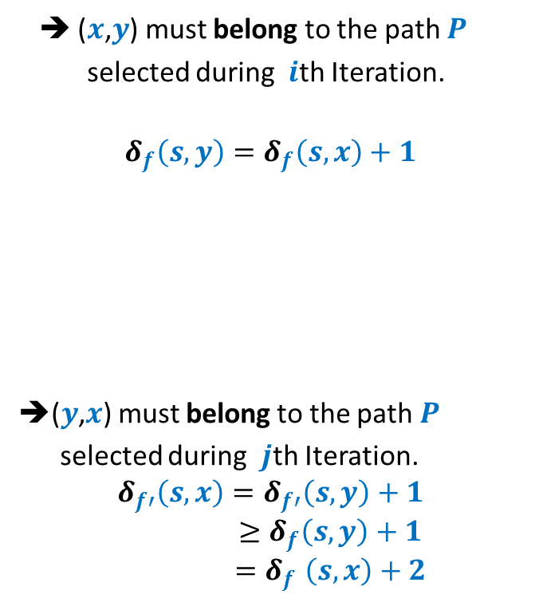




Bounding the disappearing/re-appearing of an edge
$$G_{f}$$
$$s$$
$$t$$
$$x$$
$$y$$
➔ ($x$,$y$) must belong to the path $P$
selected during $i$th Iteration.
$$δ_{f}\left(s,y\right)=δ_{f}\left(s,x\right)+1$$
➔($y$,$x$) must belong to the path $P$
selected during $j$th Iteration.
$$δ_{f′}\left(s,x\right)=δ_{f′}\left(s,y\right)+1$$
$$≥δ_{f}\left(s,y\right)+1$$
$${=δ}_{f}\left(s,x\right)+2$$
After $i$th Iteration
$$s$$
$$t$$
$$x$$
$$y$$
$$δ_{f′}\left(s,y\right)≥δ_{f}\left(s,y\right)$$
$$G_{f′}$$
After $j$th Iteration
$$s$$
$$t$$
$$x$$
$$y$$

Slide 8
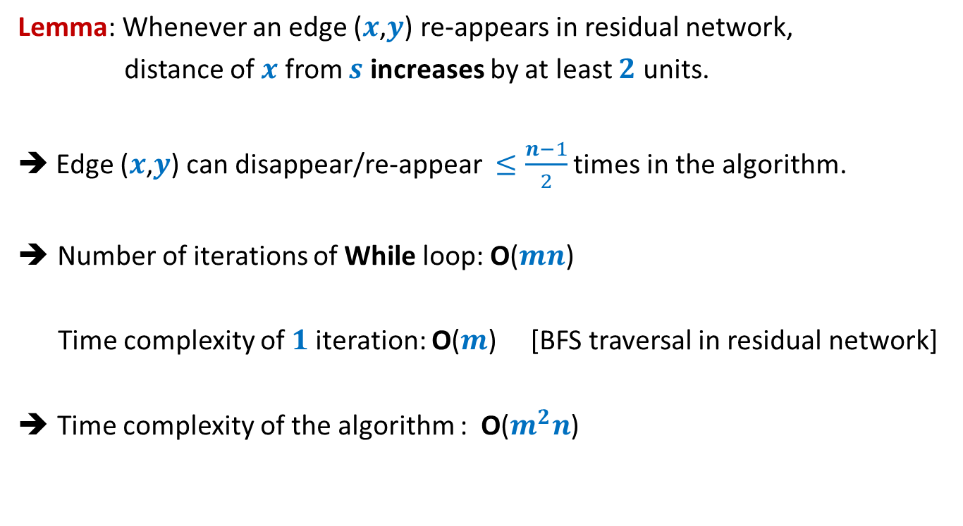
Analysis of Algorithm 2
Lemma: Whenever an edge ($x$,$y$) re-appears in residual network,
distance of $x$ from $s$ increases by at least $2$ units.
➔ Edge ($x$,$y$) can disappear/re-appear $≤\frac{n−1}{2}$ times in the algorithm.
Number of iterations of While loop: O($mn$)
Time complexity of $1$iteration: O($m$) [BFS traversal in residual network]
Time complexity of the algorithm : O($m^{2}n$)

Slide 9
Proof of the monotonic increase of distanceS in residual network

Slide 10
A crucial observation
Lemma : Distance from $s$ to each vertex increases monotonically in $G_{f}$.
$$δ_{f}\left(s,x\right)≤δ_{f′}\left(s,x\right)$$
$$δ_{f}(s,x)$$
$$s$$
$$t$$
$$x$$
$$G_{f}$$
After $i$th Iteration
$$δ_{f′}(s,x)$$
$$s$$
$$t$$
$$G_{f′}$$
$$x$$

Slide 11





Proof by contradiction
$δ_{f′}\left(s,x\right)<δ_{f}\left(s,x\right)$
Let $x$be the nearest “defaulter”.
➔ For each vertex $v$in $G_{f′}$ with $δ_{f^{′}}\left(s,v\right)<δ_{f′}(s,x)$,
$δ_{f}\left(s,v\right)≤δ_{f′}\left(s,v\right)$
$$δ_{f}(s,x)$$
$$s$$
$$t$$
$$G_{f}$$
$$x$$
$i$th Iteration
$$δ_{f′}(s,x)$$
$$G_{f′}$$
$$s$$
$$t$$
$$x$$

Slide 12





Proof by contradiction
Definitely $δ_{f}\left(s,u\right)≤δ_{f′}\left(s,u\right)$
➔Edge $\left(u,x\right)$ must have appeared in residual network after $i$th iteration.
➔Edge $\left(x,u\right)∈P$ (the path selected during $i$th Iteration)
➔ $δ_{f}\left(s,u\right)=δ_{f}\left(s,x\right)+1$
$$δ_{f}(s,x)$$
$$s$$
$$t$$
$$G_{f}$$
$$x$$
$i$th Iteration
$$δ_{f′}(s,x)$$
$$G_{f′}$$
$$s$$
$$t$$
$$u$$
$$x$$
contradiction
$>δ_{f′}\left(s,x\right)+1$
$=(δ_{f^{′}}\left(s,u\right)+1)+1$
$δ_{f}\left(s,u\right)>δ_{f′}\left(s,u\right)$

Slide 13
Well Known Algorithms for Max-Flow

Slide 14





Well known algorithms for Max-Flow
Inventor(s) | Year | Time complexity
Ford & Fulkerson
1956
O($−−$)
Edmond and Karp
1972
O($m^{2}n$)
Yefim Dinitz
1970*
O($n^{2}m$)
V.M. Malhotra,
Pramodh Kumar,
S.N. Maheshwari
1978 @IITK
O($n^{3}$)
J. Orlin
2013
O($mn$)

Slide 15
Applications and Variants Of Max-Flow

Slide 16

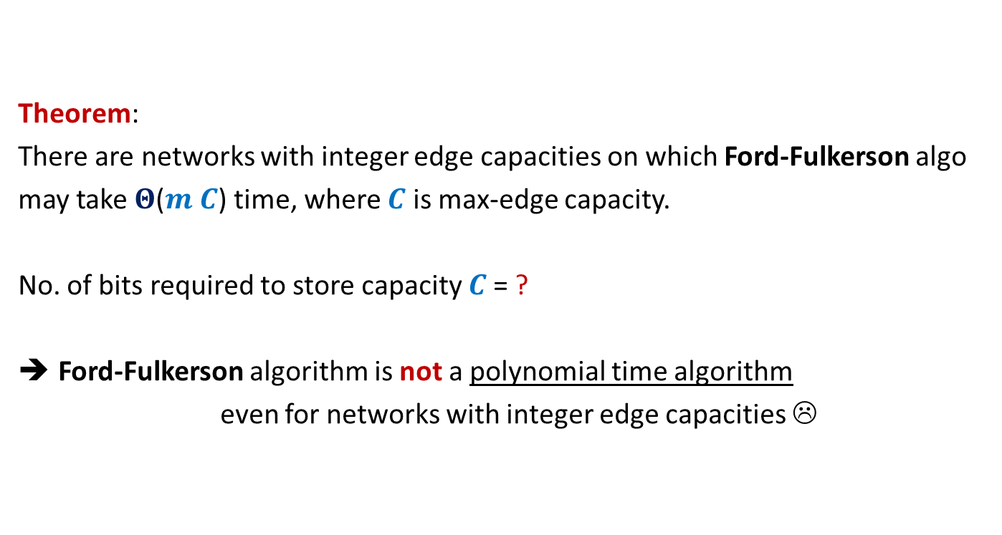

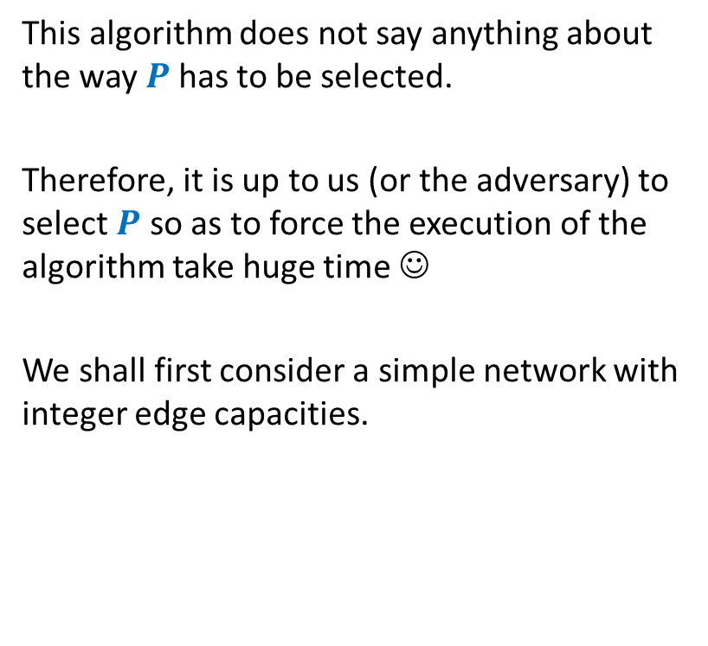


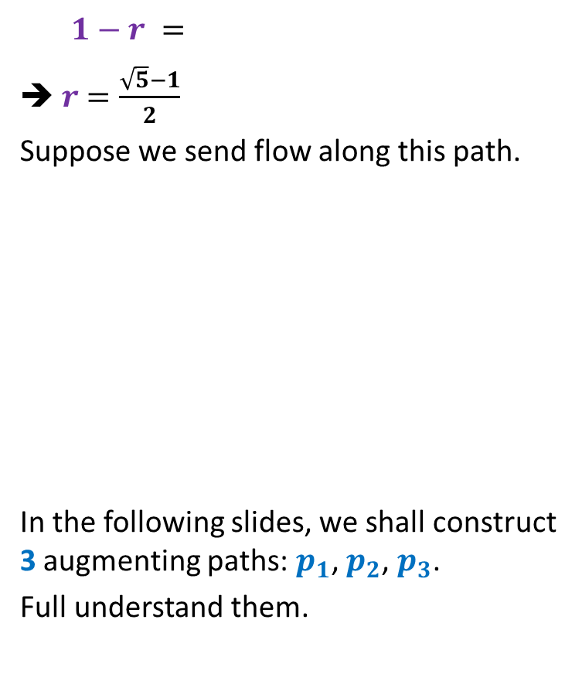

Rounding of a matrix
$$11$$
$$11.7$$
$$12$$
$$39$$ | $$19$$ | $$18$$ | $$30$$
$$37$$
$$15$$
$$20$$
$$34$$
$$11.7$$ | $$2.4$$ | $$4.3$$ | $$18.6$$
$$5.2$$ | $$6.1$$ | $$1.0$$ | $$2.7$$
$$6.7$$ | $$3.6$$ | $$9.1$$ | $$0.6$$
$$15.4$$ | $$6.9$$ | $$3.6$$ | $$8.1$$
$$12$$ | $$2$$ | $$4$$ | $$19$$
$$5$$ | $$6$$ | $$1$$ | $$3$$
$$7$$ | $$4$$ | $$9$$ | $$0$$
$$15$$ | $$7$$ | $$4$$ | $$8$$
Design an algorithm to round a $n×n$ matrix, if possible ?
Rounding always exists !
Rounding can be computed efficiently.
Using Max Flow ☺

Slide 17

Rounding of a matrix
Tool 1: Integrality of max-flow
Tool 2: An elementary observation
Max-Flow does not decrease if we increase the capacity of any set of edges.
Tool 3: A simple Homework exercise
If each matrix with entries $∈[0,1]$ can be rounded,
then each matrix can be rounded.

Slide 18

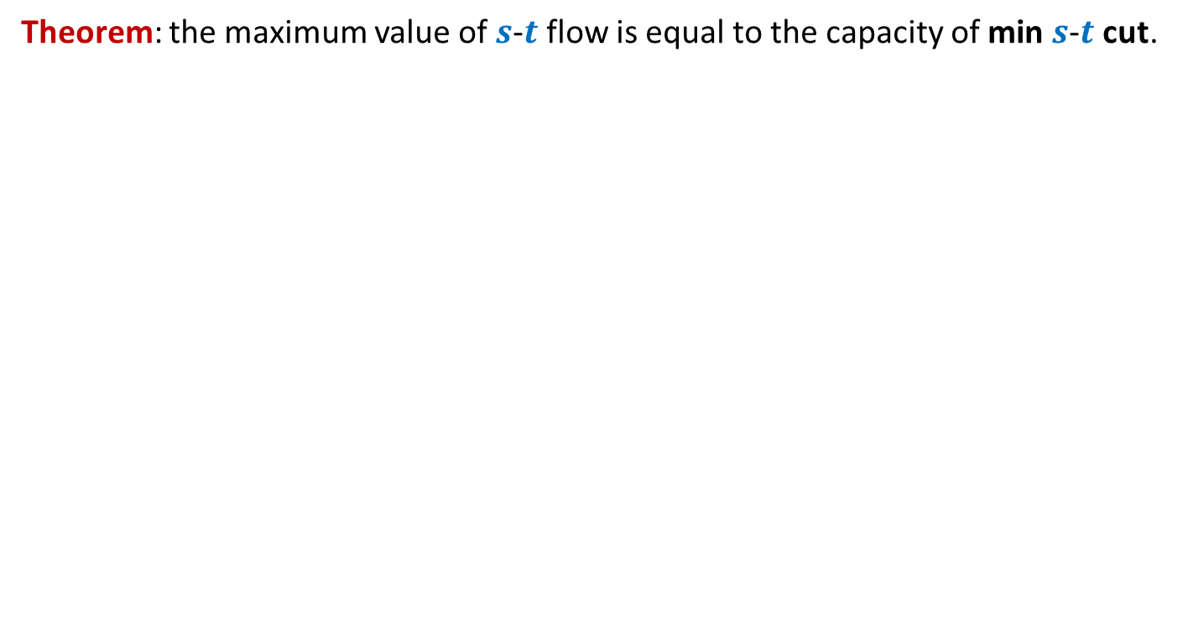
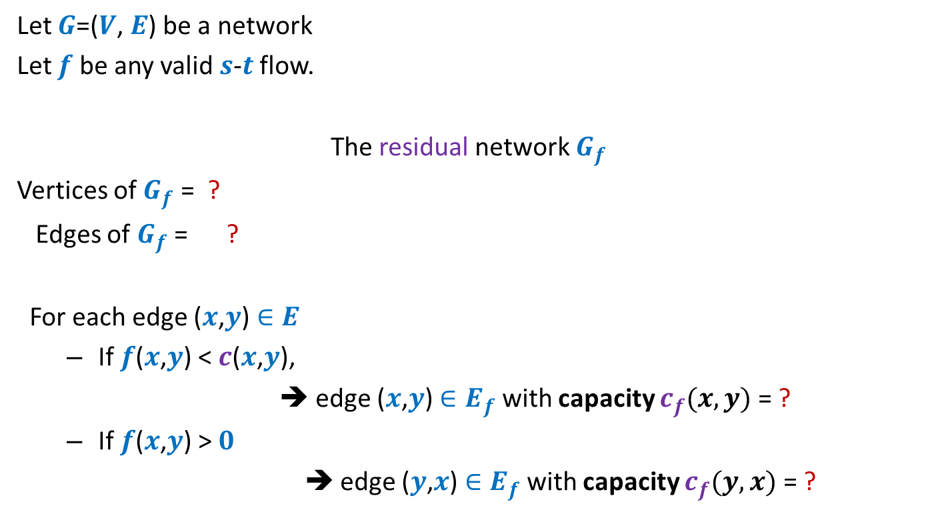
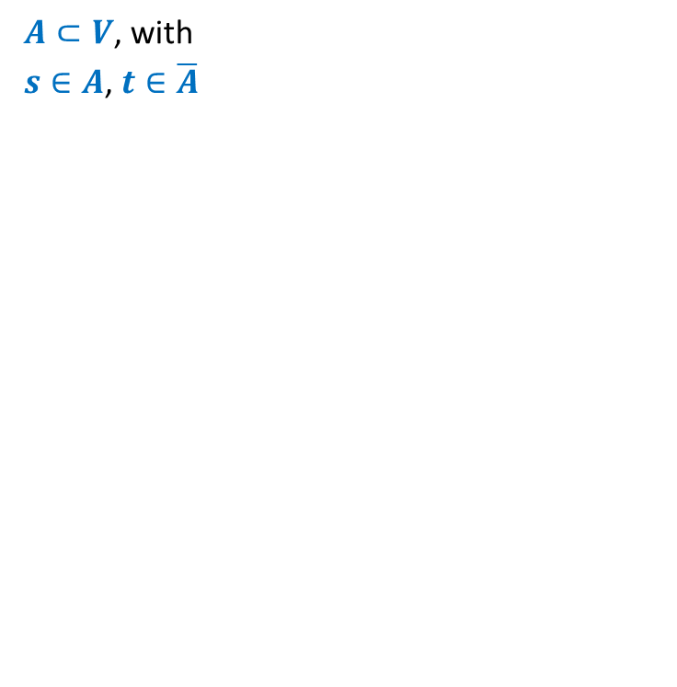






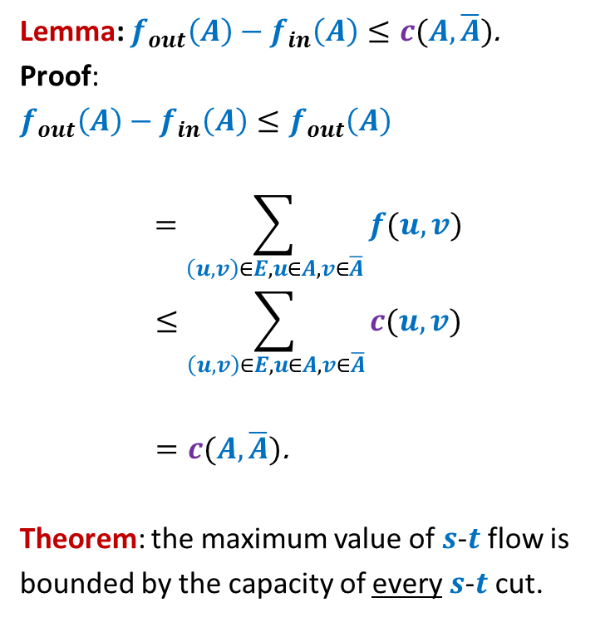







Rounding of a matrix
$$0$$
$$0.7$$
$$1$$
Tool 3
Tool 2
$$2$$ | $$2$$ | $$1$$ | $$2$$
Tool 1
rows
columns
$$2$$
$$1$$
$$2$$
$$2$$
$$0.7$$ | $$0.4$$ | $$0.3$$ | $$0.6$$
$$0.2$$ | $$0.1$$ | $$0.0$$ | $$0.7$$
$$0.7$$ | $$0.6$$ | $$0.1$$ | $$0.6$$
$$0.4$$ | $$0.9$$ | $$0.6$$ | $$0.1$$
$$1$$
$$0.2$$
$$2$$
$$2$$
$$1$$
$$0.1$$
$$2$$
$$1$$
$$0$$
$$2$$
$$0.0$$
$$1$$
$$0.7$$
$$1$$
$$2$$
$$2$$
Homework: Reproduce precise arguments on your own

