Slide 1
Design and Analysis of Algorithms (CS345/CS345A)
Lecture 25
Maximum Flow
Applications
Generalization

Slide 2
Application # 2 of Max-Flow
Bipartite Matching

Slide 3
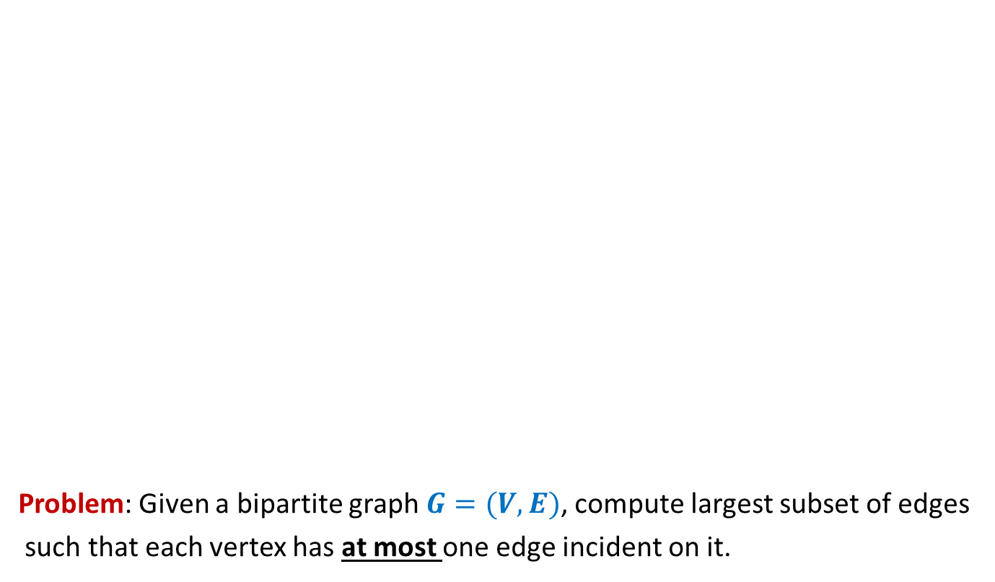
Bipartite matching
Problem: Given a bipartite graph $G=(V,E)$, compute largest subset of edges
such that each vertex has at most one edge incident on it.
applicants
jobs
Matching of size 5
Matching of size 3

Slide 4







Bipartite matching Maximum Flow
applicants
jobs
$$1$$
$$1$$
$$1$$
$$1$$
$$1$$
$$1$$
$$1$$
$$1$$
$$G′$$
$$s$$
$$1$$
$$t$$
$$1$$
$$1$$
$$1$$
$$1$$
$$1$$
$$1$$
$$1$$
$$1$$
$$1$$
$$1$$
$$1$$
$$1$$
$$1$$
$$1$$
$$1$$
How does the max-flow instance look like ?

Slide 5
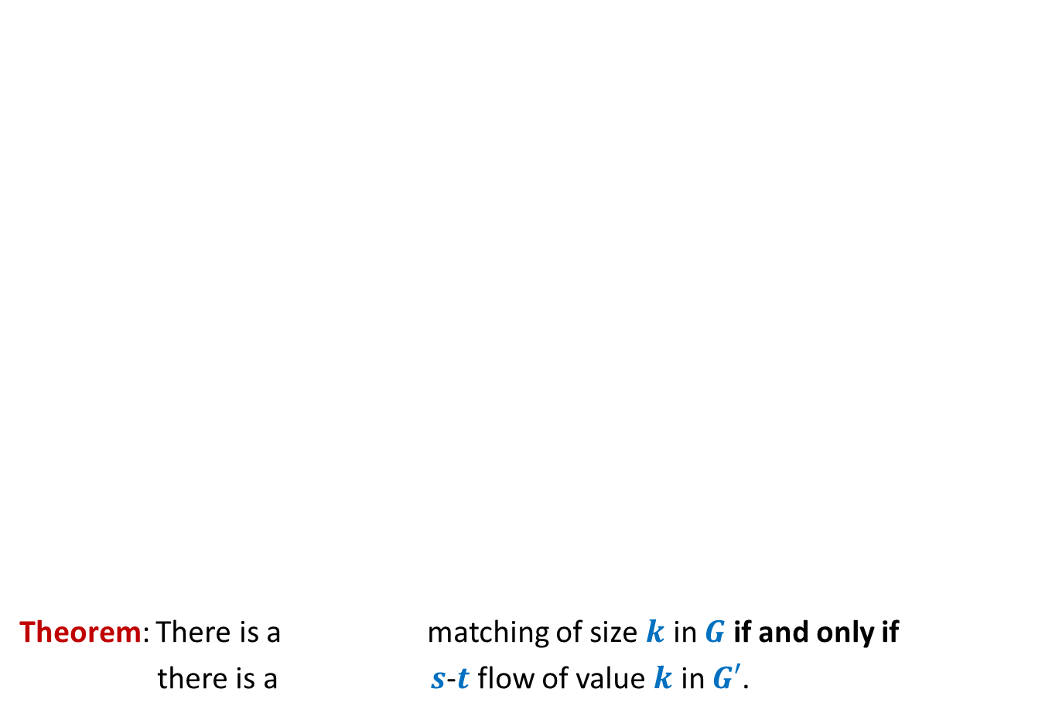

Bipartite matching Maximum Flow
Theorem: There is a matching of size $k$ in $G$ if and only if
there is a $s$-$t$ flow of value $k$ in $G′$.
Convince yourself that this theorem would directly imply that
maxflow in $G′$ = max matching in $G$
applicants
jobs
$$1$$
$$1$$
$$1$$
$$1$$
$$1$$
$$1$$
$$1$$
$$1$$
$$G′$$
$$s$$
$$1$$
$$t$$
$$1$$
$$1$$
$$1$$
$$1$$
$$1$$
$$1$$
$$1$$
What is the relation between the two instances ?
$$1$$
$$1$$
$$1$$
$$1$$
$$1$$
$$1$$
$$1$$
$$1$$
maximum
maximum

Slide 6
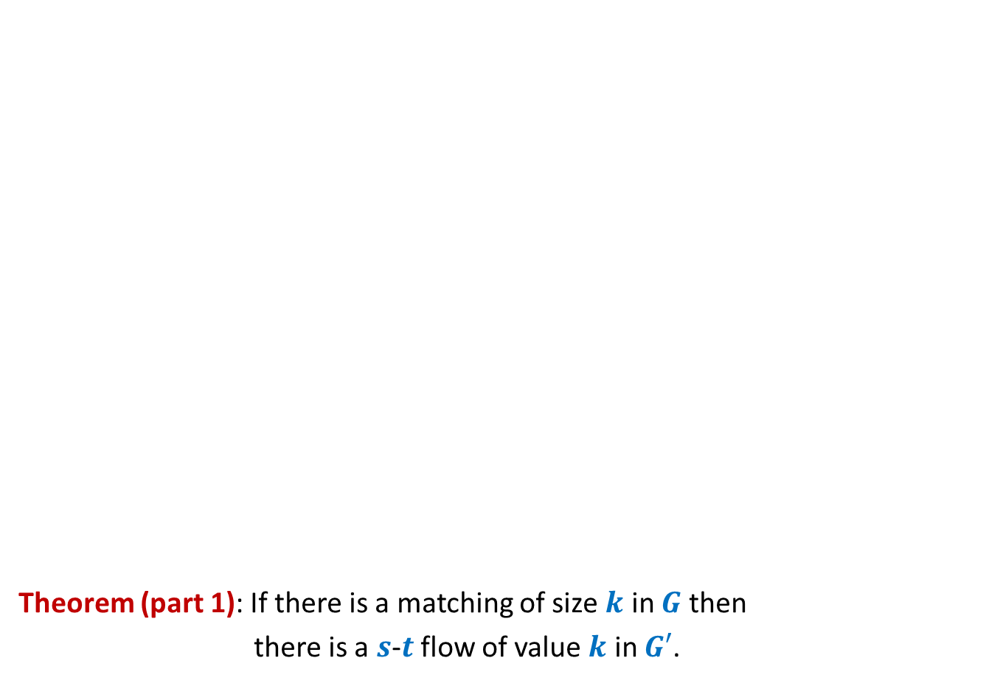
Bipartite matching Maximum Flow
Theorem (part 1): If there is a matching of size $k$ in $G$ then
there is a $s$-$t$ flow of value $k$ in $G′$.
applicants
jobs
$$1$$
$$1$$
$$1$$
$$1$$
$$1$$
$$1$$
$$1$$
$$1$$
$$G′$$
$$s$$
$$1$$
$$t$$
$$1$$
$$1$$
$$1$$
$$1$$
$$1$$
$$1$$
$$1$$
$$1$$
$$1$$
$$1$$
$$1$$
$$1$$
$$1$$
$$1$$
$$1$$

Slide 7

Bipartite matching Maximum Flow
Theorem (part 1): If there is a matching of size $k$ in $G$ then
there is a $s$-$t$ flow of value $k$ in $G′$.
Given an instance of matching of size $k$ in $G$, how will you construct a flow of value $k$ in $G′$ ?
applicants
jobs
$$1$$
$$1$$
$$1$$
$$1$$
$$1$$
$$1$$
$$1$$
$$1$$
$$G′$$
$$s$$
$$1$$
$$t$$
$$1$$
$$1$$
$$1$$
$$1$$
$$1$$
$$1$$
$$1$$
$$1$$
$$1$$
$$1$$
$$1$$
$$1$$
$$1$$
$$1$$
$$1$$

Slide 8
Bipartite matching Maximum Flow
Theorem (part 1): If there is a matching of size $k$ in $G$ then
there is a $s$-$t$ flow of value $k$ in $G′$.
applicants
jobs
$$1$$
$$1$$
$$1$$
$$1$$
$$1$$
$$1$$
$$1$$
$$1$$
$$G′$$
$$s$$
$$1$$
$$t$$
$$1$$
$$1$$
$$1$$
$$1$$
$$1$$
$$1$$
$$1$$
$$1$$
$$1$$
$$1$$
$$1$$
$$1$$
$$1$$
$$1$$
$$1$$

Slide 9
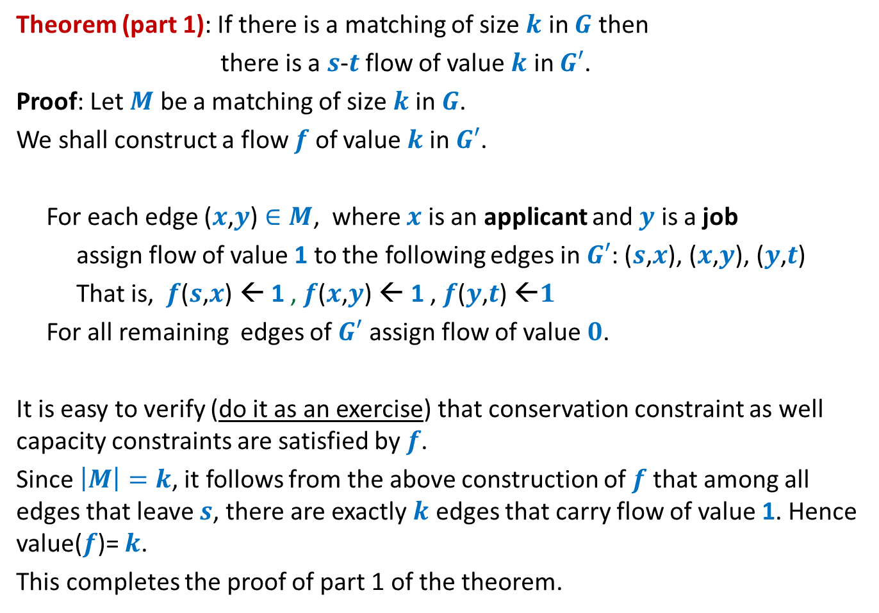
Theorem (part 1): If there is a matching of size $k$ in $G$ then
there is a $s$-$t$ flow of value $k$ in $G′$.
Proof: Let $M$ be a matching of size $k$in $G$.
We shall construct a flow $f$ of value $k$in $G′$.
For each edge ($x$,$y$) $∈M$, where $x$ is an applicant and $y$ is a job
assign flow of value 1 to the following edges in $G′$: ($s$,$x$), ($x$,$y$), ($y$,$t$)
That is, $f$($s$,$x$) ← 1 , $f$($x$,$y$) ← 1 , $f$($y$,$t$) ←$1$
For all remaining edges of $G′$ assign flow of value $0$.
It is easy to verify (do it as an exercise) that conservation constraint as well capacity constraints are satisfied by $f$.
Since $\left|M\right|=k$, it follows from the above construction of $f$that among all edges that leave $s$, there are exactly $k$ edges that carry flow of value 1. Hence value($f$)= $k$.
This completes the proof of part 1 of the theorem.

Slide 10


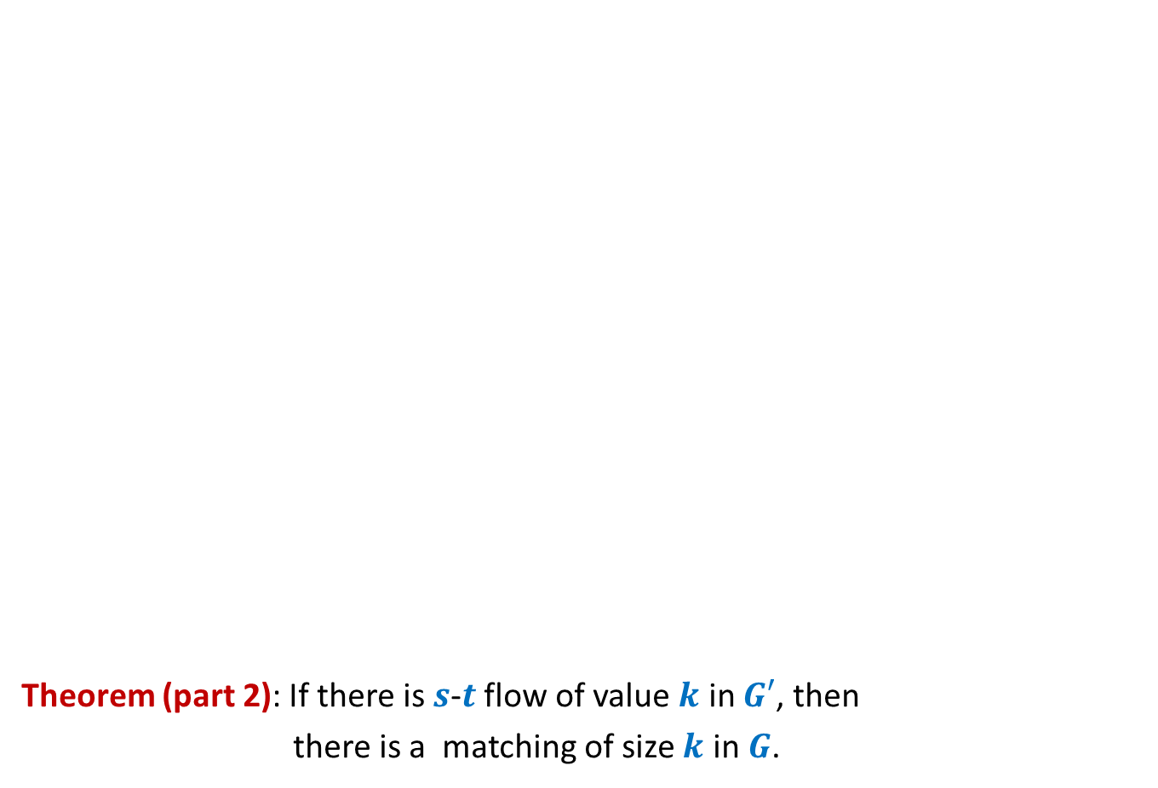
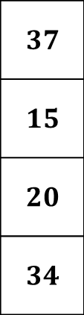

Bipartite matching Maximum Flow
Theorem (part 2): If there is $s$-$t$ flow of value $k$ in $G′$, then
there is a matching of size $k$ in $G$.
Integrality of flow
applicants
jobs
$$1$$
Unit edge capacity
$$1$$
$$1$$
$$1$$
$$1$$
$$1$$
$$1$$
$$A$$
$$1$$
$$G′$$
$$s$$
$$1$$
$$t$$
$$1$$
$$1$$
$$1$$
$$1$$
$A$= {$s$} $∪$ Applicants
$$1$$
$$1$$
$$1$$
$$1$$
$$1$$
$$1$$
$$1$$
$$1$$
Complete the proof with these pointer and verify with the proof given in the following slide.
$f_{out}\left(A\right)−f_{in}(A)$ = $k$
$$1$$
$$1$$
$$0$$
$$1$$

Slide 11
Theorem (part 2): If there is $s$-$t$ flow of value $k$ in $G′$, then
there is a matching of size $k$ in $G$.
Proof: Let $f$ be a $s$-$t$ flow of value $k$ in $G′$.
We shall now construct a matching of size $k$ in $G$.
Firstly, by integrality theorem, $f$ is integral.
Consider the set $A$= {$s$} $∪$ Applicants
So $f_{out}\left(A\right)−f_{in}(A)$ = $k$
Since there is no edge that enters $A$, so $f_{in}(A)$ = $0$,
Hence $f_{out}\left(A\right)$ = $k$.
Moreover, since capacity of each edge in $G′$ is $1$, each edge in $G′$ carries either no flow or a flow of value $1$.
Therefore, there are exactly $k$ edges between Applicants and jobs that carry flow of value $1$.
Let $M$ denote the set of these $k$ edges.
Since each edge leaving $s$ (and each edge entering $t$) has capacity $1$, there can be at most one edge from $M$incident on any applicant (or any job).
It thus follows that the set $M$is indeed a matching in $G$.
This completes the proof of part 2 of the theorem.

Slide 12
Generalization of max-flow Problem
Extending the conservation constraint

Slide 13

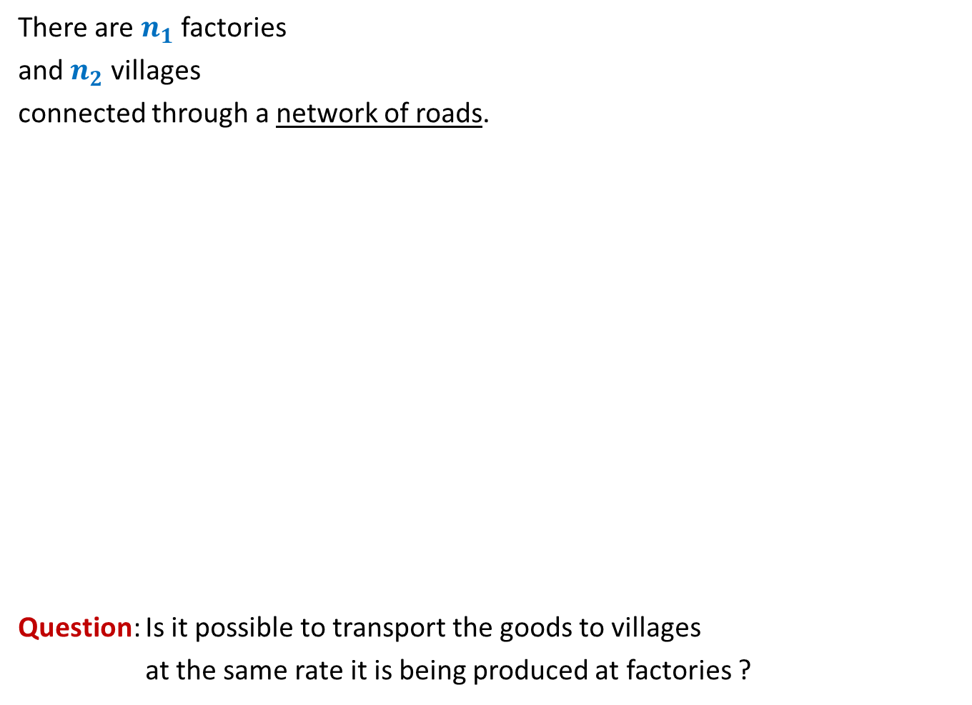
There are $n_{1}$ factories
and $n_{2}$ villages
connected through a network of roads.
Question: Is it possible to transport the goods to villages
at the same rate it is being produced at factories ?
600
400
300
No
Yes
What if roads have capacities ?
200
200
200
500

Slide 14
600
800
500
400
900
300
200
No
?
100
600
What if roads have capacities ?
200
700
200
700
300
50
200
500

Slide 15
600
800
500
400
900
300
200
No
?
100
600
200
700
200
700
300
50
200
500

Slide 16

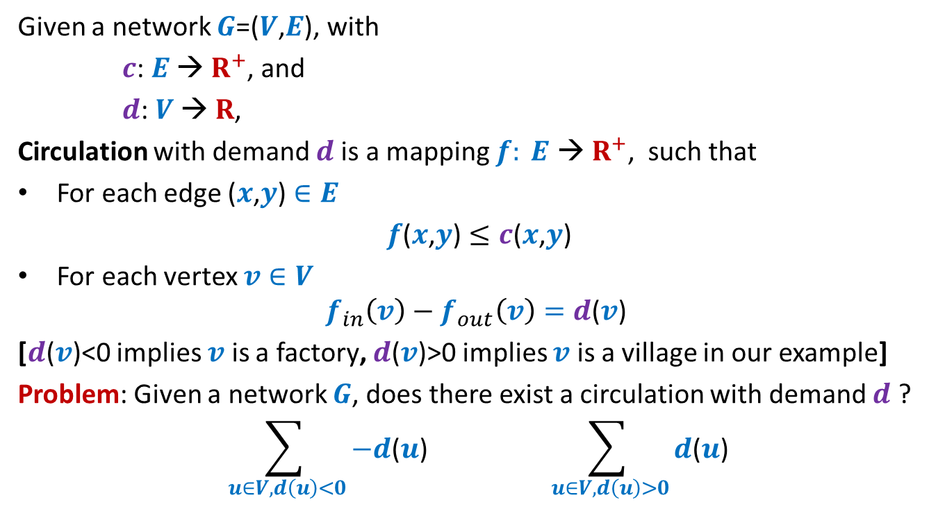
Circulation with demand
Given a network $G$=($V$,$E$), with
$c$: $E$ → $R^{+}$, and
$d$: $V$ → $R$,
Circulation with demand $d$is a mapping $f: E \text{→} R^{+}$, such that
For each edge ($x$,$y$) $∈E$
$f$($x$,$y$) $≤c$($x$,$y$)
For each vertex $v∈V$
$$f_{in}\left(v\right)−f_{out}\left(v\right)=d\text{(}v\text{)}$$
[$d\text{(}v\text{)<0}$ implies $v$ is a factory, $d\text{(}v\text{)>0}$ implies $v$ is a village in our example]
Problem: Given a network $G$, does there exist a circulation with demand $d$ ?
$$\sum_{ u∈V, d\left(u\right)<0}{−d\text{(}u\text{)}} \sum_{ u∈V, d\left(u\right)>0}{d\text{(}u\text{)}}$$
An absolutely necessary condition
$$D$$

Slide 17
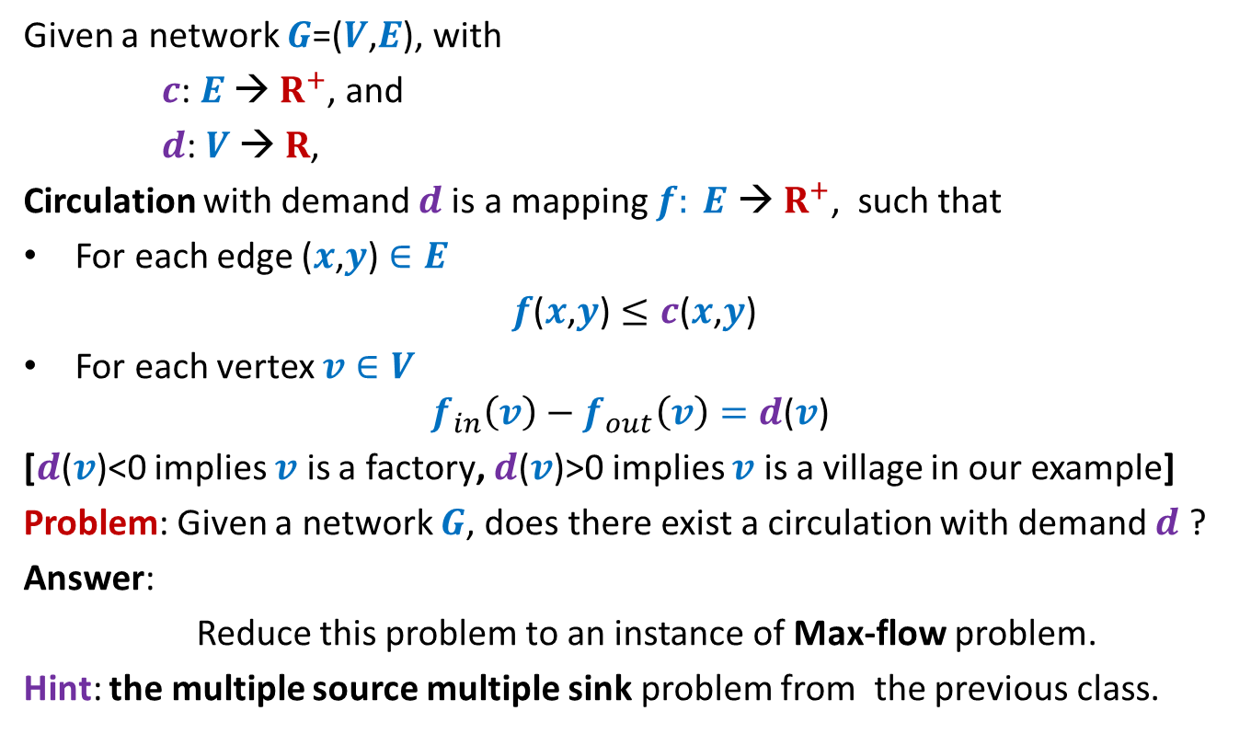
Circulation with demand
Given a network $G$=($V$,$E$), with
$c$: $E$ → $R^{+}$, and
$d$: $V$ → $R$,
Circulation with demand $d$is a mapping $f: E \text{→} R^{+}$, such that
For each edge ($x$,$y$) $∈E$
$f$($x$,$y$) $≤c$($x$,$y$)
For each vertex $v∈V$
$$f_{in}\left(v\right)−f_{out}\left(v\right)=d\text{(}v\text{)}$$
[$d\text{(}v\text{)}\text{<0}$ implies $v$ is a factory, $d\text{(}v\text{)}\text{>}\text{0}$ implies $v$ is a village in our example]
Problem: Given a network $G$, does there exist a circulation with demand $d$ ?
Answer:
Reduce this problem to an instance of Max-flow problem.
Hint: the multiple source multiple sink problem from the previous class.

Slide 18


















Circulation with demand Max-Flow
?
Question: How does the corresponding instance of max-flow look like ?
Node with demand <0
Node with demand >0
$$v$$
$$−d(v)$$
$$a$$
$$d(a)$$
This is $G′$
This is $G$
$$s$$
$$b$$
$$d(b)$$
$$−d(w)$$
$$t$$
$$w$$
$$d(c)$$
$$−d(u)$$
$$c$$
$$u$$
$$x$$
$$d(x)$$

Slide 19
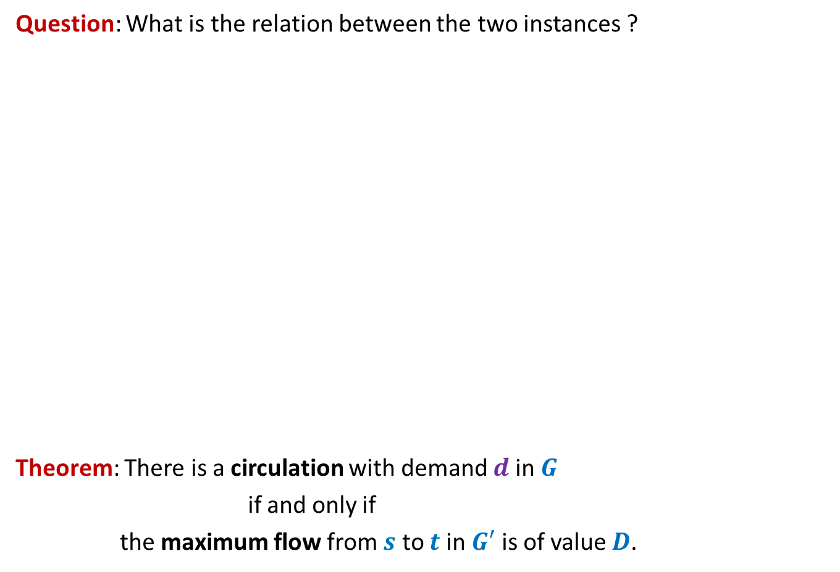
Circulation with demand Max-Flow
Question: What is the relation between the two instances ?
Theorem: There is a circulation with demand $d$in $G$
if and only if
the maximum flow from $s$ to $t$ in $G′$ is of value $D$.
Node with demand <0
Node with demand >0
$$v$$
$$−d(v)$$
$$a$$
$$d(a)$$
This is $G′$
$$s$$
$$b$$
$$d(b)$$
$$−d(w)$$
$$t$$
$$w$$
$$d(c)$$
$$−d(u)$$
$$c$$
$$u$$
$$x$$
How to prove it ?
Split it into 2 parts.
$$d(x)$$

Slide 20

Circulation with demand Max-Flow
Theorem (part 1): If there is a circulation with demand $d$in $G$,
then the maximum flow from $s$ to $t$ in $G′$ is of value $D$.
Node with demand <0
Node with demand >0
$$v$$
$$−d(v)$$
$$a$$
$$d(a)$$
This is $G′$
$$s$$
$$b$$
$$d(b)$$
$$−d(w)$$
$$t$$
$$w$$
$$d(c)$$
$$−d(u)$$
Complete the proof on your own and then verify with the proof given in the following slides.
$$c$$
$$u$$
$$x$$
$$d(x)$$

Slide 21
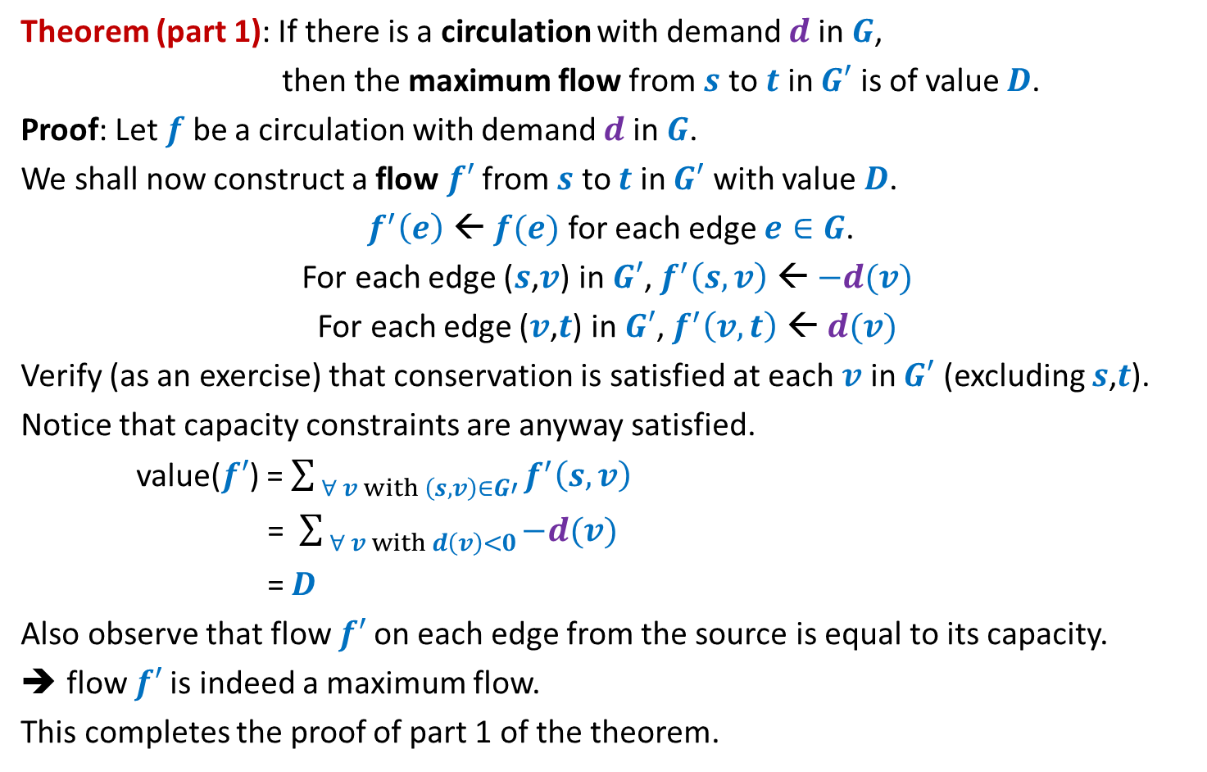
Theorem (part 1): If there is a circulation with demand $d$in $G$,
then the maximum flow from $s$ to $t$ in $G′$ is of value $D$.
Proof: Let $f$ be a circulation with demand $d$in $G$.
We shall now construct a flow $f′$from $s$ to $t$ in $G′$ with value $D$.
$f^{′}\left(e\right)$ ← $f(e)$ for each edge $e∈G$.
For each edge ($s$,$v$) in $G′$, $f^{′}\left(s,v\right)$ ← $−d(v)$
For each edge ($v$,$t$) in $G′$, $f^{′}\left(v,t\right)$ ← $d(v)$
Verify (as an exercise) that conservation is satisfied at each $v$ in $G′$ (excluding $s$,$t$).
Notice that capacity constraints are anyway satisfied.
value($f′$) = $\sum_{ ∀ v with \left(s,v\right)∈G′}{f^{′}\left(s,v\right)}$
= $\sum_{ ∀ v with d\left(v\right)<0}{−d(v) }$
= $D$
Also observe that flow $f′$on each edge from the source is equal to its capacity.
flow $f′$is indeed a maximum flow.
This completes the proof of part 1 of the theorem.

Slide 22


Circulation with demand Max-Flow
Theorem (part 2): If the maximum flow from $s$ to $t$ in $G′$ is of value $D$,
then there is a circulation with demand $d$in $G$.
Node with demand <0
Node with demand >0
$$−d(v)$$
$$v$$
$$−d(v)$$
$$a$$
$$d(a)$$
This is $G′$
$$s$$
$$b$$
$$d(b)$$
$$−d(w)$$
$$t$$
$$w$$
$$d(c)$$
$$−d(u)$$
$$c$$
$$u$$
$$x$$
$$d(x)$$

Slide 23
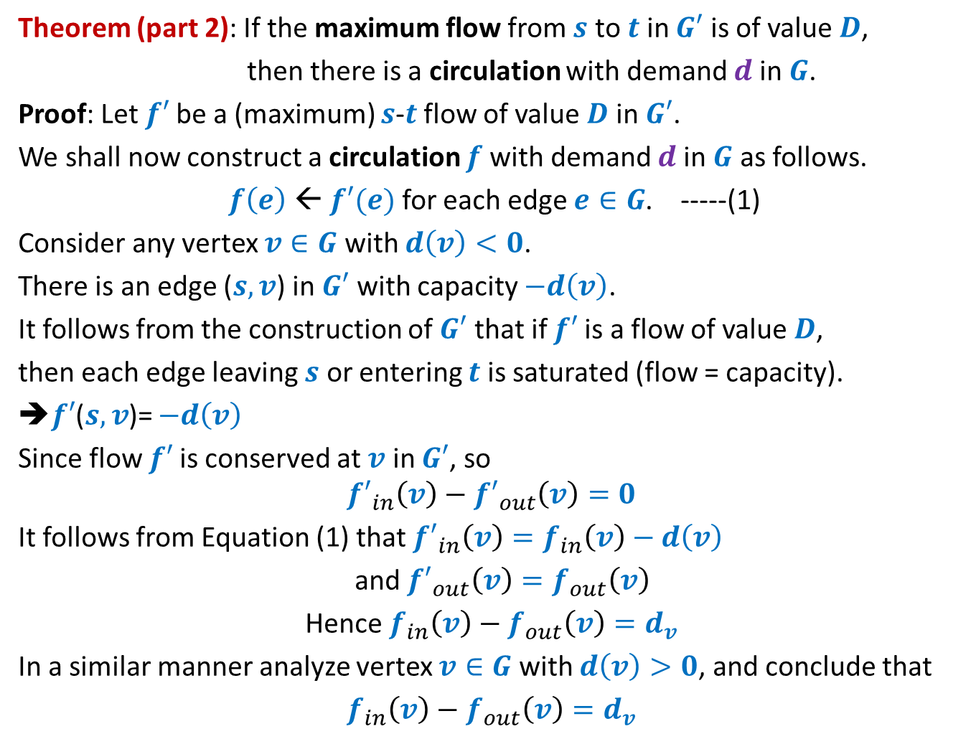
Theorem (part 2): If the maximum flow from $s$ to $t$ in $G′$ is of value $D$,
then there is a circulation with demand $d$in $G$.
Proof: Let $f′$be a (maximum) $s$-$t$ flow of value $D$ in $G′$.
We shall now construct a circulation $f$with demand $d$in $G$ as follows.
$f\left(e\right)$ ← $f′(e)$ for each edge $e∈G$. -----(1)
Consider any vertex $v∈G$ with $d\left(v\right)<0$.
There is an edge ($s,v$) in $G′$ with capacity $−d\left(v\right)$.
It follows from the construction of $G′$ that if $f′$is a flow of value $D$,
then each edge leaving $s$ or entering $t$ is saturated (flow = capacity).
➔$f′$($s,v$)= $−d\left(v\right)$
Since flow $f′$is conserved at $v$ in $G′$, so
$${f′}_{in}\left(v\right)−{f′}_{out}\left(v\right)=0$$
It follows from Equation (1) that ${f′}_{in}\left(v\right)=f_{in}\left(v\right)−d\left(v\right)$
and ${f′}_{out}\left(v\right)=f_{out}\left(v\right)$
Hence $f_{in}\left(v\right)−f_{out}\left(v\right)=d_{v}$
In a similar manner analyze vertex $v∈G$ with $d\left(v\right)>0$, and conclude that
$f_{in}\left(v\right)−f_{out}\left(v\right)=d_{v}$

Slide 24

Application # 3 of Max-Flow
Maximum no. of Edge Disjoint paths from $s$ to $t$

Slide 25
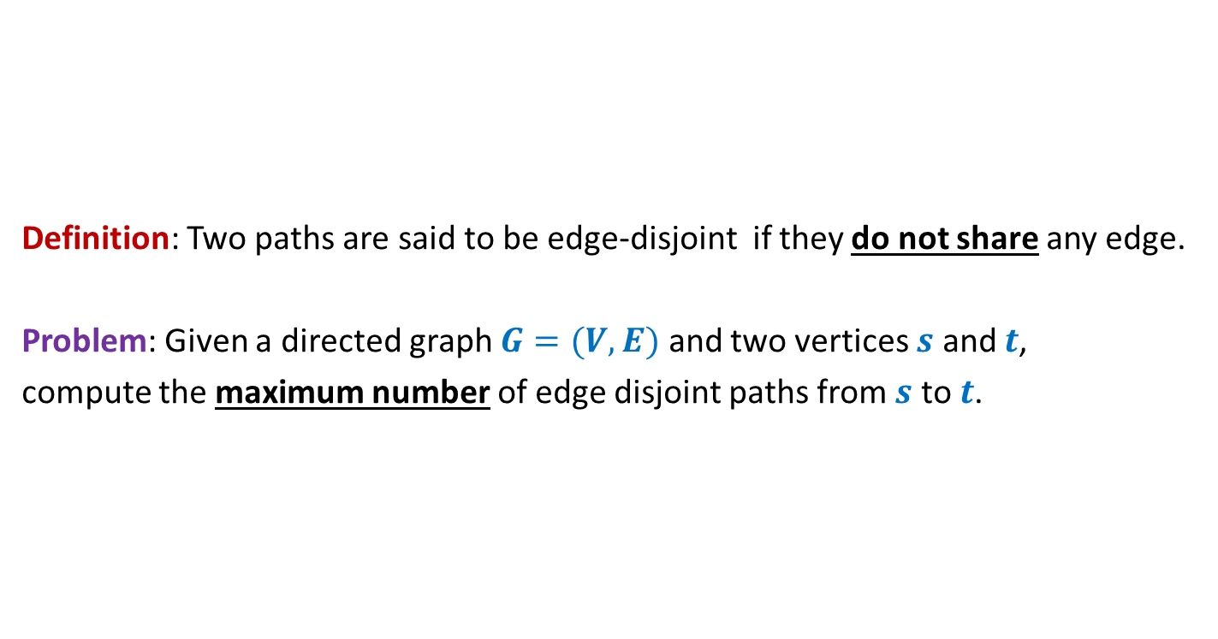

Maximum no. of Edge Disjoint paths from $s$ to $t$
Definition: Two paths are said to be edge-disjoint if they do not share any edge.
Problem: Given a directed graph $G=(V,E)$ and two vertices $s$ and $t$,
compute the maximum number of edge disjoint paths from $s$ to $t$.

Slide 26

Maximum no. of Edge Disjoint paths from $s$ to $t$
Intuition: View $G$ as a flow network, and compute max-flow from $s$ to $t$.
Question: What will be capacities of edges ?
Answer: unit capacity.
Question: What relationship exists between the two instances ?
A natural guess/intuition➔
maximum no. of $s$-$t$ paths in $G$ = max-flow from $s$ to $t$in the corresponding flow network.
$$G$$
$$s$$
$$t$$

Slide 27

Maximum no. of Edge Disjoint paths from $s$ to $t$
Theorem:
There are $k$ edge disjoint paths from $s$ to $t$ in $G$
if and only if
there is a flow of value $k$ from $s$ to $t$in corresponding flow network
$$G$$
$$s$$
$$t$$

Slide 28
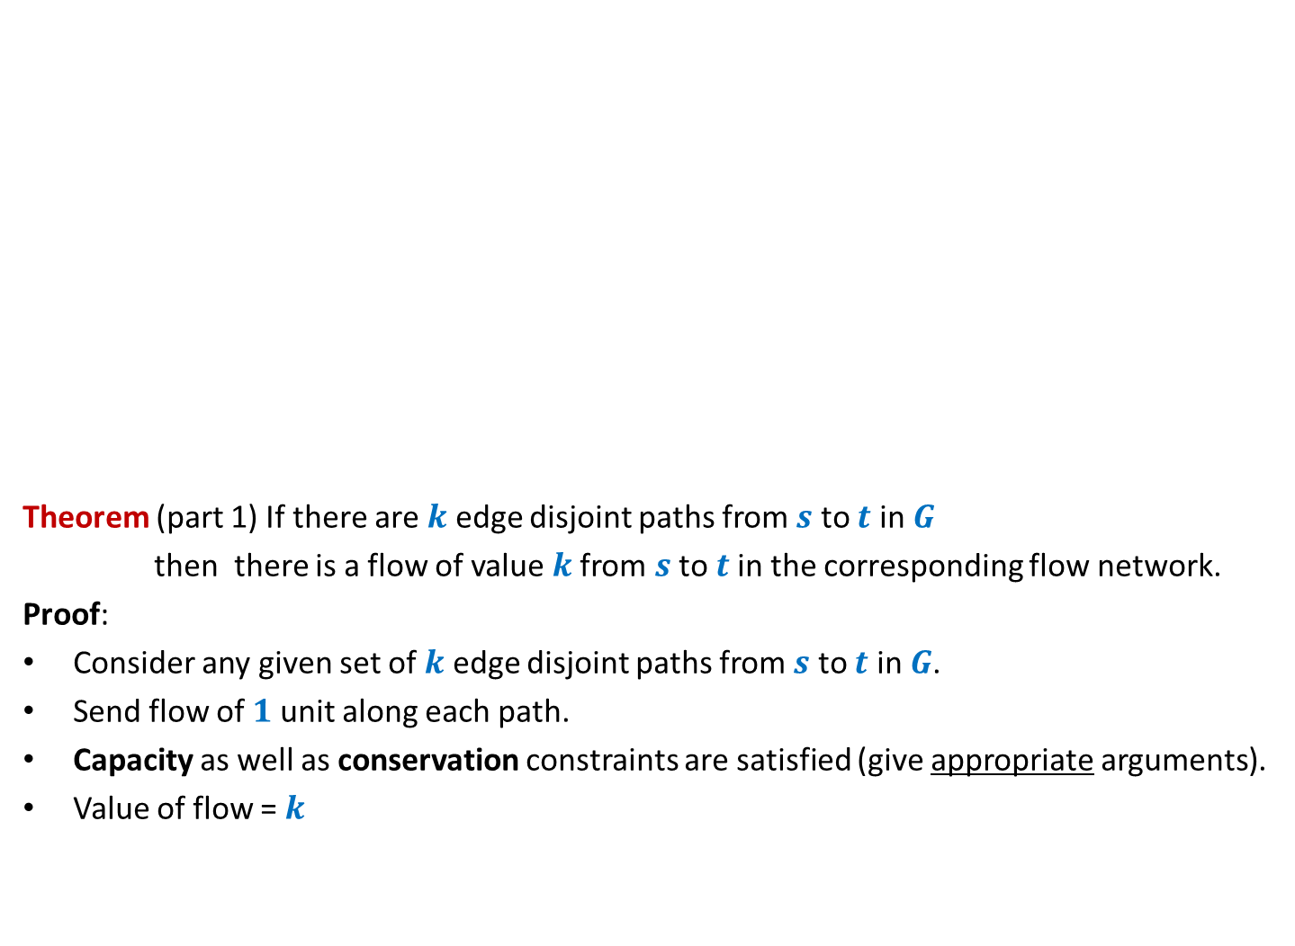
Maximum no. of Edge Disjoint paths from $s$ to $t$
Theorem (part 1) If there are $k$ edge disjoint paths from $s$ to $t$ in $G$
then there is a flow of value $k$from $s$ to $t$in the corresponding flow network.
Proof:
Consider any given set of $k$ edge disjoint paths from $s$ to $t$ in $G$.
Send flow of $1$ unit along each path.
Capacity as well as conservation constraints are satisfied (give appropriate arguments).
Value of flow = $k$
$$G$$
$$s$$
$$t$$

Slide 29

Maximum no. of Edge Disjoint paths from $s$ to $t$
Theorem (part 2) If there is a flow of value $k$from $s$ to $t$in the flow network
then there are $k$ edge disjoint paths from $s$ to $t$ in $G$.
Proof:
and
➔there exists a flow $f$ of value $k$such that $f \left(e\right)=1$or $0$for all $e∈E$.
Aim: To construct $k$ edge disjoint paths from $s$ to $t$ using edges carrying unit flow.
$$G$$
$$s$$
$$t$$
Integrality of flow
Unit edge capacity

Slide 30
Maximum no. of Edge Disjoint paths from $s$ to $t$
Theorem (part 2) If there is a flow of value $k$from $s$ to $t$in the flow network
then there are $k$ edge disjoint paths from $s$ to $t$ in $G$.
Proof: “Keep following any stream of flow originating from $s$ and terminating at $t$”.
What if we get caught in a loop ☹?
But is it possible in a flow ?
Yes, INDEED.
$$G$$
$$s$$
$$t$$

Slide 31

Maximum no. of Edge Disjoint paths from $s$ to $t$
Theorem (part 2) If there is a flow of value $k$from $s$ to $t$in the flow network
then there are $k$ edge disjoint paths from $s$ to $t$ in $G$.
$$G$$
$$s$$
$$t$$
Using the last animation as a hint,
make sincere attempts to prove this part of Theorem.
It is given on the following slide.

Slide 32
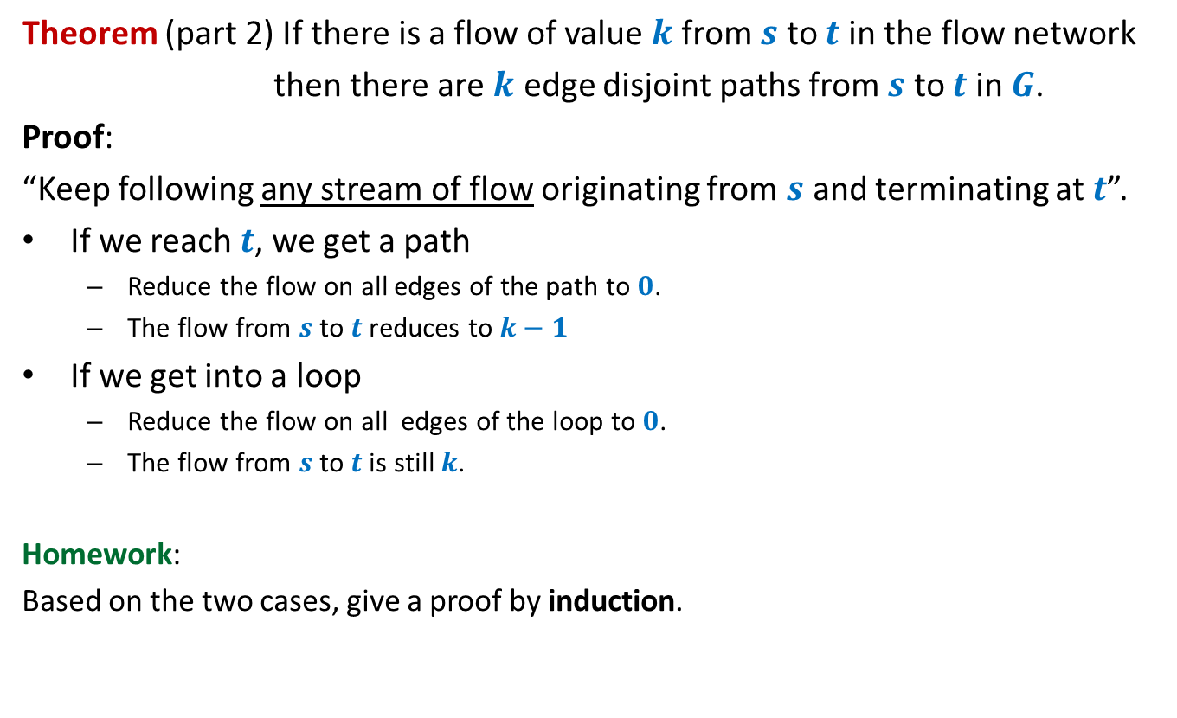
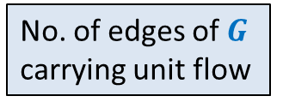


Maximum no. of Edge Disjoint paths from $s$ to $t$
Theorem (part 2) If there is a flow of value $k$from $s$ to $t$in the flow network
then there are $k$ edge disjoint paths from $s$ to $t$ in $G$.
Proof:
“Keep following any stream of flow originating from $s$ and terminating at $t$”.
If we reach $t$, we get a path
Reduce the flow on all edges of the path to $0$.
The flow from $s$ to $t$reduces to $k−1$
If we get into a loop
Reduce the flow on all edges of the loop to $0$.
The flow from $s$ to $t$is still $k$.
Homework:
Based on the two cases, give a proof by induction.
What will you induct on ?
No. of edges of $G$
$k$
No. of edges of $G$
carrying unit flow

Slide 33
An inspirational problem

Slide 34


Diagonal-Unit matrix
Definition:
A Boolean matrix is a Diagonal-Unit matrix if all entries on its diagonal are $1$.
Column-swap operation
Row-swap operation
Not a Diagonal-Unit matrix
a Diagonal-Unit matrix
$$1$$ | $$0$$ | $$1$$ | $$1$$
$$1$$ | $$1$$ | $$1$$ | $$1$$
$$1$$ | $$0$$ | $$0$$ | $$0$$
$$1$$ | $$0$$ | $$0$$ | $$1$$
$$1$$
 | $$1$$
 |  | $$1$$
 |  |  | $$1$$
?
Problem: Design an efficient algorithm to determine if we can transform a given Boolean matrix to a Diagonal-unit matrix using any sequence of swaps of rows or columns.

