Slide 1
Design and Analysis of Algorithms (CS345/CS345A)
Lecture 35
The art of algorithm design and analysis

Slide 2

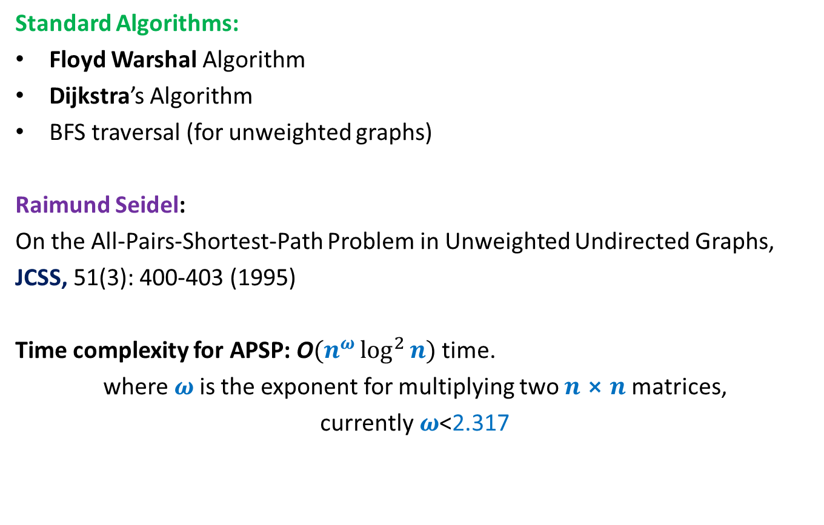
All Pairs Shortest Paths (APSP)
Matrix Multiplication
Standard Algorithms:
Floyd Warshal Algorithm
Dijkstra’s Algorithm
BFS traversal (for unweighted graphs)
Raimund Seidel:
On the All-Pairs-Shortest-Path Problem in Unweighted Undirected Graphs,
JCSS, 51(3): 400-403 (1995)
Time complexity for APSP: O$(n^{ω}\log^{2}{n})$ time.
where $ω$is the exponent for multiplying two $n⨯n$matrices,
currently$ω$<2.317
O$(n^{3})$ time in the worst case

Slide 3
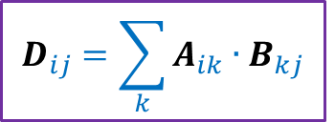
Integer Product of Matrices
2 | 3 | 0 | 3 | 7
8 | 0 | 9 | 7 | 1
0 | 0 | 4 | 0 | 0
0 | 8 | 0 | 1 | 0
5 | 3 | 0 | 5 | 0
6 | 0 | 7 | 0 | 0
0 | 9 | 8 | 0 | 7
3 | 2 | 9 | 1 | 0
6 | 1 | 8 | 9 | 0
1 | 0 | 4 | 6 | 0
A
B
D
$$D_{ij}=\sum_{k}{A_{ik}{∙B}_{kj}}$$

Slide 4













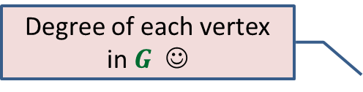

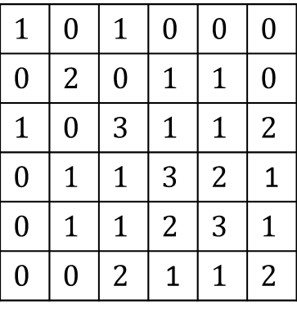





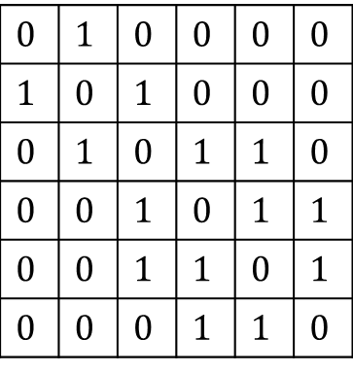


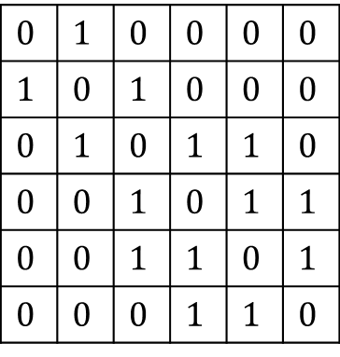


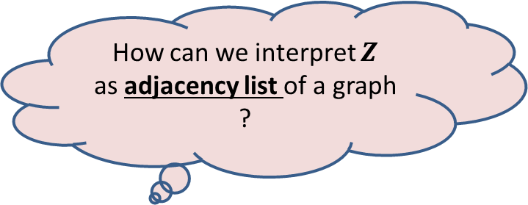

Degree of each vertex in $G$ ☺
$$1$$ | $$2$$ | $$3$$ | $$4$$ | $$5$$ | $$6$$
$$1$$
$$2$$
$$3$$
$$4$$
$$5$$
$$6$$
$$0$$ | $$1$$ | $$0$$ | $$0$$ | $$0$$ | $$0$$
$$1$$ | $$0$$ | $$1$$ | $$0$$ | $$0$$ | $$0$$
$$0$$ | $$1$$ | $$0$$ | $$1$$ | $$1$$ | $$0$$
$$0$$ | $$0$$ | $$1$$ | $$0$$ | $$1$$ | $$1$$
$$0$$ | $$0$$ | $$1$$ | $$1$$ | $$0$$ | $$1$$
$$0$$ | $$0$$ | $$0$$ | $$1$$ | $$1$$ | $$0$$
$$0$$ | $$1$$ | $$0$$ | $$0$$ | $$0$$ | $$0$$
$$1$$ | $$0$$ | $$1$$ | $$0$$ | $$0$$ | $$0$$
$$0$$ | $$1$$ | $$0$$ | $$1$$ | $$1$$ | $$0$$
$$0$$ | $$0$$ | $$1$$ | $$0$$ | $$1$$ | $$1$$
$$0$$ | $$0$$ | $$1$$ | $$1$$ | $$0$$ | $$1$$
$$0$$ | $$0$$ | $$0$$ | $$1$$ | $$1$$ | $$0$$
$$1$$ | $$0$$ | $$1$$ | $$0$$ | $$0$$ | $$0$$
$$0$$ | $$2$$ | $$0$$ | $$1$$ | $$1$$ | $$0$$
$$1$$ | $$0$$ | $$3$$ | $$1$$ | $$1$$ | $$2$$
$$0$$ | $$1$$ | $$1$$ | $$3$$ | $$2$$ | 1
$$0$$ | $$1$$ | $$1$$ | $$2$$ | $$3$$ | $$1$$
$$0$$ | $$0$$ | $$2$$ | 1 | $$1$$ | $$2$$
$$0$$
$$0$$
$$0$$
$$1$$
$$0$$
$$1$$
$$1$$
$$0$$
$$1$$
$$0$$
$$A$$
$$A$$
$$B$$
$$Z$$
$$B_{ij}=\left\{\begin{aligned}1 if Z_{ij}≠0 \\ 0 otherwise \end{aligned}\right.$$
$Z_{ii}$ : degree of$i$in $G$
$$4$$
How can we interpret $Z$
as adjacency list of a graph ?
$$6$$
$$1$$
$$2$$
$$3$$
$$G$$
$$5$$

Slide 5




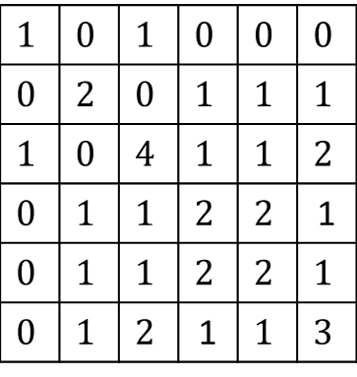










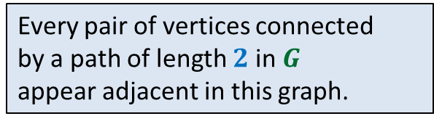
$$1$$ | $$2$$ | $$3$$ | $$4$$ | $$5$$ | $$6$$
$$1$$
$$2$$
$$3$$
$$4$$
$$5$$
$$6$$
$$0$$ | $$1$$ | $$0$$ | $$0$$ | $$0$$ | $$0$$
$$1$$ | $$0$$ | $$1$$ | $$0$$ | $$0$$ | $$0$$
$$0$$ | $$1$$ | $$0$$ | $$1$$ | $$1$$ | $$0$$
$$0$$ | $$0$$ | $$1$$ | $$0$$ | $$1$$ | $$1$$
$$0$$ | $$0$$ | $$1$$ | $$1$$ | $$0$$ | $$1$$
$$0$$ | $$0$$ | $$0$$ | $$1$$ | $$1$$ | $$0$$
$$0$$ | $$1$$ | $$0$$ | $$0$$ | $$0$$ | $$0$$
$$1$$ | $$0$$ | $$1$$ | $$0$$ | $$0$$ | $$0$$
$$0$$ | $$1$$ | $$0$$ | $$1$$ | $$1$$ | $$0$$
$$0$$ | $$0$$ | $$1$$ | $$0$$ | $$1$$ | $$1$$
$$0$$ | $$0$$ | $$1$$ | $$1$$ | $$0$$ | $$1$$
$$0$$ | $$0$$ | $$0$$ | $$1$$ | $$1$$ | $$0$$
$$1$$ | $$0$$ | $$1$$ | $$0$$ | $$0$$ | $$0$$
$$0$$ | $$2$$ | $$0$$ | $$1$$ | $$1$$ | $$1$$
$$1$$ | $$0$$ | $$4$$ | $$1$$ | $$1$$ | $$2$$
$$0$$ | $$1$$ | $$1$$ | $$2$$ | $$2$$ | 1
$$0$$ | $$1$$ | $$1$$ | $$2$$ | $$2$$ | $$1$$
$$0$$ | $$1$$ | $$2$$ | 1 | $$1$$ | $$3$$
$$0$$
$$0$$
$$0$$
$$1$$
$$0$$
$$1$$
$$1$$
$$0$$
$$1$$
$$0$$
$$A$$
$$A$$
$$B$$
$$B_{ij}=\left\{\begin{aligned}1 if Z_{ij}≠0 \\ 0 otherwise \end{aligned}\right.$$
or $A_{ij}=1$
$$4$$
$$4$$
$$6$$
$$6$$
$$1$$
$$2$$
$$3$$
$$1$$
$$2$$
$$3$$
How would you interpret this row ?
Every pair of vertices connected
by a path of length $2$ in $G$
appear adjacent in this graph.
Let us also add each edge of $G$as well to this graph if it is not already there
$$G$$
$$5$$
$$5$$
$$G^{2}$$

Slide 6










$$1$$ | $$2$$ | $$3$$ | $$4$$ | $$5$$ | $$6$$
$$j$$
$$1$$
$$2$$
$$3$$
$$4$$
$$5$$
$$6$$
$$0$$ | $$1$$ | $$0$$ | $$0$$ | $$0$$ | $$0$$
$$1$$ | $$0$$ | $$1$$ | $$0$$ | $$0$$ | $$0$$
$$0$$ | $$1$$ | $$0$$ | $$1$$ | $$1$$ | $$0$$
$$0$$ | $$0$$ | $$1$$ | $$0$$ | $$1$$ | $$1$$
$$0$$ | $$0$$ | $$1$$ | $$1$$ | $$0$$ | $$1$$
$$0$$ | $$0$$ | $$0$$ | $$1$$ | $$1$$ | $$0$$
$$0$$ | $$1$$ | $$0$$ | $$0$$ | $$0$$ | $$0$$
$$1$$ | $$0$$ | $$1$$ | $$0$$ | $$0$$ | $$0$$
$$0$$ | $$1$$ | $$0$$ | $$1$$ | $$1$$ | $$0$$
$$0$$ | $$0$$ | $$1$$ | $$0$$ | $$1$$ | $$1$$
$$0$$ | $$0$$ | $$1$$ | $$1$$ | $$0$$ | $$1$$
$$0$$ | $$0$$ | $$0$$ | $$1$$ | $$1$$ | $$0$$
$$i$$
$B_{ij}$ = $1$ if and only if there is a path between $i$ and $j$ of length $≤k+ℓ$
$$A′$$
$$A"$$
$$Z$$
Adj. Matrix of $G^{k}$
Adj. Matrix of $G^{ℓ}$
$$B_{ij}=\left\{\begin{aligned}1 if Z_{ij}≠0 \\ 0 otherwise \end{aligned}\right.$$
or ${A′}_{ij}=1$

Slide 7

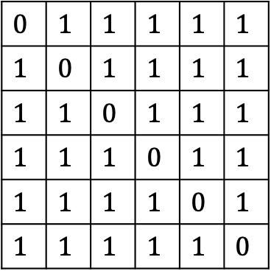

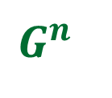
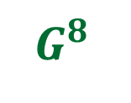
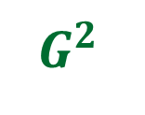
$$0$$ | $$1$$ | $$1$$ | $$1$$ | $$1$$ | $$1$$
$$1$$ | $$0$$ | $$1$$ | $$1$$ | $$1$$ | $$1$$
$$1$$ | $$1$$ | $$0$$ | $$1$$ | $$1$$ | $$1$$
$$1$$ | $$1$$ | $$1$$ | $$0$$ | $$1$$ | $$1$$
$$1$$ | $$1$$ | $$1$$ | $$1$$ | $$0$$ | $$1$$
$$1$$ | $$1$$ | $$1$$ | $$1$$ | $$1$$ | $$0$$
$$G$$
$G^{2}$
$G^{4}$
$G^{8}$
…
$$G^{n}$$

Slide 8










Distance in $G^{2}$ Distance in $G$
?
If $D_{ij}$is even ➔ ${D′}_{ij}$ = $\frac{D_{ij}}{2}$
If $D_{ij}$is odd ➔ ${D′}_{ij}$ = $\frac{D_{ij} + 1}{2}$
$$G^{2}$$
$$D′$$
$$i$$
$$j$$
$$G$$
$$D$$
$$i$$
$$j$$

Slide 9
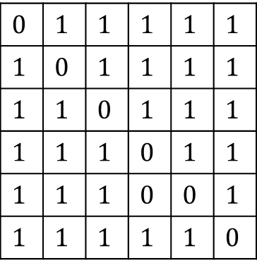
$$0$$ | $$1$$ | $$1$$ | $$1$$ | $$1$$ | $$1$$
$$1$$ | $$0$$ | $$1$$ | $$1$$ | $$1$$ | $$1$$
$$1$$ | $$1$$ | $$0$$ | $$1$$ | $$1$$ | $$1$$
$$1$$ | $$1$$ | $$1$$ | $$0$$ | $$1$$ | $$1$$
$$1$$ | $$1$$ | $$1$$ | $$0$$ | $$0$$ | $$1$$
$$1$$ | $$1$$ | $$1$$ | $$1$$ | $$1$$ | $$0$$
$$G$$
$G^{2}$
$G^{4}$
$G^{8}$
…
$$G^{n}$$

Slide 10
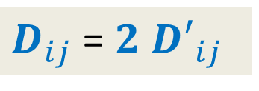

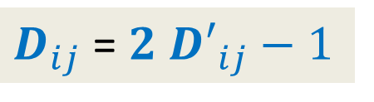
Distance in $G^{2}$ Distance in $G$
?
If $D_{ij}$is even ➔ ${D′}_{ij}$ = $\frac{D_{ij}}{2}$
If $D_{ij}$is odd ➔ ${D′}_{ij}$ = $\frac{D_{ij} + 1}{2}$
$D_{ij}$ = ${2 D′}_{ij}$
$D_{ij}$ = ${2 D′}_{ij}−1$
$$G^{2}$$
$$D′$$
$$i$$
$$j$$
$$G$$
$$D$$
$$i$$
$$j$$
Great ! So in order to compute $D$ from $D′$, all we need to determine is the parity of each $D_{ij}$.

Slide 11

Question: Given distance matrix $D′$ of $G^{2}$,
how to compute distance matrix $D$ of $G$ ?

Slide 12






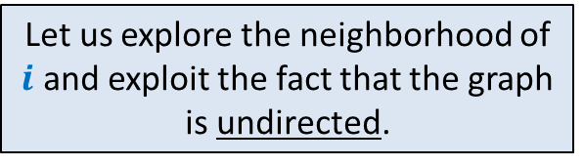


Let us explore the neighborhood of $i$ and exploit the fact that the graph is undirected.
Question: How to determine if $D_{ij}$is even or odd ?
$D_{ij}−1{≤D}_{kj}≤$ $D_{ij}+1$
$D_{ij}$is even ➔ For each neighbor $k$ of $i$
$D_{ij}$is odd ➔ For each neighbor $k$ of $i$
$${D′}_{kj}<{D′}_{ij}$$
$$k$$
What about this neighbor ?
?
$$G$$
$$i$$
$$j$$
$${D′}_{kj}≥{D′}_{ij}$$
$${D′}_{kj}≤{D′}_{ij}$$

Slide 13







Theorem:
If $D_{ij}$is even, then for each neighbor $k$ of $i$ , ${D′}_{kj}≥{D′}_{ij}$
If $D_{ij}$is odd, then for each neighbor $k$ of $i$ , ${D′}_{kj}≤{D′}_{ij}$
AND there exists at least one neighbor $k$ such that ${D′}_{kj}<{D′}_{ij}$.
How to determine whether $D_{ij}$is even or odd ?
Compare $C_{ij}$ with ${D′}_{ij}⋅Z_{ii}$
?
?
$$C$$
$$A$$
$$D′$$
$$C_{ij}=\sum_{k}{A_{ik}{∙D′}_{kj}}$$

Slide 14
Ponder over the entire algorithm
Redesign it on your own.
And get amazed by its beauty and simplicity

Slide 15


Problem 2
All-pairs closest pairs of $n$points
farthest
in O($n$ log $n$) time

Slide 16

Observation:
Farthest pair of points must lie on the boundary of the convex hull of all points.
Compute convex hull in O($n$ log $n$) time
Compute farthest pair of points of the convex hull in O($n$ log $n$) time
Can you locate the farthest pair of points ?
Can you see some structure on which these points must be lying ?
Convex hull ☺

Slide 17



Idea $1$: Compute farthest point for each point in O(log $n$) time
If we scan in clockwise or anticlockwise order ,
distance from $p_{i}$ seems to increase monotonically and then decrease monotonically.
But is it true for all convex polygons ?
No ☹
➔ Use binary search …☺
$$p_{i}$$

Slide 18
Idea $1$: Compute farthest point for each point in O(log $n$) time
Distance first increases
It then decreases
It increases again
Finally it decreases.
But is it true for all convex polygons ?
No ☹
$$p_{i}$$

Slide 19


Idea $2$: Roll the convex polygon on the floor ☺
Did you notice the journey of farthest pair of points ?

Slide 20
Idea $2$: Roll the convex polygon on the floor ☺
Max height achieved = distance between the farthest pair of points
At the moment it is achieved,
one of the two points is the pivot point.
➔
For each point, if it is a potential candidate for the farthest pair of points
We need to search for its farthest point during the time interval it is a pivot of rolling.

Slide 21



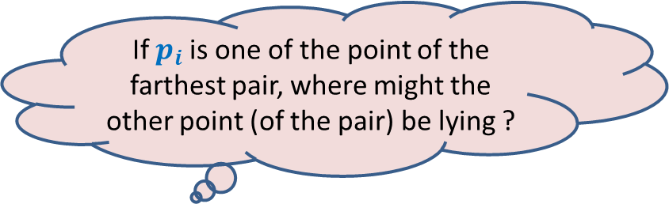



If $p_{i}$is one of the point of the farthest pair, where might the other point (of the pair) be lying ?
It must lie on this side only.
Keep scanning the above points, until
$$θ$$
Perpendicular bisector of the base
$$θ$$
$$α$$
$$p_{i−1}$$
$$p_{i}$$
$$θ≤α$$
If not, then that point will be farther from $p_{i−1}$ than $p_{i}$

Slide 22

During rolling, one of the following happens:
Either the base changes
Or a new point attains its maximum height above ground.
➔The algorithm requires just two parallel scans of the list of points of convex hull.
in O($n$) time only ☺
$$θ$$
$$θ$$
Can you see the algorithm now ?
$$α$$
$$p_{i−1}$$
$$p_{i}$$

Slide 23
Moral of this course
Approach each problem with a fresh and unconditioned mind
Try to develop insight and better understanding about the problem.
You are bound to get hurdles.
Handle each hurdle with perseverance and continue working with enthusiasm
You will surely be able to solve the problem ☺

