Slide 1
ML in the real world
CS771: Introduction to Machine Learning
Nisheeth

Slide 2
Challenges
Reproducibility
Sustainability
Validity
How to fix?

Slide 3
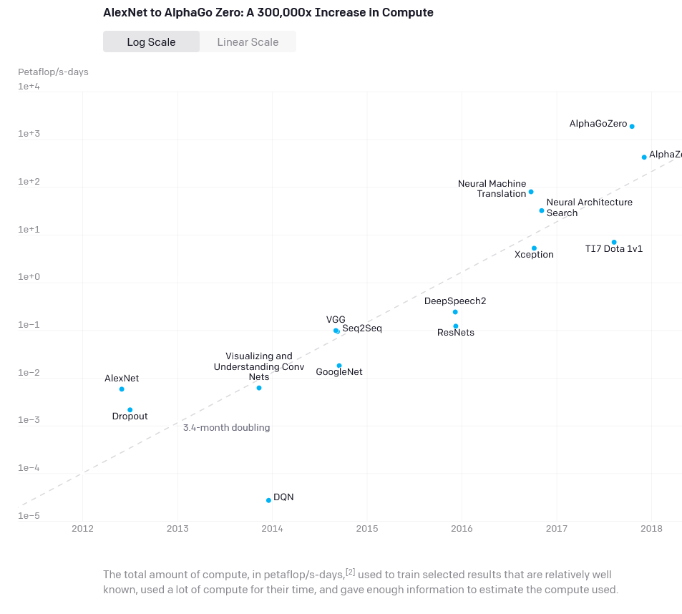
Reproducibility
Compute requirements for ML models are growing exponentially
Models are too large and too expensive to retrain by other people
How do we validate presented results?

Slide 4
Reproducibility
ML has become alchemy (link)
We very seldom know why a model works well when it does
We almost never know why a model is making a mistake on some samples
Researchers don’t share code
When code is shared, hyper-parameter settings are frequently missing

Slide 5
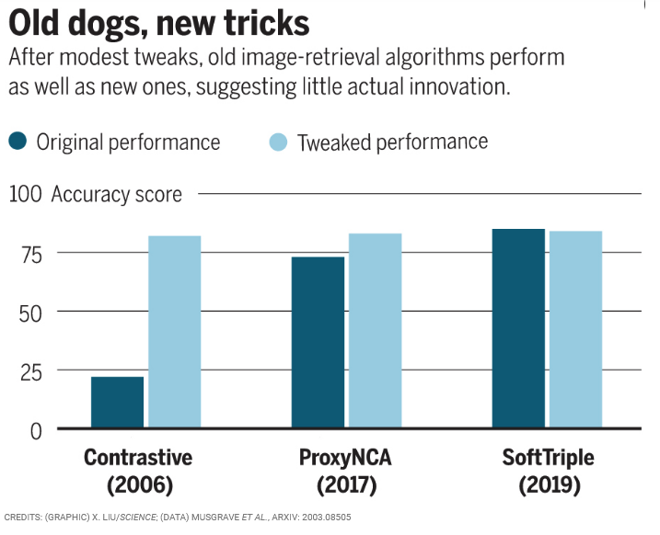
Reproducibility
Publishing standards simply require improvements over ‘state-of-the-art’ (SOTA) models
Very seldom clear what SOTA is at any point in time
Or what degree of qualitative improvement your claimed improvement buys
In some fields of ML, progress reported over the past 10-20 years is pretty illusory (link, link)

Slide 6
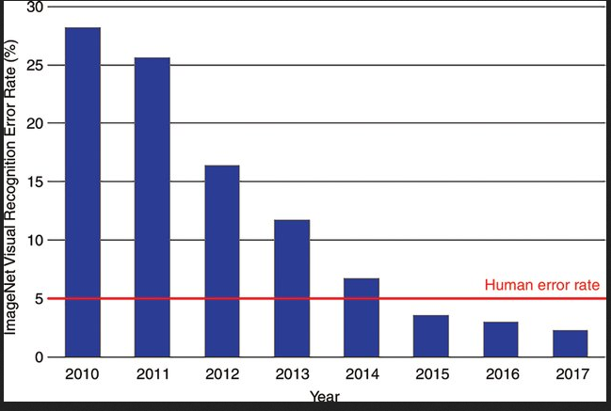
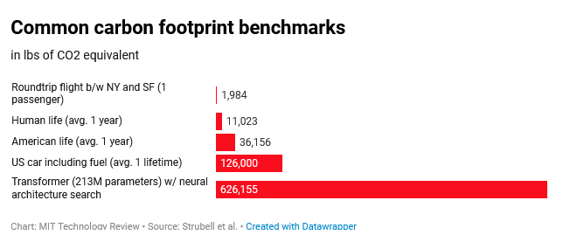
Sustainability
Diminishing results to extra complexity of models
Energy costs of training models are massive
High inequality with low reward

Slide 7
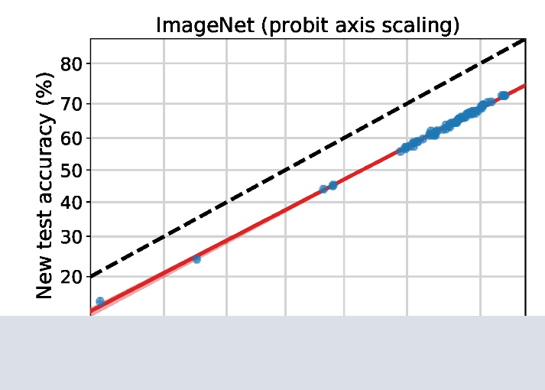
Validity
Are the labels real?
Do we care about inter-rater reliability
Distribution shifts are very real

