Slide 1
Kernelizing ML algorithms
CS771: Introduction to Machine Learning
Nisheeth

Slide 2
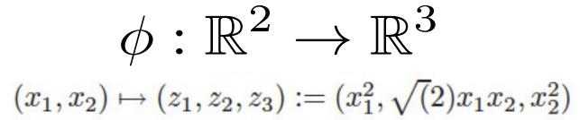
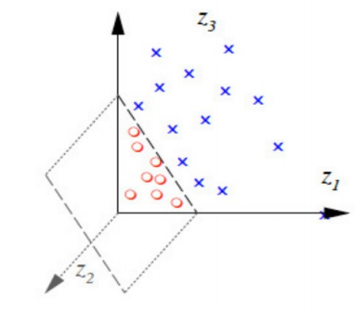
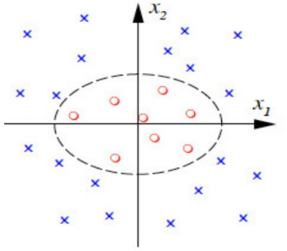

Recap: Kernel functions
Can assume a feature mapping $φ$ that maps/transforms the inputs to a “nice” space
.. and then happily apply a linear model in the new space!
The linear model in the new feature space corresponds to a nonlinear model in the original feature space

Slide 3
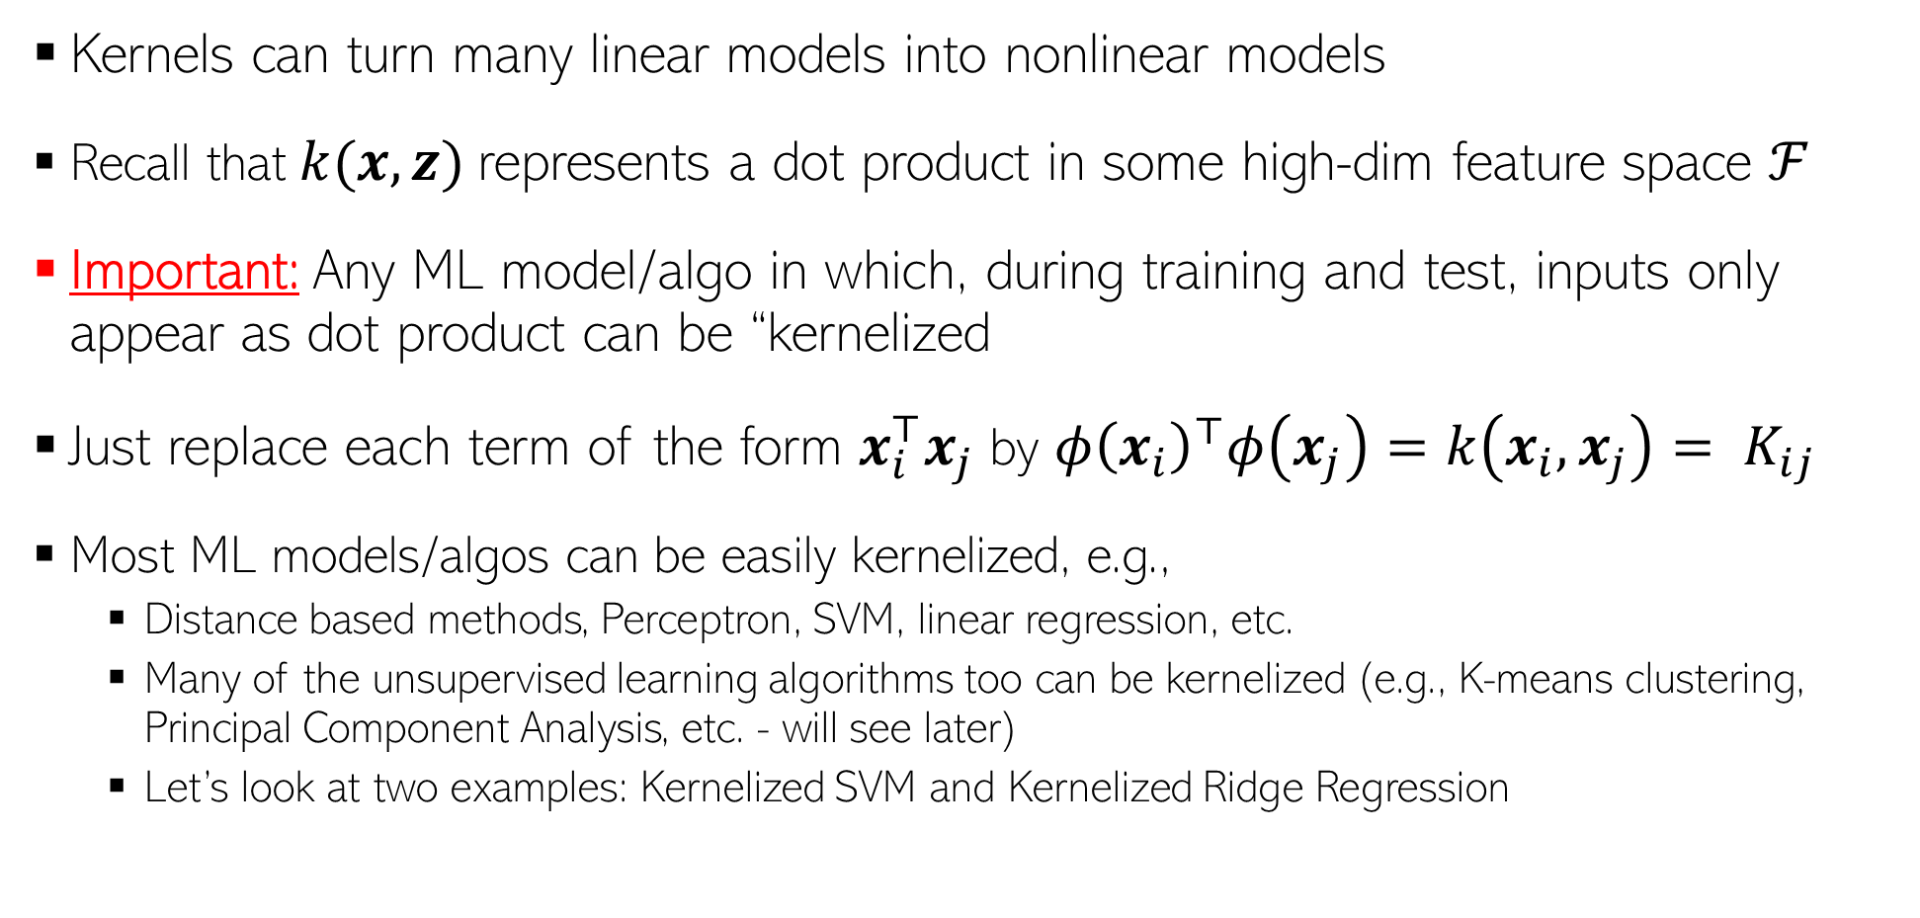
Using Kernels
Kernels can turn many linear models into nonlinear models
Recall that $k(x, z)$represents a dot product in some high-dim feature space $ℱ$
Important: Any ML model/algo in which, during training and test, inputs only appear as dot product can be “kernelized
Just replace each term of the form $x_{i}^{⊤}x_{j}$ by ${φ\left(x_{i}\right)}^{⊤}φ\left(x_{j}\right)=k\left(x_{i},x_{j}\right)= K_{ij}$
Most ML models/algos can be easily kernelized, e.g.,
Distance based methods, Perceptron, SVM, linear regression, etc.
Many of the unsupervised learning algorithms too can be kernelized (e.g., K-means clustering, Principal Component Analysis, etc. - will see later)
Let’s look at two examples: Kernelized SVM and Kernelized Ridge Regression

Slide 4
Nonlinear SVM using Kernels

Slide 5
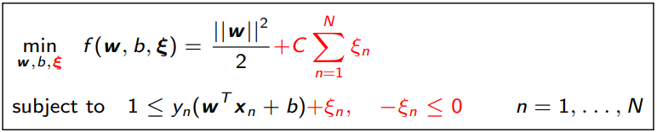
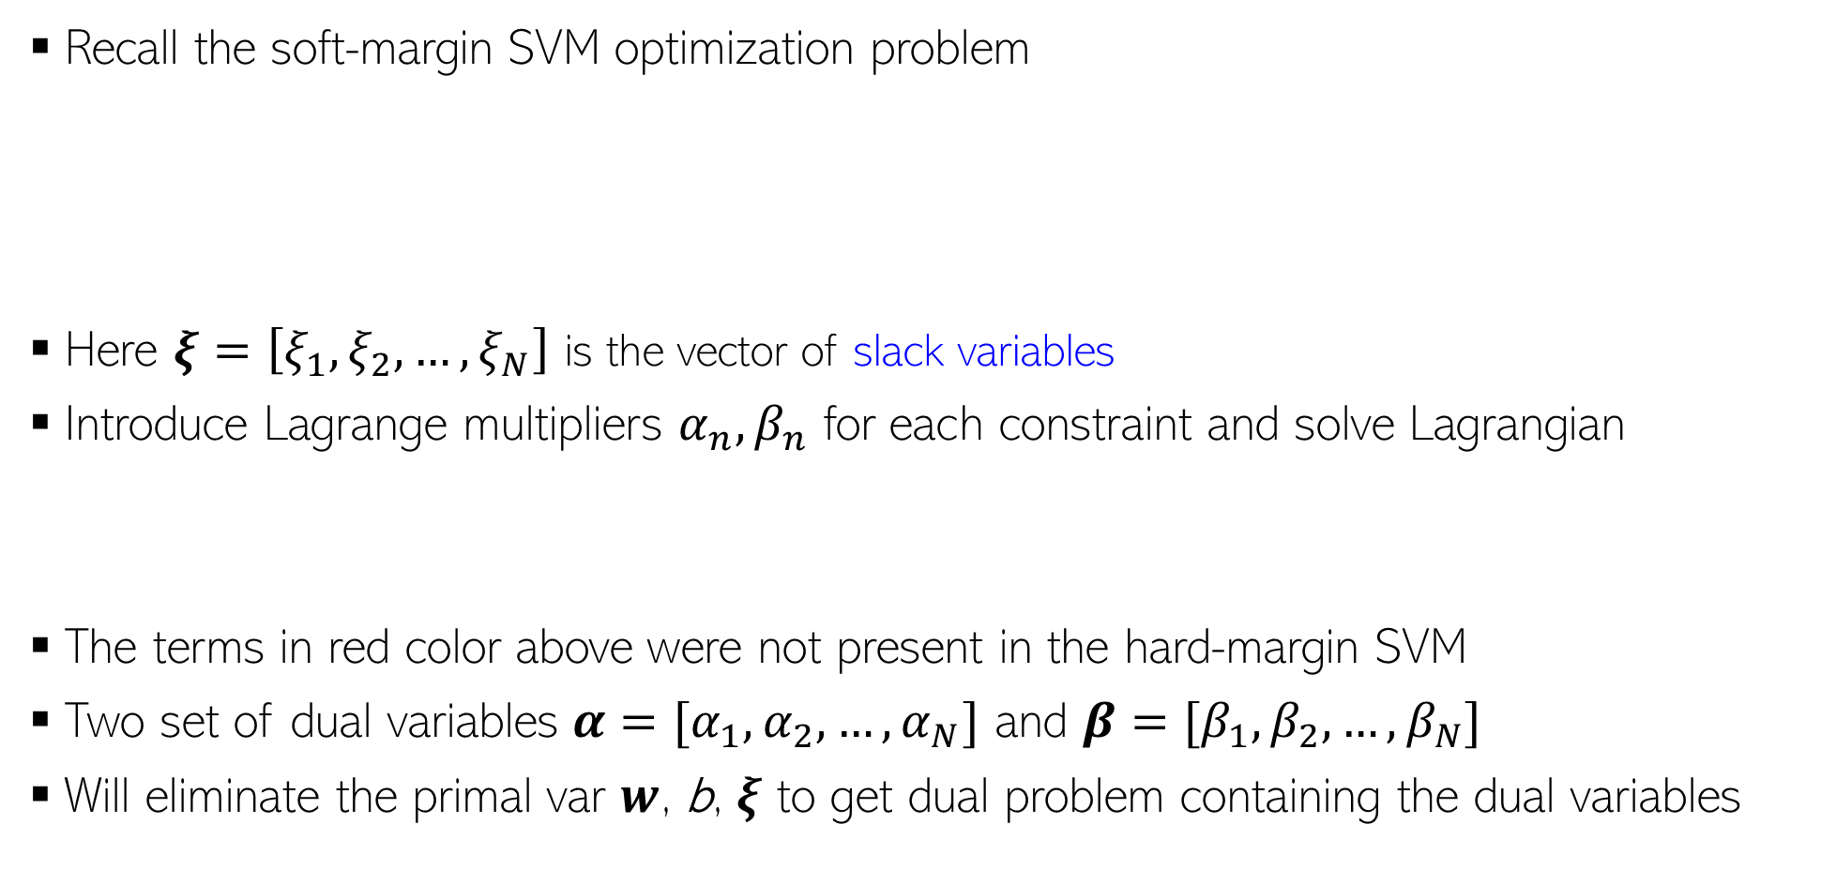
Solving Soft-Margin SVM
Recall the soft-margin SVM optimization problem
Here $ξ=\left[ξ_{1},ξ_{2},…, ξ_{N}\right]$ is the vector of slack variables
Introduce Lagrange multipliers $α_{n},β_{n}$ for each constraint and solve Lagrangian
The terms in red color above were not present in the hard-margin SVM
Two set of dual variables $α=[α_{1},α_{2},…,α_{N}]$ and $β=[β_{1},β_{2},…,β_{N}]$
Will eliminate the primal var $w$, b, $ξ$ to get dual problem containing the dual variables

Slide 6

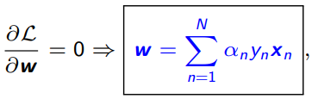


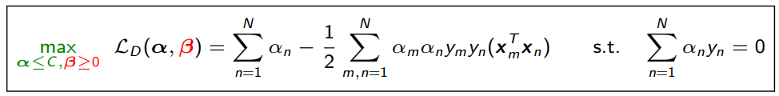

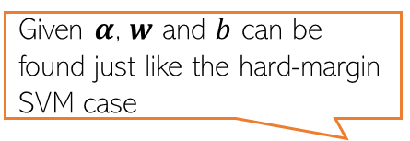

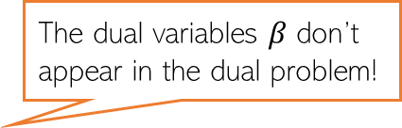
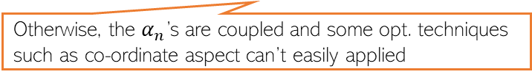
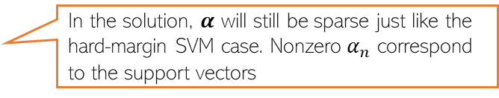
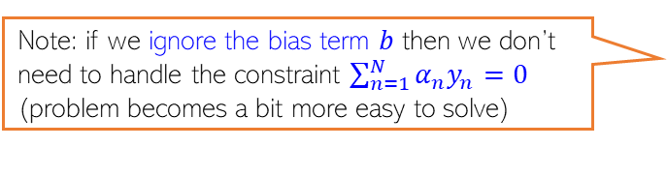
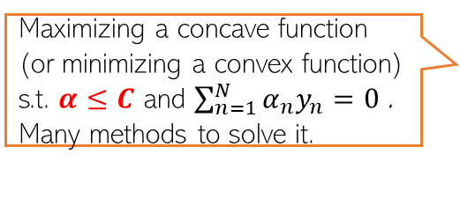
Solving Soft-Margin SVM
Note: if we ignore the bias term $b$ then we don’t need to handle the constraint $\sum_{n=1}^{N}{α_{n}y_{n}=0}$ (problem becomes a bit more easy to solve)
The Lagrangian problem to solve
Take (partial) derivatives of $ℒ$ w.r.t. $w,b$, and $ξ_{n}$ and setting to zero gives
Using $C−α_{n}−β_{n}=0$ and $β_{n}≥0$, we have $α_{n}≤C$(for hard-margin, $α_{n}≥0)$
Substituting these in the Lagrangian $ℒ$ gives the Dual problem
Otherwise, the $α_{n}$’s are coupled and some opt. techniques such as co-ordinate aspect can’t easily applied
Weighted sum of training inputs
The dual variables $β$ don’t appear in the dual problem!
Given $α$, $w$ and $b$ can be found just like the hard-margin SVM case
Maximizing a concave function (or minimizing a convex function) s.t. $α≤C$ and $\sum_{n=1}^{N}{α_{n}y_{n}=0}$. Many methods to solve it.
In the solution, $α$ will still be sparse just like the hard-margin SVM case. Nonzero $α_{n}$ correspond to the support vectors
(Note: For various SVM solvers, can see “Support Vector Machine Solvers” by Bottou and Lin)

Slide 7
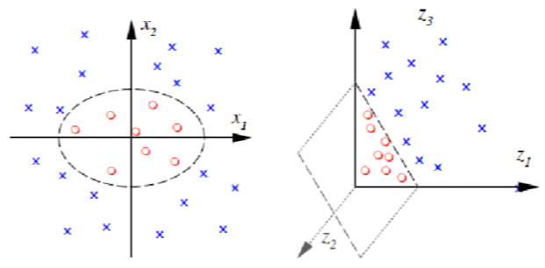
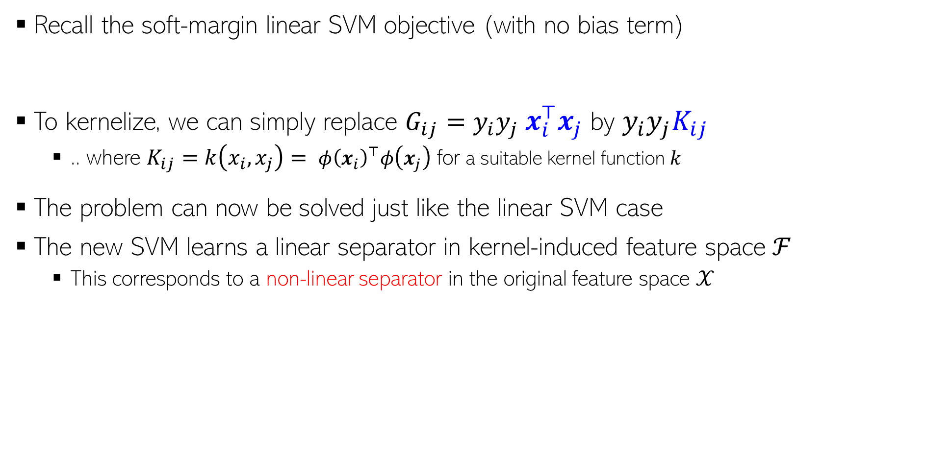

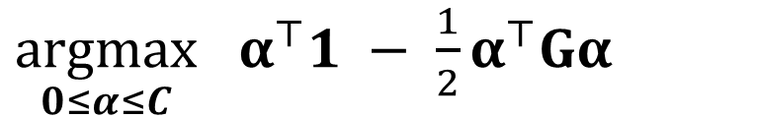
Kernelized SVM Training
Recall the soft-margin linear SVM objective (with no bias term)
To kernelize, we can simply replace $G_{ij}=y_{i}y_{j}$ $x_{i}^{⊤}x_{j}$ by $y_{i}y_{j}K_{ij}$
.. where $K_{ij}=k\left(x_{i},x_{j}\right)= {φ\left(x_{i}\right)}^{⊤}φ\left(x_{j}\right)$ for a suitable kernel function $k$
The problem can now be solved just like the linear SVM case
The new SVM learns a linear separator in kernel-induced feature space ℱ
This corresponds to a non-linear separator in the original feature space $𝒳$
$\underset{0≤α≤C}{argmax}$ $α^{⊤}1 − \frac{1}{2}α^{⊤}Gα$
$G_{ij}=y_{i}y_{j}$ $x_{i}^{⊤}x_{j}$

Slide 8
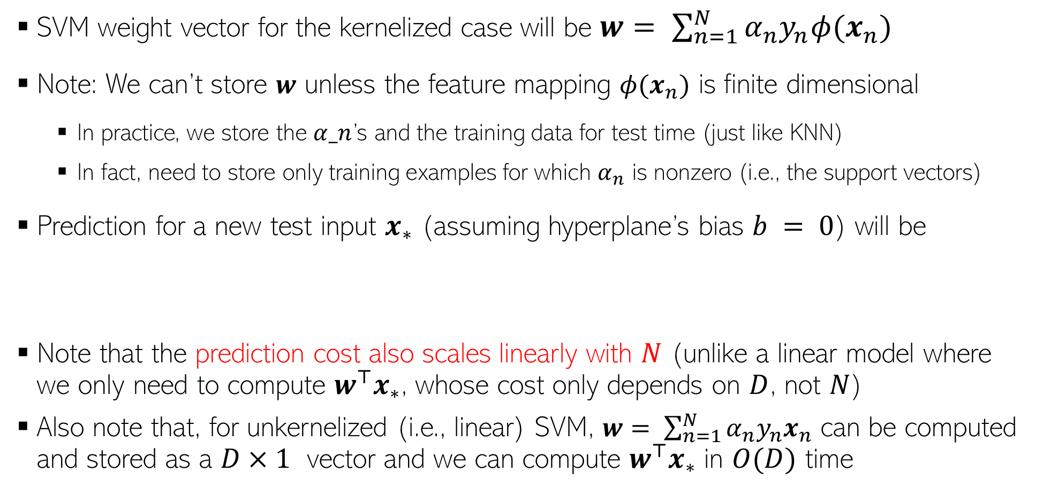
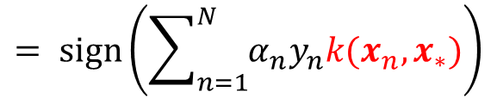
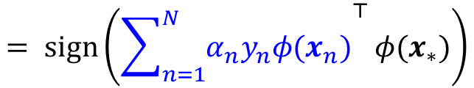

Kernelized SVM Prediction
SVM weight vector for the kernelized case will be $w= \sum_{n=1}^{N}{α_{n}y_{n}φ(x_{n})}$
Note: We can’t store $w$ unless the feature mapping $φ(x_{n})$ is finite dimensional
In practice, we store the $α_n$’s and the training data for test time (just like KNN)
In fact, need to store only training examples for which $α_{n}$ is nonzero (i.e., the support vectors)
Prediction for a new test input $x_{∗}$ (assuming hyperplane’s bias $b = 0$) will be
Note that the prediction cost also scales linearly with $N$ (unlike a linear model where we only need to compute $w^{⊤}x_{∗}$, whose cost only depends on $D$, not $N$)
Also note that, for unkernelized (i.e., linear) SVM, $w= \sum_{n=1}^{N}{α_{n}y_{n}x_{n}}$ can be computed and stored as a $D×1$ vector and we can compute $w^{⊤}x_{∗}$ in $O(D)$ time
$$= sign\left({\sum_{n=1}^{N}{α_{n}y_{n}φ(x_{n})}}^{⊤}{φ(x}_{∗})\right)$$
$$= sign\left(\sum_{n=1}^{N}{α_{n}y_{n}k(x_{n},x_{∗})}\right)$$
$$y_{∗}= sign(w^{⊤}{φ(x}_{∗}))$$

Slide 9
Nonlinear Ridge Regression using Kernels

Slide 10
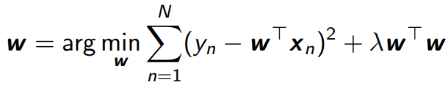




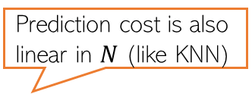

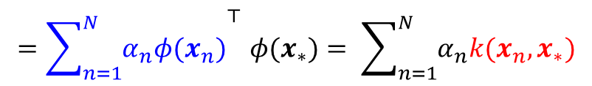
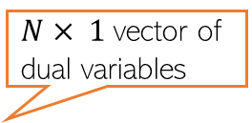
Kernelized Ridge Regression
Recall the ridge regression problem:
The solution to this problem was
Can use matrix inversion lemma
Using the lemma, can rewrite $w$ as
Kernelized weight vector will be $w= \sum_{n=1}^{N}{α_{n}φ(x_{n})}$
Prediction for a test input $x_{∗}$will be $w^{⊤}{φ(x}_{∗})$
Inputs don’t appear to be as inner product. No hope of kernelization?
They do; with a bit of algebra ☺
$N× 1$vector of dual variables
Note: Not sparse unlike SVM
where
Prediction cost is also linear in $N$ (like KNN)
$${=\sum_{n=1}^{N}{α_{n}φ(x_{n})}}^{⊤}{φ(x}_{∗})= \sum_{n=1}^{N}{α_{n}k(x_{n},x_{∗})}$$

Slide 11
Speeding-up Kernel Methods

Slide 12
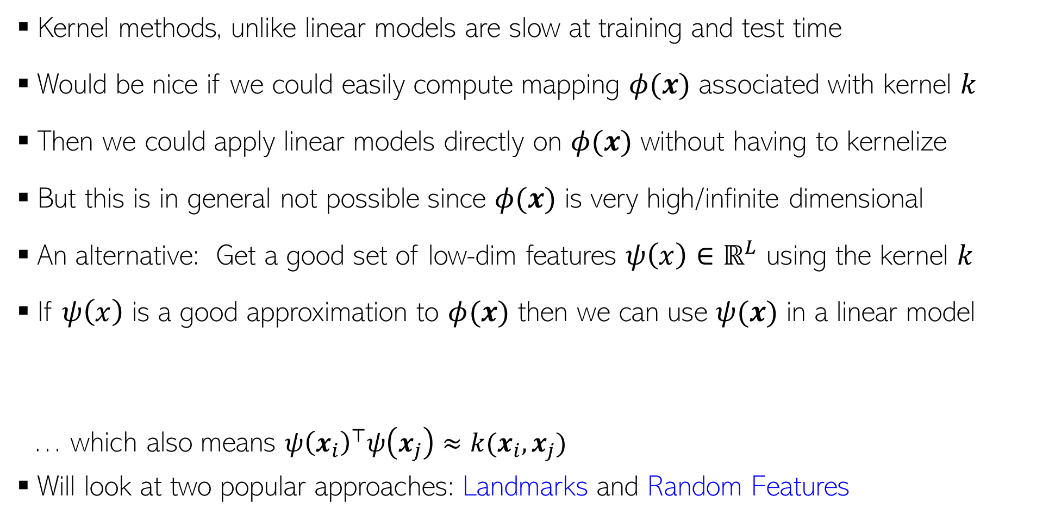
Speeding-up Kernel Methods
Kernel methods, unlike linear models are slow at training and test time
Would be nice if we could easily compute mapping $φ(x)$ associated with kernel $k$
Then we could apply linear models directly on $φ(x)$ without having to kernelize
But this is in general not possible since $φ(x)$ is very high/infinite dimensional
An alternative: Get a good set of low-dim features $ψ\left(x\right)∈ℝ^{L}$ using the kernel $k$
If $ψ\left(x\right)$ is a good approximation to $φ(x)$ then we can use $ψ(x)$ in a linear model
… which also means ${ψ\left(x_{i}\right)}^{⊤}ψ\left(x_{j}\right)≈k(x_{i},x_{j})$
Will look at two popular approaches: Landmarks and Random Features
$$Goodness Criterion: {ψ\left(x_{i}\right)}^{⊤}ψ\left(x_{j}\right)≈{φ\left(x_{i}\right)}^{⊤}φ\left(x_{j}\right)$$

Slide 13
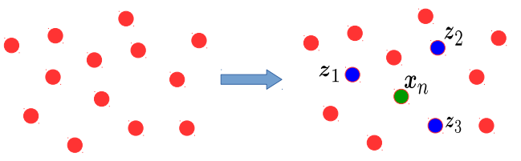
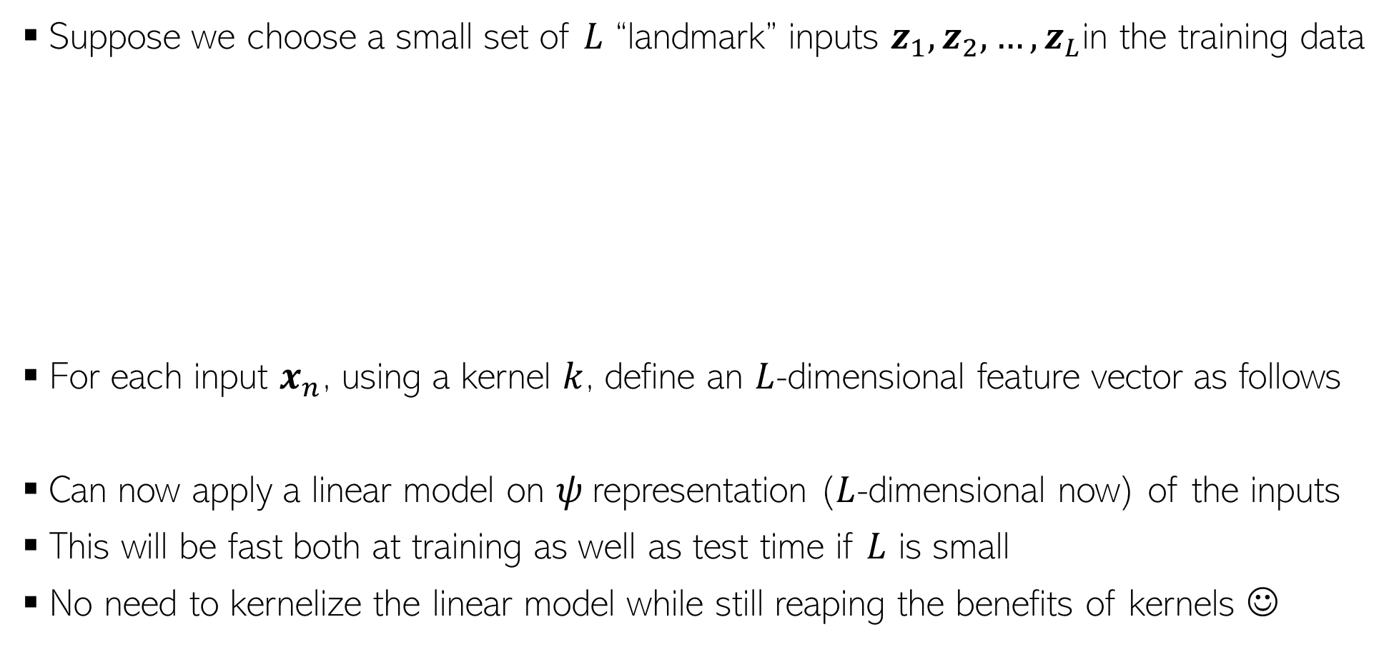
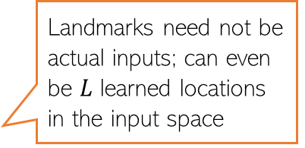
Extracting Features using Kernels: Landmarks
Suppose we choose a small set of $L$ “landmark” inputs $z_{1},z_{2},…, z_{L}$in the training data
For each input $x_{n}$, using a kernel $k$, define an $L$-dimensional feature vector as follows
Can now apply a linear model on $ψ$representation ($L$-dimensional now) of the inputs
This will be fast both at training as well as test time if $L$ is small
No need to kernelize the linear model while still reaping the benefits of kernels ☺
Landmarks need not be actual inputs; can even be $L$ learned locations in the input space
$$ψ\left(x_{n}\right)=\left[k\left(z_{1},x_{n}\right),k\left(z_{2},x_{n}\right), k\left(z_{3},x_{n}\right)\right]∈ℝ^{3}$$
$$ψ\left(x_{n}\right)=\left[k\left(z_{1},x_{n}\right),k\left(z_{2},x_{n}\right),…,k\left(z_{L},x_{n}\right)\right]∈ℝ^{L}$$

Slide 14
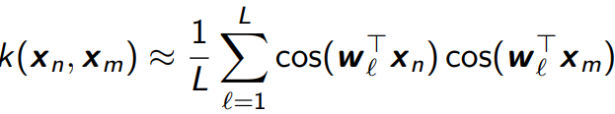

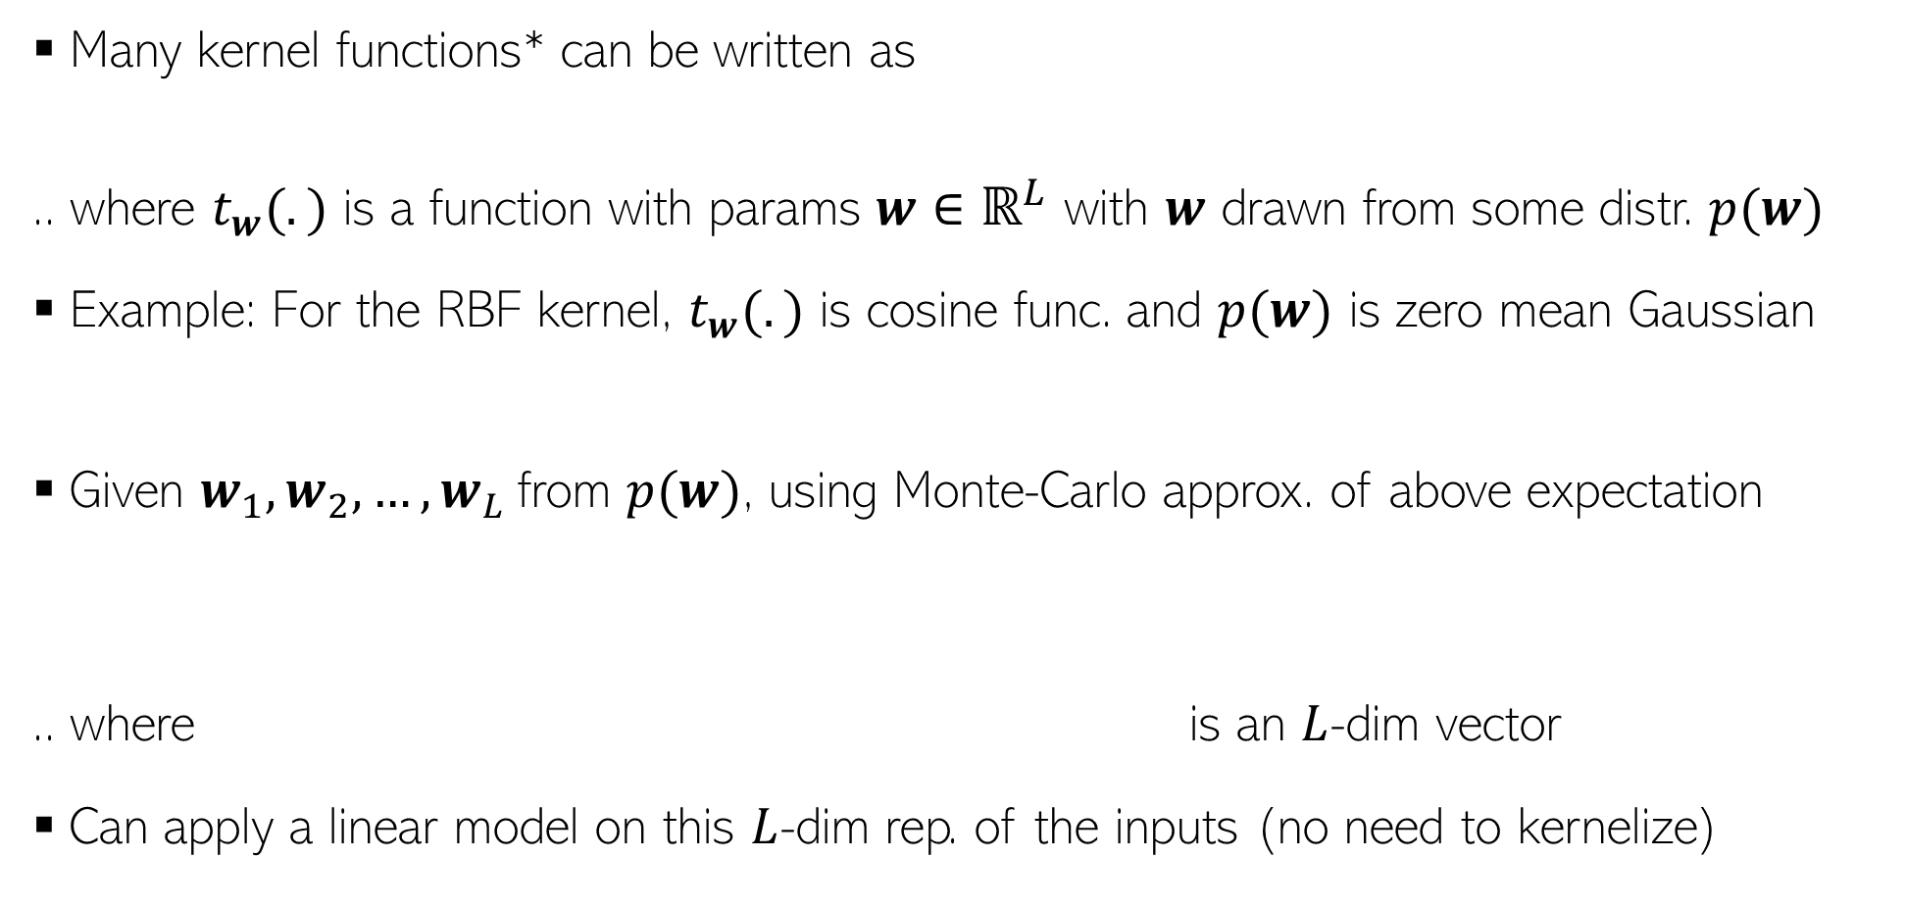
Extracting Features using Kernels: Random Features
Many kernel functions* can be written as
.. where $t_{w}(.)$ is a function with params $w∈ℝ^{L}$ with $w$ drawn from some distr. $p(w)$
Example: For the RBF kernel, $t_{w}(.)$ is cosine func. and $p(w)$ is zero mean Gaussian
Given $w_{1},w_{2},…, w_{L}$from $p(w)$, using Monte-Carlo approx. of above expectation
.. where is an $L$-dim vector
Can apply a linear model on this $L$-dim rep. of the inputs (no need to kernelize)
*Random Features for Large-Scale Kernel Machines (Recht & Rahimi, NIPS 2007. Remember the ML alchemy talk? That was these guys)

Slide 15
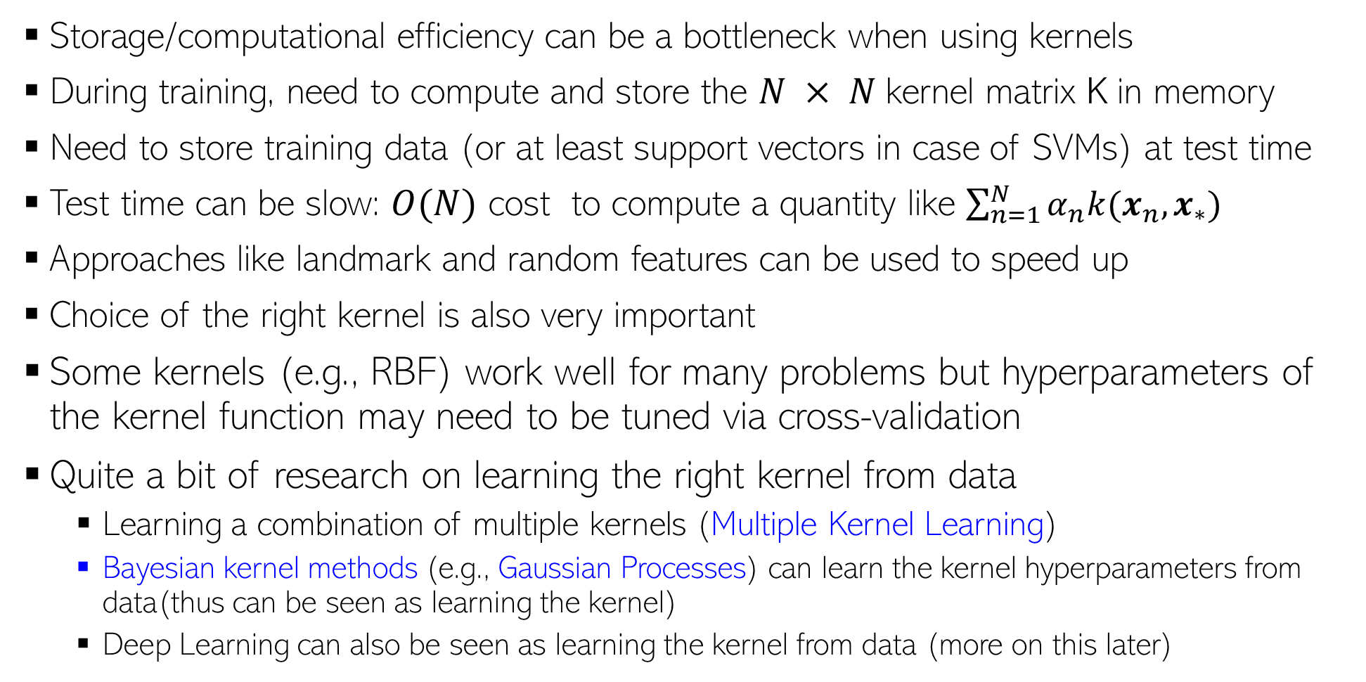
Learning with Kernels: Some Aspects
Storage/computational efficiency can be a bottleneck when using kernels
During training, need to compute and store the $N × N$kernel matrix K in memory
Need to store training data (or at least support vectors in case of SVMs) at test time
Test time can be slow: $O(N)$ cost to compute a quantity like $\sum_{n=1}^{N}{α_{n}k(x_{n},x_{∗})}$
Approaches like landmark and random features can be used to speed up
Choice of the right kernel is also very important
Some kernels (e.g., RBF) work well for many problems but hyperparameters of the kernel function may need to be tuned via cross-validation
Quite a bit of research on learning the right kernel from data
Learning a combination of multiple kernels (Multiple Kernel Learning)
Bayesian kernel methods (e.g., Gaussian Processes) can learn the kernel hyperparameters from data(thus can be seen as learning the kernel)
Deep Learning can also be seen as learning the kernel from data (more on this later)

