Slide 1
K-means extensions and evaluating clusters
CS771: Introduction to Machine Learning
Nisheeth

Slide 2
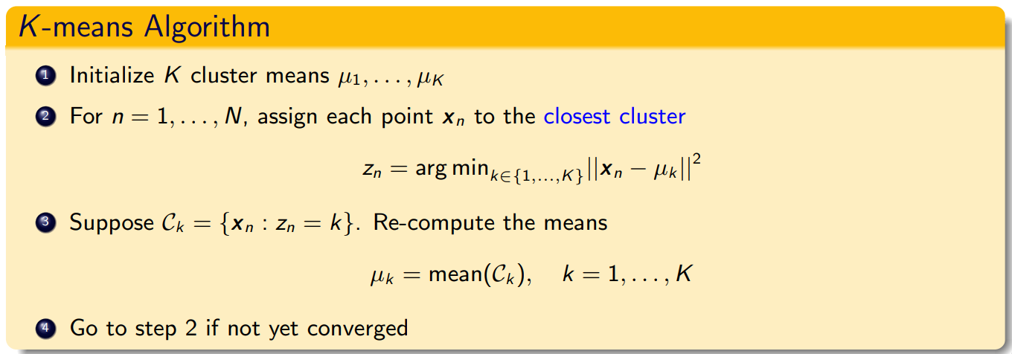

K-means algorithm: recap
Notation: $z_{n}∈\left\{1,2,…, K\right\}$ or $z_{n}$ is a $K$-dim one-hot vector
($z_{nk}$ = 1 and $z_{n} = k$mean the same)

Slide 3
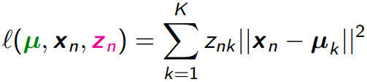
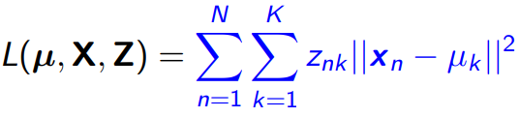
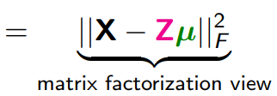

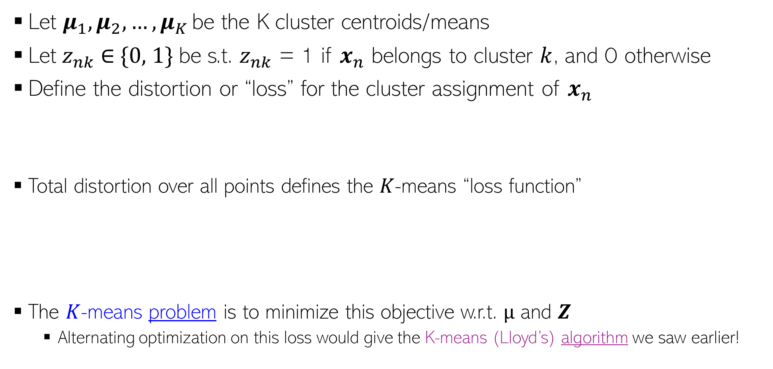

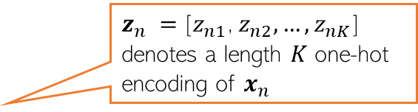

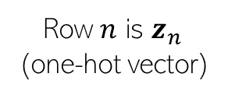
K-means loss function: recap
$z_{n} =$[$z_{n1}$, $z_{n2}, …, z_{nK}$] denotes a length $K$ one-hot encoding of $x_{n}$
Let $μ_{1},μ_{2},…, μ_{K}$ be the K cluster centroids/means
Let $z_{nk}$ ∈ {0, 1} be s.t. $z_{nk}$ = 1 if $x_{n}$ belongs to cluster $k$, and 0 otherwise
Define the distortion or “loss” for the cluster assignment of $x_{n}$
Total distortion over all points defines the $K$-means “loss function”
The $K$-means problem is to minimize this objective w.r.t. $µ$ and $Z$
Alternating optimization on this loss would give the K-means (Lloyd’s) algorithm we saw earlier!
K
K
X
Z
K
$$μ$$
N
$$≈$$
Row $k$ is $μ_{k}$
Row $n$ is $z_{n}$ (one-hot vector)

Slide 4
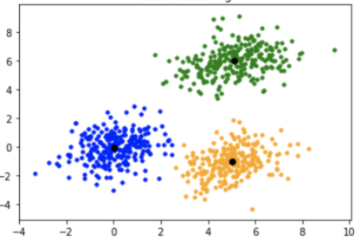
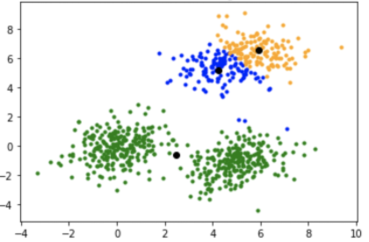
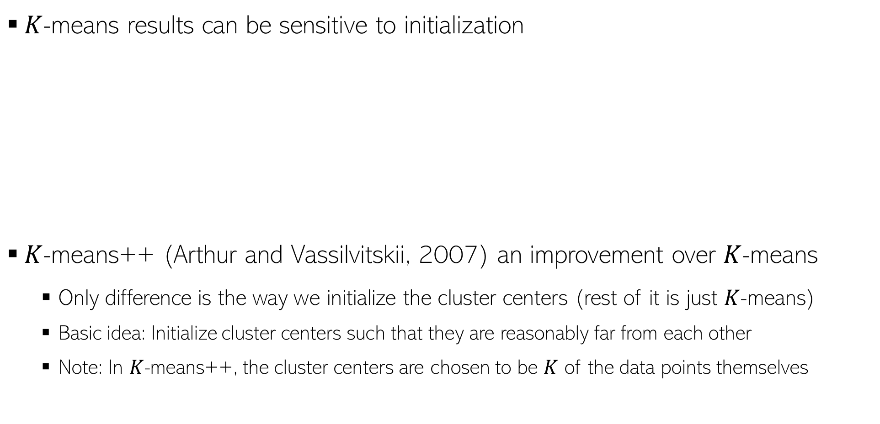
K-means++
$K$-means results can be sensitive to initialization
$K$-means++ (Arthur and Vassilvitskii, 2007) an improvement over $K$-means
Only difference is the way we initialize the cluster centers (rest of it is just $K$-means)
Basic idea: Initialize cluster centers such that they are reasonably far from each other
Note: In $K$-means++, the cluster centers are chosen to be $K$ of the data points themselves
Desired clustering
Poor initialization: bad clustering

Slide 5
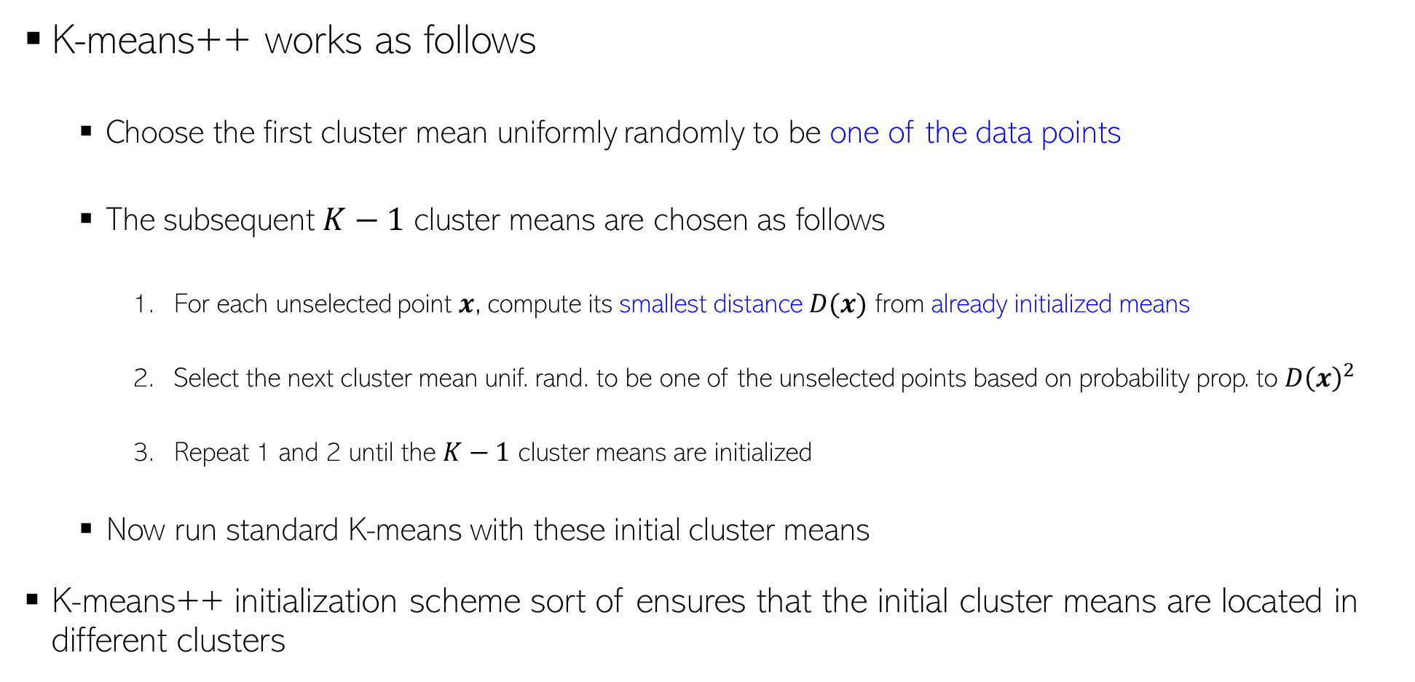
K-means++
K-means++ works as follows
Choose the first cluster mean uniformly randomly to be one of the data points
The subsequent $K−1$ cluster means are chosen as follows
For each unselected point $x$, compute its smallest distance $D(x)$ from already initialized means
Select the next cluster mean unif. rand. to be one of the unselected points based on probability prop. to $D{\left(x\right)}^{2}$
Repeat 1 and 2 until the $K−1$ cluster means are initialized
Now run standard K-means with these initial cluster means
K-means++ initialization scheme sort of ensures that the initial cluster means are located in different clusters
Thus farthest points are most likely to be selected as cluster means

Slide 6
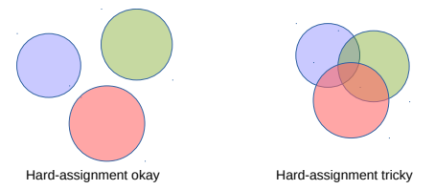



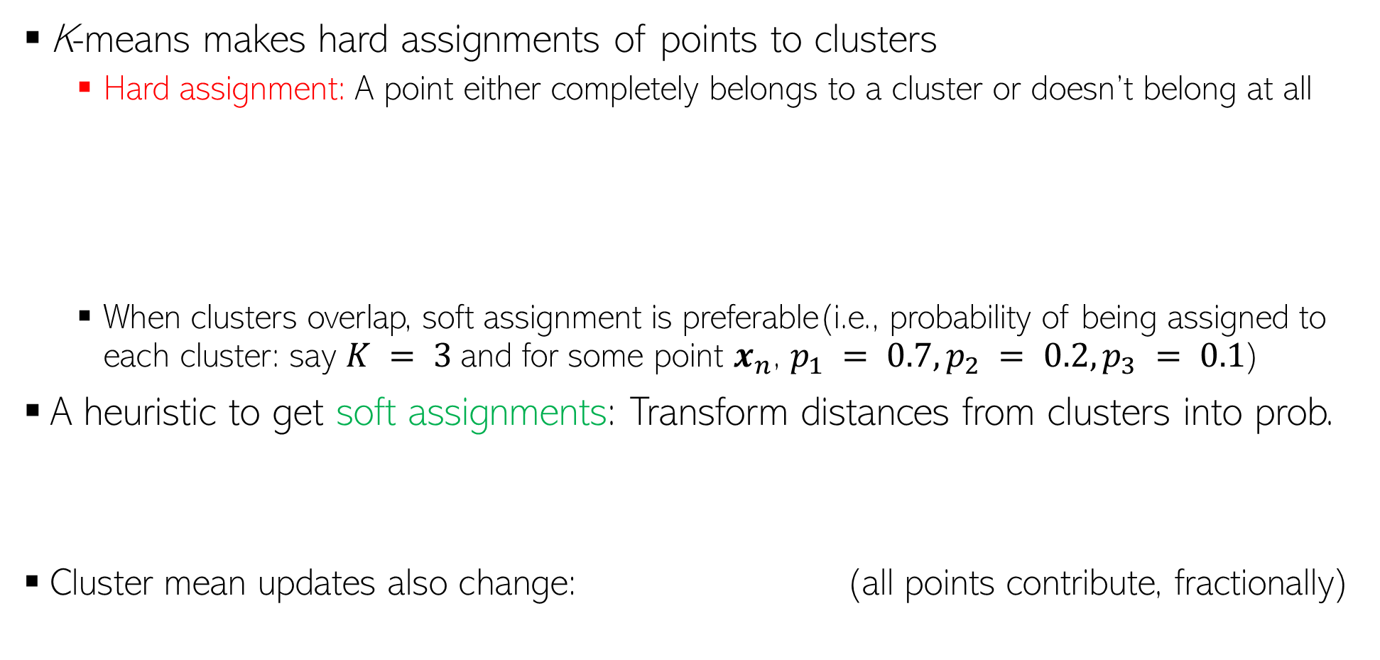
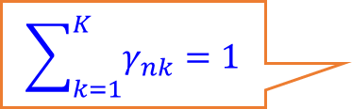
K-means: Soft Clustering
K-means makes hard assignments of points to clusters
Hard assignment: A point either completely belongs to a cluster or doesn’t belong at all
When clusters overlap, soft assignment is preferable(i.e., probability of being assigned to each cluster: say $K = 3$and for some point $x_{n}$, $p_{1} = 0.7, p_{2} = 0.2, p_{3} = 0.1$)
A heuristic to get soft assignments: Transform distances from clusters into prob.
Cluster mean updates also change: (all points contribute, fractionally)
A more principled extension of K-means for doing soft-clustering is via probabilistic mixture models such as the Gaussian Mixture Model
$$\sum_{k=1}^{K}{γ_{nk}=1}$$

Slide 7
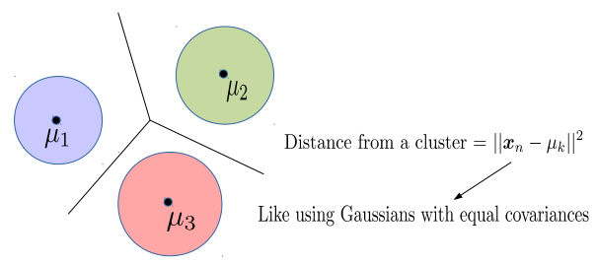
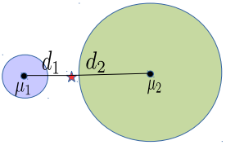
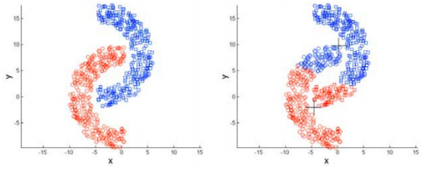
K-means: Decision Boundaries and Cluster Sizes/Shapes
K-mean assumes that the decision boundary between any two clusters is linear
Reason: The K-means loss function implies assumes equal-sized, spherical clusters
May do badly if clusters are not roughly equi-sized and convex-shaped
Reason: Use of Euclidean distances

Slide 8
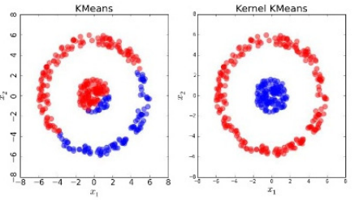
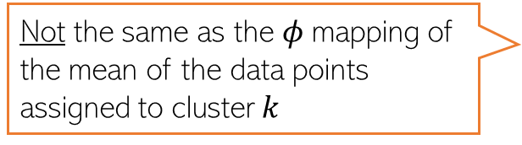
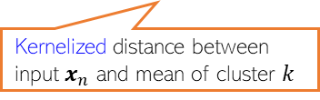
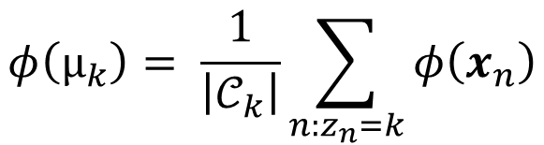

Kernel K-means
Helps learn non-spherical clusters and nonlinear cluster boundaries
Basic idea: Replace the Eucl. distances in K-means by the kernelized versions
Here $k(., .)$denotes the kernel function and $φ$ is its (implicit) feature map
Note: $φ(μ_{k})$ is the mean of $φ$ mappings of the data points assigned to cluster $k$
Kernelized distance between input $x_{n}$ and mean of cluster $k$
Not the same as the $φ$mapping of the mean of the data points assigned to cluster $k$
$$φ\left(μ_{k}\right)= \frac{1}{\left|𝒞_{k}\right|}\sum_{n:z_{n}=k}{φ\left(x_{n}\right)}$$
Can also used landmarks or kernel random features idea to get new features and run standard k-means on those
Note: Apart from kernels, it is also possible to use other distance functions in K-means. Bregman Divergence* is such a family of distances (Euclidean and Mahalanobis are special cases)
*Clustering with Bregman Divergences (Banerjee et al, 2005)

Slide 9
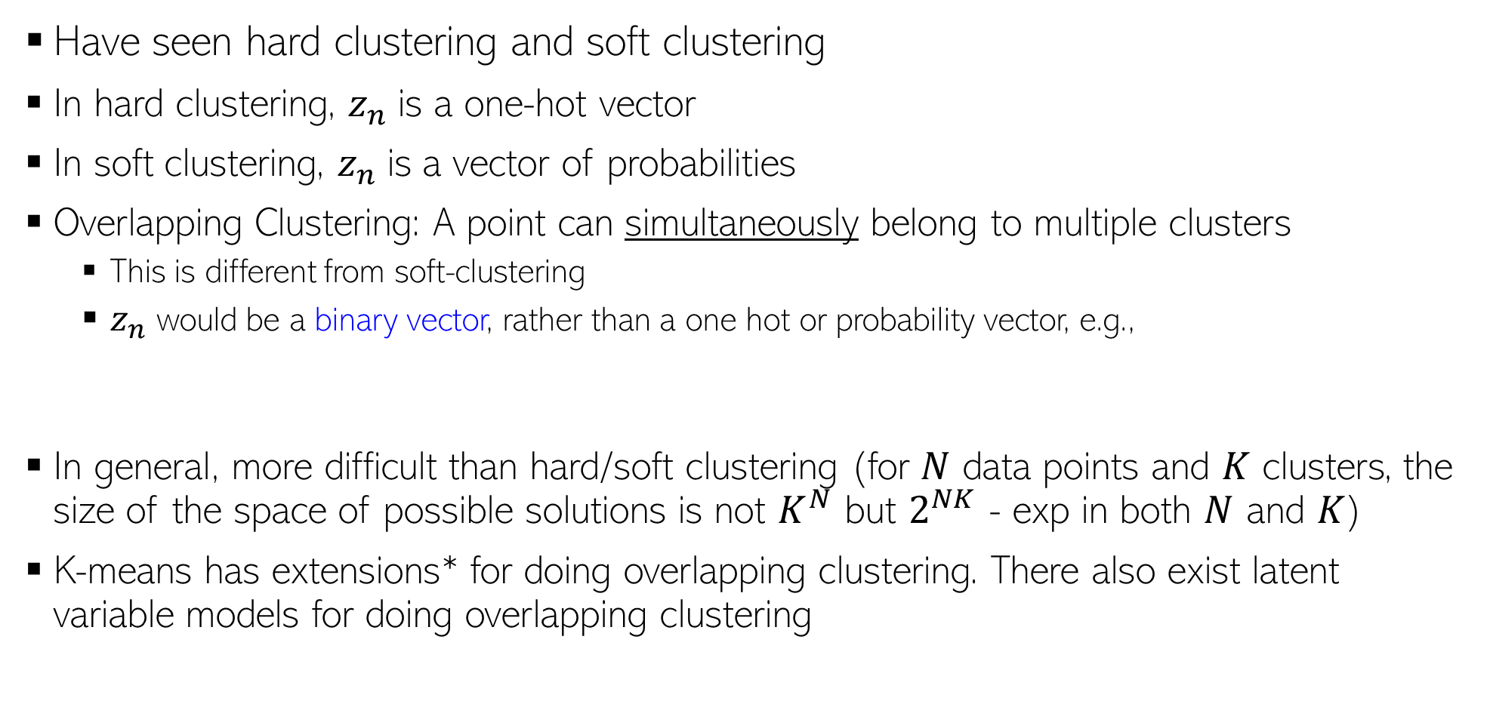
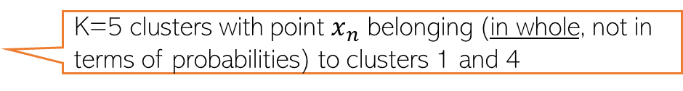

Overlapping Clustering
Kind of unsupervised version of multi-label classification (just like standard clustering is like unsupervised multi-class classification)
Have seen hard clustering and soft clustering
In hard clustering, $z_{n}$is a one-hot vector
In soft clustering, $z_{n}$is a vector of probabilities
Overlapping Clustering: A point can simultaneously belong to multiple clusters
This is different from soft-clustering
$z_{n}$ would be a binary vector, rather than a one hot or probability vector, e.g.,
In general, more difficult than hard/soft clustering (for $N$ data points and $K$ clusters, the size of the space of possible solutions is not $K^{N}$ but $2^{NK}$ - exp in both $N$ and $K$)
K-means has extensions* for doing overlapping clustering. There also exist latent variable models for doing overlapping clustering
Example: Clustering people based on the interests they may have (a person may have multiple interests; thus may belong to more than one cluster simultaneously)
$$z_{n}\text{ = [1 0 0 1 0]}$$
K=5 clusters with point $x_{n}$ belonging (in whole, not in terms of probabilities) to clusters 1 and 4
*An extended version of the k-means method for overlapping clustering (Cleuziou, 2008); Non-exhaustive, Overlapping k-means (Whang et al, 2015)

Slide 10
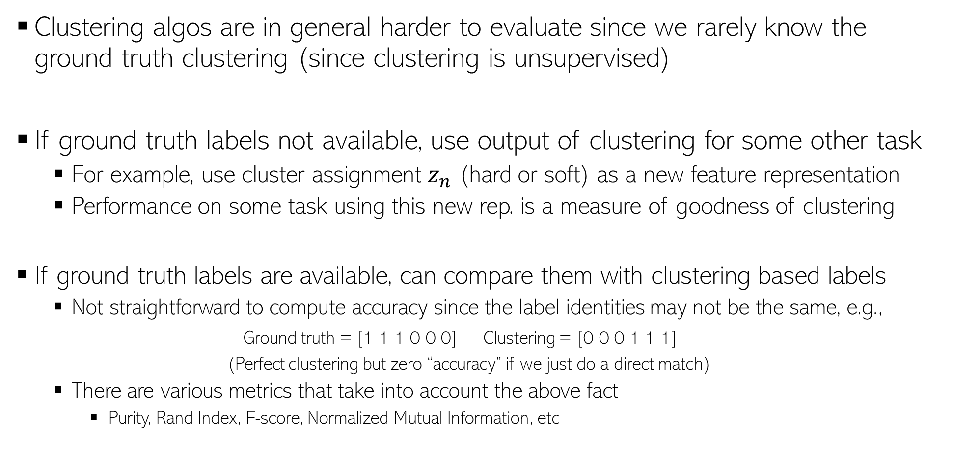
Evaluating Clustering Algorithms
Clustering algos are in general harder to evaluate since we rarely know the ground truth clustering (since clustering is unsupervised)
If ground truth labels not available, use output of clustering for some other task
For example, use cluster assignment $z_{n}$ (hard or soft) as a new feature representation
Performance on some task using this new rep. is a measure of goodness of clustering
If ground truth labels are available, can compare them with clustering based labels
Not straightforward to compute accuracy since the label identities may not be the same, e.g.,
Ground truth = [1 1 1 0 0 0] Clustering = [0 0 0 1 1 1]
(Perfect clustering but zero “accuracy” if we just do a direct match)
There are various metrics that take into account the above fact
Purity, Rand Index, F-score, Normalized Mutual Information, etc

Slide 11
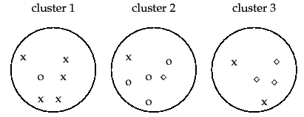




Evaluating Clustering Algorithms
Purity: Looks at how many points in each cluster belong to the majority class in that cluster
Rand Index (RI): Can also look at what fractions of pairs of points with same (resp. different) label are assigned to same (resp. different) cluster
Sum and divide by total number of points
3 classes (x, o , , assuming known ground truth labels)
5
4
3
Purity = (5+4+3)/17 $≈0.71$
Close to 0 for bad clustering, 1 for perfect clustering
Also a bad metric if number of clusters is very large – each cluster will be kind of pure anyway
True Positive: No. of pairs with same true label and same cluster
True Negative: No. of pairs with diff true label and diff clusters
$F_{β}$score is also popular
Precision
Recall
False Positive: No. of pairs with diff true label and same cluster
False Negative: No. of pairs with same true label and diff cluster

