Slide 1
Dimensionality Reduction: Principal Component Analysis
CS771: Introduction to Machine Learning
Nisheeth

Slide 2
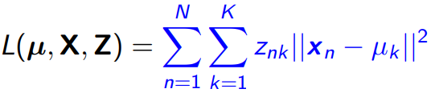
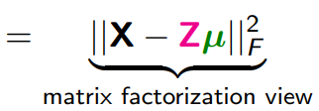



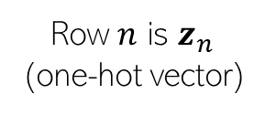
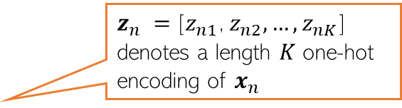
K-means loss function: recap
$z_{n} =$[$z_{n1}$, $z_{n2}, …, z_{nK}$] denotes a length $K$ one-hot encoding of $x_{n}$
Remember the matrix factorization view of the k-means loss function?
We approximated an N x D matrix with
An NxK matrix and a
KXD matrix
This could be storage efficient if K is much smaller than D
D
K
X
Z
D
N
K

Slide 3


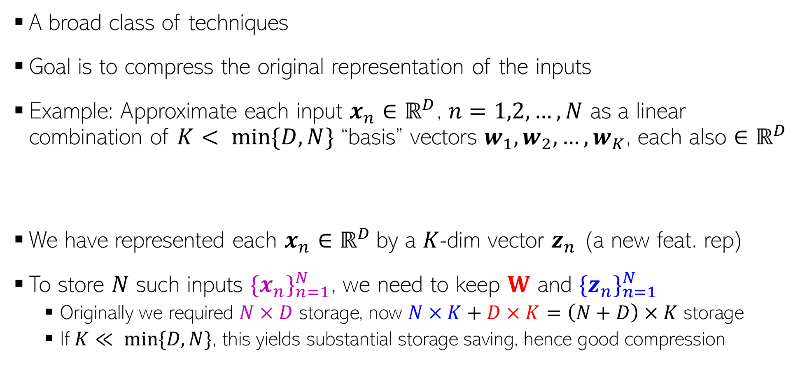



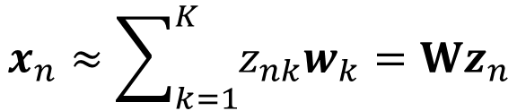
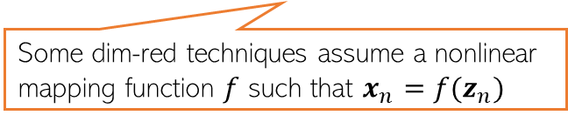
Dimensionality Reduction
Can think of W as a linear mapping that transforms low-dim $z_{n}$ to high-dim $x_{n}$
A broad class of techniques
Goal is to compress the original representation of the inputs
Example: Approximate each input $x_{n}∈ℝ^{D}$, $n=1,2,…,N$ as a linear combination of $K< min\{D,N\}$ “basis” vectors $w_{1},w_{2},…, w_{K}$, each also $∈ℝ^{D}$
We have represented each $x_{n}∈ℝ^{D}$by a $K$-dim vector $z_{n}$ (a new feat. rep)
To store $N$ such inputs ${\{x_{n}\}}_{n=1}^{N}$, we need to keep $W$ and ${\{z_{n}\}}_{n=1}^{N}$
Originally we required $N×D$ storage, now $N×K+D×K=\left(N+D\right)×K$ storage
If $K≪ min⁡\{D,N\}$, this yields substantial storage saving, hence good compression
Some dim-red techniques assume a nonlinear mapping function $f$ such that $x_{n}=f(z_{n})$
For example, $f$ can be modeled by a kernel or a deep neural net
$$x_{n}≈\sum_{k=1}^{K}{z_{nk}w_{k}}=Wz_{n}$$
$W=\left[w_{1},w_{2},…, w_{K}\right]$ is $D×K$
Note: These “basis” vectors need not necessarily be linearly independent. But for some dim. red. techniques, e.g., classic principal component analysis (PCA), they are
$z_{n}=\left[z_{n1},z_{n2},…, z_{nK}\right]$ is $K×1$

Slide 4
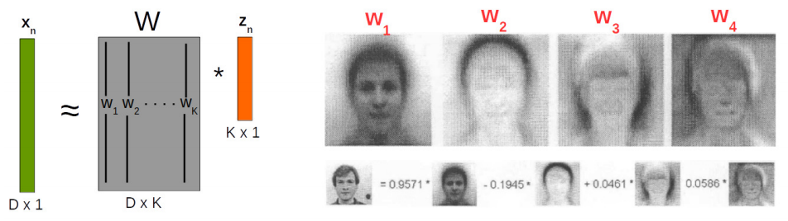







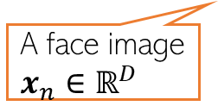


Dimensionality Reduction
Each “basis” image is like a “template” that captures the common properties of face images in the dataset
Dim-red for face images
In this example, $z_{n}∈ℝ^{K} (K=4)$ is a low-dim feature rep. for $x_{n}∈ℝ^{D}$
Essentially, each face image in the dataset now represented by just 4 real numbers ☺
Different dim-red algos differ in terms of how the basis vectors are defined/learned
.. And in general, how the function $f$ in the mapping $x_{n}= f(z_{n})$is defined
K=4 “basis” face images
+
A face image $x_{n}∈ℝ^{D}$
$$z_{n1}$$
$$z_{n2}$$
$$z_{n3}$$
$$z_{n4}$$
$$w_{4}$$
$$w_{1}$$
$$w_{2}$$
$$w_{3}$$
Like 4 new features

Slide 5
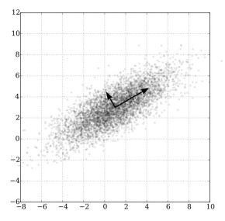

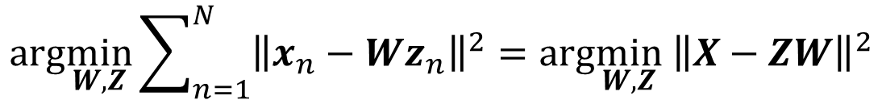

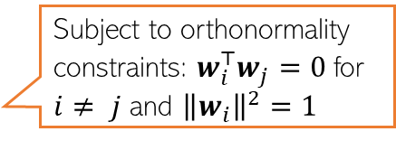

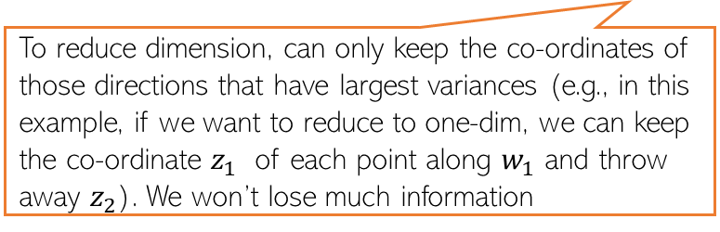



Principal Component Analysis (PCA)
A classic linear dim. reduction method (Pearson, 1901; Hotelling, 1930)
Can be seen as
Learning directions (co-ordinate axes) that capture maximum variance in data
Learning projection directions that result in smallest reconstruction error
PCA also assumes that the projection directions are orthonormal
$$e_{2}$$
PCA is essentially doing a change of axes in which we are representing the data
$e_{1},e_{2}:$ Standard co-ordinate axis ($x=[x_{1},x_{2}]$)
$$w_{1}$$
$$w_{2}$$
$w_{1},w_{2}:$ New co-ordinate axis ($z=[z_{1},z_{2}]$)
Small variance
Each input will still have 2 co-ordinates, in the new co-ordinate system, equal to the distances measured from the new origin
To reduce dimension, can only keep the co-ordinates of those directions that have largest variances (e.g., in this example, if we want to reduce to one-dim, we can keep the co-ordinate $z_{1}$ of each point along $w_{1}$ and throw away $z_{2}$). We won’t lose much information
Large variance
$$e_{1}$$
Subject to orthonormality constraints: $w_{i}^{⊤}w_{j}=0$for $i≠ j$ and ${\left\|w_{i}\right\|}^{2}=1$
$$arg\min_{W,Z}\sum_{n=1}^{N}{{\left\|x_{n}−Wz_{n}\right\|}^{2}=arg\min_{W,Z}{ \left\|X−ZW\right\|}^{2}}$$

Slide 6
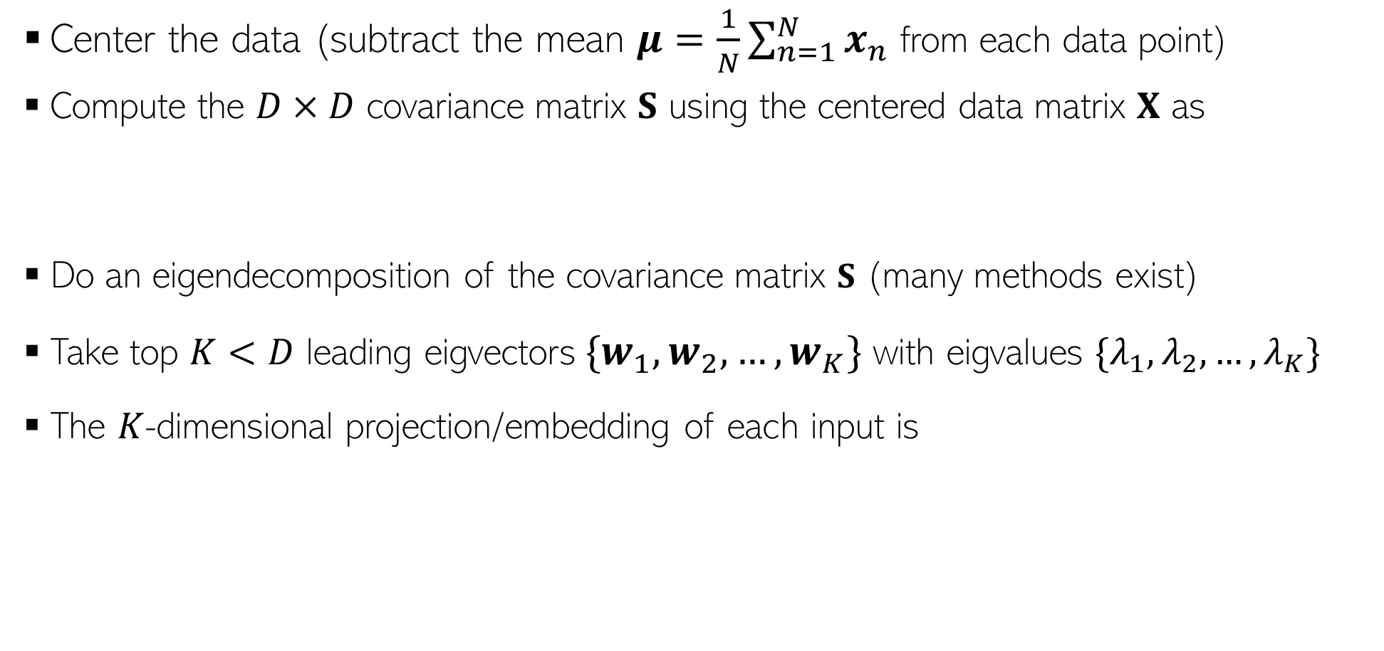




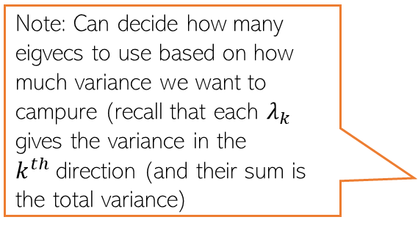
Principal Component Analysis: the algorithm
Center the data (subtract the mean $μ=\frac{1}{N}\sum_{n=1}^{N}{x_{n}}$ from each data point)
Compute the $D×D$ covariance matrix $S$ using the centered data matrix $X$ as
Do an eigendecomposition of the covariance matrix $S$ (many methods exist)
Take top $K<D$ leading eigvectors${\{w}_{1},w_{2},…, w_{K}\}$ with eigvalues $\{λ_{1},λ_{2},…, λ_{K}\}$
The $K$-dimensional projection/embedding of each input is
$$S= \frac{1}{N}X^{⊤}X$$
(Assuming $X$ is arranged as $N×D$)
Note: Can decide how many eigvecs to use based on how much variance we want to campure (recall that each $λ_{k}$ gives the variance in the $k^{th}$direction (and their sum is the total variance)
$$z_{n}≈ W_{K}^{⊤}x_{n}$$
$W_{K}=\left[w_{1},w_{2},…, w_{K}\right]$ is the “projection matrix” of size $D×K$

Slide 7
Understanding PCA: The variance perspective

Slide 8
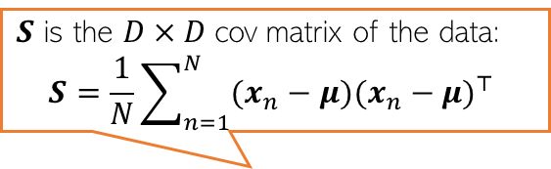




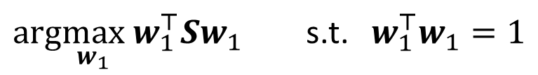


Solving PCA by Finding Max. Variance Directions
Consider projecting an input $x_{n}∈ℝ^{D}$along a direction $w_{1}$ $∈ℝ^{D}$
Projection/embedding of $x_{n}$ (red points below) will be $w_{1}^{⊤}x_{n}$ (green pts below)
Want $w_{1}$ such that variance $w_{1}^{⊤}Sw_{1}$ is maximized
Mean of projections of all inputs:
$\frac{1}{N}\sum_{n=1}^{N}{w_{1}^{⊤}x_{n}= }$ $w_{1}^{⊤}(\frac{1}{N}\sum_{n=1}^{N}{x_{n})=w_{1}^{⊤}μ}$
Variance of the projections:
$$\frac{1}{N}\sum_{n=1}^{N}{{{(w}_{1}^{⊤}x_{n}−w_{1}^{⊤}μ)}^{2}=\frac{1}{N}\sum_{n=1}^{N}{{{\{w}_{1}^{⊤}{(x}_{n}−μ)\}}^{2}=}}w_{1}^{⊤}Sw_{1}$$
$$w_{1}$$
$$x_{n}$$
$S$ is the $D×D$cov matrix of the data:
$$S=\frac{1}{N}\sum_{n=1}^{N}{(x_{n}−μ){(x_{n}−μ)}^{⊤} }$$
$$w_{1}^{⊤}x_{n}$$
For already centered data, $μ$= $0$ and $S=\frac{1}{N}\sum_{n=1}^{N}{x_{n}}x_{n}^{⊤}$ = $\frac{1}{N}XX^{⊤}$
$arg\max_{w_{1}}$ $w_{1}^{⊤}Sw_{1}$ s.t. $w_{1}^{⊤}w_{1}=1$
Need this constraint otherwise the objective’s max will be infinity

Slide 9
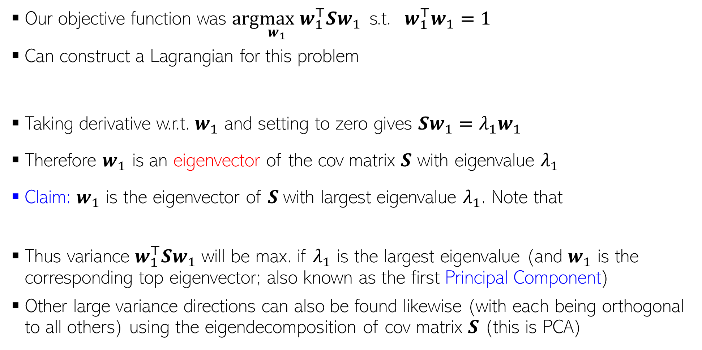



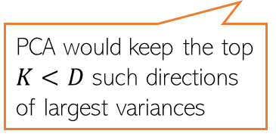
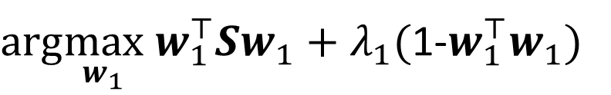
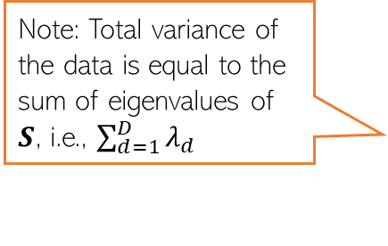
Max. Variance Direction
Variance along the direction $w_{1}$
Note: Total variance of the data is equal to the sum of eigenvalues of $S$, i.e., $\sum_{d=1}^{D}{λ_{d}}$
Our objective function was $arg\max_{w_{1}}$ $w_{1}^{⊤}Sw_{1}$ s.t. $w_{1}^{⊤}w_{1}=1$
Can construct a Lagrangian for this problem
Taking derivative w.r.t. $w_{1}$ and setting to zero gives $Sw_{1}=λ_{1}w_{1}$
Therefore $w_{1}$ is an eigenvector of the cov matrix $S$ with eigenvalue $λ_{1}$
Claim: $w_{1}$ is the eigenvector of $S$with largest eigenvalue $λ_{1}$. Note that
Thus variance $w_{1}^{⊤}Sw_{1}$ will be max. if $λ_{1}$ is the largest eigenvalue (and $w_{1}$ is the corresponding top eigenvector; also known as the first Principal Component)
Other large variance directions can also be found likewise (with each being orthogonal to all others) using the eigendecomposition of cov matrix $S$ (this is PCA)
PCA would keep the top $K<D$ such directions of largest variances
$arg\max_{w_{1}} w_{1}^{⊤}Sw_{1}+λ_{1}($1-$w_{1}^{⊤}w_{1})$
Note: In general, $S$ will have $D$ eigvecs
$w_{1}^{⊤}Sw_{1}=λ_{1}w_{1}^{⊤}w_{1}=λ_{1}$

Slide 10
Understanding PCA: The reconstruction perspective

Slide 11
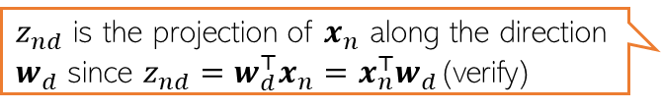


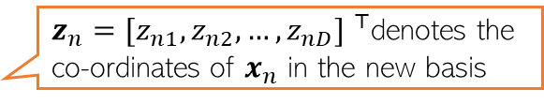

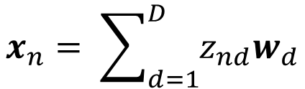
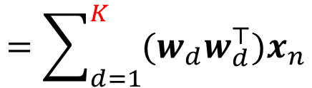
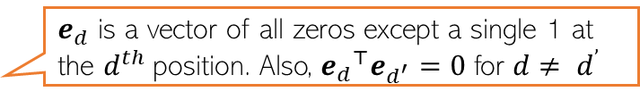


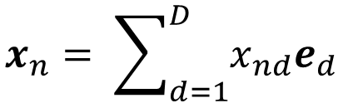
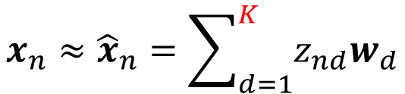
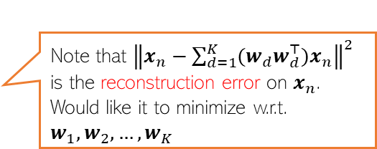
Alternate Basis and Reconstruction
Representing a data point $x_{n}= {[x_{n1},x_{n2},…, x_{nD}] }^{⊤}$ in the standard orthonormal basis $\left\{e_{1},e_{2},…, e_{D}\right\}$
Let’s represent the same data point in a new orthonormal basis $\left\{w_{1},w_{2},…, w_{D}\right\}$
Ignoring directions along which projection $z_{nd}$ is small, we can approximate $x_{n}$ as
Now $x_{n}$ is represented by $K < D$dim. rep. $z_{n} =[z_{n1},z_{n2},…, z_{nK}]$ and (verify)
$$x_{n}= \sum_{d=1}^{D}{x_{nd}e_{d}}$$
$e_{d}$ is a vector of all zeros except a single 1 at the $d^{th}$position. Also, ${e_{d}}^{⊤}e_{d^{′}}=0$ for $d≠ d^{’}$
$z_{nd}$ is the projection of $x_{n}$ along the direction $w_{d}$ since $z_{nd}=w_{d}^{⊤}x_{n}=x_{n}^{⊤}w_{d}$(verify)
$$x_{n}= \sum_{d=1}^{D}{z_{nd}w_{d}}$$
$z_{n}={[z_{n1},z_{n2},…, z_{nD}] }^{⊤}$denotes the co-ordinates of $x_{n}$ in the new basis
$$x_{n}≈{\hat{x}}_{n}=\sum_{d=1}^{K}{z_{nd}w_{d}}$$
$$=\sum_{d=1}^{K}{{(x}_{n}^{⊤}w_{d})w_{d}}$$
$$=\sum_{d=1}^{K}{{(w_{d}w}_{d}^{⊤})x_{n}}$$
Note that ${\left\|x_{n}−\sum_{d=1}^{K}{{(w_{d}w}_{d}^{⊤})x_{n}}\right\|}^{2}$ is the reconstruction error on $x_{n}$. Would like it to minimize w.r.t. $w_{1},w_{2},…, w_{K}$
$$z_{n}≈ W_{K}^{⊤}x_{n}$$
$W_{K}=\left[w_{1},w_{2},…, w_{K}\right]$ is the “projection matrix” of size $D×K$
Also, $x_{n}≈W_{K}z_{n}$

Slide 12

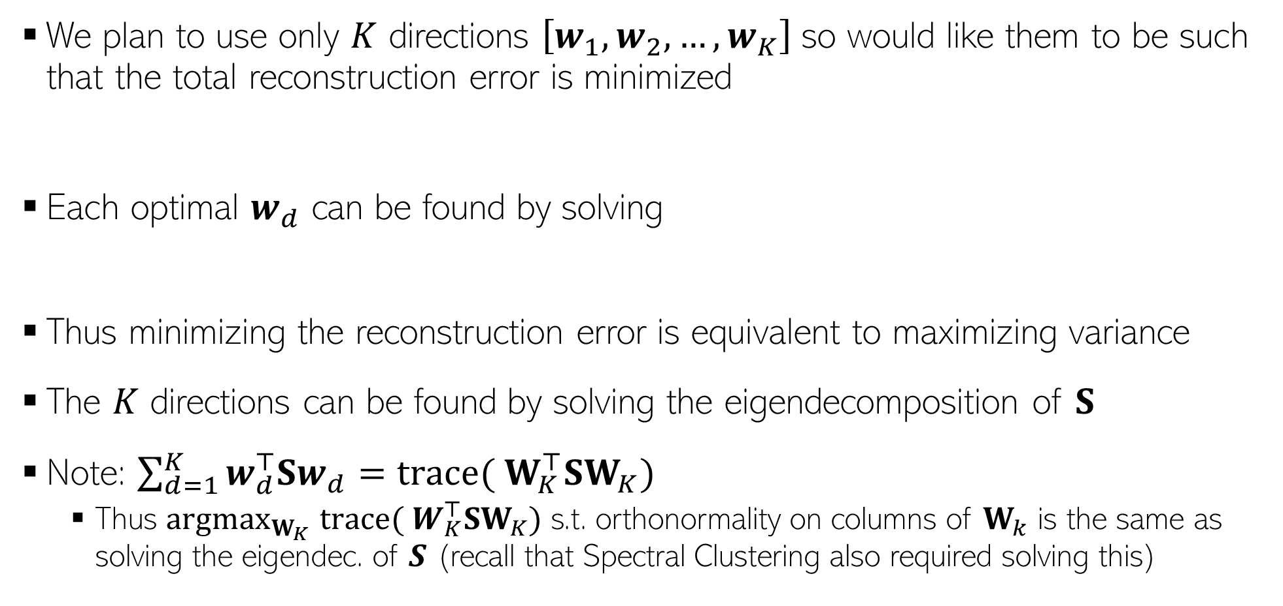


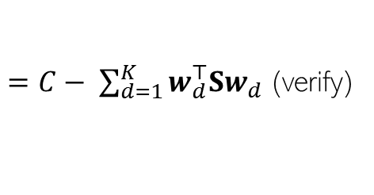
Minimizing Reconstruction Error
We plan to use only $K$ directions $\left[w_{1},w_{2},…, w_{K}\right]$so would like them to be such that the total reconstruction error is minimized
Each optimal $w_{d}$ can be found by solving
Thus minimizing the reconstruction error is equivalent to maximizing variance
The $K$ directions can be found by solving the eigendecomposition of $S$
Note: $\sum_{d=1}^{K}{w_{d}^{⊤}Sw_{d}}=trace({ W}_{K}^{⊤}SW_{K})$
Thus $argmax_{W_{K}}$ $trace({ W}_{K}^{⊤}SW_{K})$ s.t. orthonormality on columns of $W_{k}$ is the same as solving the eigendec. of $S$ (recall that Spectral Clustering also required solving this)
Constant; doesn’t depend on the $w_{d}$’s
$$ℒ\left(w_{1},w_{2},…, w_{K}\right)= \sum_{n=1}^{N}{{\left\|x_{n}−{\hat{x}}_{n}\right\|}^{2}=\sum_{n=1}^{N}{{\left\|x_{n}−\sum_{d=1}^{K}{{(w_{d}w}_{d}^{⊤})x_{n}}\right\|}^{2}}}$$
$=C− \sum_{d=1}^{K}{w_{d}^{⊤}Sw_{d}}$ (verify)
Variance along $w_{d}$
$arg\min_{w_{d}}$ $ℒ\left(w_{1},w_{2},…, w_{K}\right)=arg\max_{w_{d}} { w}_{d}^{⊤}Sw_{d}$

Slide 13
Principal Component Analysis
Center the data (subtract the mean $μ=\frac{1}{N}\sum_{n=1}^{N}{x_{n}}$ from each data point)
Compute the $D×D$ covariance matrix $S$ using the centered data matrix $X$ as
Do an eigendecomposition of the covariance matrix $S$ (many methods exist)
Take top $K<D$ leading eigvectors${\{w}_{1},w_{2},…, w_{K}\}$ with eigvalues $\{λ_{1},λ_{2},…, λ_{K}\}$
The $K$-dimensional projection/embedding of each input is
$$S= \frac{1}{N}X^{⊤}X$$
(Assuming $X$ is arranged as $N×D$)
Note: Can decide how many eigvecs to use based on how much variance we want to campure (recall that each $λ_{k}$ gives the variance in the $k^{th}$direction (and their sum is the total variance)
$$z_{n}≈ W_{K}^{⊤}x_{n}$$
$W_{K}=\left[w_{1},w_{2},…, w_{K}\right]$ is the “projection matrix” of size $D×K$

Slide 14
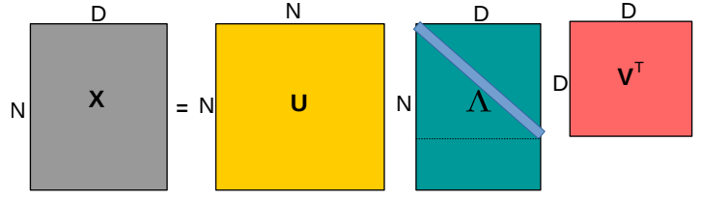
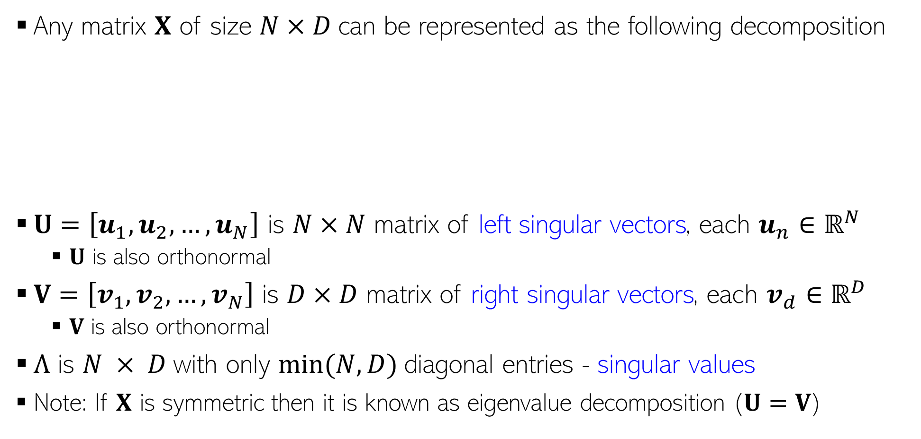

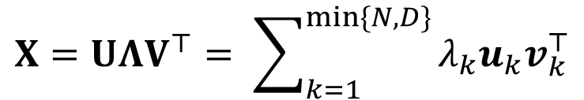
Singular Value Decomposition (SVD)
Any matrix $X$ of size $N×D$can be represented as the following decomposition
$U=\left[u_{1},u_{2},…, u_{N}\right]$ is $N×N$ matrix of left singular vectors, each $u_{n}∈ℝ^{N}$
$U$ is also orthonormal
$V=\left[v_{1},v_{2},…, v_{N}\right]$ is $D×D$ matrix of right singular vectors, each $v_{d}∈ℝ^{D}$
$V$ is also orthonormal
$Λ$ is $N × D$with only $min⁡(N, D)$diagonal entries - singular values
Note: If $X$ is symmetric then it is known as eigenvalue decomposition ($U=V$)
$$X=UΛV^{⊤}= \sum_{k=1}^{min\{N,D\}}{λ_{k}u_{k}v_{k}^{⊤}}$$
Diagonal matrix. If $N>D$, last $D−N$ rows are all zeros; if $D>N$, last $D−N$ columns are all zeros

Slide 15
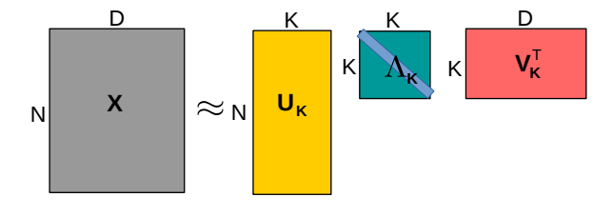
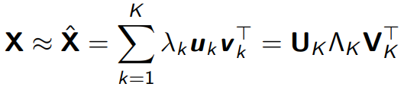
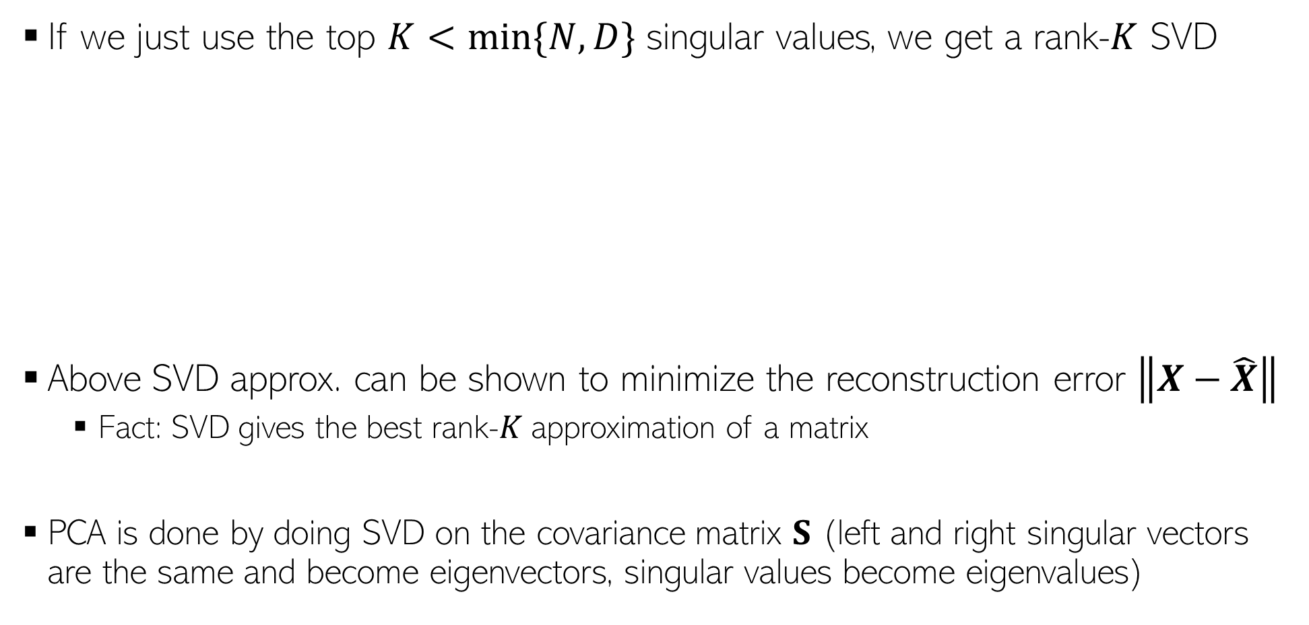
Low-Rank Approximation via SVD
If we just use the top $K<min\{N,D\}$ singular values, we get a rank-$K$ SVD
Above SVD approx. can be shown to minimize the reconstruction error $\left\|X−\hat{X}\right\|$
Fact: SVD gives the best rank-$K$ approximation of a matrix
PCA is done by doing SVD on the covariance matrix $S$ (left and right singular vectors are the same and become eigenvectors, singular values become eigenvalues)

Slide 16
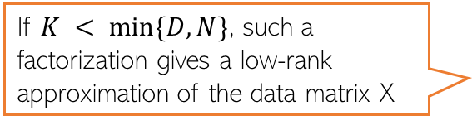
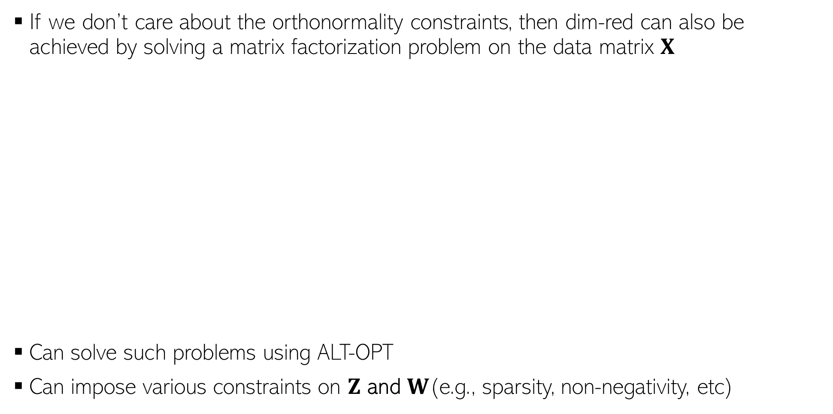


Dim-Red as Matrix Factorization
If we don’t care about the orthonormality constraints, then dim-red can also be achieved by solving a matrix factorization problem on the data matrix $X$
Can solve such problems using ALT-OPT
Can impose various constraints on $Z$ and $W$(e.g., sparsity, non-negativity, etc)
D
K
D
X
Z
W
K
N
$$≈$$
N
Matrix containing the low-dim rep of $X$
$$\left\{\hat{Z},\hat{W}\right\}= {argmin}_{Z,W}{\left\|X −ZW\right\|}^{2}$$
If $K < min⁡\{D,N\}$, such a factorization gives a low-rank approximation of the data matrix X

