Slide 1
Dimensionality Reduction (contd.)
CS771: Introduction to Machine Learning
Nisheeth

Slide 2

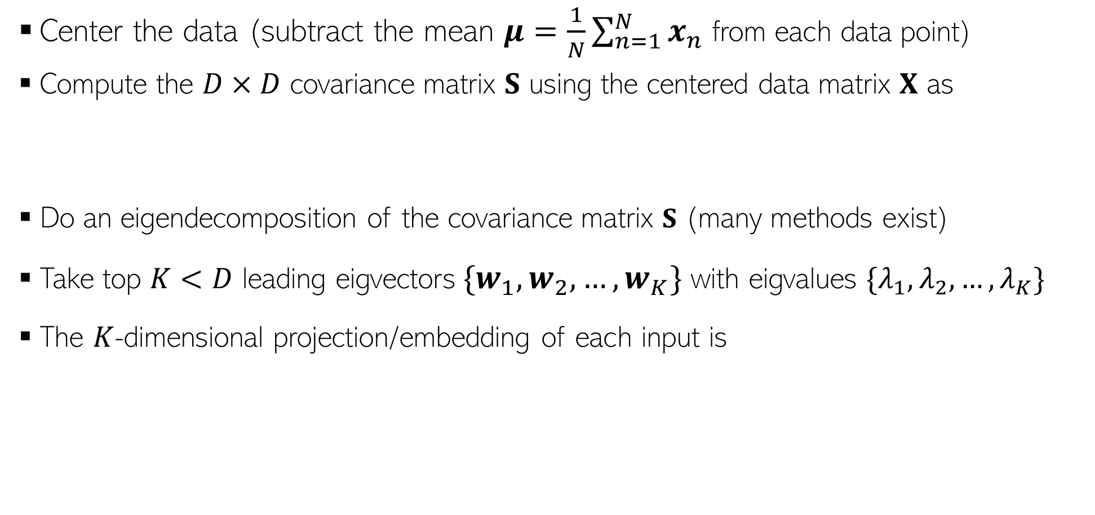




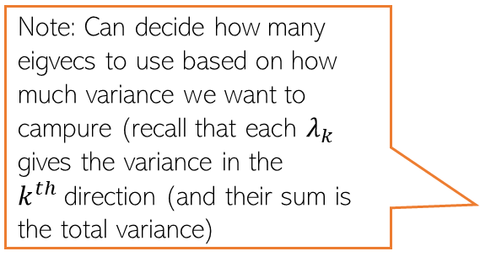
Principal Component Analysis: Recap
Center the data (subtract the mean $μ=\frac{1}{N}\sum_{n=1}^{N}{x_{n}}$ from each data point)
Compute the $D×D$ covariance matrix $S$ using the centered data matrix $X$ as
Do an eigendecomposition of the covariance matrix $S$ (many methods exist)
Take top $K<D$ leading eigvectors${\{w}_{1},w_{2},…, w_{K}\}$ with eigvalues $\{λ_{1},λ_{2},…, λ_{K}\}$
The $K$-dimensional projection/embedding of each input is
$$S= \frac{1}{N}X^{⊤}X$$
(Assuming $X$ is arranged as $N×D$)
Note: Can decide how many eigvecs to use based on how much variance we want to campure (recall that each $λ_{k}$ gives the variance in the $k^{th}$direction (and their sum is the total variance)
$$z_{n}≈ W_{K}^{⊤}x_{n}$$
$W_{K}=\left[w_{1},w_{2},…, w_{K}\right]$ is the “projection matrix” of size $D×K$

Slide 3

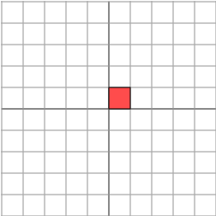


Eigendecomposition refresher
Recall that matrices are essentially instructions for transforming vectors
Consider diagonal matrices
Visuals for these slides borrowed from this tutorial. Highly recommended.

Slide 4

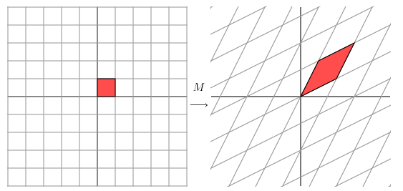
Symmetric matrices are special
Consider the symmetric matrix
It has the following effect
What is it doing?
Not clear

Slide 5
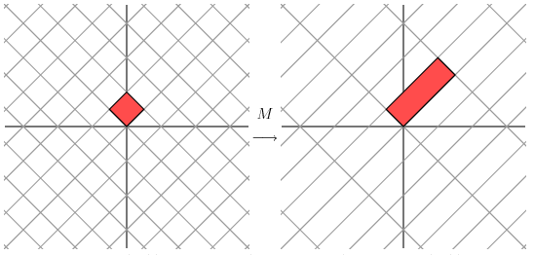
Symmetric matrices behave like diagonal matrices
Consider the same operation on a coordinate system rotated by 45 degrees
We see that the effect of the symmetric matrix M on this coordinate frame is the same as the effect of a diagonal matrix on the conventional coordinate frame

Slide 6
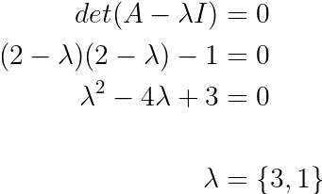
A simple eigendecomposition
From 12th class linear algebra
With eigenvectors x1 = {1,1} and x2 = {-1,1}
What does this mean?

Slide 7
Eigendecomposition to information compression
The eigendecomposition of M found the vectors we could use to form a coordinate basis
In which the matrix operation M on a vector would correspond to a simple scaling operation on the same vector
Mx = λx
Important: each eigenvalue is simply performing a scaling operation in the new coordinate basis. The bigger the eigenvalue, the bigger the transformation
If we choose to not use some of the eigenvalues, this is equivalent to not using some information in the original matrix
By selecting to ignore smaller eigenvalues, we compress information about a matrix by looking only at the most important scale transformations that matter
Pro-tip, for symmetric positive definite matrices, eigendecomposition is the same as singular value decomposition (SVD)

Slide 8
An eigendecomposition application: PCA
Center the data (subtract the mean $μ=\frac{1}{N}\sum_{n=1}^{N}{x_{n}}$ from each data point)
Compute the $D×D$ covariance matrix $S$ using the centered data matrix $X$ as
Do an eigendecomposition of the covariance matrix $S$ (many methods exist)
Take top $K<D$ leading eigvectors${\{w}_{1},w_{2},…, w_{K}\}$ with eigvalues $\{λ_{1},λ_{2},…, λ_{K}\}$
The $K$-dimensional projection/embedding of each input is
$$S= \frac{1}{N}X^{⊤}X$$
(Assuming $X$ is arranged as $N×D$)
$$z_{n}≈ W_{K}^{⊤}x_{n}$$
$W_{K}=\left[w_{1},w_{2},…, w_{K}\right]$ is the “projection matrix” of size $D×K$

Slide 9
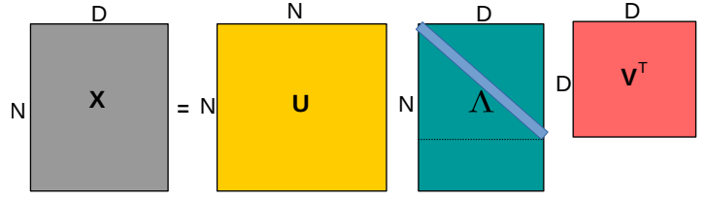
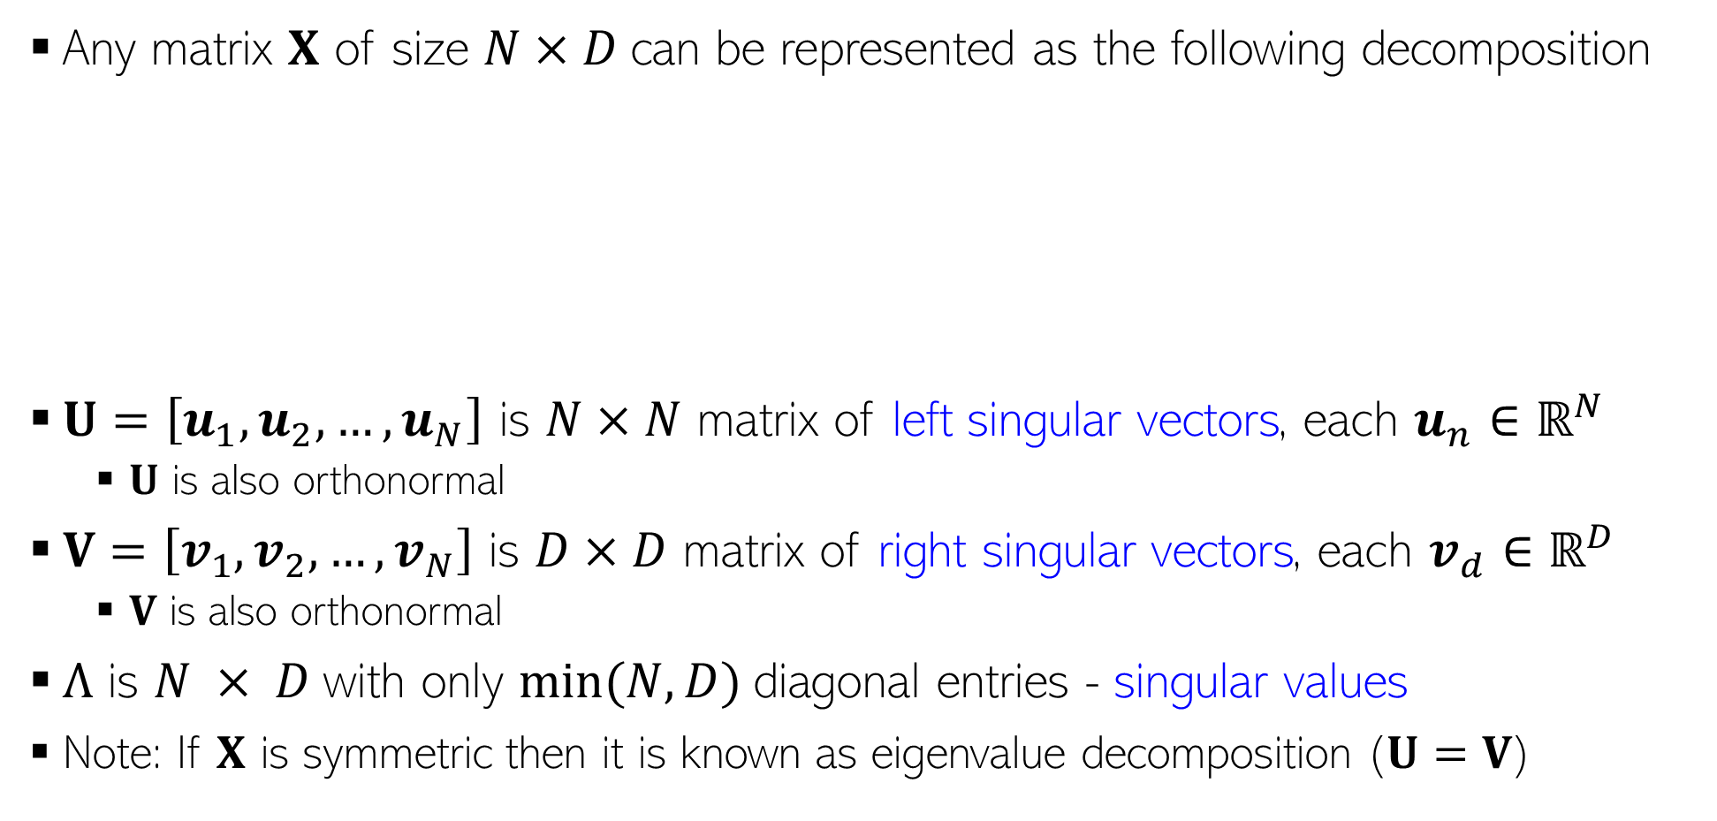

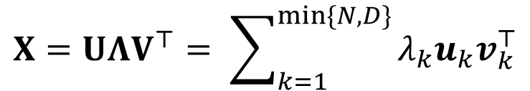
Singular Value Decomposition (SVD)
Any matrix $X$ of size $N×D$can be represented as the following decomposition
$U=\left[u_{1},u_{2},…, u_{N}\right]$ is $N×N$ matrix of left singular vectors, each $u_{n}∈ℝ^{N}$
$U$ is also orthonormal
$V=\left[v_{1},v_{2},…, v_{N}\right]$ is $D×D$ matrix of right singular vectors, each $v_{d}∈ℝ^{D}$
$V$ is also orthonormal
$Λ$ is $N × D$with only $min⁡(N, D)$diagonal entries - singular values
Note: If $X$ is symmetric then it is known as eigenvalue decomposition ($U=V$)
$$X=UΛV^{⊤}= \sum_{k=1}^{min\{N,D\}}{λ_{k}u_{k}v_{k}^{⊤}}$$
Diagonal matrix. If $N>D$, last $D−N$ rows are all zeros; if $D>N$, last $D−N$ columns are all zeros
The wikipedia article on this is a star. Highly recommended.

Slide 10
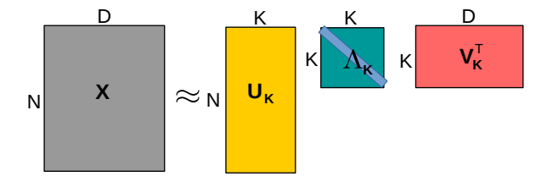
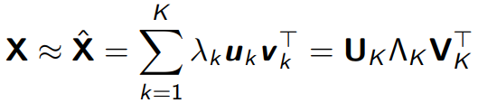
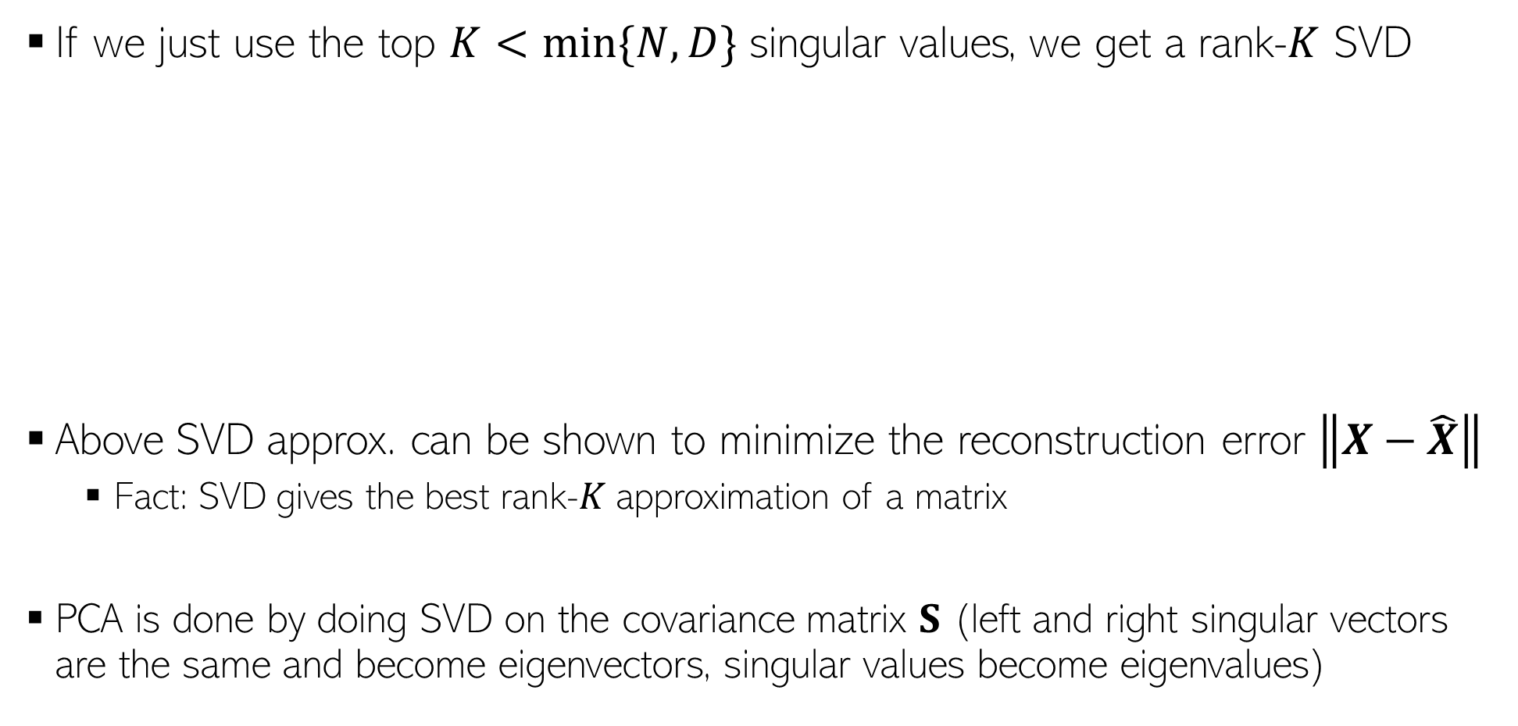
Low-Rank Approximation via SVD
If we just use the top $K<min\{N,D\}$ singular values, we get a rank-$K$ SVD
Above SVD approx. can be shown to minimize the reconstruction error $\left\|X−\hat{X}\right\|$
Fact: SVD gives the best rank-$K$ approximation of a matrix
PCA is done by doing SVD on the covariance matrix $S$ (left and right singular vectors are the same and become eigenvectors, singular values become eigenvalues)

Slide 11
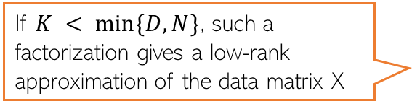
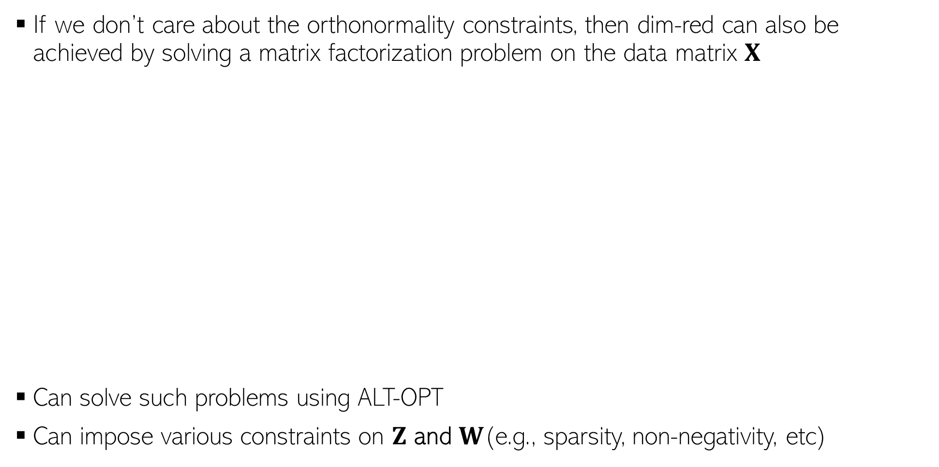
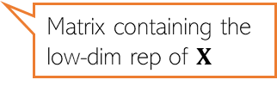

Dim-Red as Matrix Factorization
If we don’t care about the orthonormality constraints, then dim-red can also be achieved by solving a matrix factorization problem on the data matrix $X$
Can solve such problems using ALT-OPT
Can impose various constraints on $Z$ and $W$(e.g., sparsity, non-negativity, etc)
D
K
D
X
Z
W
K
N
$$≈$$
N
Matrix containing the low-dim rep of $X$
$$\left\{\hat{Z},\hat{W}\right\}= {argmin}_{Z,W}{\left\|X −ZW\right\|}^{2}$$
If $K < min⁡\{D,N\}$, such a factorization gives a low-rank approximation of the data matrix X

Slide 12
Supervised Dimensionality Reduction
Maximum variance directions may not be aligned with class separation directions
Be careful when using PCA for supervised learning problems
A better option would be to project such that
Points within the same class are close (low intra-class variance)
Points from different classes are well separated (the class means are far apart)
Direction that preserves class separation
Projecting along this will give a one dimensional embedding of each point with both classes overlapping with each other
Projecting along this will give a one dimensional embedding of each point with both classes still having a good separation
Max variance direction (given by PCA)

Slide 13
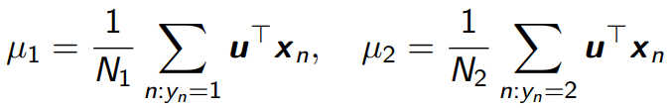


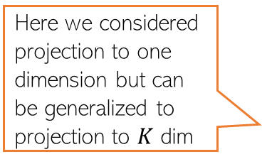
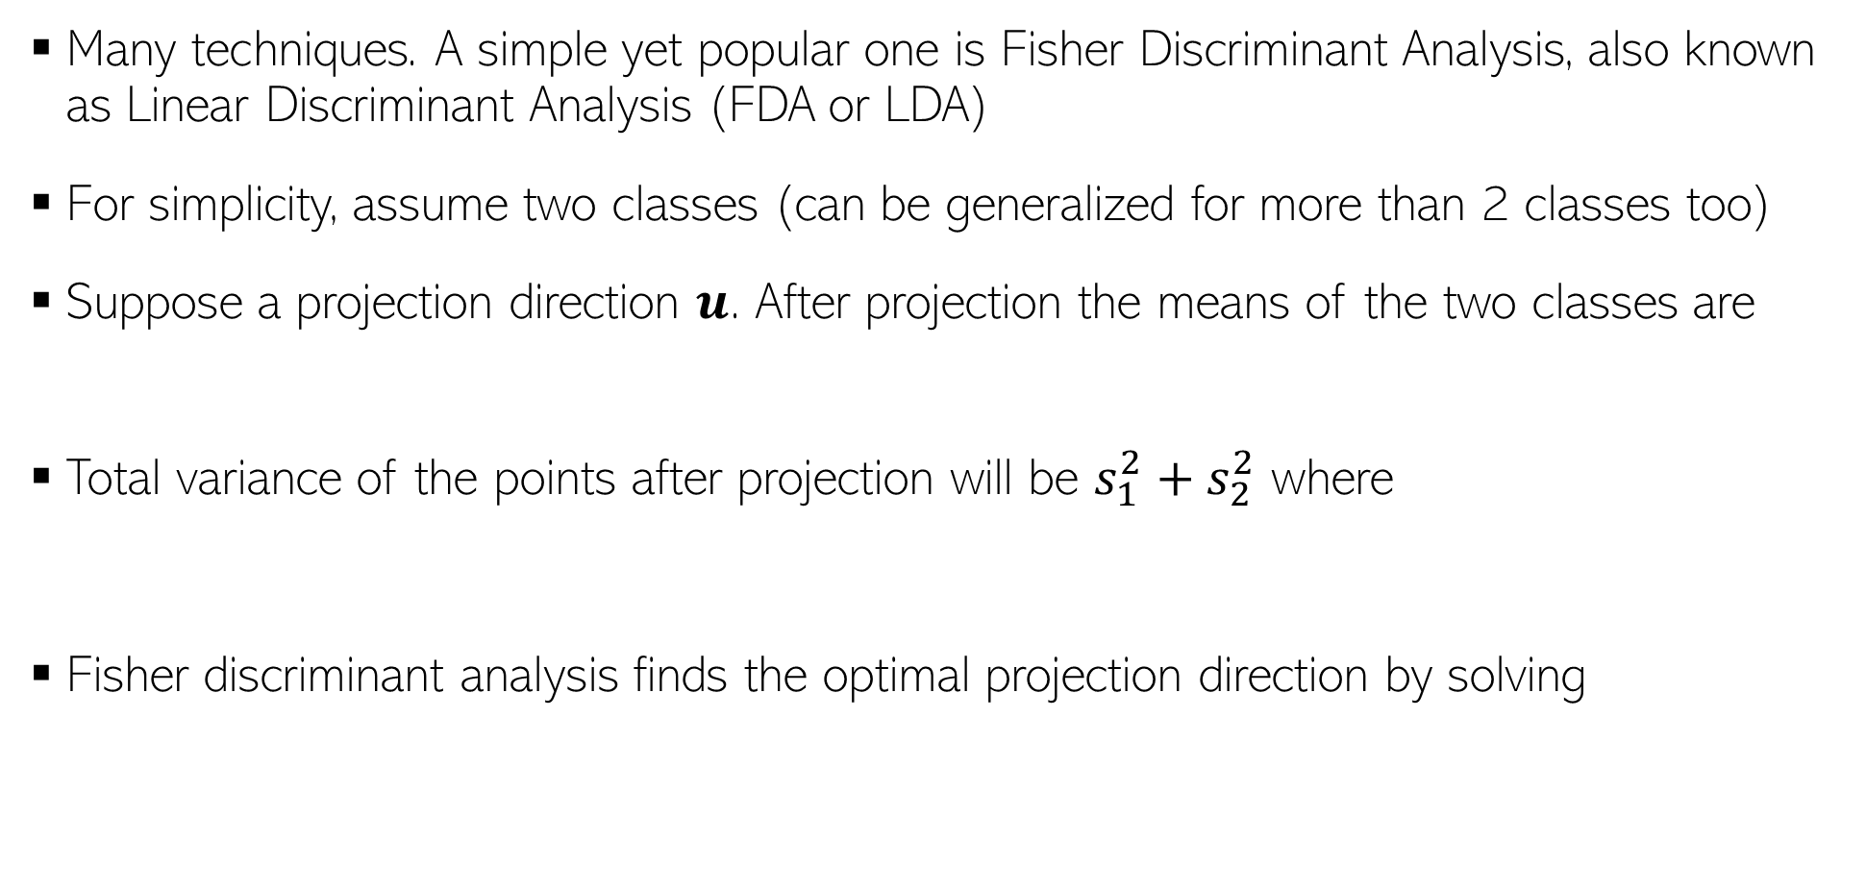
Supervised Dimensionality Reduction
Many techniques. A simple yet popular one is Fisher Discriminant Analysis, also known as Linear Discriminant Analysis (FDA or LDA)
For simplicity, assume two classes (can be generalized for more than 2 classes too)
Suppose a projection direction $u$. After projection the means of the two classes are
Total variance of the points after projection will be $s_{1}^{2}+s_{2}^{2}$ where
Fisher discriminant analysis finds the optimal projection direction by solving
This LDA should not be confused with another very popular ML technique for finding topics in text data (Latent Dirichlet Allocation)
Here we considered projection to one dimension but can be generalized to projection to $K$ dim
The solution to this problem involves solving an eigendecomposition problem that involves within class covariance matrices and between class covariance matrices
Push the means far apart
Make each class tightly packed after projection (small variance)

Slide 14
Dimensionality Reduction given Pairwise Distances between points

Slide 15
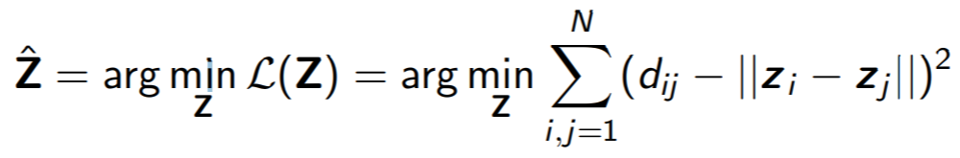
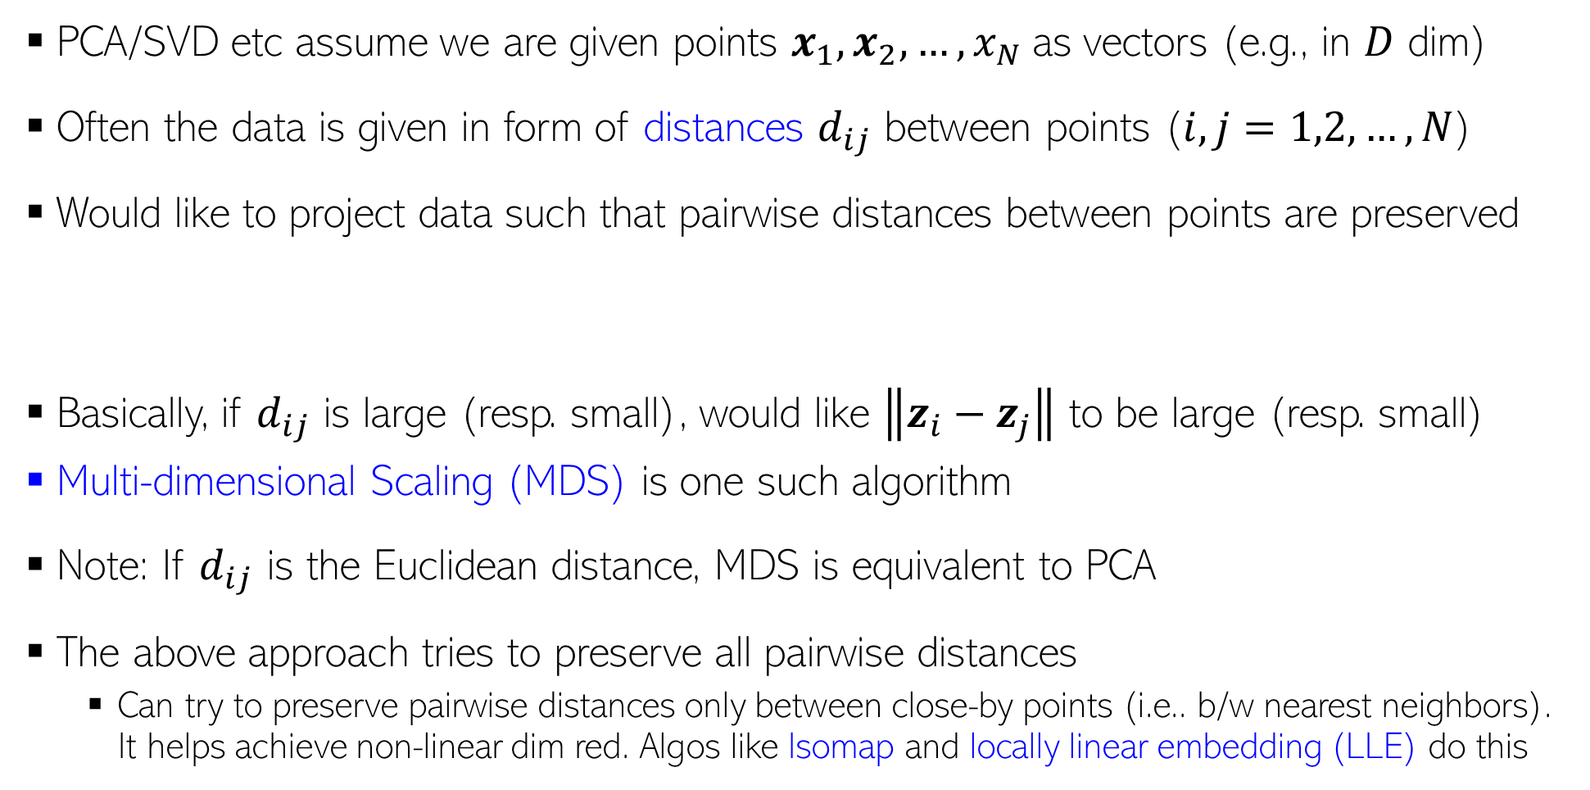
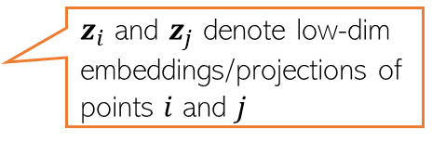
Dim. Reduction by Preserving Pairwise Distances
PCA/SVD etc assume we are given points $x_{1}, x_{2},…, x_{N}$as vectors (e.g., in $D$ dim)
Often the data is given in form of distances $d_{ij}$ between points ($i,j=1,2,…,N$)
Would like to project data such that pairwise distances between points are preserved
Basically, if $d_{ij}$ is large (resp. small), would like $\left\|z_{i}−z_{j}\right\|$ to be large (resp. small)
Multi-dimensional Scaling (MDS) is one such algorithm
Note: If $d_{ij}$ is the Euclidean distance, MDS is equivalent to PCA
The above approach tries to preserve all pairwise distances
Can try to preserve pairwise distances only between close-by points (i.e.. b/w nearest neighbors). It helps achieve non-linear dim red. Algos like Isomap and locally linear embedding (LLE) do this
$z_{i}$ and $z_{j}$ denote low-dim embeddings/projections of points $i$ and $j$

Slide 16
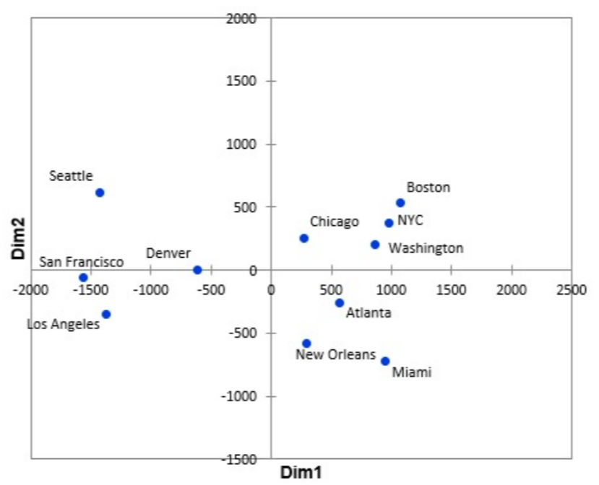
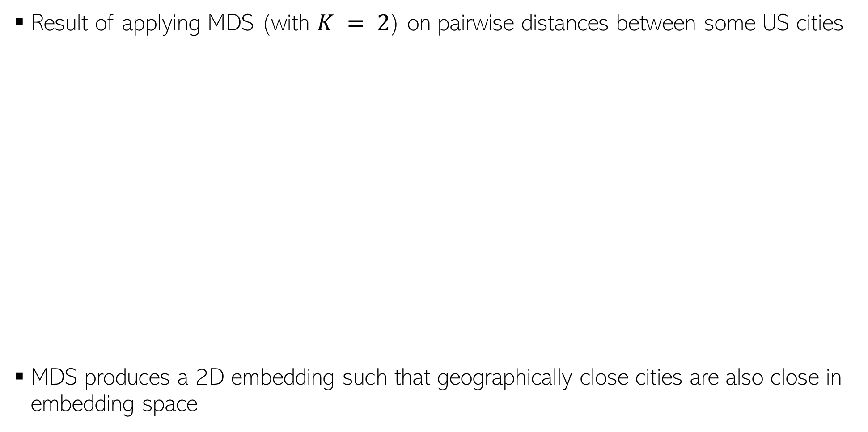
MDS: An Example
Result of applying MDS (with $K = 2$) on pairwise distances between some US cities
MDS produces a 2D embedding such that geographically close cities are also close in embedding space

Slide 17
Nonlinear Dimensionality Reduction

Slide 18
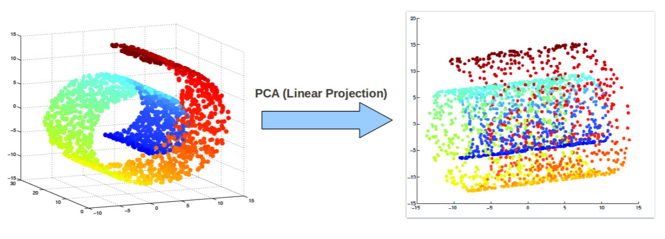
Beyond Linear Projections
Consider the swiss-roll dataset (points lying close to a manifold)
Linear projection methods (e.g., PCA) can’t capture intrinsic nonlinearities
Maximum variance directions may not be the most interesting ones
Relative positions of points destroyed after the projection

Slide 19
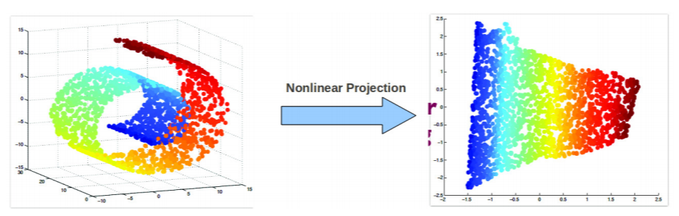
Nonlinear Dimensionality Reduction
We want to a learn nonlinear low-dim projection
Some ways of doing this
Nonlinearize a linear dimensionality reduction method. E.g.:
Cluster data and apply linear PCA within each cluster (mixture of PCA)
Kernel PCA (nonlinear PCA)
Using manifold based methods that intrinsically preserve nonlinear geometry, e.g.,
Locally Linear Embedding (LLE), Isomap
Maximum Variance Unfolding
Laplacian Eigenmap, and others such as SNE/tSNE, etc.
Relative positions of points preserved after the projection

Slide 20
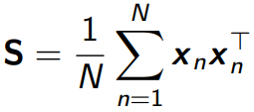

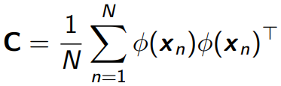



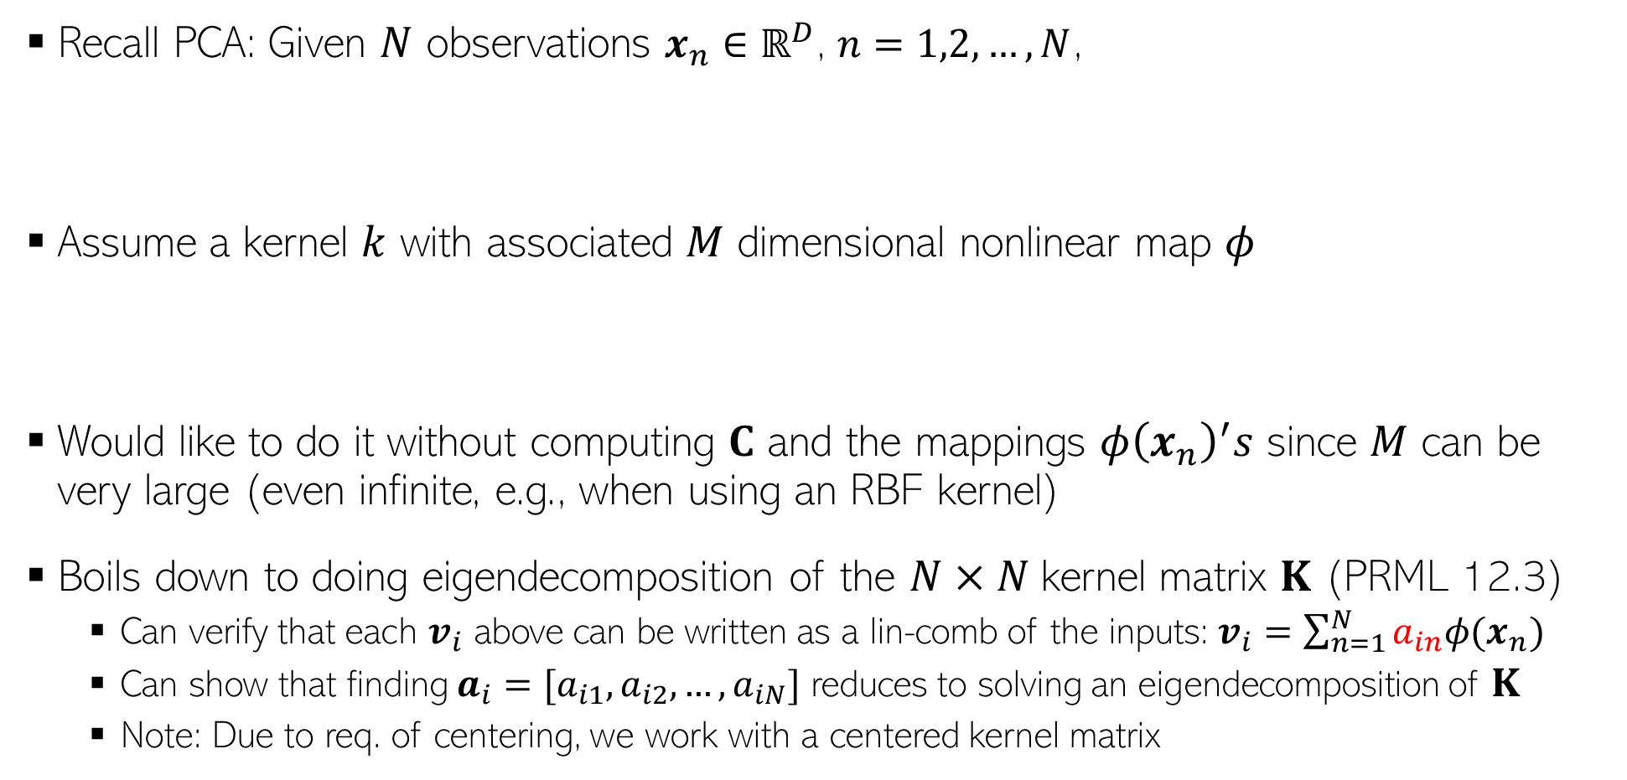
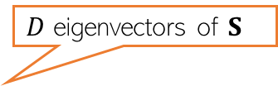

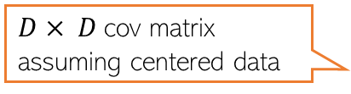
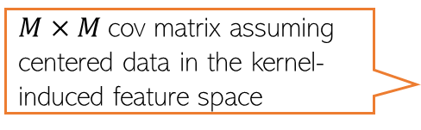
Kernel PCA
Recall PCA: Given $N$ observations $x_{n}∈ℝ^{D}$, $n=1,2,…,N$,
Assume a kernel $k$ with associated $M$ dimensional nonlinear map $φ$
Would like to do it without computing $C$ and the mappings $φ{\left(x_{n}\right)}^{′}s$ since $M$ can be very large (even infinite, e.g., when using an RBF kernel)
Boils down to doing eigendecomposition of the $N×N$kernel matrix $K$ (PRML 12.3)
Can verify that each $v_{i}$ above can be written as a lin-comb of the inputs: $v_{i}=\sum_{n=1}^{N}{a_{in}φ(x_{n})}$
Can show that finding $a_{i}=[a_{i1},a_{i2},…, a_{iN}]$ reduces to solving an eigendecomposition of $K$
Note: Due to req. of centering, we work with a centered kernel matrix
$D$ eigenvectors of $S$
$D× D$cov matrix assuming centered data
$M×M$cov matrix assuming centered data in the kernel-induced feature space
$M$ eigenvectors of $C$
$N×N$matrix of all 1s

Slide 21
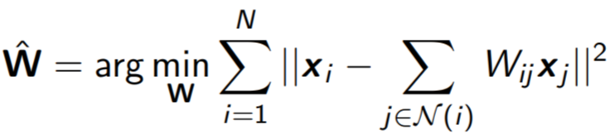
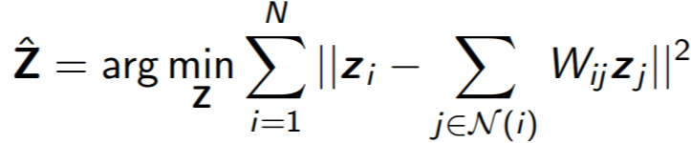
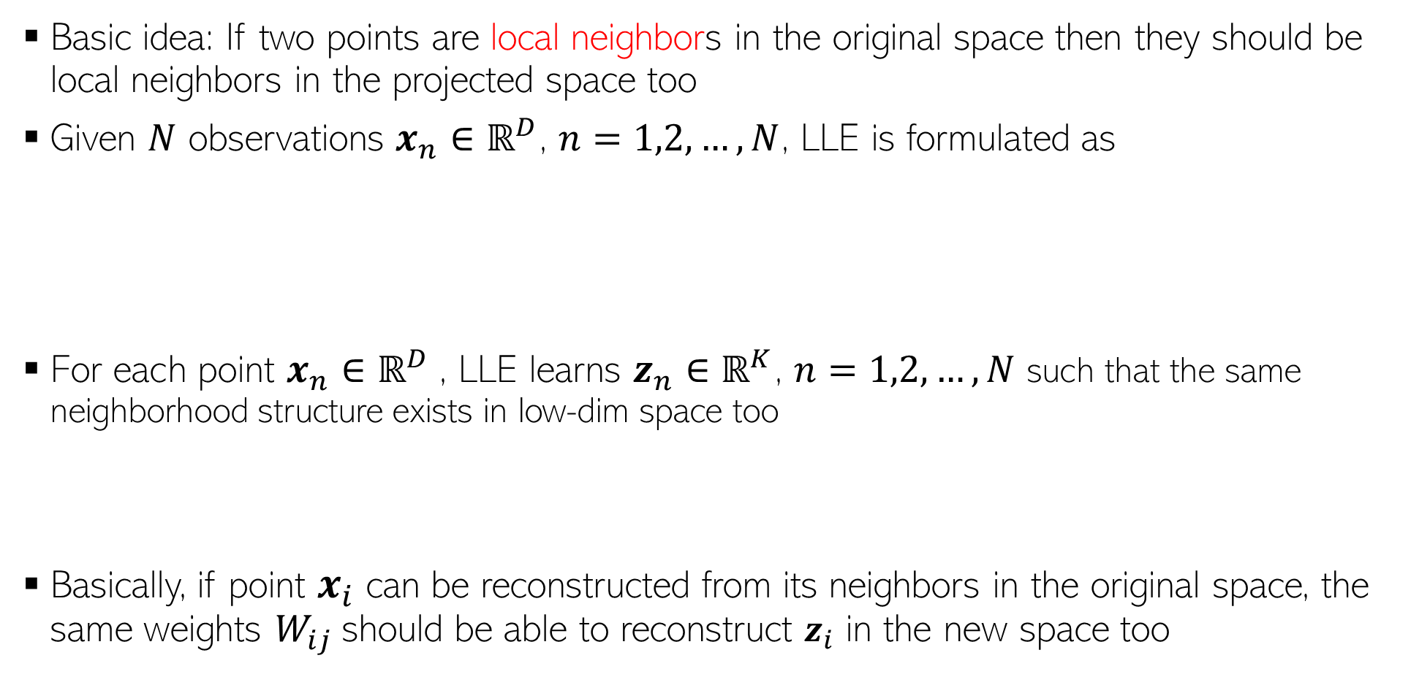
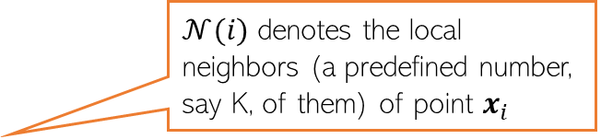
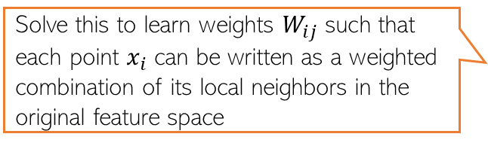
Locally Linear Embedding
Several non-lin dim-red algos use this idea
Essentially, neighbourhood preservation, but only local
Basic idea: If two points are local neighbors in the original space then they should be local neighbors in the projected space too
Given $N$ observations $x_{n}∈ℝ^{D}$, $n=1,2,…,N$, LLE is formulated as
For each point $x_{n}∈ℝ^{D}$, LLE learns $z_{n}∈ℝ^{K}$, $n=1,2,…,N$ such that the same neighborhood structure exists in low-dim space too
Basically, if point $x_{i}$ can be reconstructed from its neighbors in the original space, the same weights $W_{ij}$should be able to reconstruct $z_{i}$ in the new space too
Solve this to learn weights $W_{ij}$such that each point $x_{i}$ can be written as a weighted combination of its local neighbors in the original feature space
$𝒩(i)$ denotes the local neighbors (a predefined number, say K, of them) of point $x_{i}$
Requires solving an eigenvalue problem
S. T. Roweis and L. K. Saul. Nonlinear dimensionality reduction by locally linear embedding. Science 290 (2000)

Slide 22
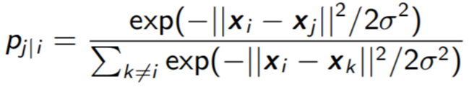
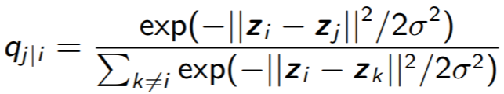
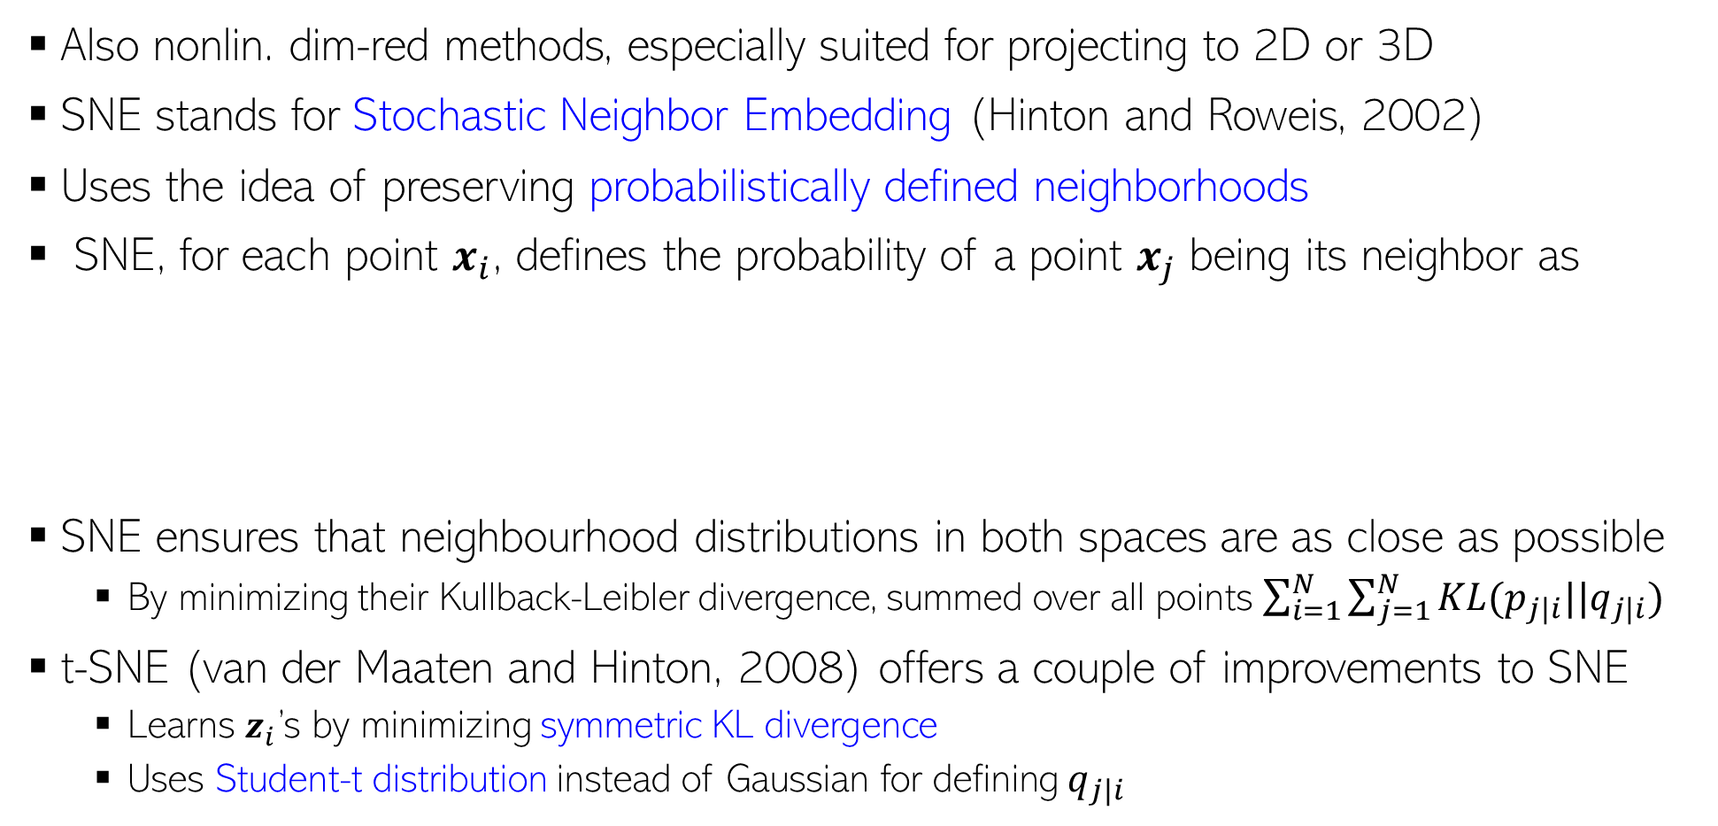
SNE and t-SNE
Thus very useful if we want to visualize some high-dim data in two or three dims
Also nonlin. dim-red methods, especially suited for projecting to 2D or 3D
SNE stands for Stochastic Neighbor Embedding (Hinton and Roweis, 2002)
Uses the idea of preserving probabilistically defined neighborhoods
SNE, for each point $x_{i}$, defines the probability of a point $x_{j}$ being its neighbor as
SNE ensures that neighbourhood distributions in both spaces are as close as possible
By minimizing their Kullback-Leibler divergence, summed over all points $\sum_{i=1}^{N}{\sum_{j=1}^{N}{KL(p_{j|i}||q_{j|i})}}$
t-SNE (van der Maaten and Hinton, 2008) offers a couple of improvements to SNE
Learns $z_{i}$’s by minimizing symmetric KL divergence
Uses Student-t distribution instead of Gaussian for defining $q_{j|i}$
Neighbor probability in the original space
Neighbor probability in the projected/embedding space

Slide 23
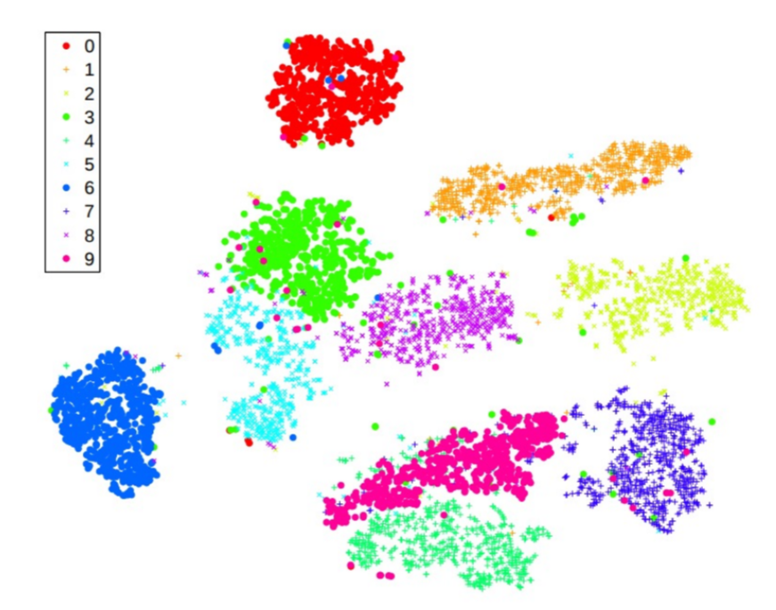
SNE and t-SNE
Especially useful for visualizing data by projecting into 2D or 3D
Result of visualizing MNIST digits data in 2D (Figure from van der Maaten and Hinton, 2008)

