Slide 1
Expectation Maximization
CS771: Introduction to Machine Learning
Nisheeth

Slide 2
Building intuition for EM: a case study
Let events be “grades in a class”
w₁ = Gets an A P(A) = ½
w₂ = Gets a B P(B) = μ
w₃ = Gets a C P(C) = 2μ
w₄ = Gets a D P(D) = ½-3μ
(Note 0 ≤ μ ≤1/6)
Assume we want to estimate μ from data. In a given class there were
a A’s
b B’s
c C’s
d D’s
What’s the maximum likelihood estimate of μ given a,b,c,d ?
Copyright © 2001, 2004, Andrew W. Moore

Slide 3
Max likelihood solution
P(A) = ½ P(B) = μ P(C) = 2μ P(D) = ½-3μ
P( a,b,c,d | μ) = K(½)ª(μ)^{b}(2μ)^{c}(½-3μ)^{d}
log P( a,b,c,d | μ) = log K + alog ½ + blog μ + clog 2μ + dlog (½-3μ)
A | B | C | D
14 | 6 | 9 | 10
Copyright © 2001, 2004, Andrew W. Moore

Slide 4
Same Problem with Hidden Information
REMEMBER
P(A) = ½
P(B) = μ
P(C) = 2μ
P(D) = ½-3μ
Someone tells us that
Number of High grades (A’s + B’s) = h
Number of C’s = c
Number of D’s = d
What is the max. like estimate of μ now?
Copyright © 2001, 2004, Andrew W. Moore

Slide 5
Same Problem with Hidden Information
REMEMBER
P(A) = ½
P(B) = μ
P(C) = 2μ
P(D) = ½-3μ
Someone tells us that
Number of High grades (A’s + B’s) = h
Number of C’s = c
Number of D’s = d
What is the max. like estimate of μ now?
We can answer this question circularly:
EXPECTATION
If we know the value of μ we could compute the expected value of a and b
Since the ratio a:b should be the same as the ratio ½ : μ
MAXIMIZATION
If we know the expected values of a and b we could compute the maximum likelihood value of μ
Copyright © 2001, 2004, Andrew W. Moore

Slide 6
EM for our problem
REMEMBER
P(A) = ½
P(B) = μ
P(C) = 2μ
P(D) = ½-3μ
We begin with a guess for μ
We iterate between EXPECTATION and MAXIMIZATION to improve our estimates of μ and a and b.
Define μ(t) the estimate of μ on the t’th iteration
b(t) the estimate of b on t’th iteration
E -step
M -step
Copyright © 2001, 2004, Andrew W. Moore

Slide 7
EM Convergence
Convergence proof based on fact that Prob(data | μ) must increase or remain same between each iteration [NOT OBVIOUS]
But it can never exceed 1 [OBVIOUS]
So it must therefore converge [OBVIOUS]
In our example, suppose we had
h = 20
c = 10
d = 10
μ(0) = 0
t | μ(t) | b(t)
0 | 0 | 0
1 | 0.0833 | 2.857
2 | 0.0937 | 3.158
3 | 0.0947 | 3.185
4 | 0.0948 | 3.187
5 | 0.0948 | 3.187
6 | 0.0948 | 3.187
Convergence is generally linear: error decreases by a constant factor each time step.

Slide 8
ALT-OPT/EM for Gaussian Mixture Model

Slide 9
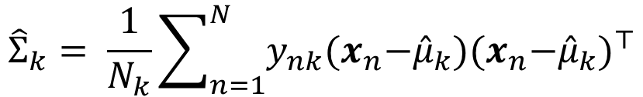

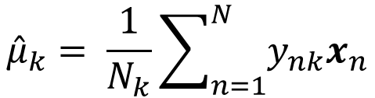
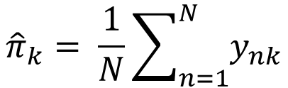

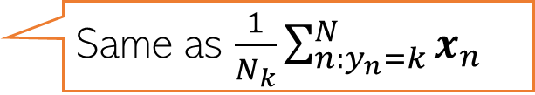
MLE for Gaussian Discriminant Analysis
Assume a $K$ class generative classification model with Gaussian class-conditionals
Assume class $k=1,2,…,K$ is modeled by a Gaussian with mean $μ_{k}$ and cov matrix $Σ_{k}$
Can assume label $y_{n}$ to be one-hot and then $y_{nk}=1$if $y_{n}= k$, and $y_{nk}=0$, o/w
Assuming class prior as $p$($y_{n}=k)=π_{k}$, the model has params $Θ={\{π_{k},μ_{k},Σ_{k}\} }_{k=1}^{K}$
Given training data ${\{x_{n}, y_{n}\} }_{n=1}^{N}$, the MLE solution will be
$${\hat{π}}_{k}= \frac{1}{N}\sum_{n=1}^{N}{y_{nk}}$$
Same as $\frac{N_{k}}{N}$ where $N_{k}$ is # of training ex. for which $y_{n}= k$
$${\hat{μ}}_{k}= \frac{1}{N_{k}}\sum_{n=1}^{N}{y_{nk}x_{n}}$$
Same as $\frac{1}{N_{k}}\sum_{n:y_{n}=k}^{N}{x_{n}}$
$${\hat{Σ}}_{k}= \frac{1}{N_{k}}\sum_{n=1}^{N}{y_{nk}{(x}_{n}−{\hat{μ}}_{k}){{(x}_{n}−{\hat{μ}}_{k})}^{⊤}}$$
Same as $\frac{1}{N_{k}}\sum_{n:y_{n}=k}^{N}{{(x}_{n}−{\hat{μ}}_{k}){{(x}_{n}−{\hat{μ}}_{k})}^{⊤} }$
See here for a derivation of the MLE for GDA

Slide 10
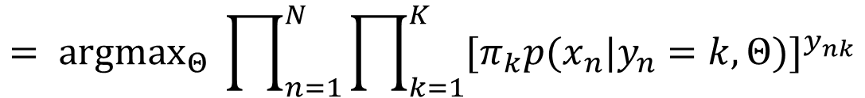

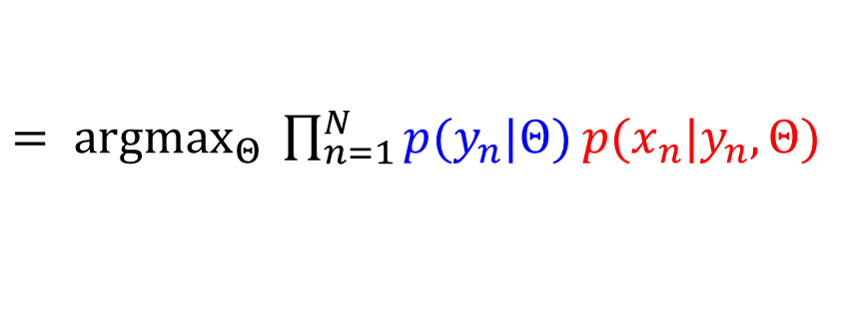
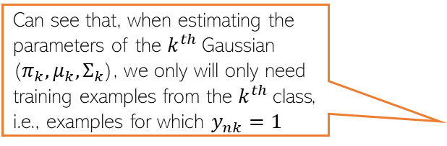


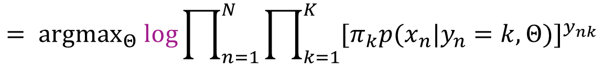
Observations on the GDA objective function
Here is a formal derivation of the MLE solution for $Θ={\{π_{k},μ_{k},Σ_{k}\} }_{k=1}^{K}$
$$\hat{Θ}= {argmax}_{Θ} p(X,y|Θ)$$
$= {argmax}_{Θ} \prod_{n=1}^{N}{p(x_{n},y_{n}|Θ)}$
multinoulli
Gaussian
$= {argmax}_{Θ} \prod_{n=1}^{N}{p(y_{n}|Θ)}$ $p({x_{n}|y}_{n},Θ)$
In general, in models with probability distributions from the exponential family, the MLE problem will usually have a simple analytic form
$= {argmax}_{Θ} \prod_{n=1}^{N}{\prod_{k=1}^{K}{π_{k}^{y_{nk}}}}$ $\prod_{k=1}^{K}{{p({x_{n}|y}_{n}=k,Θ)}^{y_{nk}}}$
Also, due to the form of the likelihood (Gaussian) and prior (multinoulli), the MLE problem had a nice separable structure after taking the log
$$= {argmax}_{Θ} \prod_{n=1}^{N}{\prod_{k=1}^{K}{{{[π}_{k}p({x_{n}|y}_{n}=k,Θ)]}^{y_{nk}}}}$$
$$= {argmax}_{Θ} log\prod_{n=1}^{N}{\prod_{k=1}^{K}{{{[π}_{k}p({x_{n}|y}_{n}=k,Θ)]}^{y_{nk}}}}$$
Can see that, when estimating the parameters of the $k^{th}$Gaussian ($π_{k},μ_{k},Σ_{k}$), we only will only need training examples from the $k^{th}$class, i.e., examples for which $y_{nk}=1$
$$= {argmax}_{Θ} \sum_{n=1}^{N}{\sum_{k=1}^{K}{y_{nk}[log π_{k}+ log 𝒩\left({x_{n}|μ}_{k},Σ_{k}\right)]}}$$
The form of this expression is important; will encounter this in GMM too

Slide 11




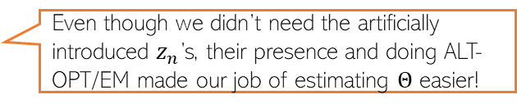
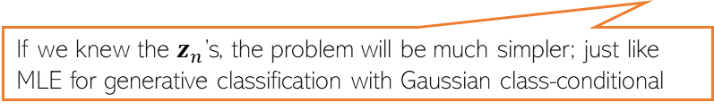
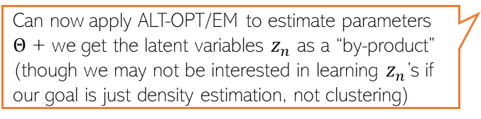
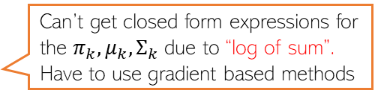
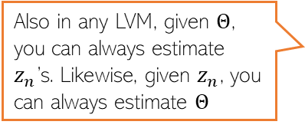
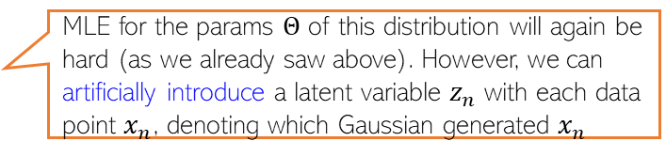

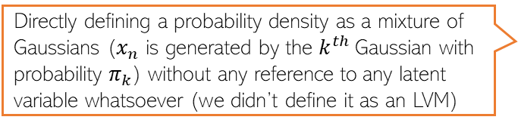
Need for EM/ALT-OPT: Two Equivalent Perspectives
Consider an LVM with latent variables and parameters. Trying to estimate parameters without also estimating the latent variables (by marginalizing them) is difficult
Consider a complex prob. density (without any latent vars) for which MLE is hard
A Gaussian Mixture Model (GMM)
$$p\left(x_{n} | Θ\right)= \sum_{k=1}^{K}{p\left(x_{n},z_{n}=k | Θ\right)}=\sum_{k=1}^{K}{p\left(z_{n}=k | φ\right)p(x_{n}|z_{n}=k,θ)}=\sum_{k=1}^{K}{π_{k}𝒩\left({x_{n}|μ}_{k},Σ_{k}\right)}$$
This issue not just for MLE for GMM but MLE for other LVMs too
MLE for GMM with cluster ids marginalized/summed/integrated out
$$Θ_{MLE}=arg\max_{Θ}\sum_{n=1}^{N}{log\sum_{k=1}^{K}{π_{k}𝒩\left({x_{n}|μ}_{k},Σ_{k}\right)}}$$
Can’t get closed form expressions for the $π_{k}, μ_{k}, Σ_{k}$ due to “log of sum”. Have to use gradient based methods
EM/ALT-OPT will help us “simulate” this condition by making guesses about the values of $z_{n}$’s
If we knew the $z_{n}$’s, the problem will be much simpler; just like MLE for generative classification with Gaussian class-conditional
Since no marginalization of the $z_{n}$’s required
Directly defining a probability density as a mixture of Gaussians ($x_{n}$ is generated by the $k^{th}$Gaussian with probability $π_{k}$) without any reference to any latent variable whatsoever (we didn’t define it as an LVM)
$$p\left(x_{n} | Θ\right)=\sum_{k=1}^{K}{π_{k}𝒩\left({x_{n}|μ}_{k},Σ_{k}\right)}$$
MLE for the params $Θ$ of this distribution will again be hard (as we already saw above). However, we can artificially introduce a latent variable $z_{n}$ with each data point $x_{n}$, denoting which Gaussian generated $x_{n}$
Can now apply ALT-OPT/EM to estimate parameters $Θ$ + we get the latent variables $z_{n}$ as a “by-product” (though we may not be interested in learning $z_{n}$’s if our goal is just density estimation, not clustering)
Also in any LVM, given $Θ$, you can always estimate $z_{n}$’s. Likewise, given $z_{n}$, you can always estimate $Θ$
Even though we didn’t need the artificially introduced $z_{n}$’s, their presence and doing ALT-OPT/EM made our job of estimating $Θ$ easier!

Slide 12
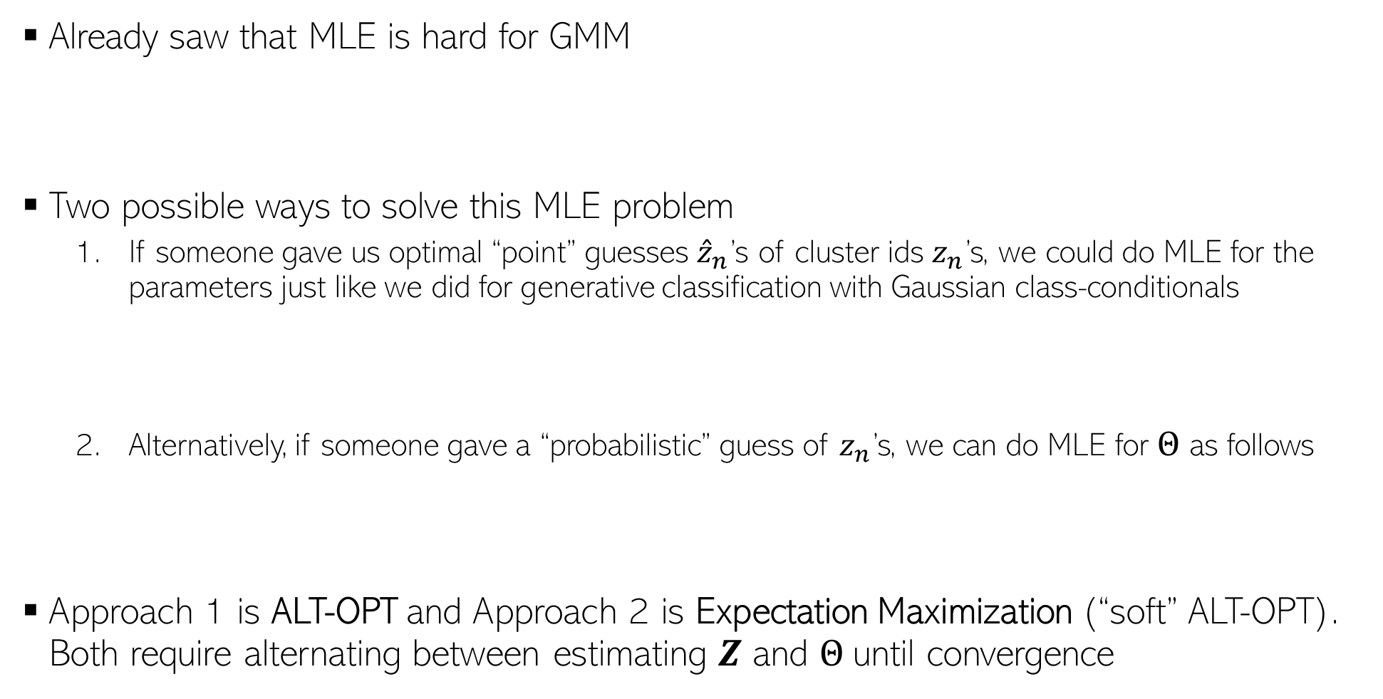
MLE for GMM
Already saw that MLE is hard for GMM
Two possible ways to solve this MLE problem
If someone gave us optimal “point” guesses ${\hat{z}}_{n}$’s of cluster ids $z_{n}$’s, we could do MLE for the parameters just like we did for generative classification with Gaussian class-conditionals
2. Alternatively, if someone gave a “probabilistic” guess of $z_{n}$’s, we can do MLE for $Θ$ as follows
Approach 1 is ALT-OPT and Approach 2 is Expectation Maximization (“soft” ALT-OPT). Both require alternating between estimating $Z$ and $Θ$until convergence
$$Θ_{MLE}=arg\max_{Θ} log p\left(X | Θ\right)= arg\max_{Θ}\sum_{n=1}^{N}{log\sum_{k=1}^{K}{π_{k}𝒩\left({x_{n}|μ}_{k},Σ_{k}\right)}}$$
Will soon see how to get these guesses
$$Θ_{MLE}= {arg\max_{Θ} log p\left(X,\hat{Z} | Θ\right)= argmax}_{Θ} \sum_{n=1}^{N}{\sum_{k=1}^{K}{{\hat{z}}_{nk}[log π_{k}+ log 𝒩\left({x_{n}|μ}_{k},Σ_{k}\right)]}}$$
In form of a probability distribution instead of a singe “optimal” guess
$$Θ_{MLE}=arg\max_{Θ} 𝔼\left[log p\left(X,Z | Θ\right)\right]={argmax}_{Θ} \sum_{n=1}^{N}{\sum_{k=1}^{K}{𝔼\left[z_{nk}\right][log π_{k}+ log 𝒩\left({x_{n}|μ}_{k},Σ_{k}\right)]}}$$
Similar to Approach 1 but maximizes an expectation
The expectation is w.r.t a distribution of Z which we will see shortly

Slide 13
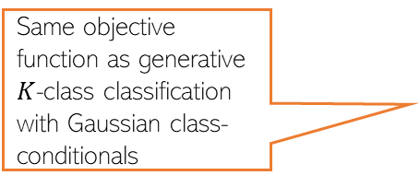


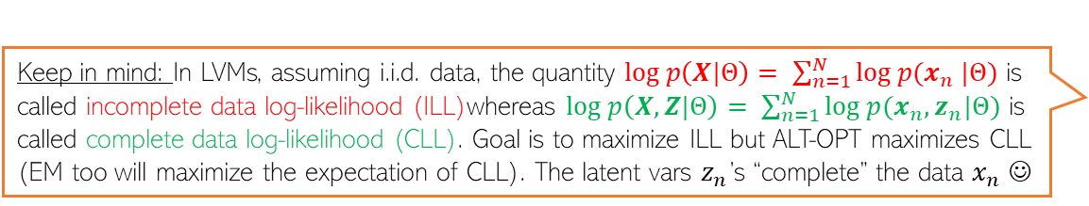

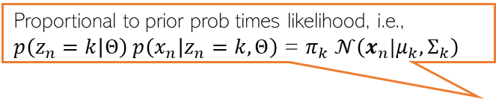

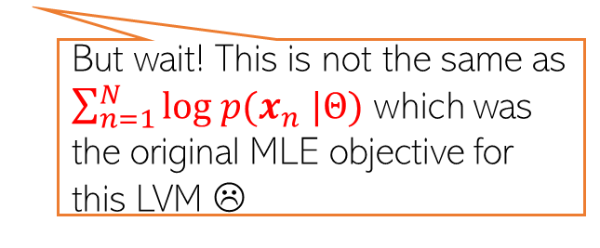

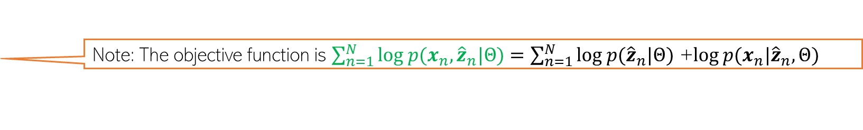

ALT-OPT for GMM
Keep in mind: In LVMs, assuming i.i.d. data, the quantity $log p\left(X|Θ\right)= \sum_{n=1}^{N}{log p(x_{n} |Θ)}$ is called incomplete data log-likelihood (ILL)whereas $log p\left(X,Z|Θ\right)= \sum_{n=1}^{N}{log p(x_{n},z_{n}|Θ)}$ is called complete data log-likelihood (CLL). Goal is to maximize ILL but ALT-OPT maximizes CLL (EM too will maximize the expectation of CLL). The latent vars $z_{n}$’s “complete” the data $x_{n}$ ☺
We will assume we have a “hard” (most probable) guess of $z_{n}$, say ${\hat{z}}_{n}$
Then ALT-OPT would look like this
Initialize $Θ= {\{π_{k}, μ_{k}, Σ_{k}\}}_{k=1}^{K}$ as $\hat{Θ}$
Repeat the following until convergence
For each $n$, compute most probable value (our best guess) of $z_{n}$ as
Solve MLE problem for $Θ$using most probable $z_{n}$’s
Proportional to prior prob times likelihood, i.e., $p\left(z_{n}=k | Θ\right) p\left(x_{n} | z_{n}=k,Θ\right)$ = $π_{k} 𝒩\left({x_{n}|μ}_{k},Σ_{k}\right)$
Posterior probability of point $x_{n}$ belonging to cluster $k$
$${\hat{z}}_{n}={argmax}_{k=1,2,…, K} p\left(z_{n}=k | \hat{Θ}, x_{n}\right)$$
Same objective function as generative $K$-class classification with Gaussian class-conditionals
$\hat{Θ}= {argmax}_{Θ } \sum_{n=1}^{N}{\sum_{k=1}^{K}{{\hat{z}}_{nk}[log π_{k}+ log𝒩\left({x_{n}|μ}_{k},Σ_{k}\right)]}}$
Note: The objective function is $\sum_{n=1}^{N}{log p(x_{n},{\hat{z}}_{n}|Θ)}=\sum_{n=1}^{N}{log p({\hat{z}}_{n}|Θ)\text{ +}log p(x_{n}|{\hat{z}}_{n},Θ)}$
$N_{k}$ : Effective number of points in cluster k
$${\hat{π}}_{k}= \frac{1}{N}\sum_{n=1}^{N}{{\hat{z}}_{nk}}$$
Does that matter? Should we worry that we aren’t solving the actual problem anymore?
But wait! This is not the same as $\sum_{n=1}^{N}{log p(x_{n} |Θ)}$ which was the original MLE objective for this LVM ☹
$${\hat{μ}}_{k}= \frac{1}{N_{k}}\sum_{n=1}^{N}{{\hat{z}}_{nk}x_{n}}$$
$${\hat{Σ}}_{k}= \frac{1}{N_{k}}\sum_{n=1}^{N}{{\hat{z}}_{nk}{(x}_{n}−{\hat{μ}}_{k}){{(x}_{n}−{\hat{μ}}_{k})}^{⊤}}$$
Not really; will see the justification soon ☺

Slide 14

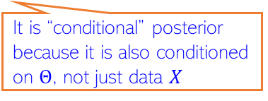

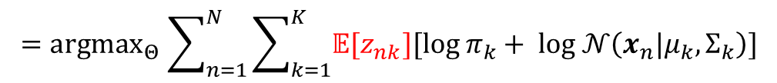
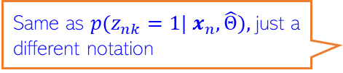
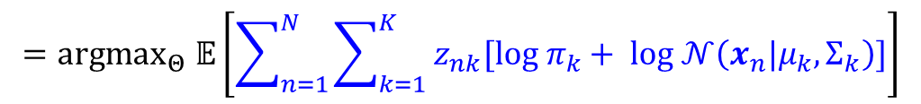





Expectation-Maximization (EM) for GMM
.. which we maximized in ALT-OPT
Expectation of CLL
EM finds $Θ_{MLE}$ by maximizing $𝔼\left[log p\left(X,Z | Θ\right)\right]$ rather than $log p\left(X,\hat{Z} | Θ\right)$
Note: Expectation will be w.r.t. the conditional posterior distribution of $Z$, i.e., $p(Z|X,Θ)$
The EM algorithm for GMM operates as follows
Initialize $Θ= {\{π_{k}, μ_{k}, Σ_{k}\}}_{k=1}^{K}$ as $\hat{Θ}$
Repeat until convergence
Compute conditional posterior $p(Z|X,\hat{Θ})$. Since obs are i.i.d, compute separately for each $n$ (and for $k=1,2,..K$)
Update $Θ$ by maximizing the expected complete data log-likelihood
It is “conditional” posterior because it is also conditioned on $Θ$, not just data $X$
Why w.r.t. this distribution? Will see justification in a bit
Needed to get the expected CLL
Requires knowing $Θ$
Same as $p(z_{nk}=1| x_{n},\hat{Θ}),$just a different notation
$$p\left(z_{n}=k | x_{n},\hat{Θ}\right)∝p\left(z_{n}=k | \hat{Θ}\right) p\left(x_{n} | z_{n}=k,\hat{Θ}\right)\text{ =} {\hat{π}}_{k}𝒩\left(x_{n}|{\hat{μ}}_{k},{\hat{Σ}}_{k}\right)$$
Solution has a similar form as ALT-OPT (or gen. class.), except we now have the expectation of $z_{nk}$being used
$${\hat{Θ}={argmax}_{Θ}𝔼}_{p(Z|X,\hat{Θ})}\left[log p\left(X,Z | Θ\right)\right]= \sum_{n=1}^{N}{𝔼_{p(z_{n}|x_{n},\hat{Θ})}\left[log p\left(x_{n},z_{n} | Θ\right)\right]}$$
$${=argmax}_{Θ}𝔼\left[\sum_{n=1}^{N}{\sum_{k=1}^{K}{ z_{nk}[log π_{k}+ log 𝒩\left({x_{n}|μ}_{k},Σ_{k}\right)]}}\right]$$
$${\hat{π}}_{k}= \frac{1}{N}\sum_{n=1}^{N}{𝔼[z_{nk}]}$$
$${\hat{μ}}_{k}= \frac{1}{N_{k}}\sum_{n=1}^{N}{𝔼[z_{nk}]x_{n}}$$
$N_{k}$ : Effective number of points in cluster k
$${=argmax}_{Θ}\sum_{n=1}^{N}{\sum_{k=1}^{K}{𝔼[z_{nk}][log π_{k}+ log 𝒩\left({x_{n}|μ}_{k},Σ_{k}\right)]}}$$
$${\hat{Σ}}_{k}= \frac{1}{N_{k}}\sum_{n=1}^{N}{𝔼[z_{nk}]{(x}_{n}−{\hat{μ}}_{k}){{(x}_{n}−{\hat{μ}}_{k})}^{⊤}}$$

Slide 15
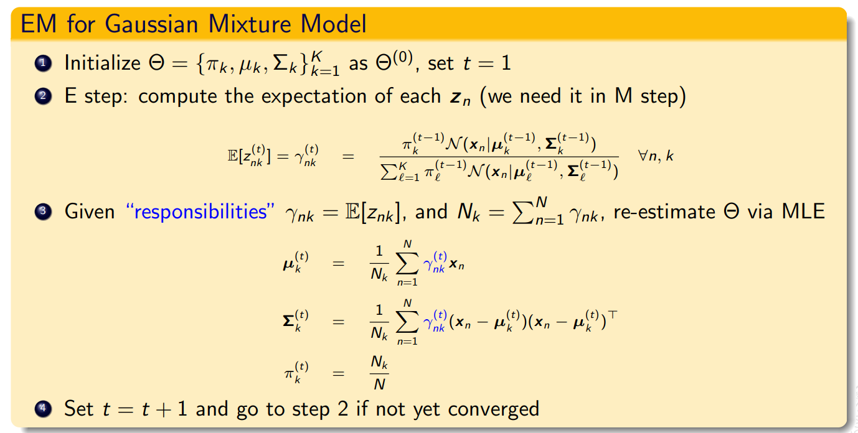

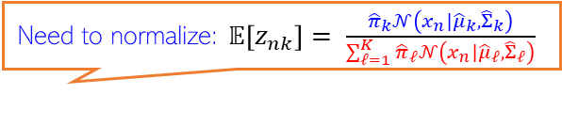



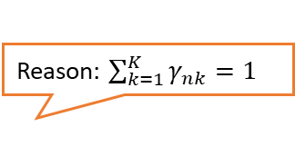
EM for GMM (Contd)
Reason: $\sum_{k=1}^{K}{γ_{nk}=1}$
Need to normalize: $𝔼\left[z_{nk}\right]= \frac{{\hat{π}}_{k}𝒩\left(x_{n}|{\hat{μ}}_{k},{\hat{Σ}}_{k}\right)}{\sum_{ℓ=1}^{K}{{\hat{π}}_{ℓ}𝒩\left(x_{n}|{\hat{μ}}_{ℓ},{\hat{Σ}}_{ℓ}\right)}}$
The EM algo for GMM required $𝔼[z_{nk}]$. Note $z_{nk}∈\{0,1\}$
$𝔼\left[z_{nk}\right]=γ_{nk}= 0×p(z_{nk}=0|x_{n},$ $\hat{Θ})+1×$ $p(z_{nk}=1|x_{n},$ $\hat{Θ})$
$= p(z_{nk}=1|x_{n},$ $\hat{Θ})$
$∝$ ${\hat{π}}_{k}𝒩\left(x_{n}|{\hat{μ}}_{k},{\hat{Σ}}_{k}\right)$
Accounts for fraction of points in each cluster
Accounts for cluster shapes (since each cluster is a Gaussian
Soft K-means, which are more of a heuristic to get soft-clustering, also gave us probabilities but didn’t account for cluster shapes or fraction of points in each cluster
Effective number of points in the $k^{th}$cluster
M-step:

Slide 16
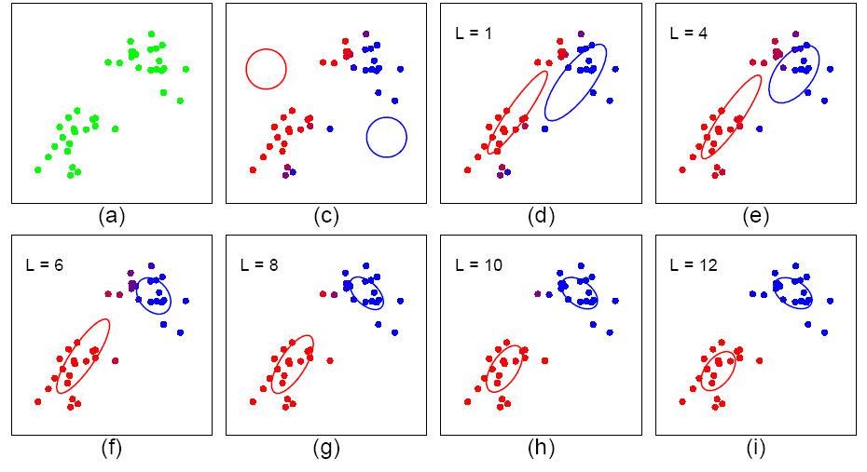
EM for GMM in action
Note: Just like with k-means, cluster initialization matters. EM only finds local optima.

