Slide 1
“Deep” Learning
CS771: Introduction to Machine Learning
Nisheeth

Slide 2
Limitations of Linear Models
2
Linear models: Output produced by taking a linear combination of input features
This basic architecture is classically also known as the “Perceptron” (not to be confused with the Perceptron “algorithm”, which learns a linear classification model)
This can’t however learn nonlinear functions or nonlinear decision boundaries
Some monotonic function
(e.g., sigmoid)

Slide 3
Limitations of Classic Non-Linear Models
3
Non-linear models: kNN, kernel methods, generative classification, decision trees etc.
All have their own disadvantages
kNN and kernel methods are expensive to generate predictions from
Kernel based and generative models particularize the decision boundary to a particular class of functions, e.g. quadratic polynomials, gaussian functions etc.
Decision trees require optimization over many arbitrary hyperparameters to generate good results, and are (somewhat) expensive to generate predictions from
Not a deal-breaker, most common competitor for deep learning over large datasets tends to be some decision-tree derivative
In general, non-linear ML models are complicated beasts

Slide 4


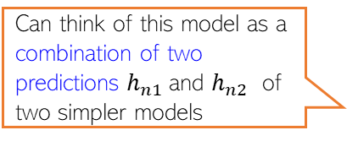
Neural Networks: Multi-layer Perceptron (MLP)
4
An MLP consists of an input layer, an output layer, and one or more hidden layers
Output Layer
(with a scalar-valued output)
Hidden layer units/nodes act as new features
Learnable weights
Hidden Layer
(with K=2 hidden units)
Can think of this model as a combination of two predictions $h_{n1}$and $h_{n2}$ of two simpler models
Input Layer
(with D=3 visible units)

Slide 5

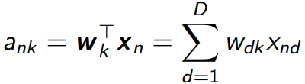

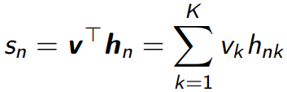
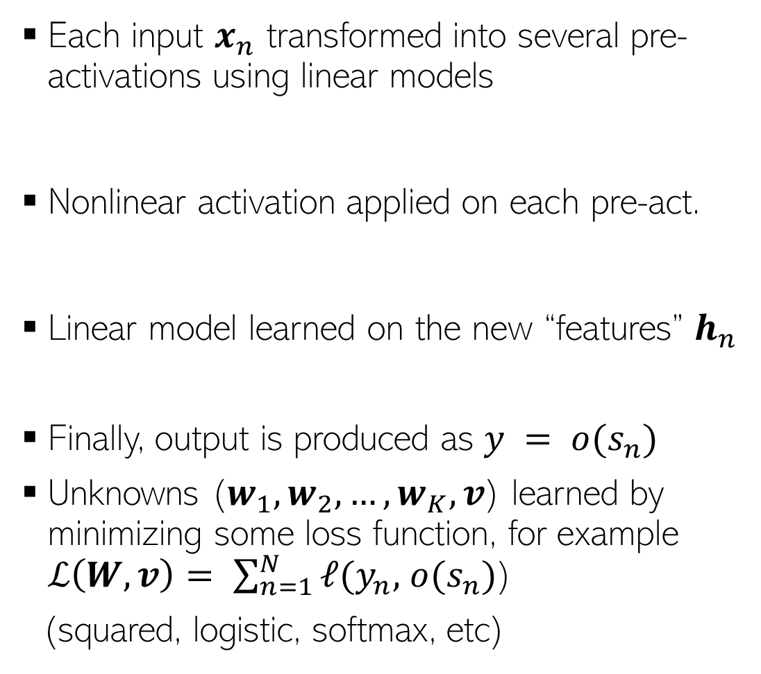
Illustration: Neural Net with One Hidden Layer
5
Each input $x_{n}$ transformed into several pre-activations using linear models
Nonlinear activation applied on each pre-act.
Linear model learned on the new “features” $h_{n}$
Finally, output is produced as $y = o(s_{n})$
Unknowns ($w_{1}, w_{2}, …, w_{K}, v$) learned by minimizing some loss function, for example $ℒ\left(W,v\right)= \sum_{n=1}^{N}{ℓ(y_{n},}$ $o(s_{n})$)
(squared, logistic, softmax, etc)
Can even be identity
(e.g., for regression y_{n} = s_{n} )

Slide 6
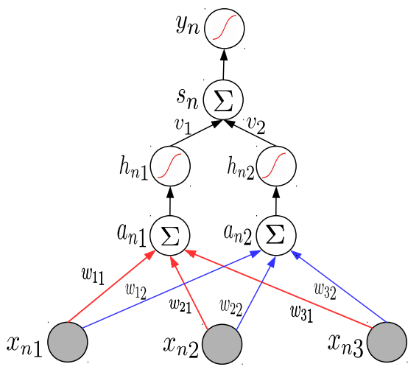
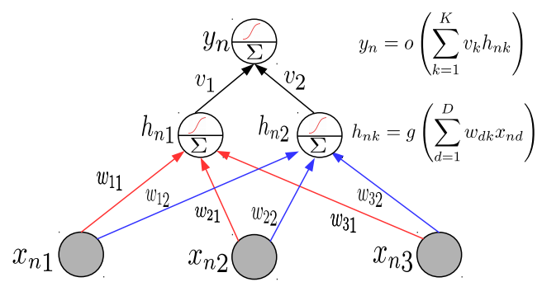

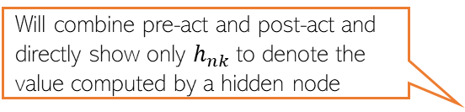
Neural Nets: A Compact Illustration
Will denote a linear combination of inputs followed by a nonlinear operation on the result
6
Note: Hidden layer pre-act $a_{nk}$ and post-act $h_{nk}$ will be shown together for brevity
Different layers may use different non-linear activations. Output layer may have none.
Will directly show the final output
Will combine pre-act and post-act and directly show only $h_{nk}$to denote the value computed by a hidden node
Single
Hidden
Layer
More succinctly..

Slide 7
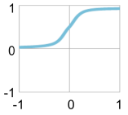
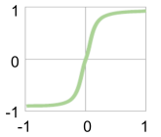

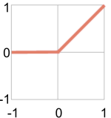
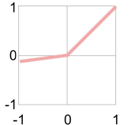

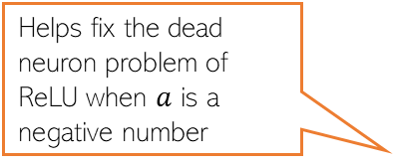
Activation Functions: Some Common Choices
7
sigmoid
tanh
For sigmoid as well as tanh, gradients saturate (become close to zero as the function tends to its extreme values)
Preferred more than sigmoid. Helps keep the mean of the next layer’s inputs close to zero (with sigmoid, it is close to 0.5)
h
h
a
a
ReLU
Leaky ReLU
ReLU and Leaky ReLU are among the most popular ones
Helps fix the dead neuron problem of ReLU when $a$ is a negative number
h
a

Slide 8
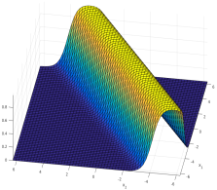
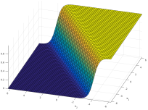
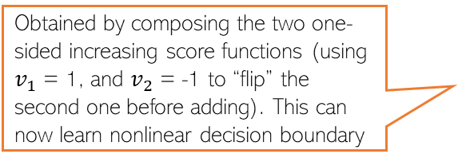
MLP Can Learn Nonlin. Fn: A Brief Justification
8
An MLP can be seen as a composition of multiple linear models combined nonlinearly
Obtained by composing the two one-sided increasing score functions (using $v_{1}$ = 1, and $v_{2}$ = -1 to “flip” the second one before adding). This can now learn nonlinear decision boundary
High-score in the middle and low-score on either of the two sides of it. Exactly what we want for the given classification problem
score
Score monotonically increases. One-sided increase (not ideal for learning nonlinear decision boundaries)
score
score
score
A nonlinear classification problem
Standard Single “Perceptron” Classifier (no hidden units)
A single hidden layer MLP with sufficiently large number of hidden units can approximate any function (Hornik, 1991)
A Multi-layer Perceptron Classifier
(one hidden layer with 2 units)
Capable of learning nonlinear boundaries

Slide 9
Examples of some basic NN/MLP architectures
9

Slide 10

Single Hidden Layer and Single Outputs
10
One hidden layer with $K$ nodes and a single output (e.g., scalar-valued regression or binary classification)

Slide 11

Single Hidden Layer and Multiple Outputs
11
One hidden layer with $K$ nodes and a vector of $C$ output (e.g., vector-valued regression or multi-class classification or multi-label classification)

Slide 12
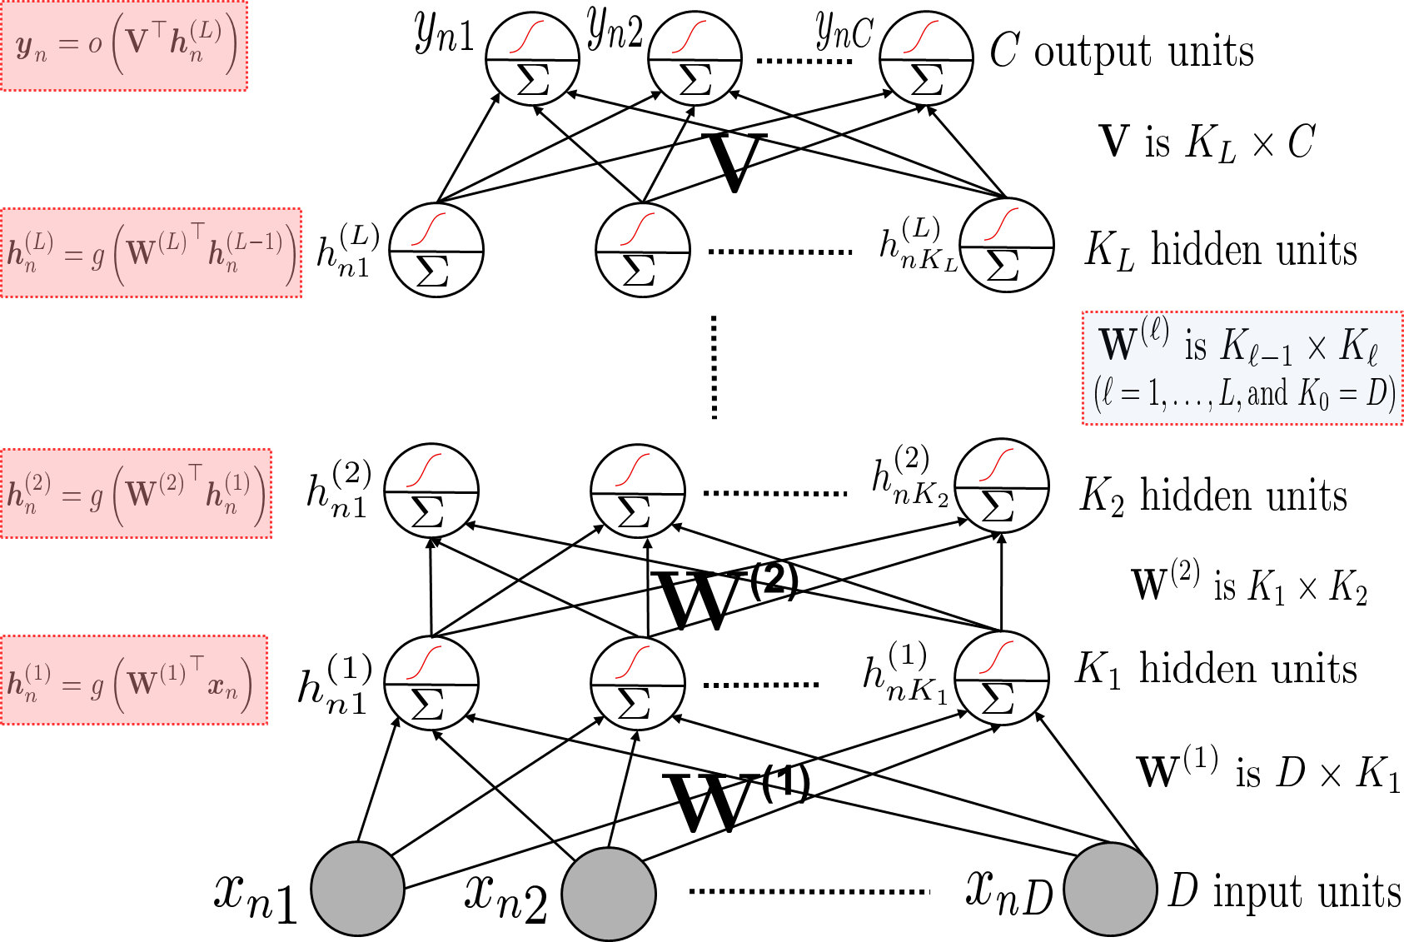
Multiple Hidden Layers (One/Multiple Outputs)
12
Most general case: Multiple hidden layers with (with same or different number of hidden nodes in each) and a scalar or vector-valued output

Slide 13
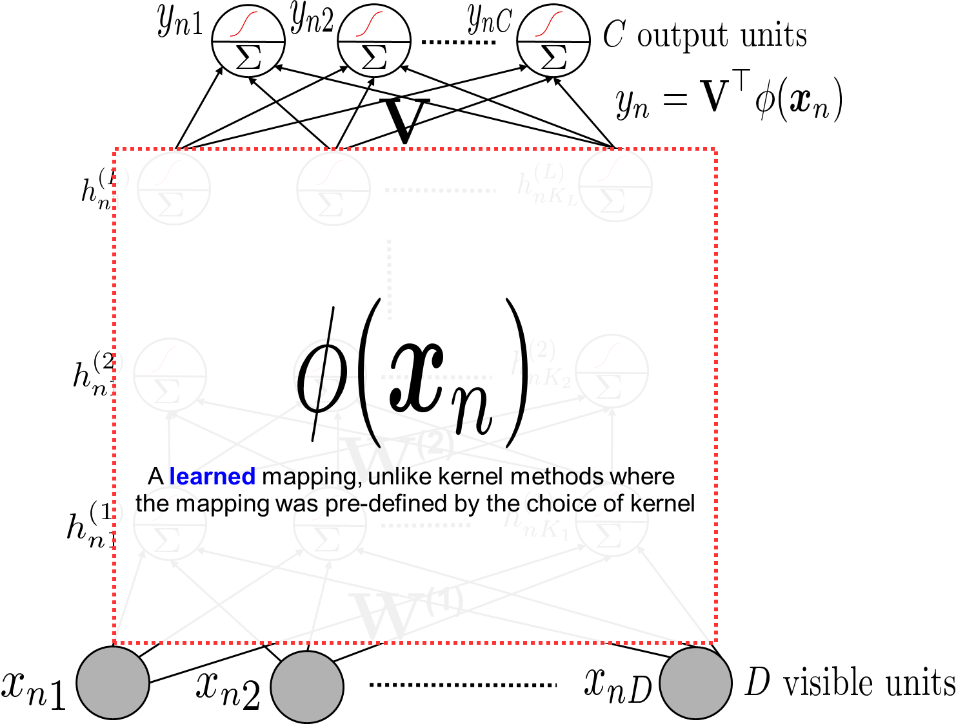

Neural Nets are Feature Learners
13
Hidden layers can be seen as learning a feature rep. $φ\left(x_{n}\right)$ for each input $x_{n}$
The last hidden layer’s values

Slide 14
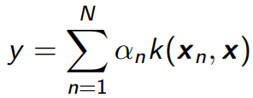
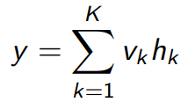
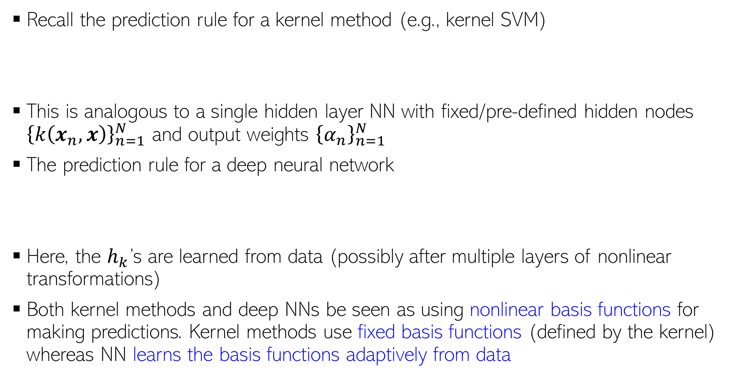
Kernel Methods vs Neural Nets
14
Recall the prediction rule for a kernel method (e.g., kernel SVM)
This is analogous to a single hidden layer NN with fixed/pre-defined hidden nodes ${\left\{k\left(x_{n}, x\right)\right\}}_{n=1}^{N}$ and output weights ${\left\{α_{n}\right\}}_{n=1}^{N}$
The prediction rule for a deep neural network
Here, the $h_{k}$’s are learned from data (possibly after multiple layers of nonlinear transformations)
Both kernel methods and deep NNs be seen as using nonlinear basis functions for making predictions. Kernel methods use fixed basis functions (defined by the kernel) whereas NN learns the basis functions adaptively from data
Also note that neural nets are faster than kernel methods at test time since kernel methods need to store the training examples at test time whereas neural nets do not

Slide 15
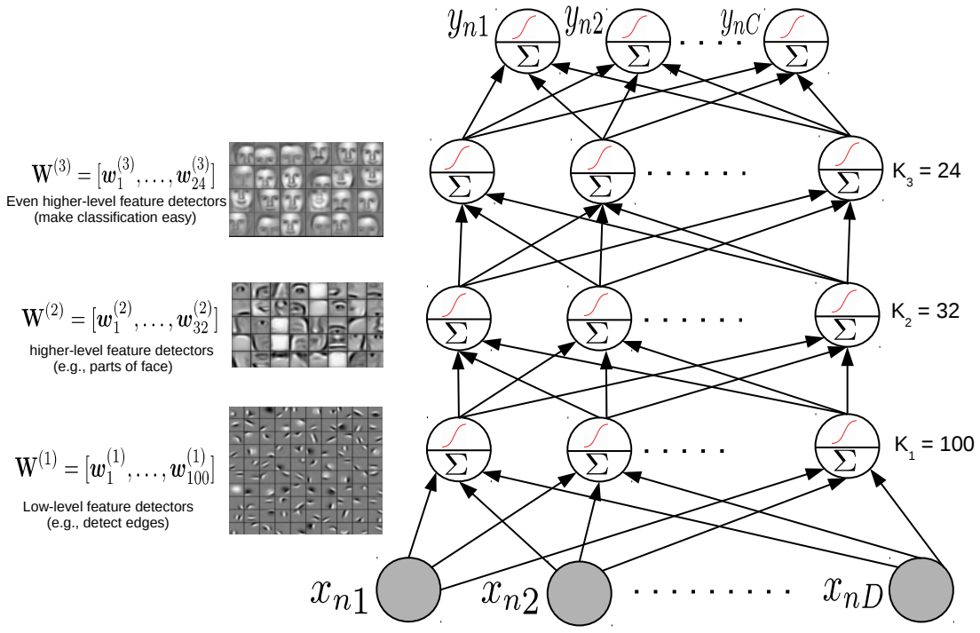


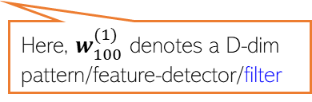
Feature Learned by a Neural Network
15
Node values in each hidden layer tell us how much a “learned” feature is active in $x_{n}$
Hidden layer weights are like pattern/feature-detector/filter
All the incoming weights (a vector) on this hidden node can be seen as representing a pattern/feature-detector/filter
Here, $w_{32}^{(2)}$ denotes a $K_{1}$-dim template/pattern/feature-detector
All the incoming weights (a vector) on this hidden node can be seen as representing a template/pattern/feature-detector
Here, $w_{100}^{(1)}$ denotes a D-dim pattern/feature-detector/filter

Slide 16

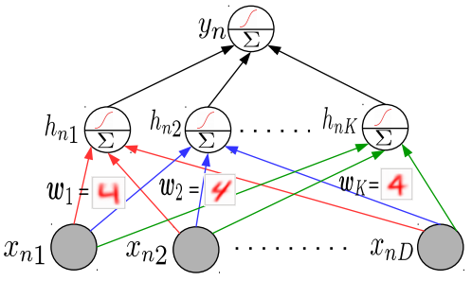
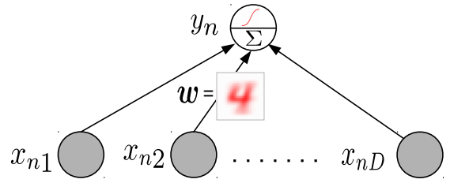
Why Neural Networks Work Better: Another View
16
Linear models tend to only learn the “average” pattern
Deep models can learn multiple patterns (each hidden node can learn one pattern)
Thus deep models can learn to capture more subtle variations that a simpler linear model

