Slide 1
Deep Learning (contd.)
CS771: Introduction to Machine Learning
Nisheeth

Slide 2


Backpropagation
2
Backpropagation = Gradient descent using chain rule of derivatives
Chain rule of derivatives: Example, if $y=f_{1}\left(x\right)$ and $x=f_{2}\left(z\right)$ then $\frac{∂y}{∂z}=\frac{∂y}{∂x}$ $\frac{∂x}{∂z}$
Start taking the derivatives of the loss function w.r.t. params of the last layer and then proceed backwards
Reuse already calculated gradients computed by the previous layer
Can reuse previous derivative computations due to the recursive nature of the neural net architecture

Slide 3
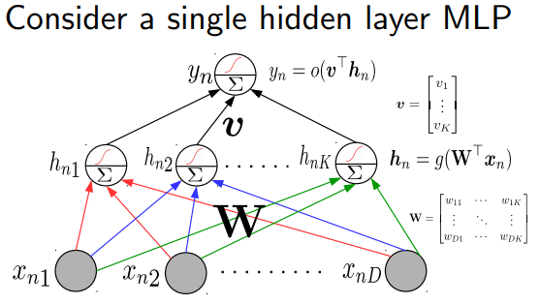
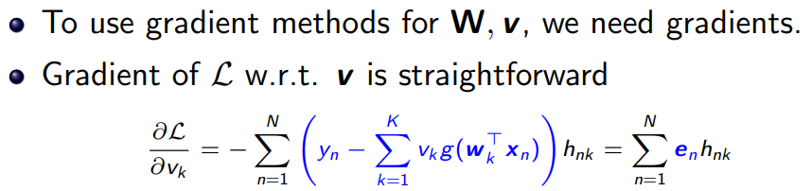
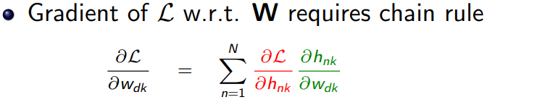
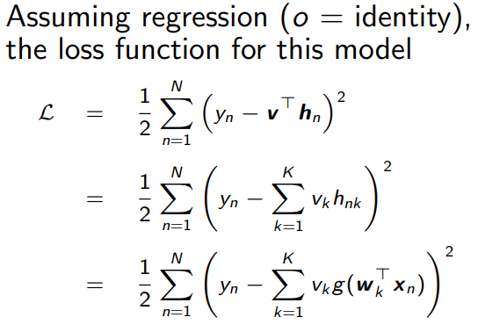


Backpropagation through an example
3

Slide 4
Backpropagation
4
Computes loss using current values of the parameters
Backprop iterates between a forward pass and a backward pass
Software frameworks such as Tensorflow and PyTorch support this already so you don’t need to implement it by hand (so no worries of computing derivatives etc)
Computes the gradient of the loss, starting with params in the last layer and going backwards
Backward Pass
Forward Pass
Using computational graphs

Slide 5
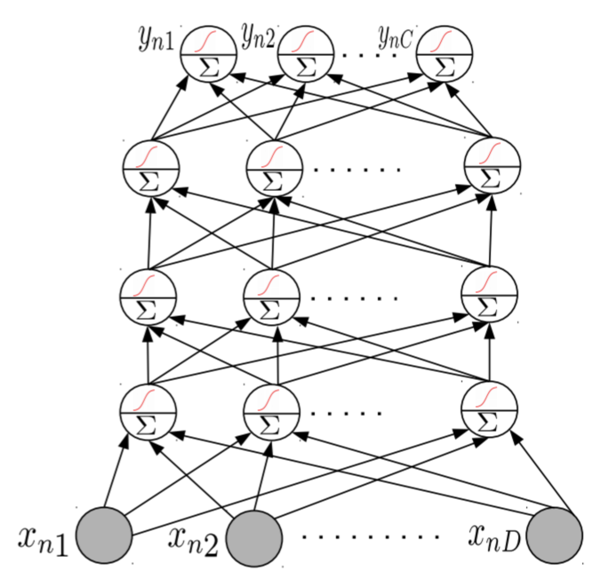
Neural Nets: Some Aspects
5
Much of the magic lies in the hidden layers
Hidden layers learn and detect good features
Need to consider a few aspects
Number of hidden layers, number of units in each hidden layer
Why bother about many hidden layers and not use a single very wide hidden layer (recall Hornik’s universal function approximator theorem)?
Complex networks (several, very wide hidden layers) or simpler networks (few, moderately wide hidden layers)?
Aren’t deep neural network prone to overfitting (since they contain a huge number of parameters)?
Choosing the right NN architecture is important and a research area in itself. Neural Architecture Search (NAS) is an automated technique to do this

Slide 6
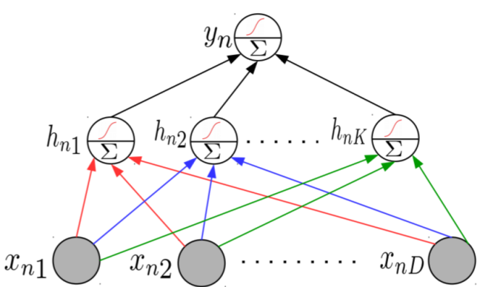
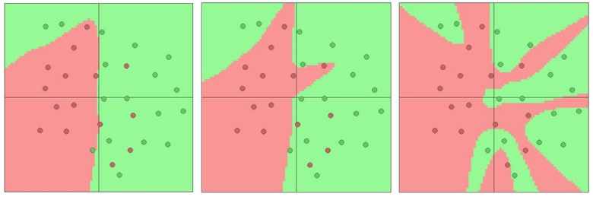
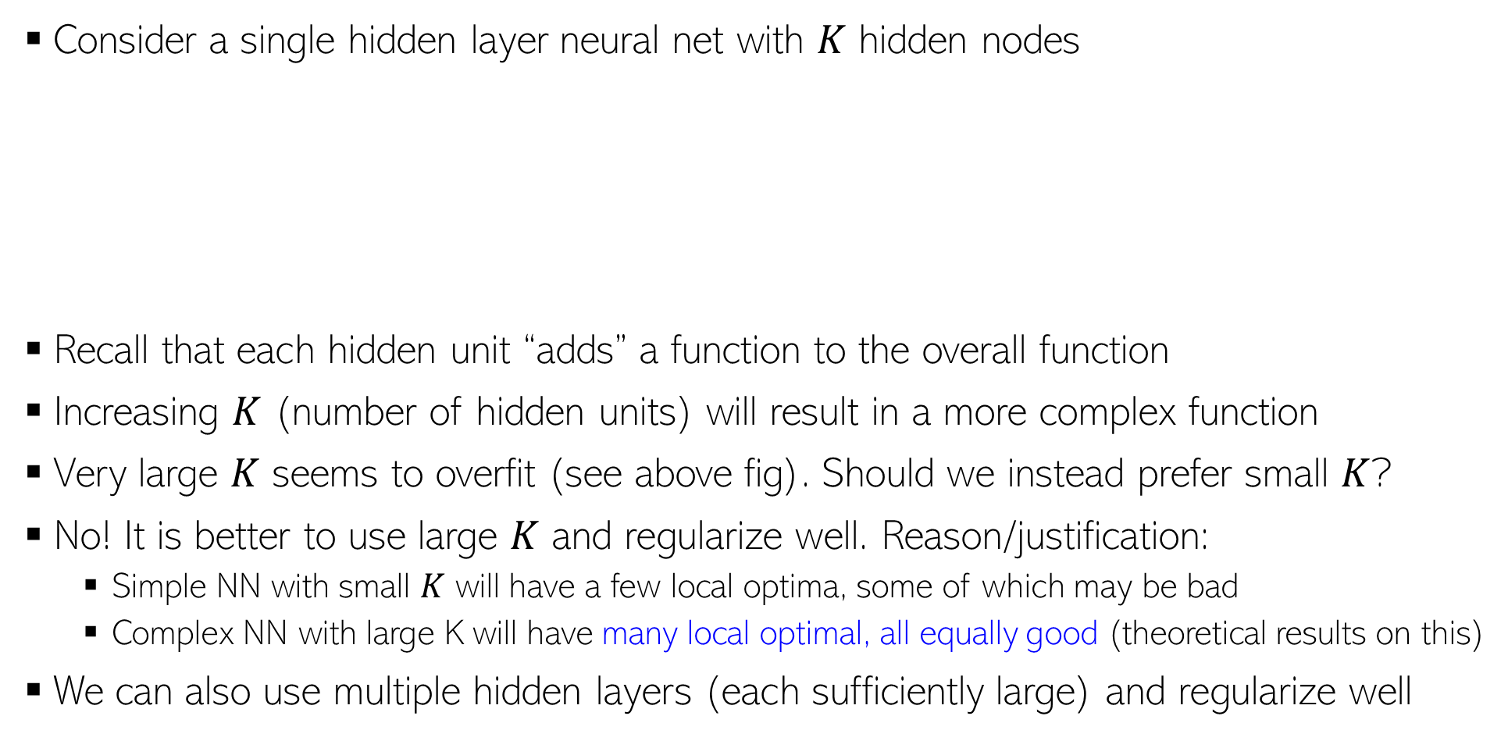
Representational Power of Neural Nets
6
Consider a single hidden layer neural net with $K$ hidden nodes
Recall that each hidden unit “adds” a function to the overall function
Increasing $K$ (number of hidden units) will result in a more complex function
Very large $K$ seems to overfit (see above fig). Should we instead prefer small $K$?
No! It is better to use large $K$ and regularize well. Reason/justification:
Simple NN with small $K$ will have a few local optima, some of which may be bad
Complex NN with large K will have many local optimal, all equally good (theoretical results on this)
We can also use multiple hidden layers (each sufficiently large) and regularize well
K = 3
K = 6
K = 20

Slide 7

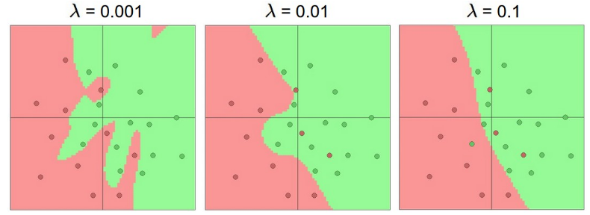
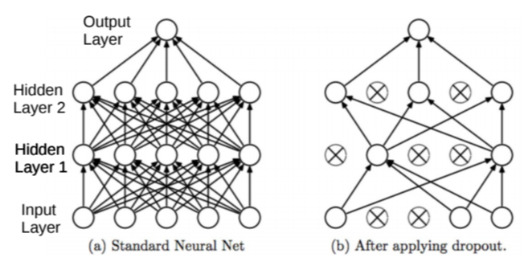
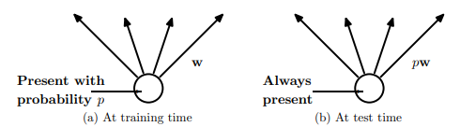

Preventing Overfitting in Neural Nets
Various other tricks, such as weight sharing across different hidden units of the same layer (used in convolutional neural nets or CNN)
7
Neural nets can overfit. Many ways to avoid overfitting, such as
Standard regularization on the weights, such as $ℓ_{2},ℓ_{1}$, etc ($ℓ_{2}$ reg. is also called weight decay)
Early stopping (traditionally used): Stop when validation error starts increasing
Dropout: Randomly remove units (with some probability $p∈ (0,1)$) during training
Single Hidden Layer NN with K = 20 hidden units and L2 regularization
Fig courtesy: Dropout: A Simple Way to Prevent Neural Networks from Overfitting (Srivastava et al, 2014)

Slide 8
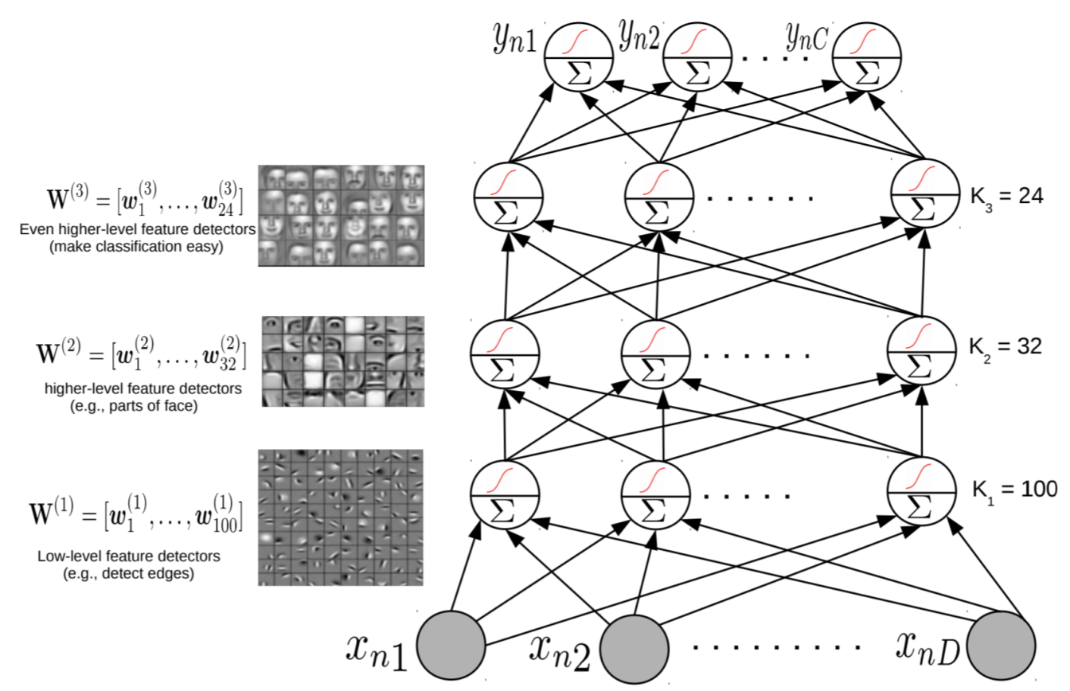
Wide or Deep?
8
While very wide single hidden layer can approx. any function, often we prefer many, less wide, hidden layers
Higher layers help learn more directly useful/interpretable features (also useful for compressing data using a small number of features)

Slide 9
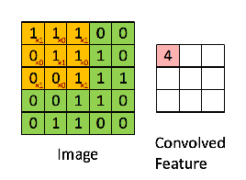
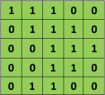

Conv nets basics
Image patch
Filter
Convolution
https://ujjwalkarn.me/2016/08/11/intuitive-explanation-convnets/

Slide 10
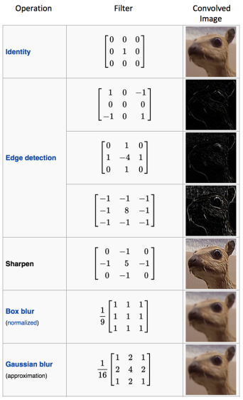
Discriminability from diverse filtering

Slide 11
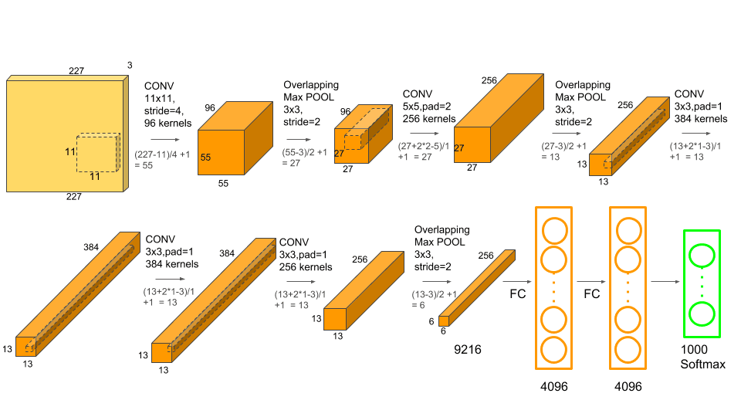
A typical convnet: AlexNet

Slide 12
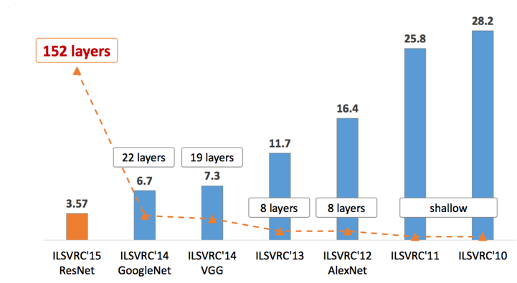
Superhuman object recognition in images

Slide 13
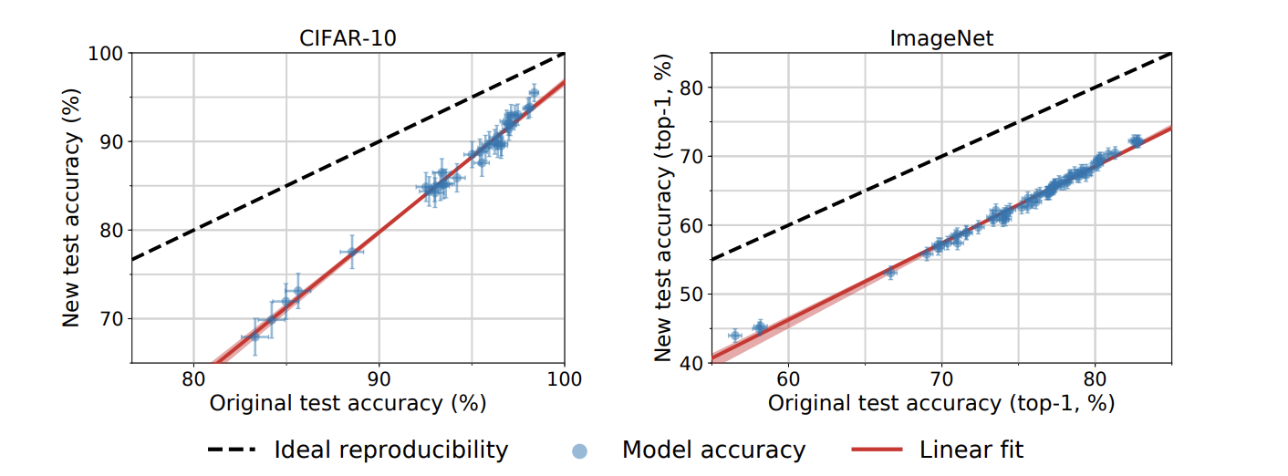
But deep networks are fickle
Do imagenet classifiers generalize to imagenet? (link)

Slide 14
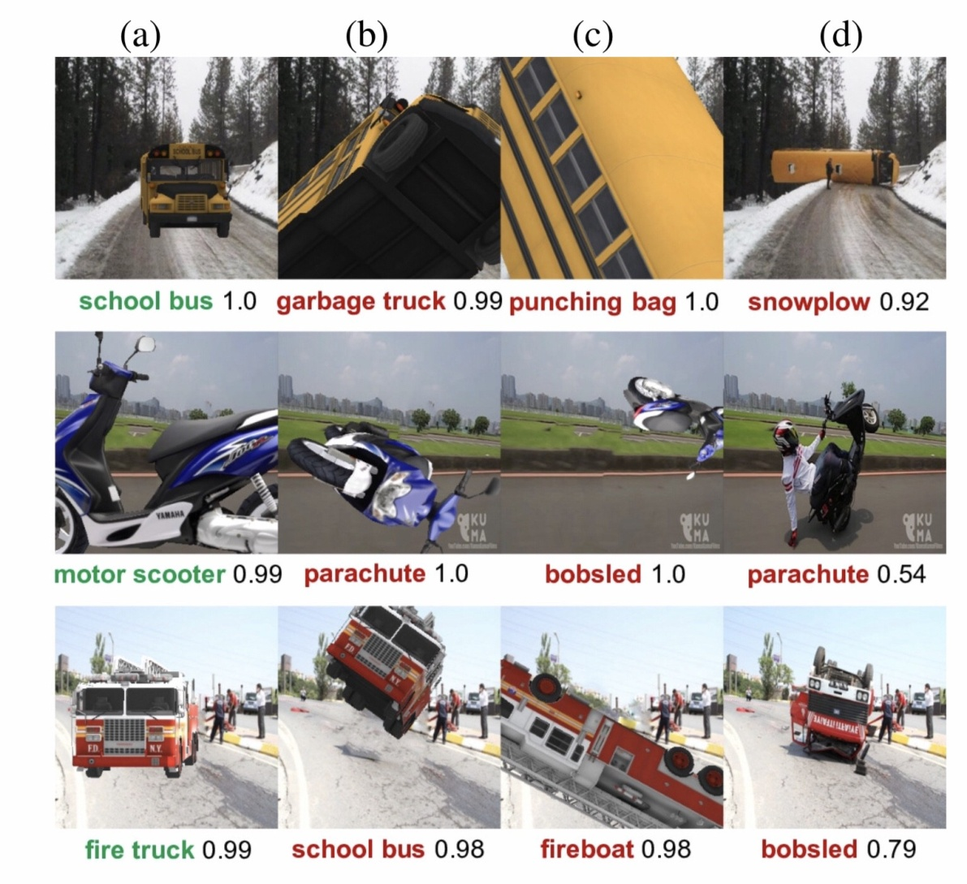
… and brittle
https://arxiv.org/pdf/1811.11553.pdf

Slide 15
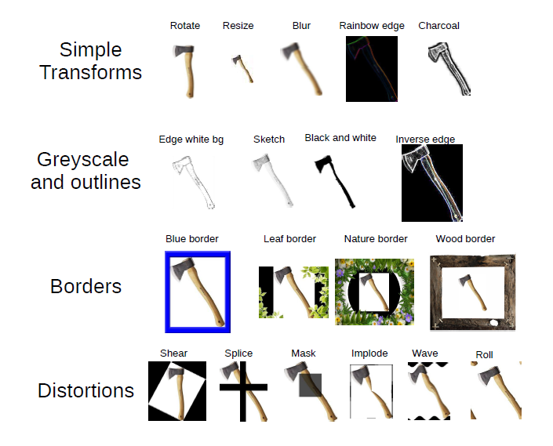
… and stupid

Slide 16
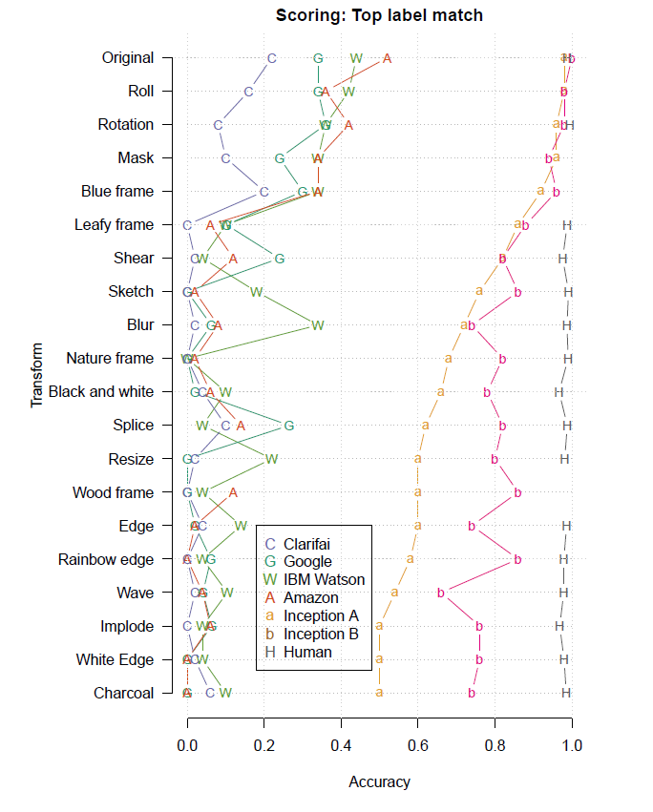
… beyond belief
Untransformed images are classified with 98% and 100% accuracy
Transformed image accuracy drops enormously
Human performance is unaffected
Humans know when they are going to have trouble

Slide 17
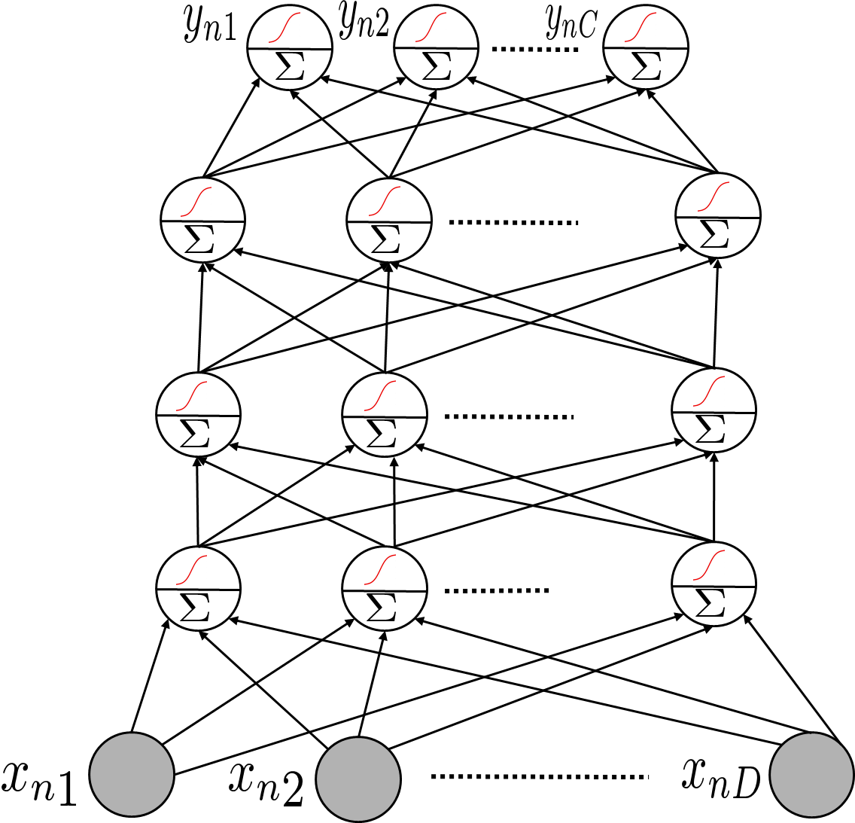
Using a Pre-trained Network
17
A deep NN already trained in some “generic” data can be useful for other tasks, e.g.,
Feature extraction: Use a pre-trained net, remove the output layer, and use the rest of the network as a feature extractor for a related dataset
Fine-tuning: Use a pre-trained net, use its weights as initialization to train a deep net for a new but related task (useful when we don’t have much training data for the new task)
This part of a pre-trained net can be used as a feature extractor on some new task
Many packages, like Tensorflow and PyTorch provide such pre-trained module ready to be used
Sometimes also known as “transfer learning” in the context of neural nets

Slide 18
Deep Neural Nets: Some Comments
18
Highly effective in learning good feature rep. from data in an “end-to-end” manner
The objective functions of these models are highly non-convex
But fast and robust non-convex opt algos exist for learning such deep networks
Training these models is computationally very expensive
But GPUs can help to speed up many of the computations
Also useful for unsupervised learning problems (will see some examples)
Autoencoders for dimensionality reduction
Deep generative models for generating data and (unsupervisedly) learning features – examples include generative adversarial networks (GAN) and variational auto-encoders (VAE)

