Slide 1
VAEs and GANs
CS771: Introduction to Machine Learning
Nisheeth

Slide 2


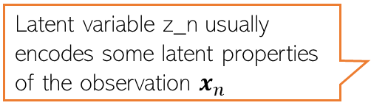

Generative Models with Latent Variables
We have already looked at latent variable models in this class
Used for
Clustering
Dimensionality reduction
Broadly, latent variable models approximate the distribution on X
Can apply this approximation in a variety of applications
Such as generation of new examples
Latent variable z_n usually encodes some latent properties of the observation $x_{n}$
$$z_{n}$$
$$x_{n}$$

Slide 3
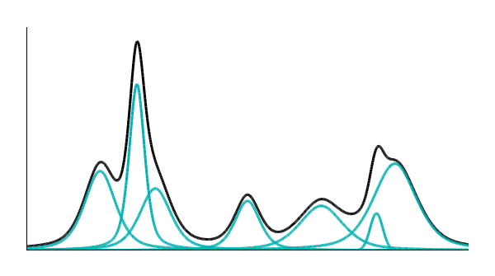


Example: Gaussian Mixture Model
(categorical)
We can sample X that looks like it was from p(X)
P(x)
P(m)
1
2
3
4
5
…..
Notes:
How many Gaussin
A point from a Guassin

Slide 4
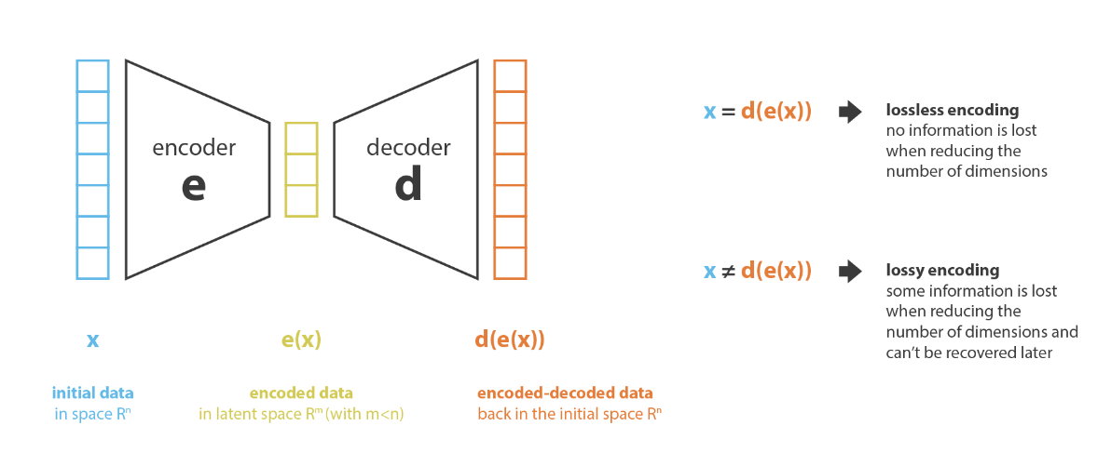
A general principle of generation
Data is encoded into a different representation
New data is generated by sampling from the new representation
GMMs are just one type of encoding-decoding scheme
Image credit (link)

Slide 5
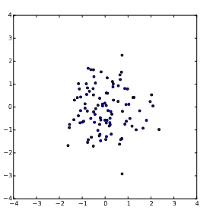
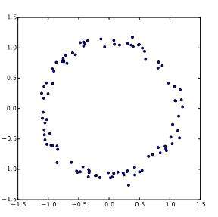

Creating flexible encoders
Actually,
Easy to encode this data distribution of a random variable X with a bivariate Gaussian
What about the data distribution of this random variable Y?

Slide 6
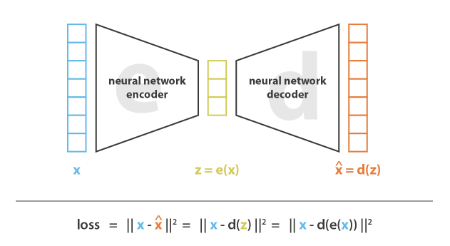
Variational auto-encoders: the basic premise
Any distribution in d dimensions can be generated by taking a set of d normally distributed random variables and mapping them through a sufficiently complex function
We use a neural network encoder to learn this function from data
Image credit (link)

Slide 7




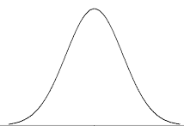


VAEs concept
Each dimension of z represents a data attribute
NN
$$μ\left(z\right)$$
$$z$$
p(x)
We approximate complex p(x) as a
composition of many simple z
Infinite Gaussian
z

Slide 8
VAEs in practice
Brute force approximation of P(X)
Sample a large number of z values
Compute
Problem, when z is high dimensional, you’d need a very large n to sample properly
VAEs try to sample p(X|z) efficiently
Key idea: the X → z mapping is sparse in a large enough neural network
Corollary: most p(X|z) will be zero
Rather than directly sample P(X|z), we try and estimate Q(z|x) that gives us the z that are most strongly connected with any given x
VAEs assume Q are Gaussian

Slide 9


The VAE objective function
We want to minimize
Which is equivalent to maximizing
VAE assumes that we can define some Q(z|X) that maximizes
The RHS is maximized using stochastic gradient descent, sampling a single value of X and z from Q(z|X) and then calculating the gradient of
See here for derivations and a more detailed explanation

Slide 10
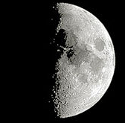
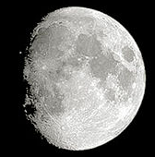
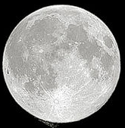
What a VAE does
Generate samples from a data distribution
For any data
Cool applications
?
decode
code
noise
noise
encode

Slide 11
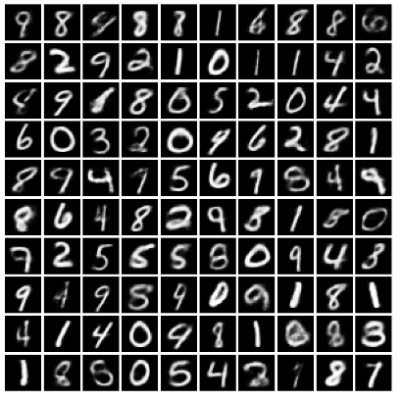
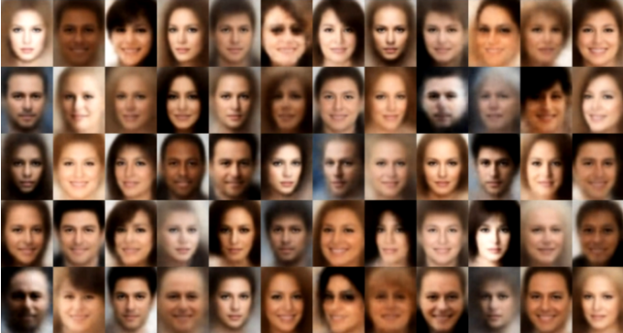
VAE outputs
Samples from a VAE trained on MNIST
Samples from a VAE trained on a faces dataset

Slide 12

VAE limitations
People have mostly moved on from VAEs to use GANs for generating synthetic high-dimensional data
VAEs are theoretically complex
Don’t generalize very well
Are pragmatically under-constrained
Reconstruction error need not be exactly correlated with realism
Realistic
Fake

Slide 13
Generative adversarial networks (GANs)
VAEs approximate P(X) using latent variables z, with the mapping between X and z pushed through a NN function approximation that ensures that the transformed data can be well represented by a mixture of Gaussians
But approximating P(X) directly is complicated, and approximating it well in the space of an arbitrarily defined reconstruction error does not generalize well in practice
GANs go about approximating P(X) using an indirect approach

Slide 14
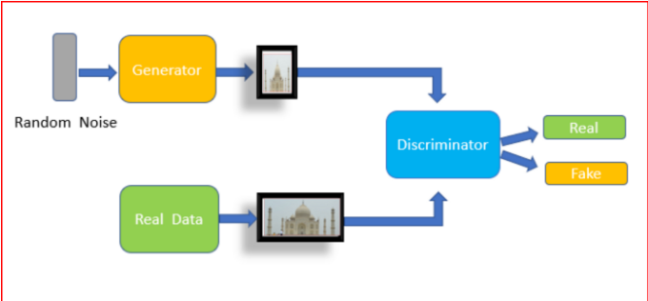
Adversarial training
Two models are trained – a generator and a discriminator
The goal of the discriminator is to correctly judge whether the data it is seeing is real, or synthetic
Objective function is to maximize classification error
The goal of the generator is to fool the discriminator
It does this by creating samples as close to real data as possible
Objectively tries to minimize classification error
No longer reliant on reconstruction error for quality assessment
Realistic
Fake

Slide 15


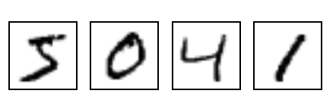
GANs
NN
Generator
v1
NN
Generator
v2
NN
Generator
v3
Discri-minator
v1
Discri-minator
v2
Discri-minator
v3
Real images:

Slide 16
GAN - Discriminator
NN
Generator
Vectors from a distribution
0
0
0
0
Decoder in VAE
Real images:
1
1
1
1
image
Discriminator
(real or fake)
1/0
Can be a convnet

Slide 17


GAN - Generator
Randomly sample a vector
NN
Generator
v1
“Tuning” the parameters of generator
The output be classified as “real” (as close to 1 as possible)
Generator + Discriminator = a network
Use gradient descent to find the parameters of generator
Discriminator
v1
1.0
0.87

Slide 18
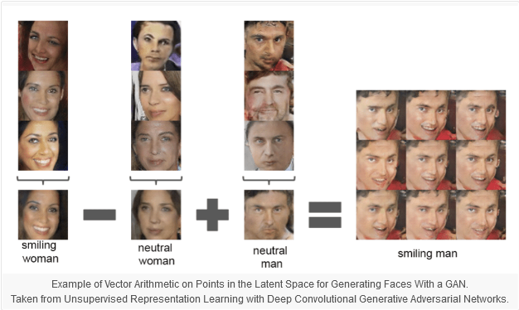
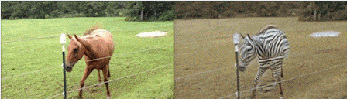
GAN outputs
The latent space learned in GANs is very interesting
People have showed that vector additions and subtractions are meaningful in this space
Can control novel item compositions almost at will
A big ‘deepfakes’ industry is growing up around this
For more details, see here

Slide 19
Summary
In CS771, you have learned the basic elements of ML
Representing data as multidimensional numerical representations
Defining model classes based on different mathematical perspectives on data
Estimating model parameters in a variety of ways
Defining learning objectives mathematically, and optimizing them
Evaluating outcomes, to some degree
What will you do with this knowledge?

