Slide 1
A MULTI-FUNCTIONAL PHOTO EDITOR
MINOR PROJECT – 1
ANSH RATHORE
RAMANUJAN COLLEGE, UNIVERSITY OF DELHI
THANKS TO MR. VIPIN RATHI (ASSISTANT PROFESSOR)

Slide 2
INTRODUCTION
A Photo Editor library with simple, easy support for image editing using Paints, Text, Filters, Emoji and Sticker like stories.
With a user-friendly interface and a wide range of powerful tools, One can effortlessly transform your ordinary photos into extraordinary works of art. From basic adjustments to advanced effects, our photo editor offers everything that need to bring your vision to life.

Slide 3
KEY FEATURES :-
FRIENDLY INTERFACE WITH INTUITIVE DESIGN.
POWEFRFUL PHOTO EFFECTS AND FILTERS USING PYTHON LIBRARIES
BASIC EDITING TOOLS LIKE CROP, ROTATE, TRIM ETC.
REAL-TIME PREVIEWS
LAYERED EDITING AND EASY SHARES.

Slide 4
TECHNOLOGIES USED AND REQUIREMENTS:-
Core technologies:-
• Languages used - Python, JavaScript, •Image processing library - OpenCV, Pillow •UI framework- Tkinter
REQUIREMENTS TO RUN:-
•Operating System: Windows 10 (64-bit) or macOS 10.15 •Processor: Intel Core i5 or AMD Ryzen 5 . •RAM: 8 GB RAM •Storage: 10 GB available hard disk space

Slide 5
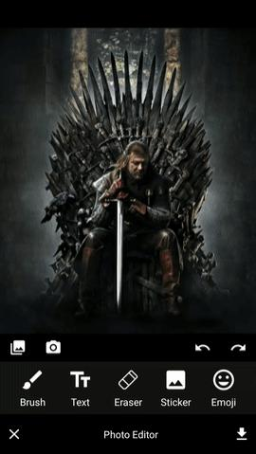
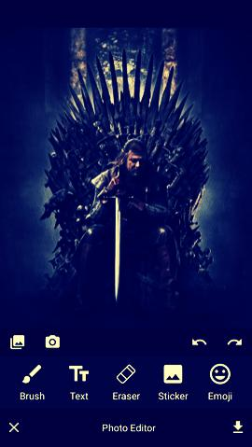
A GLIMPSE INTO EDITING
TUTORIAL (FILTER EFFECT)
We can apply inbuild filter to the source images using mPhotoEditor.setFilterEffect(PhotoFilter.BRIGHTNESS)
We can also apply custom effect using Custom.Builder

Slide 6
Challenges and Solutions
TECHNICAL CHALLENGES:-
Low-quality source images: Poor resolution or lighting can significantly limit the editing possibilities
Software limitations: Certain editing tasks may require advanced techniques or specialized software that might not be readily available or affordable.
Sometimes pip may suffer to install certain packages.
OVERCOMING CHALLENGES:-
• Use noise reduction software: Tools like Adobe Photoshop and Lightroom can effectively reduce noise in images.
•Use a color correction tool: Tools like Adobe Color Grading or Lightroom’s color grading panel can help balance colors across multiple images.

Slide 7
SUMMARY
OVERALL , This project focused on the challenges and solutions in photo editing. I explored common issues like low-quality source images, color inconsistencies, and software limitations. I Learned strategies to overcome these challenges, such as using RAW format, color correction tools, and powerful hardware. Additionally, touched upon creative challenges like artistic vision, client feedback, and time constraints.
THANK YOU

