Slide 1


Database Using SQL Server & Raw Data available over my GitHub Profile
SQL Temporary Tables With 12 Most Used Queries
AnshLibrary

Slide 2
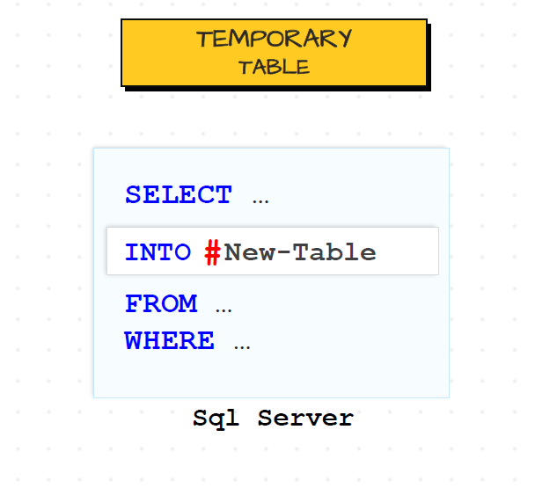
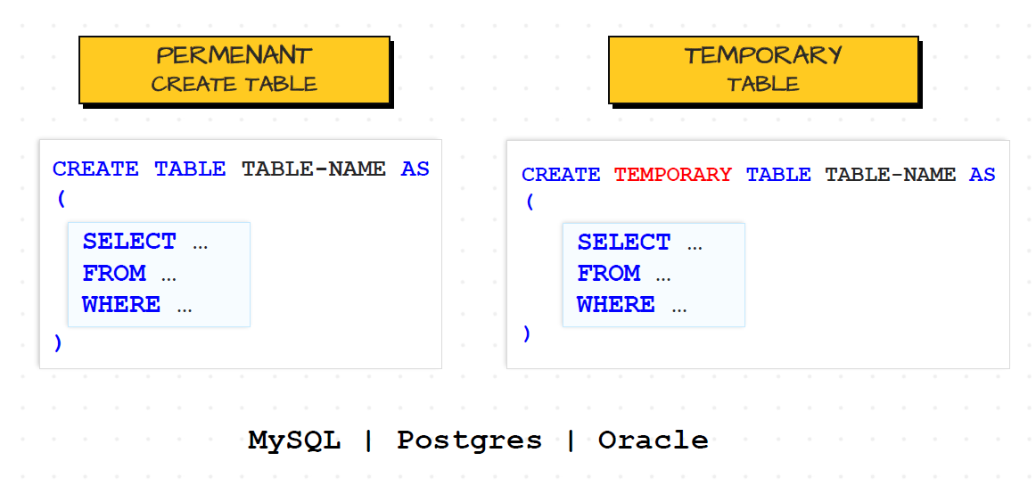
What is a Temporary Tables
Temporary Tables in SQL Server are used to store intermediate results or small subsets of data temporarily during a session, procedure, or batch. They're created with a prefix # or ##.
Syntax :
Type | Syntax | Scope | Lifetime
Local Temp Table | #TableName | Current session only | Until the session is closed
Global Temp Table | ##TableName | All sessions (globally) | Until all sessions are closed

Slide 3
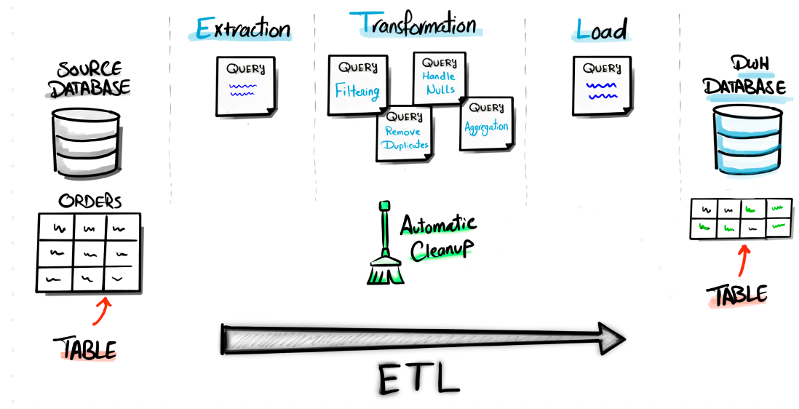
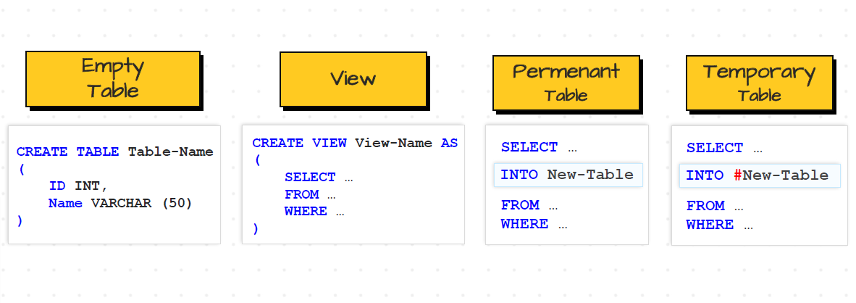
Why We Using :
Load Data to TEMP Table
Transform Data in TEMP Table
Load TEMP Table into Permanent Table

Slide 4

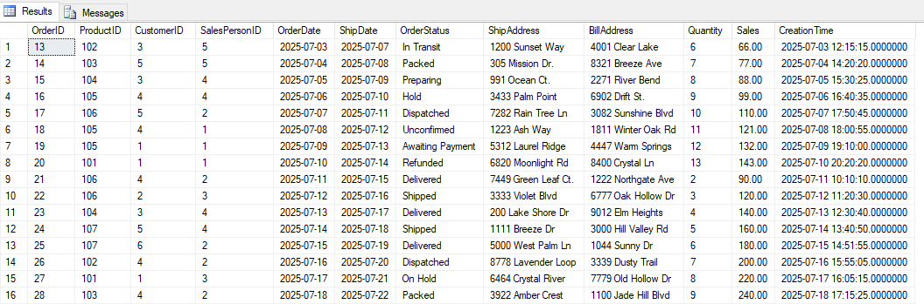
Stage Filtered Orders for ETL
--Created Like This
SELECT *
INTO #StagedOrders
FROM orders
WHERE OrderDate >= DATEADD(DAY, -7, GETDATE());
--USED BY This Select Query
SELECT * FROM #StagedOrders
Use by: Used in ETL pipelines for recent transactions..
AnshLibrary

Slide 5

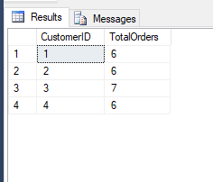
Join Orders with Customers (Data Enrichment)
sql
Calculate Customer Order Count for Loyalty Tiering
SELECT
CustomerID,
COUNT(*) AS TotalOrders
INTO #CustomerOrderCount
FROM Orders
GROUP BY CustomerID;
---------------------------------------------------------------------
SELECT * FROM #CustomerOrderCount
WHERE TotalOrders > 5;
Use by: Classify customers into loyalty tiers.
AnshLibrary

Slide 6

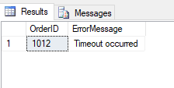
Temporary Table to Store Failed API Response Data
CREATE TABLE #FailedAPIOrders
(OrderID INT, ErrorMessage NVARCHAR(255));
-- later insert failed records in ETL flow
INSERT INTO #FailedAPIOrders VALUES (1012, 'Timeout occurred');
----------------------------------------------------------------------------------
SELECT * FROM #FailedAPIOrders
Use by: Log temporary failures in automation pipelines.
.
AnshLibrary

Slide 7

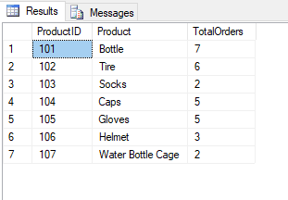
Prepare Summary Before Final Reporting
SELECT
ProductID,
COUNT(OrderID) AS TotalOrders
INTO #EmpOrderSummary
FROM Orders
GROUP BY ProductID;
--------------------------------------------------------------------------
SELECT p.ProductID, p.Product, TotalOrders
FROM Products p
JOIN #EmpOrderSummary s ON p.ProductID = s.ProductID;
Use by: Simplifies final reporting logic.
AnshLibrary

Slide 8

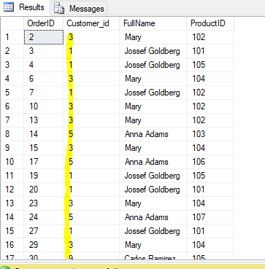
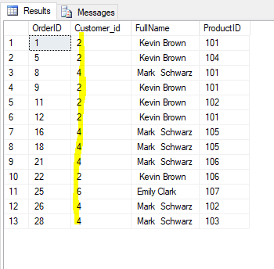
Store Large Joins Temporarily for Reuse
SELECT
o.OrderID,
c.Customer_id,
COALESCE(c.First_Name, '') + ' ' + COALESCE(c.Last_Name, '') AS FullName,
p.ProductID
INTO #JoinedData
FROM Orders o
JOIN Customers c ON o.CustomerID = c.Customer_id
JOIN Products p ON p.ProductID = o.ProductID;
--------------------------------------------------------------------------------------------
SELECT * FROM #JoinedData
WHERE Customer_id NOT IN(2,4,6,8) ;
SELECT * FROM #JoinedData
WHERE Customer_id IN(2,4,6) ;
Used For :Avoid recalculating large joins.
AnshLibrary

Slide 9

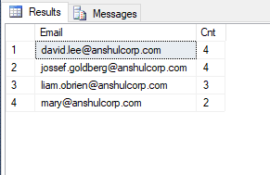
Track Duplicate Customers (Audit)
SELECT
Email,
COUNT(*) AS Cnt
INTO #DuplicateEmails
FROM Customers
GROUP BY Email
HAVING COUNT(*) > 1;
----------------------------------------------------------------------------------
select * from #DuplicateEmails
Use by: Pre-cleaning step before marketing export..
AnshLibrary

Slide 10

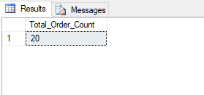
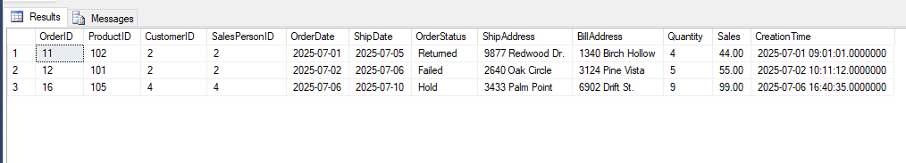
Session-Based Work in Stored Procedures
CREATE PROCEDURE sp_TempAnalysis
AS
BEGIN
SELECT *
INTO #RecentOrders
FROM Orders
WHERE OrderDate >= DATEADD(DAY, -30, GETDATE());
END
-------------------------------------------------------------------------------------------
SELECT COUNT(*)Total_Order_Count
FROM #RecentOrders;
SELECT * FROM #RecentOrdersWHERE OrderStatus
IN ( 'Failed', 'Returned','Hold');
Use by: Temp tables help modularize stored procedure logic.
.
AnshLibrary

Slide 11

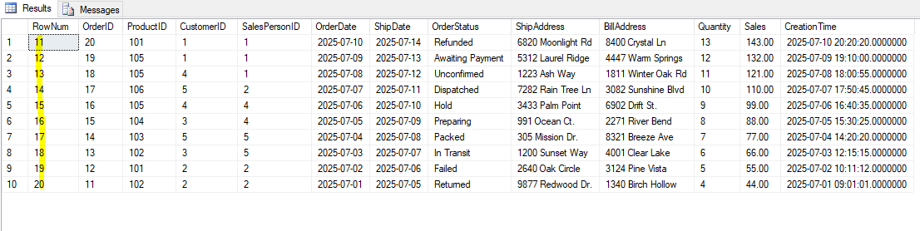
Temp Table for Pagination Results
SELECT
ROW_NUMBER() OVER (ORDER BY OrderDate DESC) AS RowNum, *
INTO #PagedOrders
FROM Orders;
--------------------------------------------------------------------------
SELECT * FROM #PagedOrders
WHERE RowNum BETWEEN 11 AND 20;
Using: Manual pagination logic for APIs
AnshLibrary

Slide 12

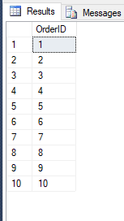
Join Order & Archive to Detect Duplicates
SELECT
OrderID
INTO #AllOrders
FROM Orders
UNION ALL
SELECT
OrderID
FROM OrdersArchive;
--------------------------------------------------------------------------------------
SELECT TOP 10 OrderID
FROM #AllOrders
GROUP BY OrderID
HAVING COUNT(*) > 1;
Use by: Archive audit and cleanup task.
AnshLibrary

Slide 13

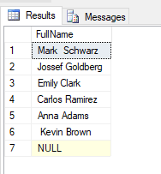
Merge Customer Details for Upload
SELECT
c.Customer_id, c.First_Name + ' ' + c.Last_Name AS FullName,
o.OrderID
INTO #MergedUpload
FROM Customers c
JOIN Orders o ON c.Customer_id = o.CustomerID;
-- Export #MergedUpload to external system.
----------------------------------------------------------------------------------------------
SELECT Distinct FullName FROM #MergedUpload
ORDER BY FullName DESC
Use by: Prepare CSV upload format temporarily..
AnshLibrary

Slide 14
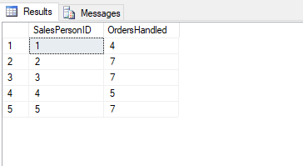
11
Top Employee Order Volume Summary
SELECT
SalesPersonID,
COUNT(*) AS OrdersHandled
INTO #TopEmployees
FROM Orders
GROUP BY SalesPersonID
HAVING COUNT(*) > 2;
-----------------------------------------------------------------------------
Use Case: Used in internal leaderboard or reward system
AnshLibrary

Slide 15
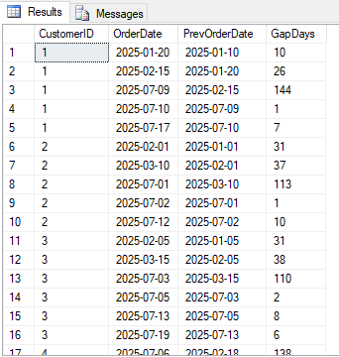
12
Customer Order Gap Analysis
SELECT
CustomerID,
OrderDate,
LAG(OrderDate) OVER(PARTITION BY CustomerID ORDER BY OrderDate) AS PrevOrderDate
INTO #CustomerOrderGaps
FROM Orders;
--------------------------------------------------------------------------------------
SELECT *, DATEDIFF(DAY, PrevOrderDate, OrderDate) AS GapDays
FROM #CustomerOrderGaps
WHERE PrevOrderDate IS NOT NULL;
Use Case: Tracks customer inactivity periods.
AnshLibrary

